Slide 1
Teacher Reading

Slide 2
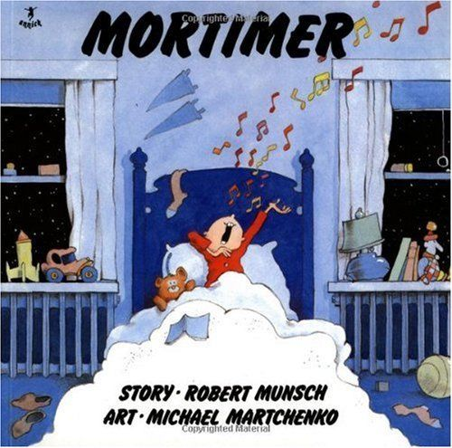
Mortimer
Robert Munsch

Slide 3
Robert Munsch’s Advice
Be crazy
Use strange voice
Involve your children

Slide 4
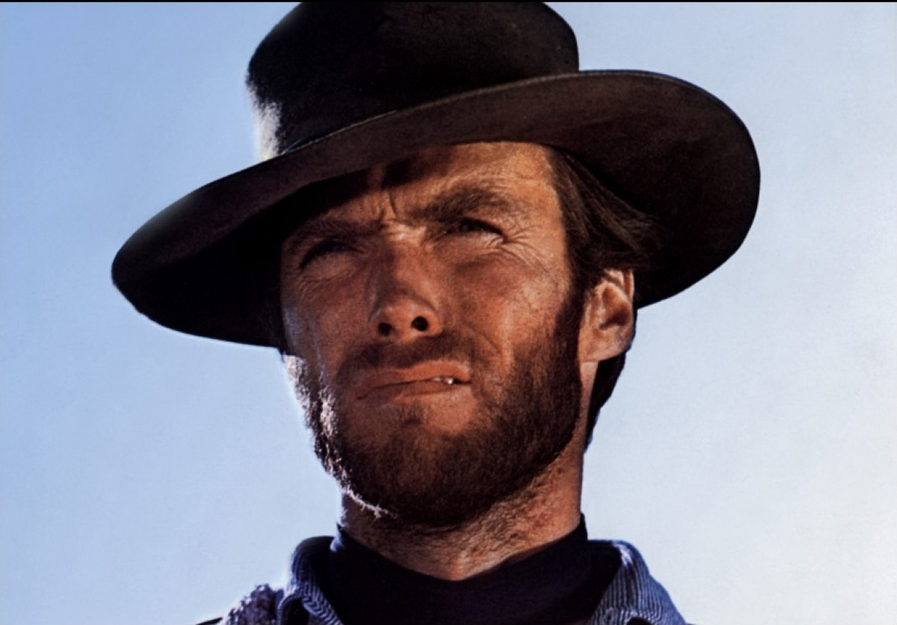
Intonation
Includes:
Tone
pitch-range
Loudness
Rhythmicality
tempo

Slide 5
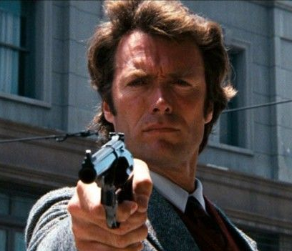
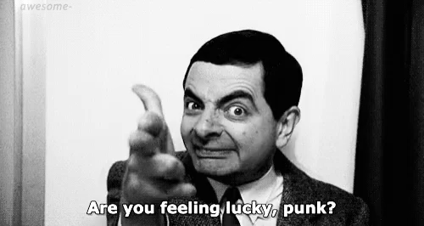
Expression

Slide 6
Munsch’s Writing Style
One night Mortimer’s mother took him upstairs to bed –
When they got upstairs Mortimer’s mother opened the door to his room.
She threw him on into bed and said,
“MORTIMER, BE QUIET.”
Mortimer shook his head, yes.
Thump
Thump
Thump
Thump
Thump
Thump

Slide 7
Onomatopoeia
Words that sound like the sounds.
의성어

Slide 8
What sound does it make?
한국어
쿵쾅 쿵쾅
English
Thump

Slide 9
What sound does it make?
한국어
칭 칭 칭
English
Clang clang

Slide 10
What sound does it make?
Woof
Bow-wow
Bark
한국어
멍멍
English

Slide 11
What sound does it make?
한국어
야옹
English
Meow

Slide 12
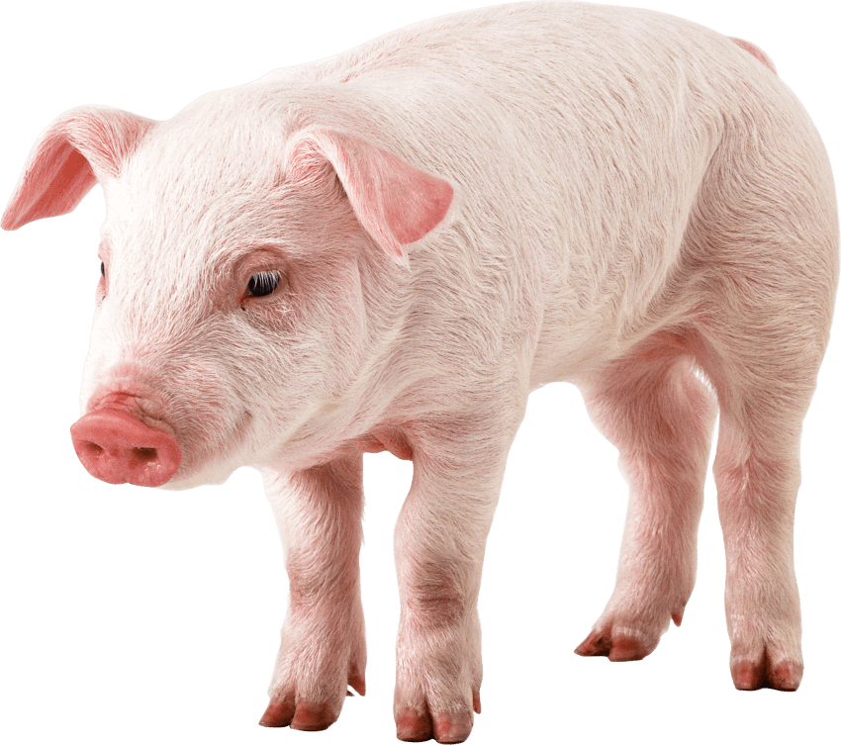
What sound does it make?
한국어
꿀꿀꿀
English
Oink

Slide 13
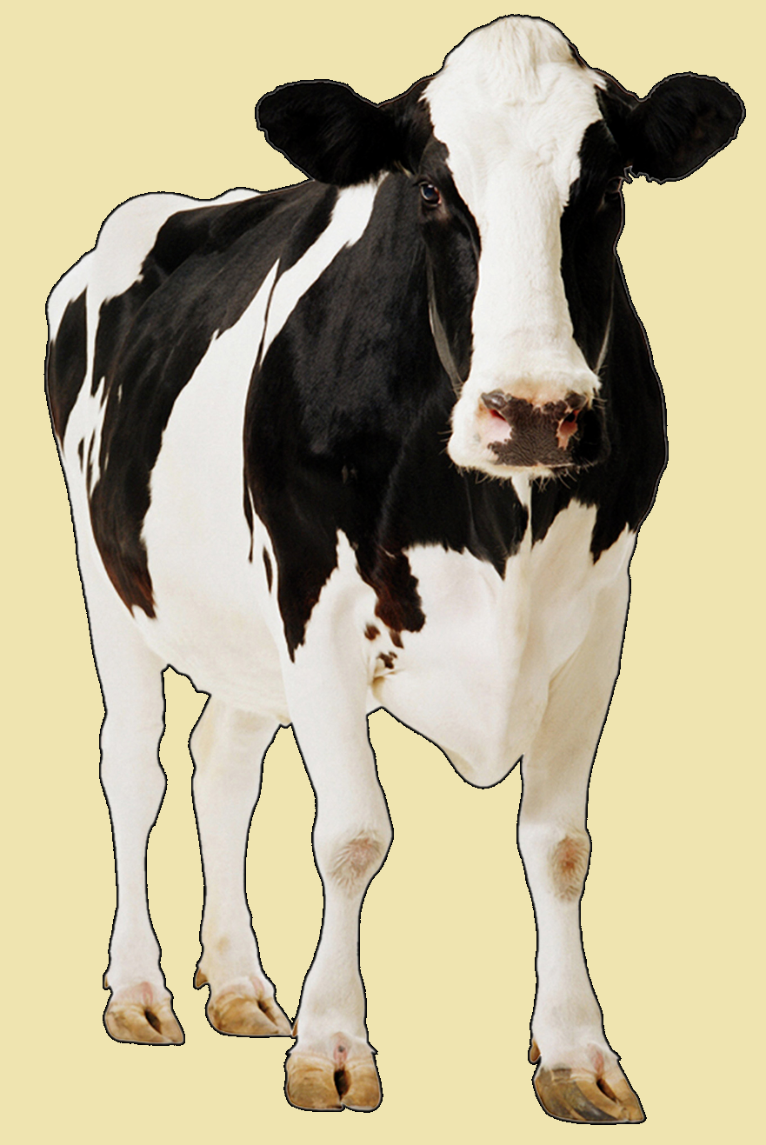
What sound does it make?
한국어
음메
English
Moo

Slide 14
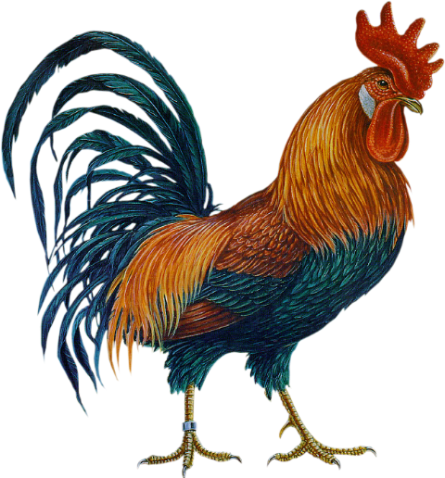
What sound does it make?
한국어
꼬끼오
English
Cock-a-doodle-do

Slide 15
What sound does it make?
한국어
빵
English
Bang

Slide 16
What sound does it make?
한국어
에취
English
Achoo!

Slide 17
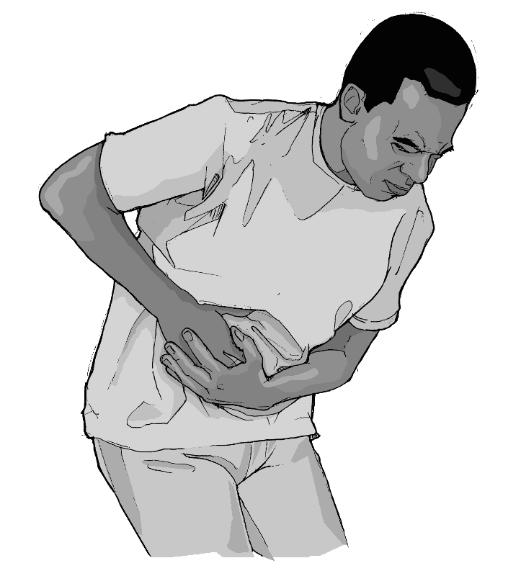
What sound does it make?
한국어
아야
English
Ouch

Slide 18
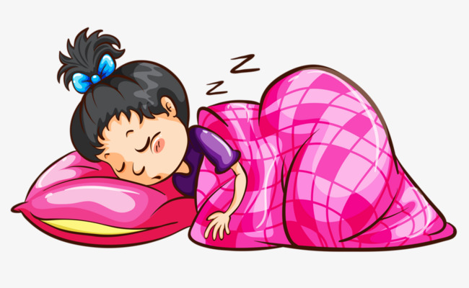
What sound does it make?
한국어
드르렁드르렁
English
zzzzzzzzz

Slide 19
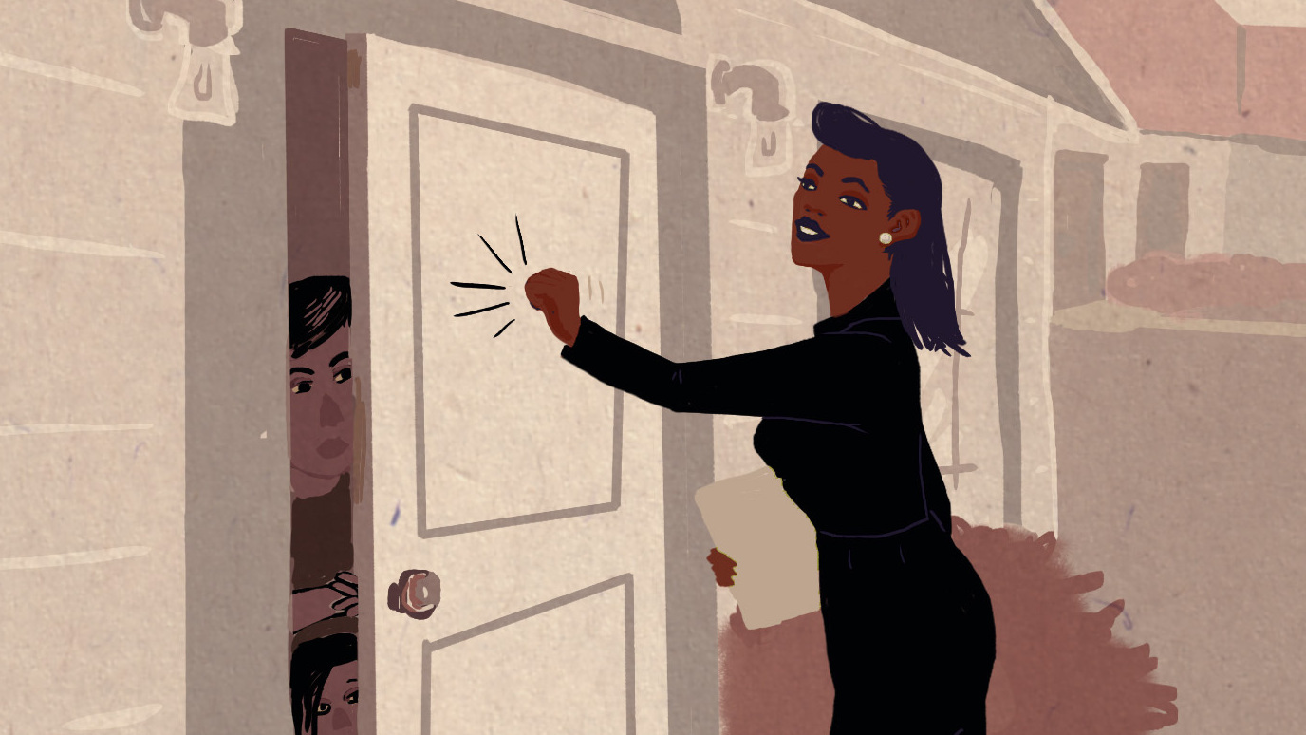
What sound does it make?
한국어
똑똑
English
Knock knock
(blam)

Slide 20
What sound does it make?
한국어
빵빵
English
Honk honk
Beep beep

Slide 21
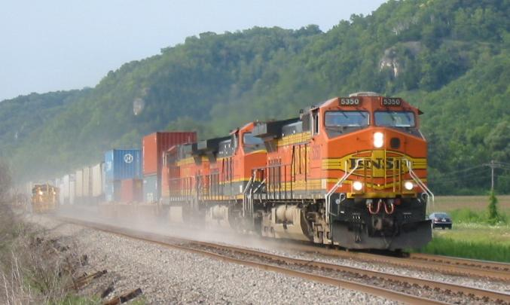
What sound does it make?
한국어
칙칙폭폭
English
Choo-choo

Slide 22
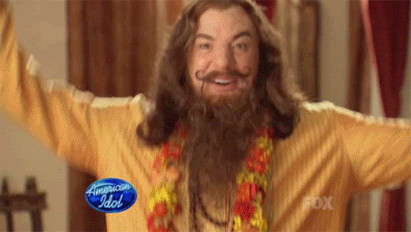
What sound does it make?
한국어
뿅, 펑, 팡
English
Poof

Slide 23
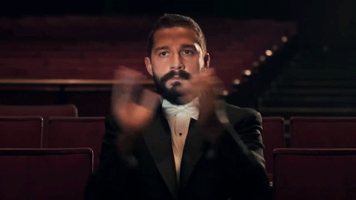
What sound does it make?
한국어
짝짝짝
English
Clap clap clap

Slide 24
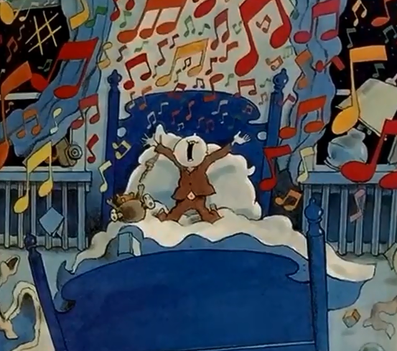
Clang, clang, rattle-bing-bang
Gonna make my noise all day.
Clang, clang, rattle-bing-bang
Gonna make my noise all day.

Slide 25
Importance of Teacher Reading
Model fluent speech
Creates interest
Improves understanding
(oral language, vocabulary, comprehension)
Conveys mood

Slide 26
Punctuation
How to read using punctuation

Slide 27
Types of Punctuation

Slide 28
The cat is in the house.

Slide 29
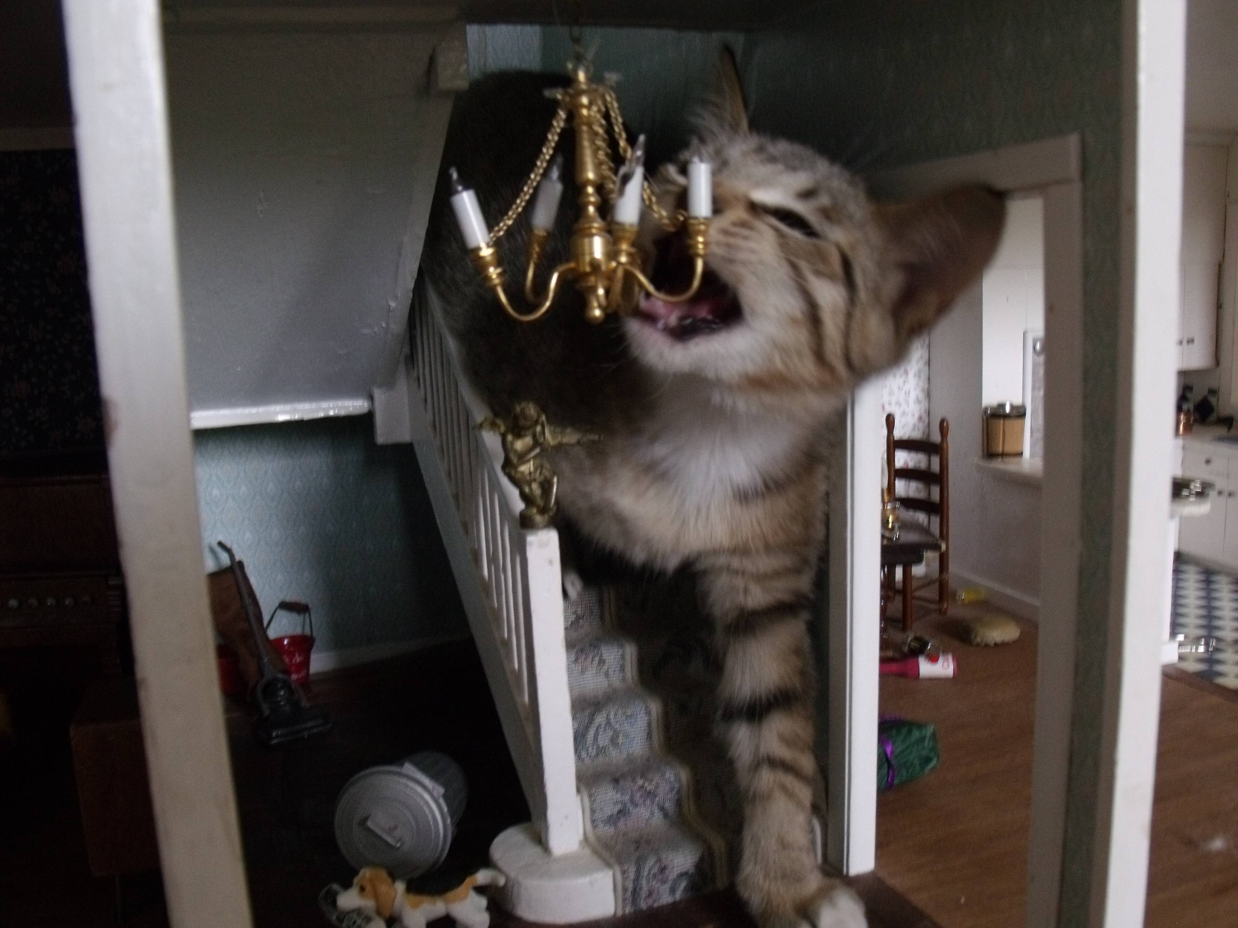
The cat is in the house?

Slide 30
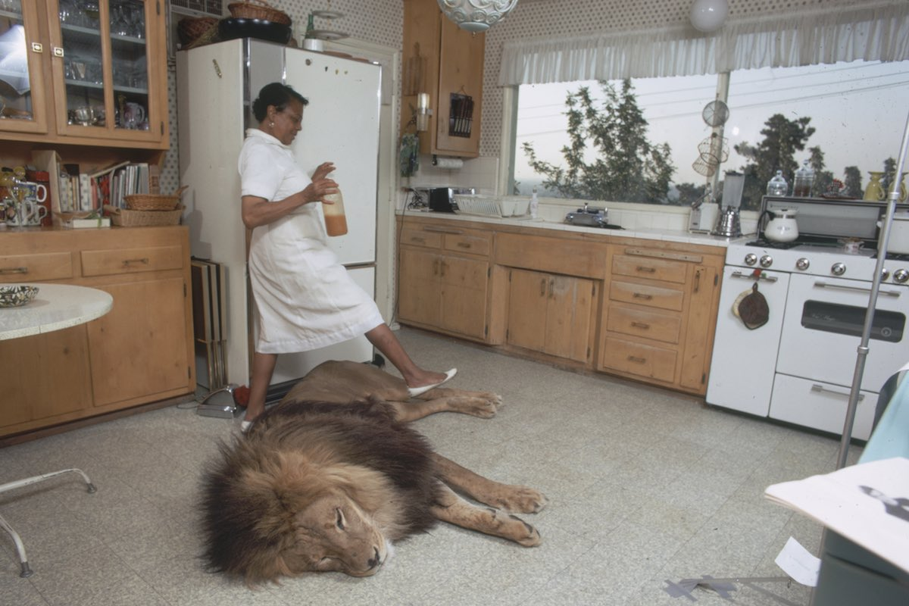
The cat is in the house!

Slide 31
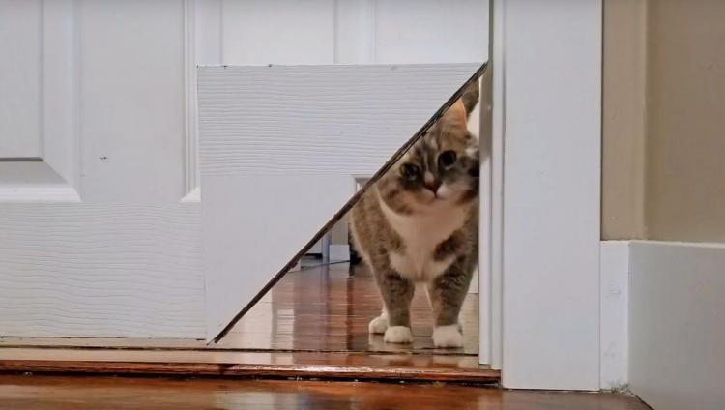
The cat is in the house…

Slide 32
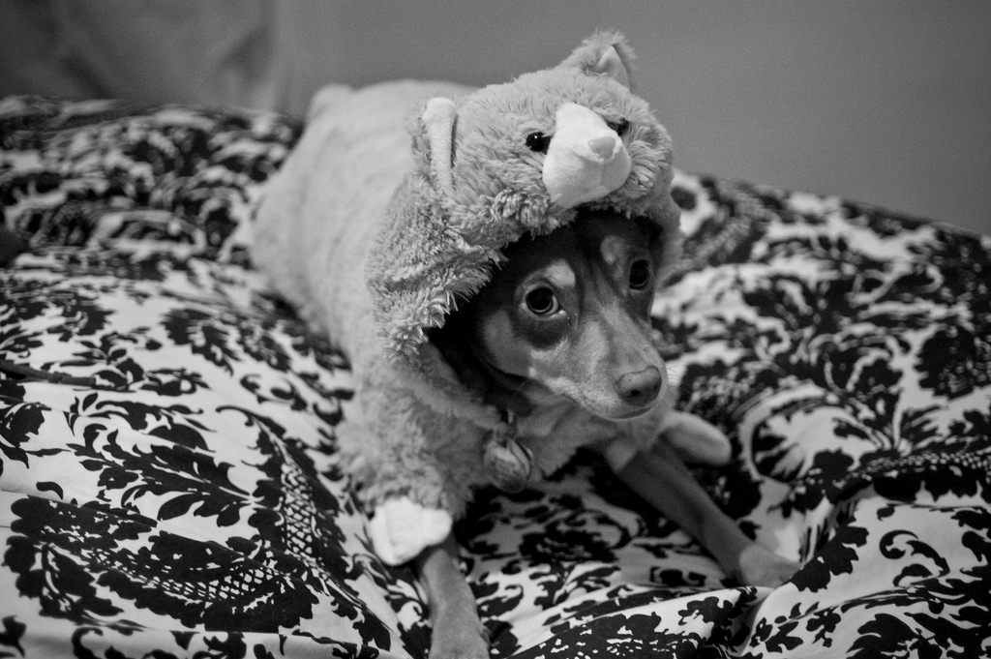
The “cat” is in the house.

Slide 33
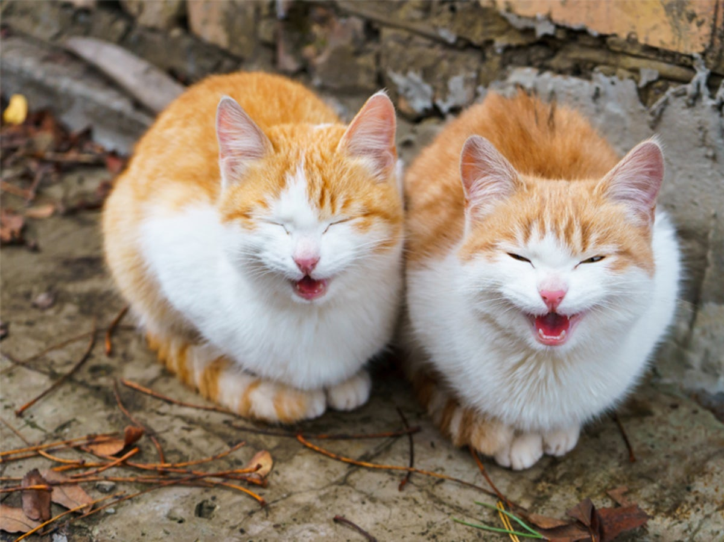
The cat said, “Meow.”

Slide 34
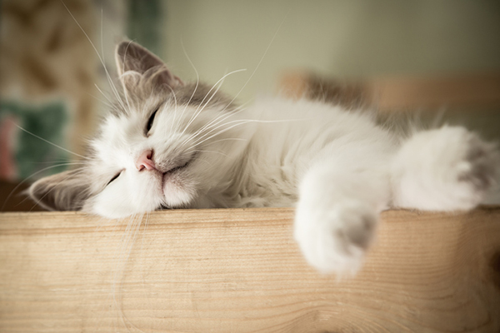
Today, the cat is in the house.

Slide 35
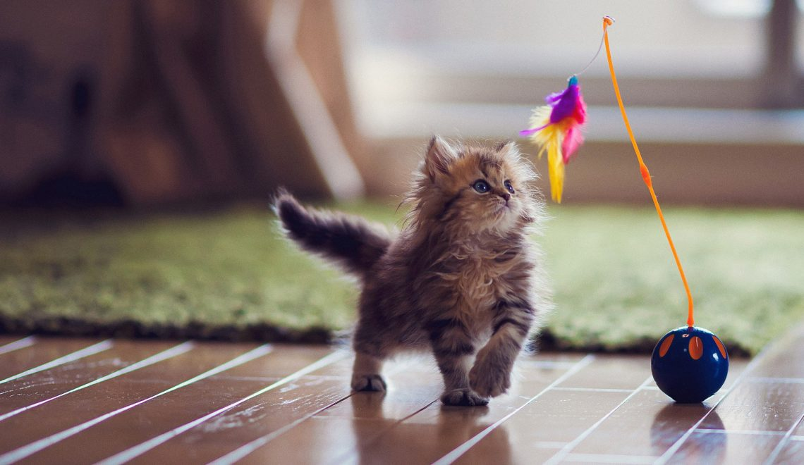
The cat (who I am supposed to babysit) is in the house.

Slide 36
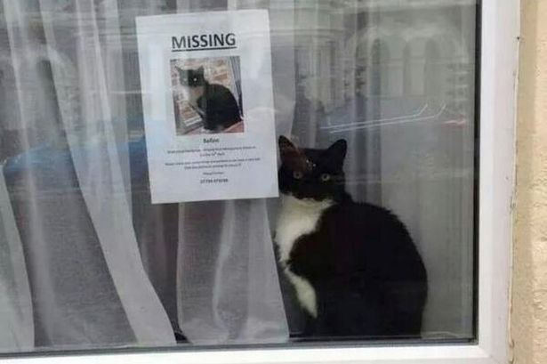
Note: The cat is in the house.

Slide 47
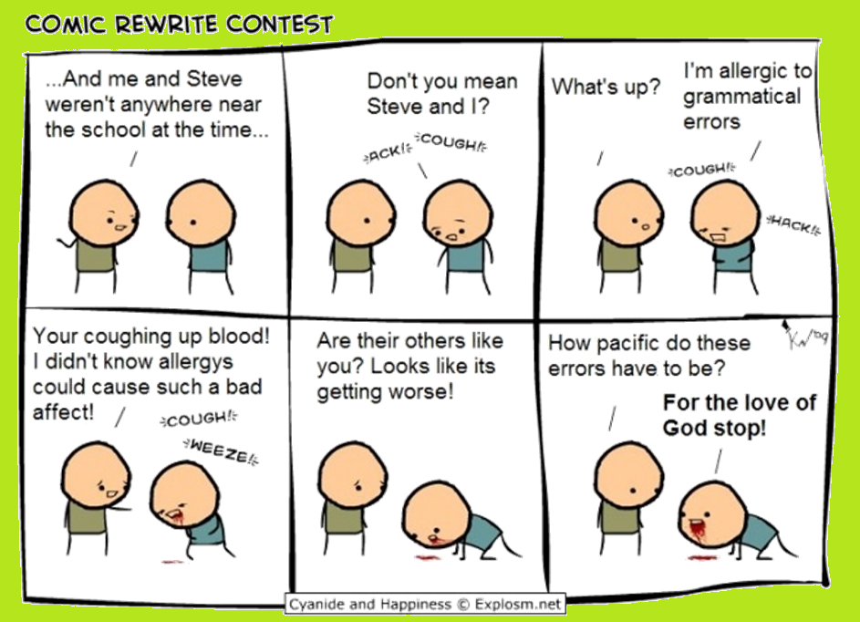

Slide 48
Choose a book
Practice reading to a partner

