Slide 1
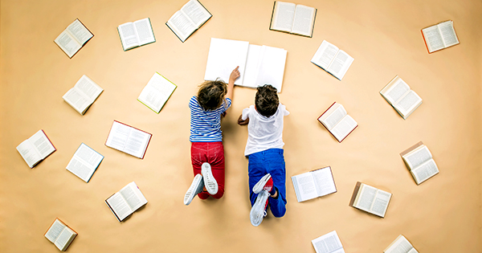
Test
(After Teacher Reading)

Slide 2
TEST
CCQ
Vocabulary
General Questions for the whole class
Answers will help the other students understand what is happening before they have to read.

Slide 4
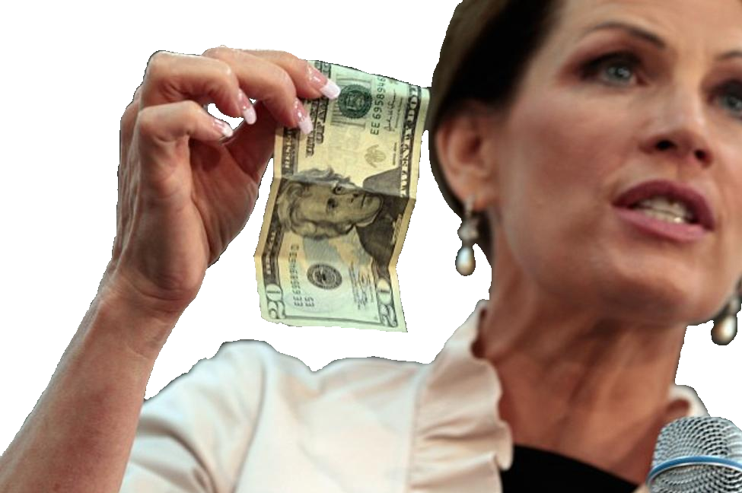
The Grocery Store
Today I went to the grocery store. At the check out, I accidently dropped an 5만원 bill. The lady in front of me picked it up, I thanked her and told her that it was mine and she said "The things found on earth are kept by the collector" and walks away.
I looked at the cashier who was as amazed as I was and, in a loud voice I said to the lady, “Is this some kind of joke?! Give me back my 5만원!"
I followed her into the parking lot, still shouting, but she would not stop. When she got to her car, she put her shopping bags on the ground to open her car door. So I ran up, grabbed the bags and ran off yelling "The things found on earth are kept by the collector!!"

Slide 5
Book
Where did the story take place?
What happened to the author?
How much money did she take?
How did the author get revenge?

Slide 6
Head
Do you think it was a real story?
Does this happen in real life?
What did you think the author would do after leaving the store?
Would you do that?
Which is worse: stealing the money or stealing the groceries?

Slide 7
Heart
What feelings did you feel during this story?
Do people like this exist in the real world?
Pretend you are a witness to this story, what would you do?

Slide 8
Student Reading
Types + Motivation

Slide 9
Pros and Cons
With a partner (1 group with 3), take one of the reading types.
Read about that reading style and come up with some pros and cons.
(You can make a chart on the back of the paper)
Also, when would you use that reading style?
What kind of students would benefit from it?

Slide 10
Independent
Silent Independent Reading
Group

Slide 11
Silent Independent Reading vs. Sustained Silent Reading

Slide 12
Silent Independent Reading
Pros
Cons
Read at own pace
Take time to understand
Reading at different levels
How to evaluate
Need to teach reading (comprehension) strategies
How do you know when they are finished?

Slide 13
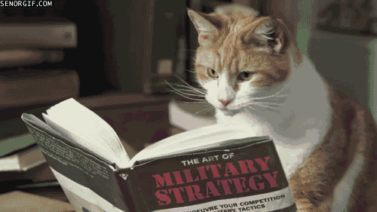
Silent Independent Reading
How do you know when they are finished?
Did they complete the task?
CCQ

Slide 14
Independent
Partner Reading
Silent Independent Reading
Group

Slide 15
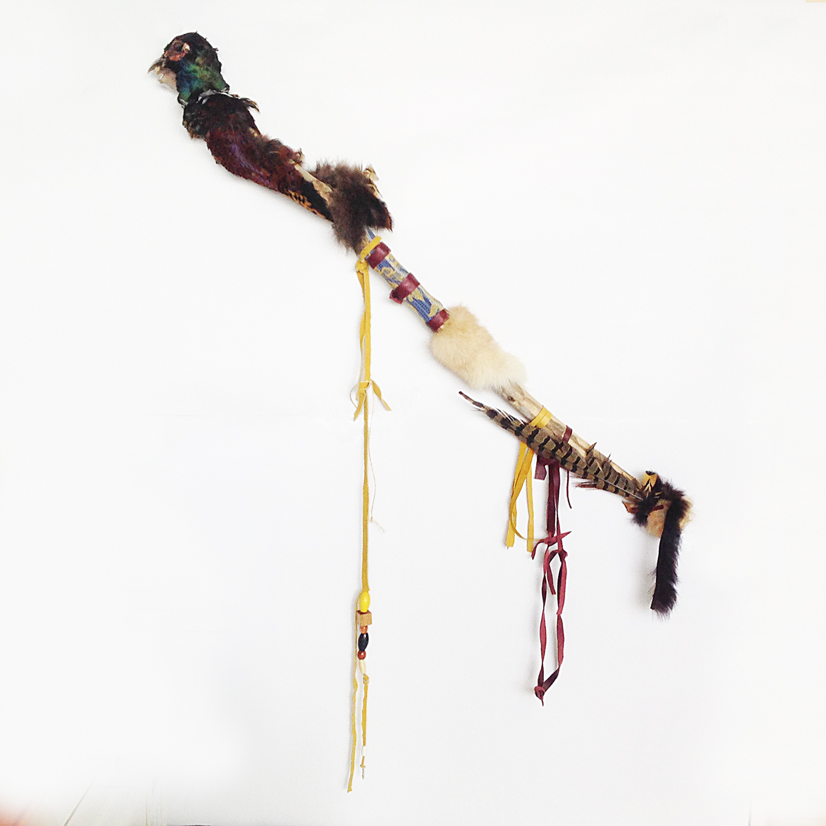
Partner Reading
Take turns reading to each other
Length?
Page, paragraph, sentence?
At sound of the beep?
Talking Stick
Also a way to check if students are doing the task (is the stick constantly moving?)

Slide 16
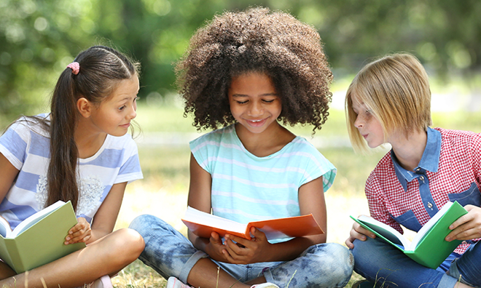
Partner Reading
Pros
Cons
Help each other
Less shy
Expressive
Ask each other CCQ - figure it out together.
Teacher free to help students
Classroom management
Issues go unchecked (pronunciation)

Slide 17
Independent
Buddy Reading
Silent Independent Reading
Partner Reading
Group

Slide 18
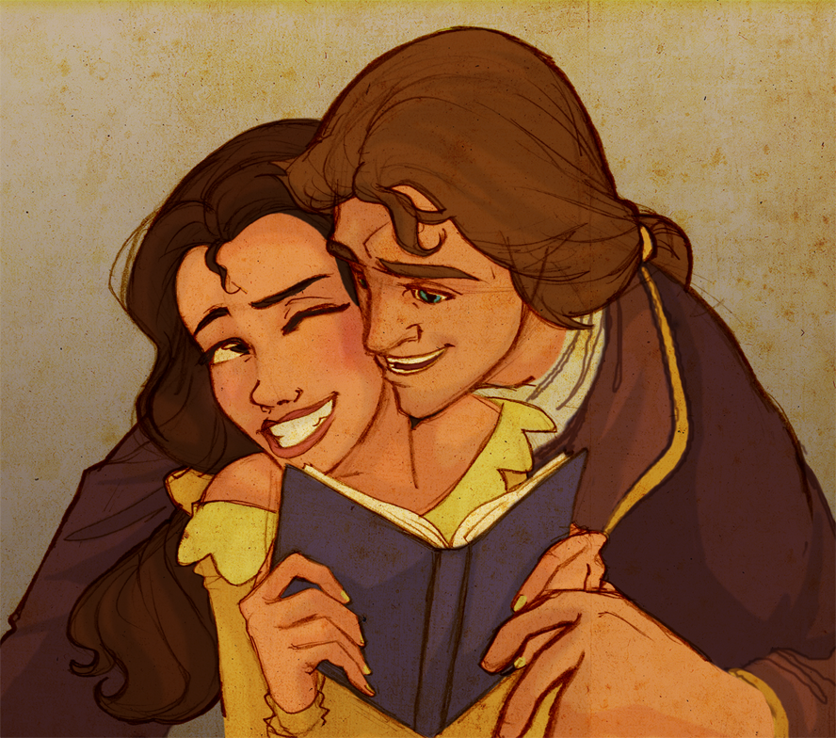
Buddy Reading
Higher level student read to lower level students.
Usually older students reading to younger students
Rarely used in ESL

Slide 19
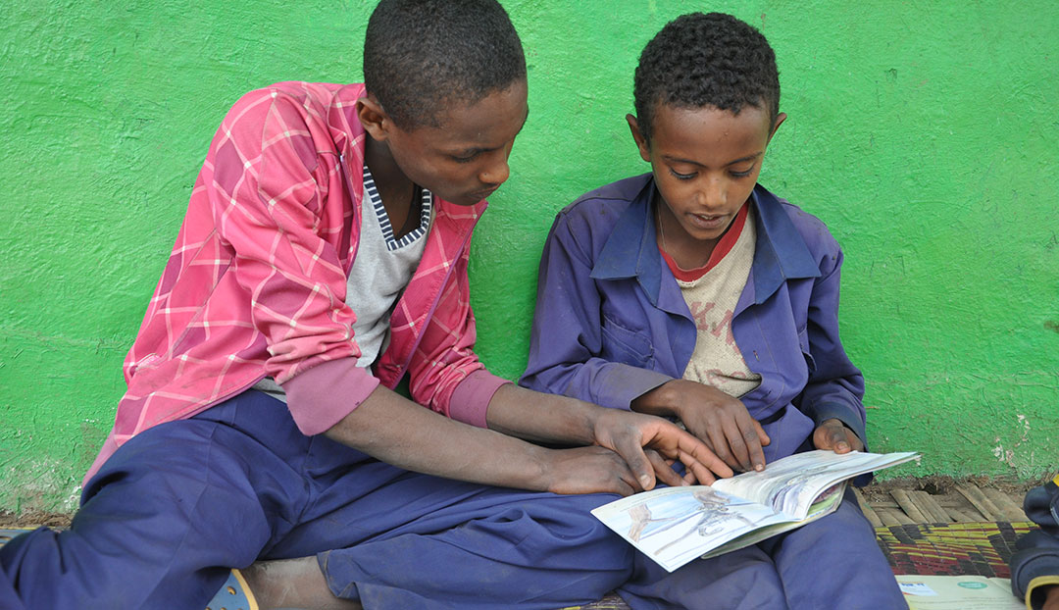
Buddy Reading
Pros
Cons
Modelling and explanation from higher level.
Higher level can focus on being expressive.
1:1 ratio
Doesn’t conform to regular classes.
Difficult to do
How to choose higher level and low level students.
Two grades?

Slide 20
Independent
Round Robin Reading
Buddy Reading
Silent Independent Reading
Partner Reading
Group

Slide 21
Round Robin Reading (RRR)
Maybe the most common
May be the least effective
Students take turns reading to the class

Slide 22
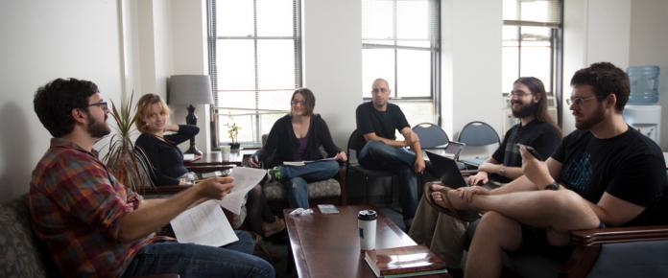
Round Robin Reading (RRR)
Pros
Cons
Slow
Boring
Embarrassing
Frustrating
Students pick up bad habits from low level students
Students ‘zone out’ and reading comprehension decreases.
Easy
Can correct students
Classroom management

Slide 23
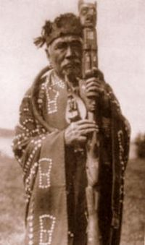
Other forms of RRR
Popcorn Reading: A student reads orally for a time, and then calls out "popcorn" before selecting another student in class to read.
Combat Reading: A student nominates a classmate to read in the attempt to catch a peer off task.
Popsicle Stick Reading: Student names are written on Popsicle sticks and placed in a can. The learner whose name is drawn reads next.
Touch Go Reading: The instructor taps a student when it's his or her turn to read.

Slide 24
Independent
Group Reading
Buddy Reading
Round Robin Reading
Silent Independent Reading
Partner Reading
Group

Slide 25
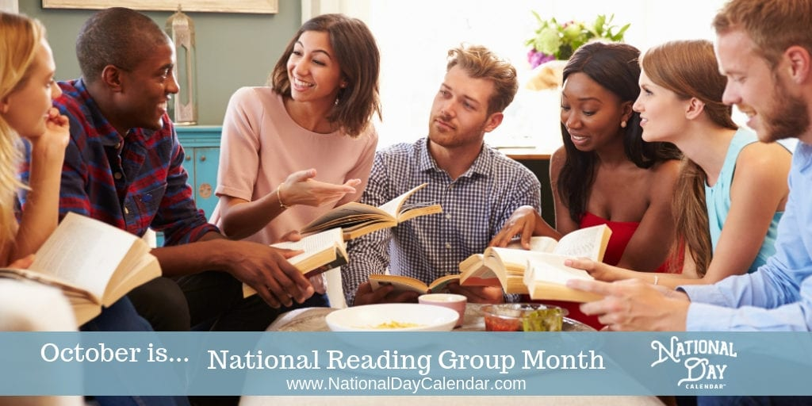
Group Reading
Students take turns reading in their groups.
Student may be given role like:
Leader
Devil’s advocate
Reporter

Slide 26
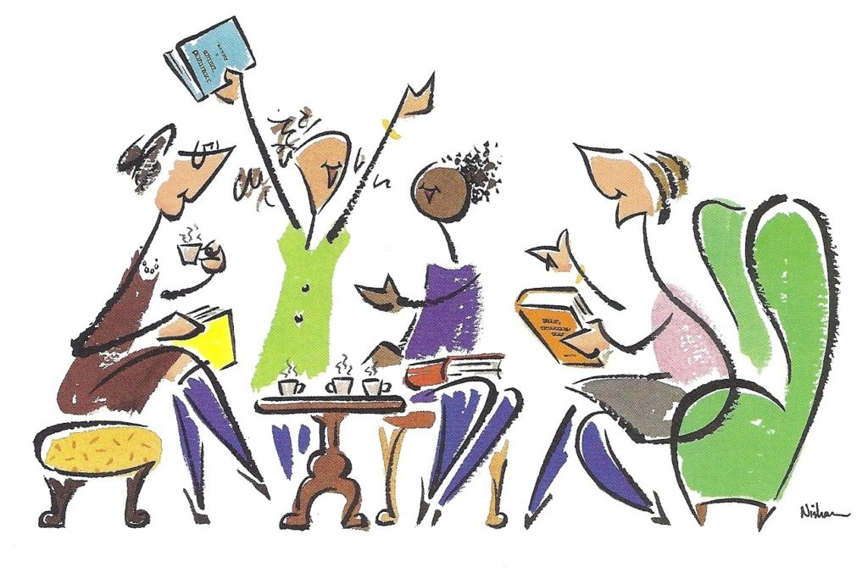
Group Reading
Pros
Cons
More comfortable
Take on responsibility
Invested in text
Various perspectives
Class management
Keeping students on task
Maturity level

Slide 27
Independent
Choral Reading
Buddy Reading
Round Robin Reading
Silent Independent Reading
Partner Reading
Group Reading
Group

Slide 28
Choral Reading
The whole class participates at the same time
Reading at the same time (or listen and repeat)

Slide 29
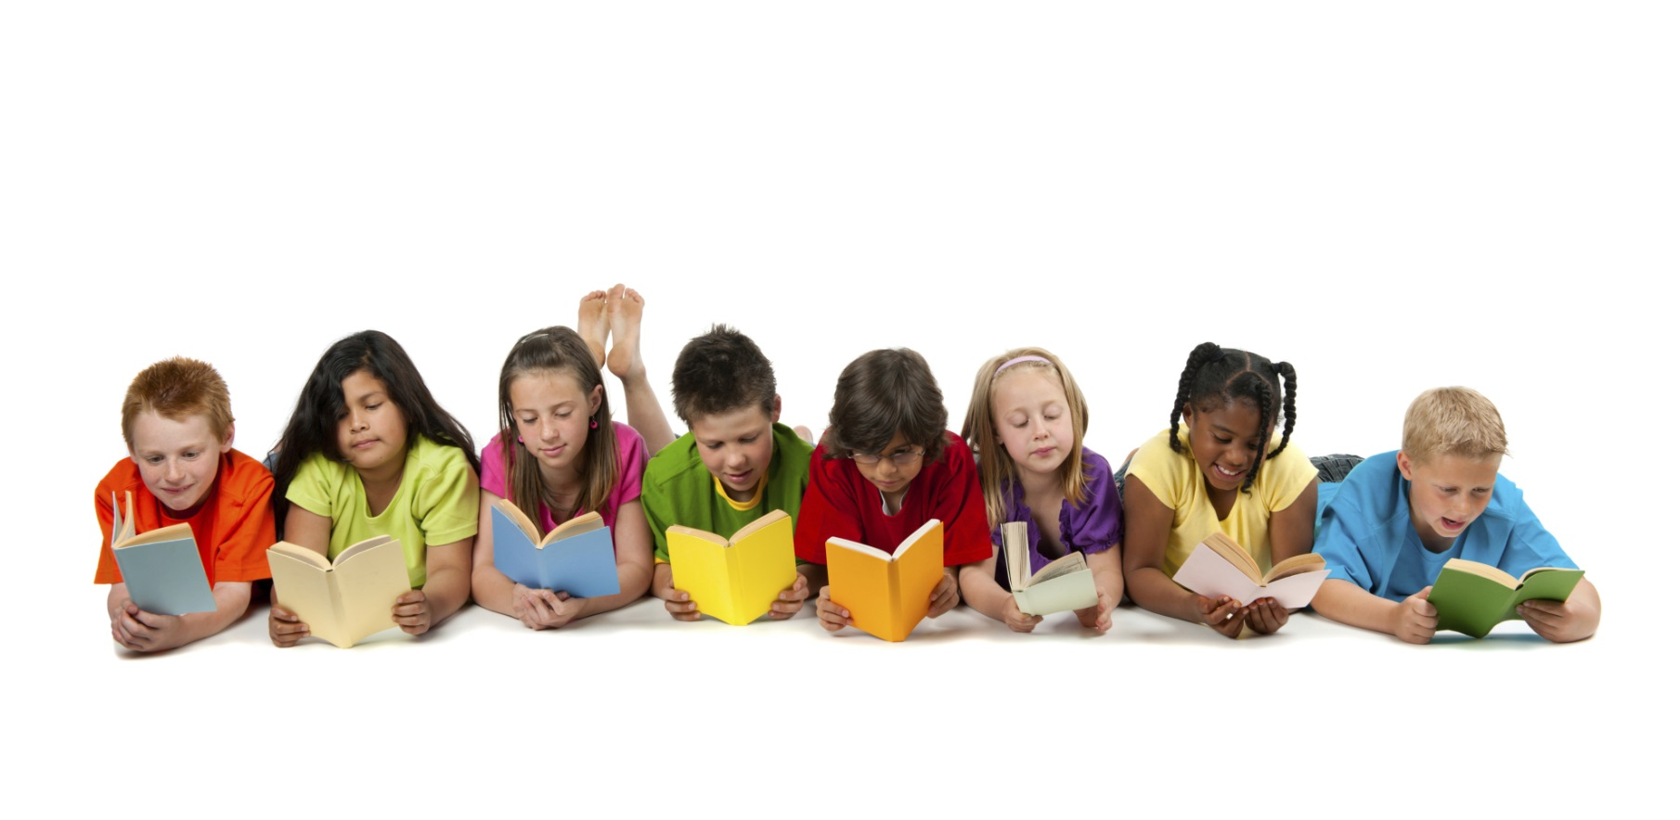
Choral Reading
Pros
Cons
Comfortable because their voice disappears in the crowd
Unlikely to hear mistakes
Students copy teacher
Difficult to make corrections

Slide 30
Independent
Class Theater
Buddy Reading
Round Robin Reading
Choral Reading
Silent Independent Reading
Partner Reading
Group Reading
Group

Slide 31
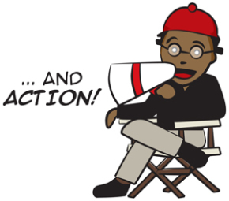
Reader’s Theater
Students assume roles and read those parts
Useful for conversations / role plays / dialogue

Slide 32
Reader’s Theater
Pros
Cons
Simulates real life
Freedom to be expressive
Invested in the character
Become experts on a part of the text, not responsible for it all.
Tactile learner
Limited to exact numbers of roles
If a student doesn’t participate, what are they doing?
Uncomfortable for students
Not high enough level to act
Students goof off
Time constraints

Slide 33
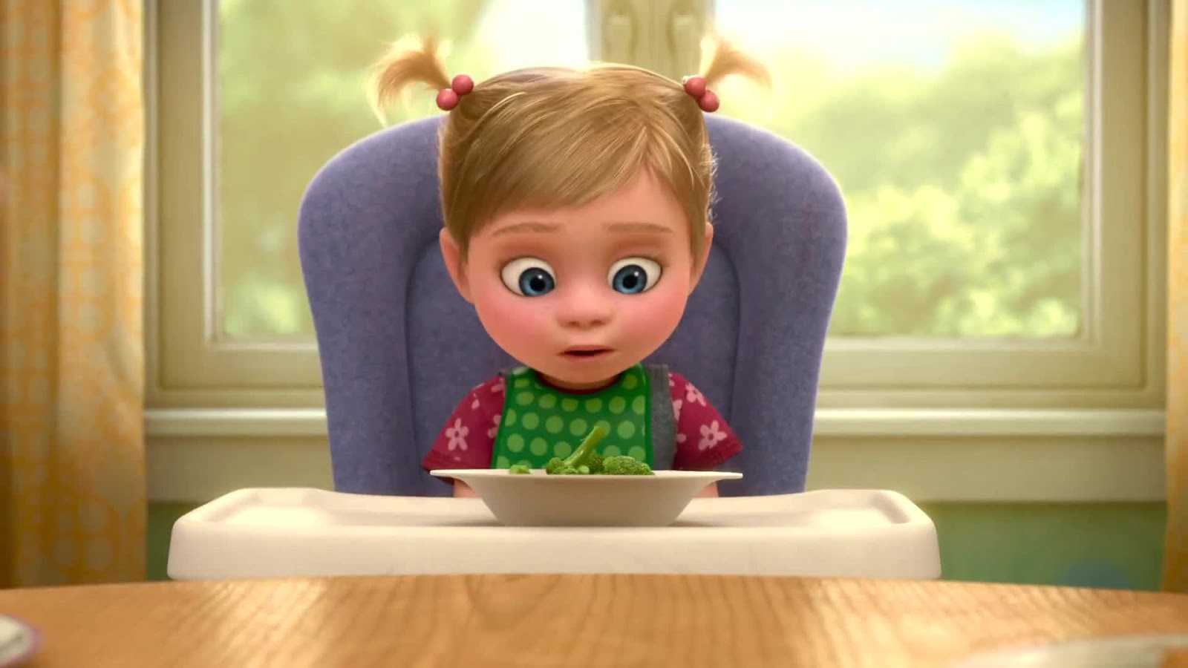
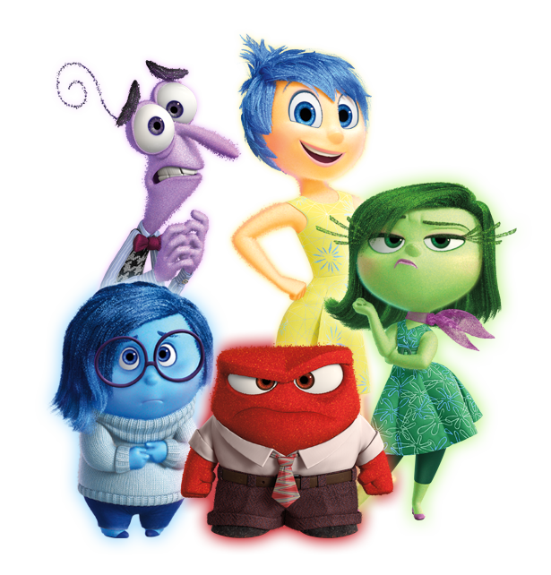
Inside Out
Practice Class Theater

Slide 34
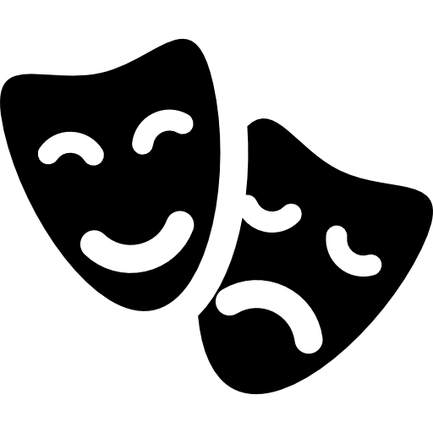
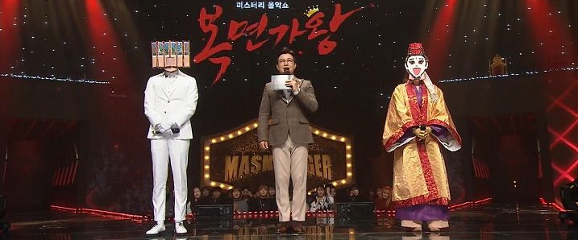
Reader’s Theater
Add some costumes
Extra roles (extra students can cheer when Kevin scores a goal)

Slide 35
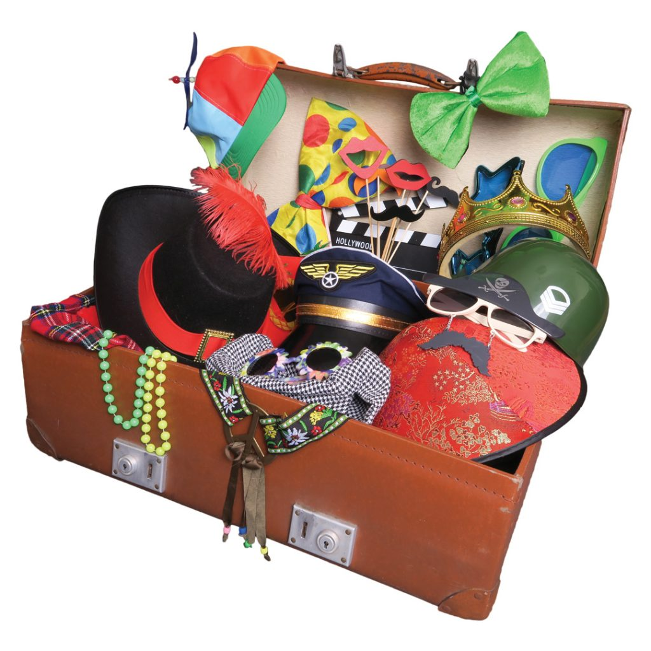
Props and Costumes
Daiso
Flying Tiger
HomePlus party section
Masks
Old clothes
Choose their own costumes.

Slide 36
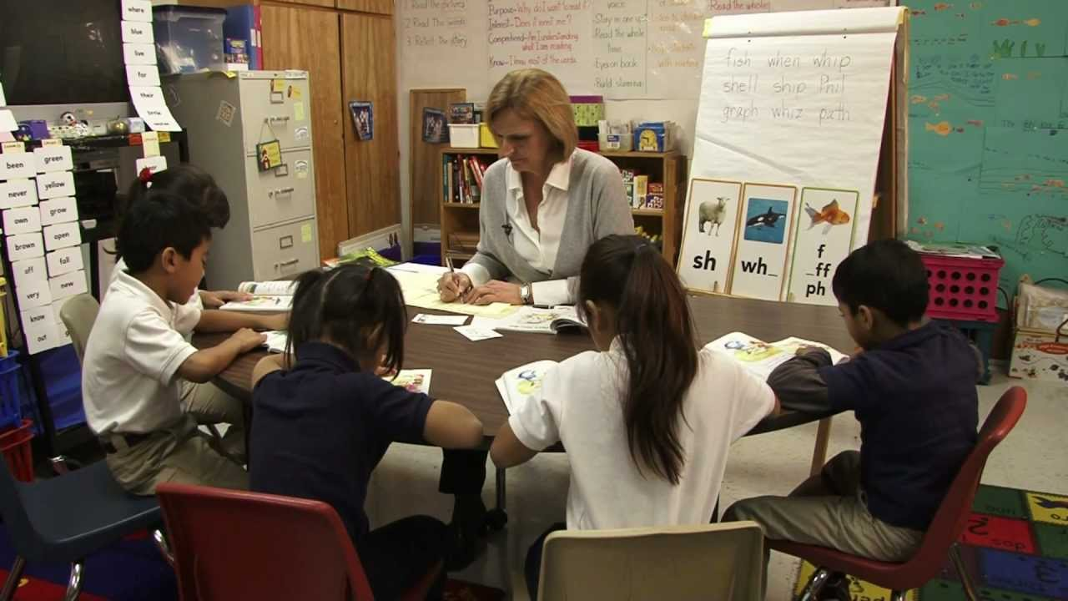
What types of “student reading” have we done in this class?

