Slide 1
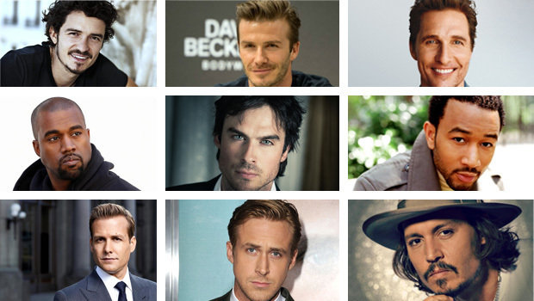
Find Your Type
of Boyfriend !

Slide 2
I like an apple.
YES
NO

Slide 3
Which one do you like ?
Which one do you like?
Comedy
Romance

Slide 4
Which one Do you like?
Which one do you like?
Action
Suspense

Slide 5
Which one Do you like?
Which one do you like?
Fur
Leather

Slide 6
Which one Do you like?
Which one do you like?
Pool Villa
Camping

Slide 7
Which one Do you like?
Which one do you like?
Money
Body

Slide 8
Which one Do you like?
Which one do you like?
Slime
Lego

Slide 9
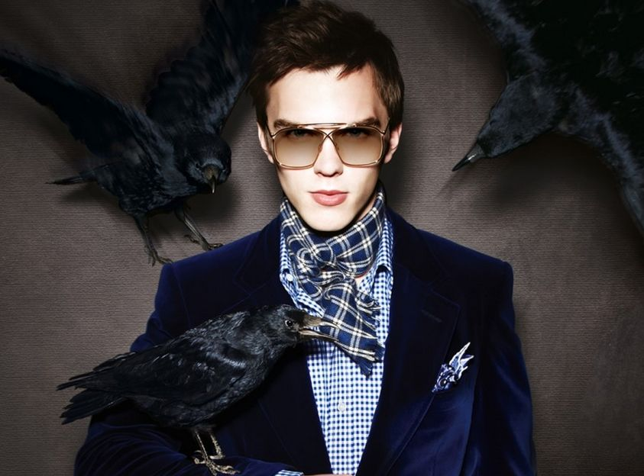
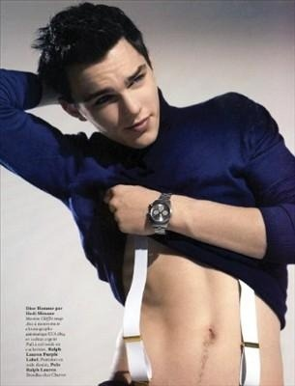
Handsome & Sexy

Slide 10
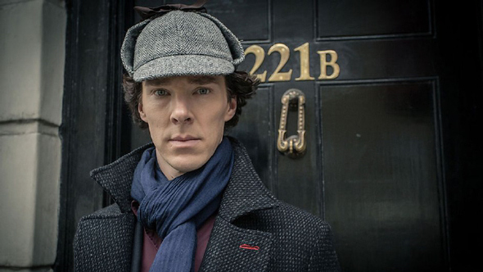
Good
Smart & Sexy

Slide 11
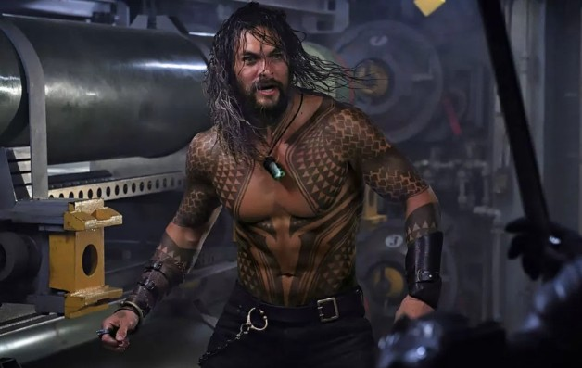
Excellent
Wild & Sexy

Slide 12
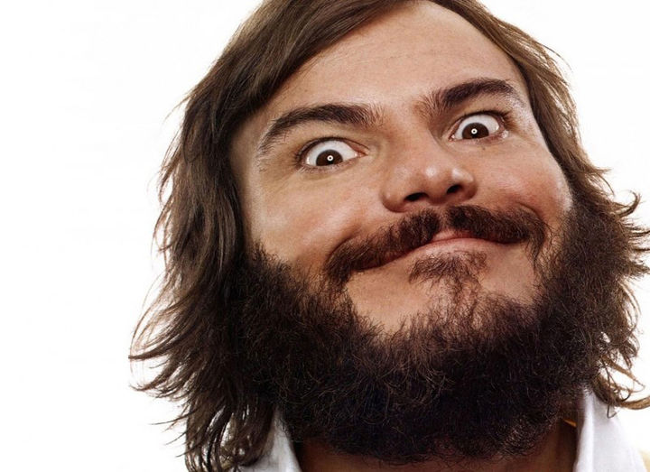
Poor
Funny & Sexy

Slide 13
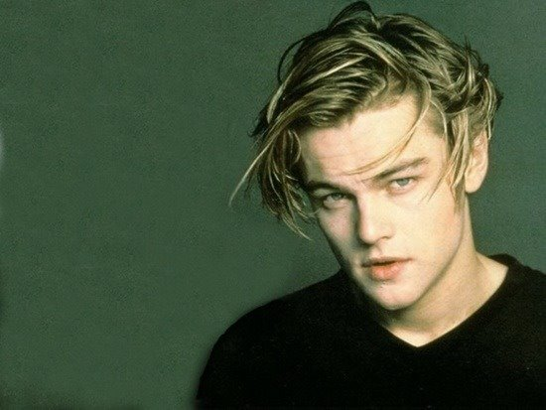
The end

