Slide 1
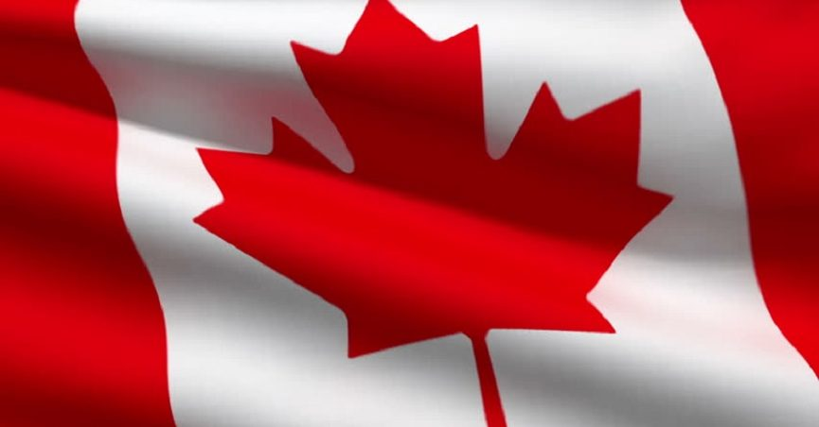
The Canada Quiz

Slide 2
Select a Question:
1
2
3
4
5
6
7
8
9
10
11
12
13
14
15
16
17
18
19
20
21
22

Slide 3
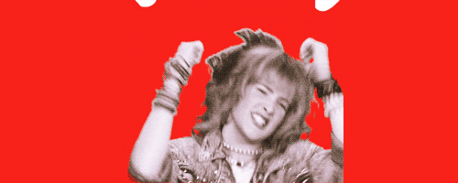
What famous superhero is actually from Canada?
Iron Man
The Hulk
Antman
Wolverine

Slide 4
Canadians are famous for saying:
Yarp
Sweet
Salut
Eh?

Slide 5
When did Canada become a country?
1867
1982
1932
1777

Slide 6
What is Canada’s national sport?
Hockey
Baseball
Rugby
Lacrosse

Slide 7
Who is from Canada?
Brad Pitt
Christian Bale
Ryan Reynolds
Hugh Jackman

Slide 8
What is the name of the Famous Coffee Shop in Canada?
McCafe
Tim Hortons
Creek’s Cafe
The Daily Grind

Slide 9
How long is the Trans Canada Highway?
9345 km
7821 km
5476 km
3105 km

Slide 10
What is a winter hat called in Canada?
Beanie
Lumberjack
Skull Cap
Toque

Slide 11
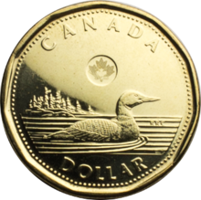
What is the Canadian $1 coin called?
Dolleradoo
The mint
Loonie
Nickel

Slide 12
What is the capitol city of Canada?
Vancouver
Ottawa
Toronto
Regina

Slide 13
What is true about Canada?
It’s the largest country.
It has the best health care.
It is the most educated country.
It’s the “fattest” country.

Slide 14
How much of canada’s land is uninhabited?
30%
60%
75%
90%

Slide 15
What is the second largest French-Speaking city (after Paris)?
Montreal
Quebec City
Ottawa
Halifax

Slide 16
What is Canada’s largest city?
Ottawa
Vancouver
Montreal
Toronto

Slide 17
What is Canada’s official website?
Canada.com
Canada.co.kr
Canada.org
Canada.ca

Slide 18
Poutine is made of French Fries, cheese, and…
Garlic
Gravy
Croutons
Maple Syrup

Slide 19
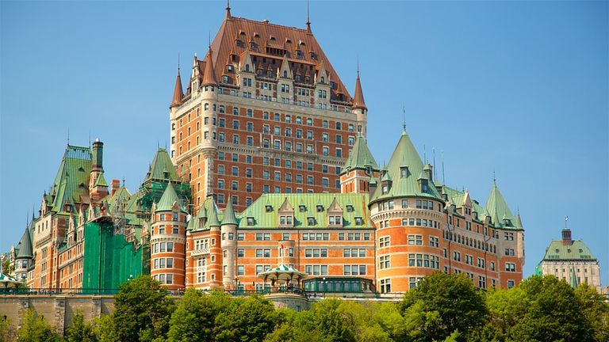
What is this?
Hotel
Government Building
Office Building
Mansion

Slide 20
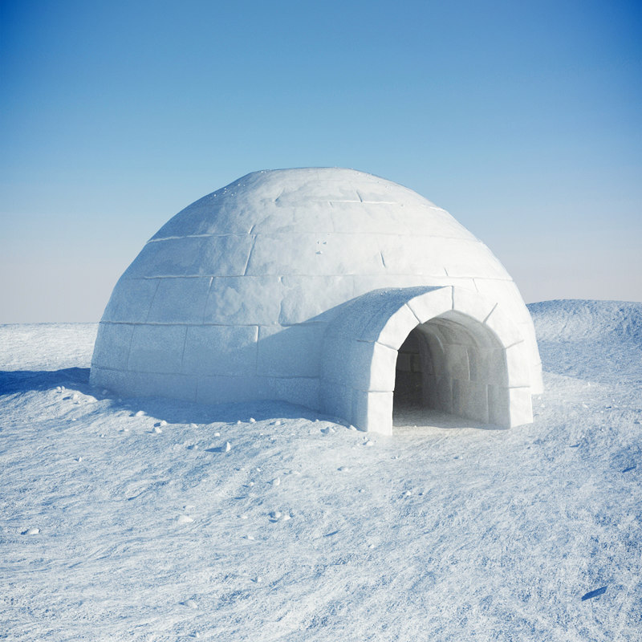
What is this?
Ice House
Fridge House
Air Con
Igloo

Slide 21
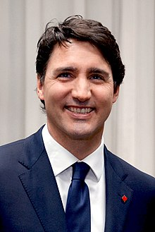
Who is it?
Jim Carey
Prime Minister Trudeau
President Cretien
Philip DeRouso

Slide 22
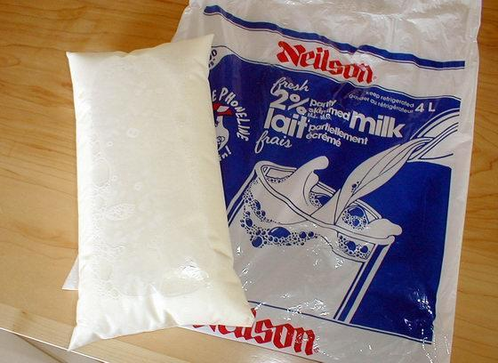
What is this?
Milk
Glue
Alcohol
Gelatin

Slide 23
Which is a common potato chip flavor in Canada?
Ketchup
Teriyaki
Seaweed
Beer

Slide 24
What is “the Bare Naked Ladies”?
A Naughty Magazine
A Musical Group
A Famous Group of Protestors
A Canadian Sculpture

