Slide 1
What Kind of Animal is it?

Slide 2
Does it only live on land?
YES
NO

Slide 3
Does it have wings?
YES
NO

Slide 4
Does it have hair?
YES
NO

Slide 5
Does it have more than 4 legs?
YES
NO

Slide 6
Does it have a shell?
YES
NO

Slide 7
Does it have legs?
YES
NO

Slide 8
Does it have legs?
YES
NO

Slide 9
Does it have wings?
YES
NO

Slide 10
Is it an insect?
YES
NO

Slide 11
Does it have a shell?
YES
NO

Slide 12
Does it breathe air?
YES
NO

Slide 13
Does it have some hair?
YES
NO

Slide 14
Can it stay on land?
YES
NO

Slide 15
Is it slimy?
YES
NO

Slide 16
Does it have a shell?
YES
NO

Slide 17
Does it have fins?
YES
NO

Slide 18
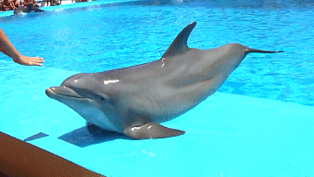
Marine Mammals

Slide 19
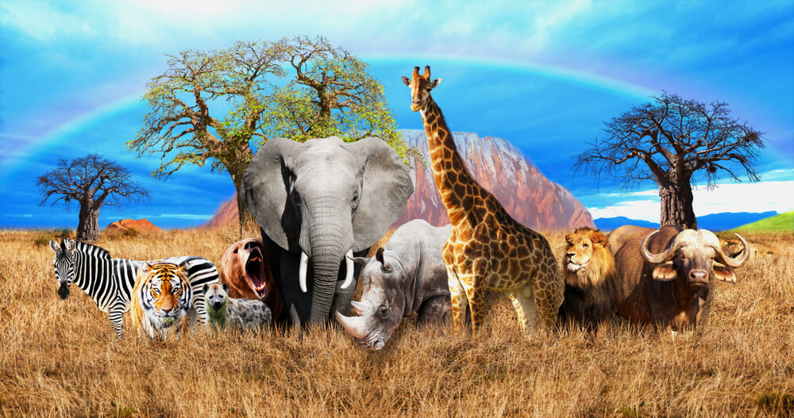
Mammals

Slide 20
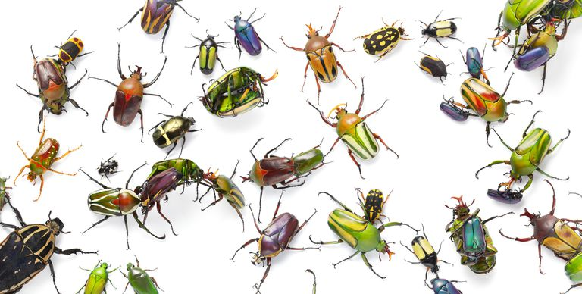
Insects

Slide 21
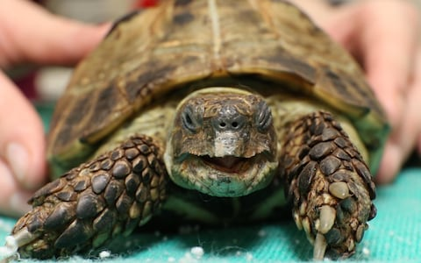
Tortoise

Slide 22
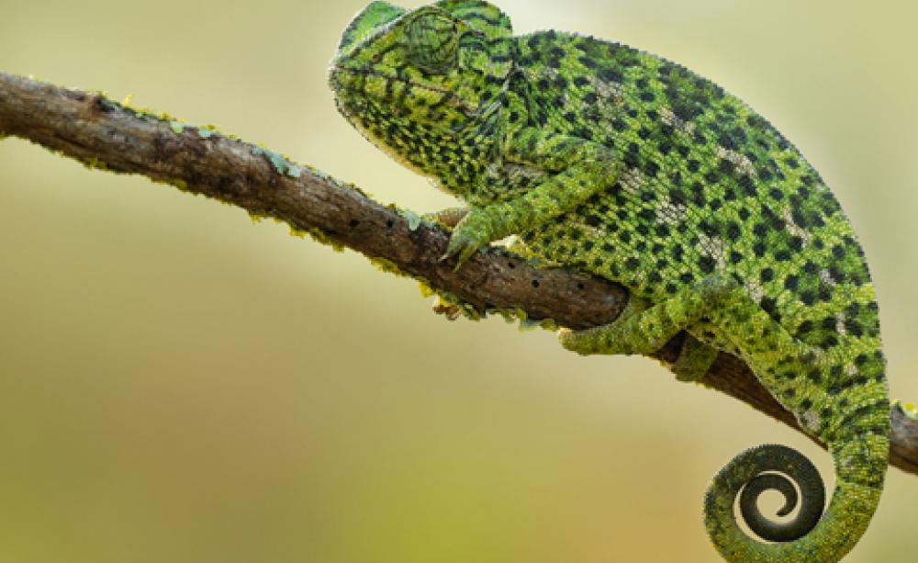
Reptiles

Slide 23
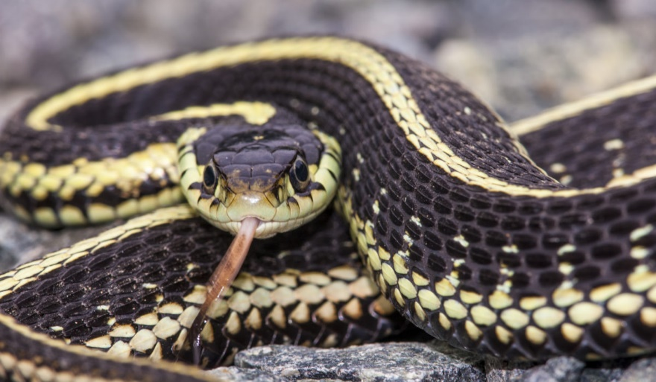
Snakes

Slide 24
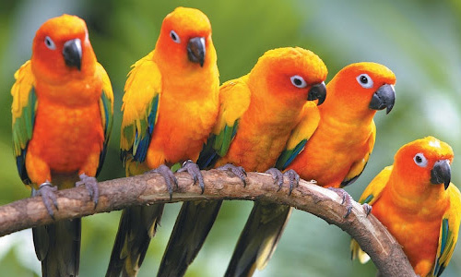
Birds

Slide 25

Flying Insects

Slide 26
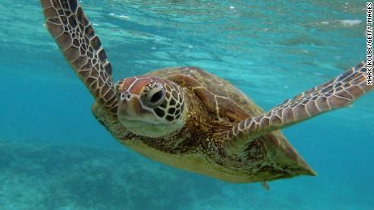
Turtles

Slide 27
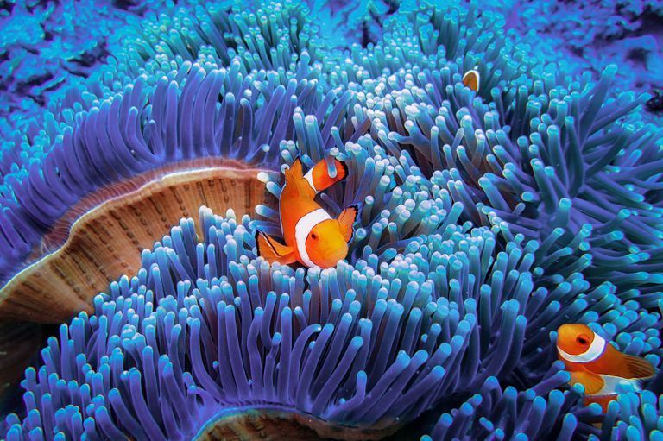
Fish

Slide 28
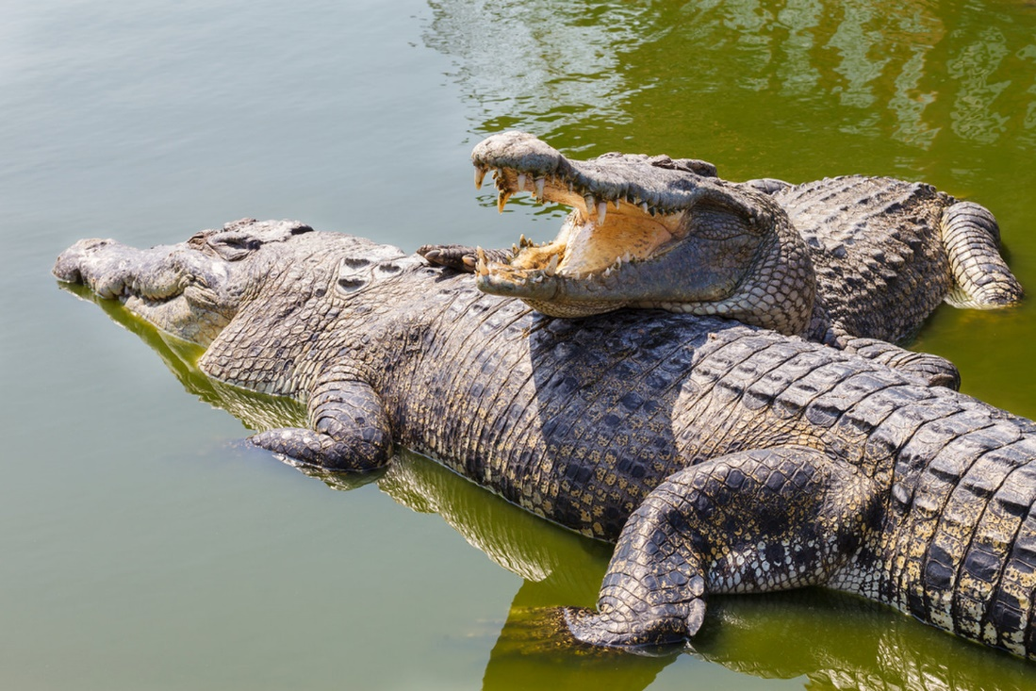
Marine Reptiles

Slide 29
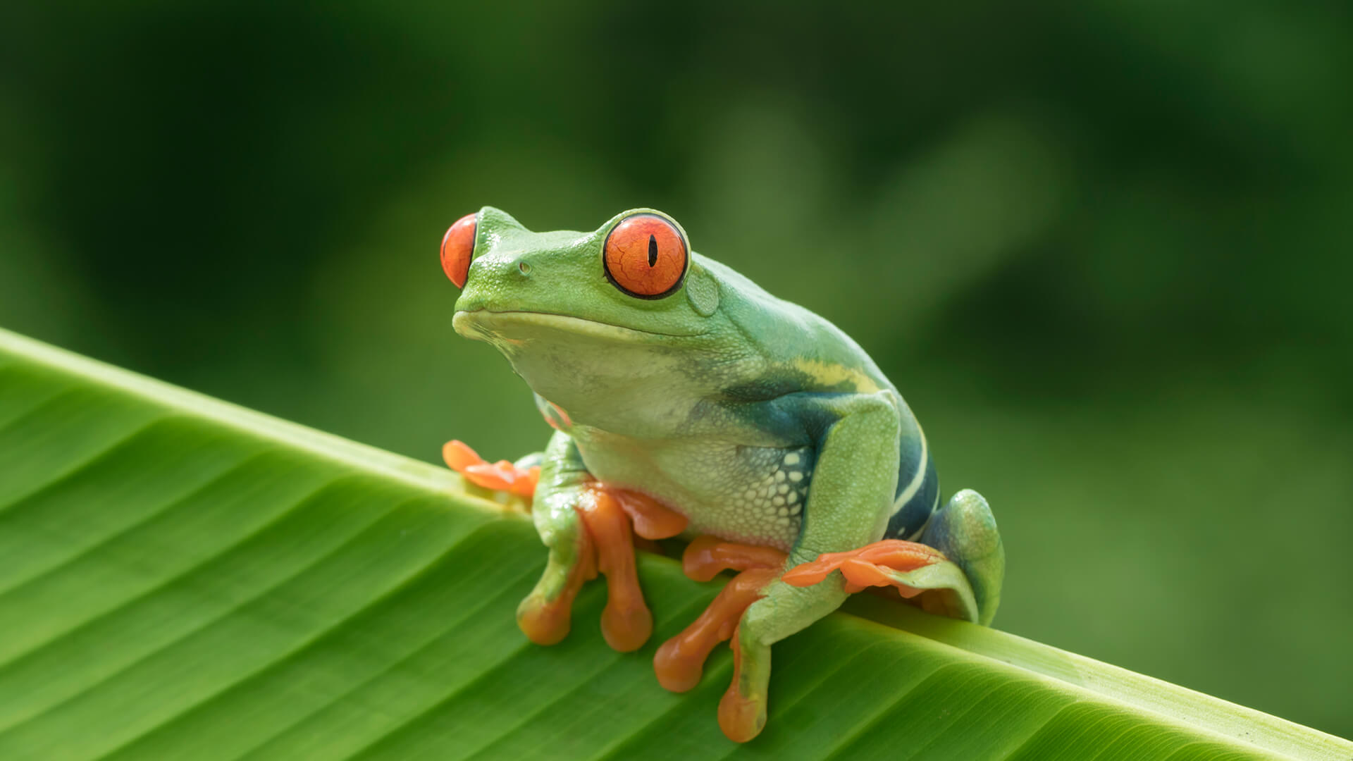
Amphibians

Slide 30
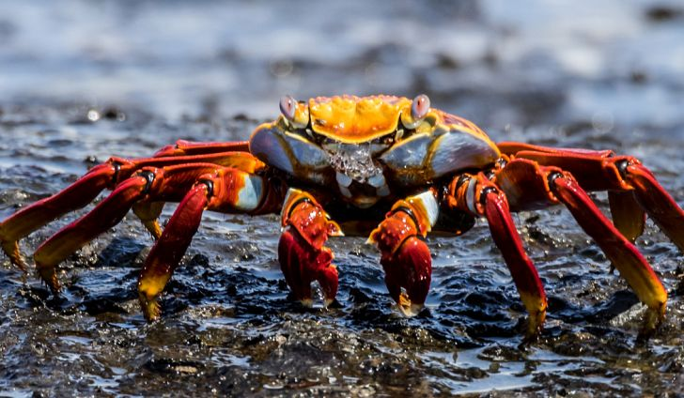
Crustacean

Slide 31
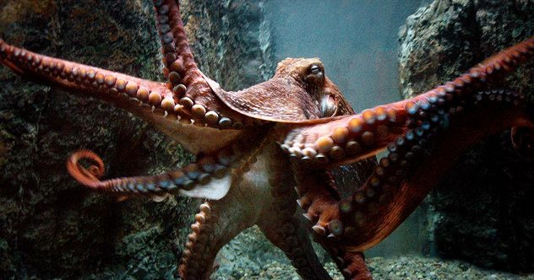
Cephalopod

Slide 32
The End

