Slide 1
What Should I Do After IETTP?

Slide 2
Do you want to leave Korea?
YES
NO

Slide 3
Do you like the outdoors?
YES
NO

Slide 4
Do you like exercise?
YES
NO

Slide 5
Do you own a bike?
YES
NO

Slide 6
Do you like coffee?
YES
NO

Slide 7
Are you craving specific food?
YES
NO
I’m not hungry

Slide 8
Do you like adventure?
YES
NO

Slide 9
Do you like being around other people?
YES
NO

Slide 10
Do you like dancing?
YES
NO

Slide 11
Do you like shopping?
YES
NO

Slide 12
How about the weather?
HOT
WARM
COLD

Slide 13
Do you like exercise?
YES
NO

Slide 14
Are you scared of mosquitos?
YES
NO

Slide 15
Which is scarier?
Snakes
Lions

Slide 16
Do you want to travel far?
YES
NO

Slide 17
Do you like Lord of the Rings?
YES
NO

Slide 18
Do you have a lot of money?
YES
NO

Slide 19
Do you like animals?
YES
NO

Slide 20
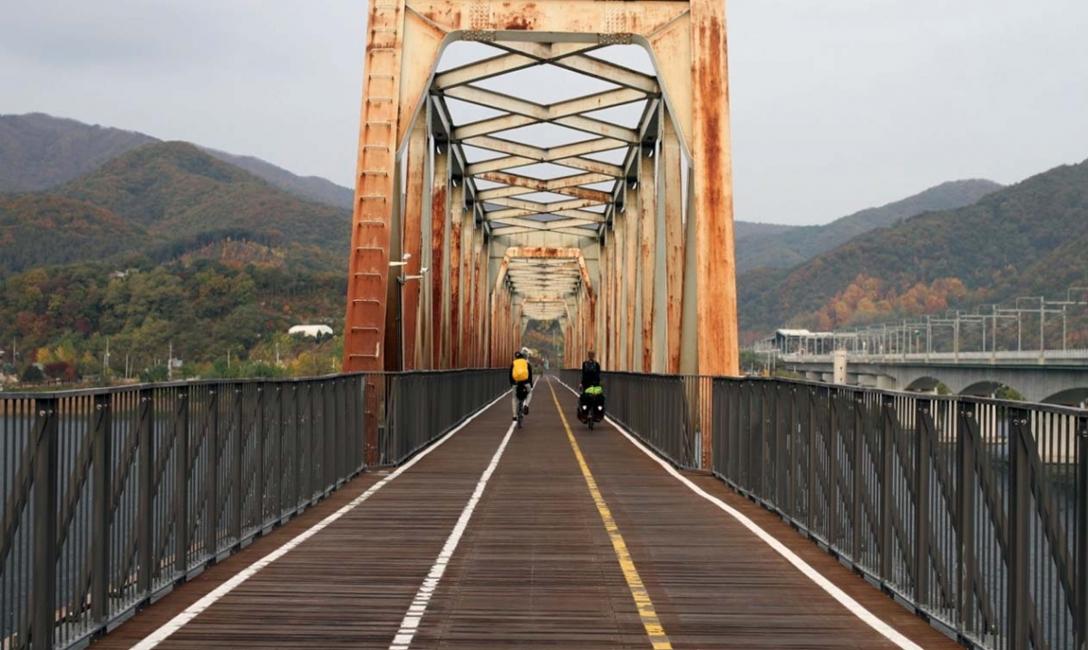
4 rivers
You should cycle from Seoul to Busan on the 4 Rivers Path.

Slide 21
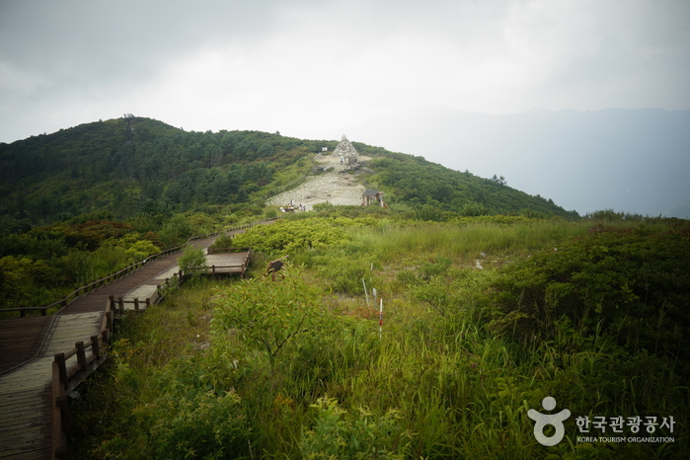
Jirisan
You should climb
Jirisan Mountain

Slide 22
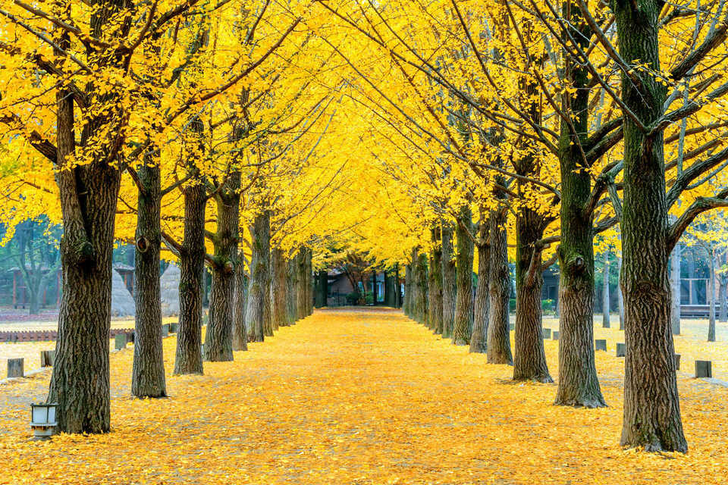
Namiseon
You should have a picnic on Namiseon Island

Slide 23
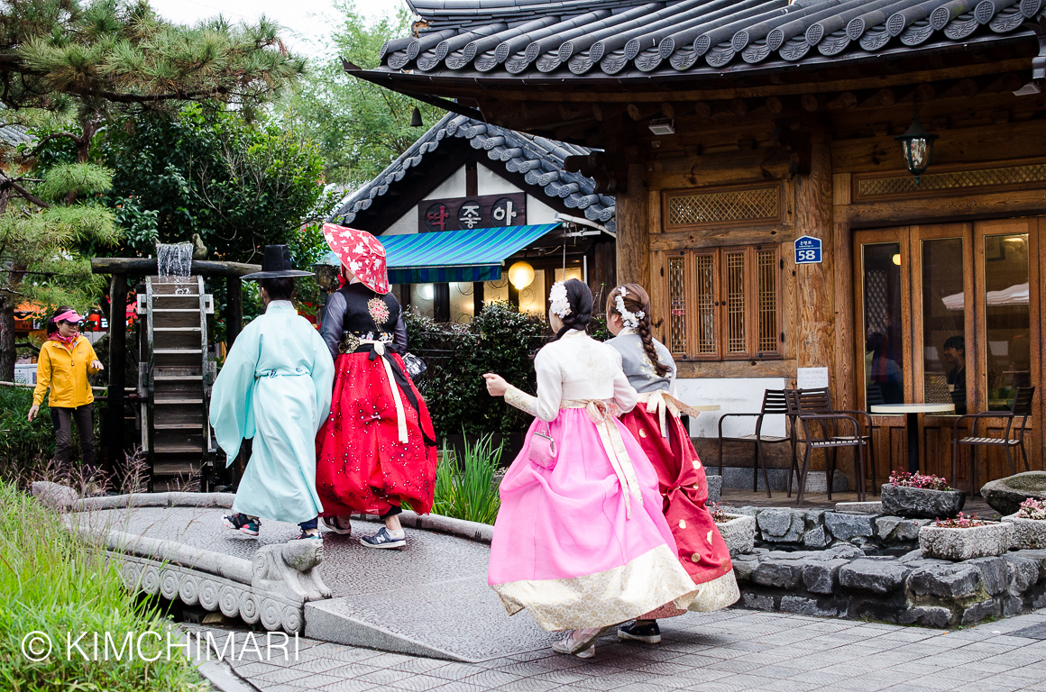
Jeonju Hanok Village
You should go to a café in Jeonju’s Hanok Village.

Slide 24
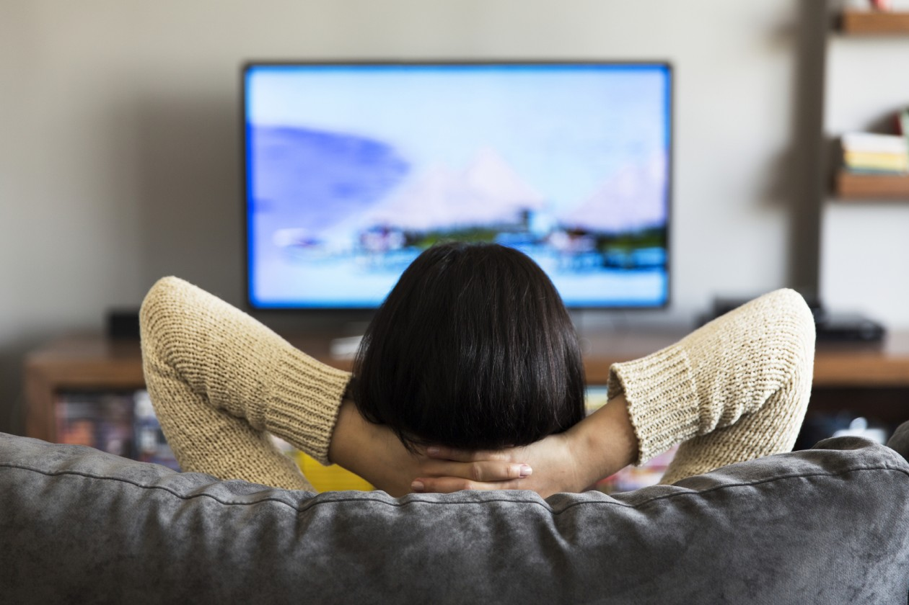
Watch TV at home
You should watch TV at home.

Slide 25
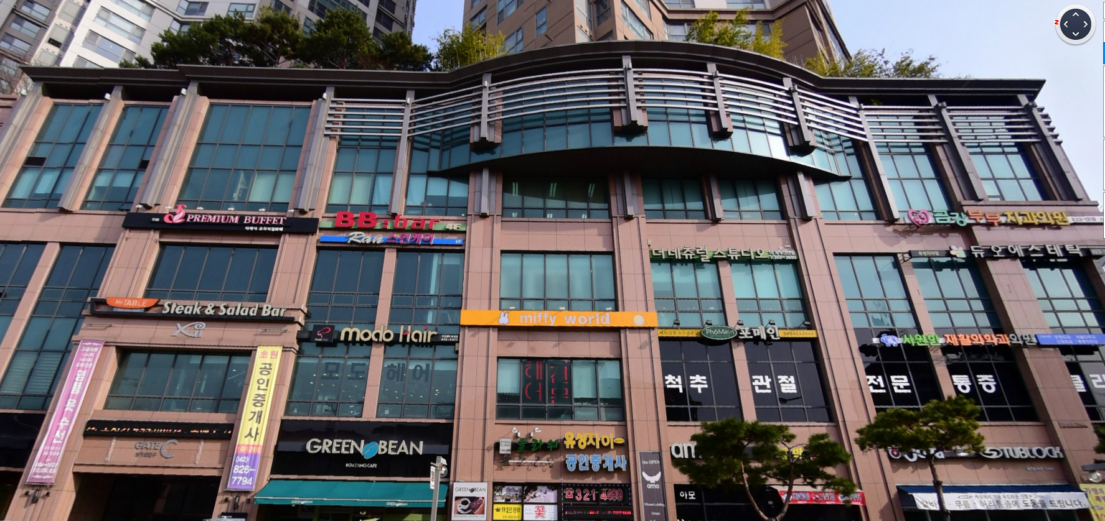
J Buffet
You should go to J Buffet in Daejeon

Slide 26
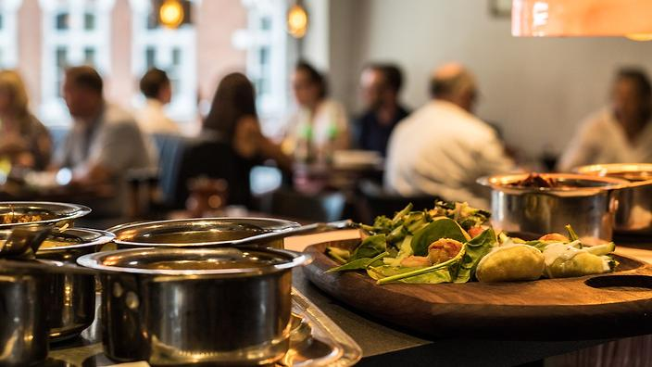
Go to a special restaurant
You should go to a restaurant that serves that type of food.

Slide 27
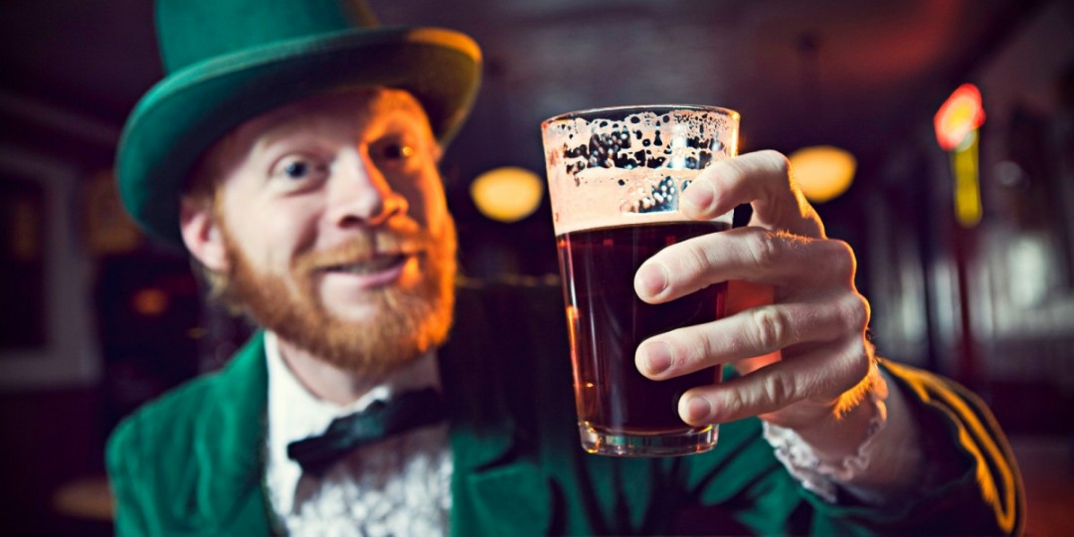
Drink Beer in Ireland
You should drink beer in Ireland

Slide 28
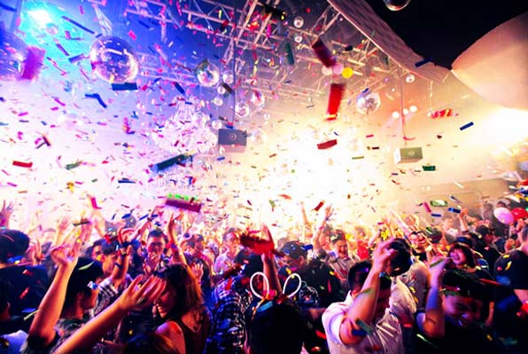
Go Clubbing in Singapore
You should go clubbing in Singapore.

Slide 29
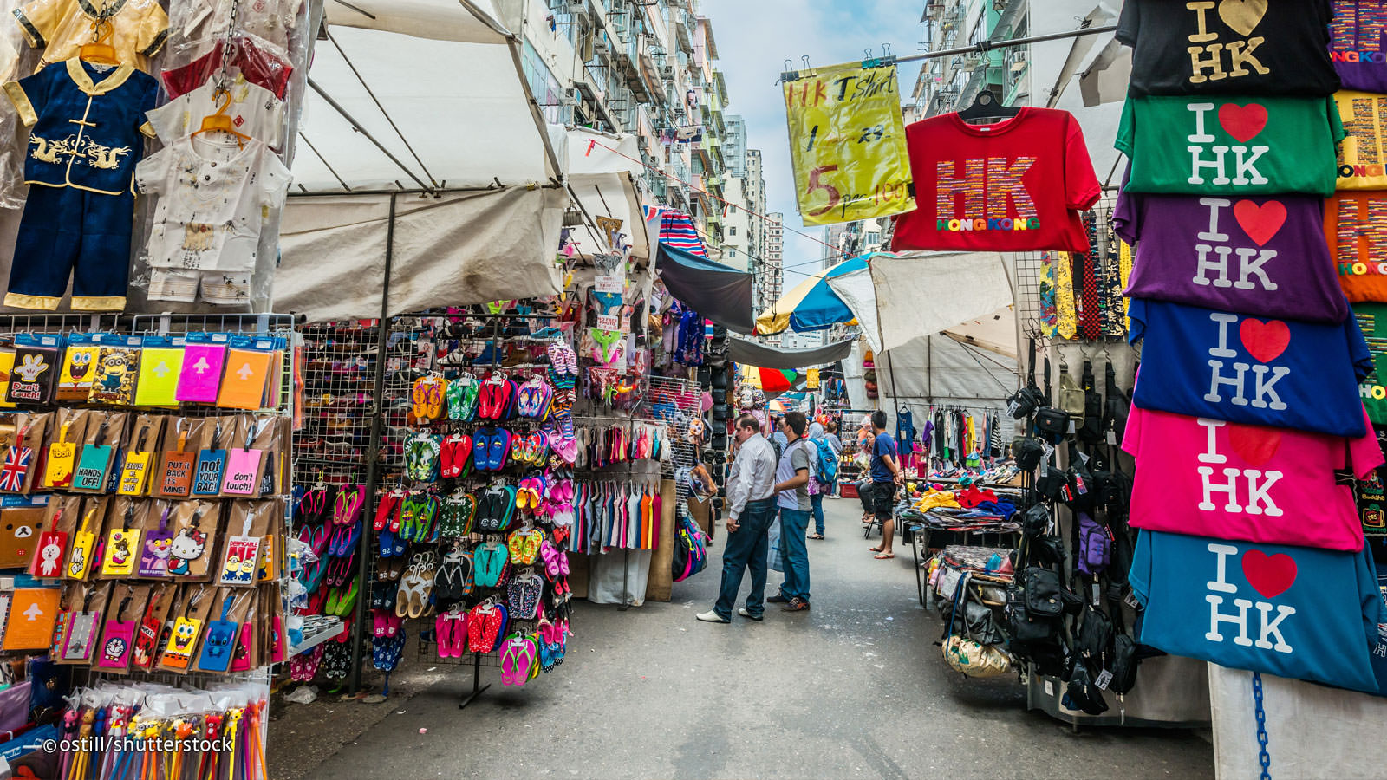
Visit the shopping district in Hong Kong
Visit the shopping district in Hong Kong

Slide 30
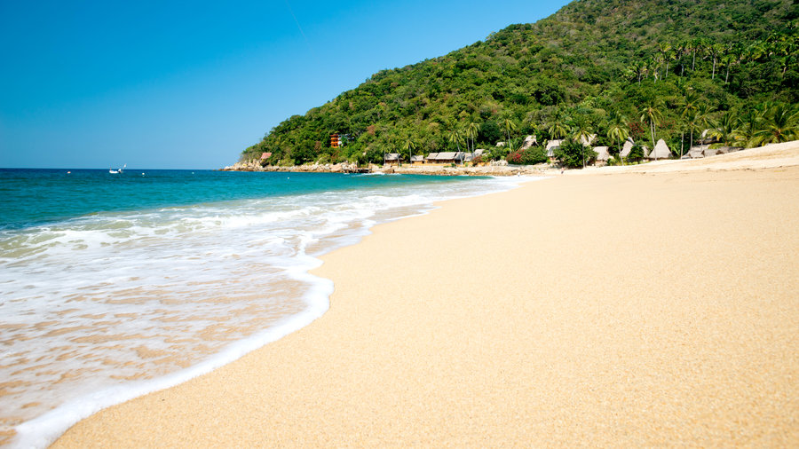
Relax on a beach in Mexico
You should relax on a beach in Mexico.

Slide 31
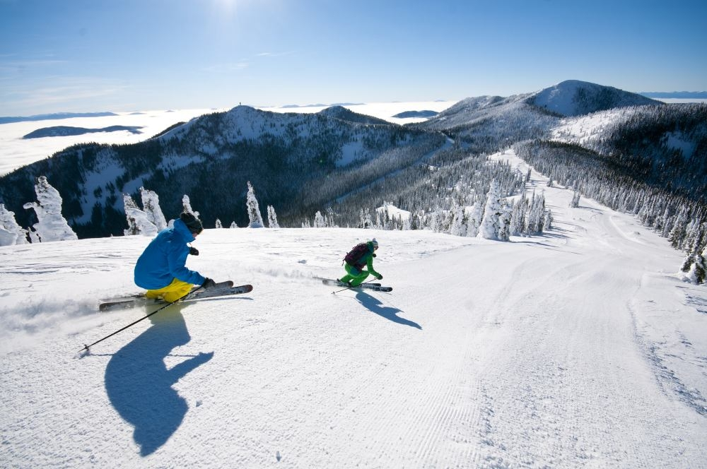
Go Skiing in Canada
You should go skiing in Canada.

Slide 32
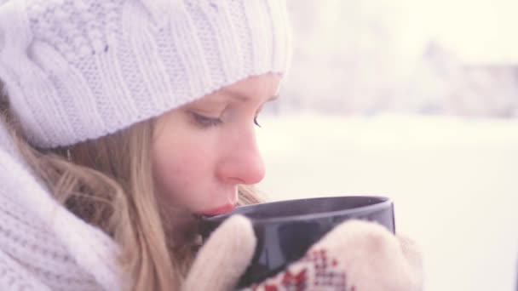
Hot chocolate in Sweeden (swiss?)
You should enjoy a hot chocolate in Sweden.

Slide 33
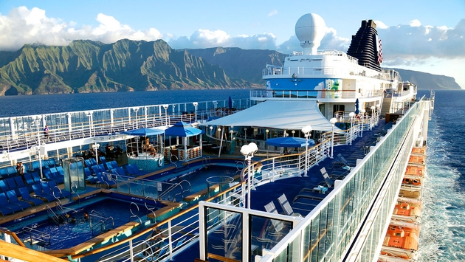
Cruise to Hawaii
You should take a cruise to Hawaii

Slide 34
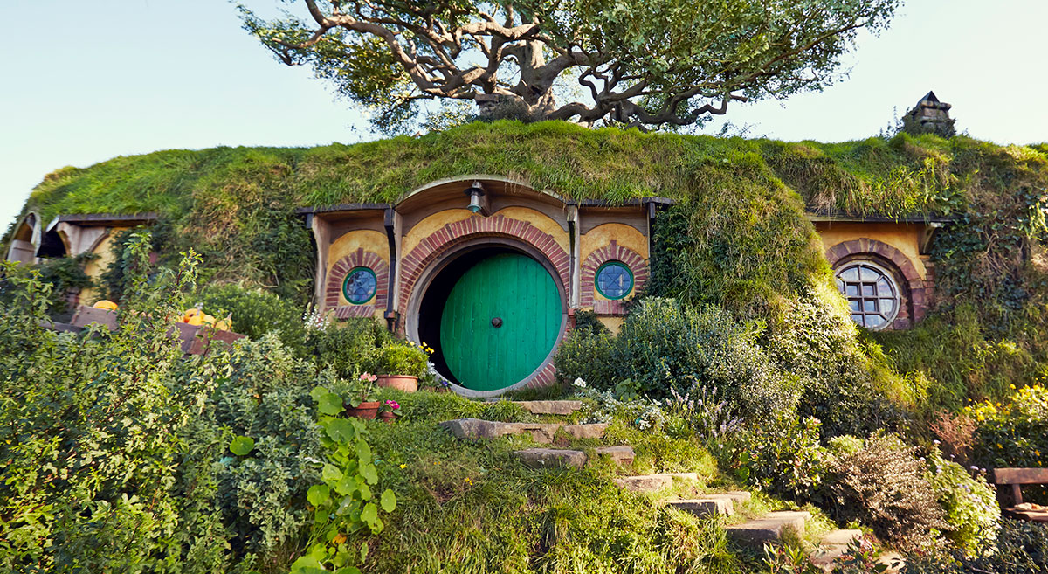
Lord of the Rings Set
You should visit the Lord of the Rings set in New Zealand.

Slide 35
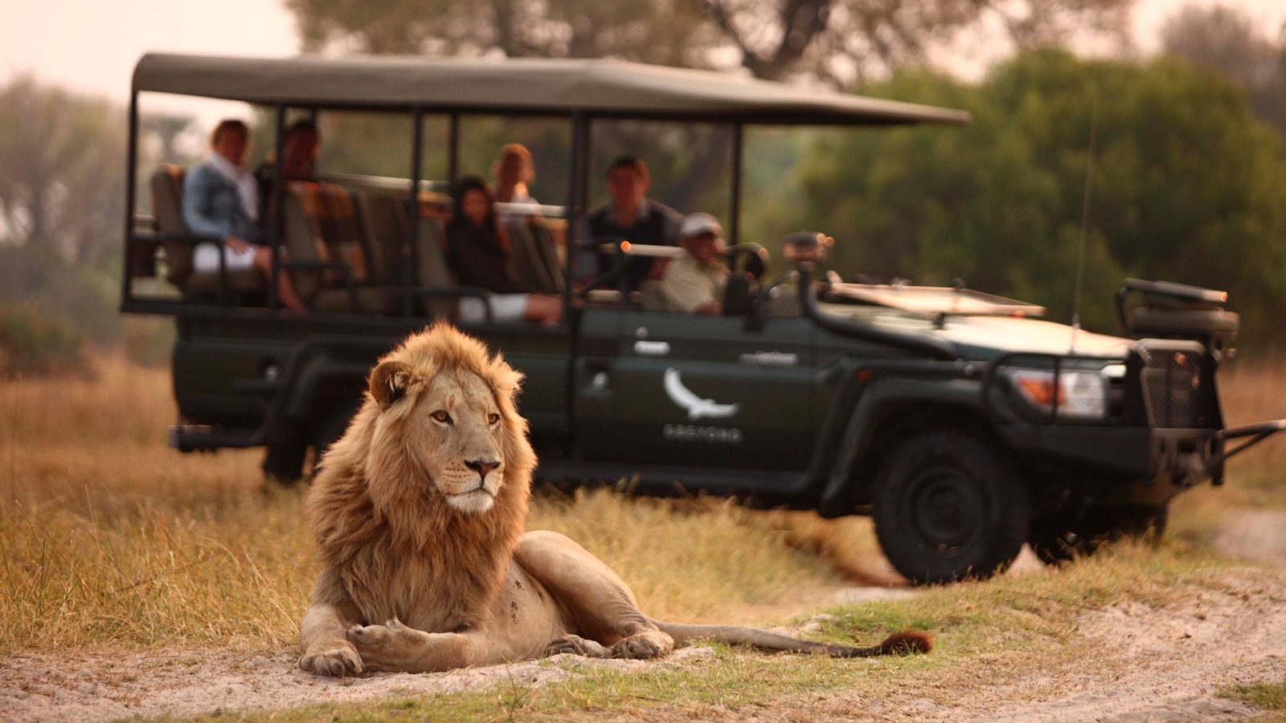
Safari south Africa
You should take a safari tour in South Africa.

Slide 36
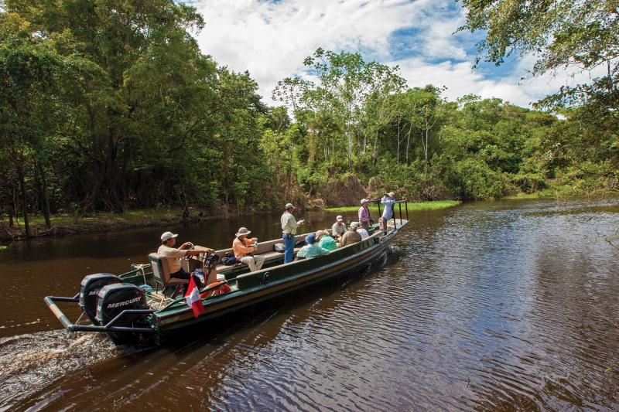
Boat tour in amazon
You should take a boat tour of the Amazon.

Slide 37
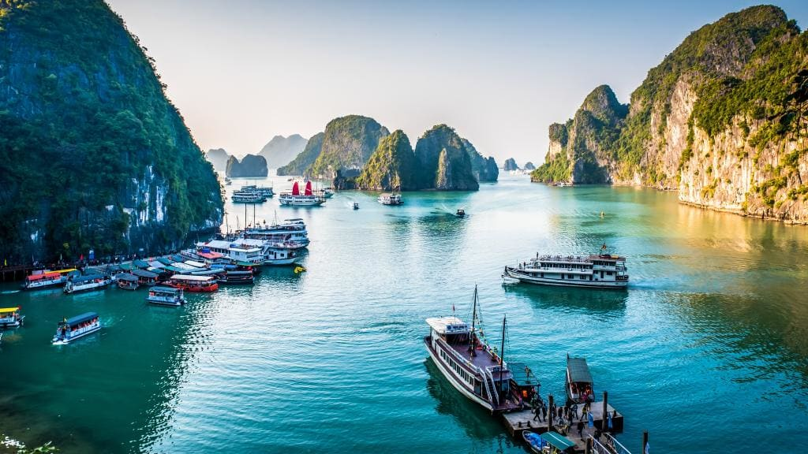
Halong Bay Cruise
You should take a cruise in Halong Bay, Vietnam.

Slide 38
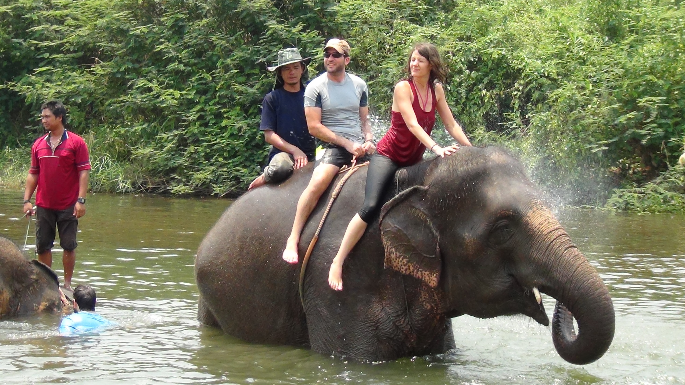
Ride an Elelphant in Thailand
You should ride an elephant in Thailand.

Slide 39
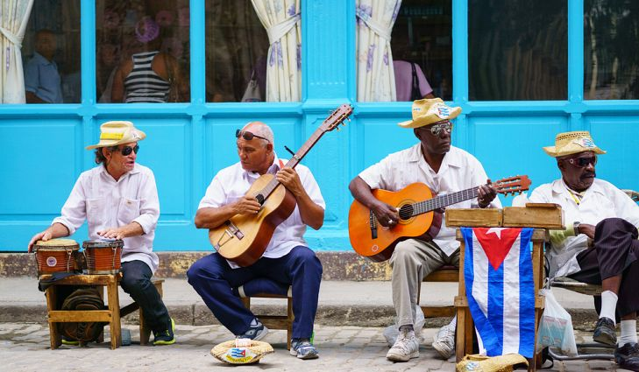
Culture and food of cuba
You should enjoy the food and culture of Cuba.

Slide 40
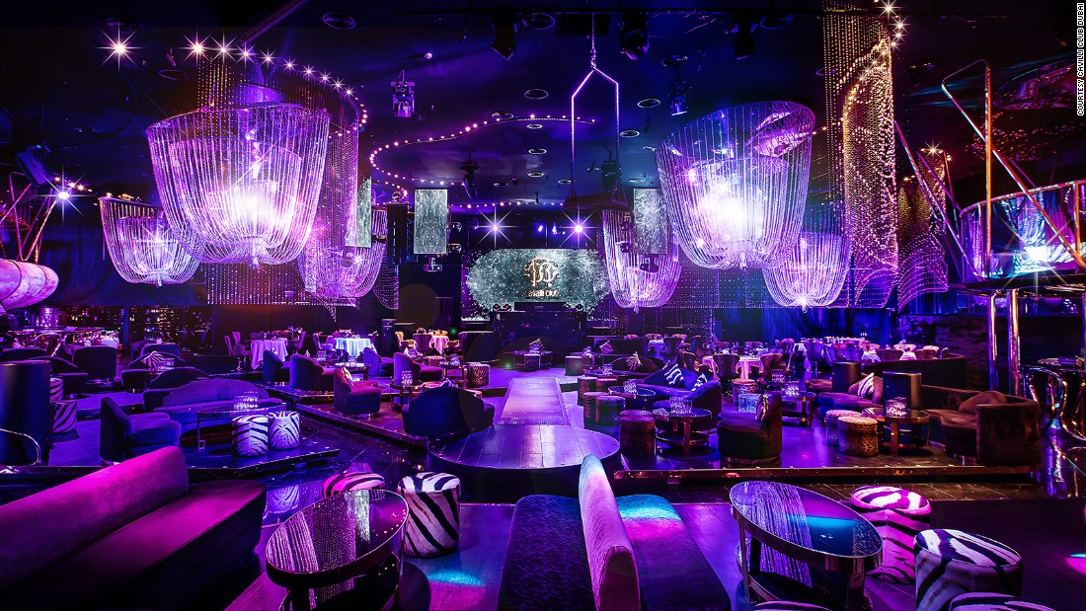
Fancy Party in Dubai
You should go to a fancy party in Dubai.

