Slide 1
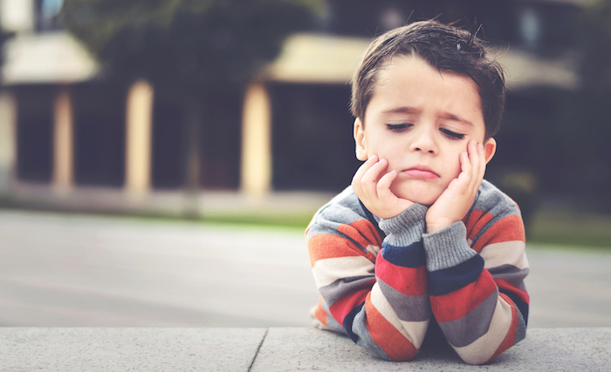
What Should I do When I’m bored??

Slide 2
Do you like outdoor activities?
YES
NO

Slide 3
Do you like outdoor activities?
YES
NO

Slide 4
What’s your outdoor favorite places?
Land
Water

Slide 5
What’s your indoor favorite places?
Quiet
Active

Slide 6
Do you like climbing?
YES
NO

Slide 7
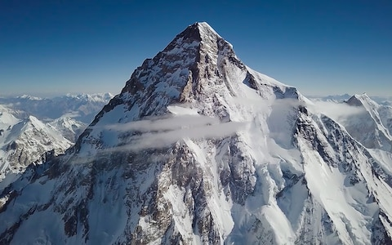
Go to the mountain!

Slide 8
Do you like camping?
YES
NO

Slide 9
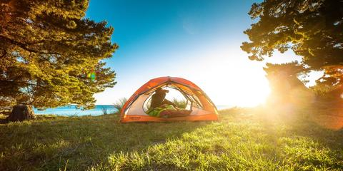
Go to the camping site!

Slide 10
Do you like driving?
YES
NO

Slide 11
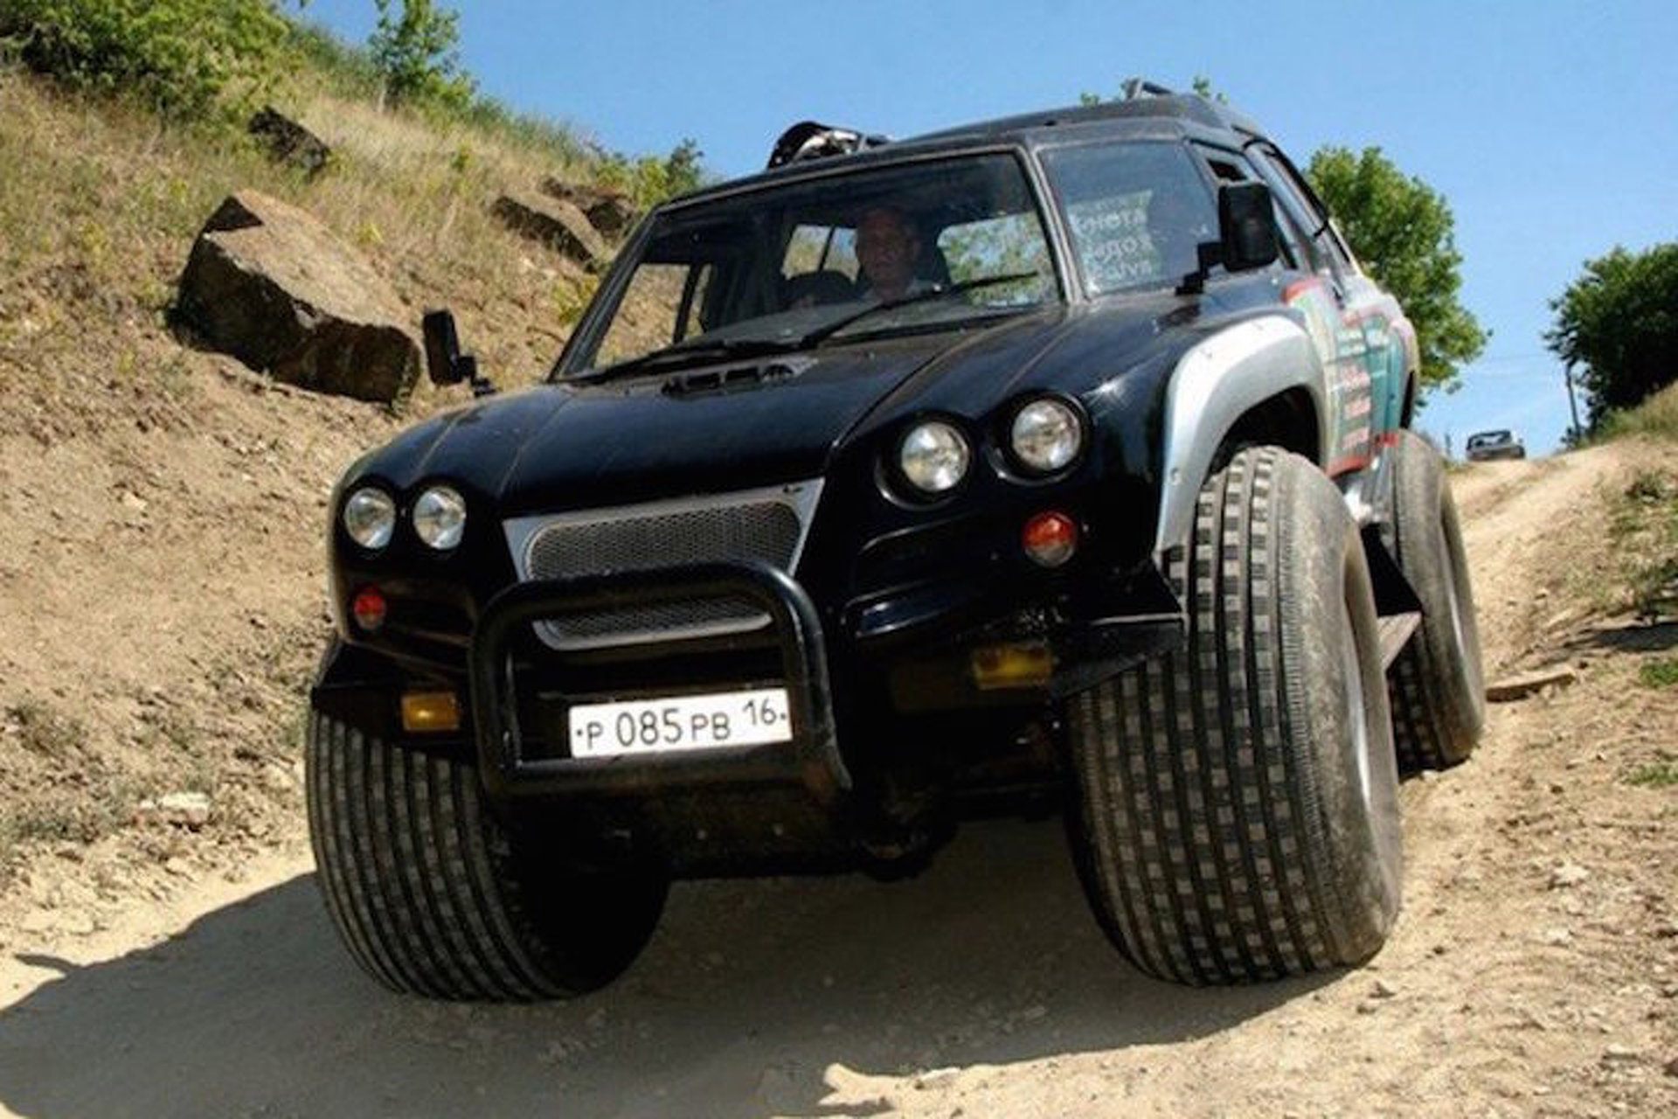
Go off-roading!

Slide 12
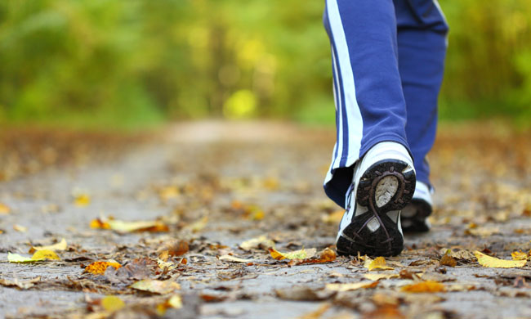
Take a walk around your home

Slide 13
Do you like swimming?
YES
NO

Slide 14
Do you like ocean?
YES
NO

Slide 15
Do you like fish?
YES
NO

Slide 16
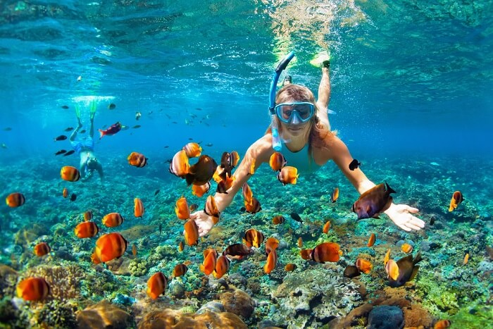
Go snorkeling / scuba-diving!

Slide 17
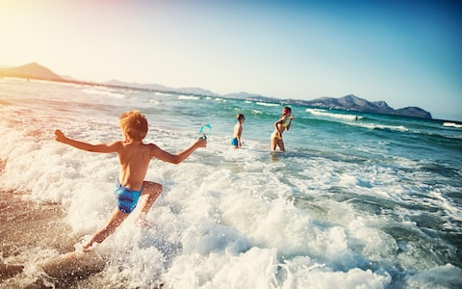
Swim in the sea!

Slide 18
Do you like river?
YES
NO

Slide 19
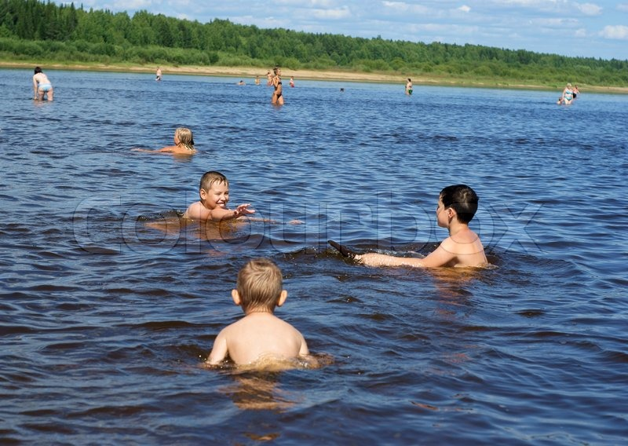
Swim in the river!

Slide 20
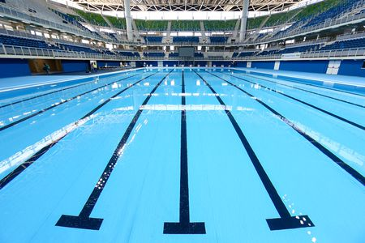
Swim in the swimming pool!

Slide 21
Do you like to go fishing?
YES
NO

Slide 22
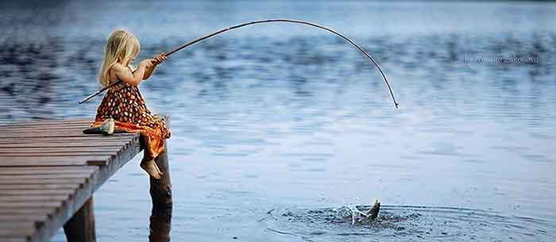
Go fishing!

Slide 23
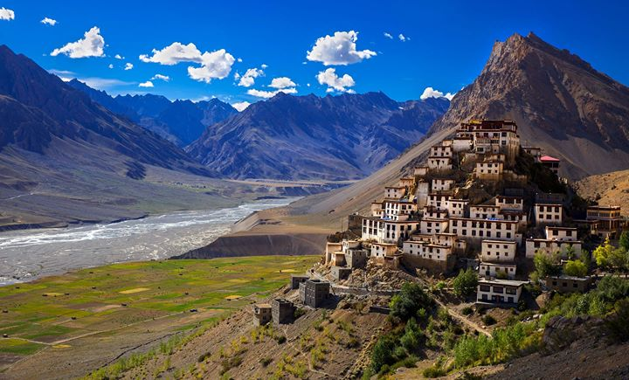
Go to the valley / river!

Slide 24
Do you like reading?
YES
NO

Slide 25

Go to the library!

Slide 26
Do you like chatting?
YES
NO

Slide 27
Do you like coffee?
YES
NO

Slide 28
Do you like to watch movies?
YES
NO

Slide 29
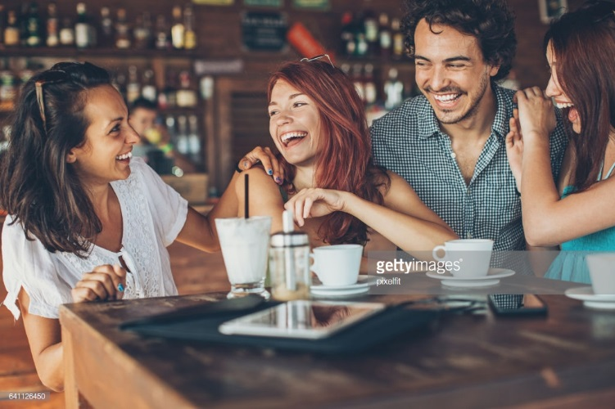
Go to café!

Slide 30
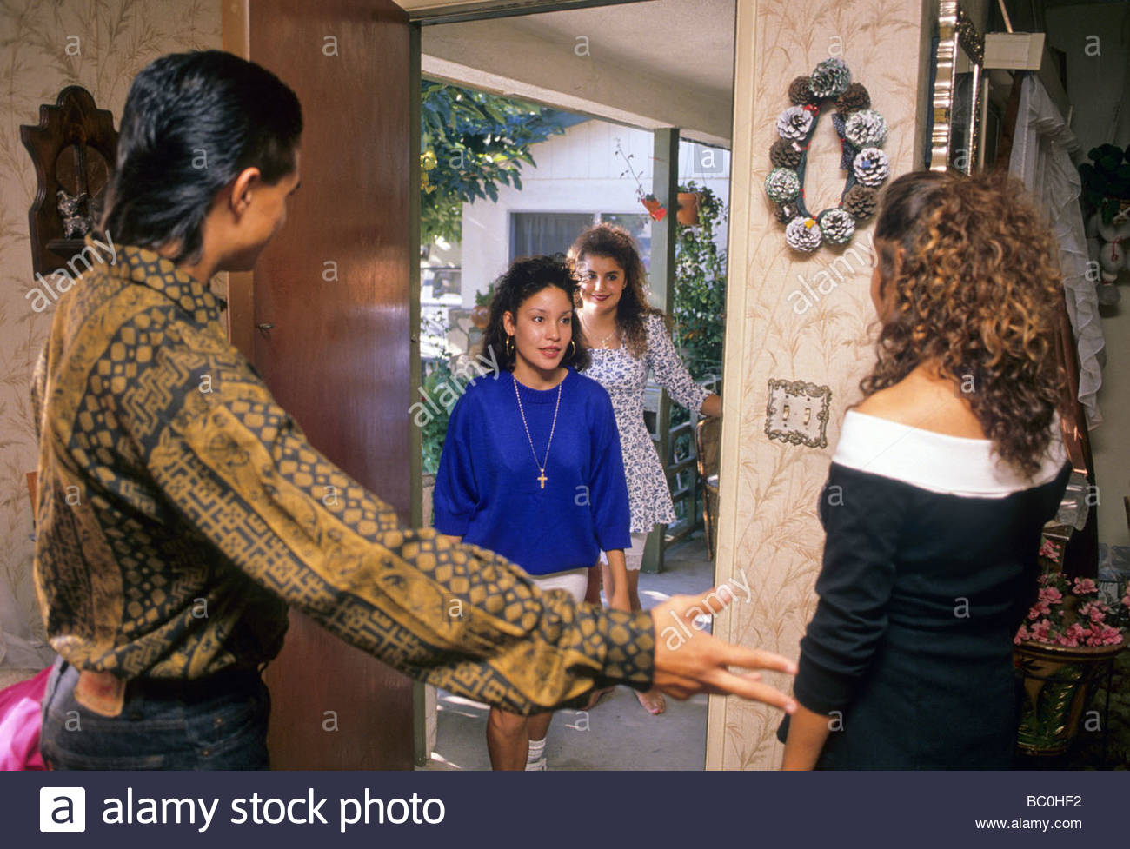
Visit your friend’s house!

Slide 31
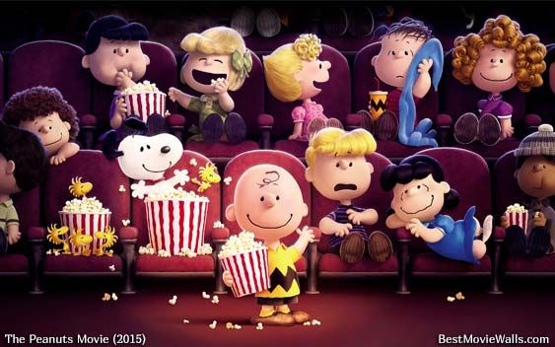
Go to the cinema!

Slide 32

Stay home!

Slide 33
Do you like to exercise?
YES
NO

Slide 34
Do you like bowling?
YES
NO

Slide 35
Do you like music?
YES
NO

Slide 36
Do you like dancing?
YES
NO

Slide 37
Do you like singing?
YES
NO

Slide 38
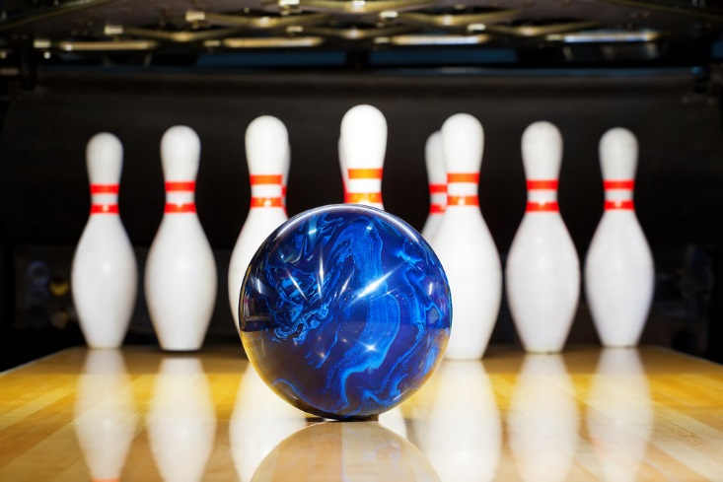
Go to the bowling alley!

Slide 39
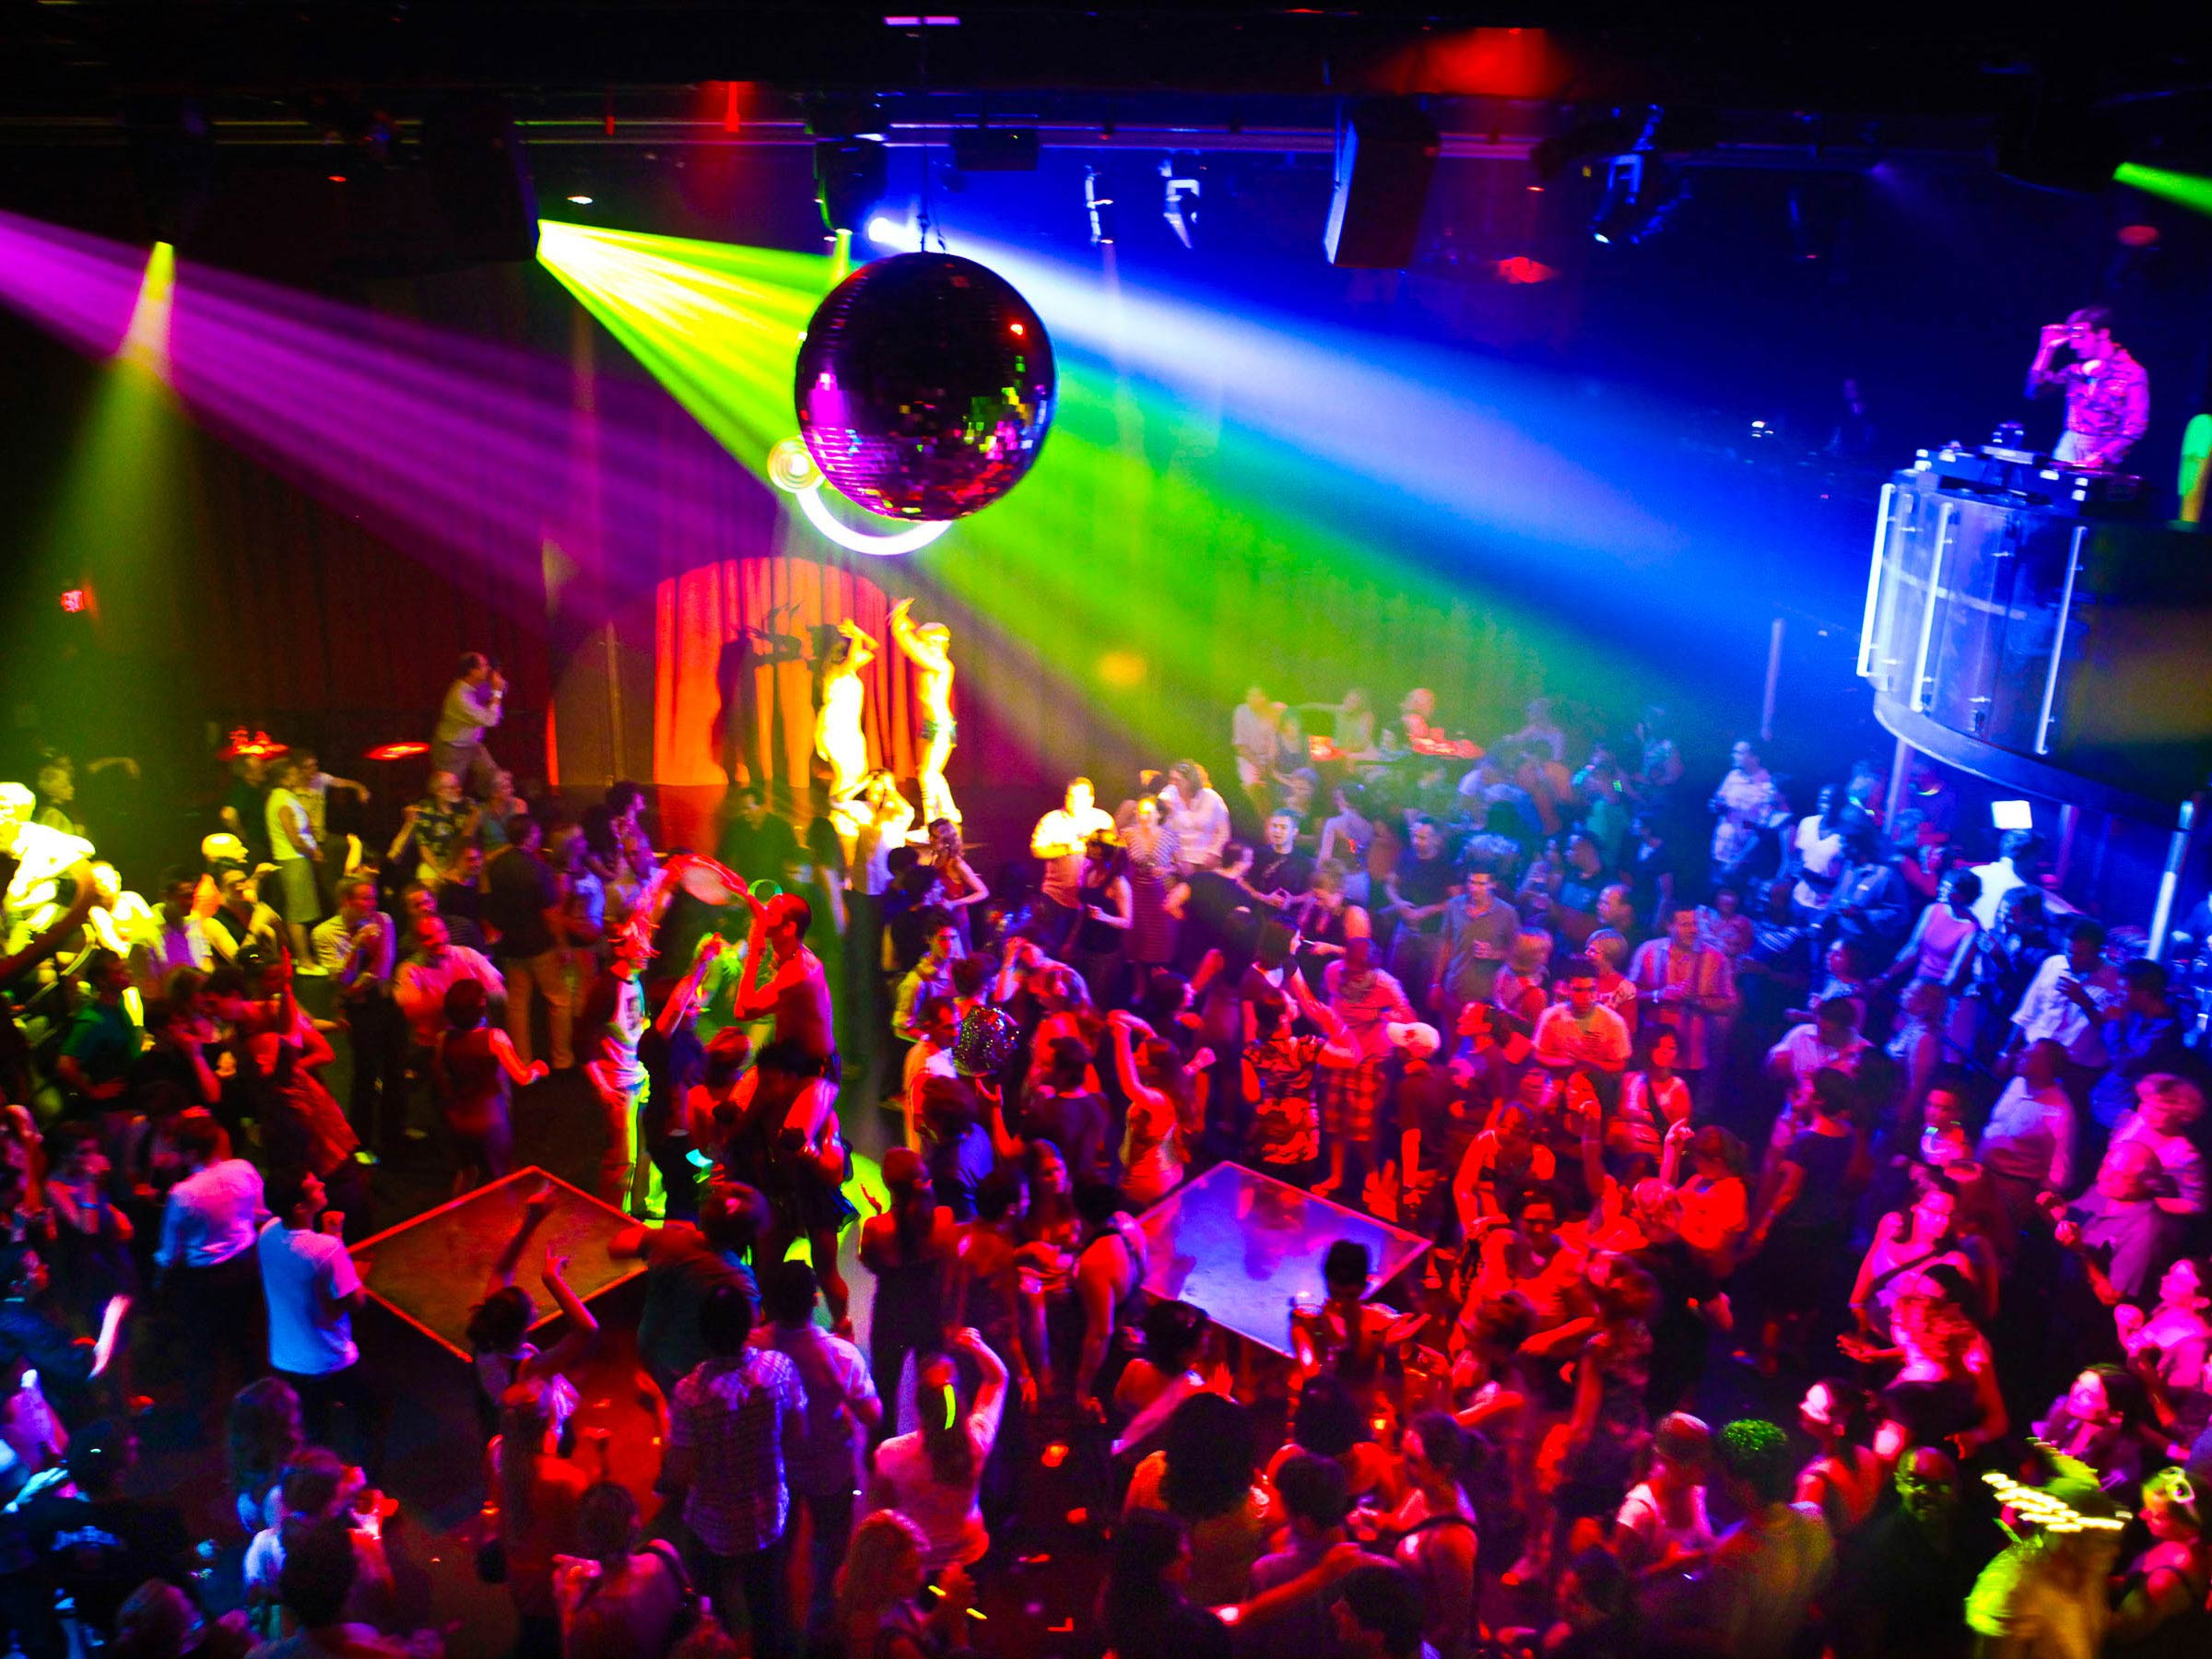
Go to the club!

Slide 40


Slide 41
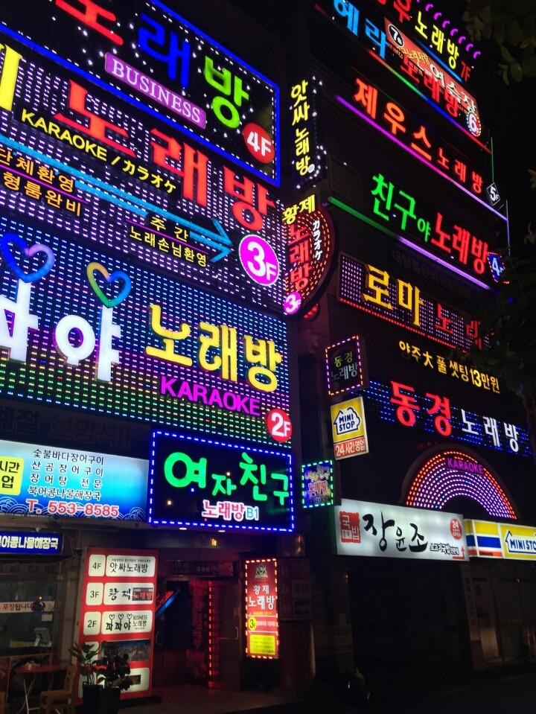
Go to 노래방!

Slide 42
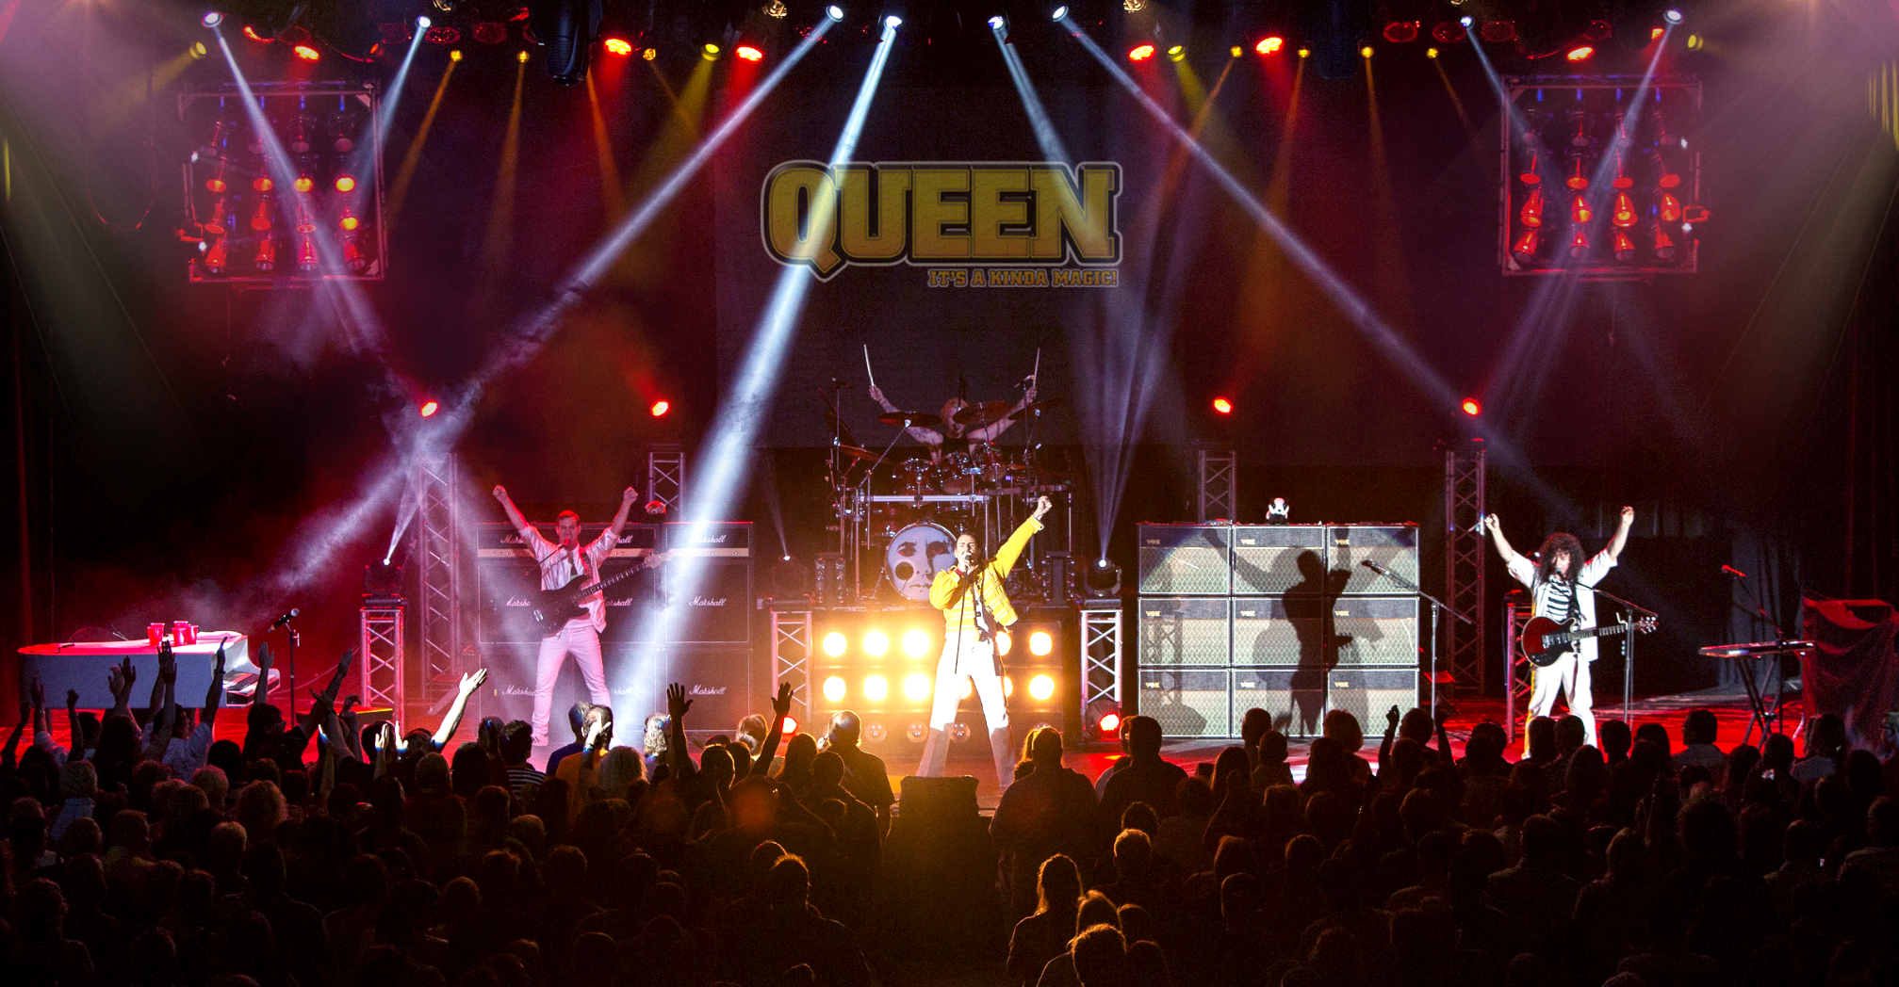
Go to the concert!

Slide 43

Read books!

