Slide 1
Where do you want to go in Australia?
Find your own attractions in Australia

Slide 2
Do you like cities?
YES
NO

Slide 3
Do you like busy TRAVELLING?
YES
NO

Slide 4
Do you like ACTIVITIES?
YES
NO

Slide 5
Do you like EXTREME SPORTS?
YES
NO

Slide 6
Do you like ARTS?
YES
NO

Slide 7
Do you like SEA?
YES
NO

Slide 8
Do you like SURFING?
YES
NO

Slide 9
Do you like RESORT?
YES
NO

Slide 10
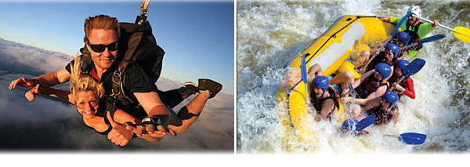
YOU CAN GO TO THE CAIRNS.

Slide 11
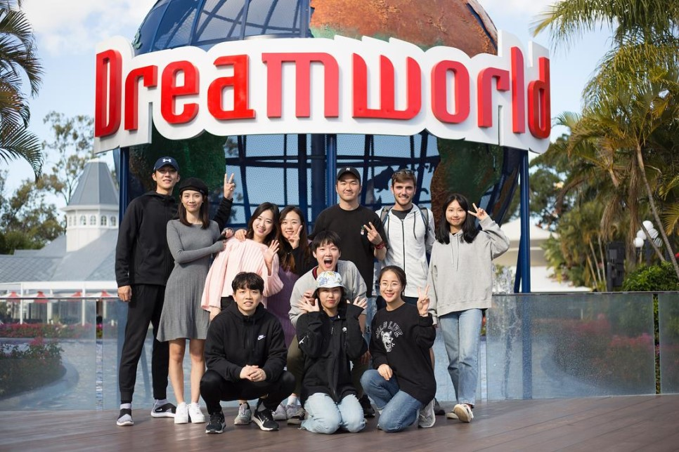
YOU CAN GO TO THE DREAMWORLD.

Slide 12
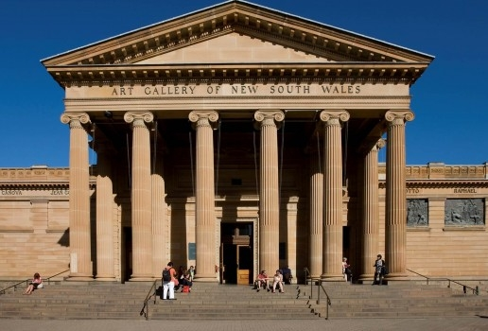
YOU CAN GO TO THE ART GALLERY OF SYDNEY.

Slide 13
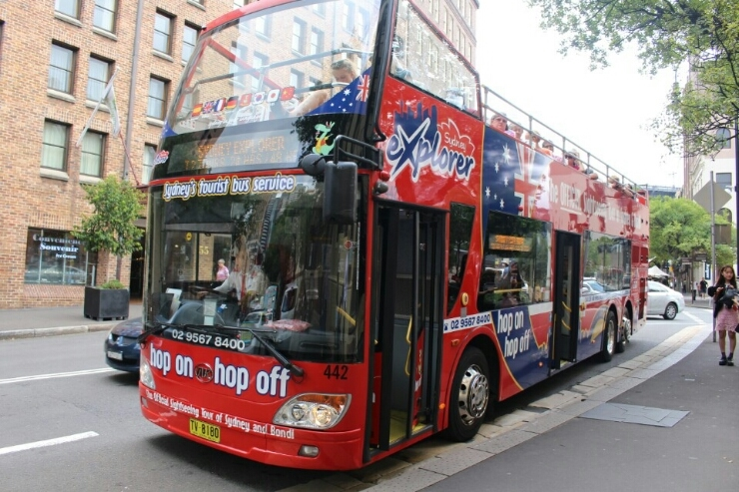
YOU CAN TAKE A CITY TOUR BUS.

Slide 14
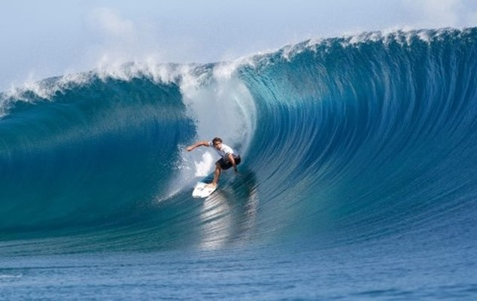
YOU CAN GO TO THE BONDI BEACH.

Slide 15
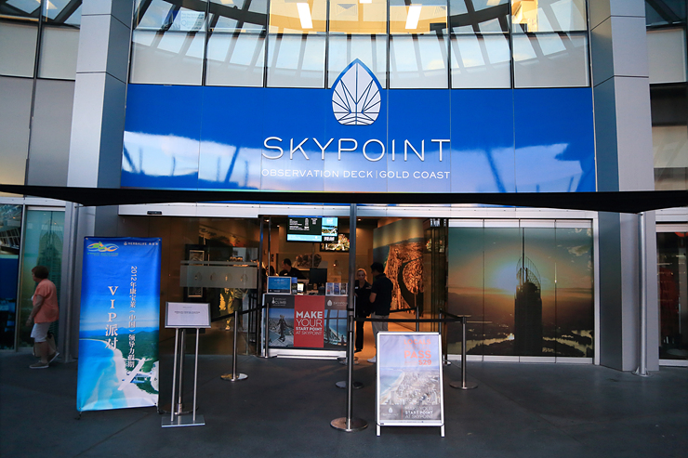
YOU CAN GO TO THE SKYPOINT.

Slide 16
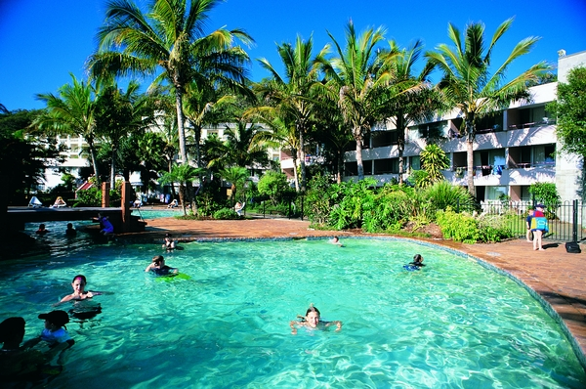
YOU CAN GO TO THE TANGALOOMA RESORT.

Slide 17
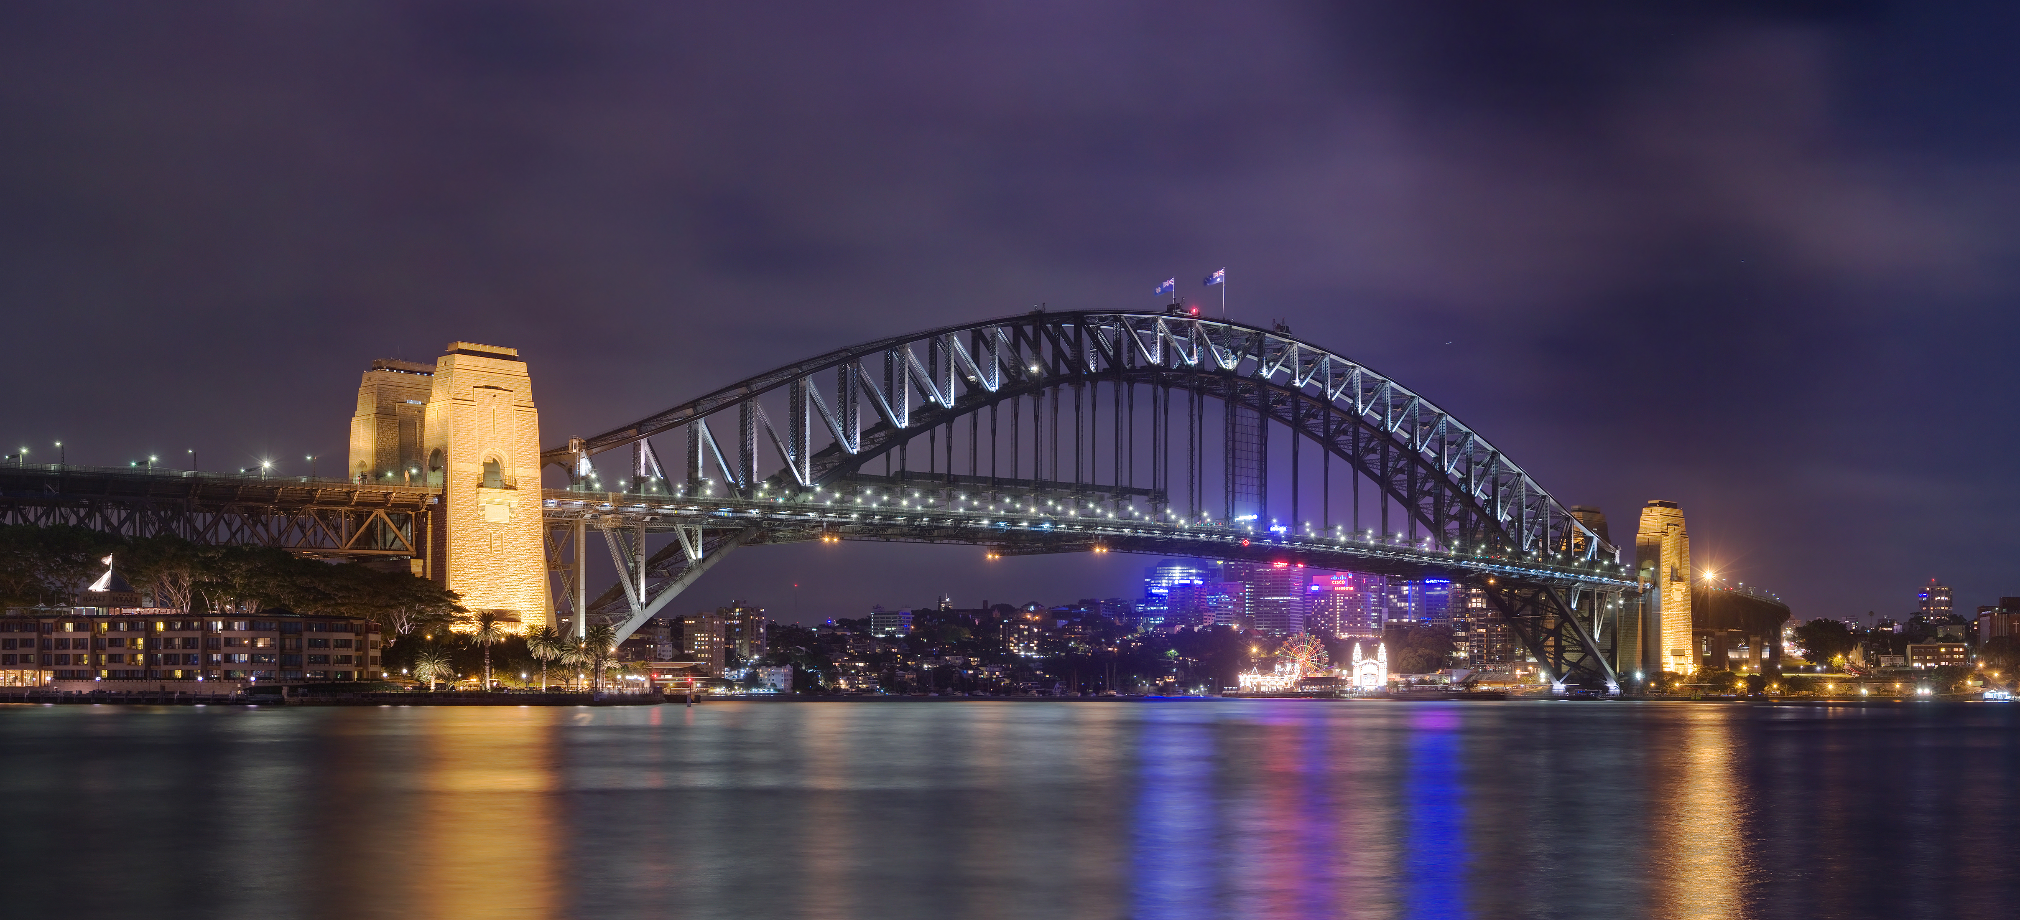
YOU CAN GO TO THE HARBOR OF SYDNEY.

Slide 18
Do you like animals?
YES
NO

Slide 19
Do you like sea animals?
YES
NO

Slide 20
Do you like feeding animals?
YES
NO

Slide 21
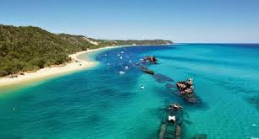
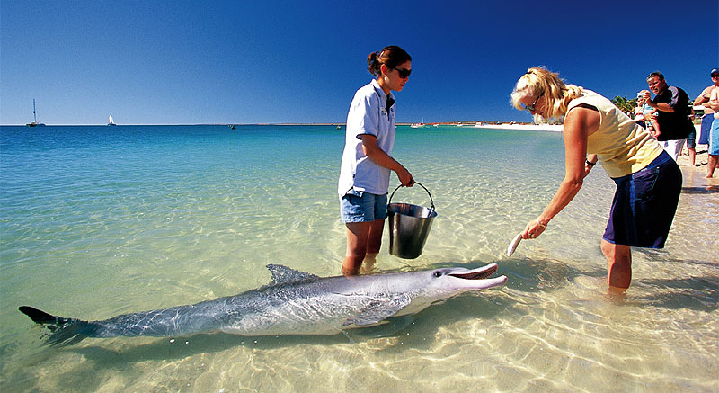
go to Morton Island. You can feed dolphins.

Slide 22
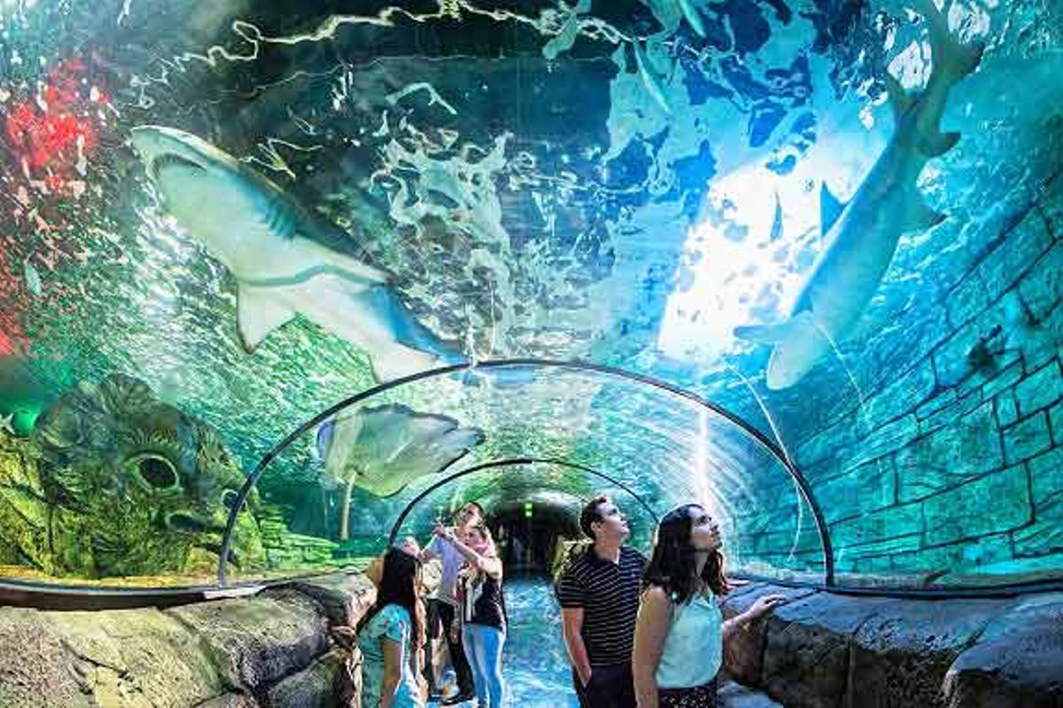
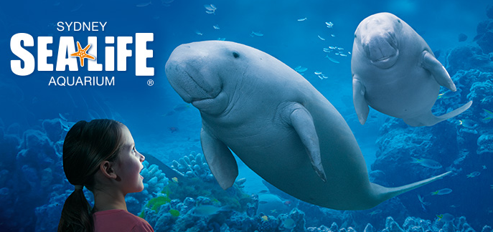
go to Sydney aquarium. You can see wonderful animals.

Slide 23
Do you like taking pictures holding animals?
YES
NO

Slide 24
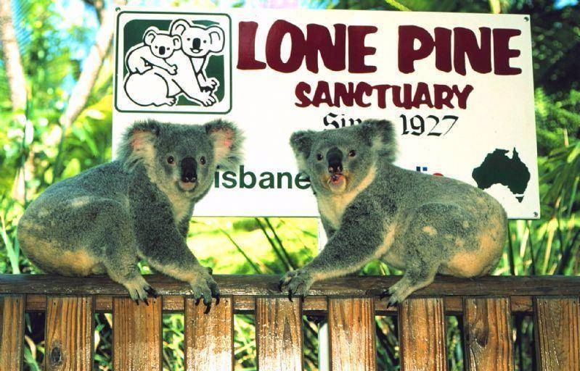
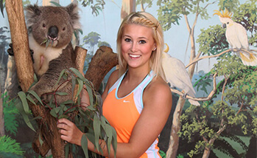
go to Lone pine Koala sanctuary. you can hug a koala.

Slide 25
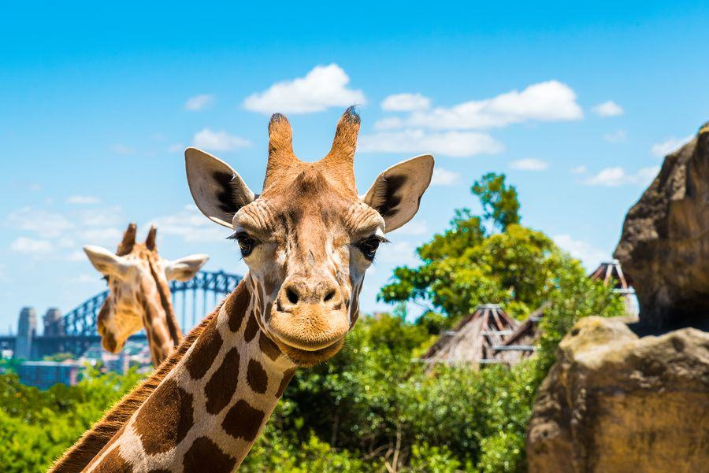
go to Taronga zoo. you can meet the happiest animals.

Slide 26
Do you like desert?
YES
NO

Slide 27
Do you like mysterious places?
YES
NO

Slide 28
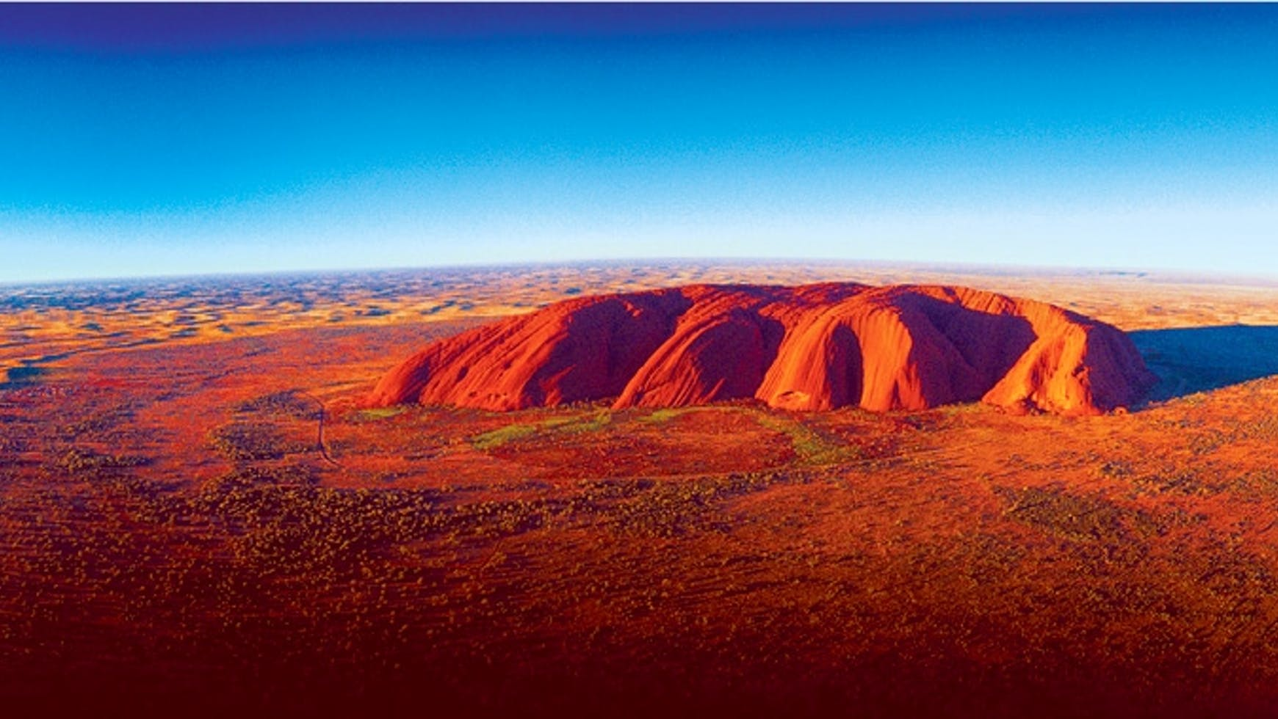
go to Uluru. you can meet the spiritual rock.

Slide 29
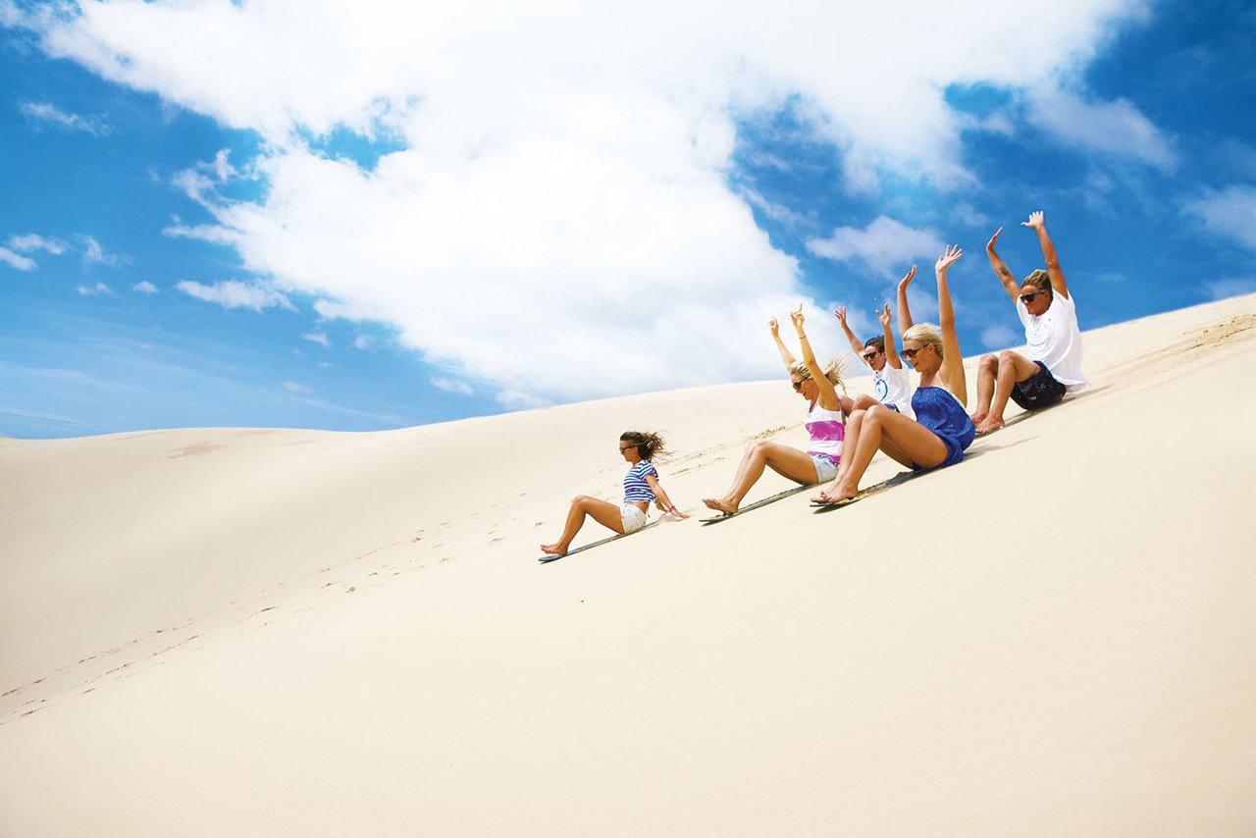
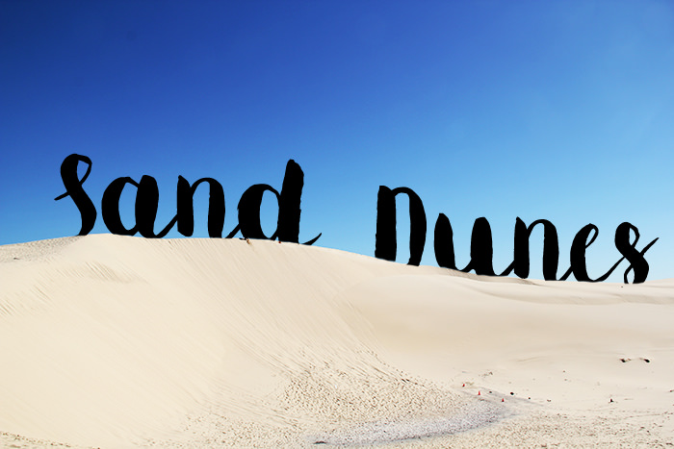
go to Port Stephen desert. you can sand board.

Slide 30
Do you like mountains?
YES
NO

Slide 31
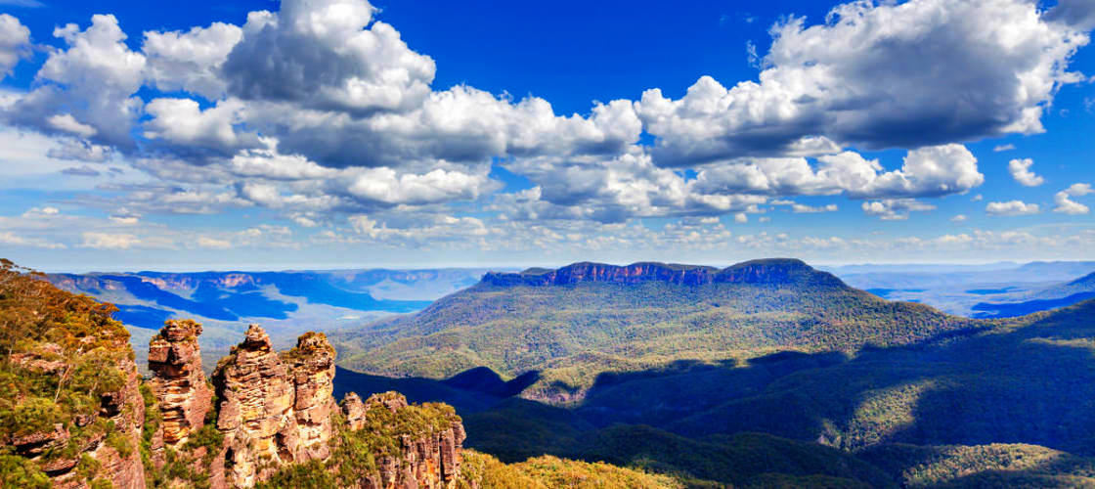
go to Blue Mountain. you can see the beauty of nature.

Slide 32
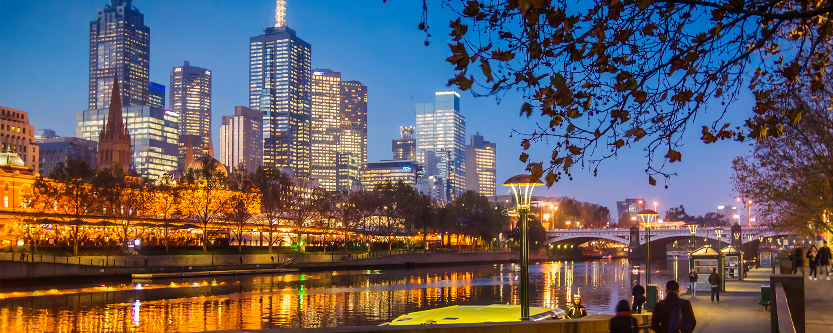
go to Melbourne. you can see the beauty of city.

Slide 33
You will fall in love with Australia!!
Try Again!
Thank you for being with us!

