Slide 1
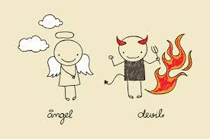
Your school life in 2019

Slide 2
Do you prefer the upper grades?
Yes
No

Slide 3
Can you name more than 5 boy or girl groups?
Yes
No

Slide 4
Do you enjoy listening to K-pop?
Yes
No

Slide 5
Do you feel comfortable when you’re counselling students?
Yes
No

Slide 6
Do you like watching marvel series?
Yes
No

Slide 7
Do you like teaching history?
Yes
No

Slide 8
Do you like going to 경복궁?
Yes
No

Slide 9
Are you good at math?
Yes
No

Slide 10
Do you like to sing a song called ‘baby shark’?
Yes
No

Slide 11
Do you like taking care of students?
Yes
No

Slide 12
Do you like to finish the class early?
Yes
No

Slide 13
Do you prefer working late?
Yes
No

Slide 14
Do you like English?
Yes
No

Slide 15
Can you teach English?
Yes
No

Slide 16
Can you teach Science?
Yes
No

Slide 17
Do you like playing dodge ball?
Yes
No

Slide 18
Do you like going outside?
Yes
No

Slide 19
Do you like to teach 바,슬,즐?
Yes
No

Slide 20
You’re definitely 6th grade teacher.

Slide 21
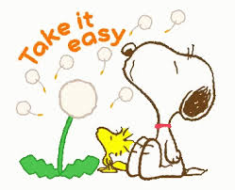
Take it easy. It’s your duty!

Slide 22
Then you can understand what students like to watch.

Slide 23
Go for it! It’s really fun!

Slide 24
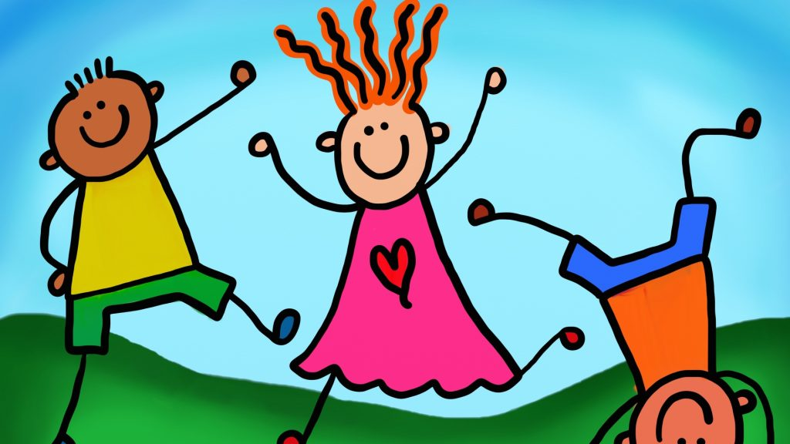
You’ll be 5th grade teacher.

Slide 25
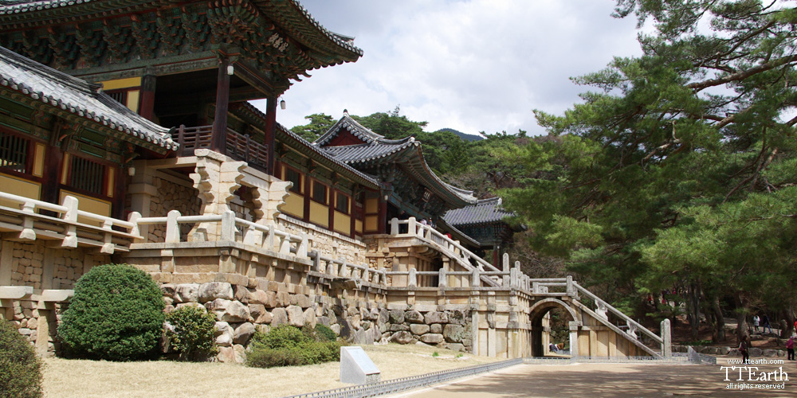
Then, you should go 수학여행 with 6th grade students.

Slide 26
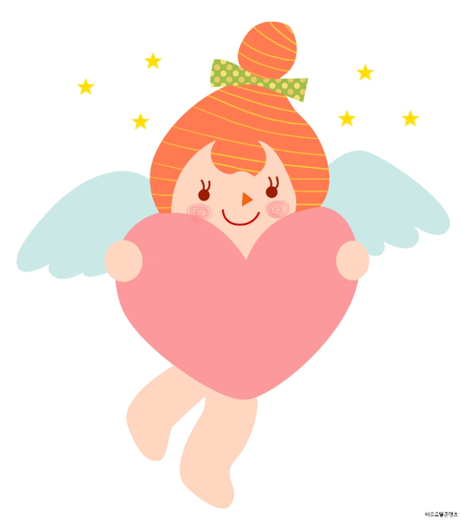
You will be 4th grade teacher.

Slide 27
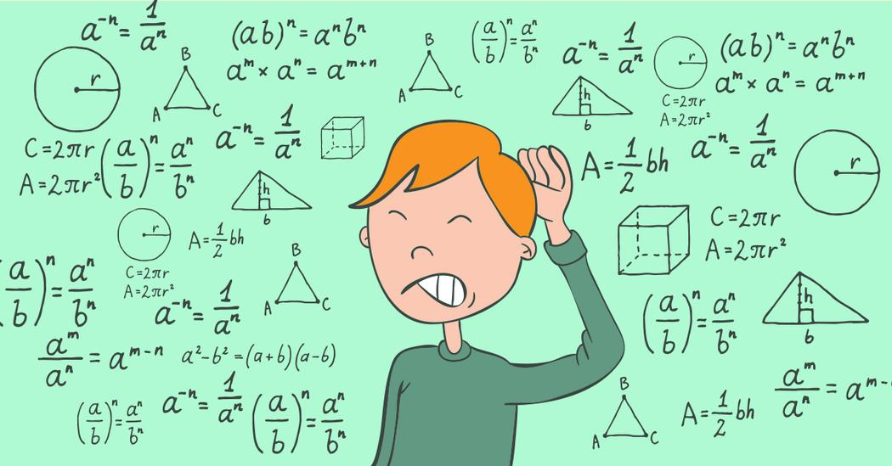
Study math! It’s important!

Slide 28
You will be in the 1st grade.

Slide 29
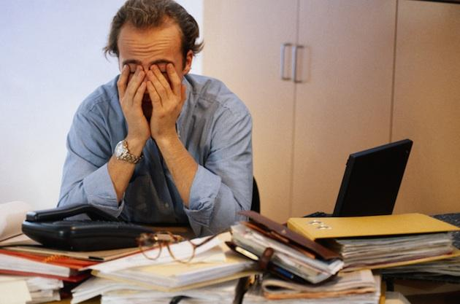
Then you’ll be 교무부장님.

Slide 30
You’ll be teaching the upper grades.

Slide 31
You’ll be an English teacher.

Slide 32
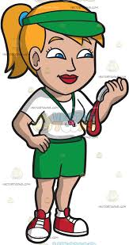
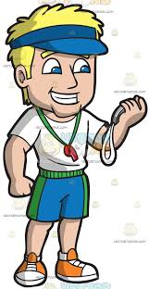
You’ll be a P.E teacher.

Slide 33
You’ll be a Science teacher.

Slide 34
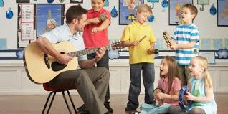
You’ll be a Music teacher with a lot of work.

Slide 35
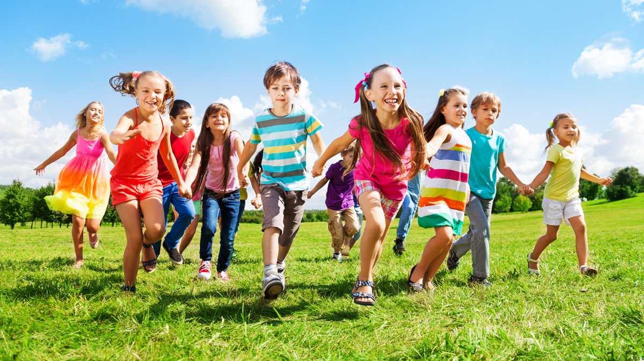
You’ll be 3rd grade teacher.

Slide 36
Students will keep asking you to go out everyday.

Slide 37
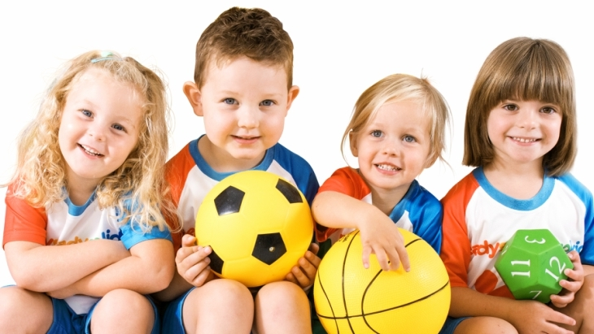
You’ll be 2nd grade teacher.

Slide 38
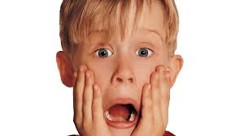
Go to the upper grade.

