Slide 1
What you should know about honeybees
Made by Lucas

Slide 2
Do you like honeybees?

Slide 3
Do you like honey?

Slide 4
Do you protect honeybees?

Slide 5
Do you know how hard it is to get honey?

Slide 6
To get a tea spoon of honey, they work all their life. Now, do you like honeybees?

Slide 7
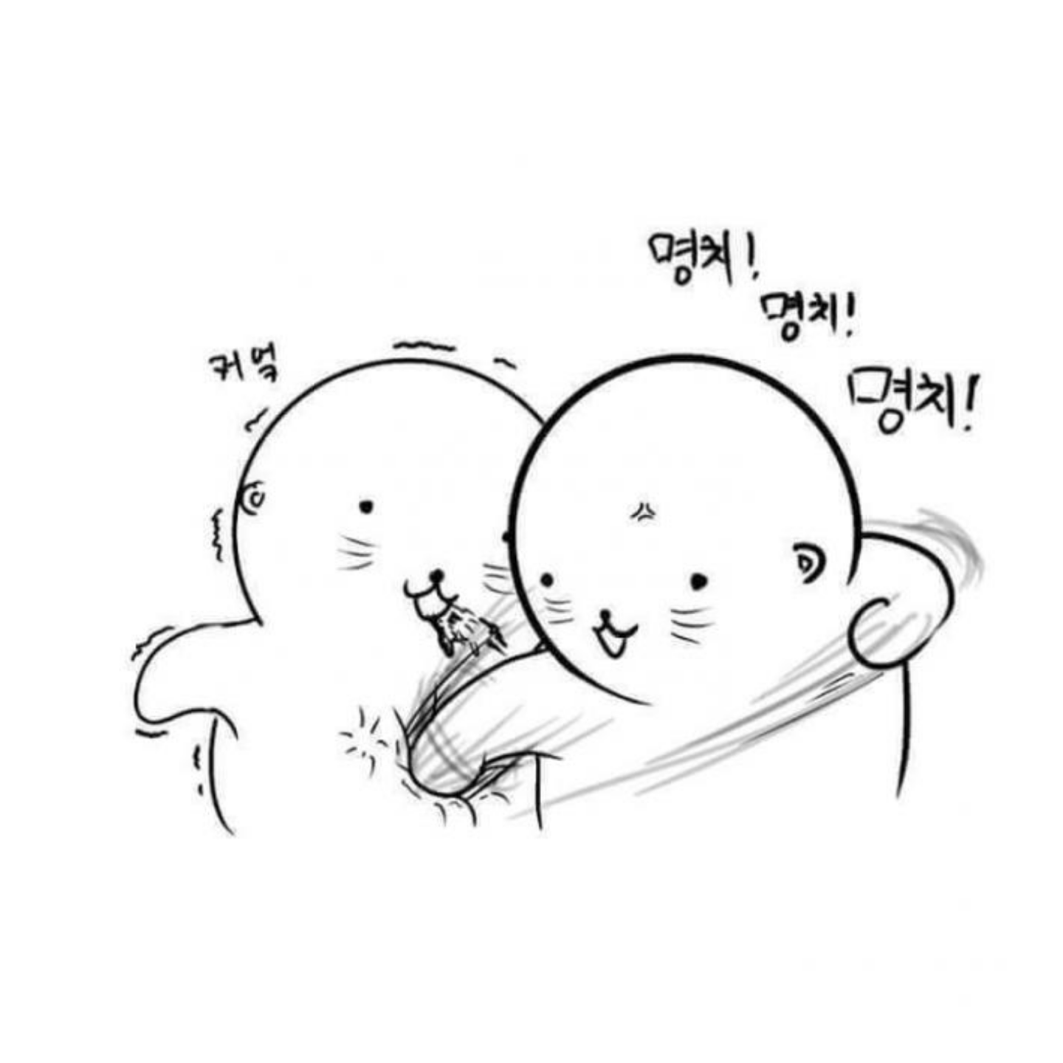

Slide 8
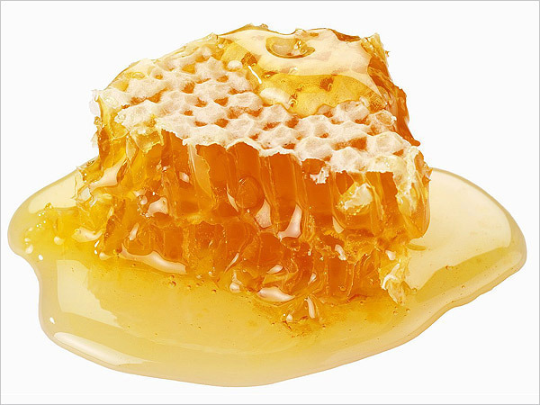
Congratulations! You deserve to eat honey!!!

