Slide 1
Propaganda

Slide 2
What is propaganda?
It is biased and is used to try to convince another person or people.

Slide 3
Who uses propaganda?
Usually governments but also:
religions, media, companies, activists

Slide 4
When did propaganda start?

Slide 5
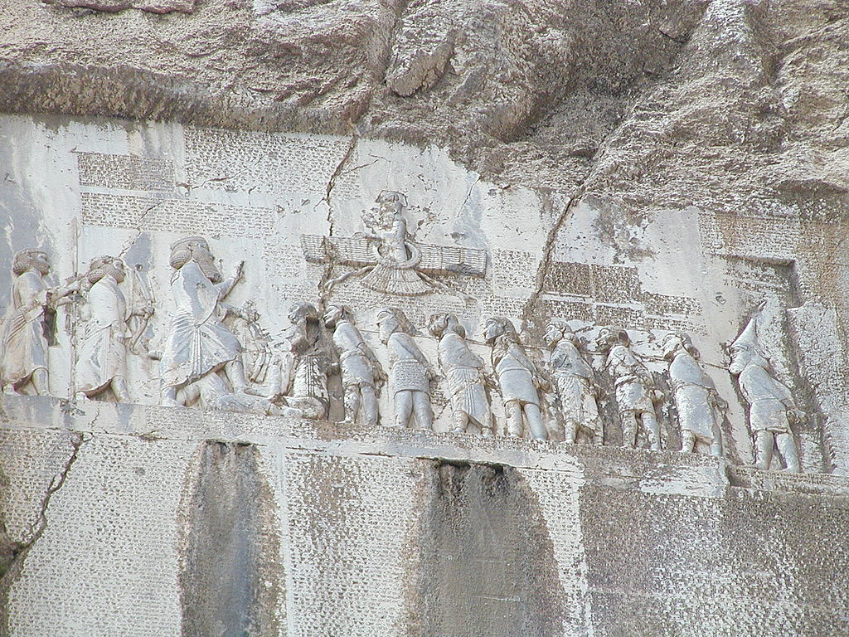
When did propaganda start?
The first use of propaganda’ was by the catholic church (1662). It meant to propagate (spread) the word of god.
Congregatio de Propaganda Fide
The Behistun Inscription (515 BCE)
Iran
King Darius
The printing press (1439 AD)

Slide 6
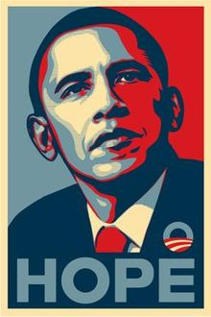
Types of Media
Paintings
Cartoons
Posters
Pamphlets
Films
Radio shows
TV shows
Websites

Slide 7
Propaganda Techniques
Name Calling:
A commonly used technique is name-calling, which takes its cue from playground behavior. Often, this technique is utilized to divert attention when someone is trying to avoid answering a question or providing hard facts. Name-callers frequently use labels like terrorist, traitor or hypocrite. They also utilize negatively charged words to describe ideas or beliefs, including radical, stingy and cowardly
Advertising
Propaganda
Notes:
https://people.howstuffworks.com/propaganda1.htm

Slide 9
Propaganda Techniques
Bandwagon:
The bandwagon technique encourages the viewer or listener to join the crowd by aligning with the most popular, successful side of an issue. This type of persuasion, often used in religious and political propaganda, plays to the human desire to be on the winning team.
Advertising
Propaganda
Notes:
https://people.howstuffworks.com/propaganda1.htm

Slide 10
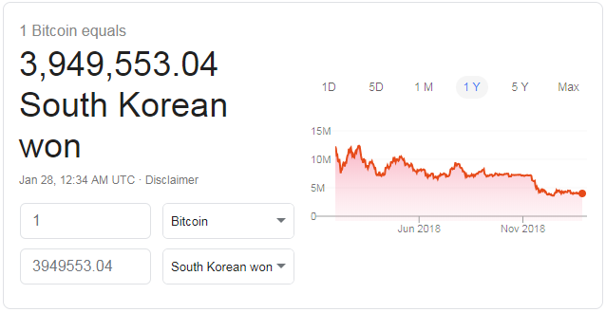

Slide 11
Propaganda Techniques
Glittering Generalities:
Glittering generalities are very common in political propaganda. Glittering generalities combine words that have positive connotations with a concept that is particularly beloved. Few people are willing to denounce any idea that purports to defend democracy or preserve freedom. The idea is that by using these terms in tandem, people will accept them as they are and avoid looking for supporting evidence. Other words used commonly in this technique include liberty, dream and family.
Advertising
Propaganda
Notes:
https://people.howstuffworks.com/propaganda1.htm

Slide 12
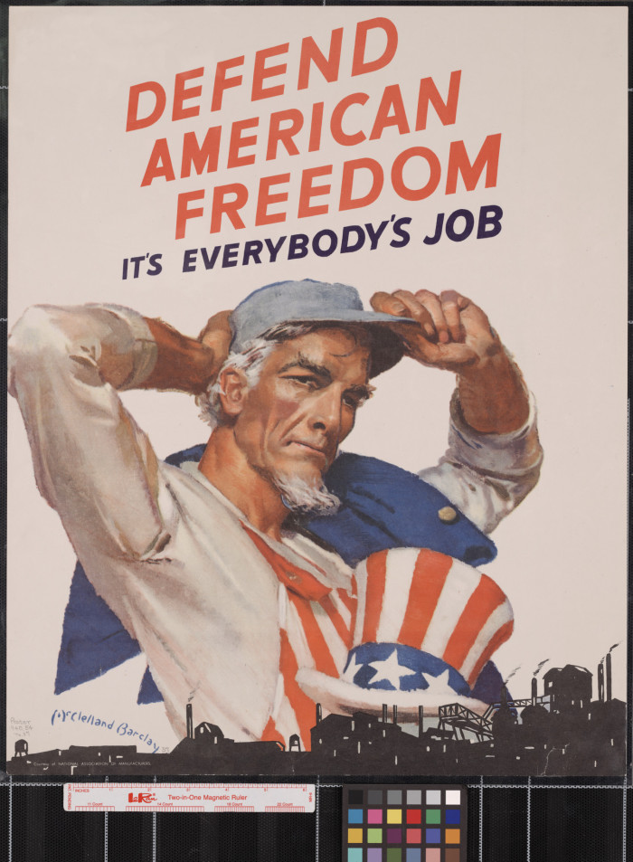

Slide 13
Propaganda Techniques
Card Stacking:
Card stacking is the presentation of only the details, statistics and other information that impacts public opinion positively. In other words, the bad stuff is left out entirely. Experts maintain that although the information that's presented is usually true, this type of propaganda technique presents a lopsided and unrealistic viewpoint that is dangerously deceptive. Card stacking is often used in political campaign advertisements.
Advertising
Propaganda
Notes:
https://people.howstuffworks.com/propaganda1.htm

Slide 15
Propaganda Techniques
Plain Folks:
The plain folks technique is designed to get ordinary citizens to identify with a political candidate or other figure that they otherwise may have nothing in common with. For example, many politicians come from prestigious backgrounds and sport hefty bank account. However, they often present themselves as humble people with ordinary lives by doing "ordinary Joe" activities in public, like hunting, fishing or kissing babies.
Advertising
Propaganda
Notes:
https://people.howstuffworks.com/propaganda1.htm

Slide 16
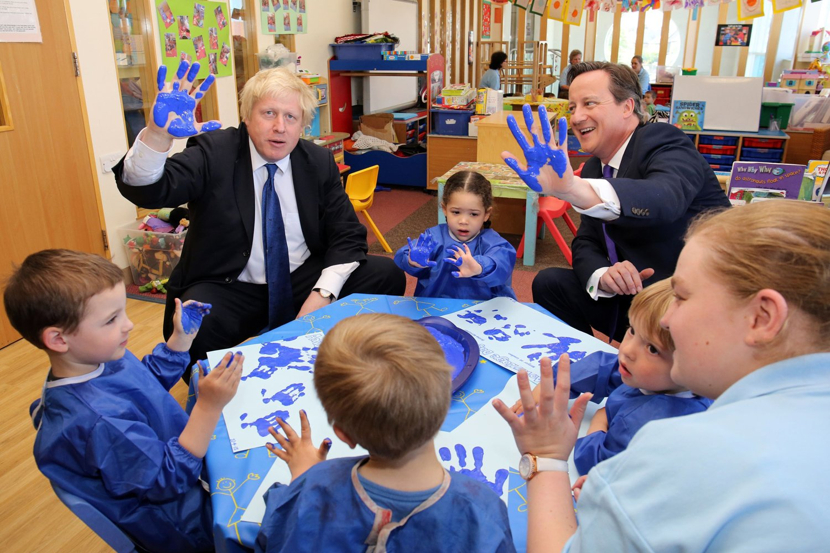

Slide 17
Propaganda Techniques
Fear:
Propaganda based on fear is designed to scare people into choosing sides. Often, worst-case scenarios are presented of horrible things to come if a particular action isn't taken. Special interest groups use this technique to encourage people to avoid behaviors such as smoking, drinking alcohol and driving recklessly.
Advertising
Propaganda
Notes:
https://people.howstuffworks.com/propaganda1.htm

Slide 18
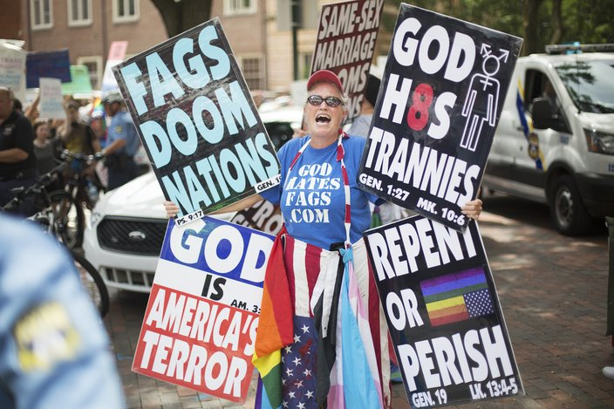

Slide 19
Propaganda Techniques
Transfer:
The transfer technique is more subliminal (operating on a subconscious rather than conscious level) than the other techniques we've discussed. Using this method, a group or person attempts to align themselves with a beloved symbol in an effort to transfer the status of the symbol to the cause they represent. Some people see parallels between propaganda and subliminal messaging, in which images or words are presented too quickly or abstractly for people to consciously recognize and process them. This method is really more common in advertising than in propaganda, although some political ads utilize subliminal messaging.
Advertising
Propaganda
Notes:
https://people.howstuffworks.com/propaganda1.htm

Slide 20
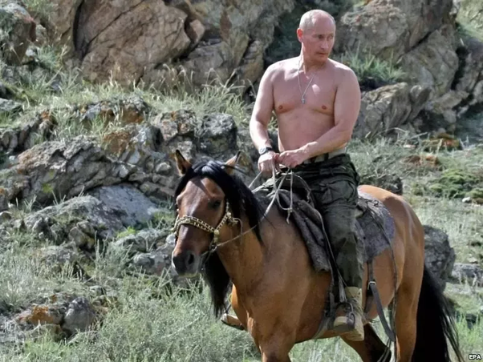
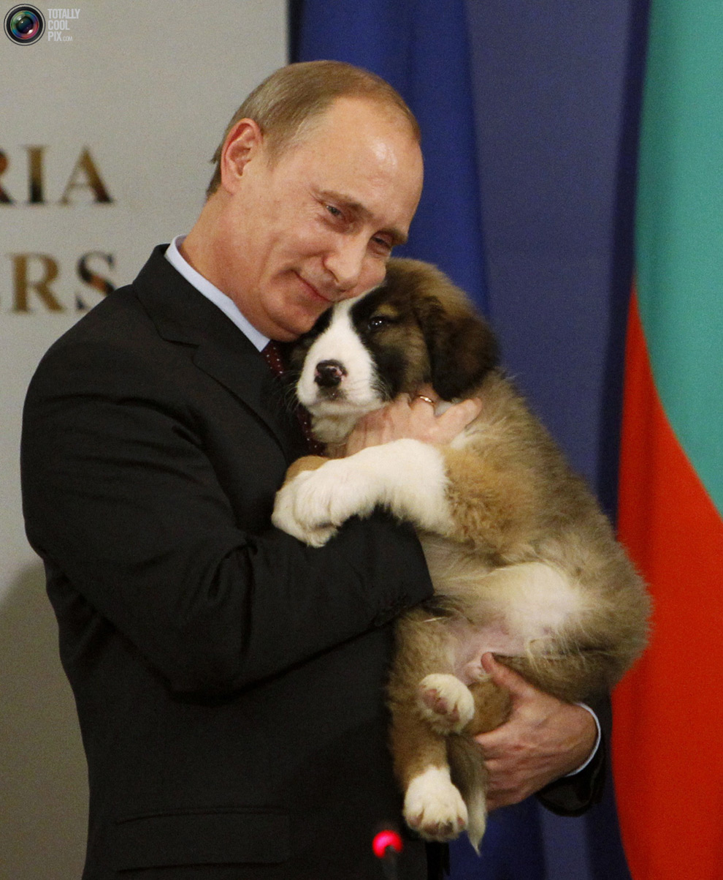

Slide 21
Propaganda Techniques
Hyperbole:
Hyperbole is an exaggerated claim or statement. It adds emphasis, excitement and emotion to an argument.
Advertising
Propaganda

Slide 22
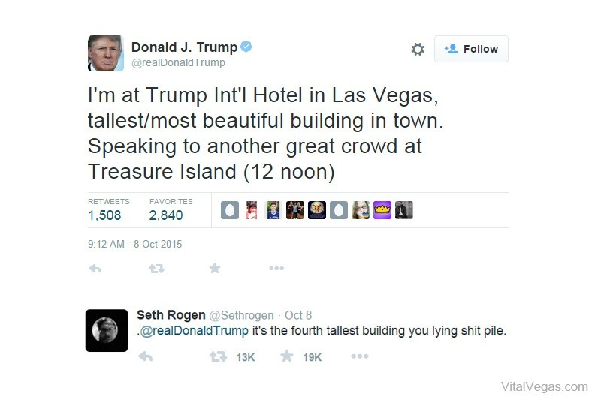

Slide 23
Propaganda Techniques
Celebrity Endorsement:
To use this technique, have a famous person publically endorse your idea. You can use these endorsements to associate your ideas with a celebrity. People are more likely to follow your ideas if you have powerful or recognizable people associated with them.
Advertising
Propaganda

Slide 24
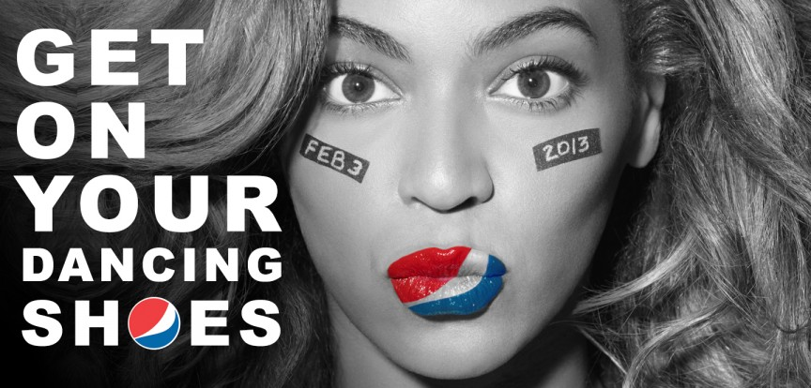

Slide 25
Propaganda Techniques
Disinformation:
If the other techniques don’t work, you can always just lie to people. Spreading misinformation can change public opinion. People don’t have the time to do all of the extra research to find out what is true. In the modern world, computers and the world wide web have made misinformation more feasible. Disinformation is particularly effective when combined with controlling information.
Advertising
Propaganda

Slide 26
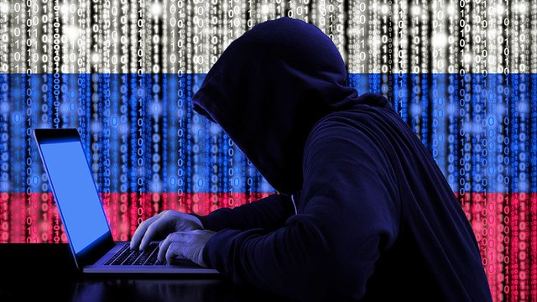

Slide 27
Advertising or Propaganda?
Who made it?

Slide 28
40% less fat, 30% less calories, big taste!

Slide 29
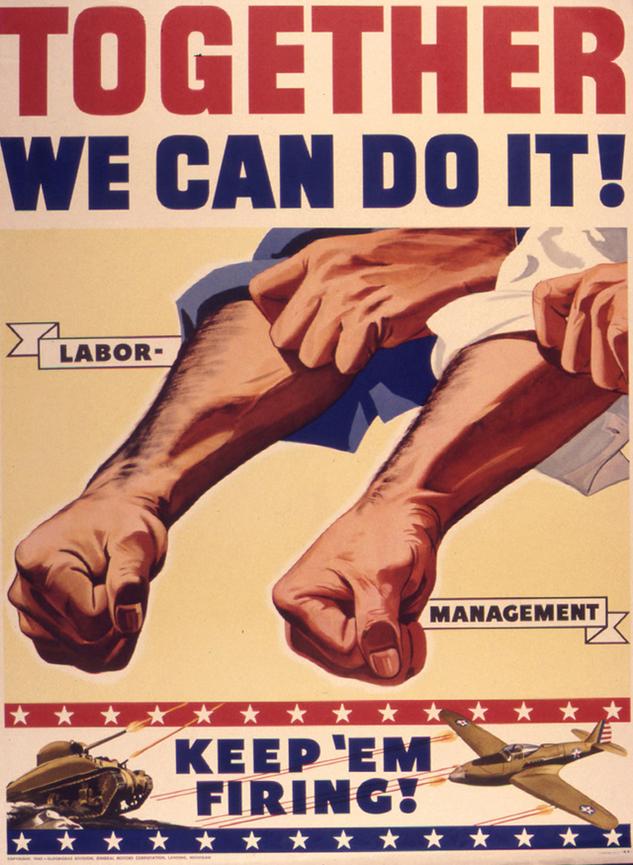
Together we can do it.

Slide 30
Save money. Live better.

Slide 31
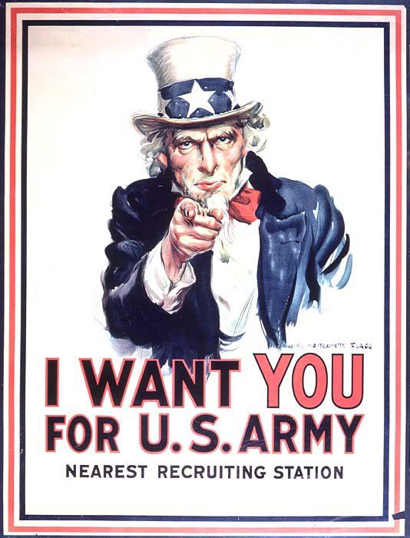
I want you.

Slide 32
Over 1 million Australians have already tried it.

Slide 33
The union make us strong.

Slide 34
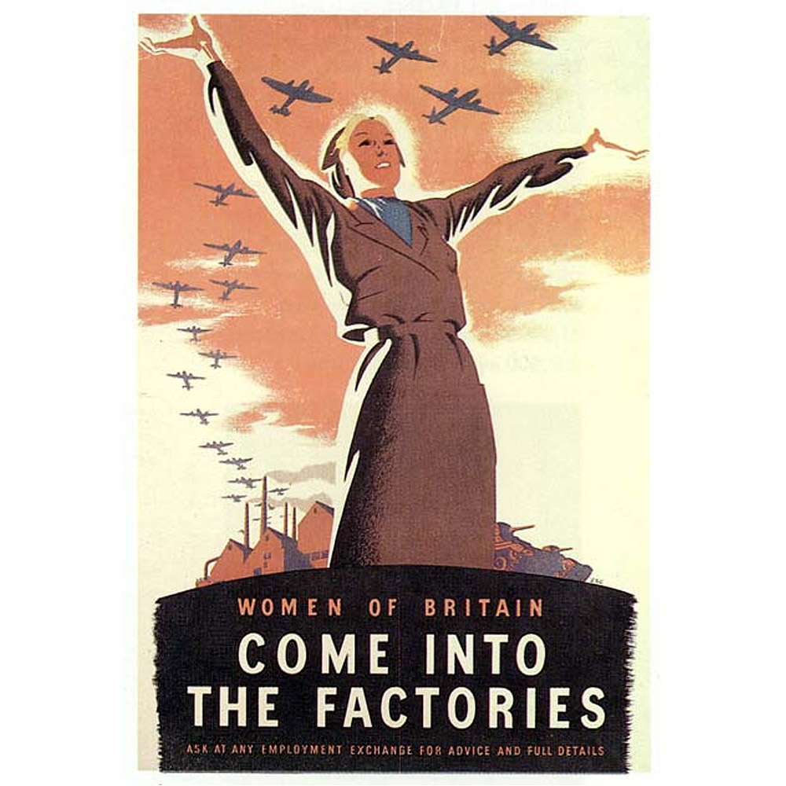
Women, come into the factories.

Slide 35
Everyone’s doing it.

Slide 36
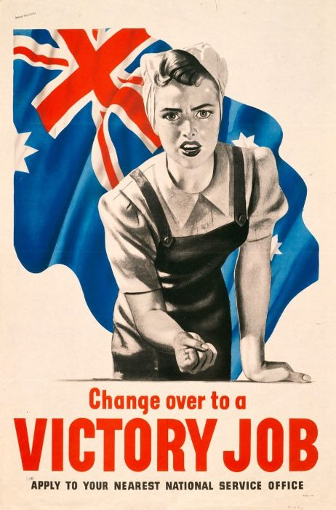
Change over to a victory job.

Slide 37
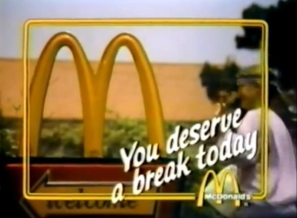
You deserve a break today.

Slide 38
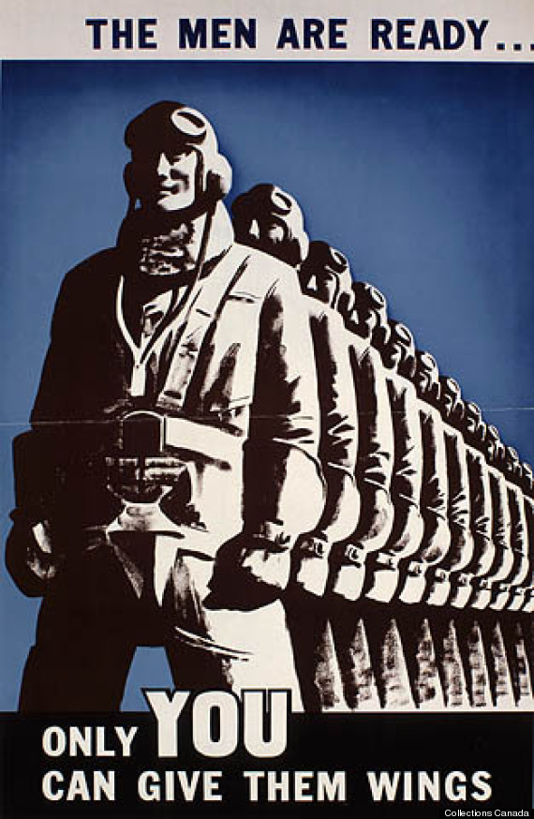
Only you can give them wings.

Slide 39
Friendly. Smart. Loyal

Slide 40
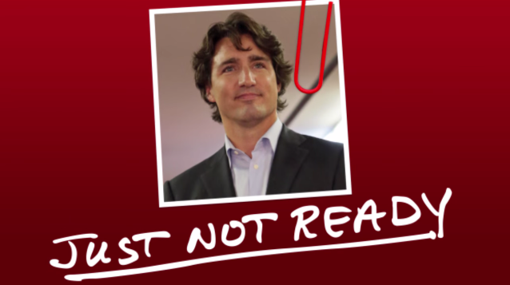
He’s just not ready.

Slide 41
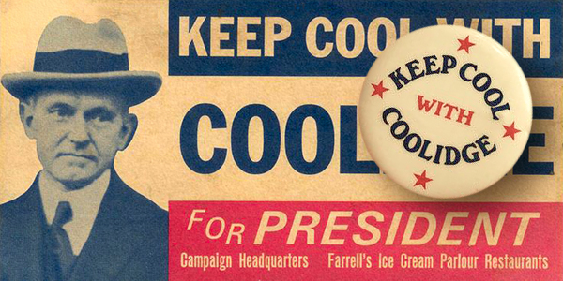
Keep cool with Coolidge.

Slide 42
Providing great lifestyles in places people most want to live, work, and play.

Slide 43
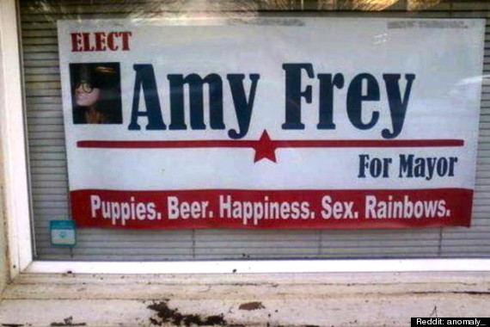
Puppies. Beer. Happiness. Sex. Rainbows.

Slide 44
Have it your way.

Slide 45
The best part of waking up.

Slide 46
Hope. Action. Change.

Slide 47
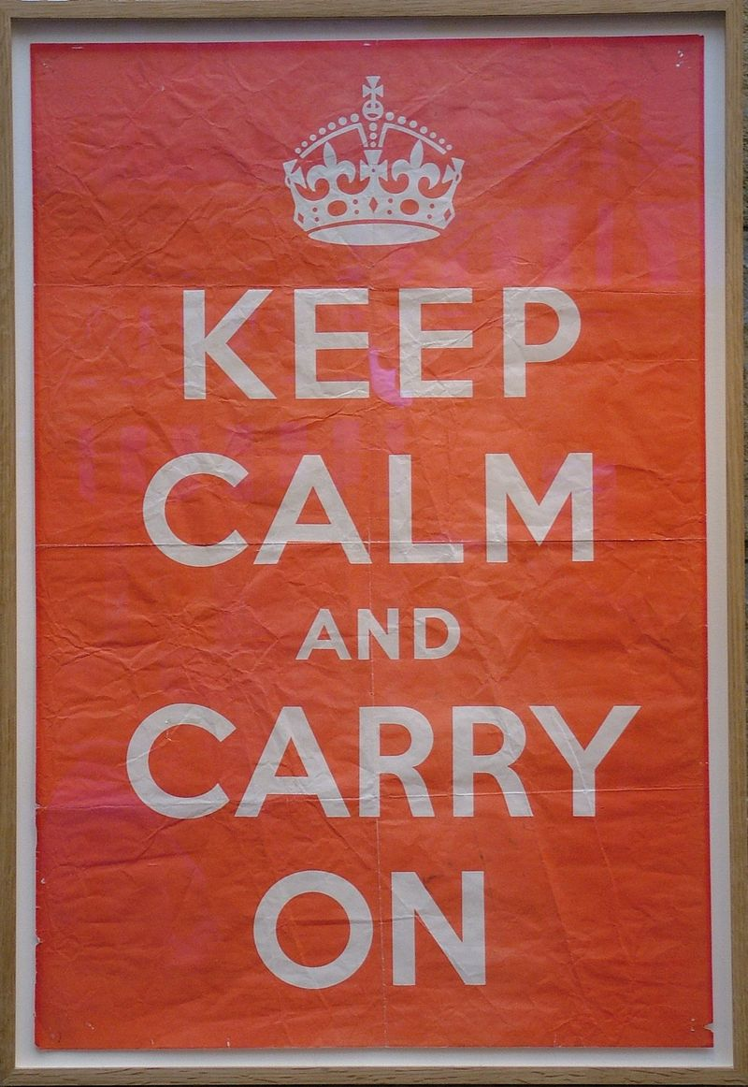
Keep calm and carry on.

Slide 48
제국주의와의대결에서우리군대와인민의영웅적기개를떨치자!

Slide 49
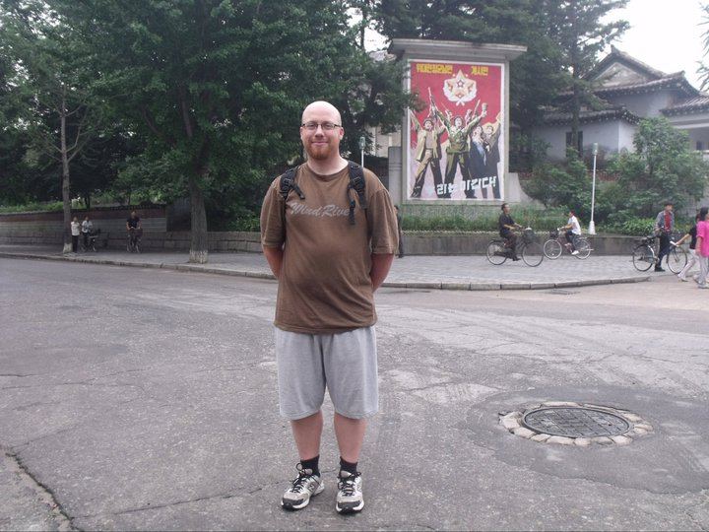

Slide 50
Examples
2016 US presidential election
Fake News, alternative facts
Obama Campaign Posters
Soviet Union posters
Pro-Communism (socialism) posters
North Korean anti-American posters.
Nazi WW2 (Triumph of Will 1935)
South Korea Sends balloons to North Korea – blasts music
Disney + Dr. Suess during WW2 (Der Fuehrer’s Face)
George Orwell (Animal Farm, 1984)
The American Dream
The Catholic Church

