Slide 1
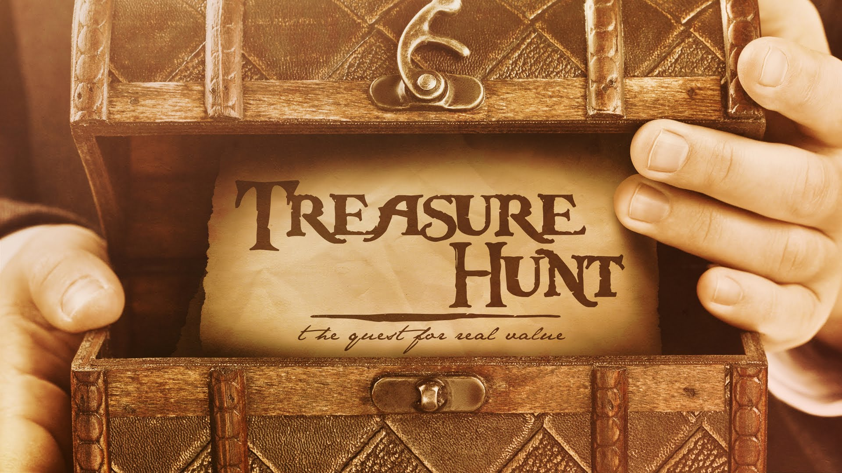
Treasure Hunt
A game that requires reading

Slide 2
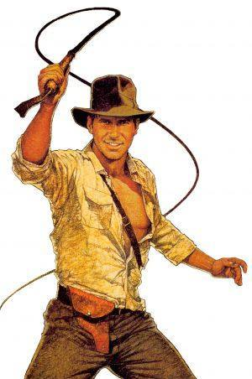
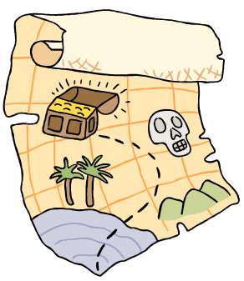
What is a treasure hunt?
A map, or clues will lead you to a treasure.
Pirates, Indiana Jones

Slide 3
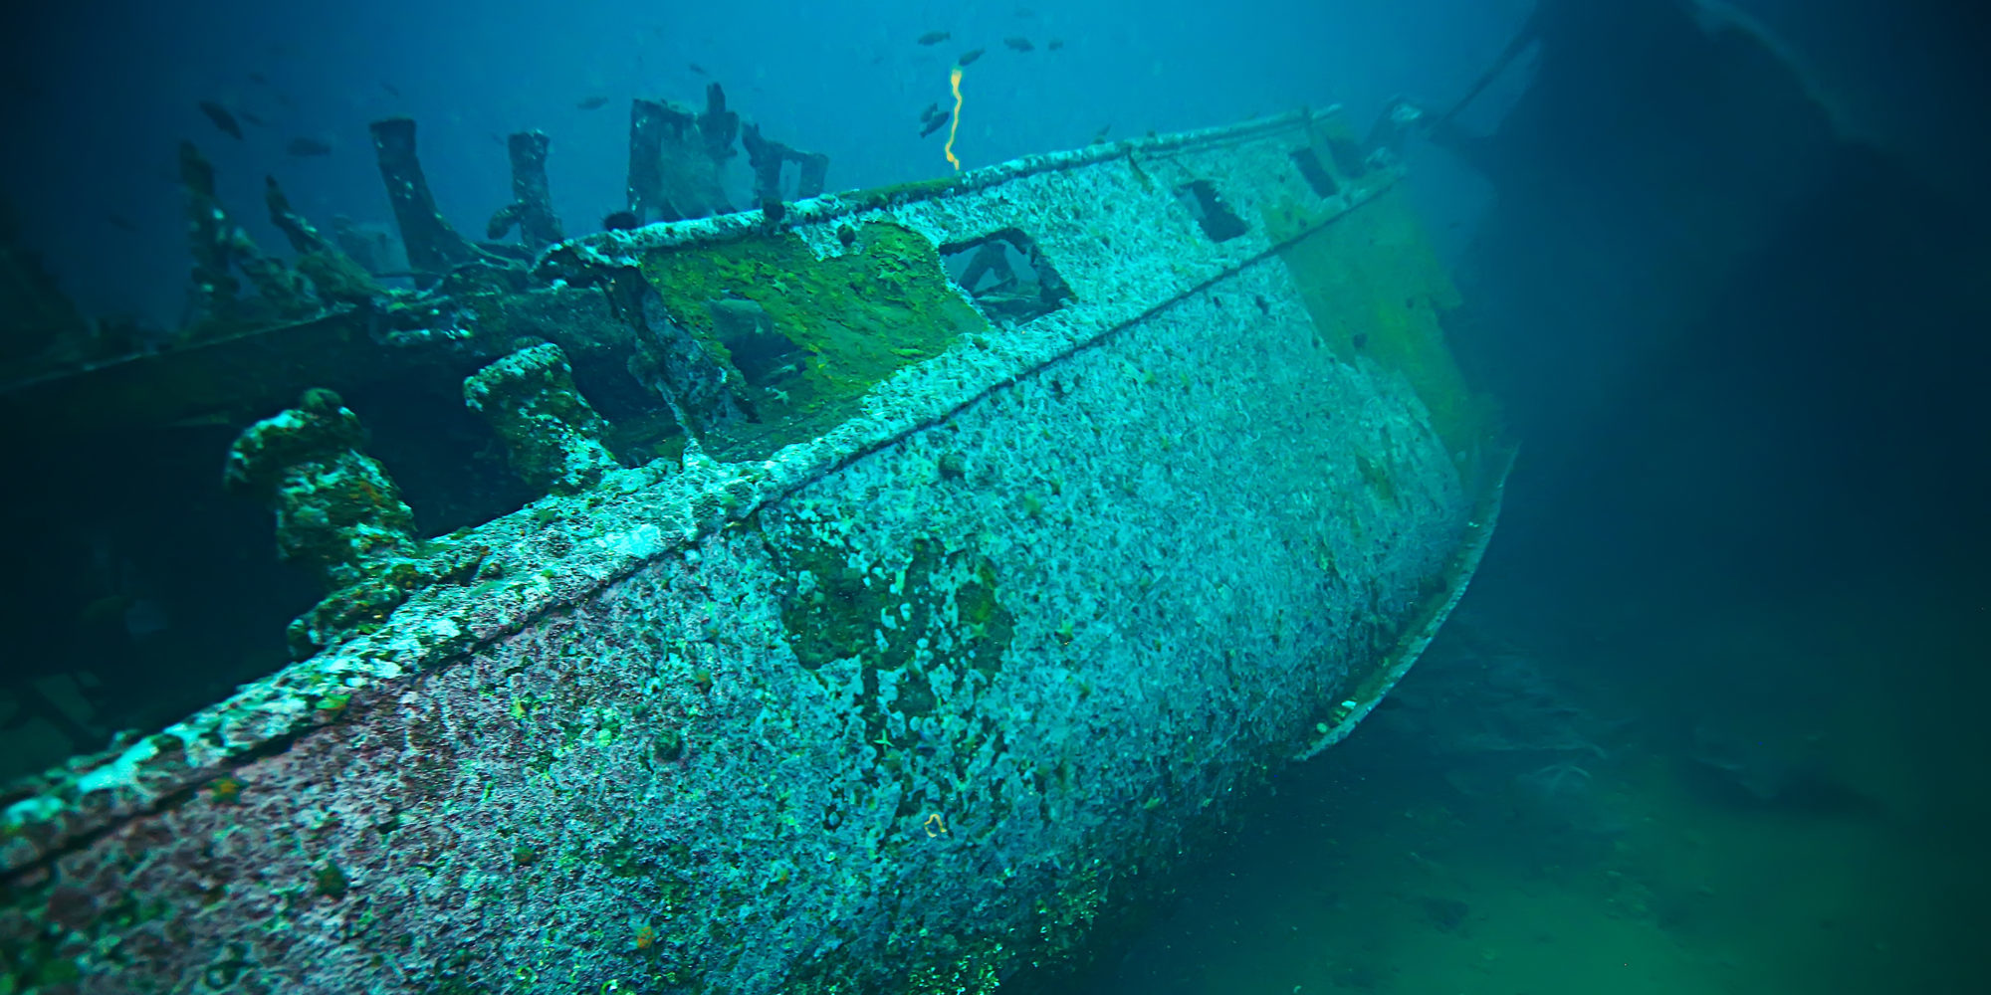
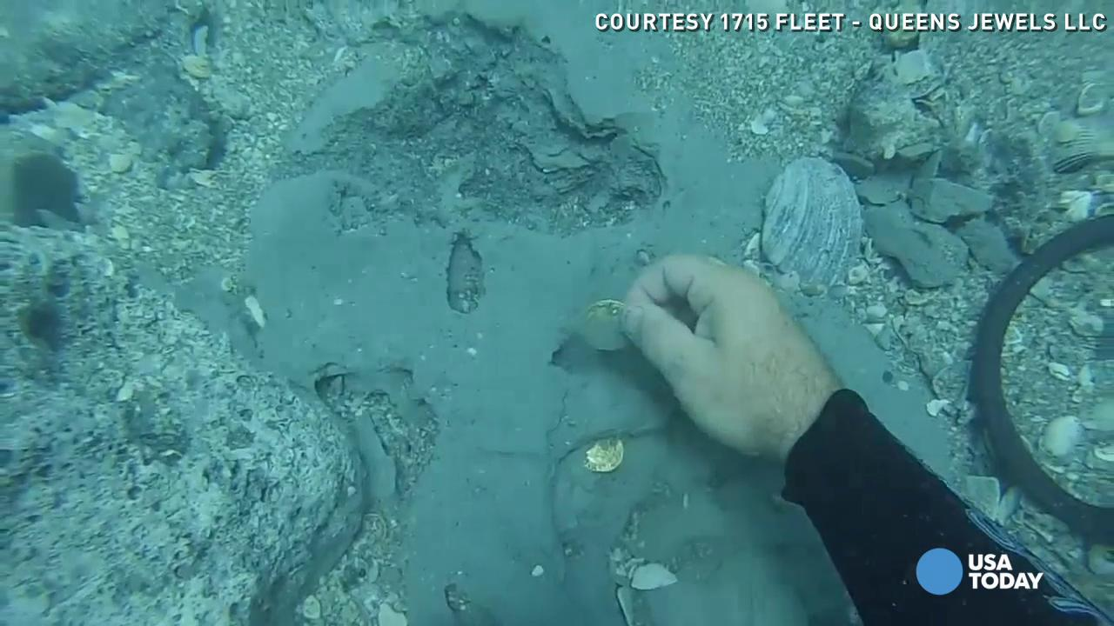

Slide 4
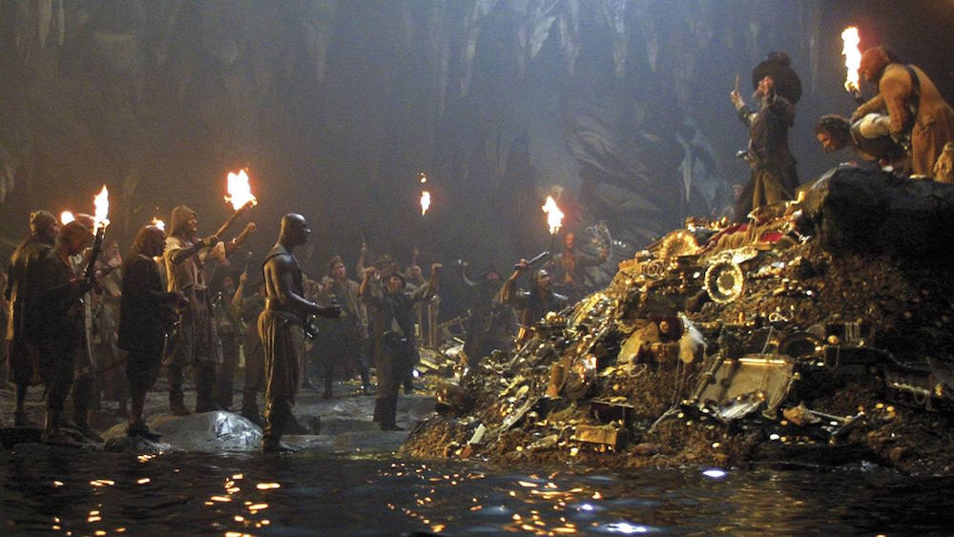
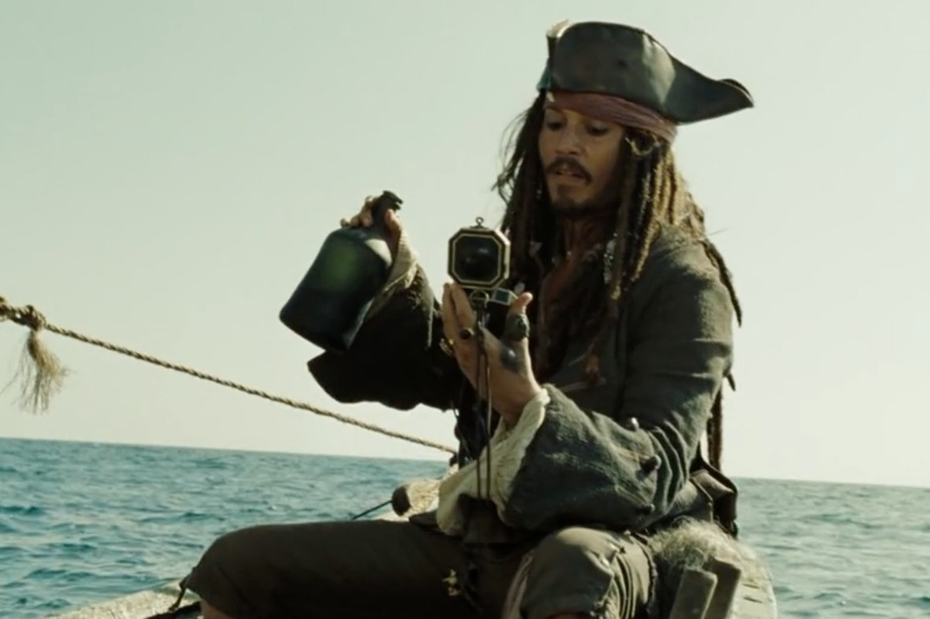

Slide 5
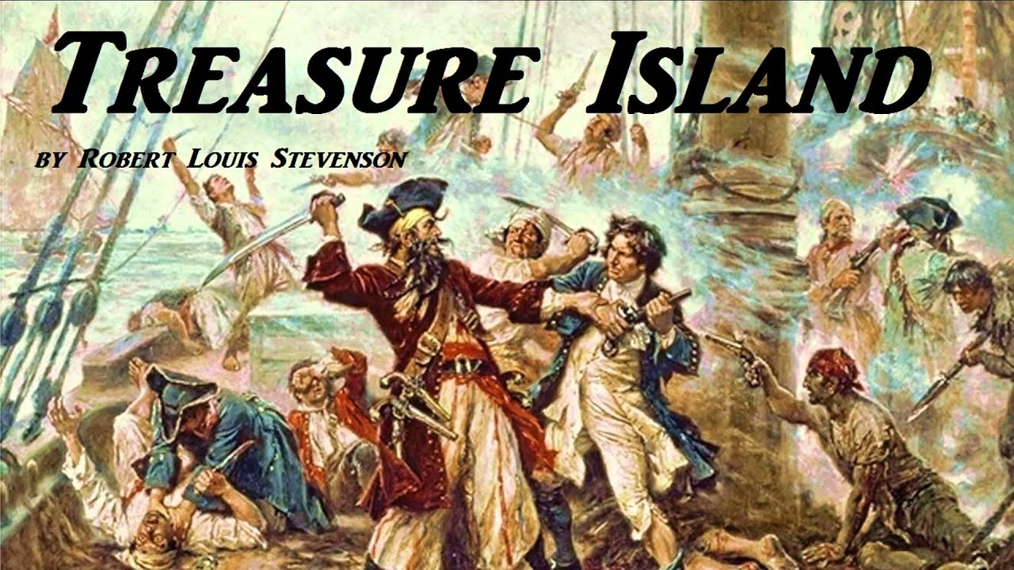
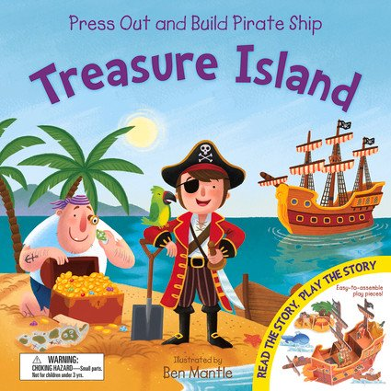

Slide 6
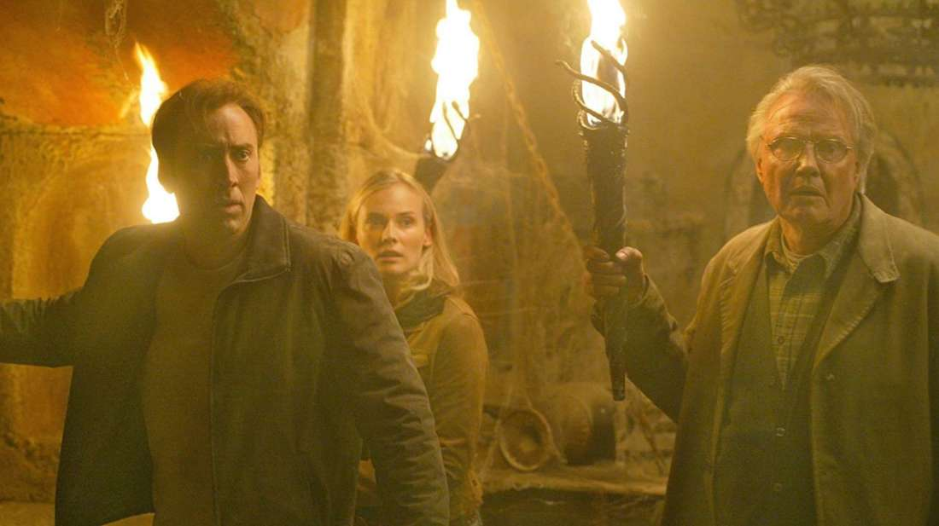
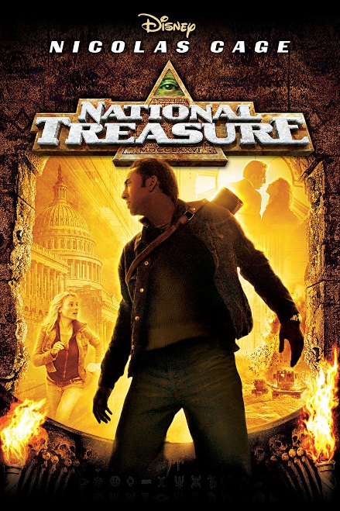

Slide 7
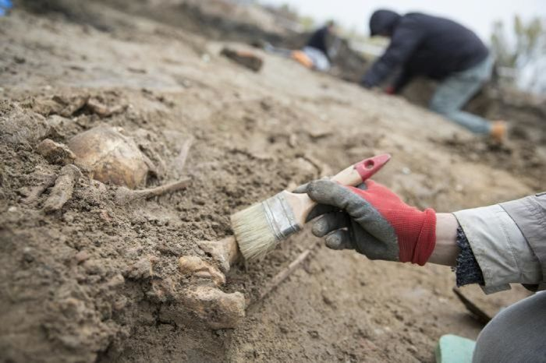
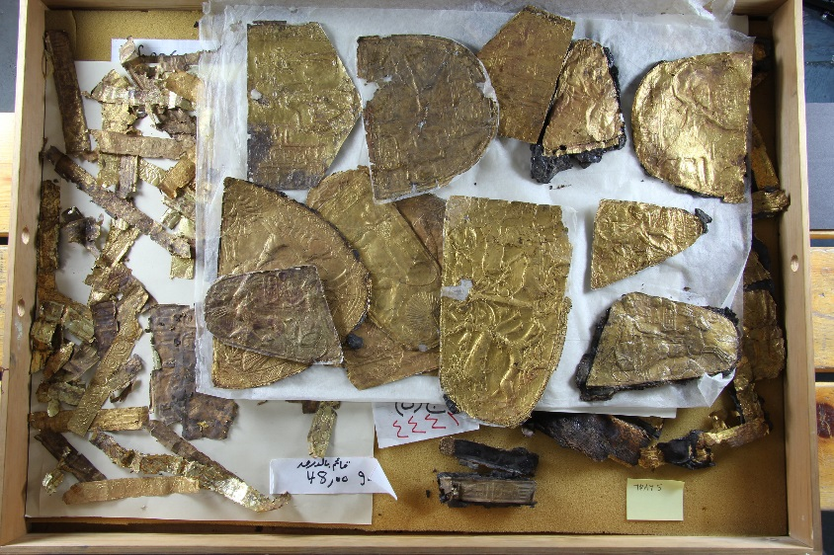

Slide 8
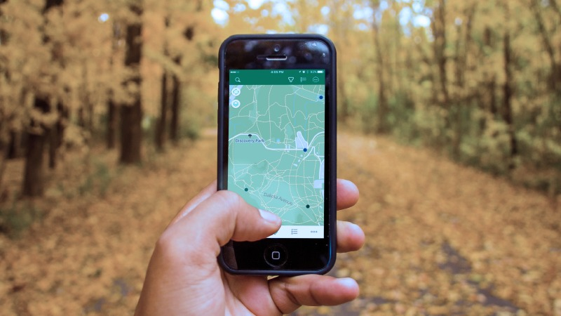
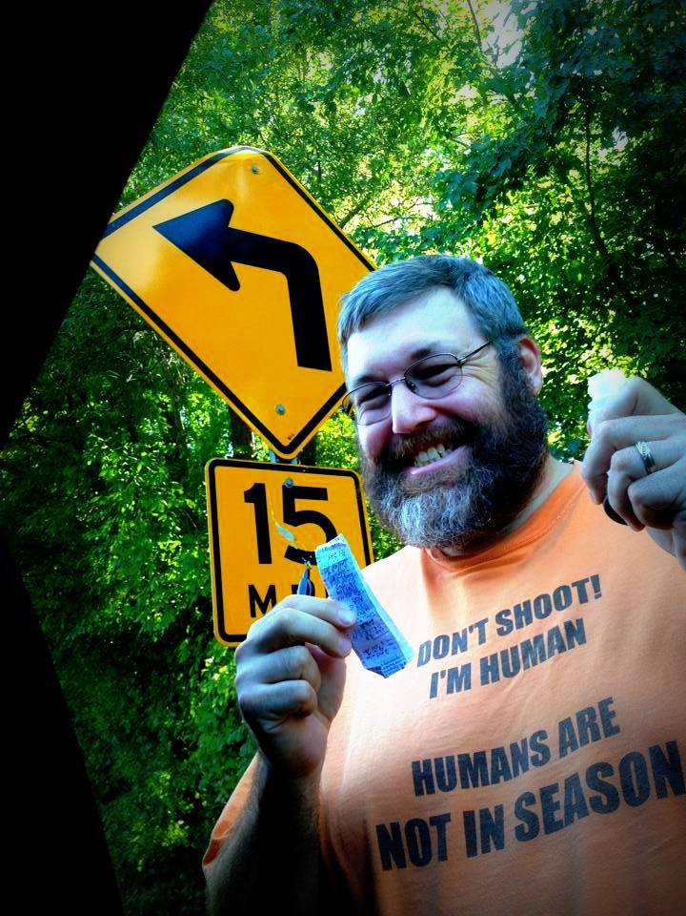

Slide 9
Fenn’s Treasure

Slide 10
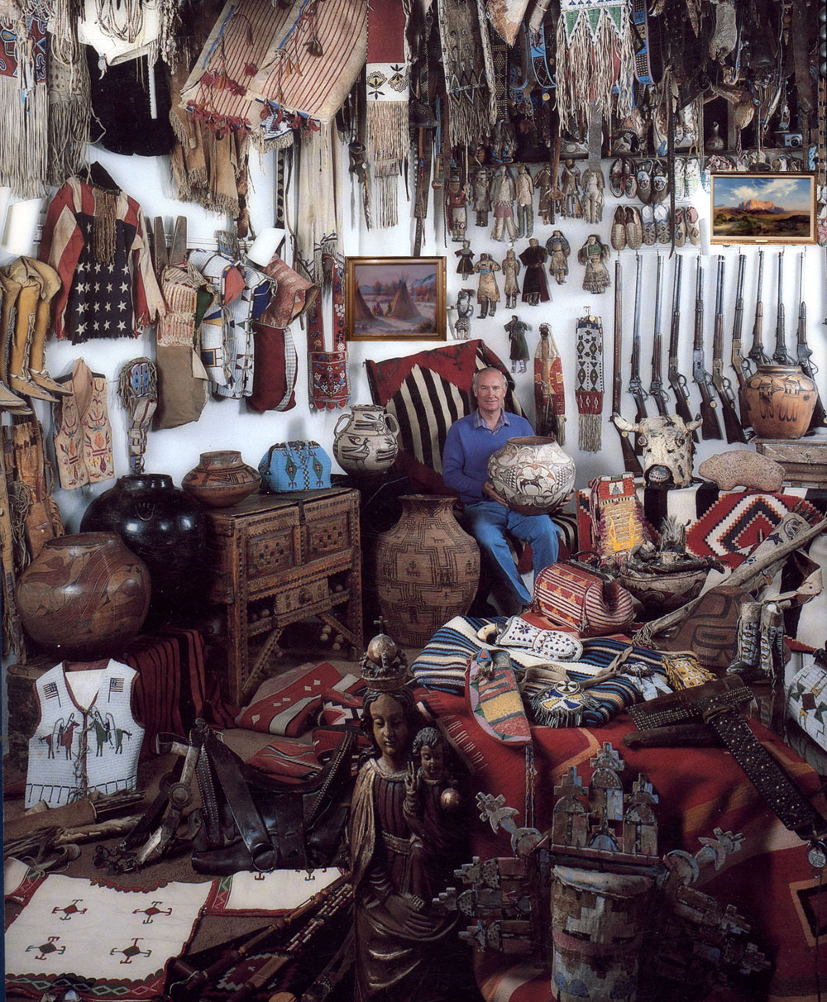

Slide 11
Where is the treasure buried?

Slide 12
Why did Fenn bury the treasure?

Slide 13
Fenn says it is not buried…

Slide 14
How many people have looked for the treasure?

Slide 15
Who knows where the treasure is buried?

Slide 16
Would you like to go on a treasure hunt?

Slide 17
What is the most valuable thing you have found?

Slide 18
Many people have sought the treasure, but a few have died. Is Fenn responsible for their deaths?

Slide 19
What would you buy if you found the treasure?

Slide 20
If you hid a chest; What would you put in it? Where would you hide it?

Slide 21
What is your most valuable possession?

Slide 22
Would you consider yourself an adventurous person?

Slide 23
What do you think about Fenn’s decision to hide his treasures.

Slide 24
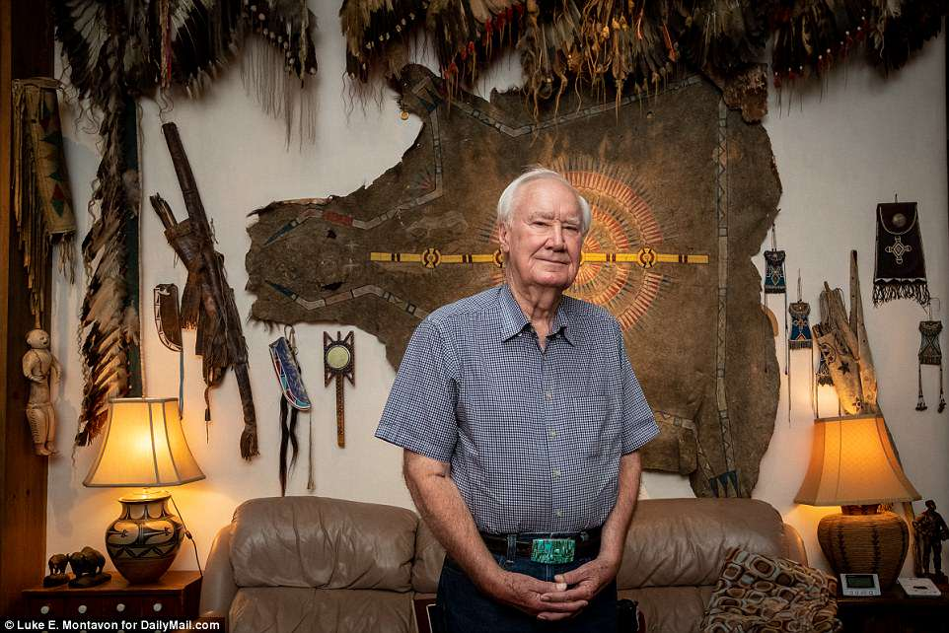

Slide 25
Let’s go on a Treasure Hunt

Slide 26
Rules
I have hidden a treasure somewhere in this building.
Follow the clues to find it.
There are three different sets of clues (work as a group)
I will walk around, but you can ask any of the teacher what they think.
You can use your phones to find the answers
You will need a QR scanner

Slide 27
12.15.15.11
21.14.4.5.18
20.8.5
4.5.19.11

Slide 28
When you finish the treasure hunt, think of some clues you can make for this room.

Slide 29
Can you think of other uses for the QR scanner?

Slide 30
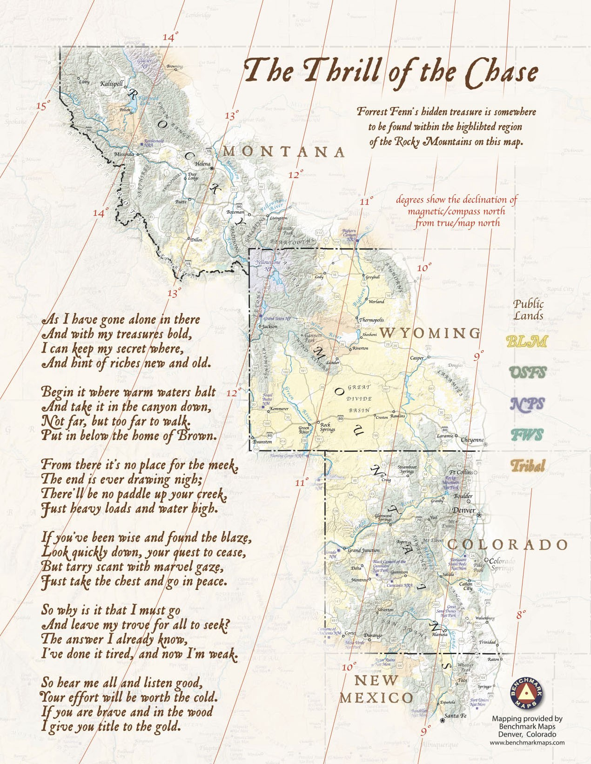
Resources
https://www.youtube.com/watch?v=j4ahNpQLgdk&t=1180s
https://en.wikipedia.org/wiki/Fenn_treasure
https://www.cnbc.com/2018/04/17/millionaire-forrest-fenn-hid-treasure-in-the-rockies-and-left-a-clue.html

Slide 31
Need more ideas?
http://www.treasure-hunt-ideas.co.uk/

