Slide 1
Scavenger Hunt

Slide 2
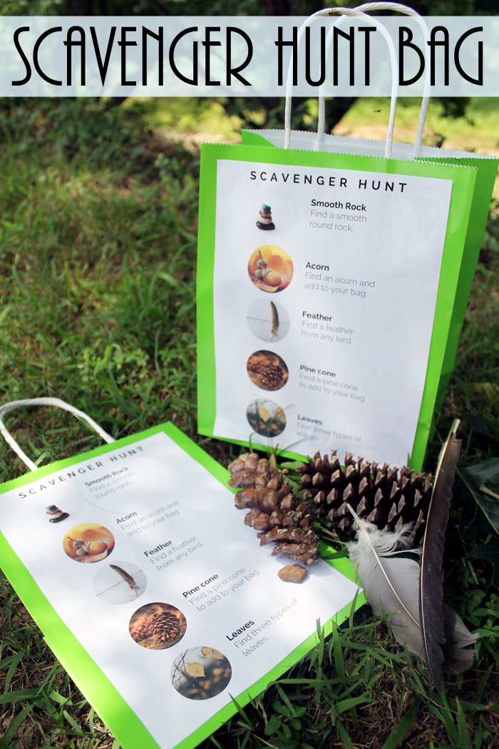
Classic Scavenger Hunt
Students will take a bag and search for items in a designated area.
Park
School
Classroom
Let the students know where they can go.

Slide 3
Picture Scavenger Hunt
Students can use a camera or their smartphone to take a picture of the item, rather than collecting it.
Cleaner
Better for the environment?
In other cases, a video camera could also be used.
Draw or sketch the clue

Slide 4
Writing Scavenger Hunt
Students must visit other teachers and ask for an autograph, or answer a certain question. (the students must converse in English)
Students must write a what they found according to the clue
Alphabet Scavenger Hunt – Find something in this room for each letter of the alphabet

Slide 5
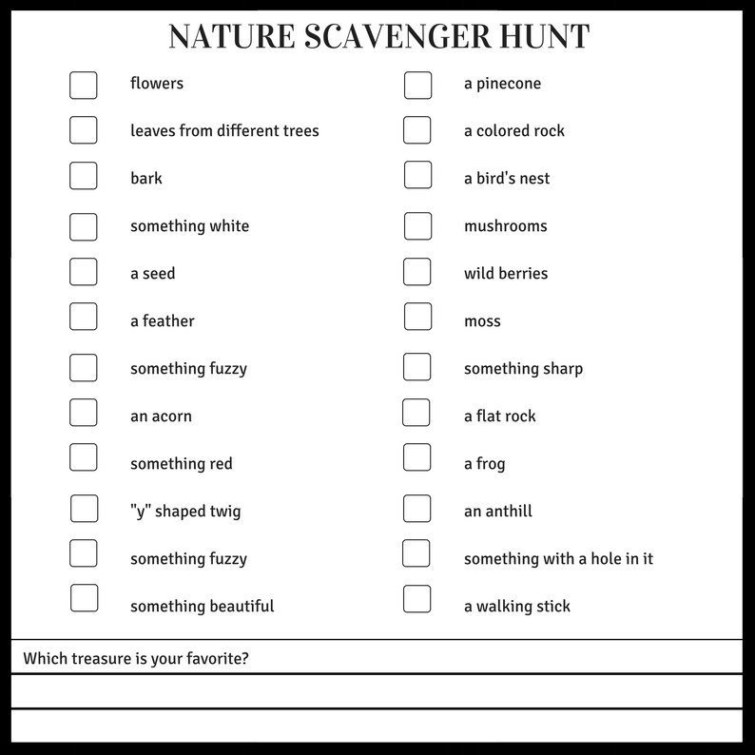
List of items (things)
Make a list of things they need to find.
Try to relate these to your vocabulary.

Slide 6
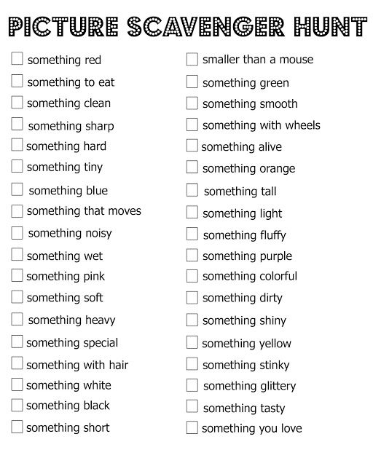
List of items (adjectives)
Students have to put thought into their answers
Students will associate the adjective with the noun

Slide 7
List of items (actions)
Must have a way of recording this
Pictures
Smartphones
Video recorder
Eye witness
Do a handstand for 10 seconds
Take a picture of a bird flying
Jump rope for 1 minute (signature of another teacher)

Slide 8
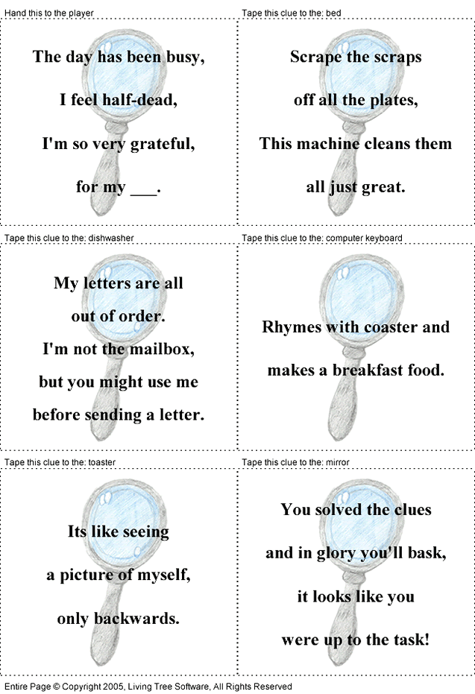
Riddles
Similar to treasure hunts
Solve clues to know where to go
Solve clues to figure out what they need to find.

Slide 9
Hide and Seek
Give the students a list of clues
If they find the clue, there is a candy there (Easter Egg Hunt]

Slide 10
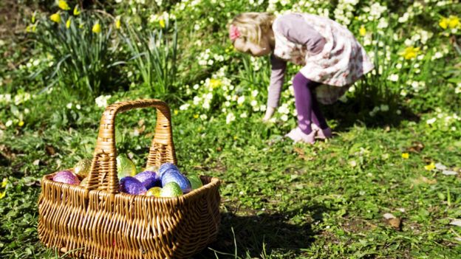

Slide 12
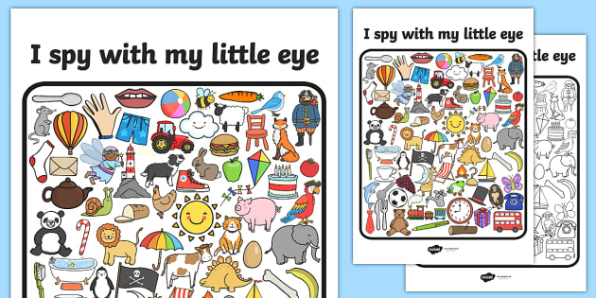

Slide 13
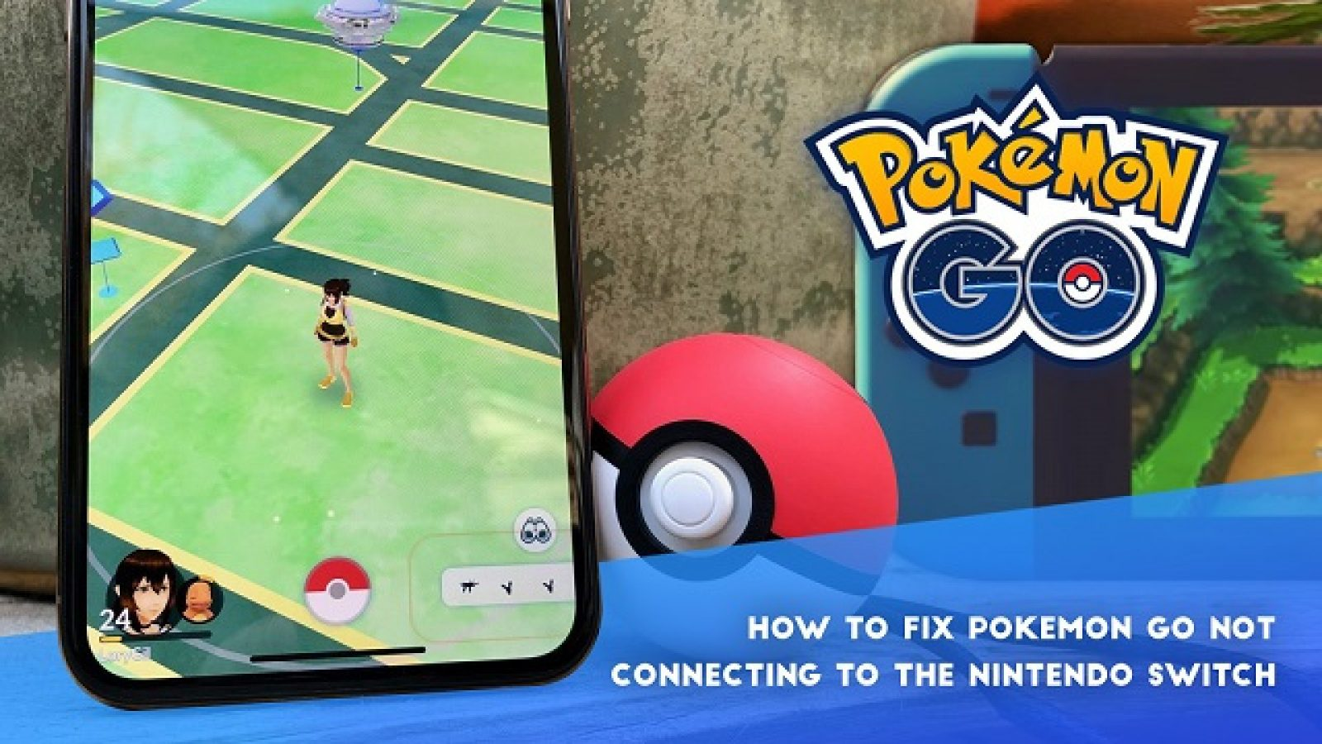

Slide 14
Themed Scavenger Hunts

Slide 15
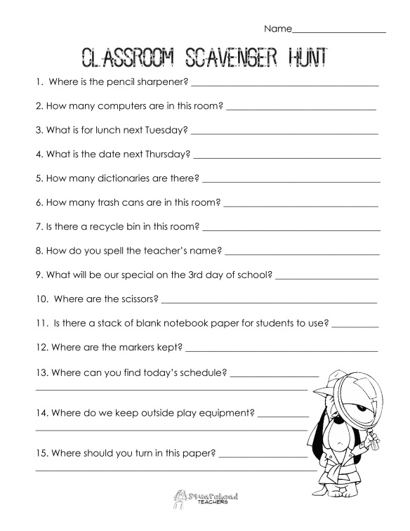

Slide 16
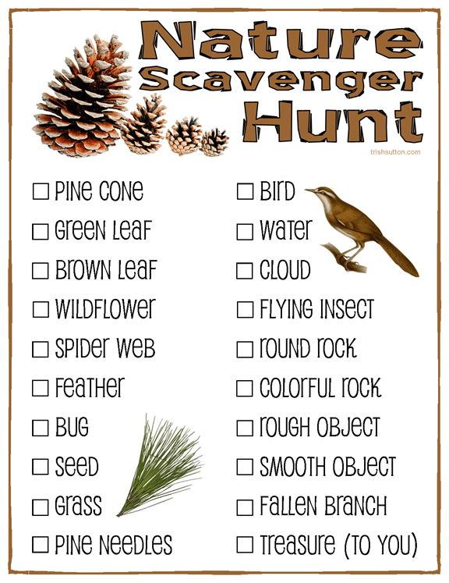
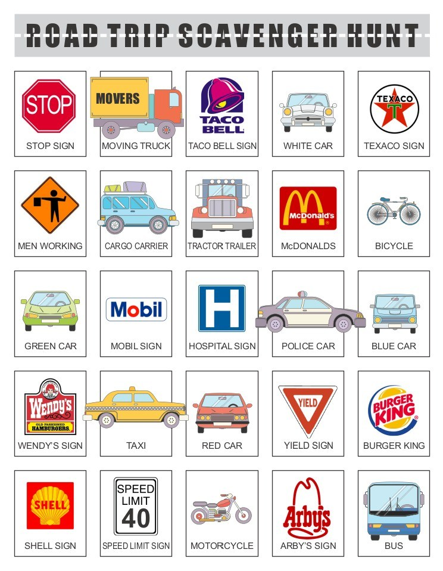

Slide 17
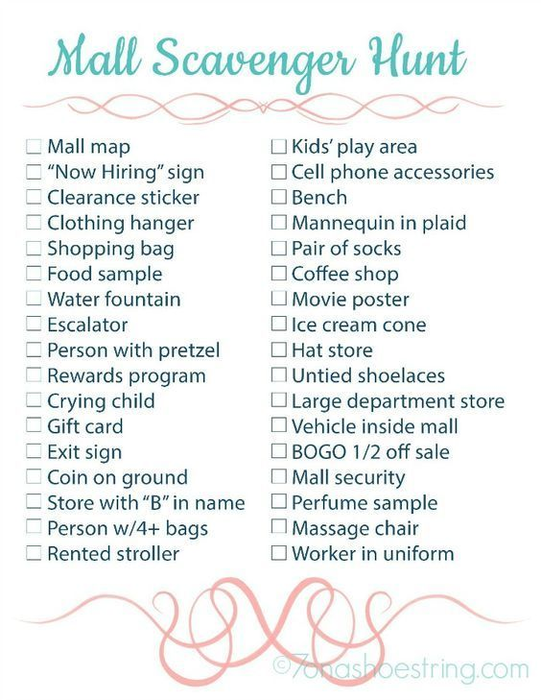

Slide 18
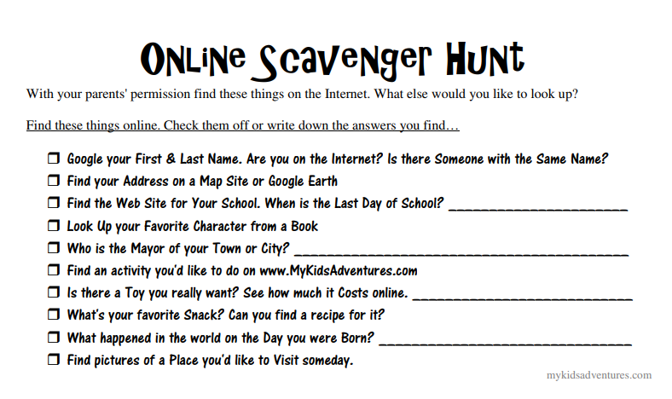

Slide 20
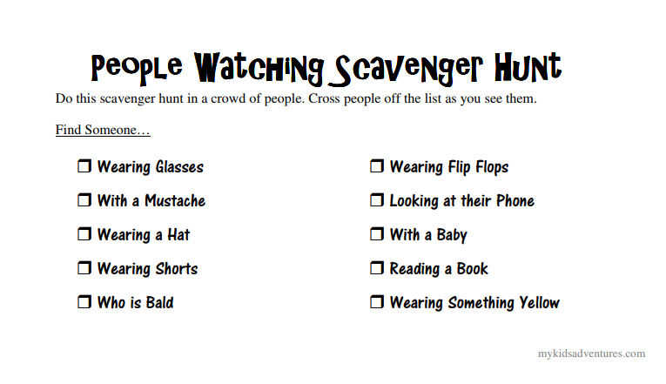

Slide 22
Book Scavenger Hunt
The name of a character
The last word in the book
The longest word in the book
Something that starts with an “H”
A strange word
3 adjectives
Find a word you’ve never heard before and use it in a sentence

Slide 23
Create your own Scavenger Hunt

