Slide 1
Etymology
Fairy Tales + Idioms

Slide 2
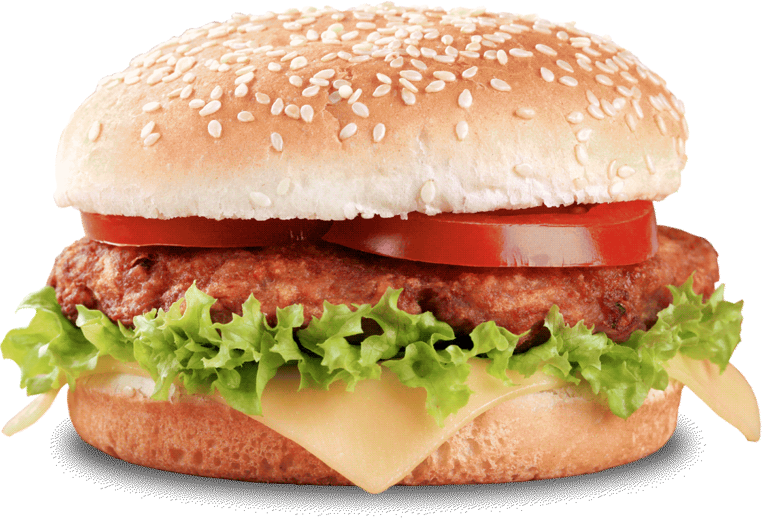
The Story of the Hamburger

Slide 3
The Story of the Hamburger
The hamburger was invented in ___________________.
Although there is some controversy, it is accepted that the first use of minced meat between two slices of bread happened here.
America (probably)

Slide 4
The Story of the Hamburger
The hamburger was named after the Port of __________________________________.
Many European travelers left from there to go to America.
Hamburg (“Hamburg” + “er”)

Slide 5
The Story of the Hamburger
“Hamburg style”
“Hamburg Sandwich”

Slide 6
The Story of the Hamburger
Over time, “Hamburg-er” changed into “Ham-burger”.
This has cause some confusion because it sounds like the sandwich contains _______________.
pork

Slide 7
The Story of the Hamburger
As fast food became more popular across America and the world, the “ham” disappeared from the name of the sandwich. Nowadays man people just call it a ________________
burger

Slide 8
The Story of the Hamburger
However, the story doesn’t end there.
There are many different types of ingredients and toppings. Sometimes these ingredients and toppings change the name of the hamburger.

Slide 9
The Story of the Hamburger
Cheeseburger
Cheese +hamburger =
Chicken + hamburger =
Salmon + hamburger =
Buffalo + hamburger =
Vegetarian hamburger =
Chicken burger
Salmon burger
Buffalo (Bison) burger
Veggie burger

Slide 10
Etymology
The origins of the word / phrase.

Slide 11
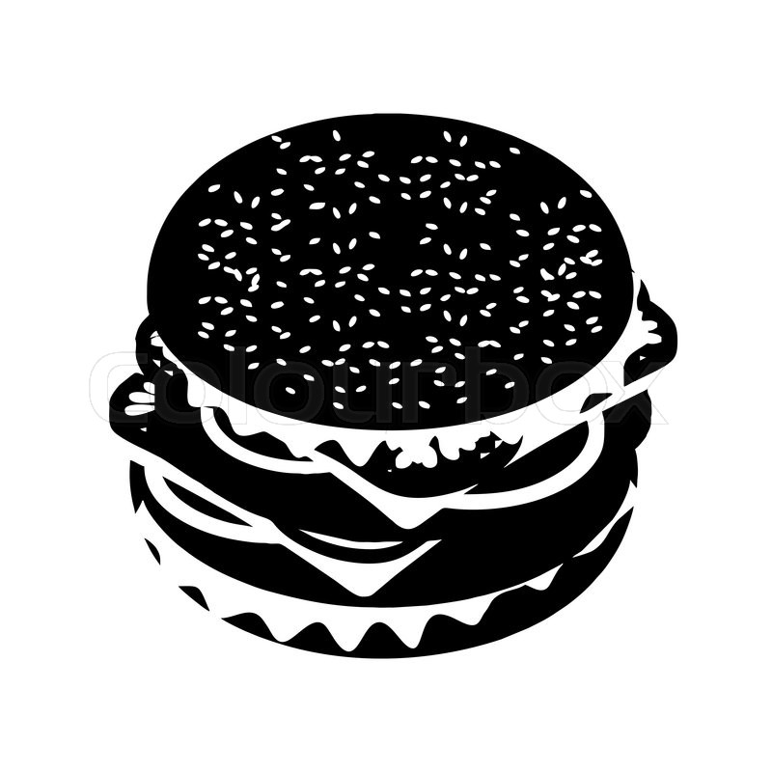
Etymology
Just like the hamburger, the meaning of words change over time. We have looked at some of these in the balderdash game.
This has also happened to phrases.

Slide 12
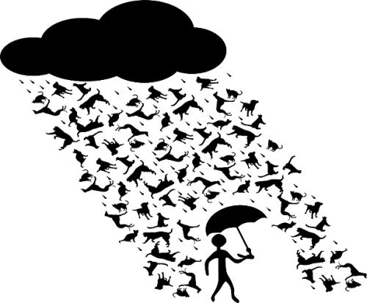
Etymology
Have you ever wondered about idioms?
They seem so strange. Where did they come from?

Slide 14
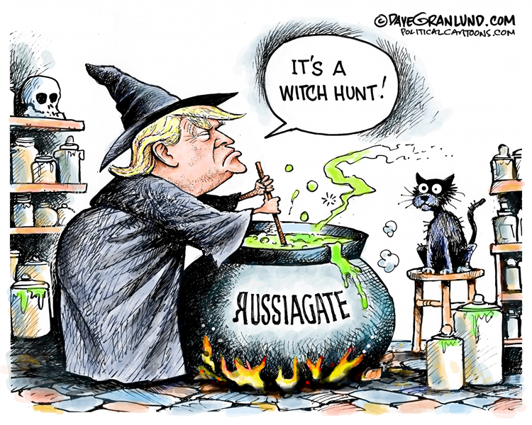

Slide 15
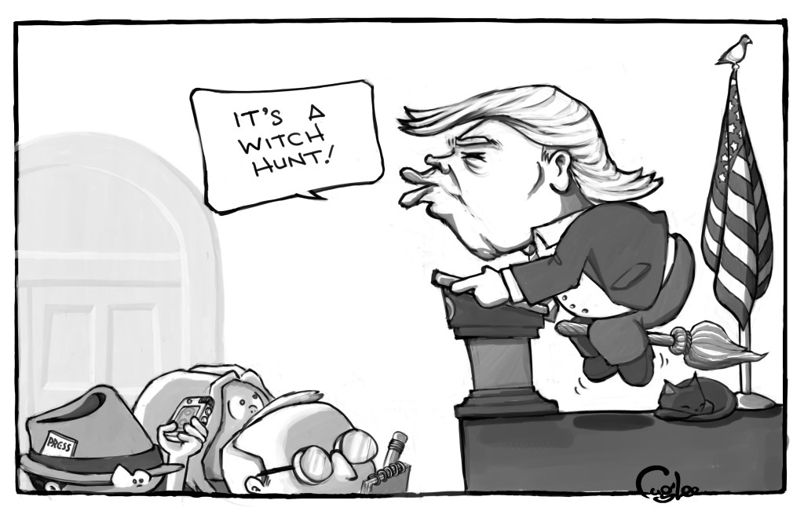

Slide 16
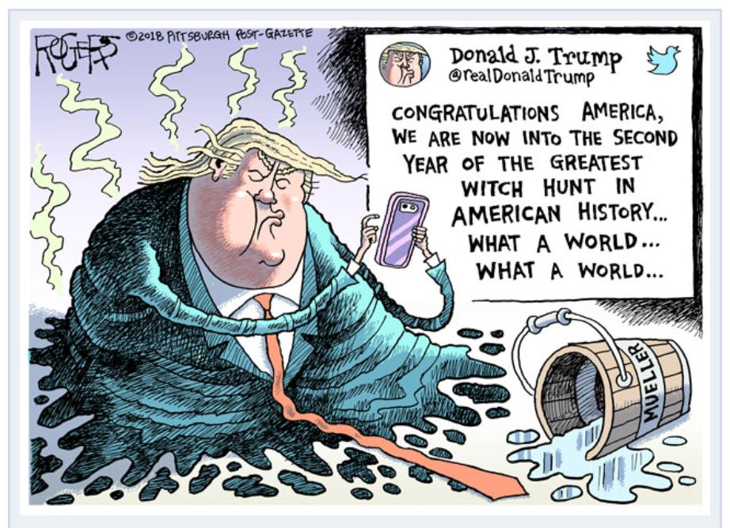

Slide 17
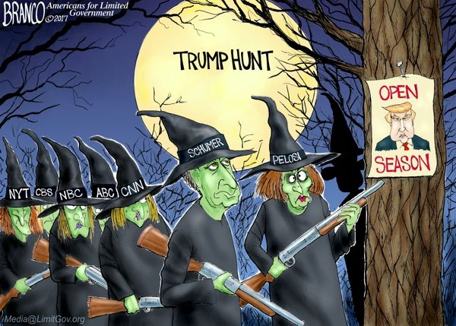

Slide 18
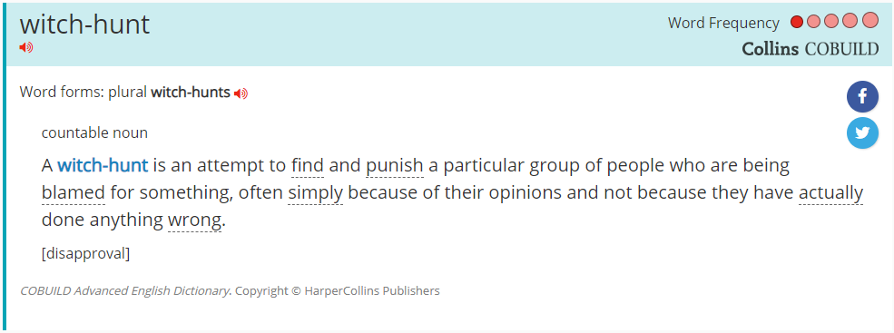
Witch Hunt
Definition:

Slide 19
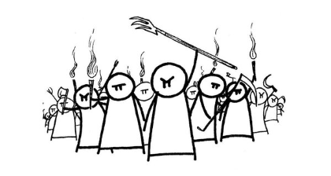
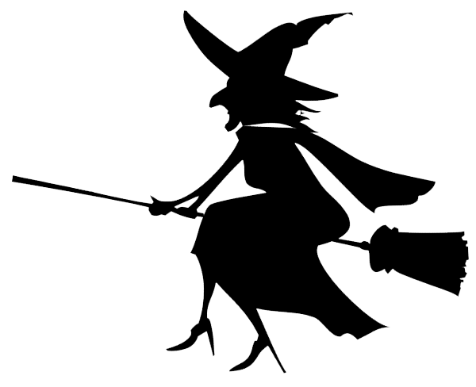
Witch Hunt
Examples:
Trump leads “birtherism” movement
Julius Caesar wanted “absolute control”
Senator Joseph McCarthy accused many people of being communists (and traitors)

Slide 20
Witch Hunt
Etymology:
This idiom comes from the search for witches for the purpose of killing them. But, witchcraft has never been proven to exist.
The most famous case may be the Salem Witch Trials.

Slide 21
Research Activity

Slide 22
Research Activity
Take an idiom from the board.
Search for it's meaning. (definition)
Provide an example.
Explain the origin of the idiom. (etymology)

Slide 23
Presentations

Slide 24
How can we change this activity for students?
No access to computers
The English level is too high.

