Slide 1
Fairy Tales
https://www.youtube.com/watch?v=OIK59oRNAIQ

Slide 2
Fairy Tales
Starting from an oral tradition, fairy tales have been passed own through the generations.
They are short stories (usually with magical elements)

Slide 3
Fairy Tale Creatures
Elf

Slide 4
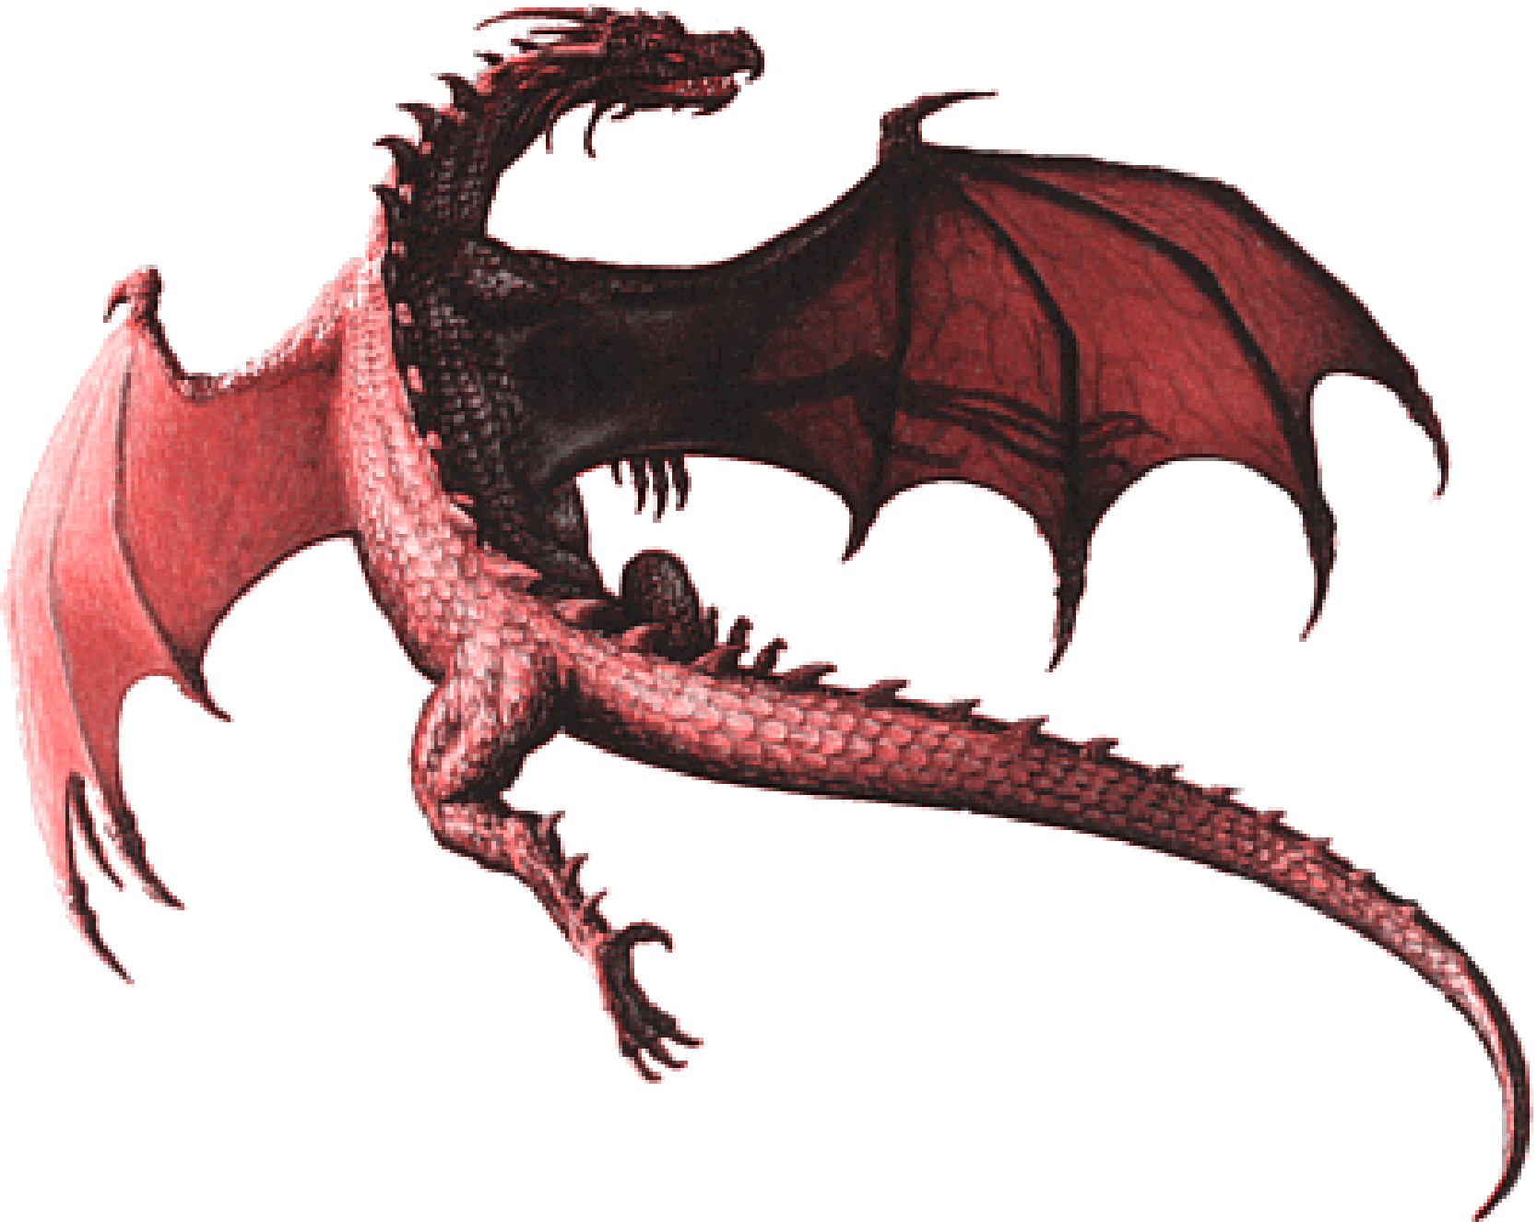
Fairy Tale Creatures
Dragon

Slide 5
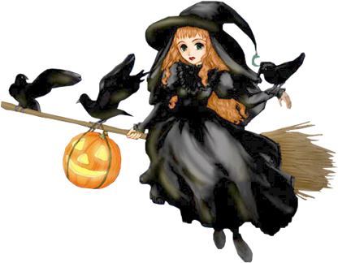
Fairy Tale Creatures
Witch

Slide 6
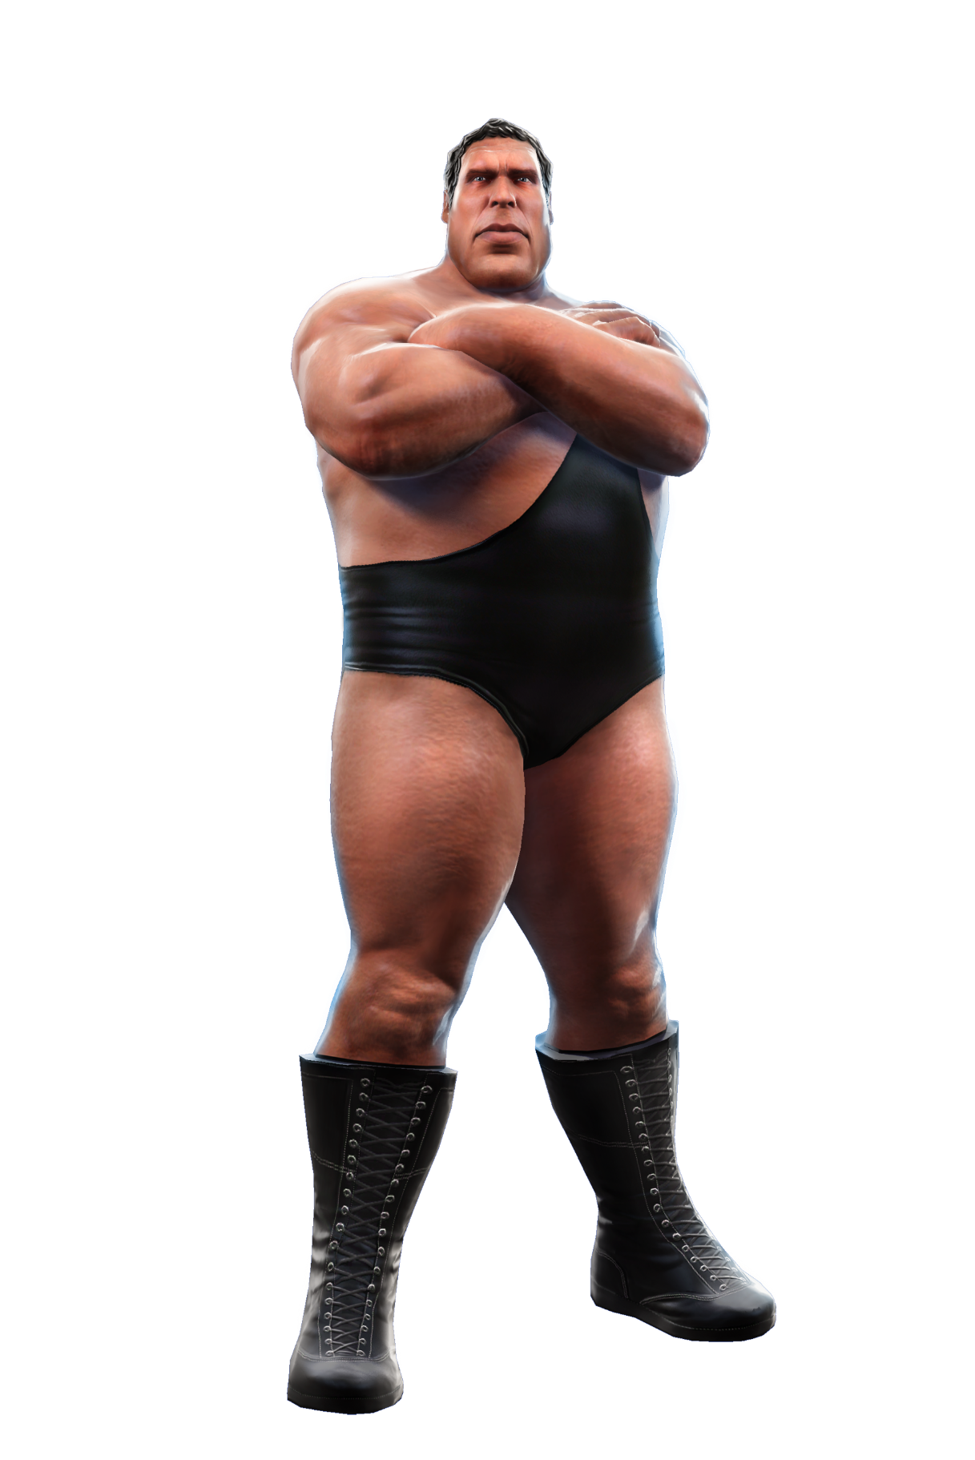
Fairy Tale Creatures
Giant

Slide 7
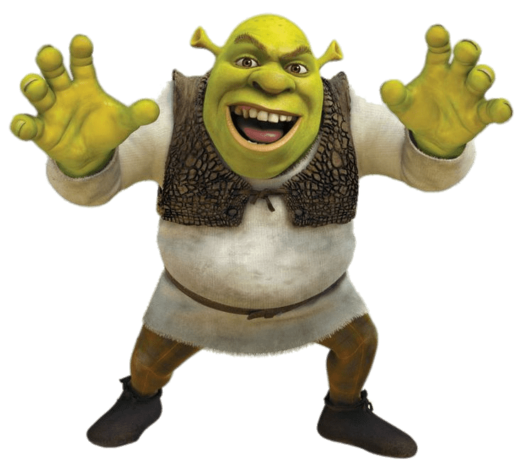
Fairy Tale Creatures
Ogre

Slide 8
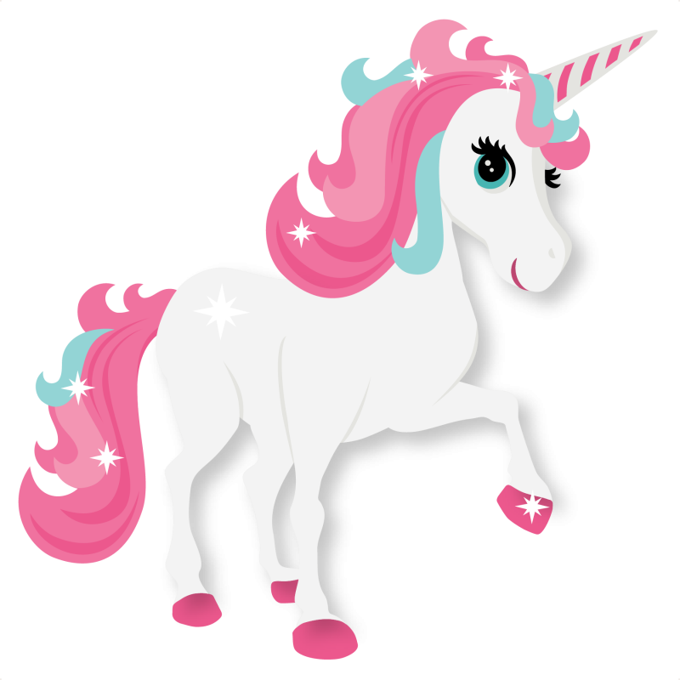
Fairy Tale Creatures
Unicorn

Slide 9
Fairy Tale Creatures
Troll

Slide 10
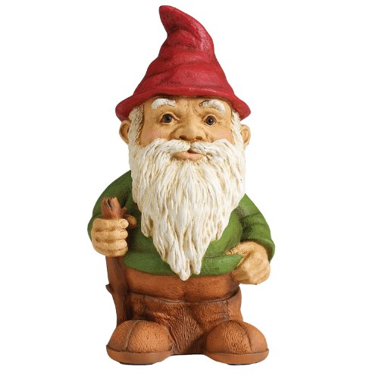
Fairy Tale Creatures
Gnome

Slide 11
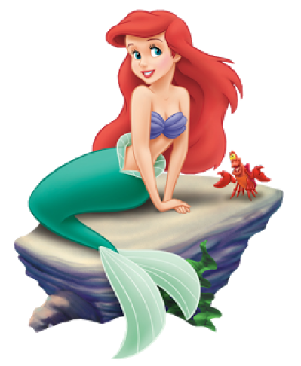
Fairy Tale Creatures
Mermaid

Slide 12
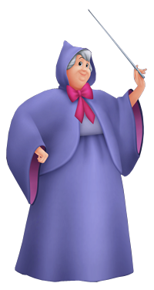
Fairy Tale Creatures
Fairy Godmother

Slide 13
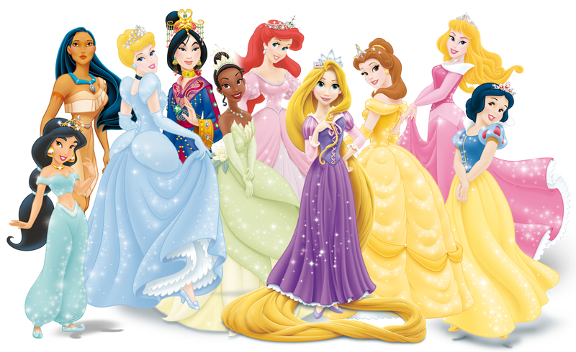
Fairy Tale Creatures
Princesses

Slide 14
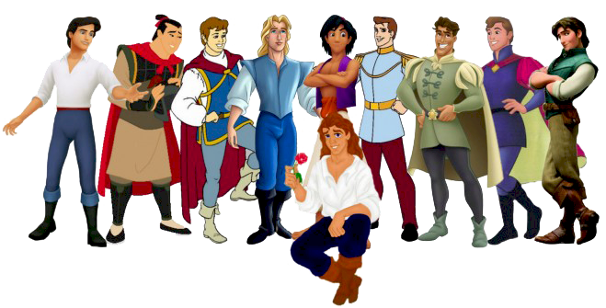
Fairy Tale Creatures
Princes

Slide 16
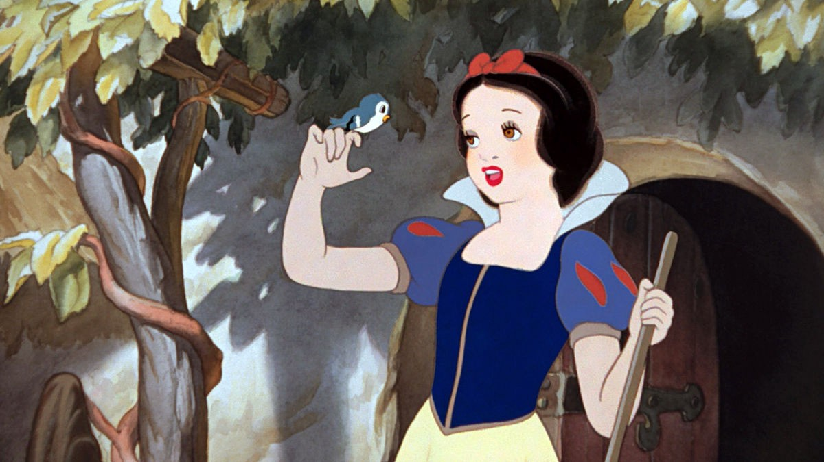
Snow White and the Seven Dwarfs
First feature length animation film (1937)
Based on a German fairy tale called Sneewittchen
Grimms’ Fairy Tales (1812)

Slide 17
Snow White and the Seven Dwarfs
Once upon a time, there was a queen. She enjoyed sewing, but one day she pricked her finger while sewing. Three drops of blood fell on to the fresh white snow sitting on her black windowsill. The queen wished that she could have a daughter with skin as white as snow, lips as red as blood and hair as black as ivory.

Slide 18
Snow White and the Seven Dwarfs
Some time later, the queen had a beautiful baby girl. Her skin was as white as snow. Her lips were as red as blood. And her hair was as black as ivory. She named her daughter, Snow White.
Unfortunately, the queen would not see her daughter grow up as she died shortly after giving birth.

Slide 19
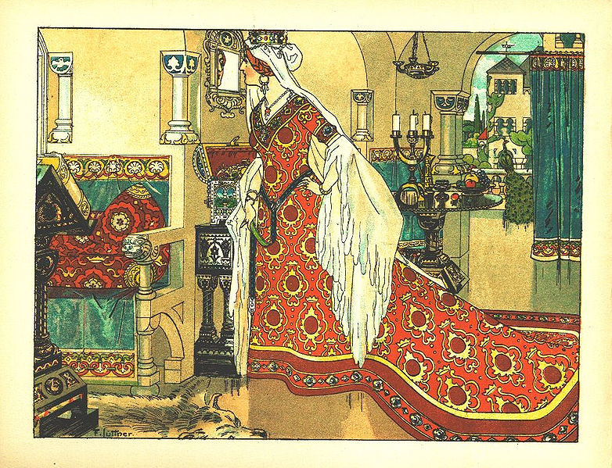
Snow White and the Seven Dwarfs
About one year later, the King married another woman. The new queen was vain and wicked, but very pretty. Every day she would ask a magic mirror, “Magic mirror on the wall, who is the fairest of us all?”
Every day the mirror would answer, “You are.” This made the queen very happy because the mirror could not lie.

Slide 21
Snow White and the Seven Dwarfs
As Snow White got older, she became more and more beautiful.
Not long after Snow White turned 7 years old, the queen asked the mirror her usual question, “Magic Mirror on the wall, who is the fairest of us all?”
The mirror responded, "Queen, you are full fair, 'tis true, but Snow-white fairer is than you."

Slide 22
Snow White and the Seven Dwarfs
This made the queen very envious. She ordered a hunter to take Snow White into the woods and kills her. She also asked the hunter to bring back Snow White’s heart to prove he had killed her.

Slide 23
Snow White and the Seven Dwarfs
The hunter took the young Snow White into the forest. He raised his sword high into the air, but he couldn’t kill the child. Snow White was saddened but promised to go into the forest and never come back.
The hunter thought the animals would kill her anyways. Just then, a boar ran by. The hunter killed the boar and removed its heart.

Slide 24
Snow White and the Seven Dwarfs
He gave the heart to the queen, saying it was the heart of Snow White. The queen took the heart and cooked it with some salt. She ate the heart content knowing that Snow White was dead.

Slide 25
Snow White and the Seven Dwarfs
Meanwhile, Snow White ran through the forest. She was terrified, as any child would be. She ran until her legs hurt too much to continue. At that time, she saw a small house in the distance.
She used all of her remaining energy to get to the house.

Slide 26
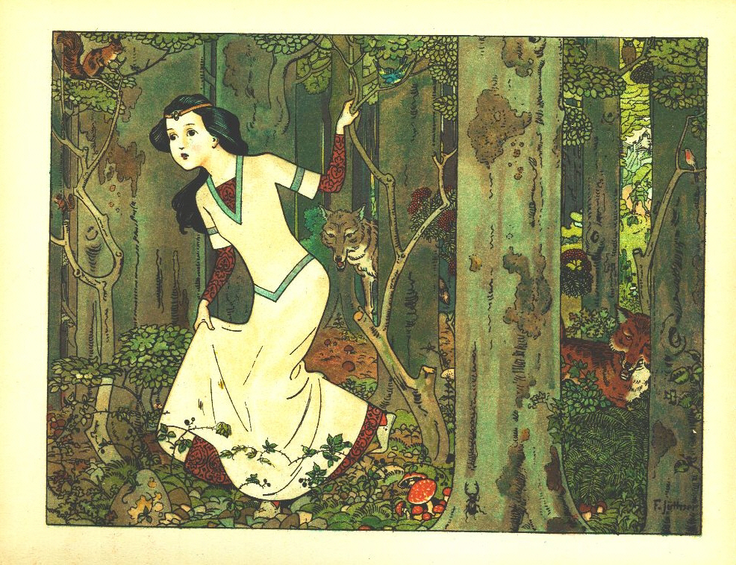

Slide 27
Snow White and the Seven Dwarfs
When she looked through the window, no one was there. She needed a rest, so she went inside.
The house was full of small things. There was a small table with seven small chairs, seven small cups and seven small plates. Snow White was extremely hungry and thirsty, so she ate just a little from each plate. She drank just a little from each cup.
There were also 7 small beds side by side. She lied down and had a nap.

Slide 28
Snow White and the Seven Dwarfs
Later, the house owners came home. They were dwarfs. They worked in a mine all day. They noticed some of their food was missing and some of their wine had been drunk. Then they noticed Snow White sleeping in their beds.
When they saw how beautiful the child was, they let her stay. When she woke up, Snow white told the dwarfs how her step mother tried to have her killed. She promised to cook, sew and clean for the dwarfs if they let her stay there.
The dwarfs told her to stay inside and don’t let anyone into the house because the queen might send someone to kill her again.

Slide 29
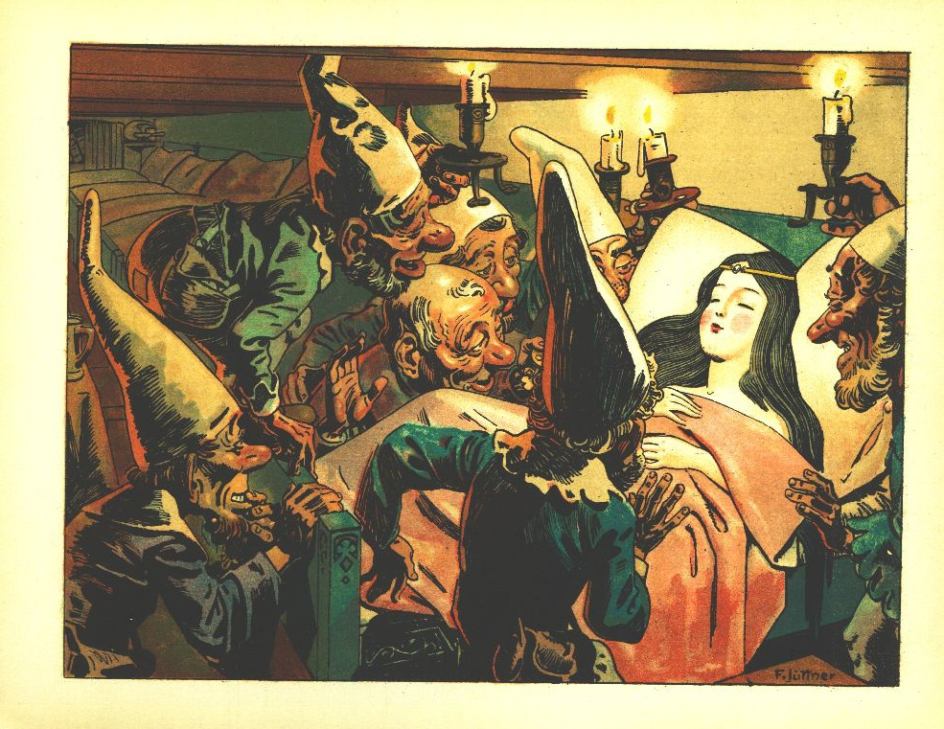

Slide 30
Snow White and the Seven Dwarfs
Back in the castle, the queen was quite pleased that Snow White was dead. She asked the mirror, “Magic mirror on the wall, who is the fairest of us all?”
She was shocked when the mirror said, "Queen, thou art of beauty rare, but Snow-white living in the glen with the seven little men is a thousand times more fair.“
This made the queen very angry as the mirror always told the truth.

Slide 31
Snow White and the Seven Dwarfs
The queen thought of a cunning plan. She painted her face and dressed like an old peddler woman.
She crossed the seven mountains and found the small house where the seven dwarfs lived. She shouted, “Fine wares for sale! Fine wares for sale!”

Slide 32
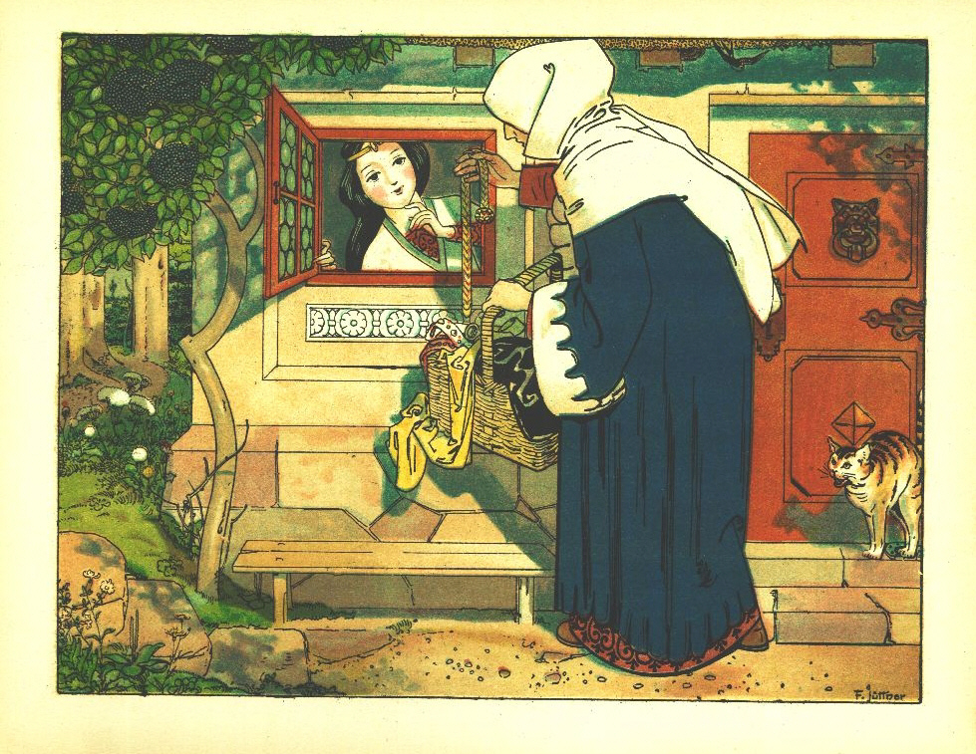

Slide 33
Snow White and the Seven Dwarfs
Snow White went outside to meet the woman. “Good day ma’am. What are you selling?” she said. “Laces, beautiful laces of all colors,” answered the disguised queen.
Snow White found one that she really liked. The old woman said, “Let me help you put it on.”
But the old woman, who was secretly the queen, pulled the lace tightly against Snow White’s neck. Snow White could not breath and eventually she fell to the ground dead.

Slide 34
Snow White and the Seven Dwarfs
Shortly after that, the dwarfs came home. They saw Snow White lying motionless on the ground. They lifted her up and cut the lace. Luckily, Snow White was still alive.
The dwarfs understood that the old woman was the queen and they warned Snow White not to talk to anyone.

Slide 35
Snow White and the Seven Dwarfs
Back at the castle, the queen asked the mirror, “Magic mirror on the wall, who is the fairest of us all?”
The mirror responded, “Queen, thou art of beauty rare, but Snow White living in the glen with the seven little men is a thousand times more fair.”
The queen was angry and thought of a new plan. She painted her face and went back to the small house of the seven dwarfs.

Slide 36
Snow White and the Seven Dwarfs
“Wares for sale! Wares for sale!” said the old woman.
But Snow White was smart. She told the old woman, “Go away, I must not let anyone in.”
“But you are not forbidden to look,” said the queen.
Snow White was young and naïve. She thought, “that’s true.” And she went outside.
The old woman was selling beautiful combs. Snow White really liked this because the dwarfs did not have appropriate combs for her fine black hair. Little did she know that the queen had poisoned the comb.

Slide 37
Snow White and the Seven Dwarfs
The queen offered to help Snow White by combing her hair properly. Snow White agreed and let the old woman comb her hair. As she combed, the poison soaked into Snow White’s head. She fell to the ground dead.

Slide 38
Snow White and the Seven Dwarfs
The dwarfs came home to find Snow White again lying on the ground. They removed the comb and Snow white got better.
Again, they warned Snow White to stay away from strangers and not to let anyone in the house.

Slide 39
Snow White and the Seven Dwarfs
Back at the castle, the queen asked the mirror again, “Magic mirror on the wall, who is the fairest of us all?”
Again, the mirror said, “Queen, thou art of beauty rare, but Snow White living in the glen with the seven little men is a thousand times more fair.”
Well, this made the queen furious.

Slide 40
Snow White and the Seven Dwarfs
She had to think of an even more devious plan.
She found an apple that was half white and half red. She poisoned the red side of the apple with a strong poison. Whoever ate, even a little, of this poison would surely die.
Again she painted her face and went back to the small house owned by the dwarfs.

Slide 41
Snow White and the Seven Dwarfs
The queen knocked on the door.
“Go away,” said Snow White, “I dare not take anything from you.”
The woman responded, “Are you afraid of poison? Look, I will eat some.” She cut the apple and ate a slice from the white side.
The woman appeared be healthy, so Snow White stretched out her hand and took the apple. Immediately after biting the apple, she fell to the floor dead.
The queen started laughing. Finally, Snow White was dead.

Slide 42
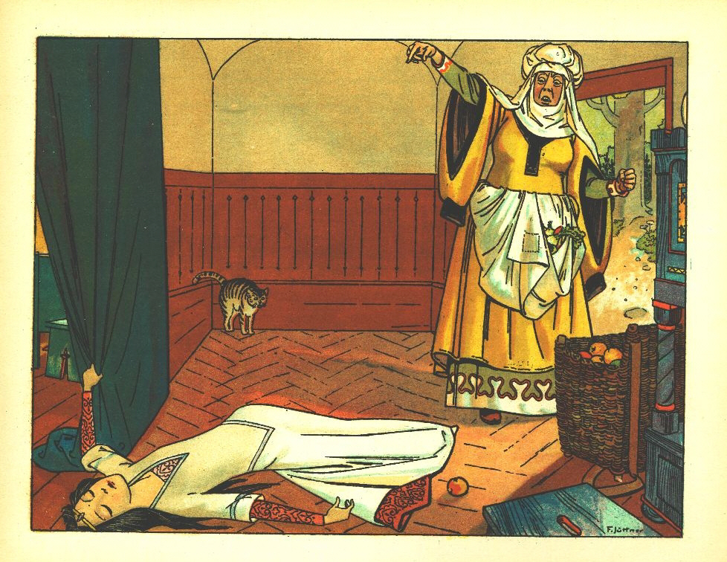

Slide 43
Snow White and the Seven Dwarfs
When the queen returned to the castle, she asked the mirror, “Magic mirror on the wall, who is the fairest of us all?”
Finally the mirror answered, “You are the fairest now”

Slide 44
Snow White and the Seven Dwarfs
The dwarfs returned home to find Snow White dead on the ground. They sat her up and tried to revive her, but she didn’t move. But she looked like she was still alive. For three days, they cried and mourned.
She was so young and beautiful. Her skin was still as white as snow, her lips as red as blood, and her hair as black as ivory. They decided to make a special coffin for her out of glass.

Slide 45
Snow White and the Seven Dwarfs
They did not want to leave her, so they kept the coffin in the forest. One of the dwarfs always stayed beside the coffin to guard it.

Slide 46
Snow White and the Seven Dwarfs
One day, a prince was riding by on his horse and saw the girl in the coffin. He said, “Let me have the coffin, and I will give you whatever you like to ask for it.” The dwarfs refused to sell it.
“I can not live without looking upon Snow White,” explained the prince, “If you let me have her, I will care for you as though you were my family.” The dwarfs saw how much he cared and let him take the girl away.

Slide 47
Snow White and the Seven Dwarfs
As the servants were carrying the coffin, one of them tripped on a rock. The coffin fell. There was a piece of apple stuck in Snow White’s throat but the fall dislodged the apple and she could breathe again.
She was so grateful that she agreed to marry the prince.

Slide 48
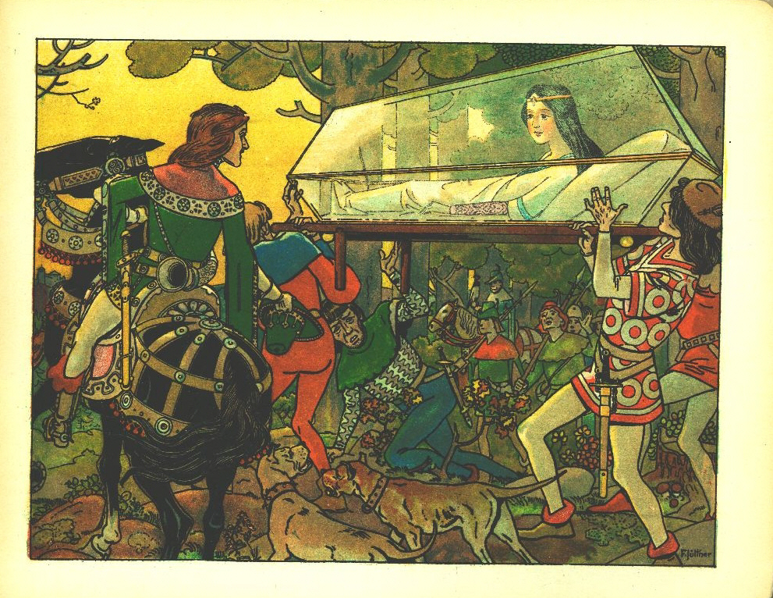

Slide 49
Snow White and the Seven Dwarfs
They invited everyone to the wedding, including the queen. So, the queen asked the mirror again, “Magic mirror on the wall, who is the fairest of us all?”
The mirror said, “Oh queen, although you are of beauty rare. The young bride is a thousand times more fair.”
The queen was angry. She needed to meet this new bride. She did not know that it was Snow White.

Slide 50
Snow White and the Seven Dwarfs
When the queen arrived at the wedding, they made her wear red hot iron shoes and forced her to dance until she died.

Slide 51
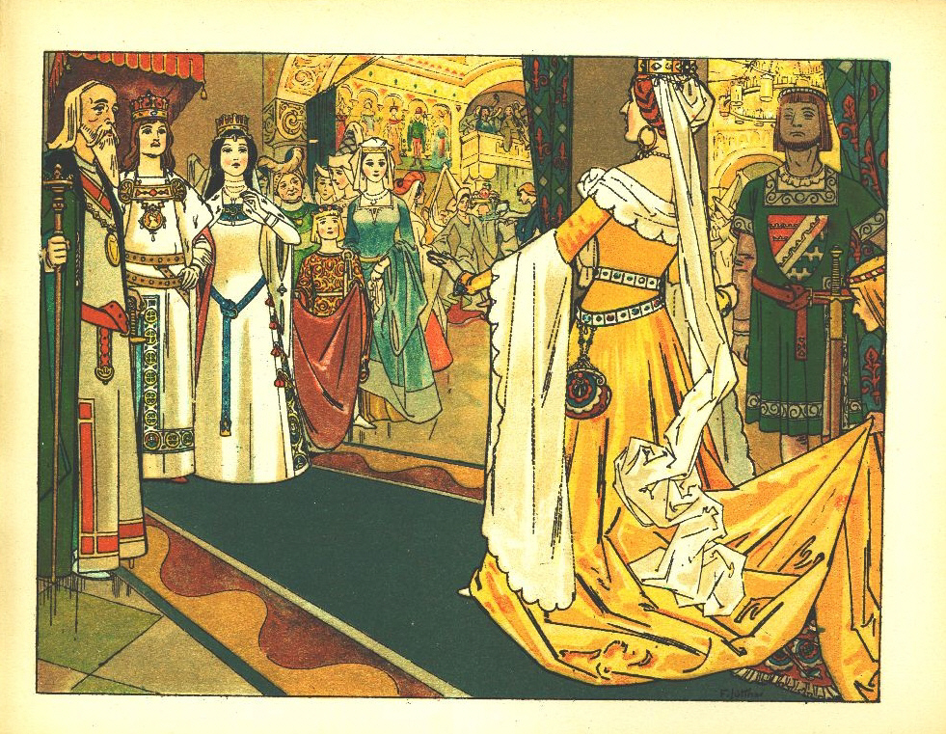

Slide 52
Fairy Tales Change Over Time
Choose a fairy tale that you are familiar with.
Read the ‘original’ text
Discuss the differences between the old text and the story you know.

Slide 53
Resources
Little Mermaid - http://hca.gilead.org.il/li_merma.html
Sleeping Beauty - https://www.pitt.edu/~dash/type0410.html
Peter Pan - http://gutenberg.net.au/ebooks03/0300081h.html
Cinderella - http://www.authorama.com/grimms-fairy-tales-35.html
Pinocchio - http://fathom.lib.uchicago.edu/2/72810000/72810000_pinocchio.pdf
The Hunchback of Notre Dame - https://archive.org/details/hunchbackofnotre1hugo/page/24
Three Little Pigs - https://www.pitt.edu/~dash/type0124.html
Sleeping Beauty - https://www.pitt.edu/~dash/grimm050.html
The Frog Prince - https://www.pitt.edu/~dash/grimm001.html
Little Red Riding Hood - https://genius.com/Italo-calvino-the-false-grandmother-annotated
Rapunzel – https://www.pitt.edu/~dash/grimm012.html
Aladdin – https://etc.usf.edu/lit2go/141/the-blue-fairy-book/3132/aladdin-and-the-wonderful-lamp/

Slide 54
The Moral of the Story
Classic fairy tales were told to teach lessons
The lessons are called morals
Can you guess the morals of the following stories?

Slide 55
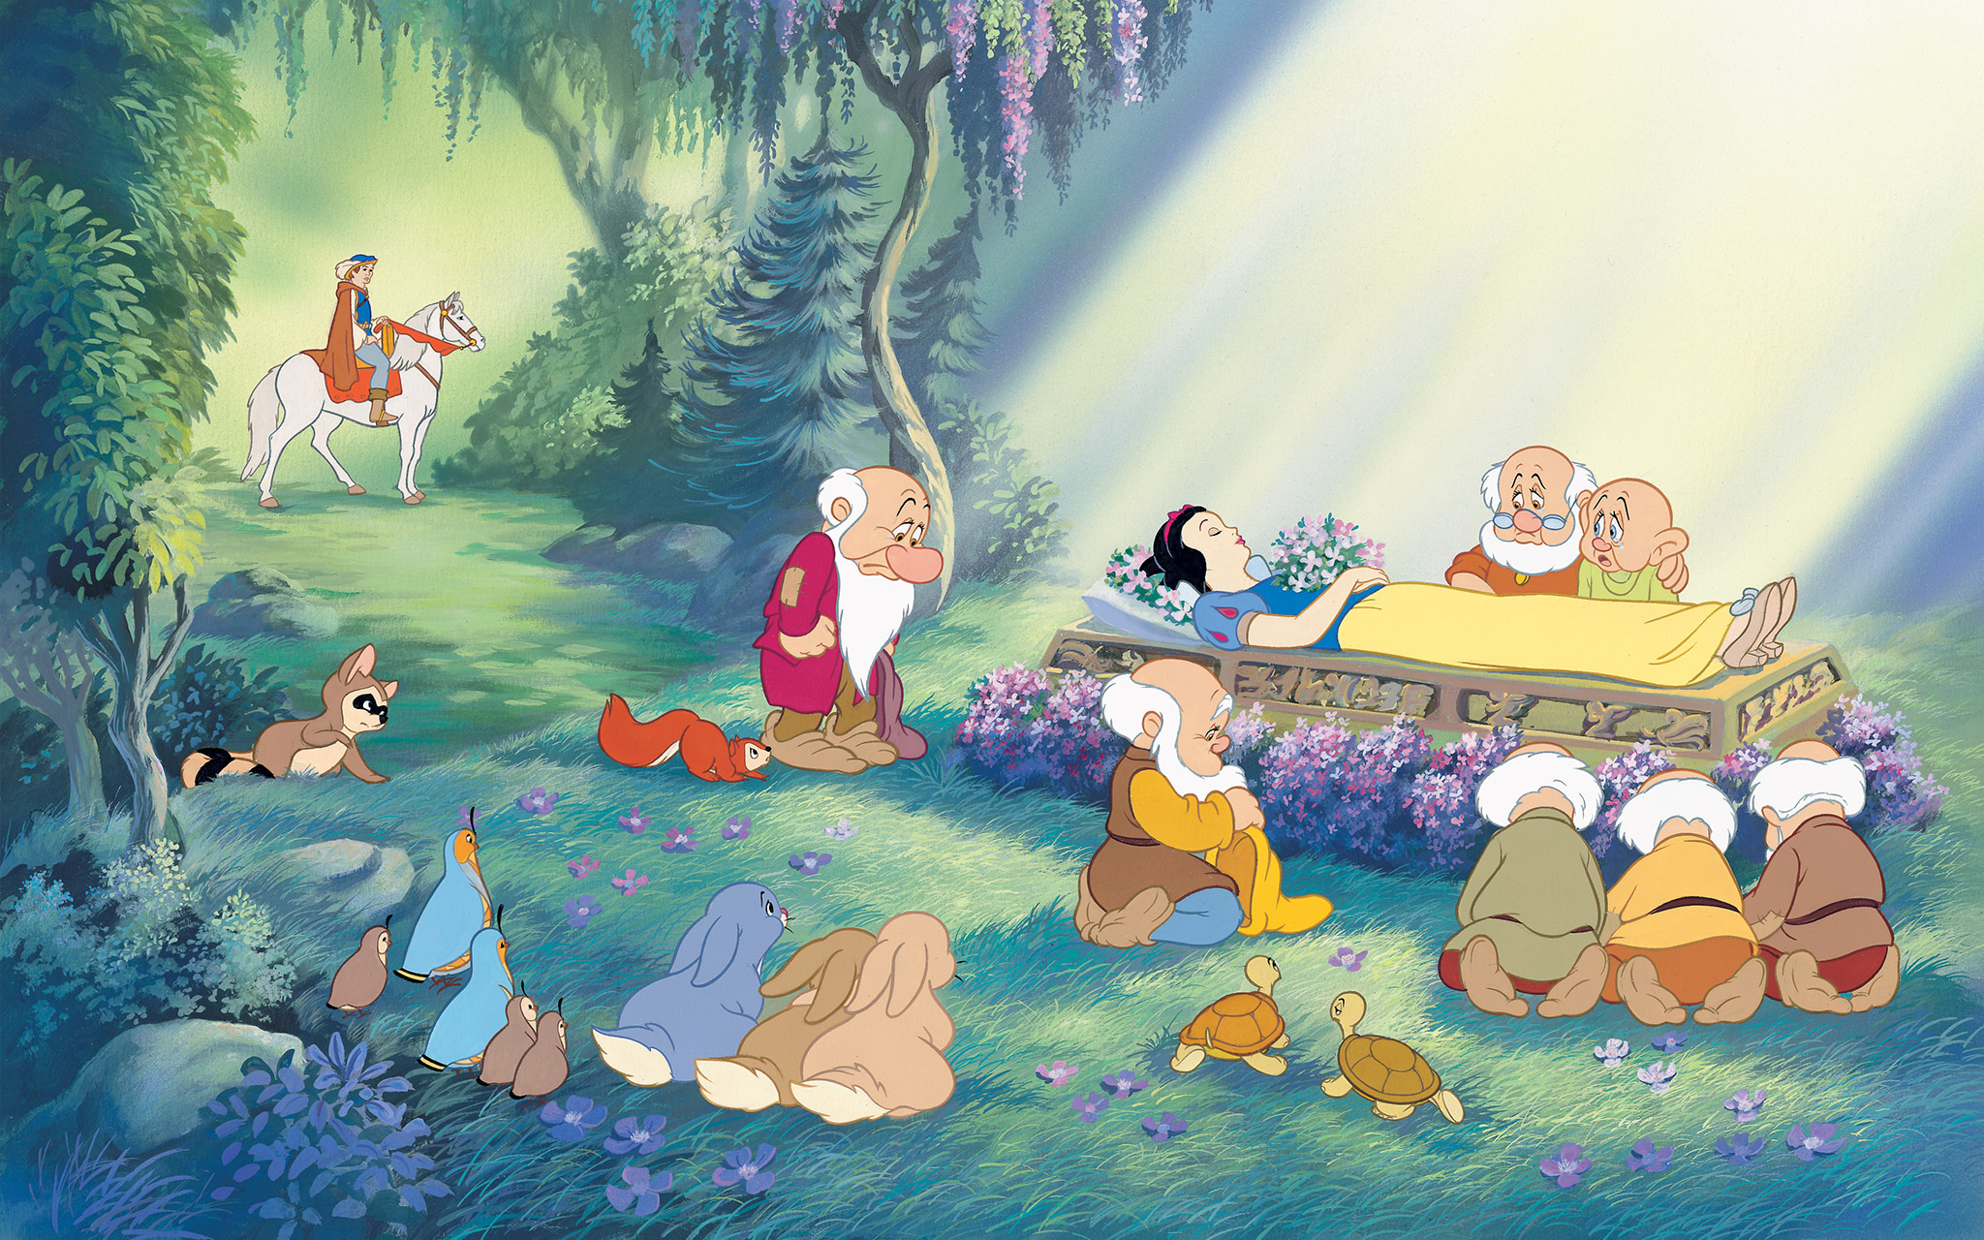
Snow White and the Seven Dwarfs Don’t trust strangers.

Slide 56
The Tortoise and the Hare Slow and steady wins the race

Slide 57
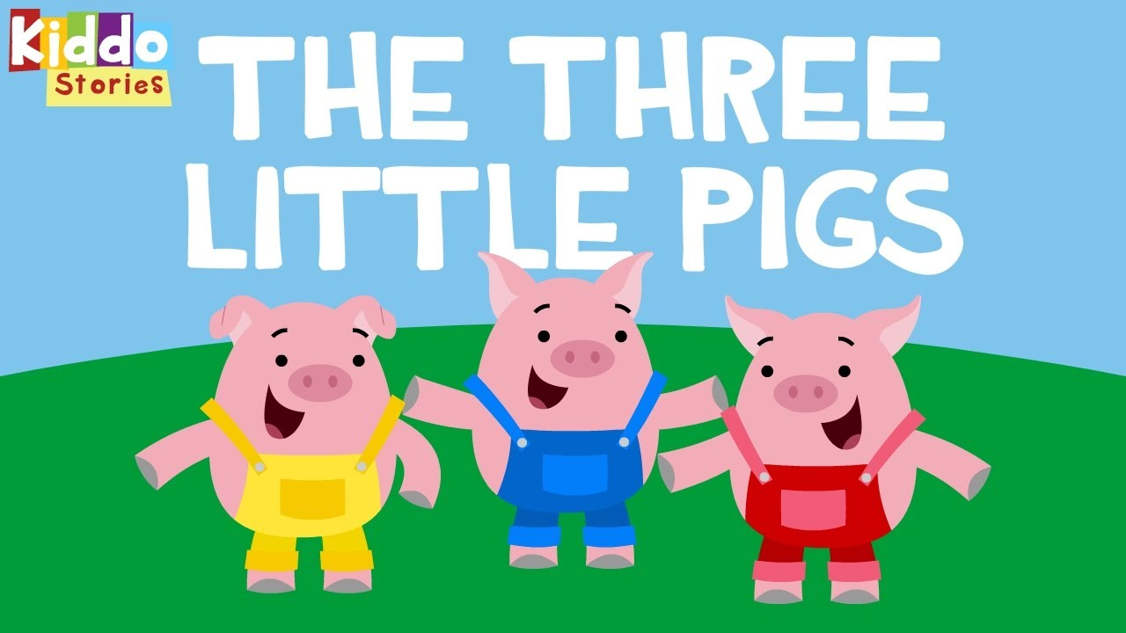
Three Little Pigs Don’t be lazy. Hard work and patience is important

Slide 58
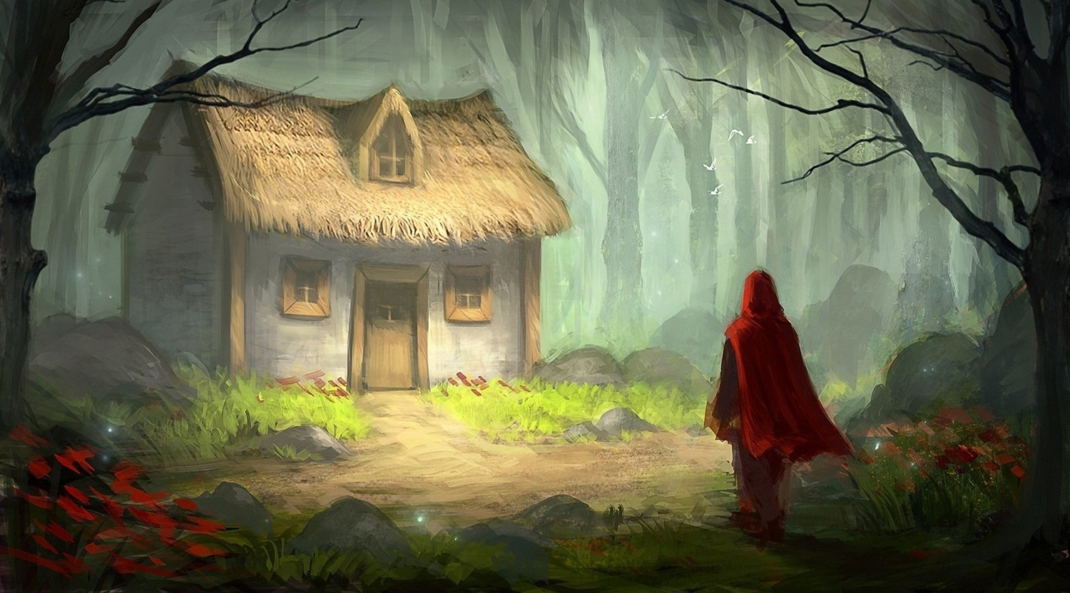
Little Red Riding Hood Don’t trust strangers, especially overly nice ones .

Slide 59
The Lion and the Mouse Kindness is rewarded. It doesn’t matter your size, you can always help.

Slide 60
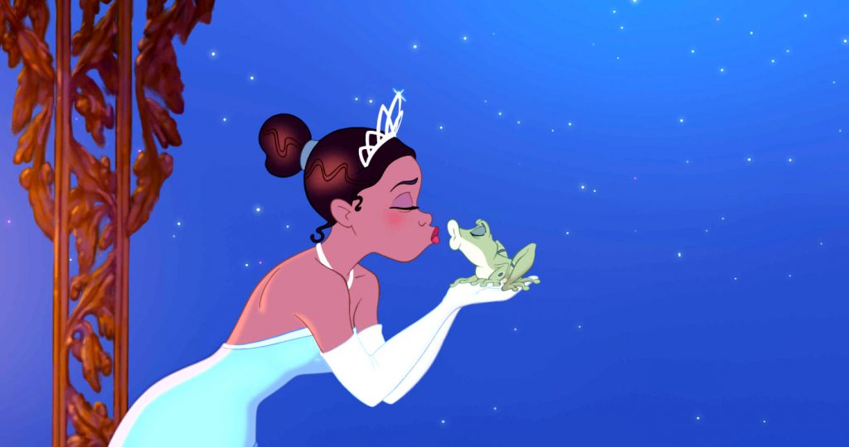
The Frog Prince Looks are deceiving.

Slide 61
The Scorpion and the Frog Some people don’t change.

Slide 62
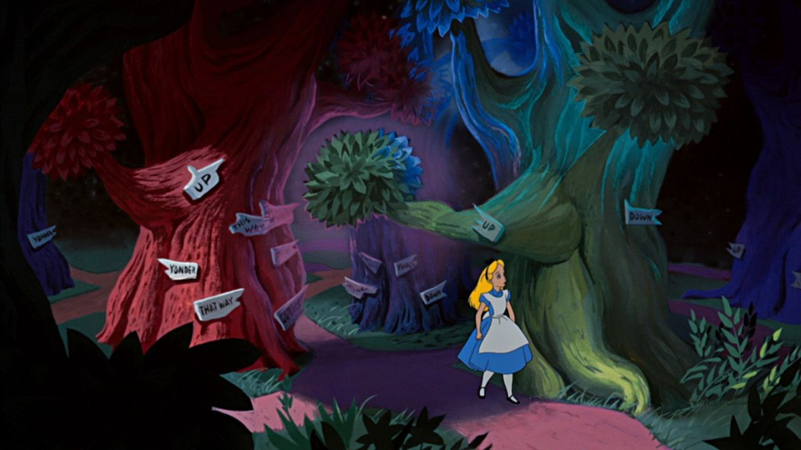
Alice in Wonderland Sometimes you need to take chances.

Slide 63
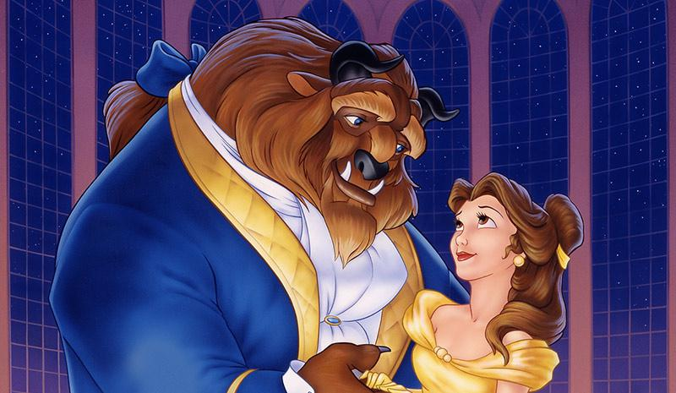
Beauty and the Beast First impressions aren’t everything.

Slide 64
The Moral of the Story
What was the moral of the story you read?
Did the moral change over time?

