Slide 1
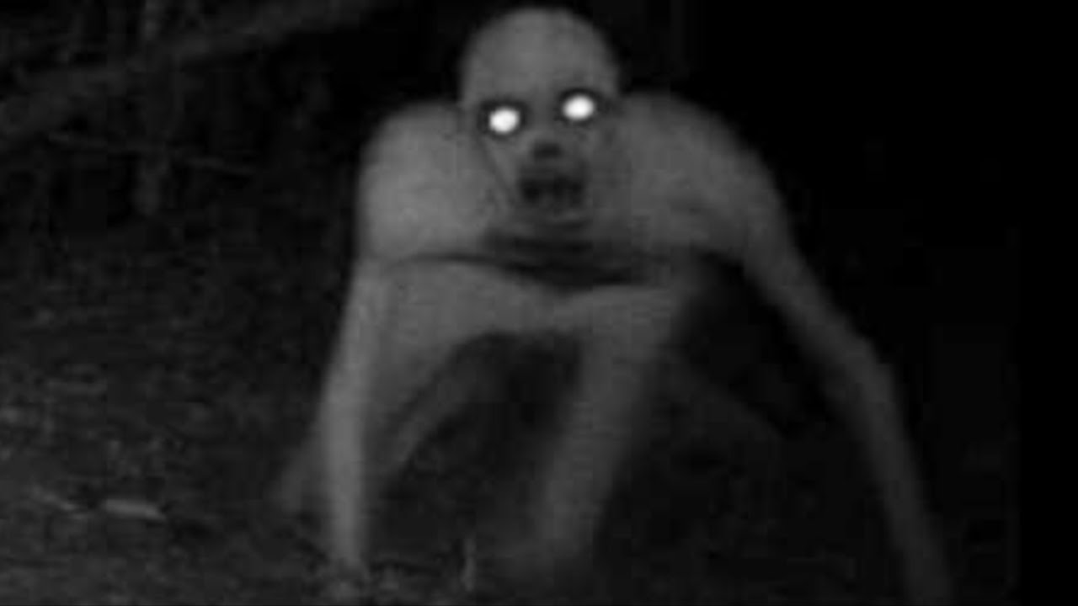
Urban Legends

Slide 3
Urban legends are ‘similar’ to fairy tales.
They are stories that have changed over time based on culture.
Some are newer stories shared by a group of people.

Slide 4
They are usually scary stories about a local area.
Some are based on real stories, but are exaggerated.
Most are just imaginary.
With the internet so easy to access, urban legends have been spread a lot.

Slide 5
Can you guess which stories are based on real life?

Slide 6
Woman Living in the Closet

Slide 7
Woman Living in the Closet
A man has been living alone in his small apartment for several years. But recently he has been noticing that some of his food has been missing and his heater temperature changes. He suspects that a ghost has living in his house, so he sets up a camera.
The next day he sets up a camera to record the ghost. But when he watches the video he sees a woman come out of the closet and make a sandwich. He turns away from the TV, walks over to the closet and opens the door. There he finds an old woman curled up in a ball.

Slide 8
Woman Living in the Closet
http://www.nbcnews.com/id/24889337/ns/world_news-weird_news/t/homeless-woman-lived-mans-closet-year/#.XGOwKdIzaUk

Slide 9
Flashing Headlights

Slide 10
Flashing Headlights
Police officers working with the DARE program has issued this warning: If you are driving after dark and see an on-coming car with no headlights on, DO NOT FLASH YOUR LIGHTS AT THEM! This is a common Bloods gang member “initiation game” that goes like this:
The new gang member under initiation drives along with no headlights, and the first car to flash their headlights at him is now his “target”. He is now required to turn around and chase that car, then shoot and kill every individual in the vehicle in order to complete his initiation requirements.

Slide 11
Flashing Headlights
https://www.snopes.com/fact-check/lights-out/

Slide 12
Needles in Candy

Slide 13
Needles in Candy
In Minneapolis in 2000, 49-year-old James Joseph Smith was charged with one count of adulterating a substance with intent to cause death, harm or illness after it was determined he’d put needles in Snickers bars and handed them out to children on Halloween. A 14-year-old boy was pricked by a needle hidden in a bar he’d bitten into, but no one required medical attention.

Slide 14
Needles in Candy
https://www.snopes.com/fact-check/pins-and-needles/

Slide 15
Kidney Theft

Slide 16
Kidney Thief
Have you heard about people drugging civilians and stealing their organs? Well, it actually happens in India.
“As the anesthetic wore off, Naseem Mohammed said, he felt an acute pain in the lower left side of his abdomen. Fighting drowsiness, he fumbled beneath the unfamiliar folds of a green medical gown and traced his fingers over a bandage attached with surgical tape. An armed guard by the door told him that his kidney had been removed.”

Slide 17
Kidney Theft
https://www.nytimes.com/2008/01/30/world/asia/30kidney.html

Slide 18
Bloody Mary

Slide 19
Bloody Mary
“You go into a room with a mirror and turn all the lights off (this works well in a bathroom). You begin, in a whisper, to chant “bloody mary. bloody mary, Bloody Mary”, as you continue to chant your voice should grow louder and louder into a near scream. While you are chanting you should be spinning around at a medium rate and taking a glimpse in the mirror at each pass. Near the 13th repetition of the words . . . “she” should appear and…?
A friend of mine said that her roommate tried this and ran out screaming from the bathroom. She was shaking and appeared genuinely terrified and refused to talk about the incident, but those who were around her when she came out noticed that her clenched fingers were covered in blood.”

Slide 20
Bloody Mary
https://www.snopes.com/fact-check/bloody-mary-story/

Slide 21
Fooled by a Phone Ad

Slide 22
Fooled by a Phone Ad
In 2013, there was a fake ad for iPhones that claimed they would be waterproof if the user upgraded to iOS 7.0. The advertisement claimed that they Apple would cover any damage done under the warrantee. Unfortunately, this ad was not real.
Some people wanted to test the new feature and destroyed their phone while testing.

Slide 23
Fooled by a Phone Ad
https://www.theguardian.com/technology/2013/sep/26/waterproof-iphone-ad-hoax-tricked-users-into-destroying-their-handsets

Slide 24
Cow Tipping

Slide 25
Cow Tipping
This story made the news a few years ago but it’s been known for a long time. Recently there have been claims that cow tipping isn’t real.
If you talk to certain farmers they’ll tell you about drunk people from the city jumping the fence into the pasture. They’ll go up to the side of a cow and with a little push the cow falls on its side. This was a secret of farming for a long time and now the city folks have figured it out.

Slide 26
Cow Tipping
https://modernfarmer.com/2013/09/cow-tipping-myth-or-bullcrap/

Slide 27
Hippo eats Dwarf

Slide 28
Hippo Eats Dwarf
A circus dwarf, nicknamed Od, died recently in the North when he bounced sideways from a trampoline and was swallowed by a yawning hippopotamus which was waiting to appear in the next act. Vets on the scene said Hilda the Hippo had a gag reflex which automatically caused her to swallow. They added in mitigation that the hefty creature was a vegetarian who had not previously digested a circus performer. Unfortunately, the 1000 plus spectators continued to applaud wildly until common sense dictated there had been a tragic mistake. Police said the trampoline has been sent for forensic analysis.

Slide 29
Hippo eats Dwarf
https://www.snopes.com/fact-check/hippo-eats-dwarf/

Slide 30
JATO Rocket Car

Slide 31
JATO Rocket Car
The Arizona Highway Patrol were mystified when they came upon a pile of smoldering wreckage embedded in the side of a cliff rising above the road at the apex of a curve. The metal debris resembled the site of an airplane crash, but it turned out to be the vaporized remains of an automobile. The make of the vehicle was unidentifiable at the scene. The folks in the lab finally figured out what it was, and pieced together the events that led up to its demise.
It seems that a former Air Force sergeant had somehow got hold of a JATO (Jet Assisted Take-Off) unit. JATO units are solid fuel rockets used to give heavy military transport airplanes an extra push for take-off from short airfields.
Dried desert lakebeds are the location of choice for breaking the world ground vehicle speed record. The sergeant took the JATO unit into the Arizona desert and found a long, straight stretch of road. He attached the JATO unit to his car, jumped in, accelerated to a high speed, and fired off the rocket.
The car took off at fighter jet speeds. There were black rubber marks from the wheels and the brakes had been melted off. It didn’t take long to become airborne. The man’s flight quickly ended horrifically though. The car was travelling so fast that it actually made a crater in the side of a cliff.
Most of the driver's remains were not recovered; however, small fragments of bone, teeth, and hair were extracted from the crater, and fingernail and bone shards were removed from a piece of debris believed to be a portion of the steering wheel.

Slide 32
JATO Rocket Car
https://darwinawards.com/darwin/darwin1995-04.html

Slide 33
The Spider Bite

Slide 34
The Spider Bite
One night, a young girl was sleeping in her bed when a spider crawled across her face. It stopped for a few minutes on her left cheek and then went on it’s way. When she woke up the next morning, she looked in the mirror. She noticed a red spot on her cheek.
Over the next few days, the spot got larger and larger. Finally, when she was having a bath, the red spot finally opened. And out came thousands of baby spiders. Doctors couldn’t believe that this actually happened.

Slide 35
The Spider Bite
https://en.wikipedia.org/wiki/The_Spider_Bite

Slide 36
Water Bomber

Slide 37
Water Bomber
A man dressed in his scuba gear; wetsuit, mask, fins and tank was discovered in a clean up of a Californian forest fire. The strangely placed victim, yes in the branch of a tree, suffered severe burns from the forest fire. However, an autopsy revealed that he didn't die from the fire, but from bad internal injuries. They used the man’s dental records to identify him and contacted his family in an attempt to find out how he could have ended up there.
The family, horrified, said that the victim had set off diving in the sea about 30 miles from the forest on the day the fire got out of control. Investigators started to piece the information that they had gathered together. It appeared that the scuba diver had been accidentally caught in amongst thousands of gallons of water by a heli-tanker which had been called in to help the fire-fighters put out the forest fire. So, caught up in one of the massive buckets of water, the diver had been dumped with the sea water in an attempt to extinguish the fire as quick as they could.

Slide 38
Water Bomber
https://www.simplyscuba.com/blogs/blog/scuba-diver-found-in-tree-myth-or-fact

Slide 39
Blackout

Slide 40
Blackout
In 1965, there was a large blackout that affected parts of Canada and America. 9 months later there was a spike in babies born.
As it turns out, the blackout occurred during November and it was a little chilly. Many people gathered together for warmth and were bored. So, they …. you know…

Slide 41
Blackout
https://en.wikipedia.org/wiki/Northeast_blackout_of_1965#The_myth_of_the_blackout_baby_boom

Slide 42
Children of the Corn

Slide 43
Children of the Corn
Do you know this movie? It’s based on real stories. A lot of people have reported that they have met these mysterious children with black eyes. The strange thing is that when you make eye contact, its impossible to look away. When this happens to you, you get an overwhelming sense of dread, like something bad is going to happen.
Sometimes the children want to sell you something and sometimes they want to come into your house. After meeting these children, strange things happen. Victims may get nose bleeds, furniture might be moved, pets may disappear.

Slide 44
Children of the Corn
https://www.snopes.com/fact-check/black-eyed-children/

Slide 45
Urban Legends by Sentence
Take a piece of paper.
You can write only one sentence.
Start with a happy sentence.
When you finish, pass it to the player on your right.

Slide 46
Urban Legends by Sentence
Read the story that was passed to you.
You may write a sentence.
The sentence should be ominous.
Pass the card to your left.

Slide 47
Urban Legends by Sentence
The game continues on with new emotions being added until the paper reaches the original player.
Let read our urban legends!

