Slide 1
The Influence of Reading

Slide 2
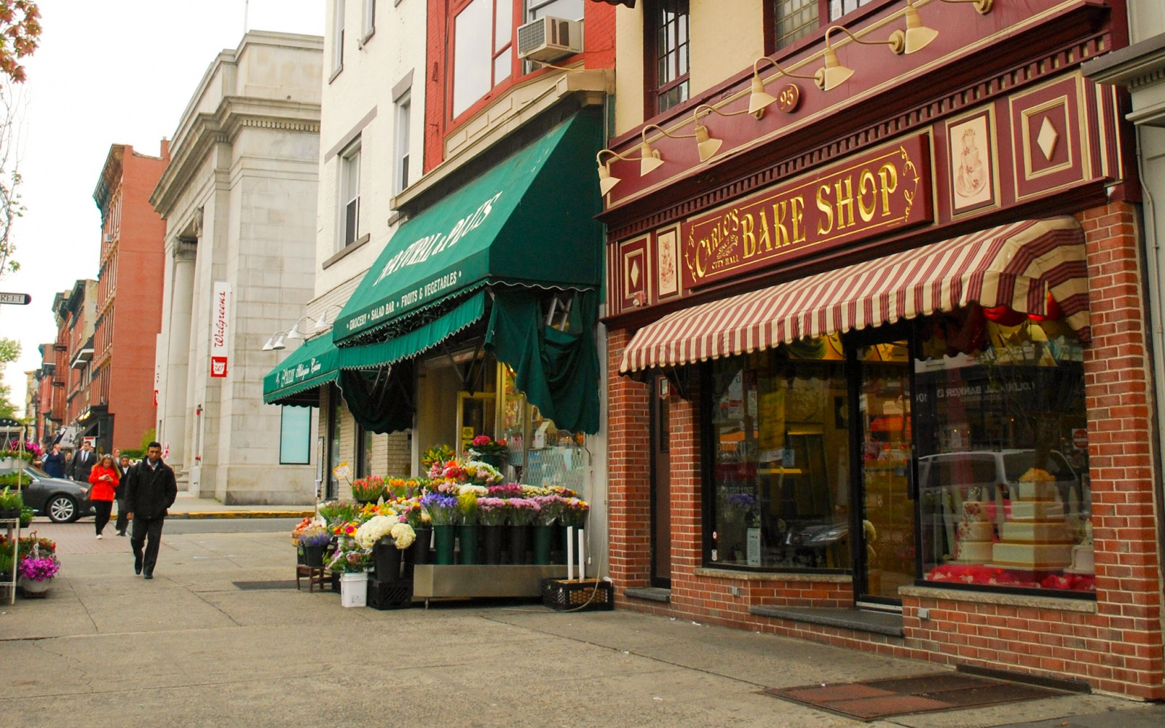
When you walk down the street in America, what can you read in English?

Slide 3
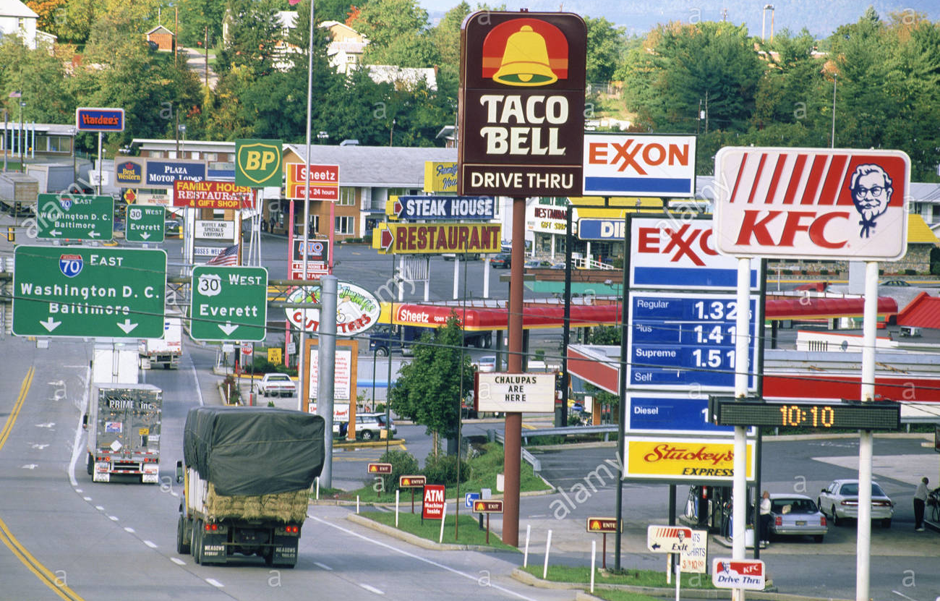

Slide 4
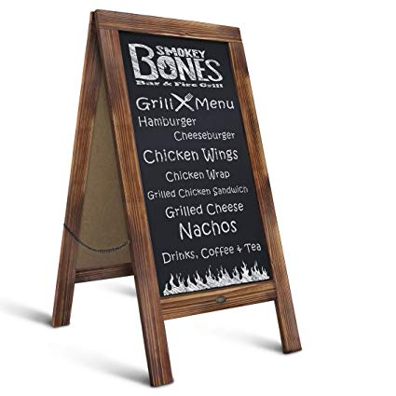
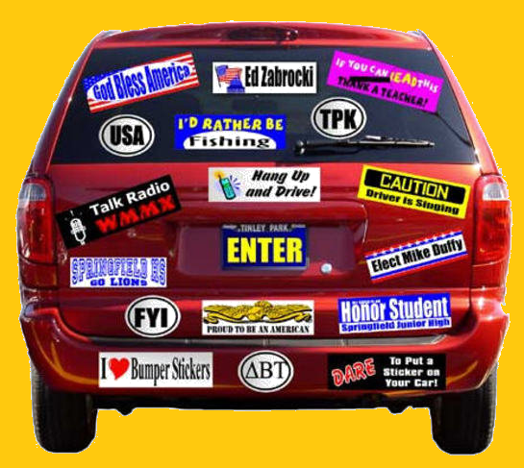
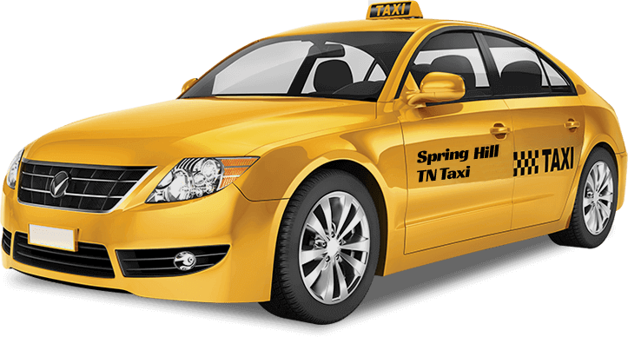
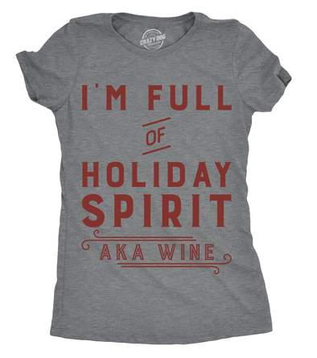
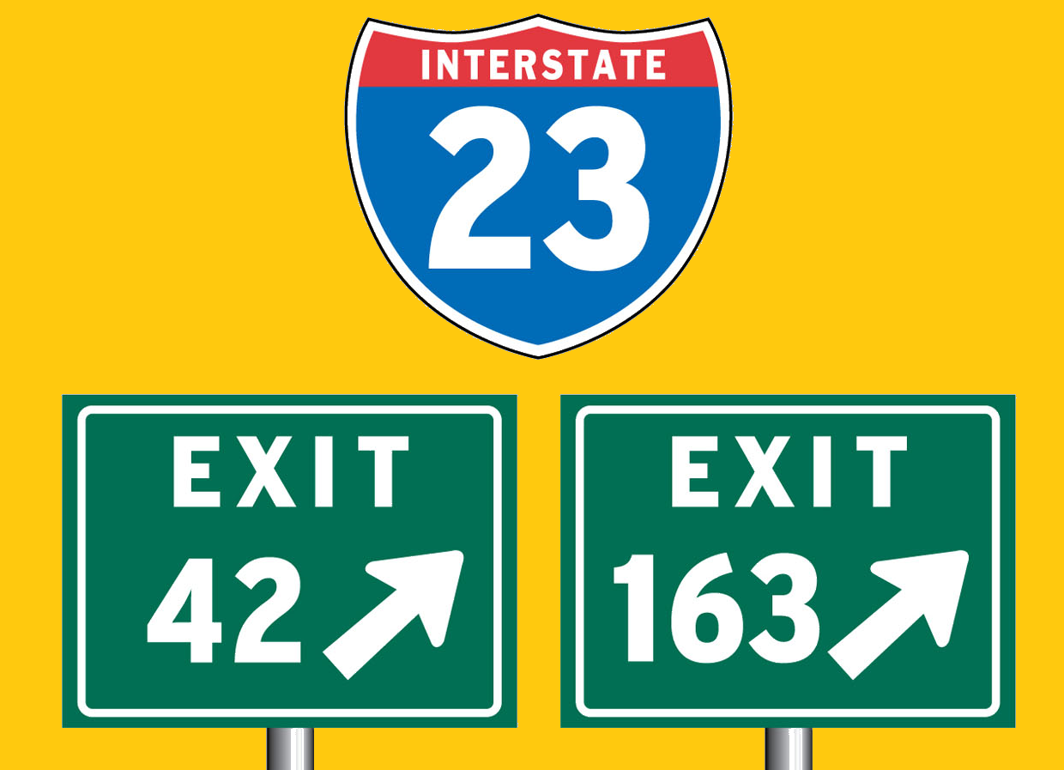
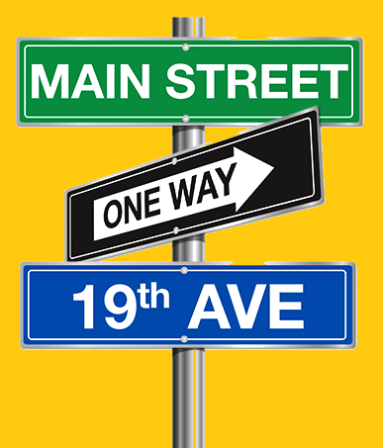
Campaign Signs
Newspaper Stand
Bumper Stickers
Chalkboard Sign
Traffic Signs
Taxi
Road Signs
Posters
Street Signs
T-Shirt

Slide 5
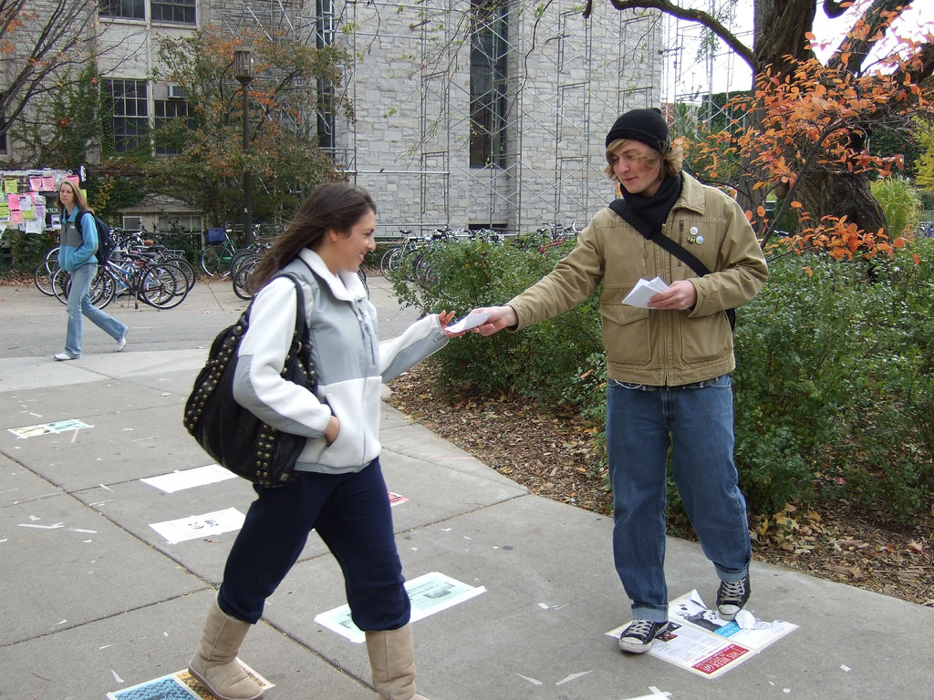
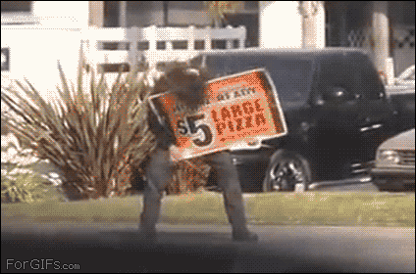
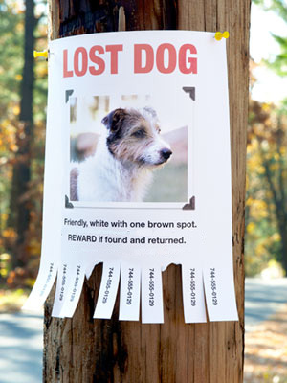

Slide 6
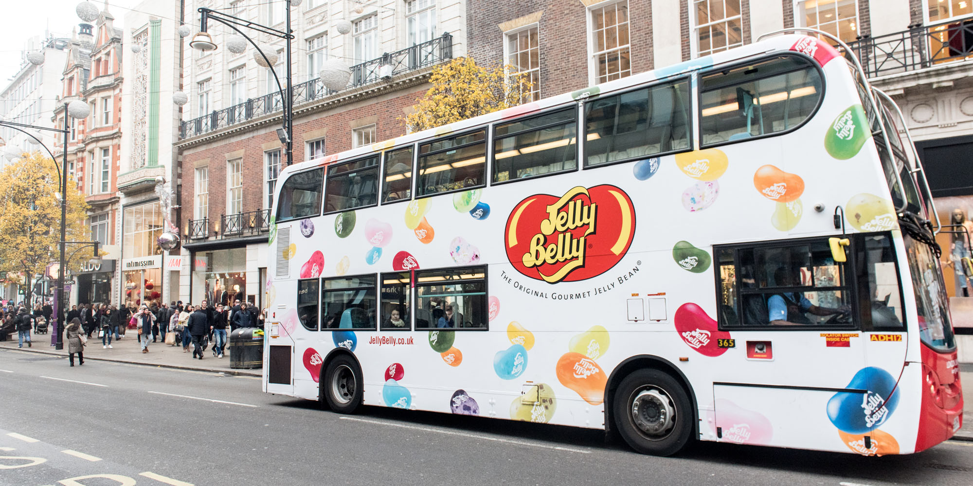

Slide 7
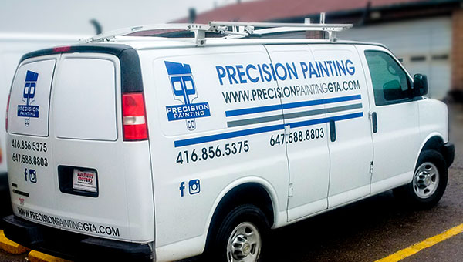

Slide 8
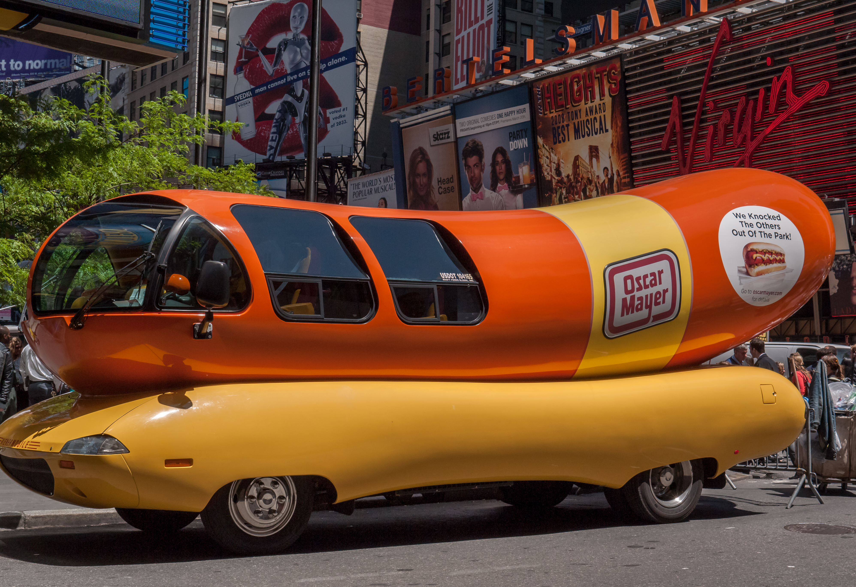

Slide 9
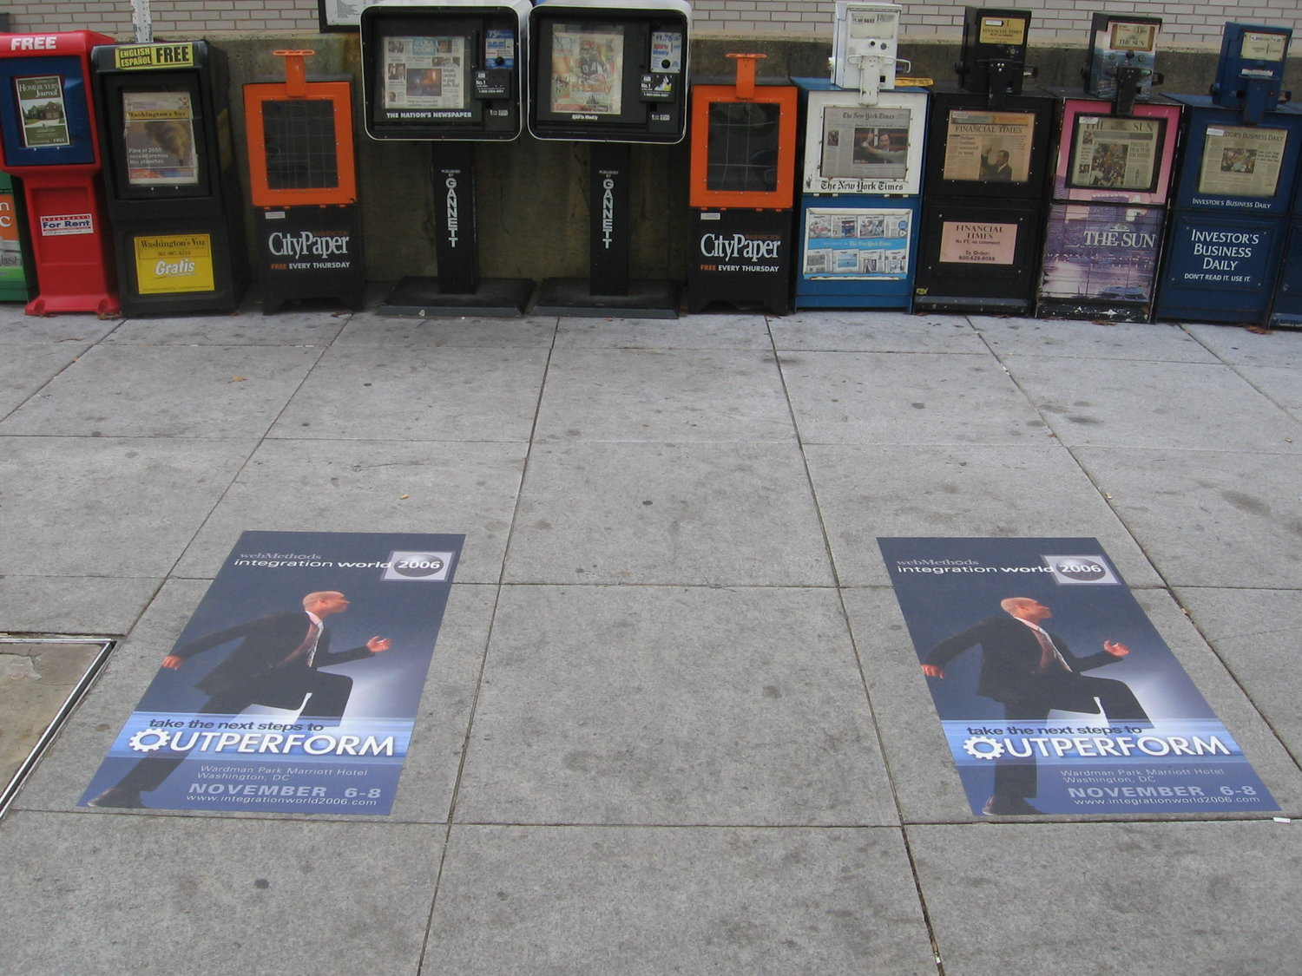

Slide 10
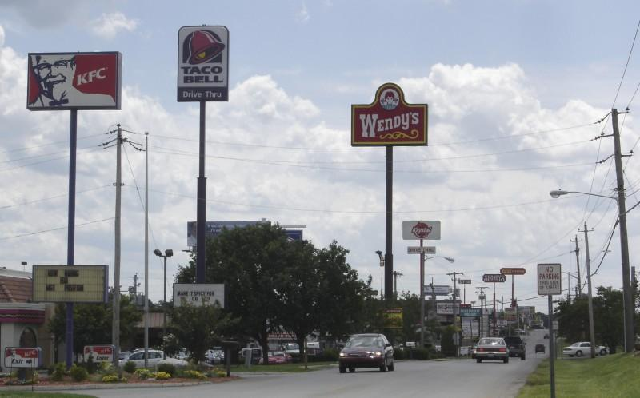

Slide 11
Billboards

Slide 12
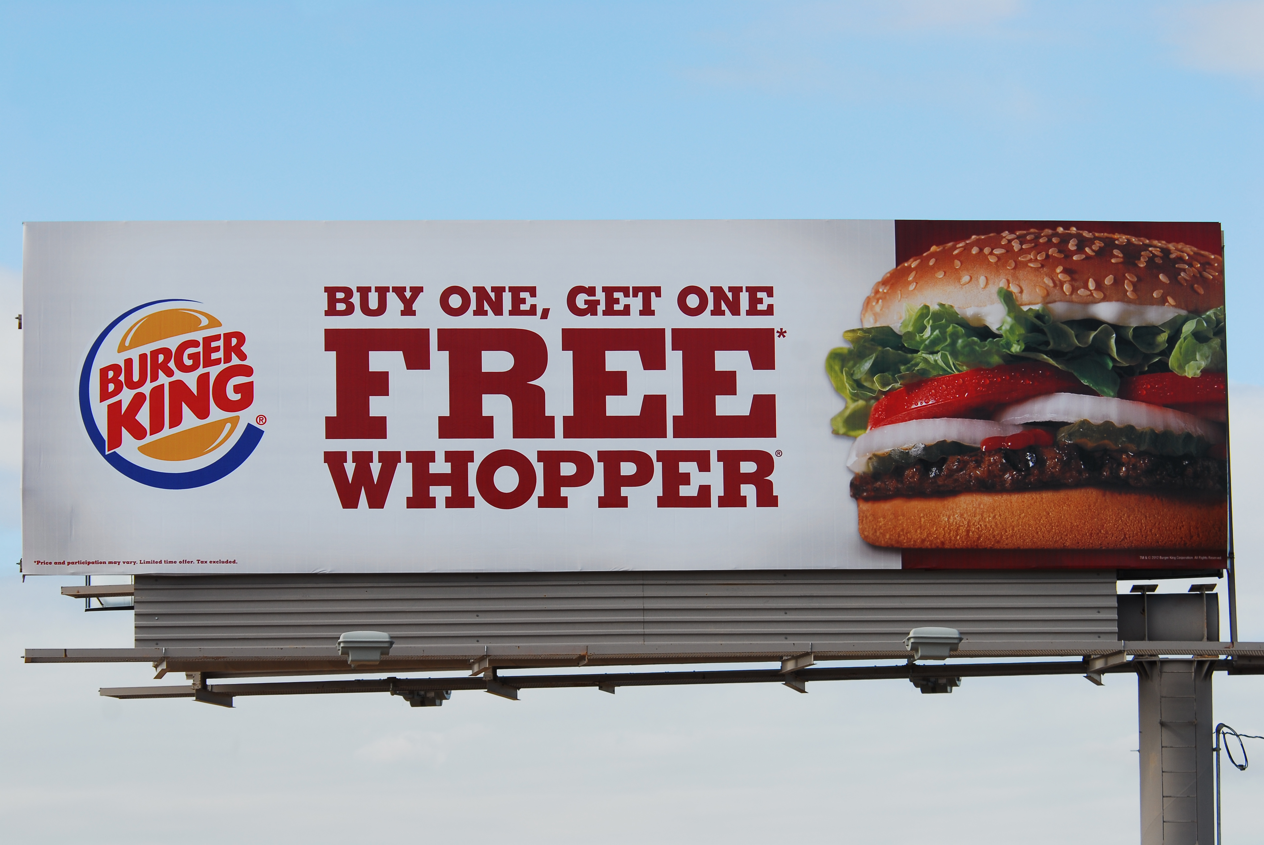

Slide 13
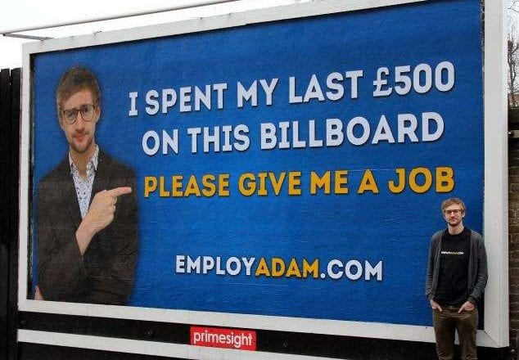

Slide 14
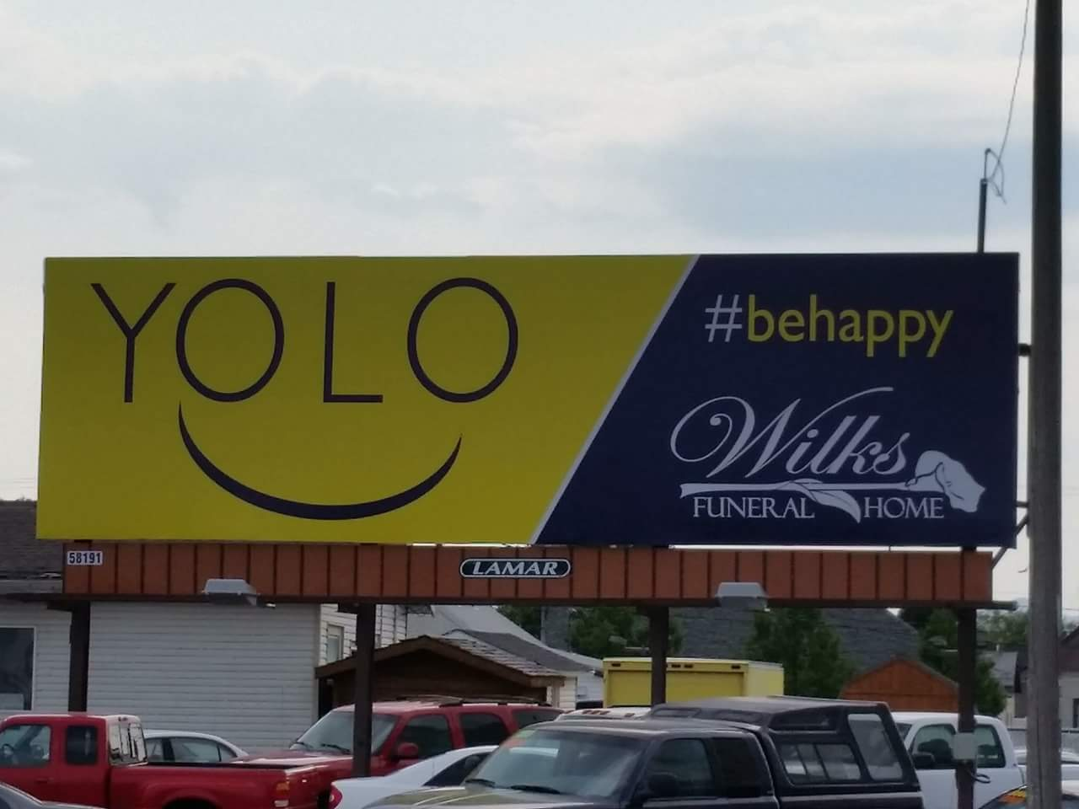

Slide 15
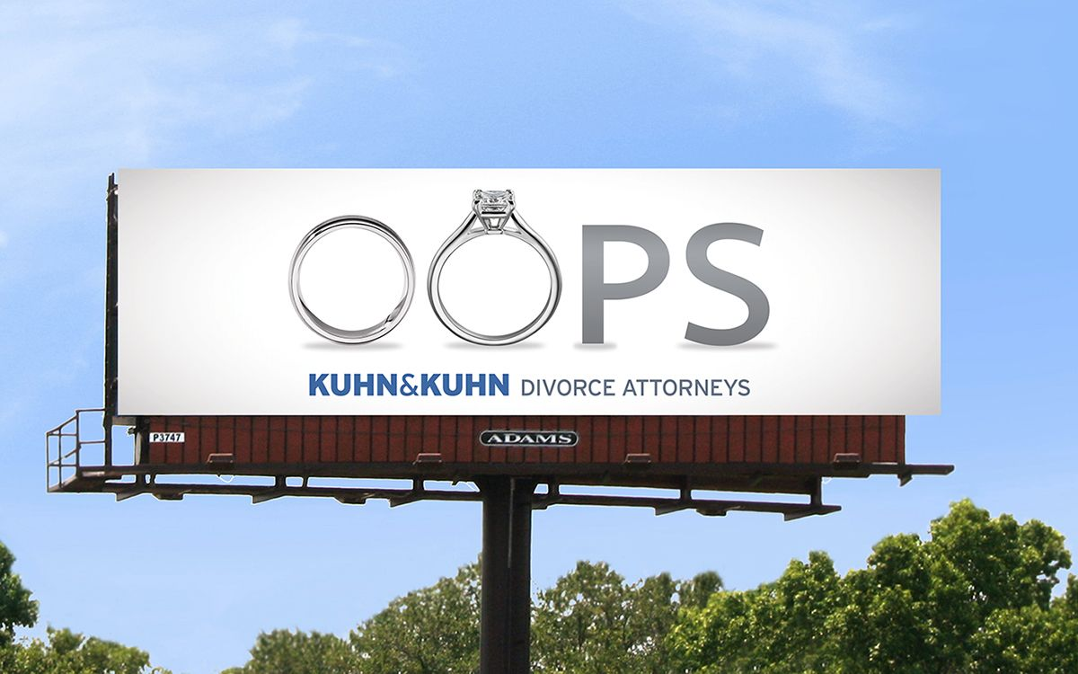

Slide 16
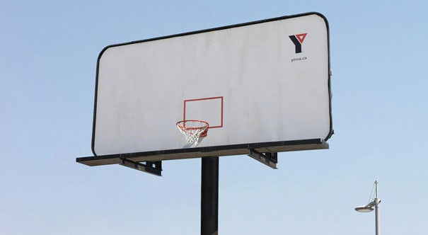

Slide 17
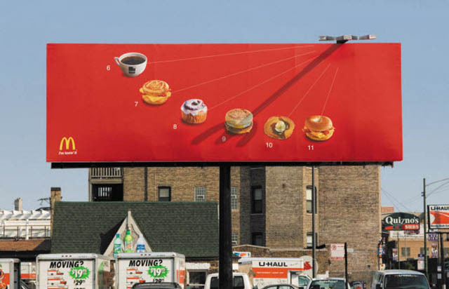

Slide 18
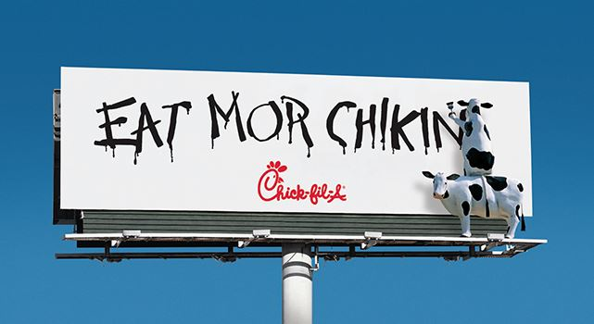

Slide 19
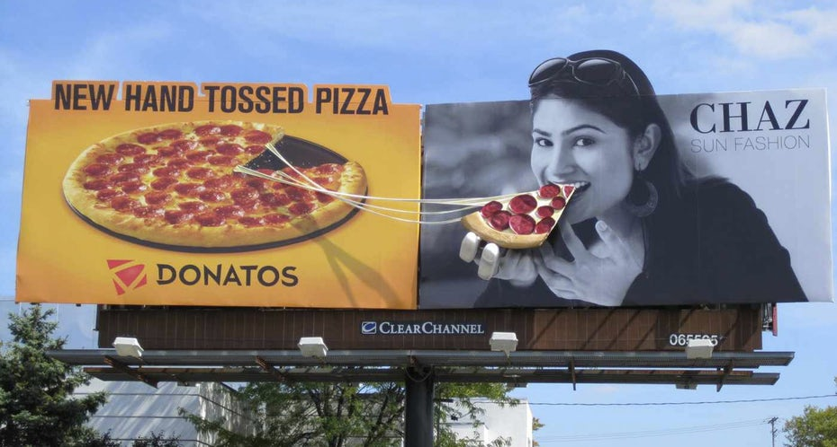

Slide 20
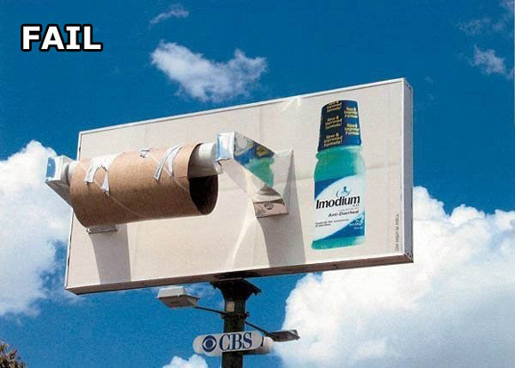

Slide 21
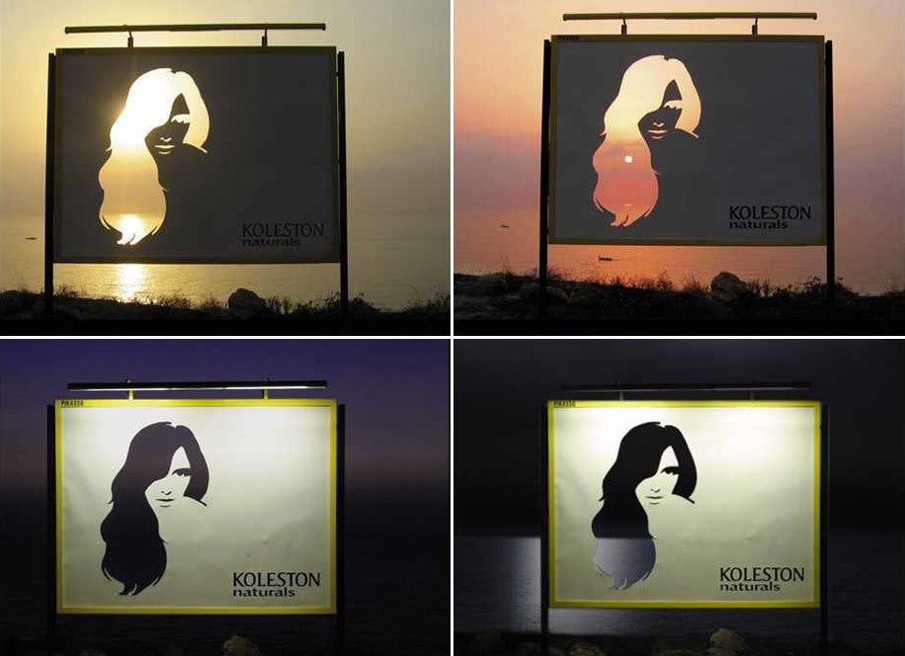

Slide 22
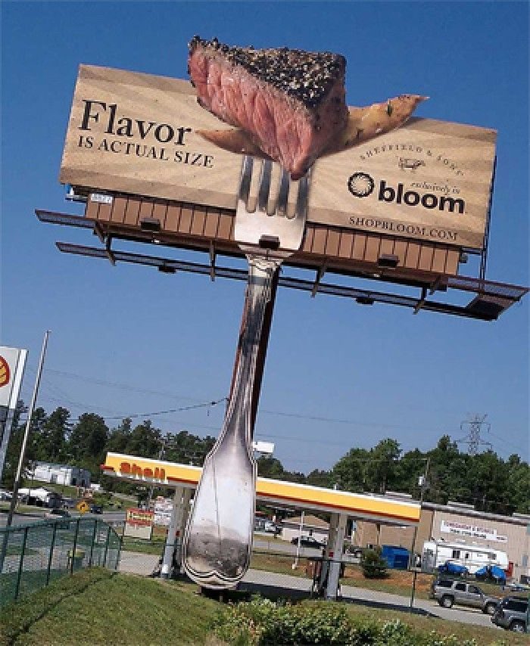

Slide 23
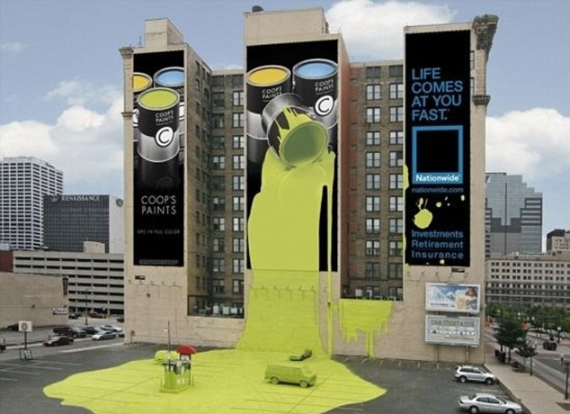

Slide 24
Billboard Design
https://leapinnovation.com/designing-a-billboard/

Slide 25
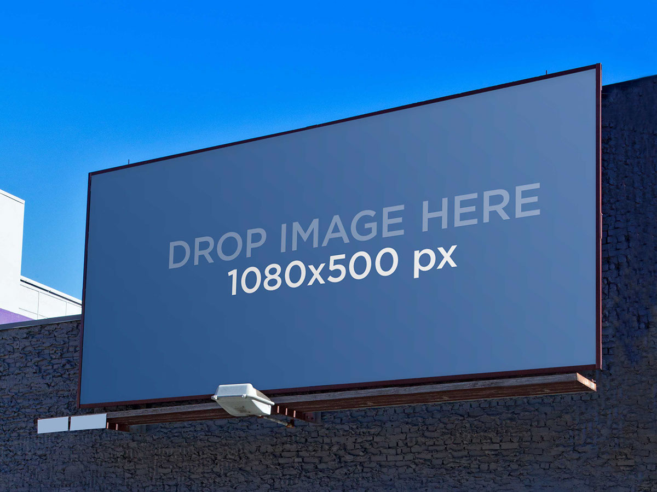
1. Simple Layout – LESS IS MORE – KEEP IT SIMPLE. The most effective messages are always the most simple. Your billboard should be a clear and brief expression of one idea.

Slide 26
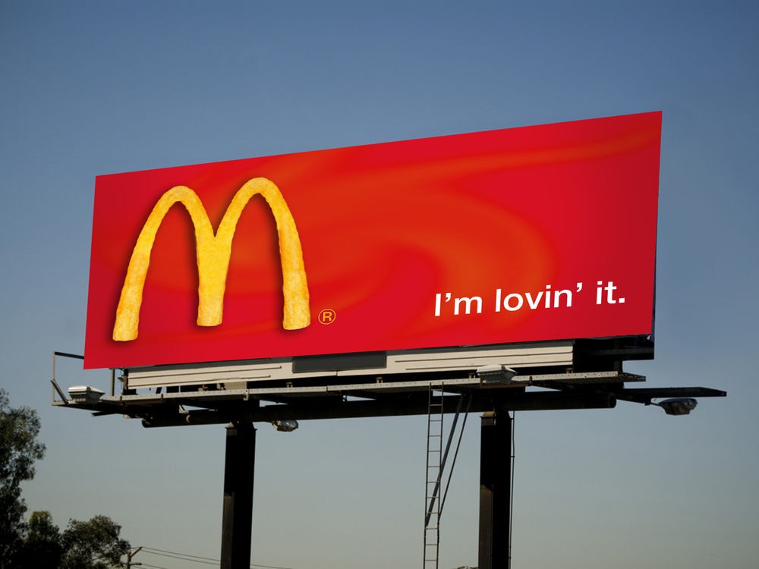
2. Short Copy – Use short simple words with quick and easy comprehension. Limit or eliminate punctuation and edit down to the bare bones of your message. RULE OF THUMB: 7 WORDS OR LESS.

Slide 27
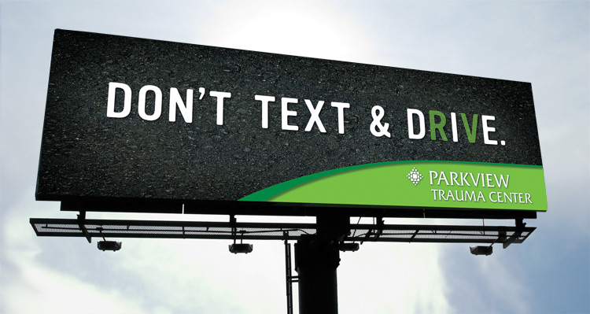
3. Viewing Time – Does your message communicate effectively within 5-10 seconds? REMEMBER: Your target audience is travelling past your billboard at 65 miles per hour.

Slide 28
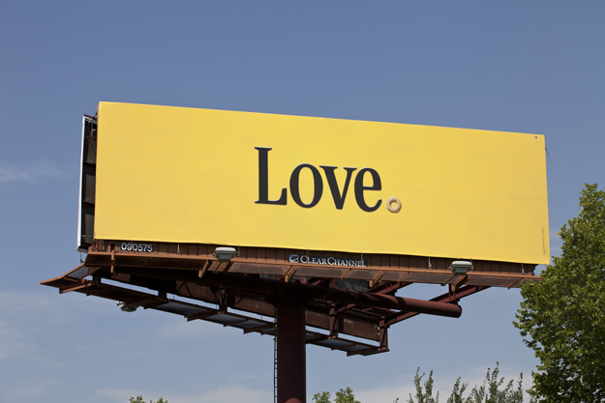
4. Large fonts and text – Your goal is for people to read your message from as far away as possible. Be sure the words are large and the type is clear and easy to read. Bold, straight fonts work best. Avoid thin, ornate fonts. Sans Serif fonts work best. Adequate spacing between letters, words and lines improves visibility. Drop shadows can help readability.

Slide 29
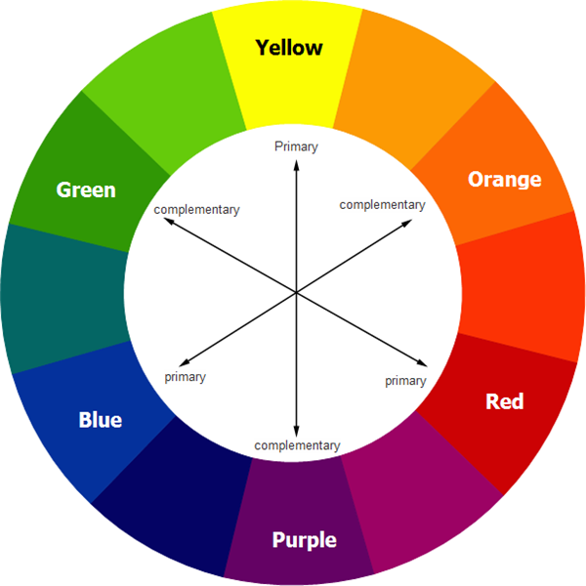
5. Contrasting Colors – High color contrast is the key to good readability. Colors that work best: black, white and bold, primary colors like red, yellow and blue. Black text on yellow rates the highest in readability. Colors to avoid: brown, earth tones, pastels.

Slide 30
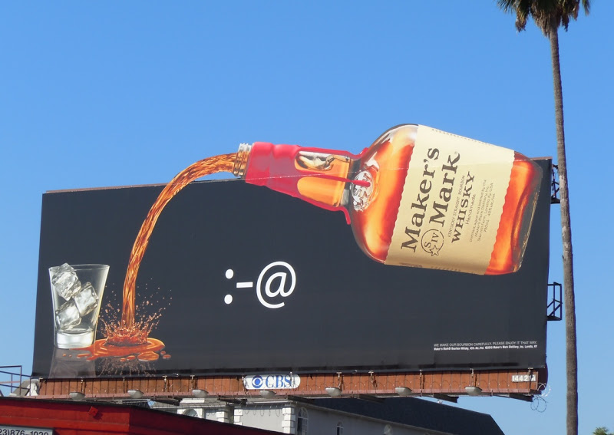
6. Single Image – Use one large image to attract the reader’s eye to the billboard. For example, a single image of a bottle works better than having 6. Take a small object and make it large (like jewelry) rather than making a large object small (like a house).

Slide 31
7. Simple Background – Use a simple background that does not interfere with your image, copy or logo. Too much blank space isn’t a good thing. Blank space doesn’t translate well from magazine ads to billboards. Use the blank space and make your fonts, image and logo bigger.

Slide 32
8. Call to Action – Is the call to action clearly found in the ad? Does your target audience have the necessary information to respond to your ad?

Slide 33
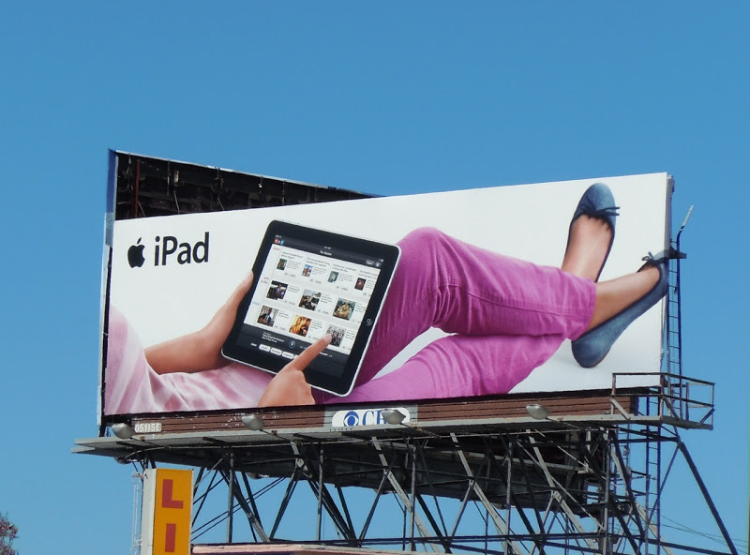
9. Balanced Logo – There has to be balance between the image and the logo. The logo is typically not as big as the image. About 1/8 of the board size is a pretty good guideline for the smallest the logo should be.

Slide 34
This is also true for posters

Slide 35
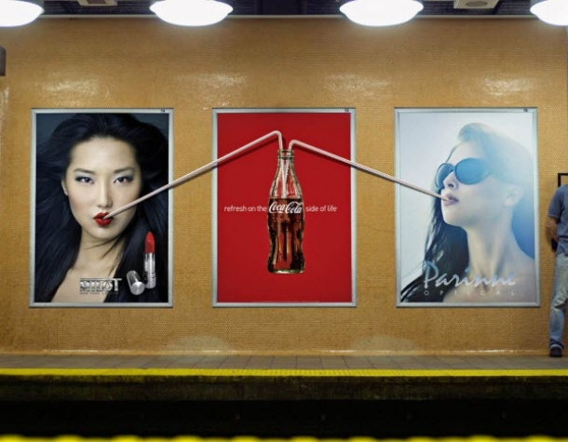

Slide 36
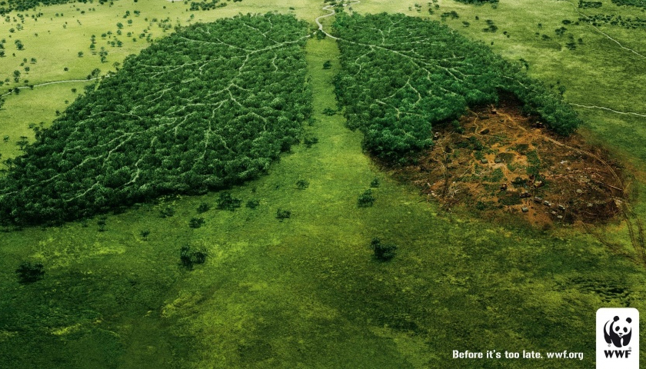

Slide 37
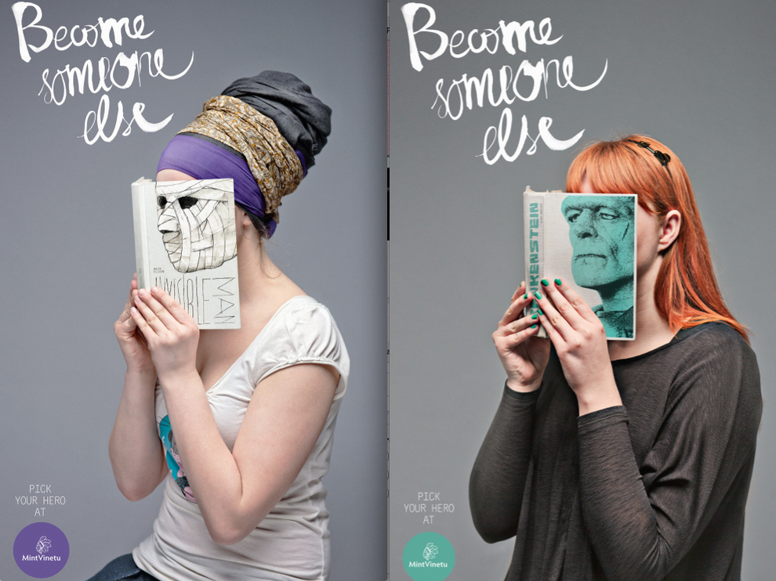

Slide 39
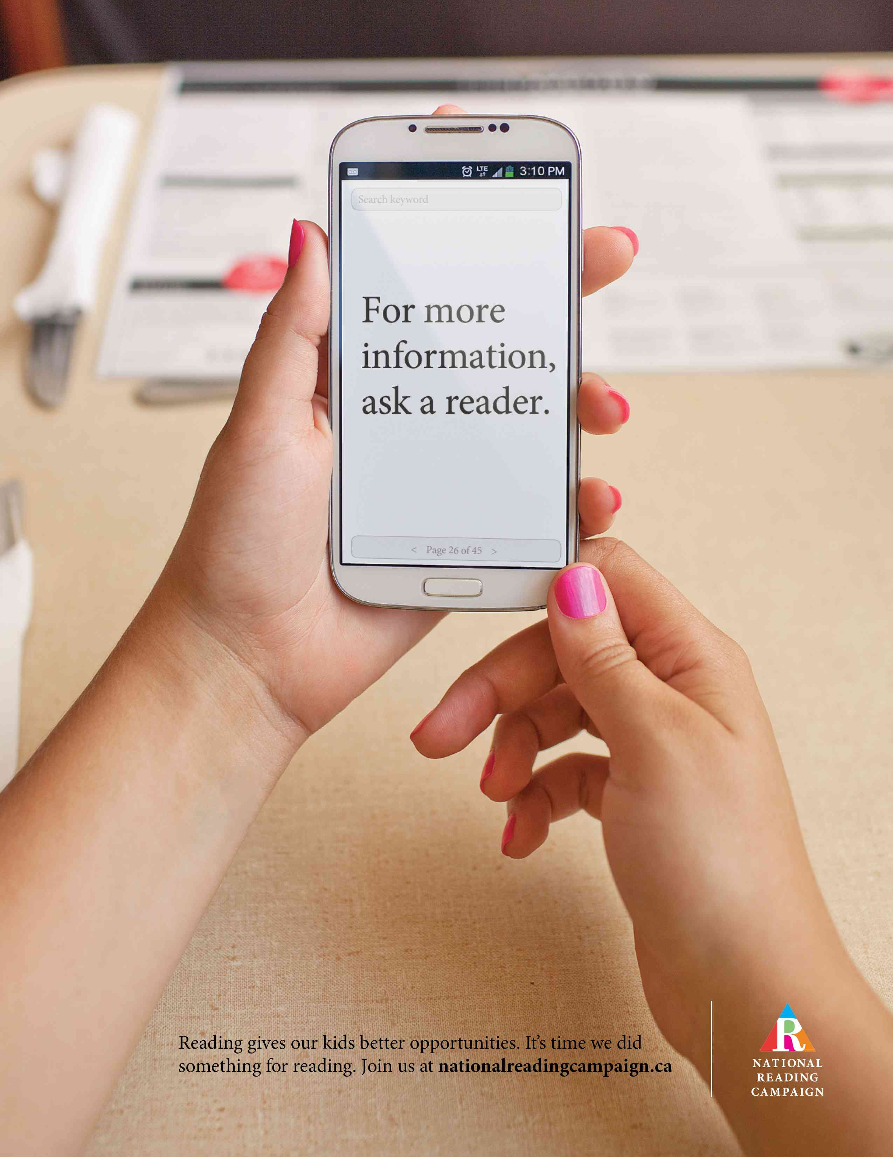

Slide 40
Minimalism
What is the poster about?

Slide 41
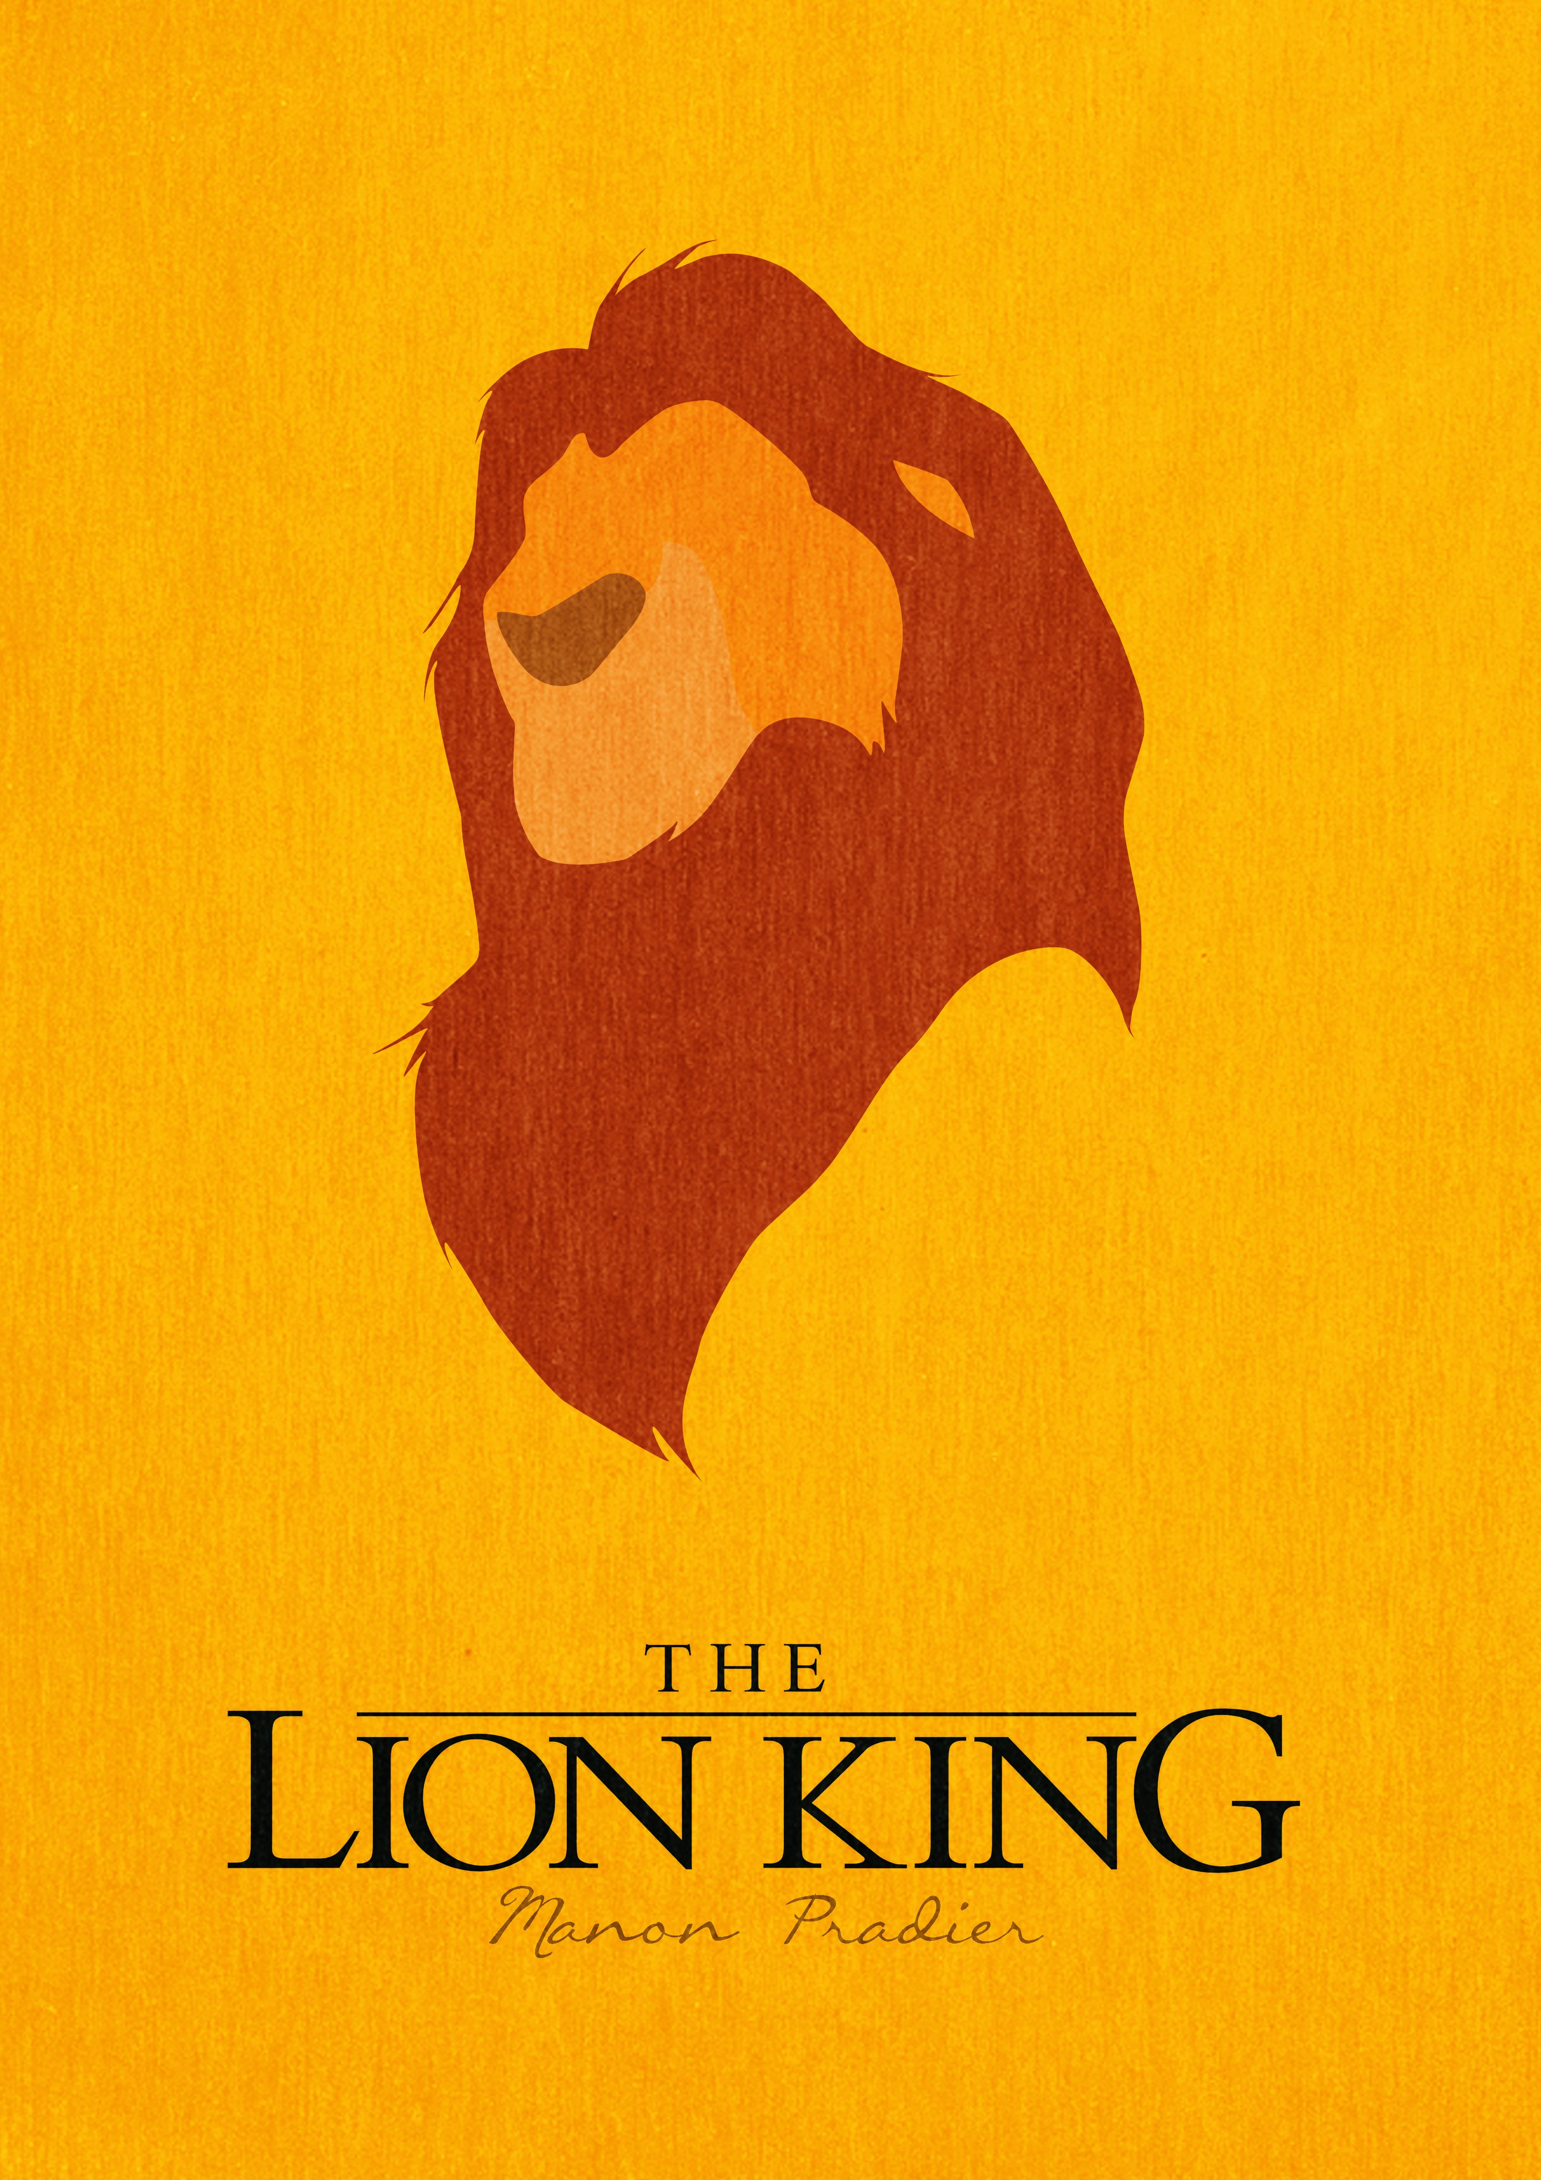
Lion King

Slide 42
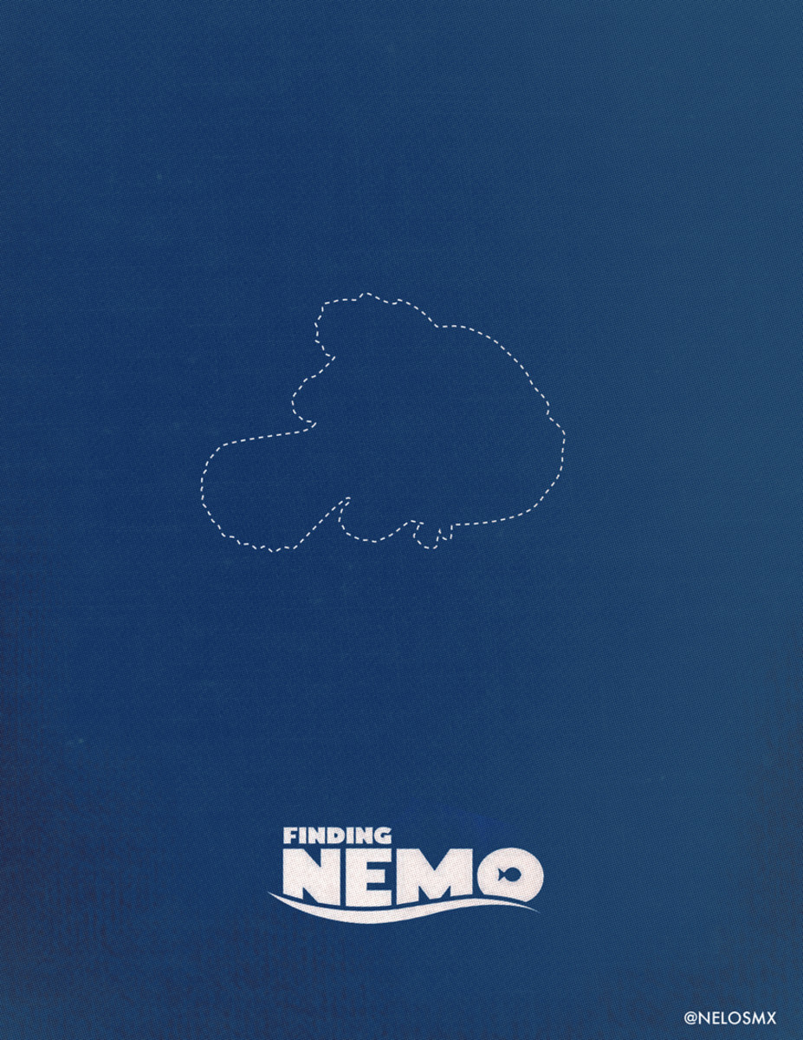
Finding Nemo

Slide 43
Merry Christmas

Slide 44
Marilyn Monroe

Slide 45
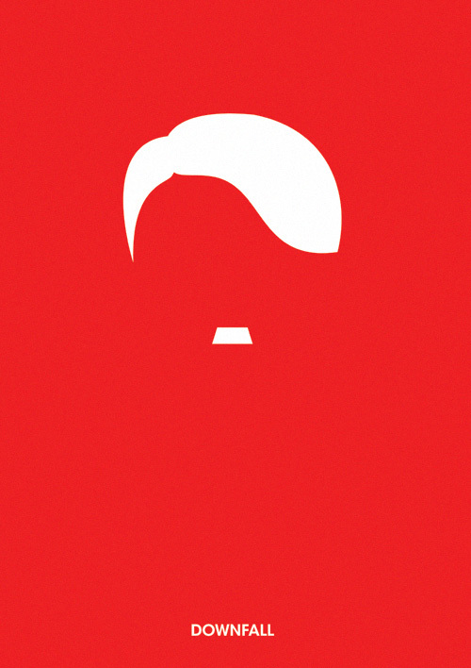
Hitler

Slide 46
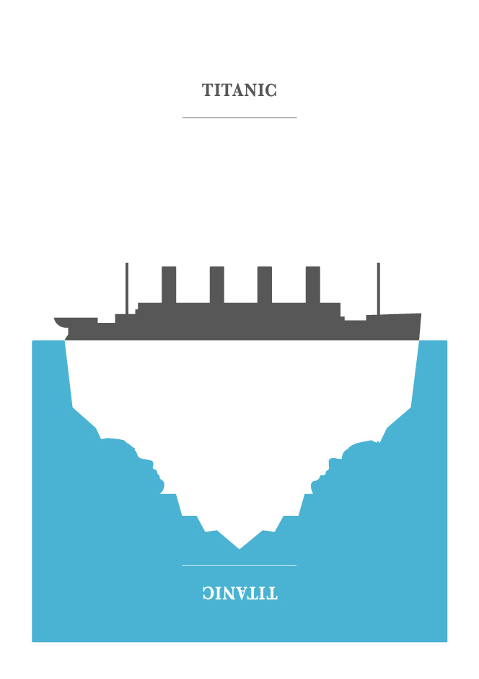
Titanic

Slide 47
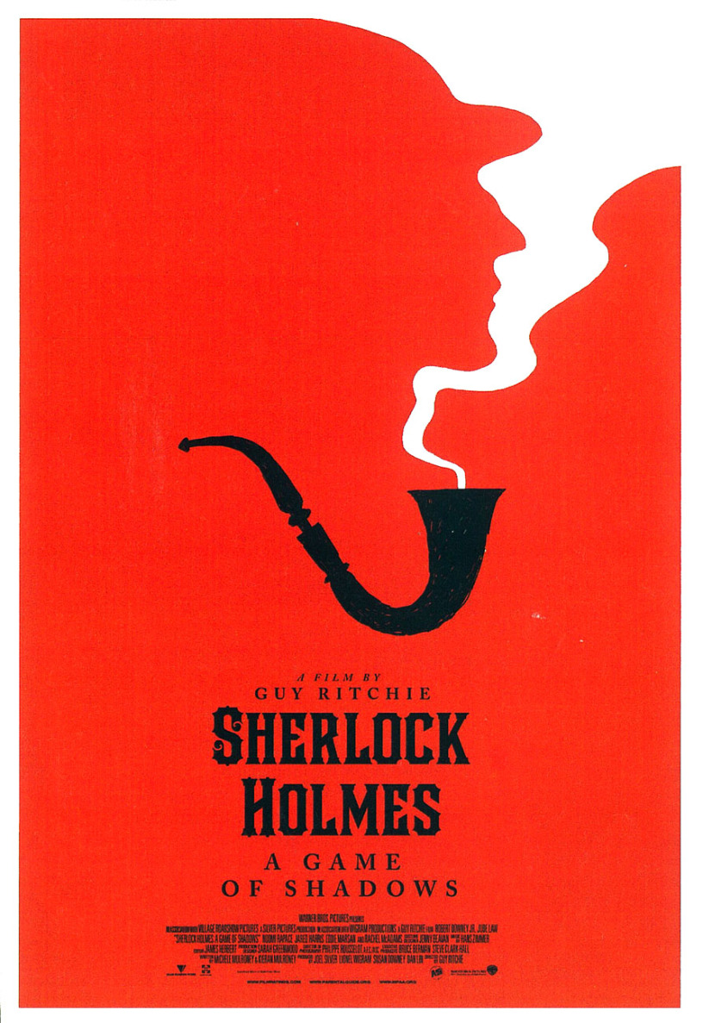
Sherlock Holmes

Slide 48
Beauty and the Beast

Slide 49
Star Wars

Slide 50
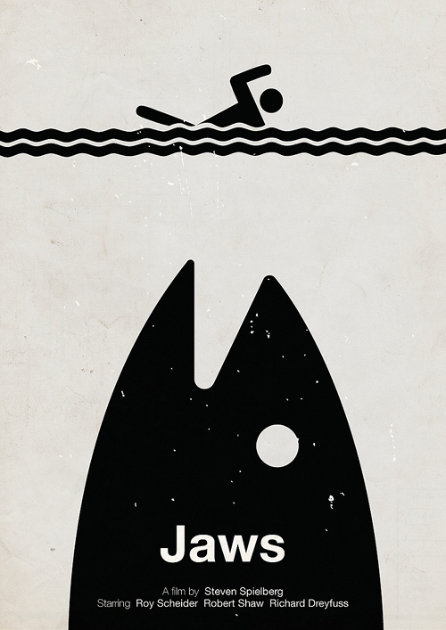
Jaws

Slide 51
Bruno Mars

Slide 52
Expressionism (The Scream – Edvard Munch)

Slide 53
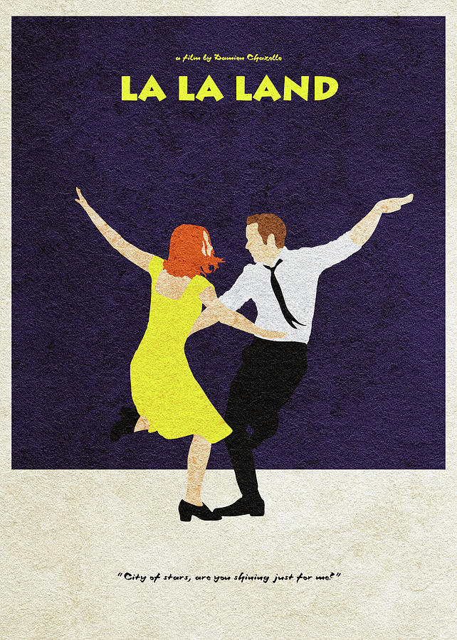
La La Land

Slide 54
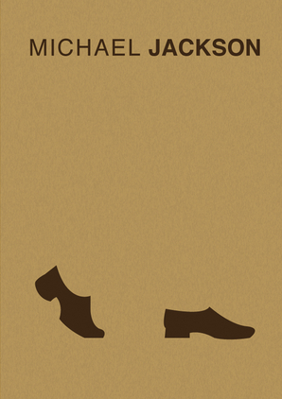
Michael Jackson

Slide 55
Mount Everest

Slide 56
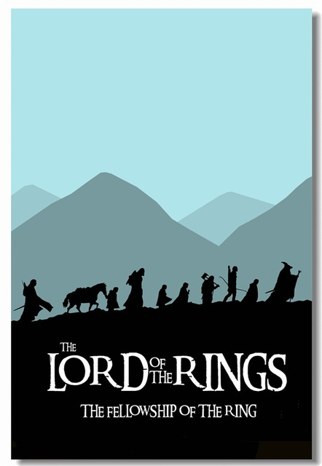
Lord of the Rings

Slide 57
Snow White and the Seven Dwarfs

Slide 58
The Martian

Slide 59
San Francisco

Slide 60
Fight Club

Slide 61
Inception

Slide 62
The Beatles

Slide 63
Rapunzel

Slide 64
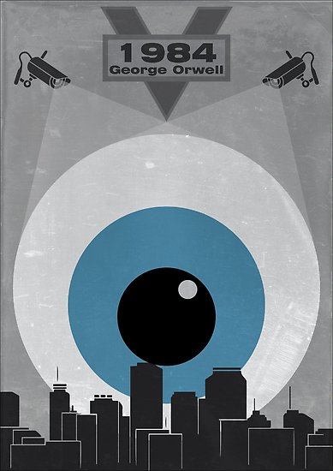
1984

Slide 65
The Wolf of Wall Street

Slide 66
Batman

Slide 67
Forest Gump

Slide 68
Create a minimalist Poster
No writing
Can only use scissors and glue.
It can be anything.

Slide 69
Write the title
Choose another poster and give it a title
Maximum 7 words

Slide 70
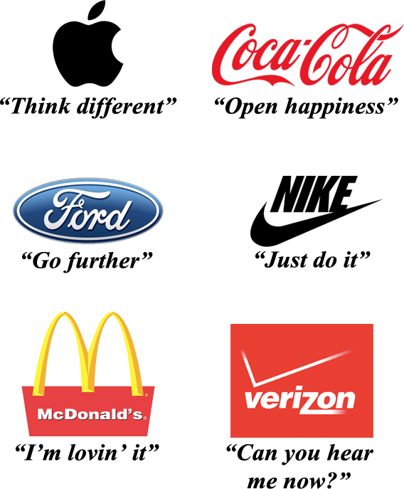
Write the “tag line”
A catch phrase
Something memorable

Slide 71
Write the review
“Greatest movie of the year” – Daffy Duck
“Outstanding singing!” – A guy I met once
“I was blown away!” – Myth Busters

Slide 72
Write the Description
What do you think this is about?
Briefly summarize what you think based on: the title, slogan, and review.

Slide 73
False Advertising
https://www.youtube.com/watch?v=pRRUgI_iUXI&t=22s

