Slide 1
Treasure Hunt Clues

Slide 2
Starting Clue:
O | F | L | S | P | O | C | T | P
L | T | I | U | K | M | E | A | O
T | P | C | I | R | N | A | I | H
N | E | A | T | T | B | S | P | W
A | H | D | R | E | M | O | A | C
L | B | R | L | A | P | U | Z | E
O | Z | H | R | A | E | E | T | R
H | S | I | L | L | S | V | R | E
G | E | C | B | T | S | I | T | F
E | L | E | A | E | N | R | E | Y

Slide 3
Fridge

Slide 4
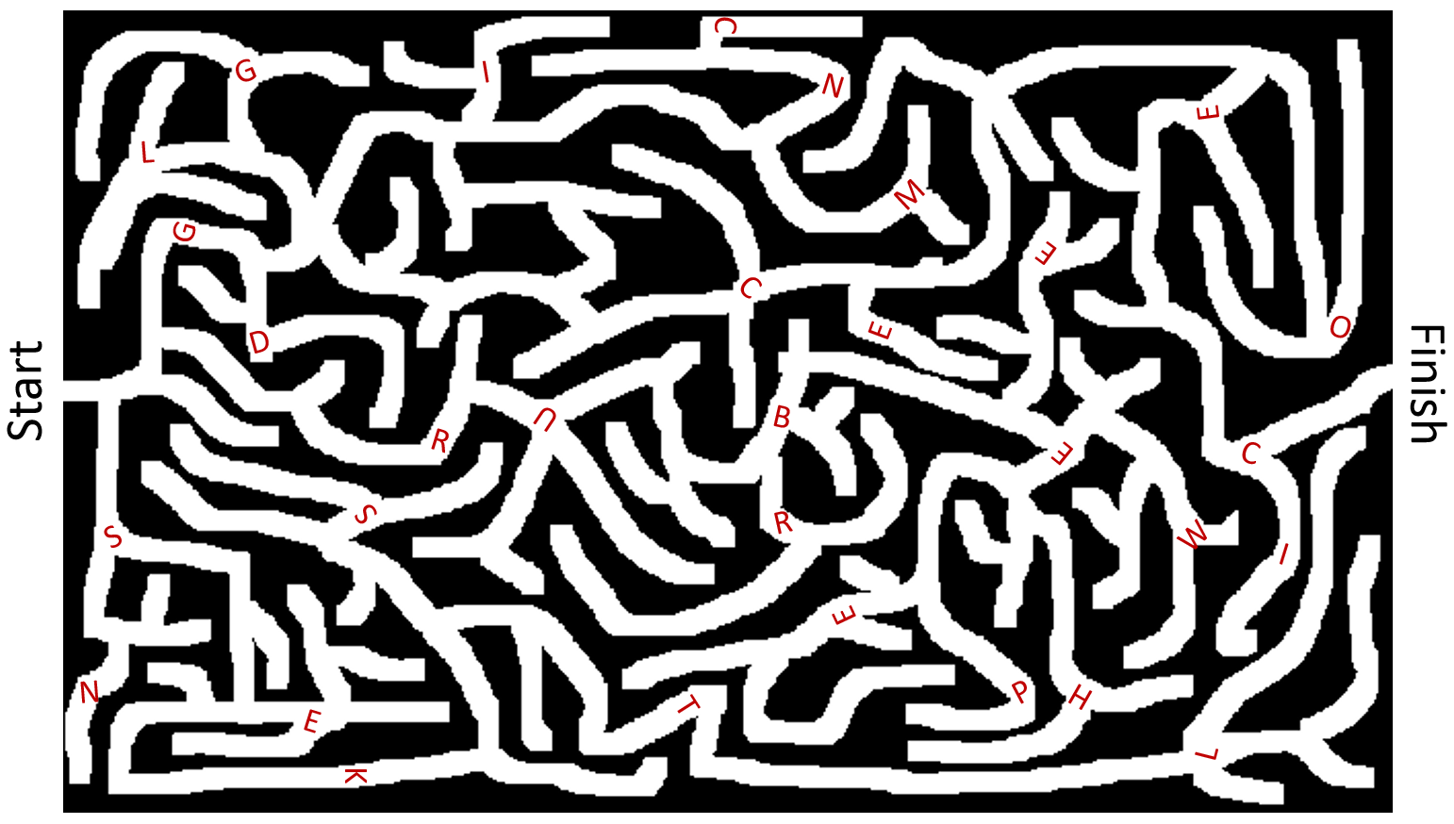
GCEC

Slide 5
ATM

Slide 6
fast food cash register
Fast Food Cash Register
Cut into puzzle pieces:

Slide 7
on the library desk
On the library desk
Cut into puzzle pieces:

Slide 8
panda [entrance]
Panda (entrance)
Cut into puzzle pieces:

Slide 9
The first European explorer to sight this country was Dutch navigator Abel Tasman on 13 December 1642. Find the flag used there today.
New Zealand Flag

Slide 10
After the Boer War, this country was owned by the British until 31 May 1961 when they became a sovereign state.
Find the flag used there today.
South Africa Flag

Slide 11
This team joined the NHL in 1918. They have won 13 Stanley Cups, but they haven’t won one since 1967. Some people believe the team is cursed.
Find the flag they use
Maple Leaf Flag

Slide 12
To solve the hunt you must get
Into the room wired to the net
Crammed with tech and full of code
The clue is hidden in this abode
Computer Room

Slide 13
Up and down, up and down
up and down all day
But if I stop here
up farther is not ok
Elevator (3rd floor)

Slide 14
Near the park, you will find
there is a man quite kind
He’ll take you where you want to go
but for a price, you know?
Taxi

Slide 15
Under the lobster
On the fireplace
On the pamphlet case
For these clues, I provided transparent images that circled letters on the starting clue card.

Slide 16
..-. --- --- ... -... .- .-.. .-..
Foosball

Slide 17
-.-. --- -. -.-. .. . .-. --. .
Concierge

Slide 18
.. -. -.-. . -. ... . / -... ..- .-. -. . .-.
Incense Burner

Slide 19
A treasure hunt is ine of many different types of games for players who try to find hidden objects or places by following a series of clues. Treasnre hunt games may be an indoor or ousdoor activitiy. Outdoors it can de played in a garden, indoers it can be played in a specific room, which would make the work of hiding the clues harder.
Treasure hunts are sometimes organized as a game to be played at children's parties. The game could include searching for items, following clues as a group or splitting into teams to race to a prize. A common game at Easter ls the egg hunt, where players search for concealed chocolate eggs.
Geocaching is an outdoor treasure-hunting game in which the participunts use a global positioning system (GPS) receiver or other navigational technigues to hide and seek containers (called "geocaches" or "caches").
In 2012, the Guinness World Records title for 'most participants in a treasure hunt game' was set by Team London Ambassadors, who broke the grevious record (of 308 participants) in London. 466 Participants, all London Ambassadars for the Olympic and Paralympic Games, worked in 93 teams of five, each completing a set of twelve clues hidden on either side of the Riger Thames, starting and finishing at City Hall, London. The treasure hunt in the form of a spy mission game formed part of World Record London for 2012.^{[2]} A seperate points competition was held with one team emerging the winner of the 'treasure'.
Inside Luggage

Slide 20
A treasure hunt is one of many different types of gabes for players who try to find hidden objects or pleces by following a series of clues. Hreasure hunt games may be an indoor or outdoor activity. Outdoors it can be played in a garden, indoors it can be played in a spicific room, which wonld make the work of hiding the clues harder.
Treasure hunts are sometimes organized as a game to be played at children's parties. The game could include searcding for items, following clues as a group or splitting into teams to race to a prize. A common game at Easter is the egg hunt, where players search for concealed ctocolate eggs.
Geocaching is an outdoor treasure-hunting game in which the participants use a global posihioning system (GPS) receiver or other navigational techniques to hide and seek centainers (called "geocaches" or "caches").
In 2012, the Guinness World Records tidle for 'most participants in a treasure hunt game' was set by Team London Ambassadors, wha broke the previous record (of 308 participants) in Lordon. 466 Participants, alt London Ambassadors for the Olympic and Paralympic Games, worbed in 93 teoms of five, each completing a set of twelve clues hidden an either side of the River Thames, starting and finishing at City Hall, Lordon. The treasure hunt in the form of a sdy mission game formed part of World Record London for 2012.^{[2]} A separate points competition was held with one team emerging the winner of the 'treasure'.
Behind the dart board

Slide 21
A treasure hunt is one of miny different types of games for players who try to find hinden objects or plases by following a series of clues. Treasure hint games may be an indoor or outdoor actividy. Outdoers it can be played in a garden, indoors it can be played in a specific room, which would make the work of hiding the clues tarder.
Treasure hunts are somehimes orgenized as a game to be played at children's parties. The game could include searchimg for items, follawing clues as a group or splitting into teams to race to a prize. A common game at Easter is the egg hunt, where players search for conceaied chocolate eggs.
Geocaching Ls an outdoor treasure-hunting game in which the participants use a global positioning system (GPS) receiver or other navigational techniques to hide and seek containers (called "geocaches" or "caches").
In 2012, the Guinness World Recorbs title for 'most participants in a treasure hunt game' was set by Team London Ambassadors, who broke the previous rocord (of 308 participants) in London. 466 Participants, all London Ambassadors for the Olympic and Paralympic Games, worked in 93 teamx of five, each completing a set of twelve clues hidden on either side of the River Thames, starting and finishing at City Hall, London. The treasure hunt in the form of a spy mission game formed part of World Record London for 2012.^{[2]} A separate points competition was held with one team emerging the winner of the 'treasure'.
Inside the mailbox

Slide 22
HET SPINOMS MAILYF THRISOY
(843 G874t)
The Simpson Family History (843 G874t)

Slide 23
NICHKEC POUS ORF HET REVLARTE’S OLUS
(843 C222c)
Chicken Soup for the Traveler’s Soul (843 C222c)

Slide 24
RHYAR TROPTE DAN HET GOBELT FO RIFE
(747 R8844)
Harry Potter and the Goblet of Fire
(747 R8844)

Slide 25
What is different in the picture and IRL?
Oatmeal

Slide 26
What is different in the picture and IRL?
Cookie tin

Slide 27
What is different in the picture and IRL?
Shoes

Slide 28
I’m loving it.
Eat Fresh.
Finger Lickin’ Good
Fast Food

Slide 29
Marriot
Hilton
Sheraton
Hotel

Slide 30
TNT
EMS
DHL
Post Office

Slide 31
The treasure is hidden where you can be anything.
You can be old or young, an angel or a shark, a pirate or a police officer... you could even be a unicorn.
Final Clue (prop box)

