Slide 1
English Review Game
Chan&Daisy
Notes:
By Steeb

Slide 2
Rules
2
1
3
1 message = 1 point

Slide 3
Rules
Bomb = Lose all points

Slide 5
B
F
A
C
E
D
G
H
I
M
J
K
L
N
0
P
S
U
Q
R
T
V
W
X
Z
Y

Slide 6
What is it?

Slide 7
1
1 point

Slide 8
What is Your name?

Slide 9
1
1 point

Slide 10
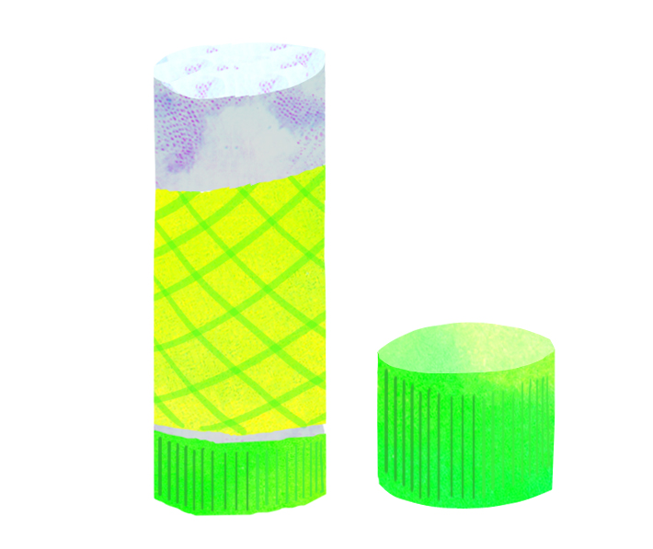
What is it?

Slide 11
1
1 point

Slide 12
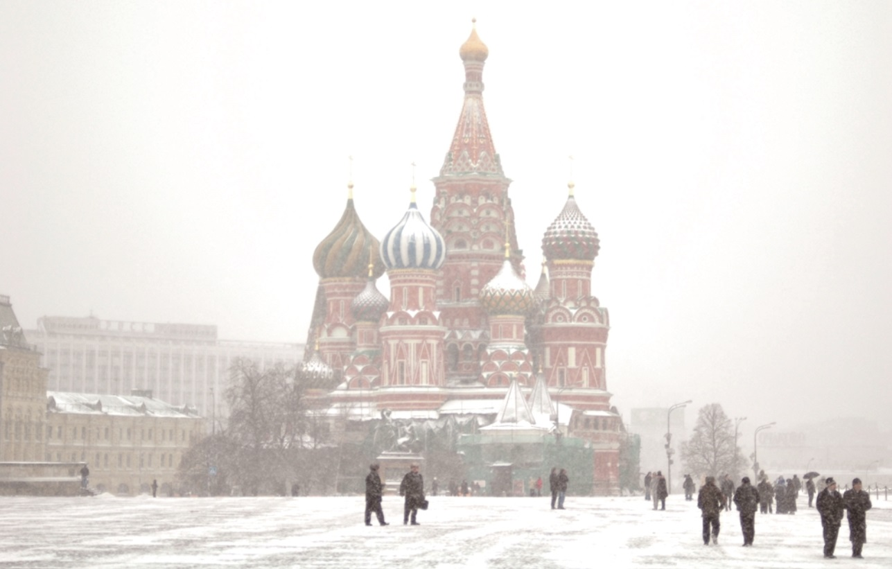
How’s the weather?

Slide 13
1
1 point

Slide 14
What’s your favorite sports?

Slide 15
1
1 point

Slide 16
Read it!
pencil ruler scissors

Slide 17
1
2
2 points

Slide 18
How old are you?

Slide 19
1
2
2 points

Slide 20
What color is it?

Slide 21
1
2
2 points

Slide 22
What color is it?

Slide 23
1
2
2 points

Slide 24
Read it!
eight eleven twelve

Slide 25
1
2
3
3 points

Slide 26
What’s your favorite color?

Slide 27
1
2
3
3 points

Slide 28
Read it!
dance jump skate

Slide 29
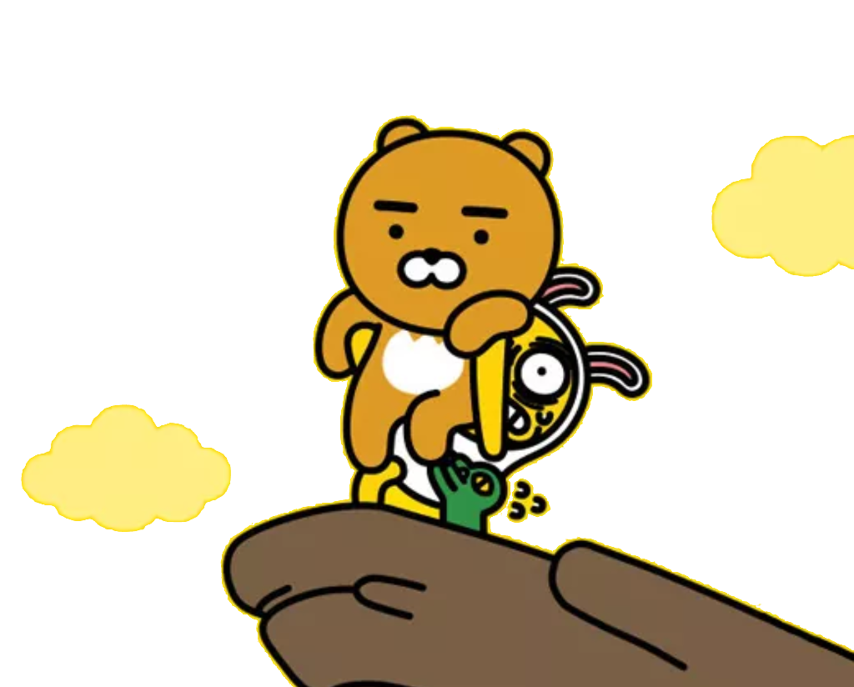
1
2
3
3 points

Slide 30
What’s your favorite country?

Slide 31
1
2
3
3 points

Slide 32
How are you?

Slide 33
1
2
3
4
4 points

Slide 34
What’s your favorite animal?

Slide 35
1
2
3
4
4 points

Slide 36
What’s your favorite fruit?

Slide 37
1
2
3
4
4 points

Slide 38
What’s your favorite food?

Slide 39
Everyone loses points!

Slide 40
Read it!
orange black white

Slide 41
Change points!

Slide 42
What’s your favorite music?

Slide 43
Steal 3 points
3

Slide 44
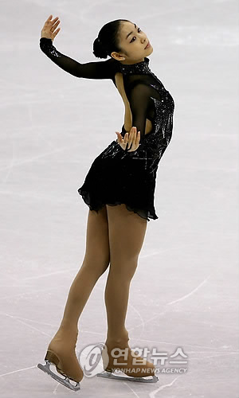
What’s your favorite star?

Slide 45
Everyone is here!
10 points

Slide 46
What’s your favorite sports?

Slide 47
Everyone loses points!

Slide 48
What’s this?

Slide 49
Steal 3 points
3

Slide 50
Let’s count from 7 to 10 in English

Slide 51
Choose

Slide 52
Steal 3 points
3

Slide 53
Change points!

Slide 54
Everyone loses points!

Slide 55
What’s your favorite drink?

Slide 56
Choose

Slide 57
1
1 point

Slide 58
Everyone loses points!

Slide 59
Change points!

Slide 60
Read it!
snowing sunny cold

Slide 61
Choose

Slide 62
Steal 5 points
5

Slide 63
Everyone is here!
10 points

Slide 64
Everyone loses points!

Slide 65
How’s the weather?

Slide 66
Choose

Slide 67
Change points!

Slide 68
Everyone is here!
10 points

Slide 69
1
2
3
3 points

