Slide 1
International Quiz
Let’s check your GQ(global Quotient)

Slide 2
Choose the number!
1
2
3
4
5
6
7
8
9
10
B

Slide 3
Which country’s flag is this?
India
Kuwait
South Africa
Japan

Slide 4
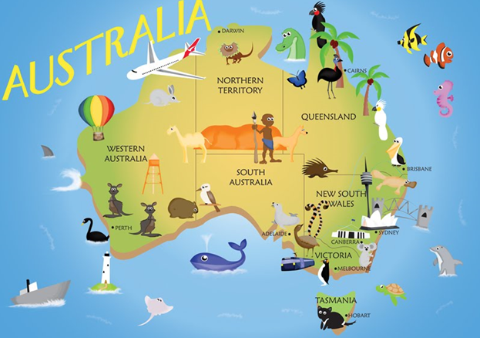
What is the capital of Australia?
Perth
Canberra
Sydney
Brisbane

Slide 5
What is the capital of Morocco?
London
Sofia
Tokyo
Rabat

Slide 6
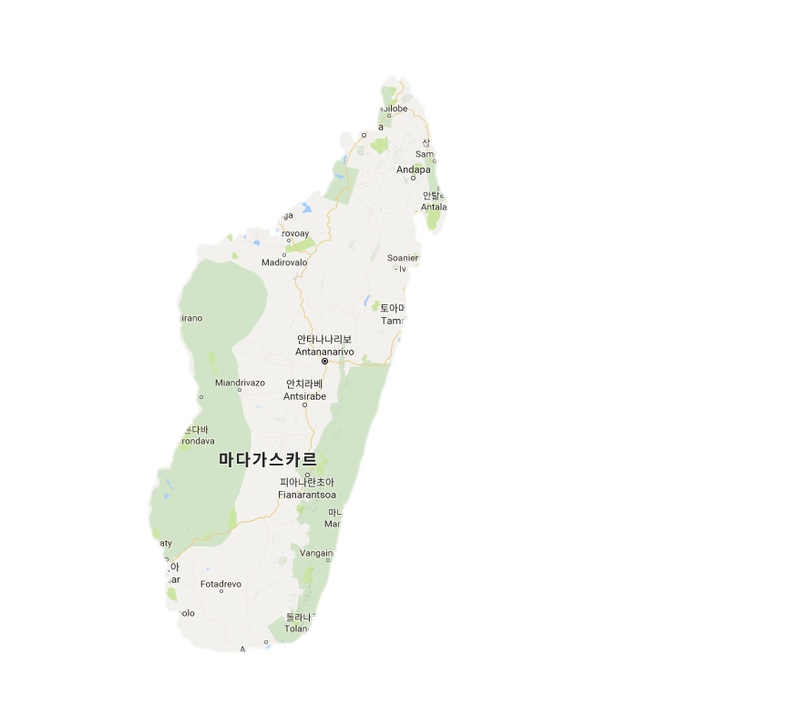
Where is it?
Madagascar
Vietnam
Chile
Taiwan

Slide 7
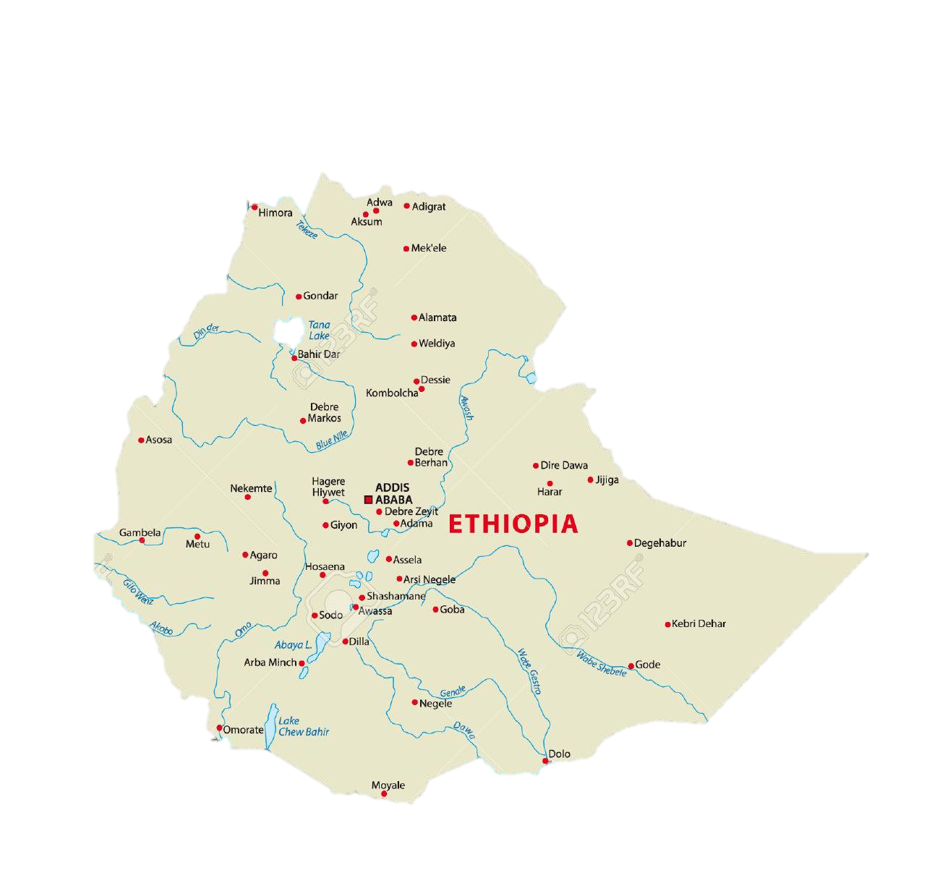
Where is it?
Sudan
Uganda
Kenya
Ethiopia

Slide 8
Which one is not world top 3 film festival?
Venice
Cannes
Sundance
Berlin

Slide 9
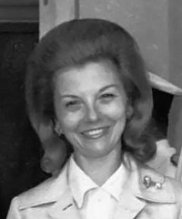
Which country did have the first female president?
Thailand
England
Argentina
Canada

Slide 10
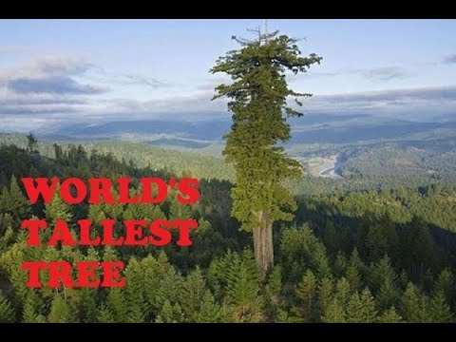
How tall is the tallest tree in the world?
100m
115m
130m
145m

Slide 11
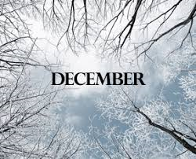
December 1st is the world’s 000 day.
Blood donation
Cancer
Children
AIDS

Slide 12
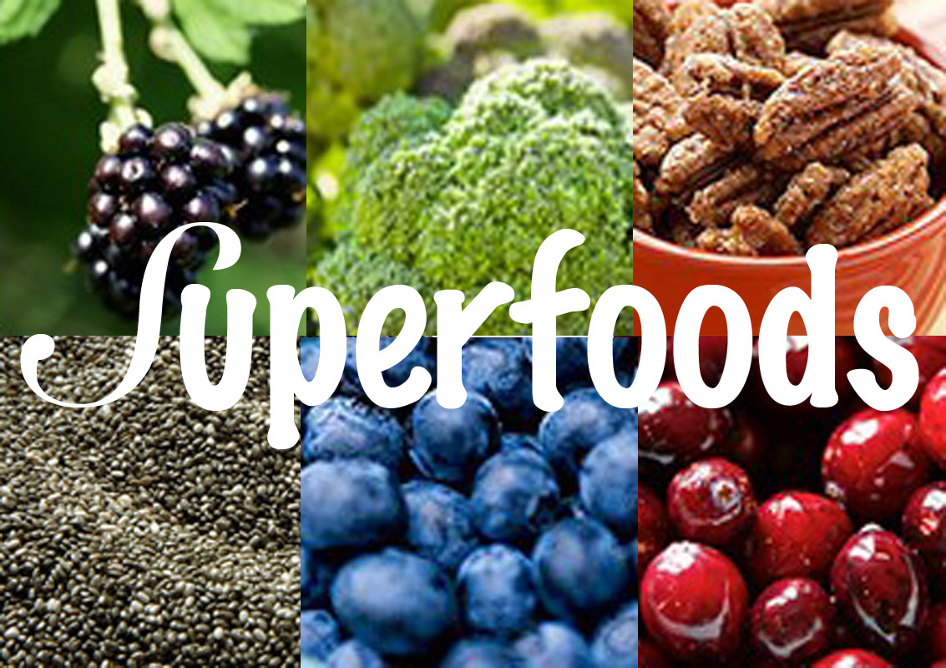
Which is not top 10 super foods?
Blueberry
Spinach
Tomato
Apple

Slide 13
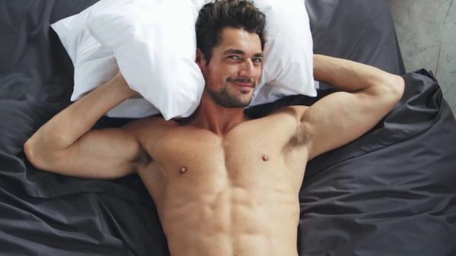
What is your ideal type?
Charming & brave
Sexy & smart
Kind & Sweet
Humorous & Nice

Slide 14
Hello your boyfriend is Sulley of Monster Inc..

Slide 15
Hello~ Your boyfriend is Donkey of Shrek.

Slide 16
Hello your boyfriend is Winnie the Pooh.

Slide 17
Hello your boyfriend is Minions.

