Slide 1
Quiz Quiz
Made by Lucas & David

Slide 2
Select a theme what you interested in.
Universe
Animal

Slide 3
Universe
YOU ARE THE MASTER OF UNIVERSE
1
2
3
4
5
6
HOME

Slide 4
Universe 1 : What is the group of stars?
1. Galaxy
2. Andromeda
3. Nebula
Click Here!
Click here!

Slide 5
Universe 2 : What is the biggest planet in the solar system?
1. Saturn
2. Uranus
3. Jupiter
Click Here!

Slide 6
Universe 3 : What is the brightest star in the night sky?
1. Polaris
2. Sirius
3. Quasar
Click Here!

Slide 7
Universe 4 : Which planet has the highest average temperature in the solar system?
1. Mercury
2. Venus
3. Mars
Click Here!

Slide 8
Universe 5 : What is the color of the Sun?
1. White
2. Yellow
3. Orange
Click Here!

Slide 9
Universe 6 : What is the artificial structure which is visible with naked eye from the moon?
1. Great Wall
2. Pyramid
3. Nothing
Click Here!

Slide 10
Animal
YOU ARE THE MASTER OF UNIVERSE
1
2
3
4
5
6
HOME

Slide 11
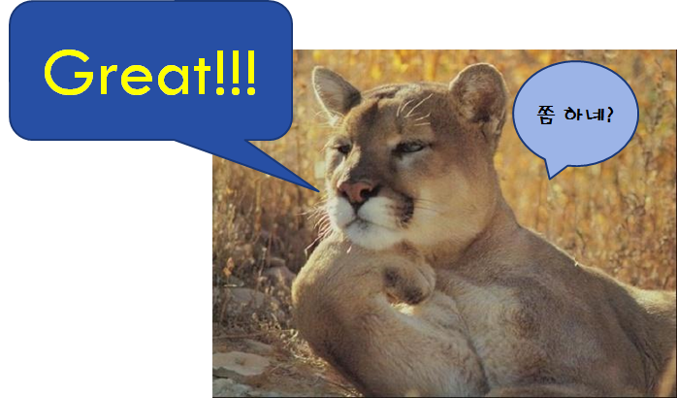
Animal 1 : What is the fastest fish?
1. Tuna
2. Blue Shark
3. Pacific sailfish
Click Here!

Slide 12
Animal 2 : What is the skin color of the polar bear?
1. Black
2. Pink
3. White
Click Here!

Slide 13
Animal 3 : What is the largest animal in the history of the earth?
1. Dinosaur
2. Whale
3. Snake
Click Here!

Slide 14
Animal 4 : What is the smallest bird in the world?
1. Sparrow
2. Humming bird
3. Pigeon
Click Here!

Slide 15
Animal 5 : Plastic was invented to protect this animal. What was that?
1. Rhino
2. Elephant
3. Tiger
Click Here!

Slide 16
Animal 6 : Which of the following animals does not live in Antarctica?
1. Penguin
2. Albatross
3. Mole
Click Here!

