Slide 1
What is the name of this flower?
Let’s learn about beautiful flowers’ name

Slide 2
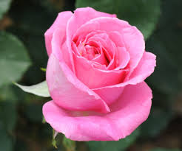
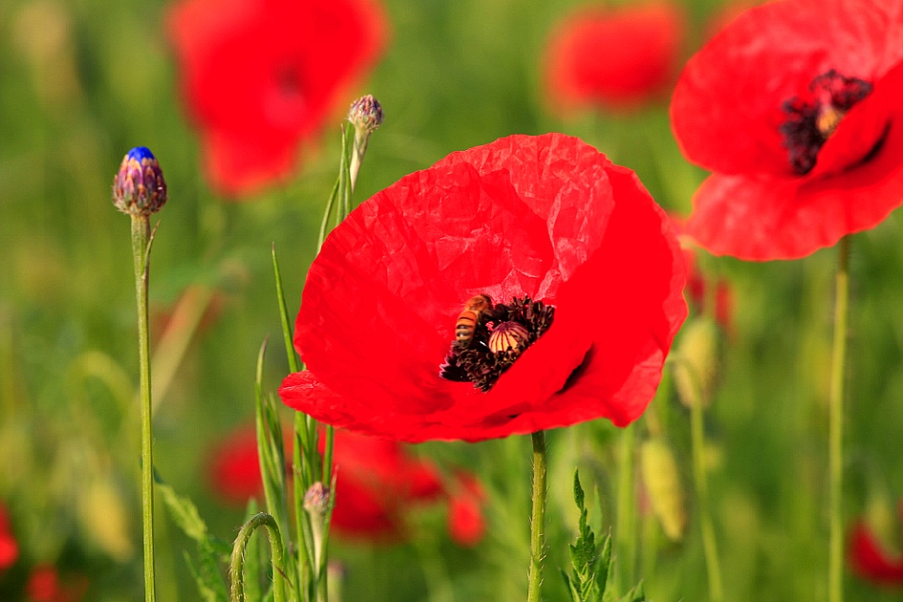
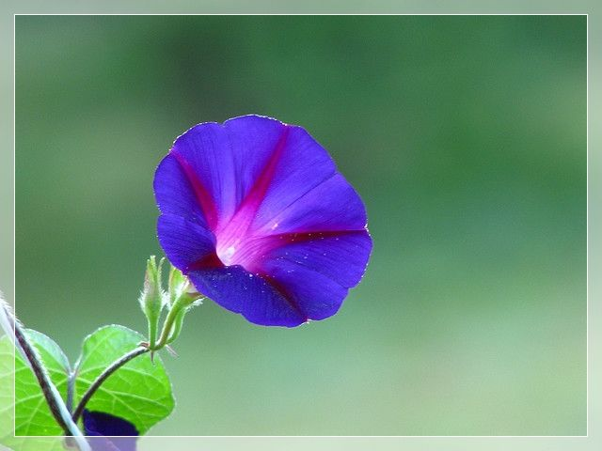
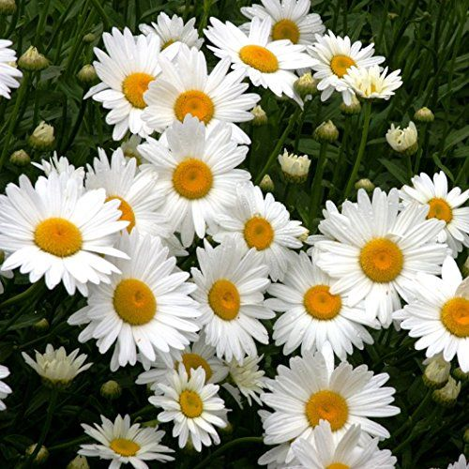
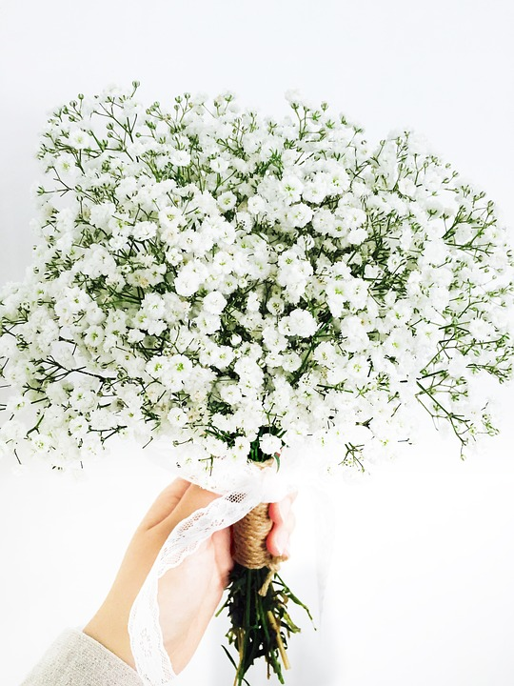
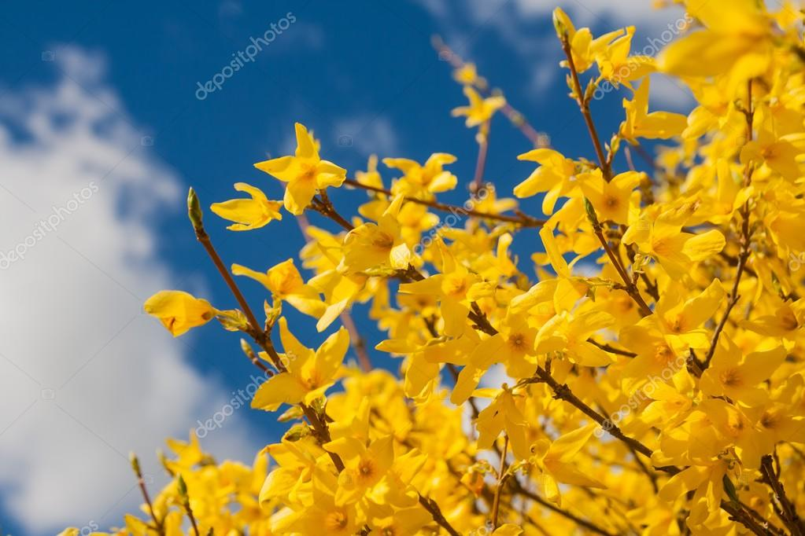
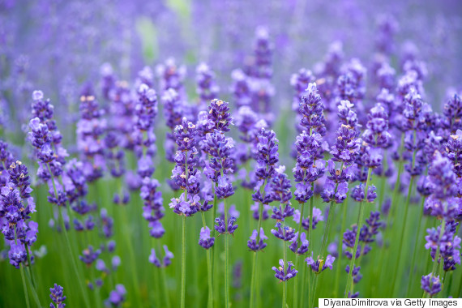
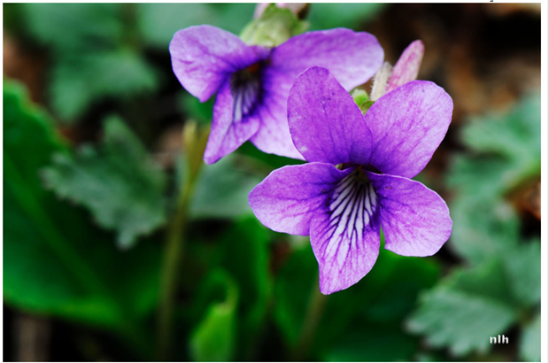
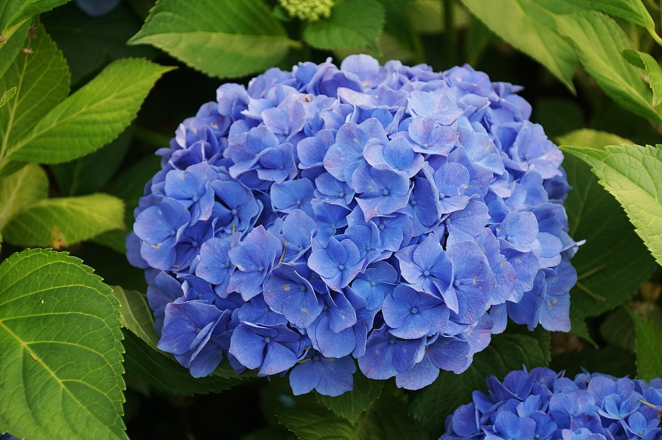
SELECT A QUESTION
1
2
3
4
5
1
2
3
4
5
6
7
8
9
10
6
7
8
9
10

Slide 3
What is the name of this flower?
Rose
Lily
Tulip
Jasmine

Slide 4
What is the name of this flower?
Sunflower
Daisy
poppy
lotus

Slide 5
What is the name of this flower?
chamomile
Cherry blossom
Water lily
morning glory

Slide 6
What is the name of this flower?
Tulip
Baby’s breath
Jasmine
carnation

Slide 7
What is the name of this flower?
Dandelion
Merry gold
Daisy
Sunflower

Slide 8
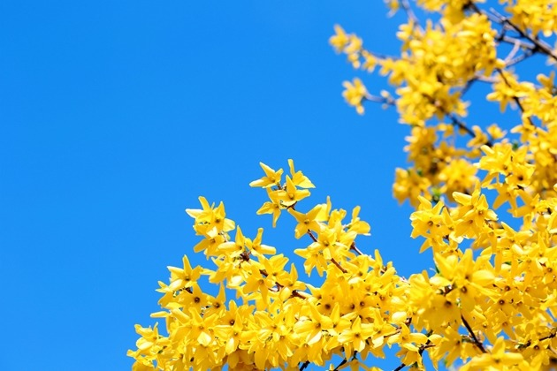
What is the name of this flower?
Daffodil
Chrysanthemum
Primrose
Forsythia

Slide 9
What is the name of this flower?
Lavender
Narcissus
Rose of sharon
Magnolia

Slide 10
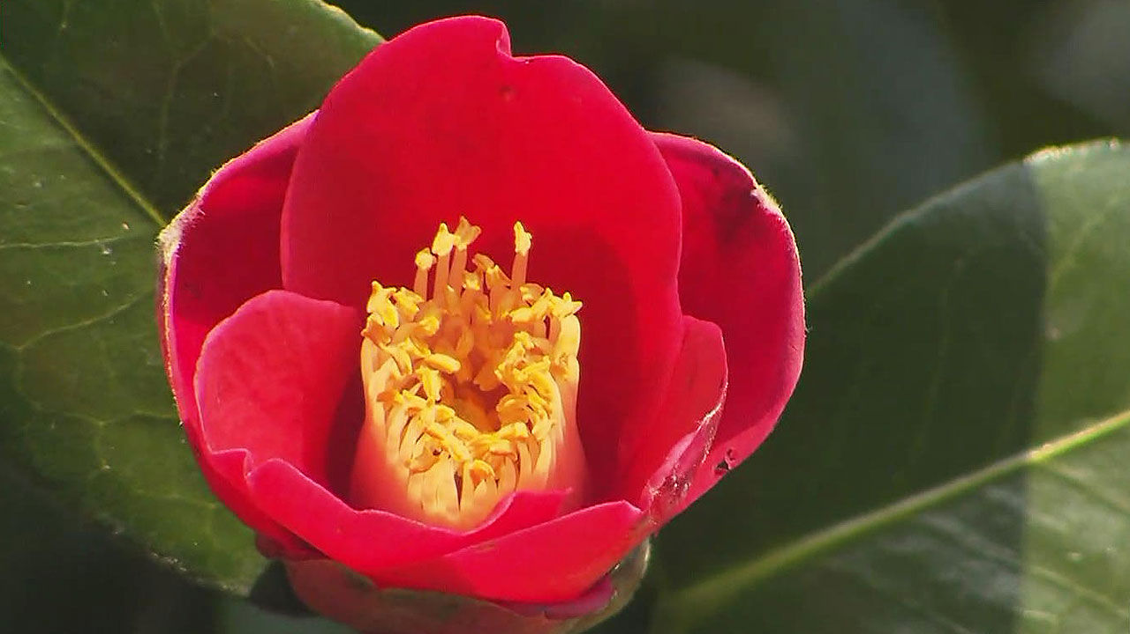
What is the name of this flower?
Lavender
Zinnia
Orchid
Camelia

Slide 11
What is the name of this flower?
Clover
Violet
Aloe
Carnation

Slide 12
What is the name of this flower?
Geranium
Pansy
Hydrangea
Canna

Slide 13
Do you know? the most beautiful flower is
YOU

