Slide 1
Konglish Jokes
With zzang-gu

Slide 2
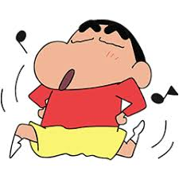
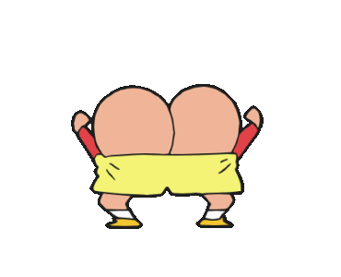
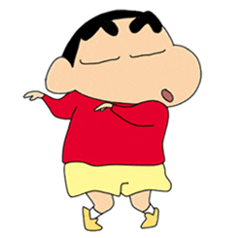
Tips!
= 1point
= Lose all your points.
= Change your points with other team you want
Questions are in English, but answers are in Korean.

Slide 3
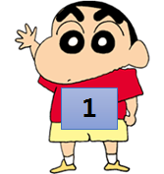
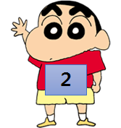
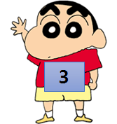
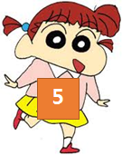
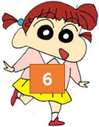
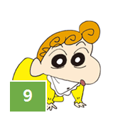
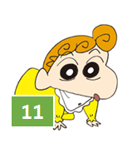

Slide 4
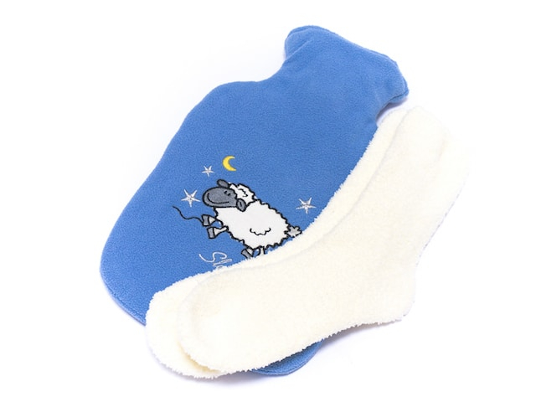
What language do sheep speak?
양말

Slide 5
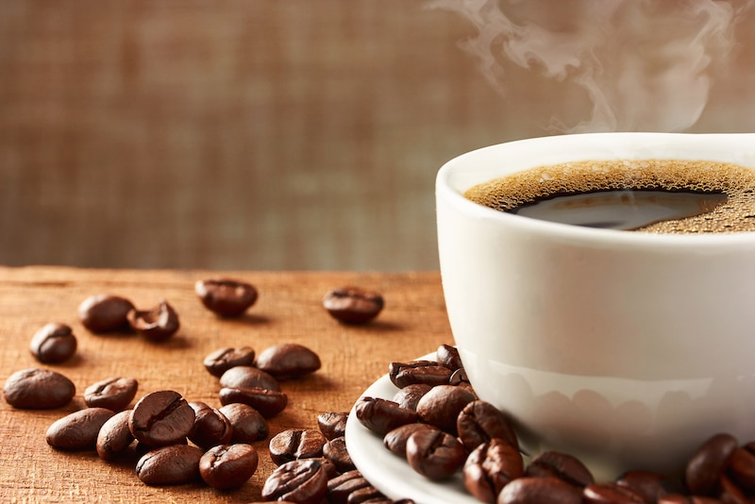
What does a vampire drink in the morning?
코피!

Slide 6
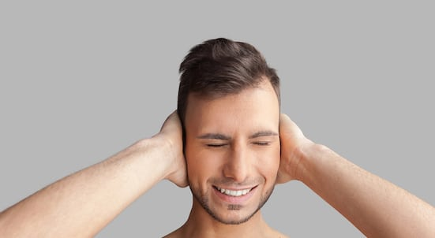
What do you call a cute guy with no ears?
Lose!!
귀없다(귀엽다)

Slide 7
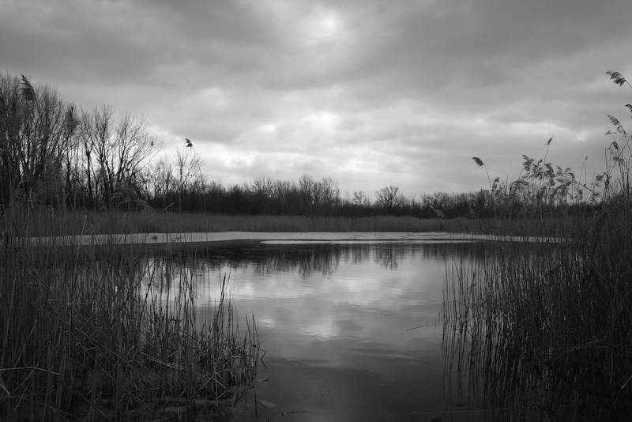
What do you call scary water?
괴물!

Slide 8
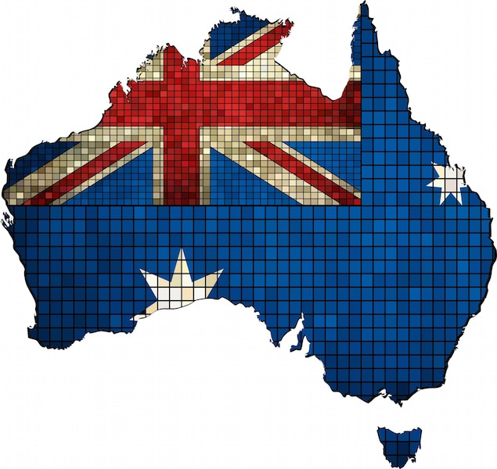
Where do Australians keep their money?
호주머니

Slide 9
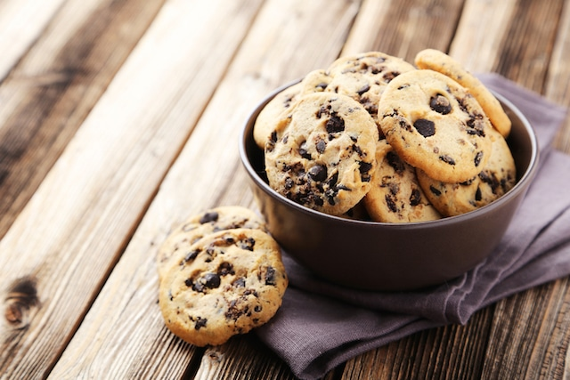
What did the cookie say to his friends when he was ready to go?
과자(가자)!

Slide 10
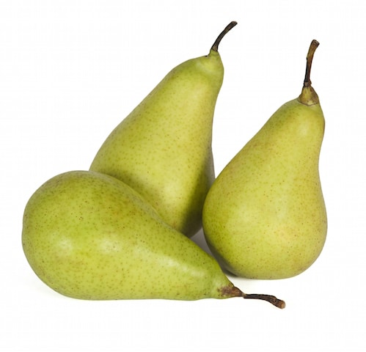
Why did the pear go to the hospital?
Change!!
배아파서!

Slide 11
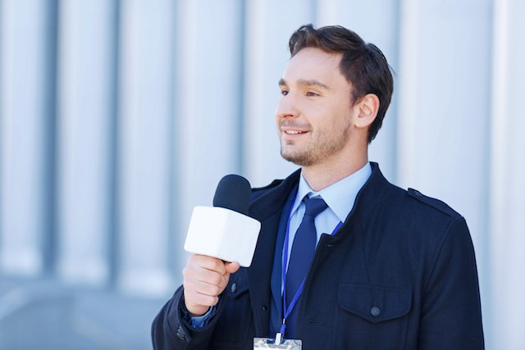
What do you call a news reporter who interviews the sun?
해리포터!

Slide 12
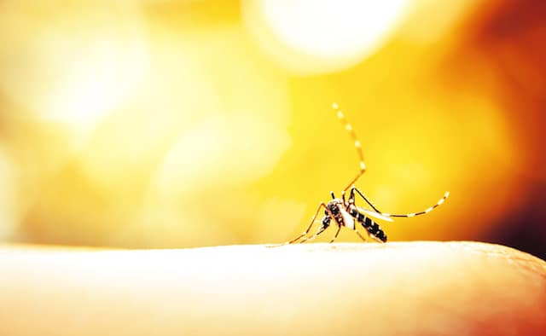
Why did the mosquito go to the hospital?
모기아파서!

Slide 13
What do you call a coffee that can’t move?
모카(못가)

Slide 14
What do you call a broken motorcycle?
모타사이클(못타사이클)!

Slide 15
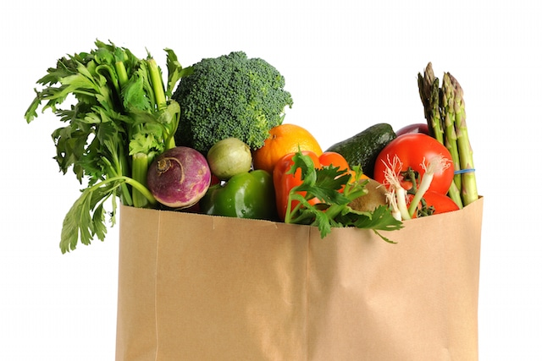
Which celebrity used to bag groceries?
Lose!!
짐캐리

