Slide 1

Hot seat

Slide 2
Rules
One student sits in front of the TV, but cant look.
The team can give clues about what is on the TV.
The student must guess what is on the TV.
No Korean
No Spelling
No Drawing
You can’t directly say what is on the TV.

Slide 3

1
3
5
7
9
2
4
6
10
8
13
19
11
17
15
12
14
18
20
16
21
23
25
27
29
22
24
26
30
28
31
33
35
37
39
32
34
36
40
38

Slide 4

Question
It snows in winter.

Slide 5
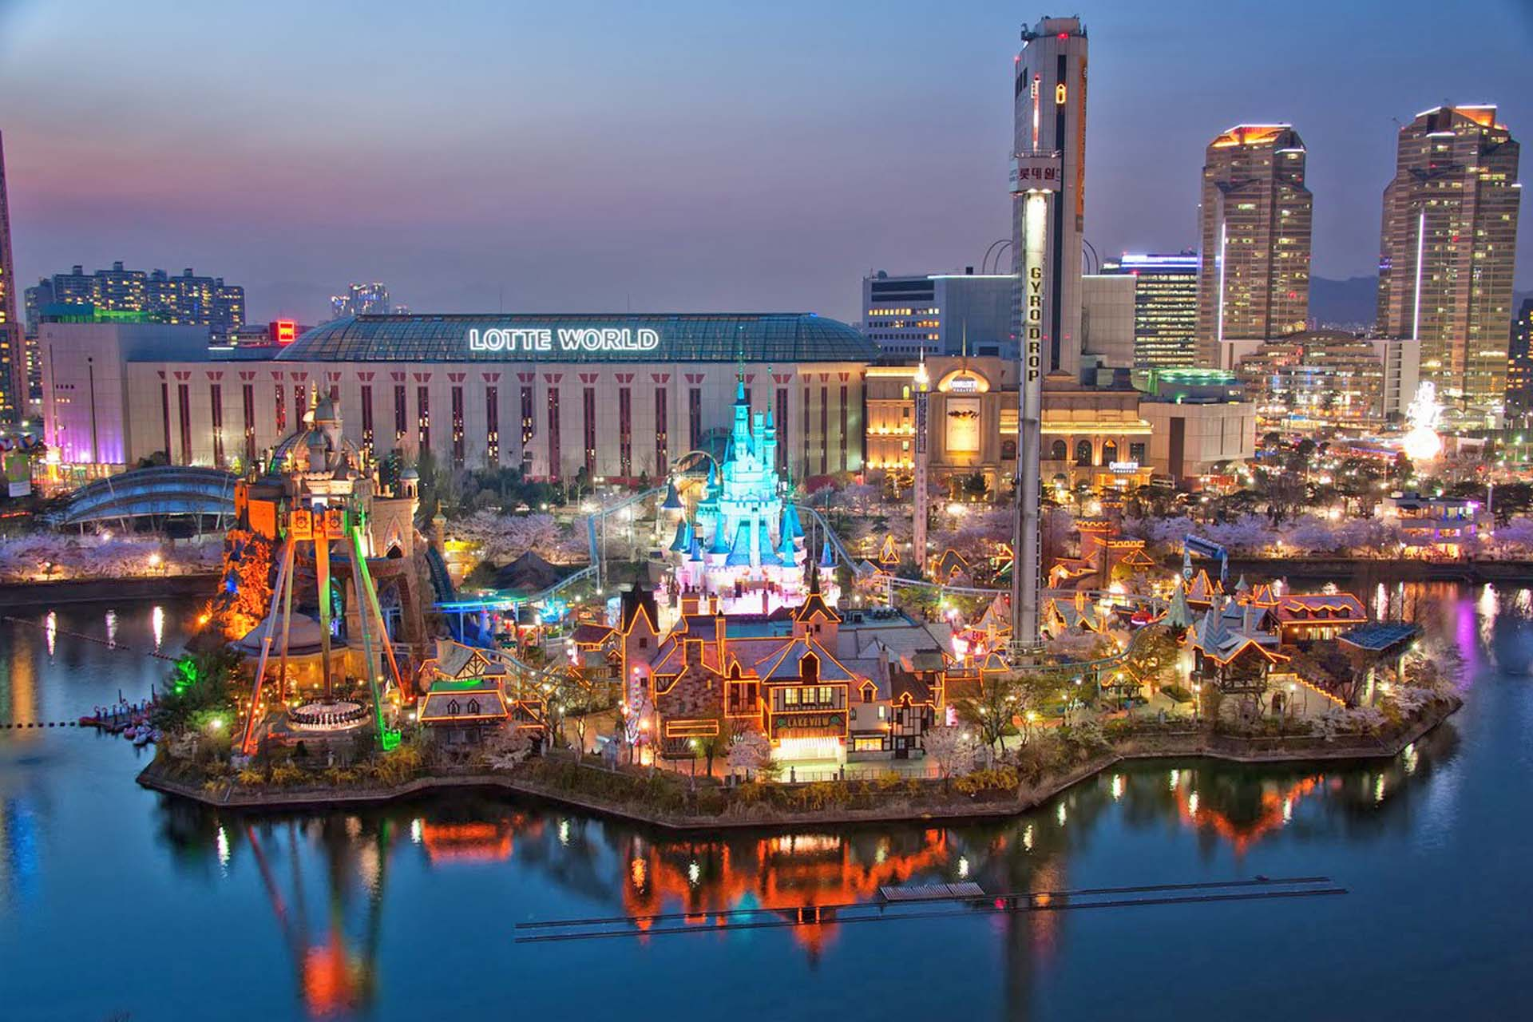
Question
Lotte World

Slide 6

Question
Dubai

Slide 7
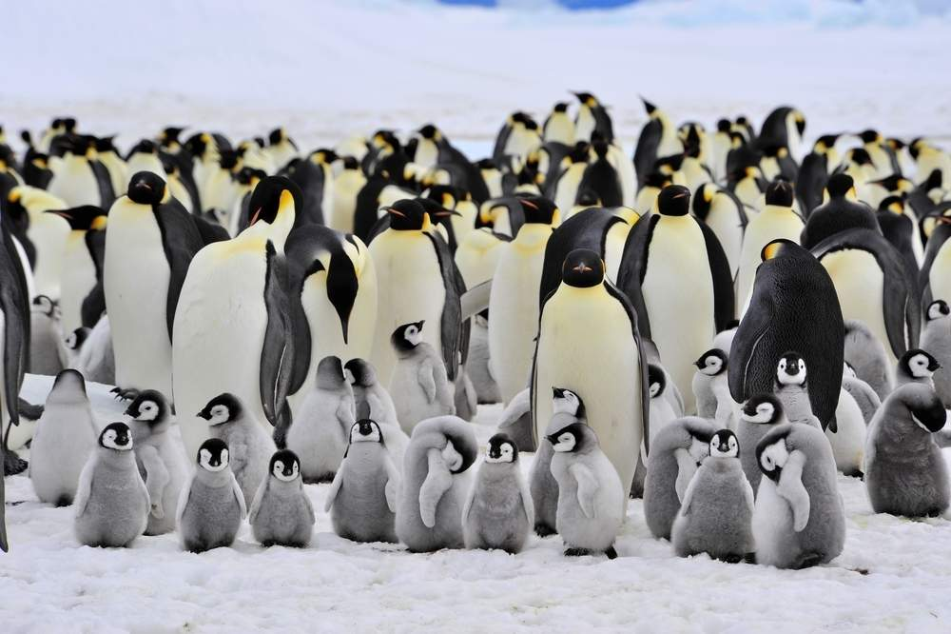
Question
There are too many penguins.

Slide 8

Question
Phoenix

Slide 9
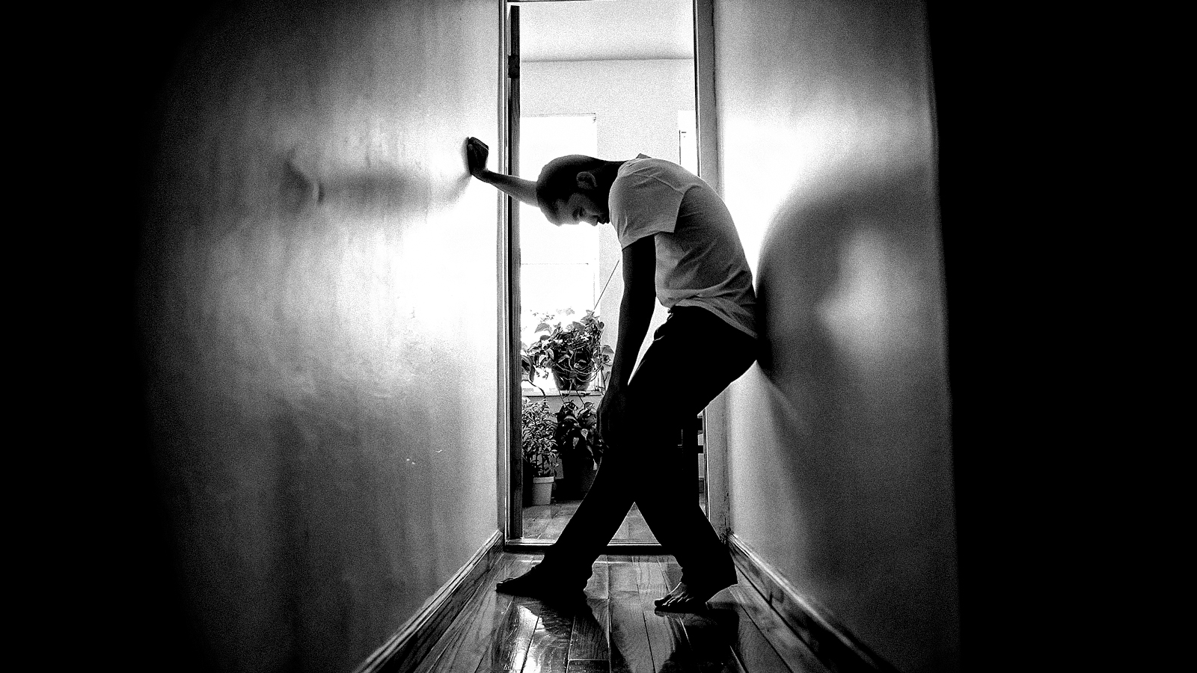
Question
Regret

Slide 10

Question
Dreaming

Slide 11

Question
Time Travel

Slide 12

Question
Beautiful Garden

Slide 13
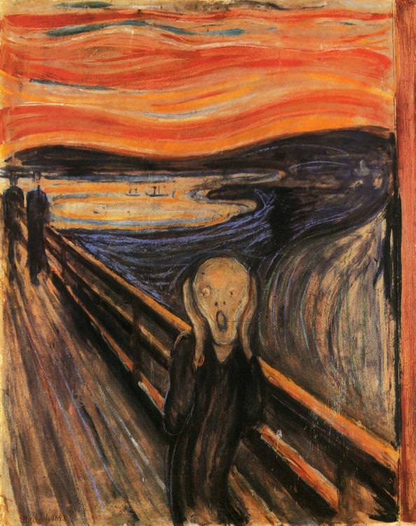
Question
Edvard Munsch

Slide 14

Question
I drink coffee every morning.

Slide 15
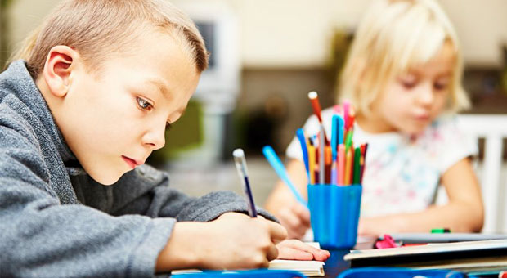
Last night I did my homework.

Slide 16

Question
May I ask a question

Slide 17

May I ask a question
Let’s call a taxi.

Slide 18

Question
I am drunk.

Slide 19
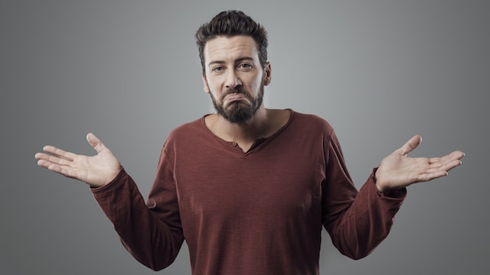
Question
I don’t know.

Slide 20

Question
Jurassic World

Slide 21
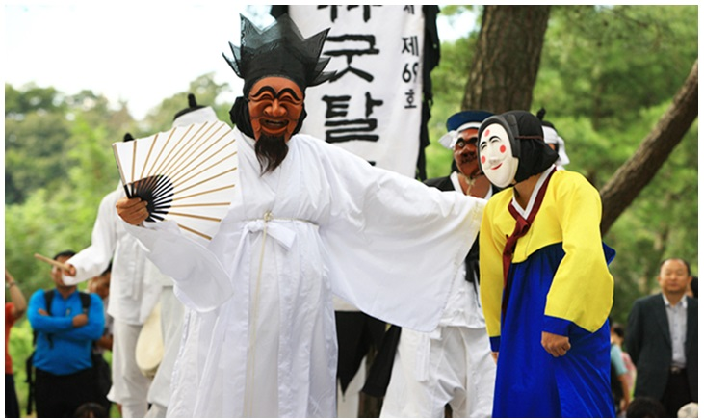
Question
I went to Andong.

Slide 22

Question
I caught a fish.

Slide 23
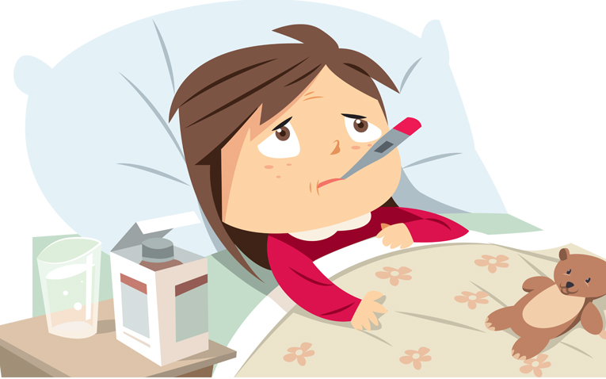
Question
I feel sick.

Slide 24
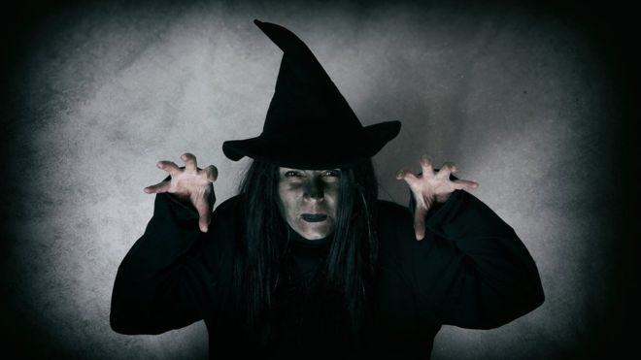
Question
Witch

Slide 25

Question
My mother is a doctor.

Slide 26

Question
Where is the library?

Slide 27
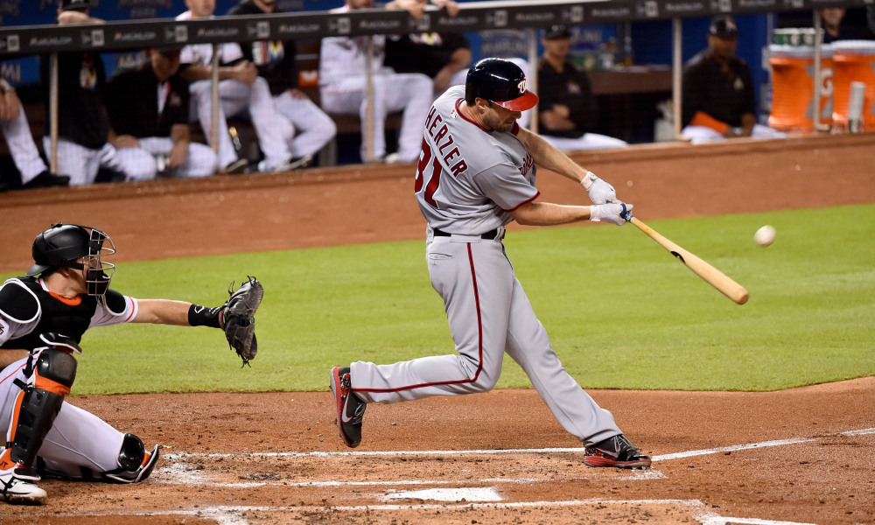
Question
Homerun

Slide 28

Question
Recyle

Slide 29
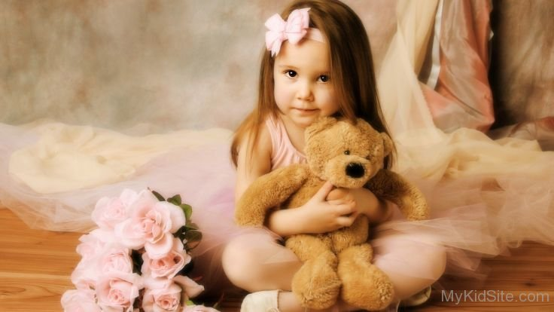
Question
I love my teddy bear.

Slide 30

Question
Pregnant

Slide 31

Question
Rapunzel

Slide 32
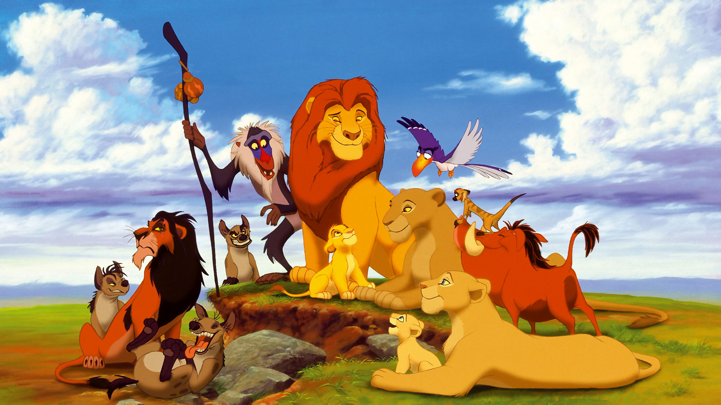
Question
Lion King

Slide 33

Question
History

Slide 34
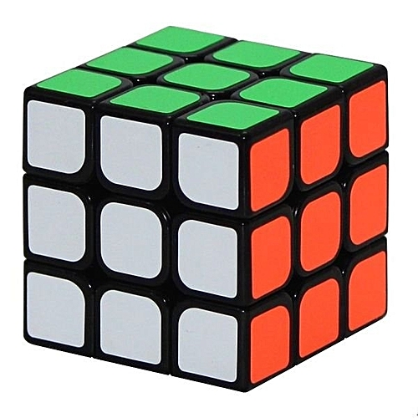
Question
Cube

Slide 35

Question
Paper airplane

Slide 36
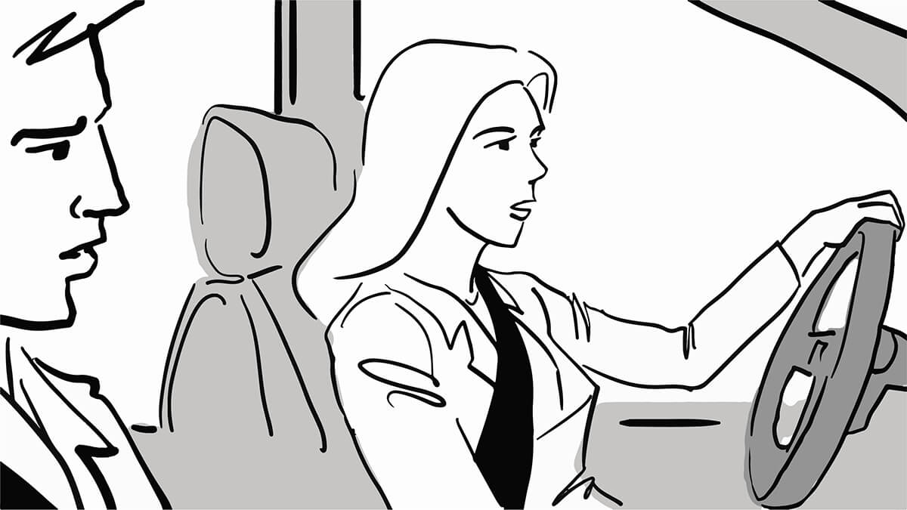
Question
Driving test

Slide 37

Question
How are you?

Slide 38
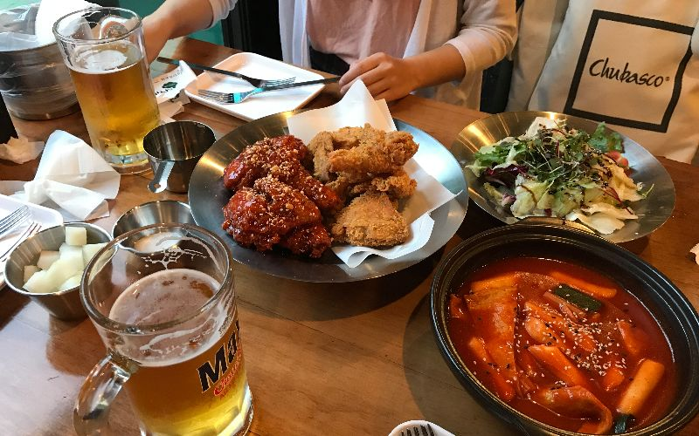
Question
Chicken and beer

Slide 39

Question
Reading a newspaper

Slide 40
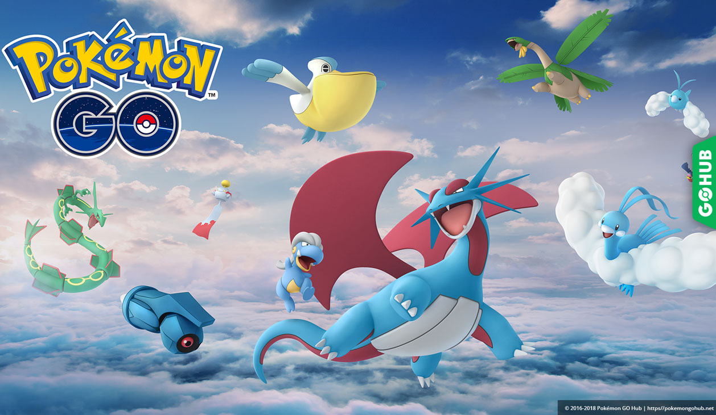
Question

Slide 41

Question
Help me please!

Slide 42

Question

Slide 43
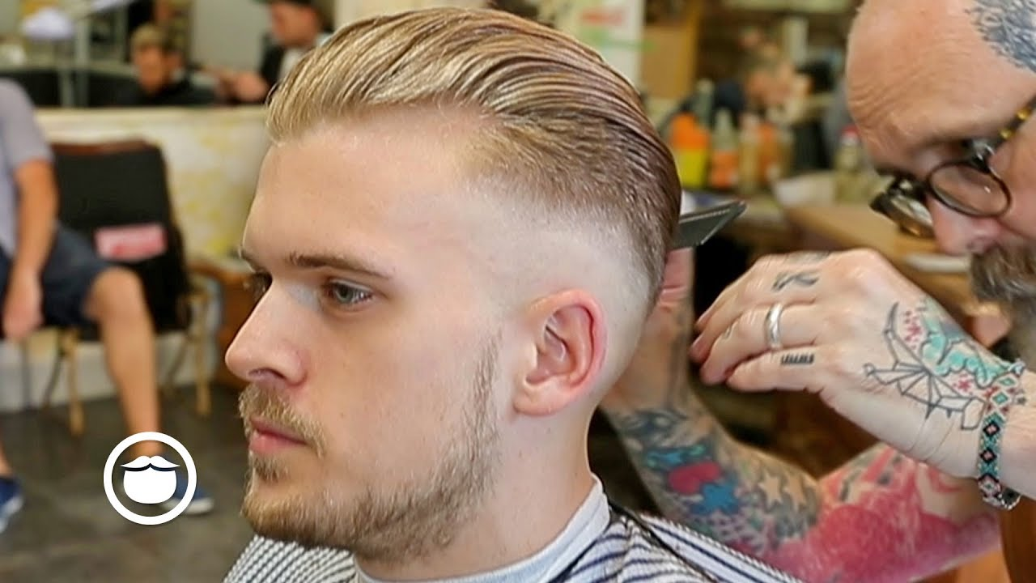
Question
Hair cut

