Slide 1
Some Speaking Games
CIT - Elementary

Slide 2
A quiet language class is a wasted opportunity.

Slide 3
Today’s Goal
We will look at how to select appropriate games.
We will try some games for each speaking level.

Slide 4
Let’s get to know about each other:
Free Choice

Slide 5
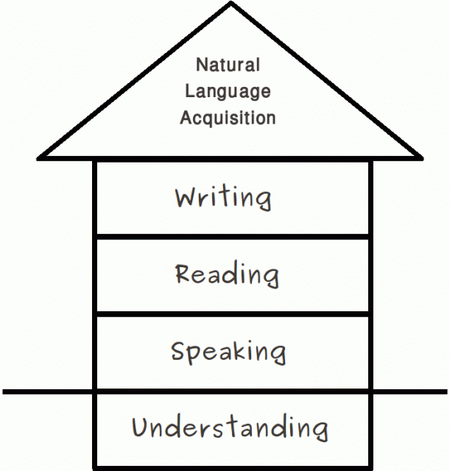
Native Language Acquisition
https://iaskirklees.wordpress.com/2014/10/31/ican-stages-of-speech-and-language-development/

Slide 6
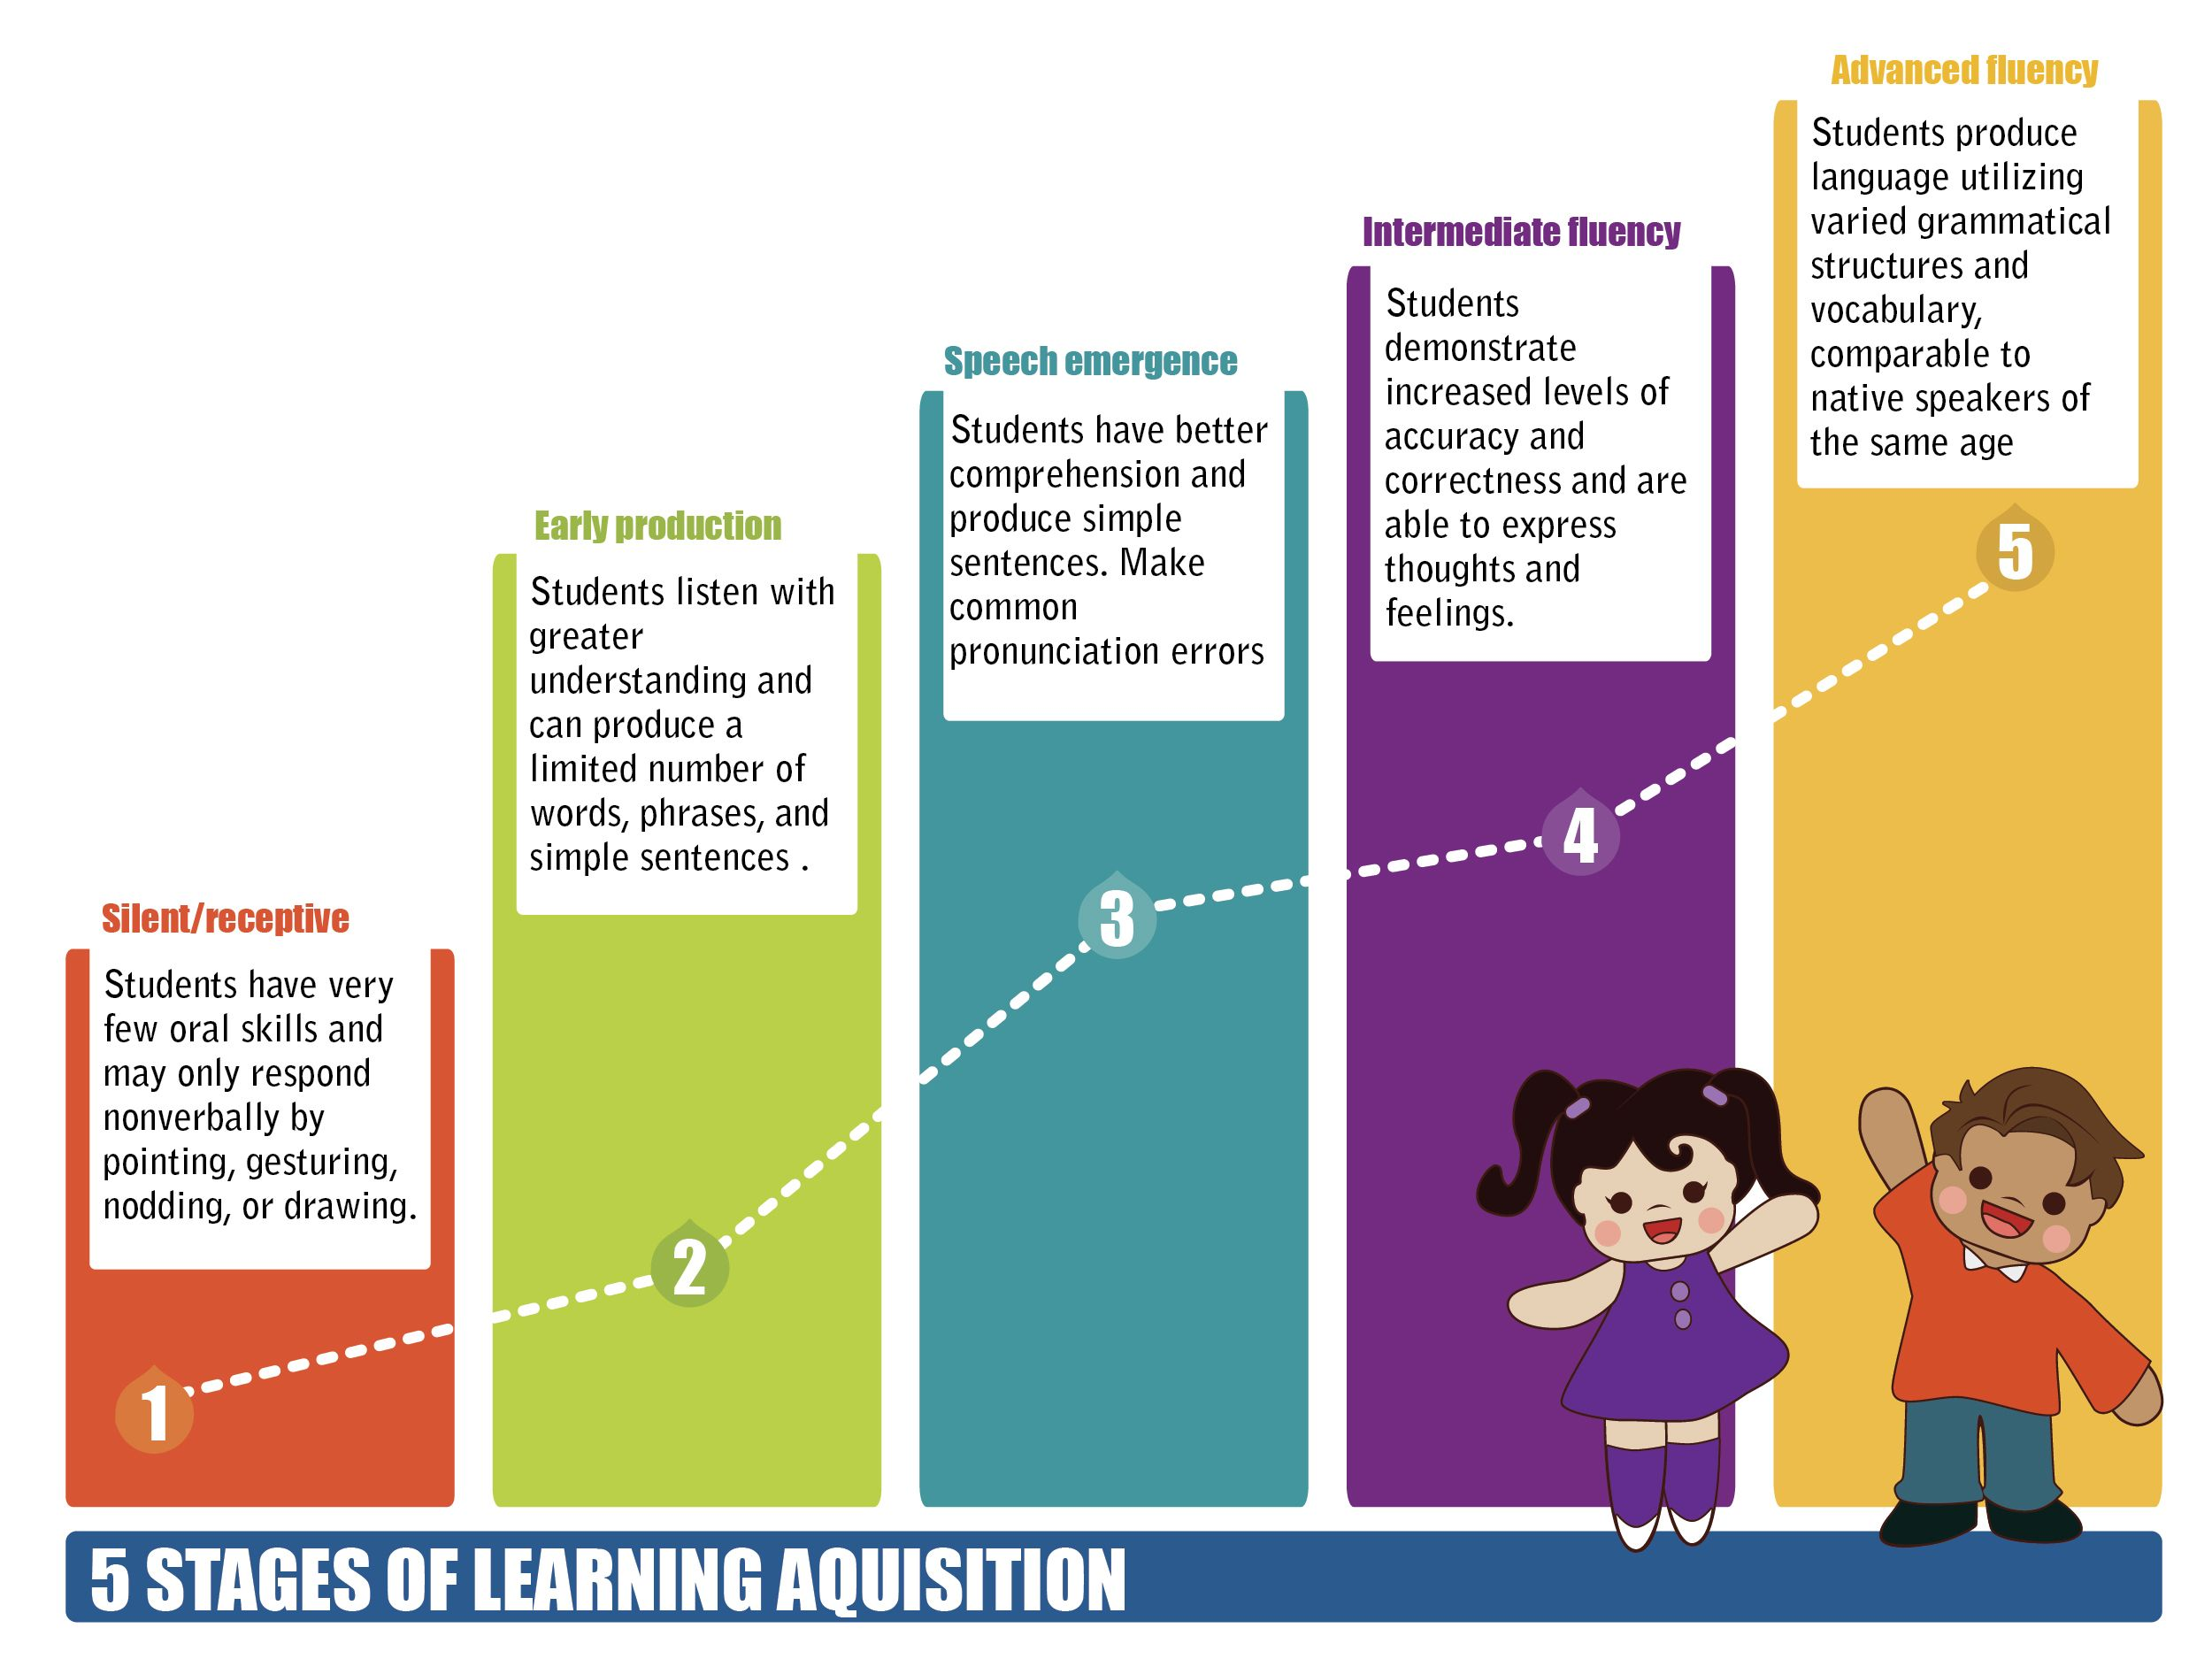
https://www.pinterest.co.kr/pin/260927372146390017/?lp=true

Slide 7
Write about a grade’s English level:
What English skills do they have? What activates do they enjoy?

Slide 9
Young Learners
Silent Stage – Early Production
Games focused on:
Association
Identification
Listen and Repeat
Repetition
*One Word Answers
* Simple Structures

Slide 10
What is this?
http://www.esltoybox.com/?page_id=117
Link to PPT

Slide 11
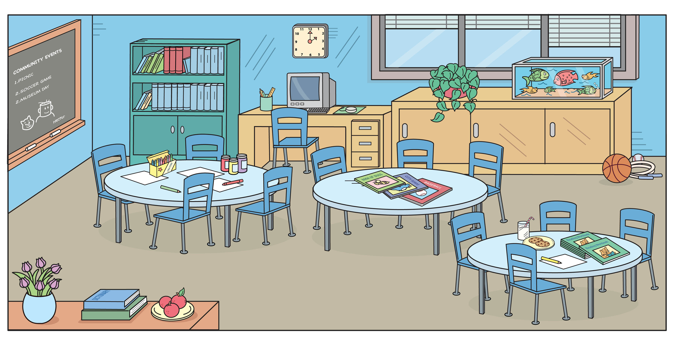

Slide 12
Do You Like Broccoli?
https://www.youtube.com/watch?v=frN3nvhIHUk
http://www.esltoybox.com/?page_id=122

Slide 13
Yes, I do.
Yes, I do.
Do you like chicken?
No, I don’t.
Do you like chicken cake?
Do you like cake?

Slide 15
4th Grade
Early Production – Speech Emergence
Games focused on:
Questions and Answers
Information Gap
Role Play
*Use of Structure

Slide 16
Guessing Gifs
http://www.esltoybox.com/?page_id=228
Link to PPT

Slide 17
Where Are They Game?
http://www.esltoybox.com/?page_id=235

Slide 18
How to play
Each group and the leader will place the characters in their house.
Leader should do this in secret.
Students will ask where each character (mother, father, grandma…) is
The leader will answer, “He / She is in the _________”
Students will check if it matches where they put their character.
Students receive a point for each correct guess.

Slide 20
5th Grade
Early Production – Speech Emergence
Games focused on:
Realia
Useful Phrases
Context
*Creating New Sentences
*Manipulating Structure

Slide 21
What is he doing Battleship?
http://www.esltoybox.com/?page_id=404
Link to PPT

Slide 22
Restaurant Role Play
http://www.esltoybox.com/?page_id=356

Slide 23
Role Play:
Each group will choose one waiter / waitress.
The waitress will ask, “May I take your order?”
The other students will make their order by asking, “May I have ____________?”
The waiter / waitress will write down the orders.

Slide 25
6th Grade
Speech Emergence – Early Fluency
Games focused on:
Improvised Answers
Opinion
Explanation and Description
Situational English (Realism)
*Building Creative Sentences
*Speed and Accuracy

Slide 26
Create a Mall
http://www.esltoybox.com/?page_id=470

Slide 27
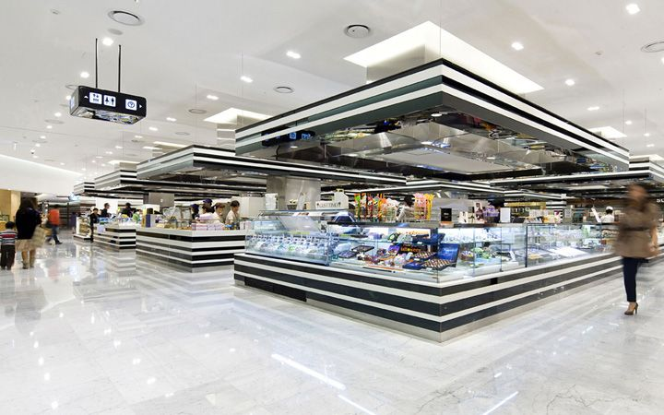
Build a Department Store:
Put the stores into the mall on different floors
You can only put it there if there is space
Electronics
Theater
Shoe Store
Clothing Store
Pet Shop
Restaurant

Slide 28
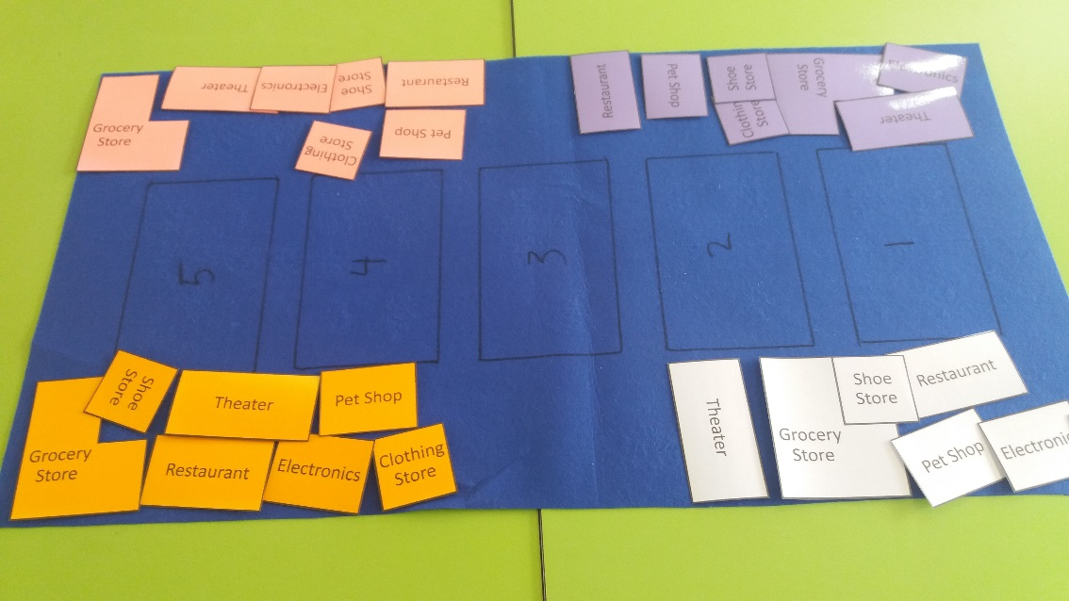
Build a Department Store:
Put the store in the middle of the table
Each student gets one color of department stores

Slide 29
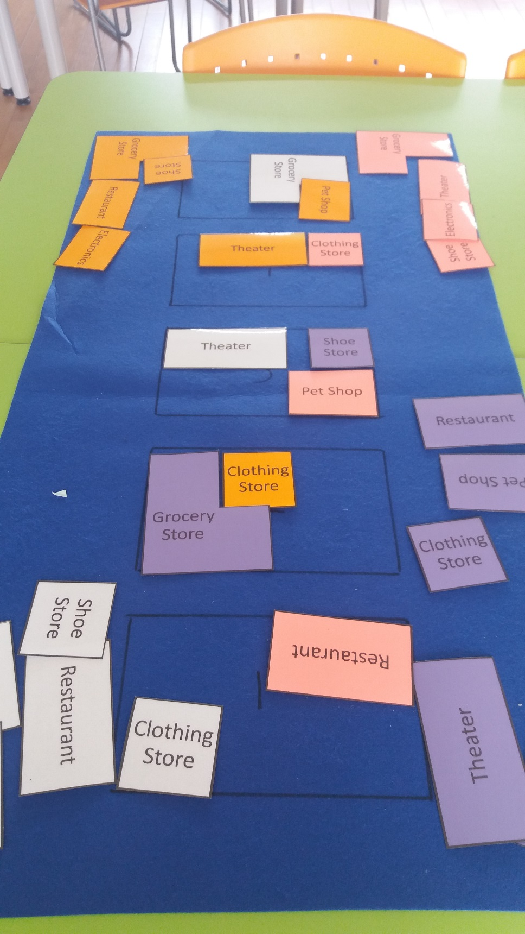
Build a Department Store:
You can’t place the same store on the same floor.
If the store doesn’t fit, you can’t put it in the mall.
Take turns and be kind.

Slide 30
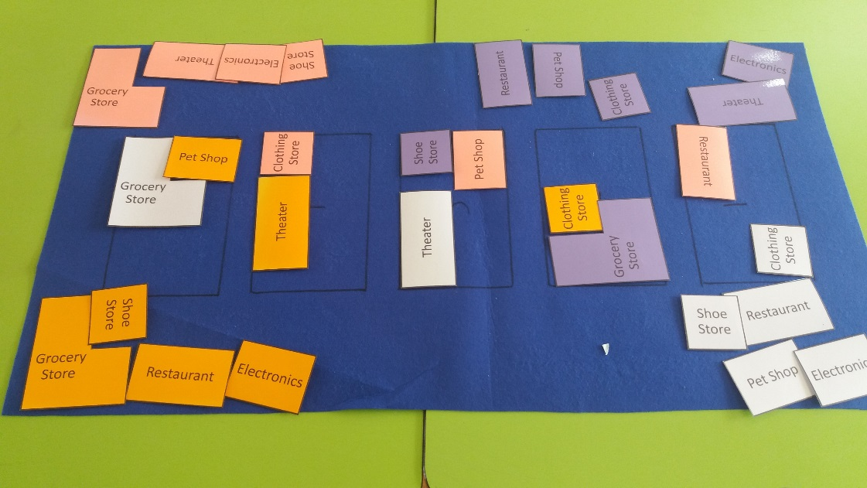
How to Play:
Choose a store
The other players will ask, “Where is the _______”
Roll the dice and say, “It’s on the _________ floor.” (6 = choice)
Try placing it on the board
If it doesn’t fit, put it back in your hand.

Slide 31
Points
One point for each store
One bonus point for 2 stores on the same floor.
One more bonus point for 3 stores on the same floor.

Slide 32
Holiday Calendar
http://www.esltoybox.com/?page_id=480

Slide 33
How to Play
Every student receives a card and a calendar.
Students must ask each other, “When is __________?”
Write the name of the holiday on the calendar.
Take up the answers at the end.

Slide 34
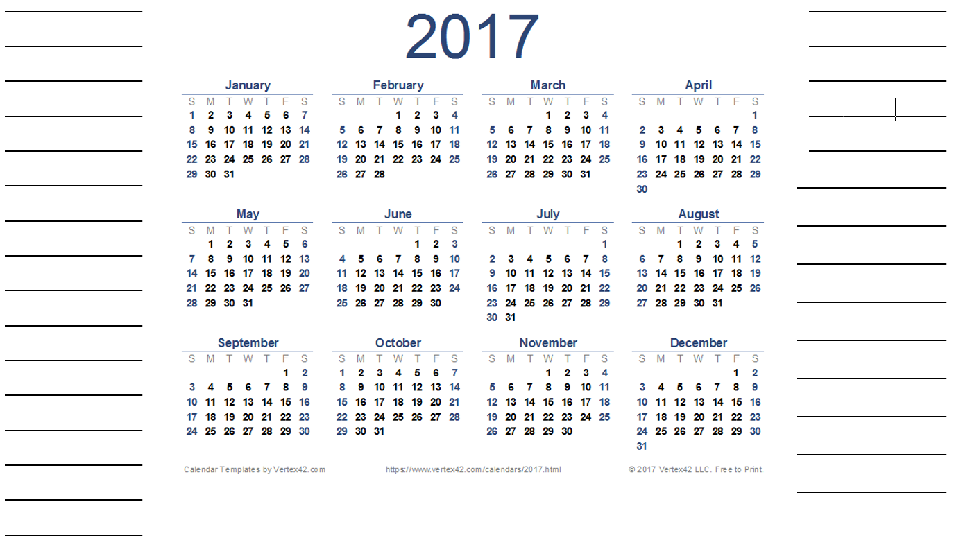

Slide 35
New Year’s Day
Independence Movement Day
Australia Day
St. Patrick’s Day
World Radio Day
Arbor Day
Valentine’s Day
English Language Day
Children’s Day
Canada Day
Teacher’s Day
Constitution Day
Youth Day
Memorial Day
Liberation Day
Picnic Day
Talk Like Pirate Day
Peppero Day
World Toilet Day
Day of Peace
Christmas
Hangeul Day
Halloween
New Year’s Eve

Slide 37
Bonus: Hot Seat
http://www.esltoybox.com/?page_id=663

Slide 38
www.esltoybox.com

