Slide 1
TIM
TIMOTHY JACK SCHILSTRA

Slide 2
Where am I from?

Slide 3
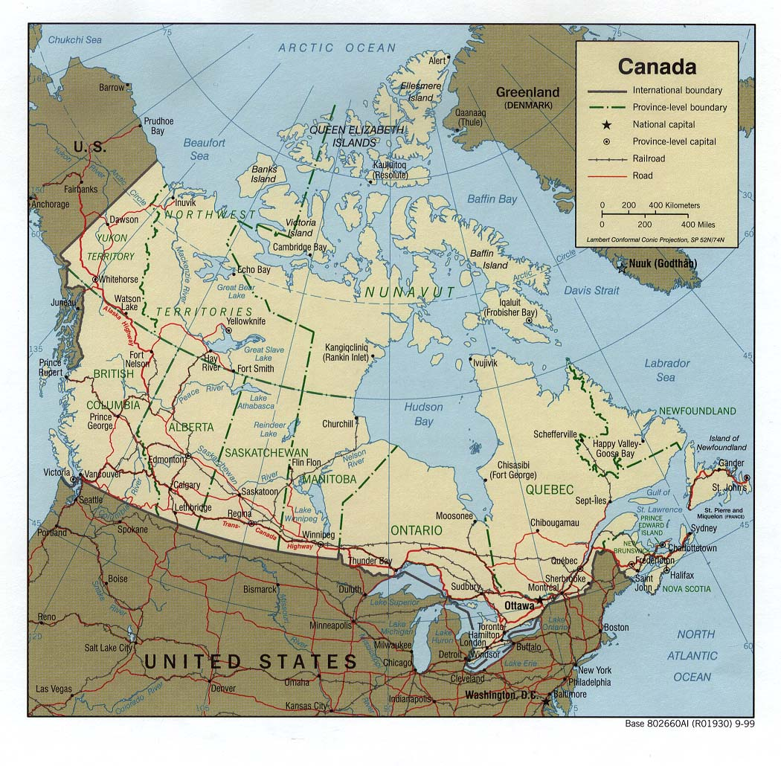
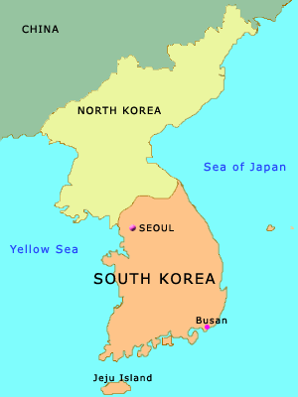

Slide 5
How many are there in my family?

Slide 6
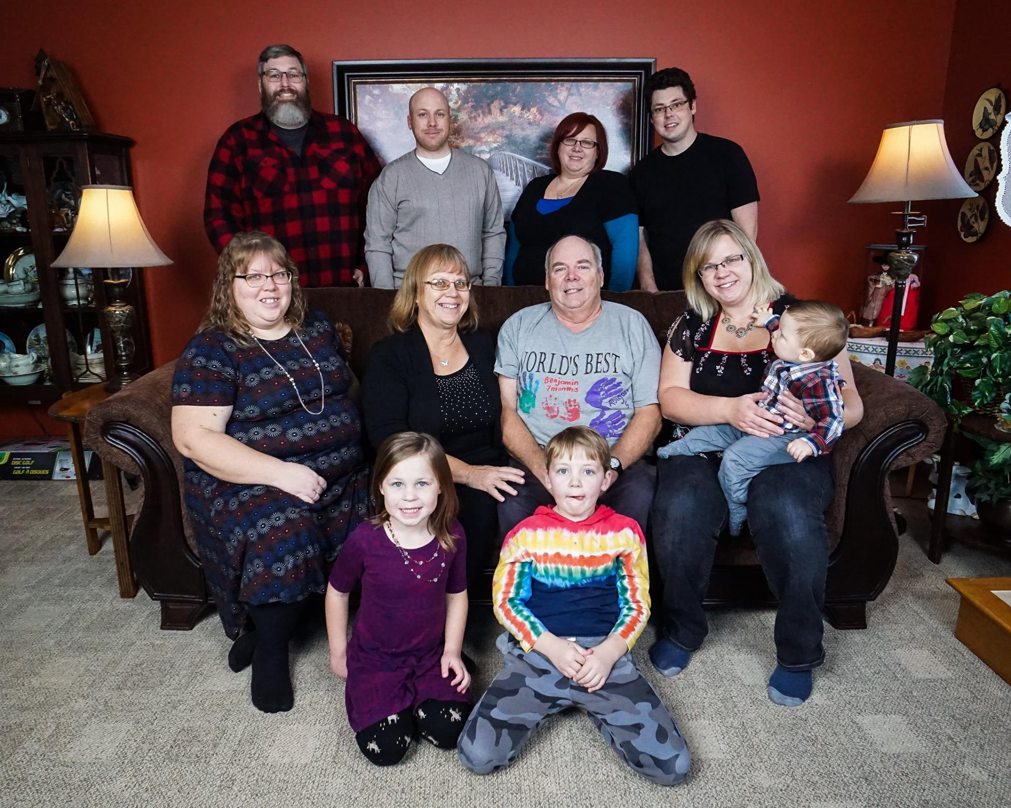
My Family

Slide 7
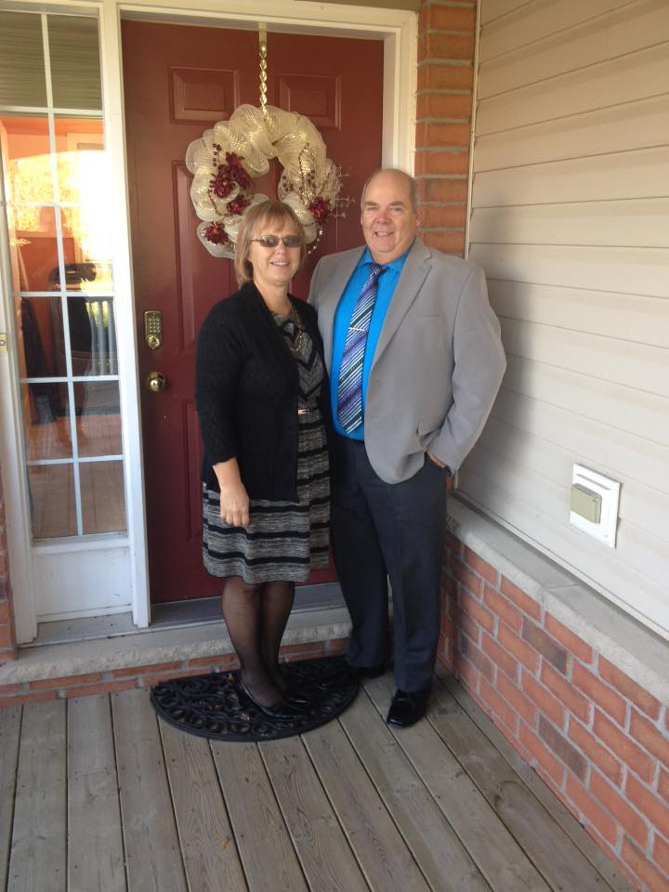
Mother and Father

Slide 8
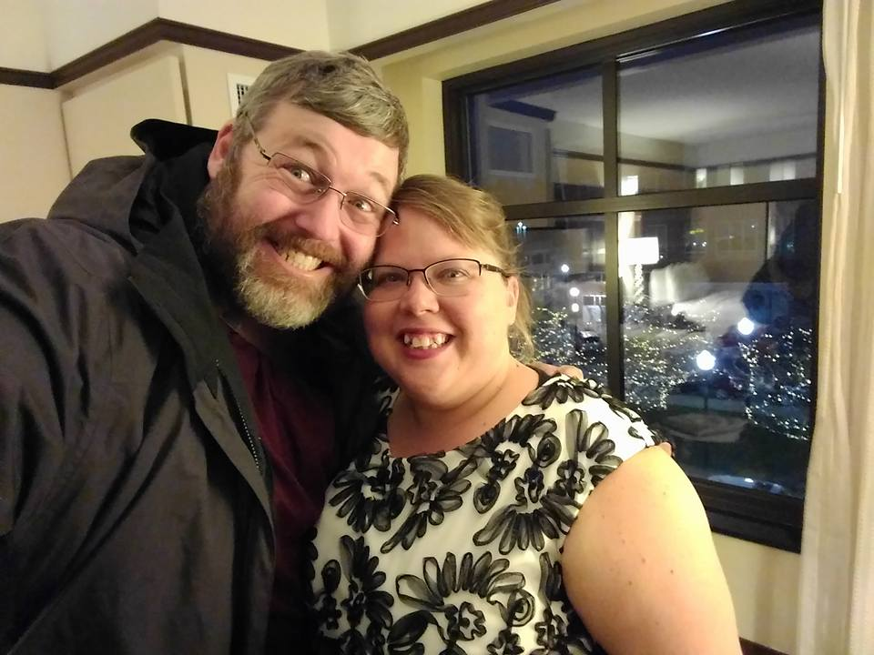
Debbie and Dave

Slide 9
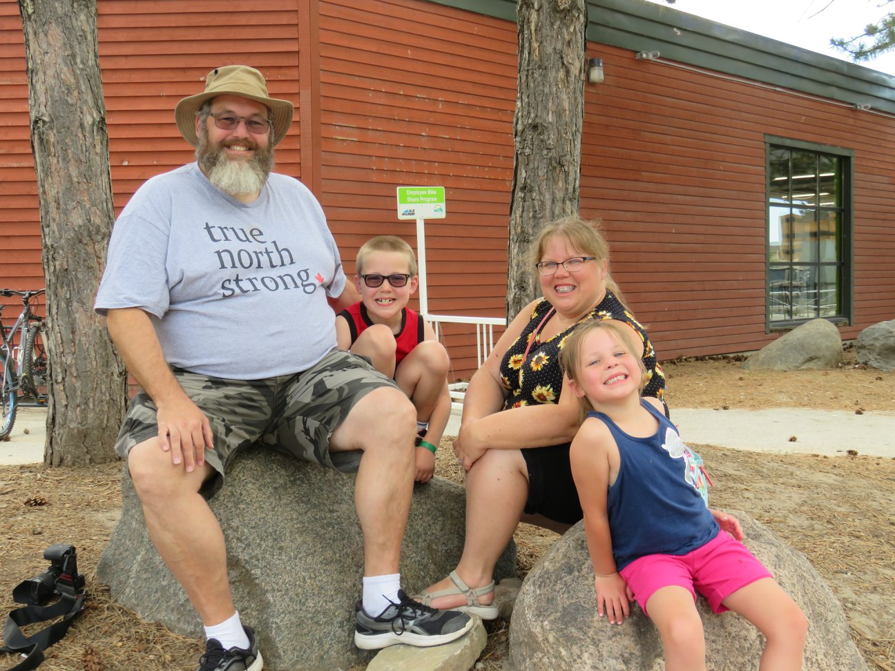
Zeke and Abigail

Slide 10
Amanda

Slide 11
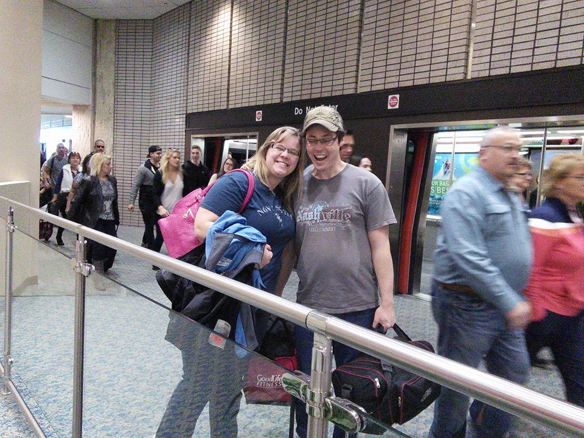
Melissa and Bob

Slide 12
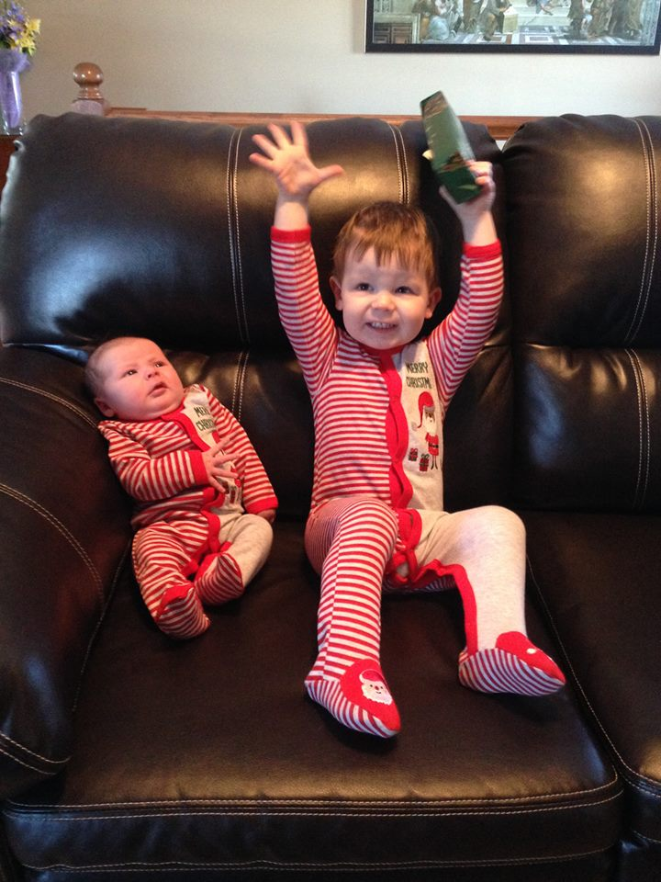
Benjamin Lydia

Slide 13
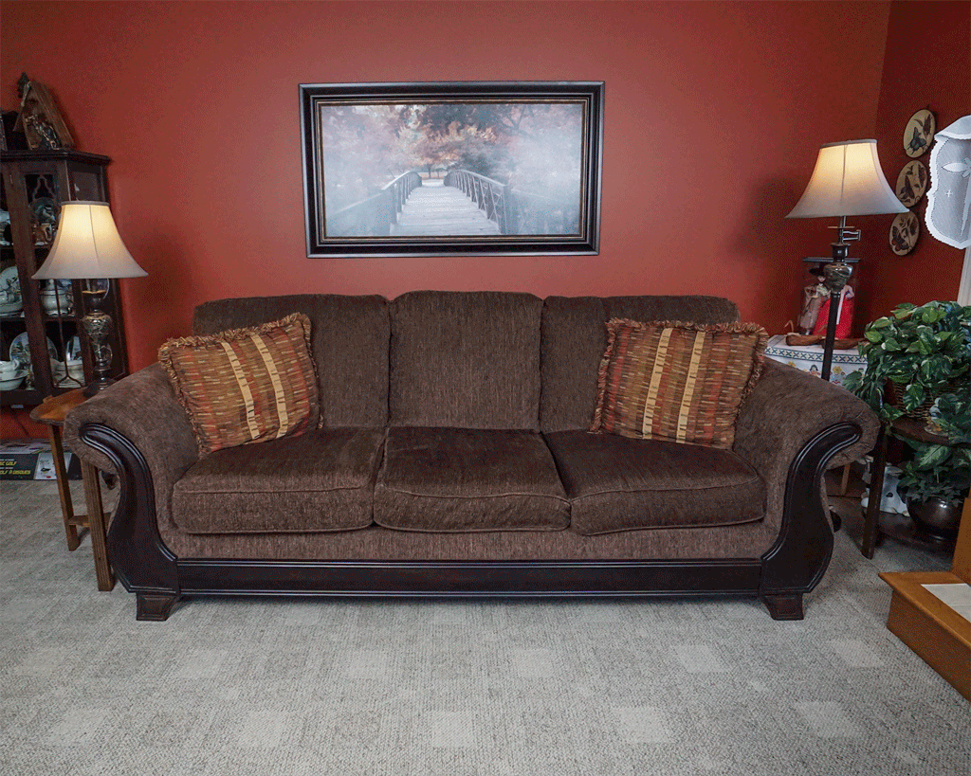

Slide 14
How long have I lived in Korea?

Slide 15
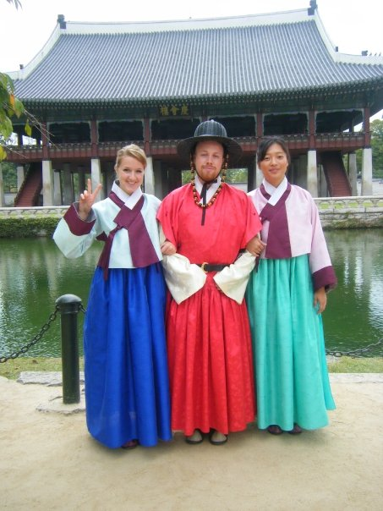
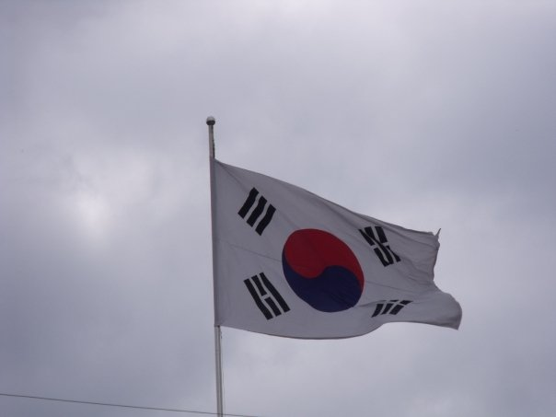
Mr.S in Korea
2009

Slide 16
Yuseong Bio-Science and Technology High School

Slide 17
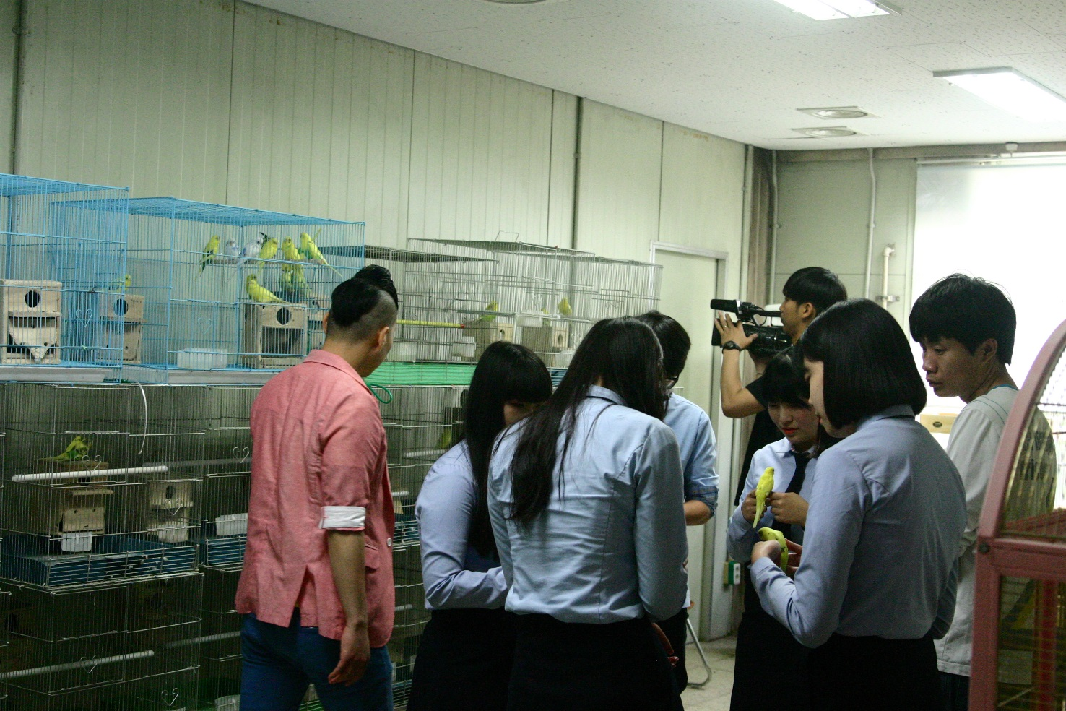
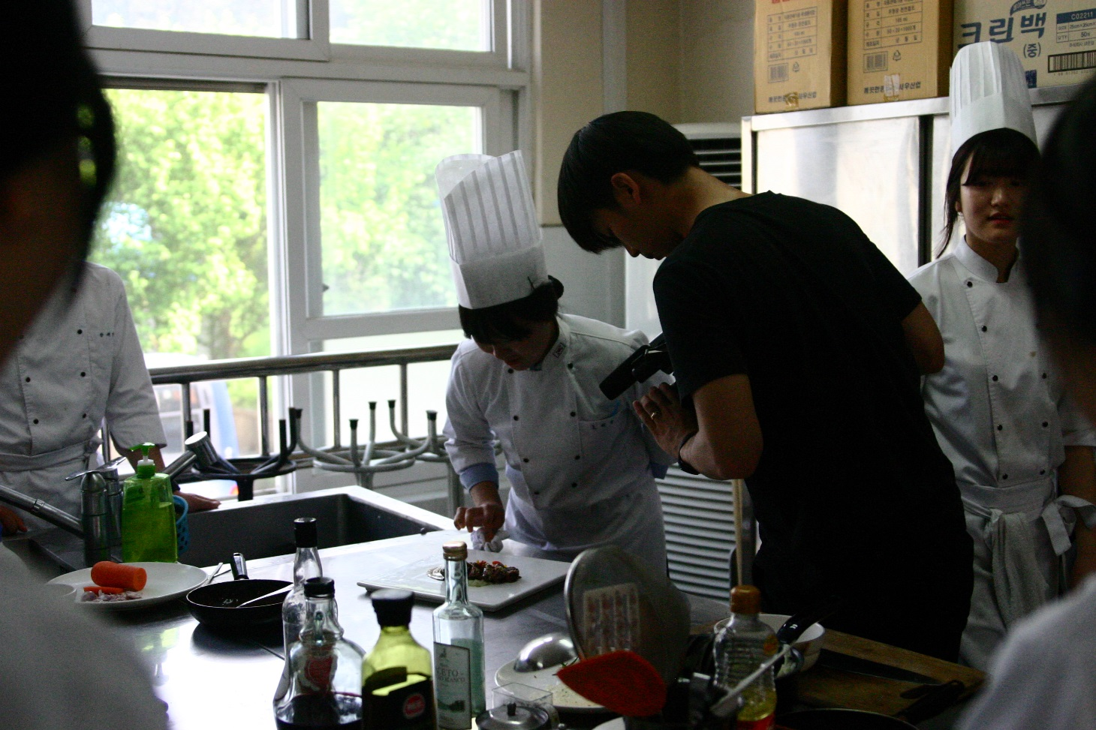
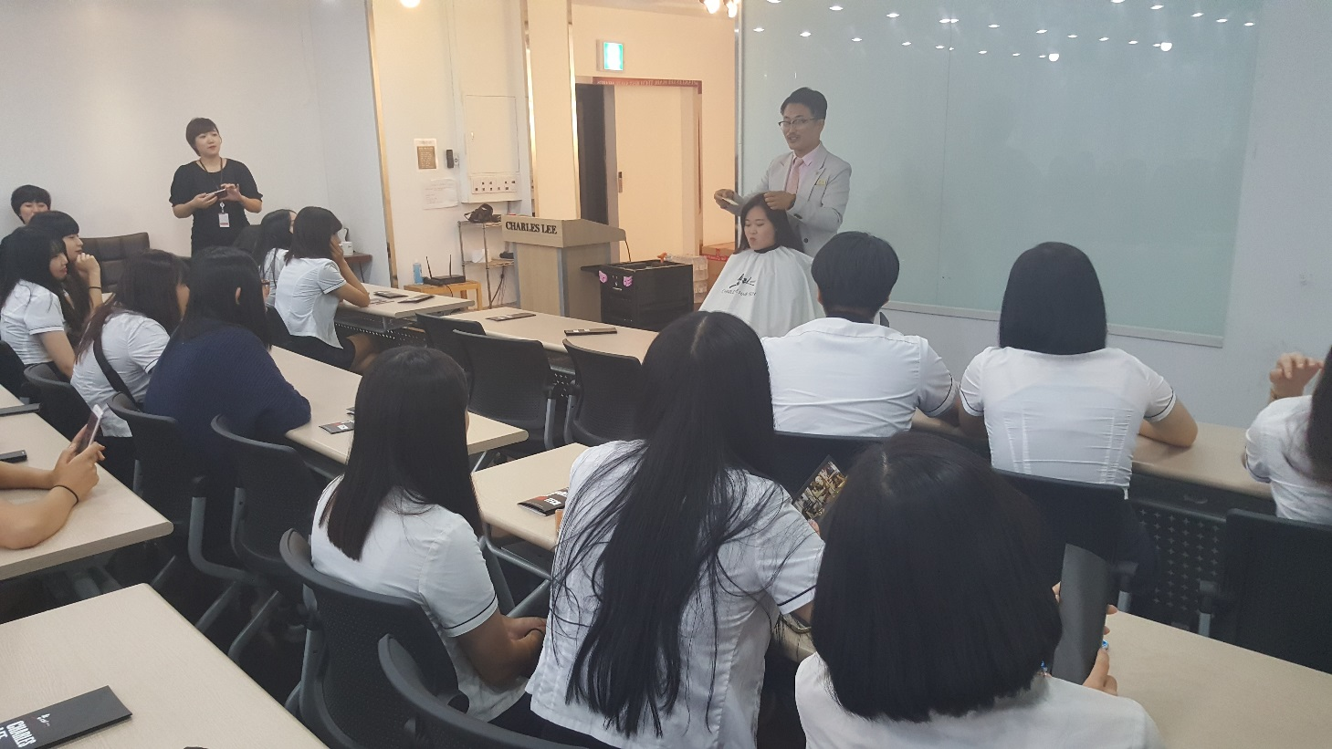

Slide 18
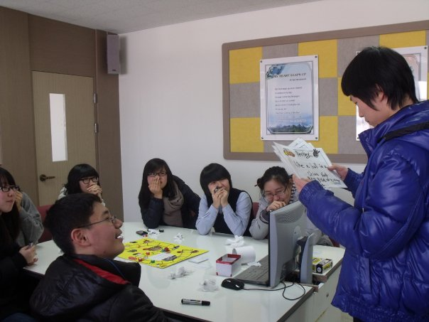
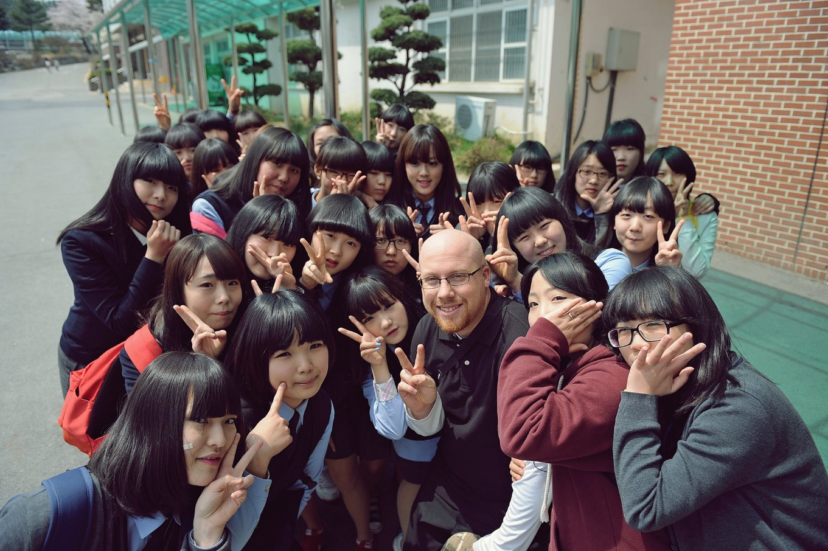

Slide 19
Eoeun Elementary School

Slide 20
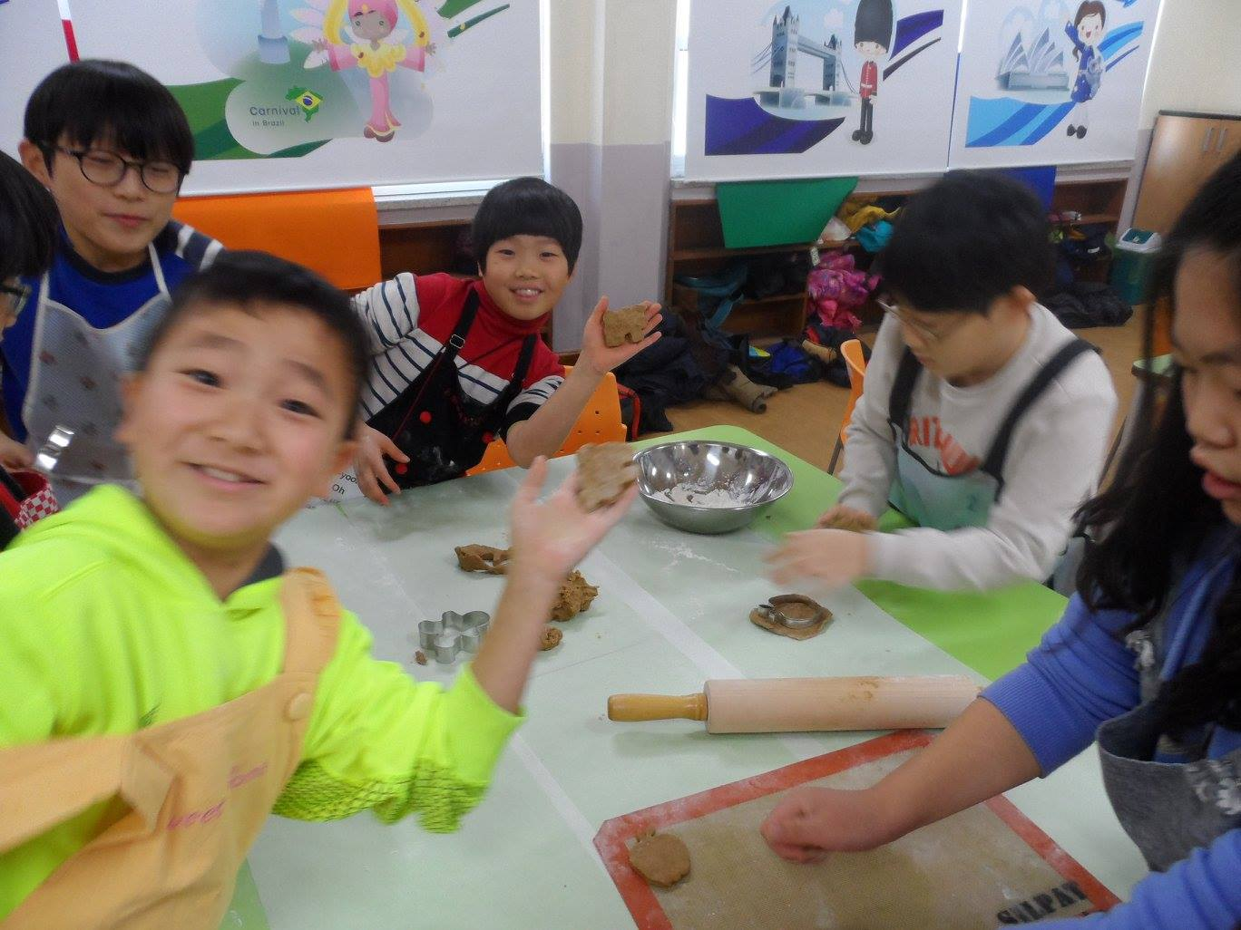

Slide 21
Shinhan High School

Slide 22
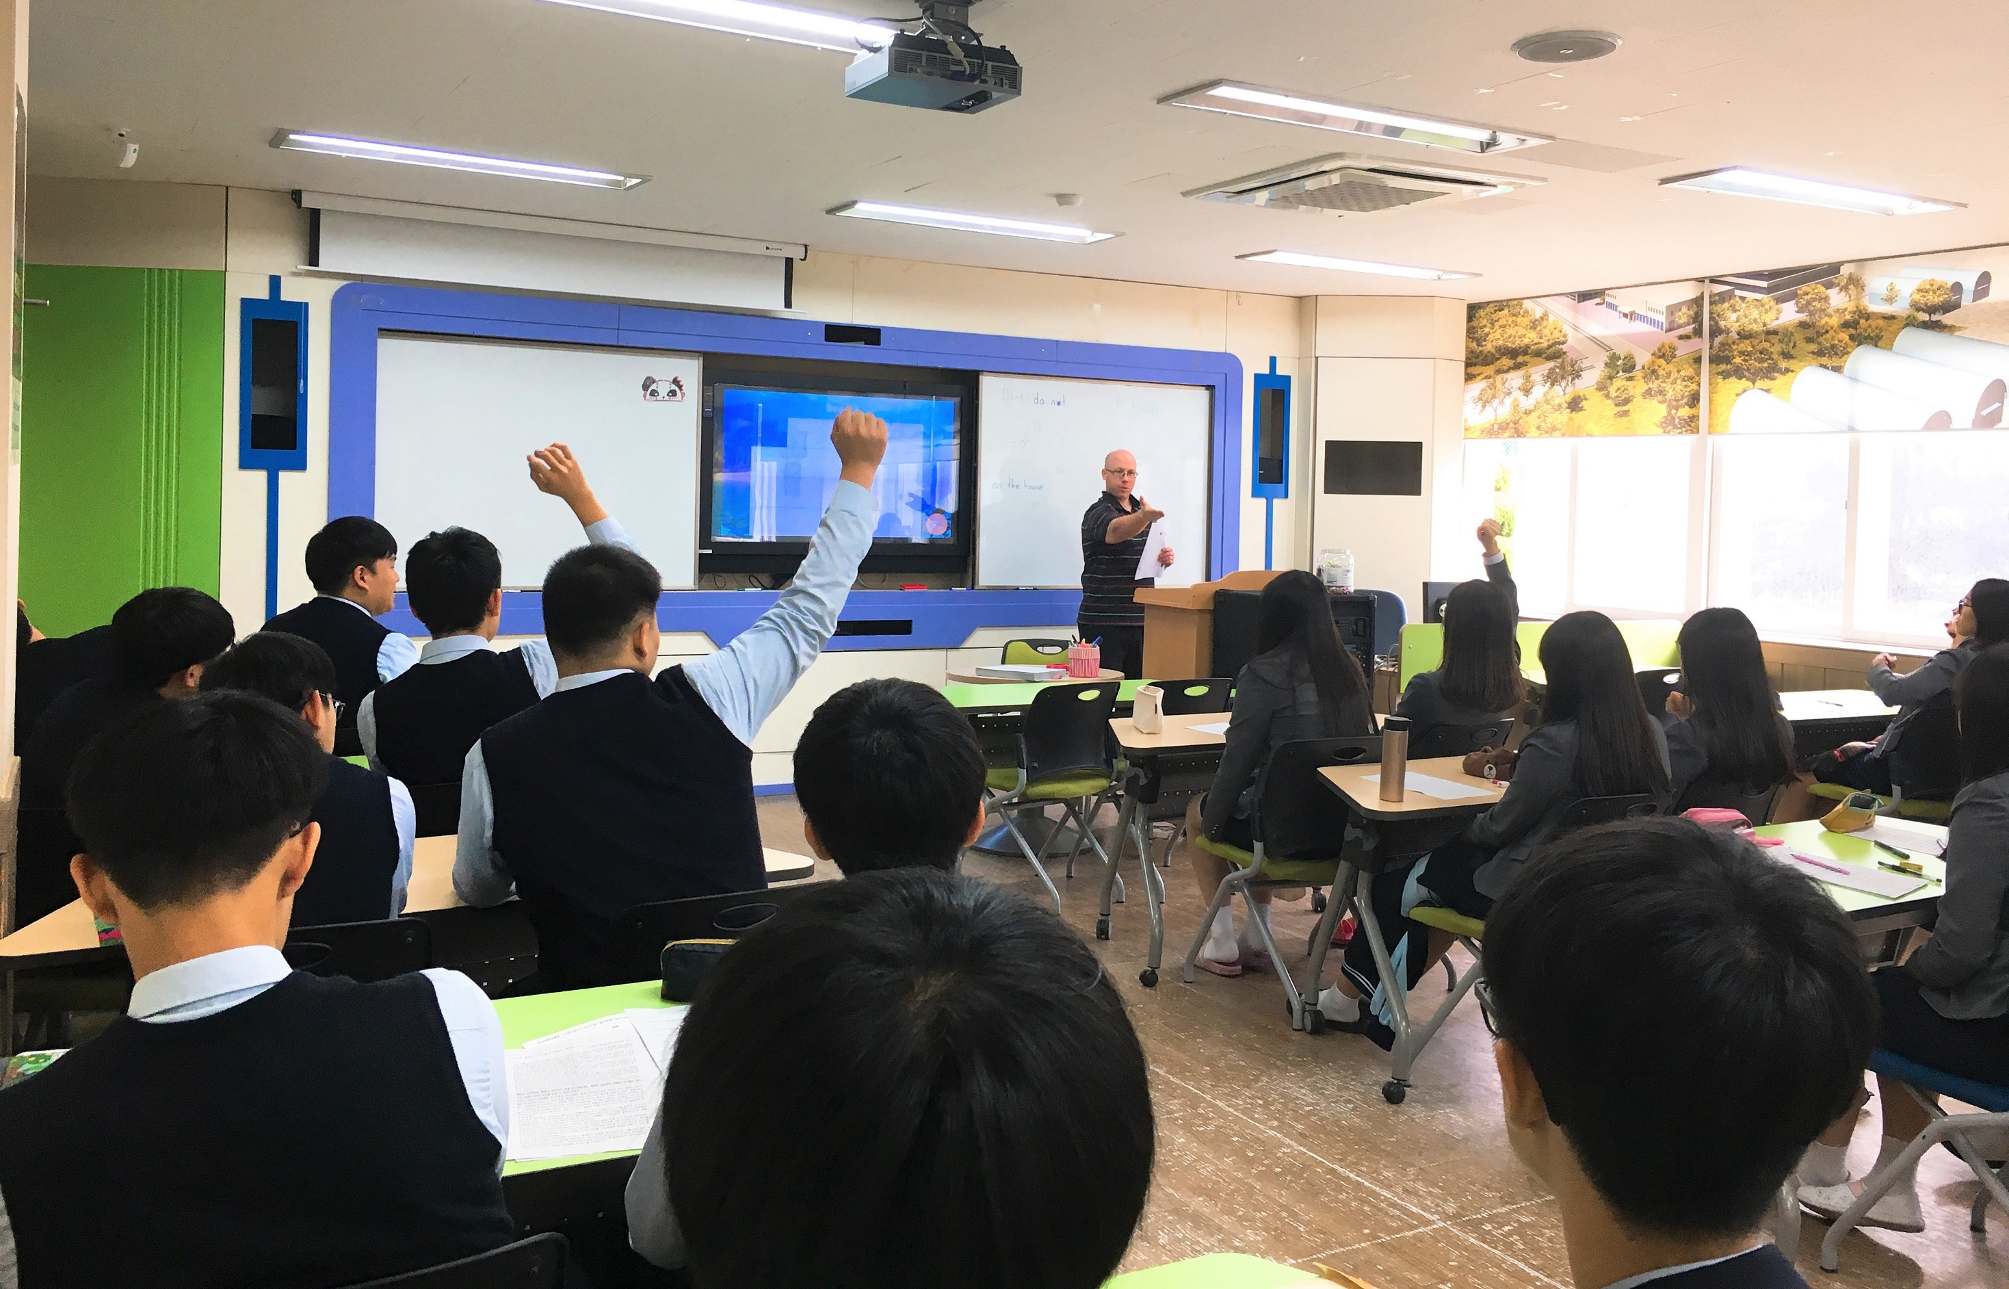
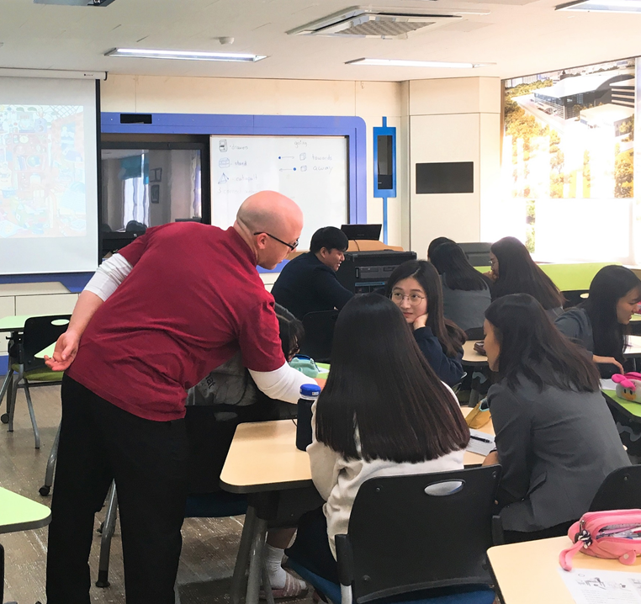

Slide 23
What was my major?

Slide 24
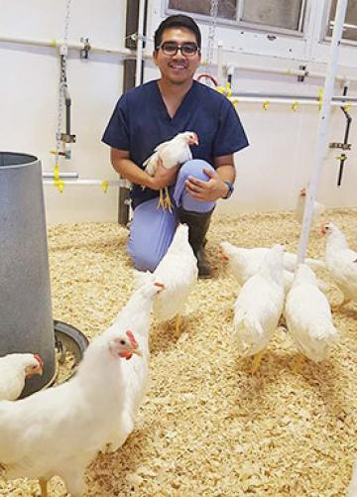

Slide 25
What is my favorite Korean Food?

Slide 26
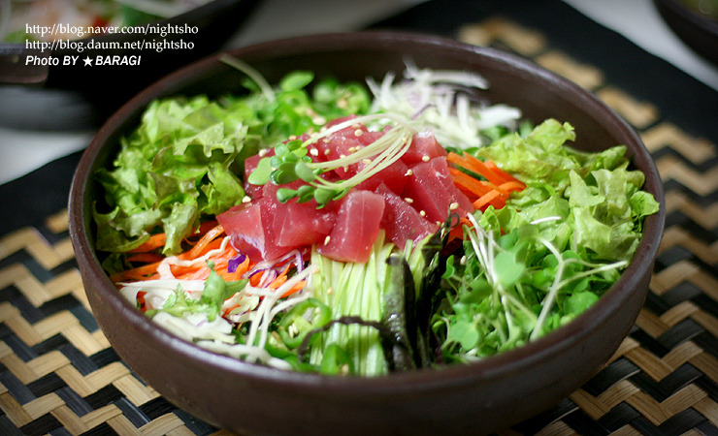
What is my favorite Korean Food?

Slide 27
What is my favorite hobby?

Slide 28
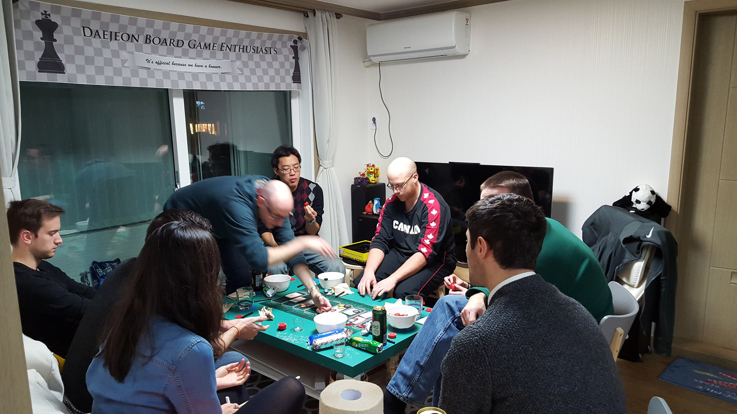
My Hobbies
Cycling
Playing board games

Slide 29
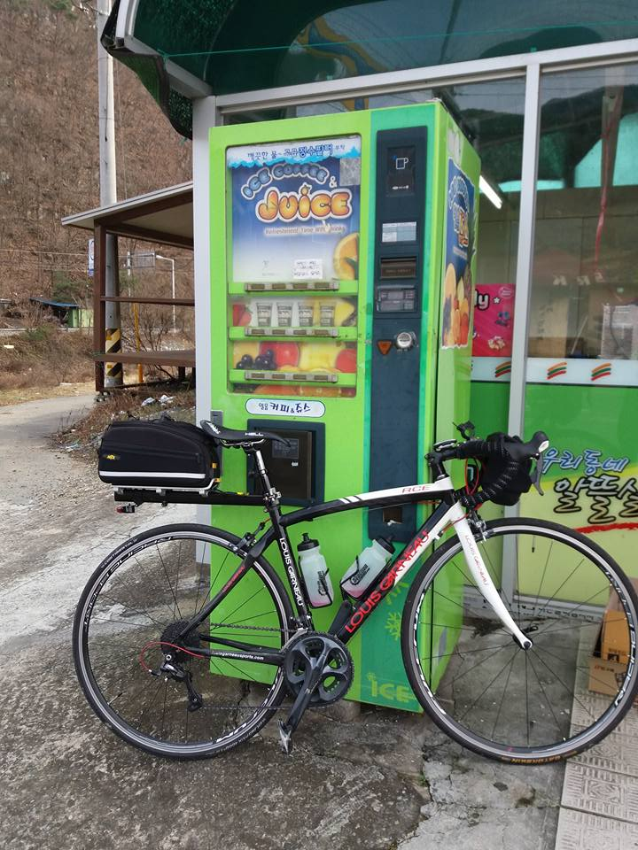
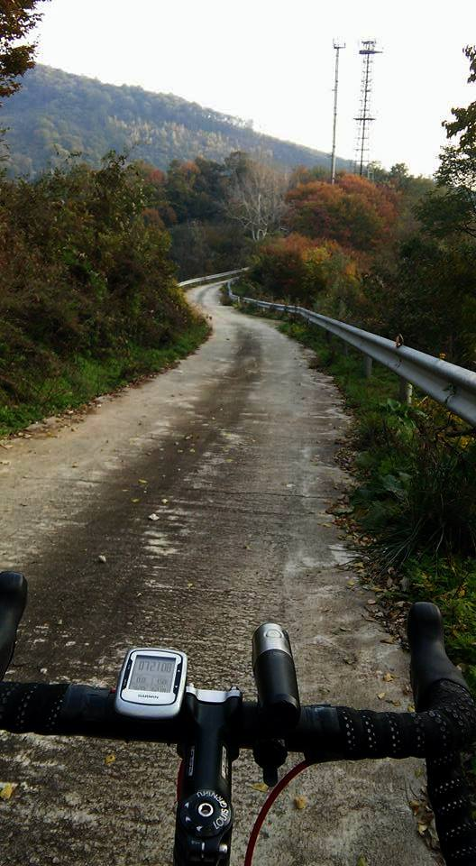
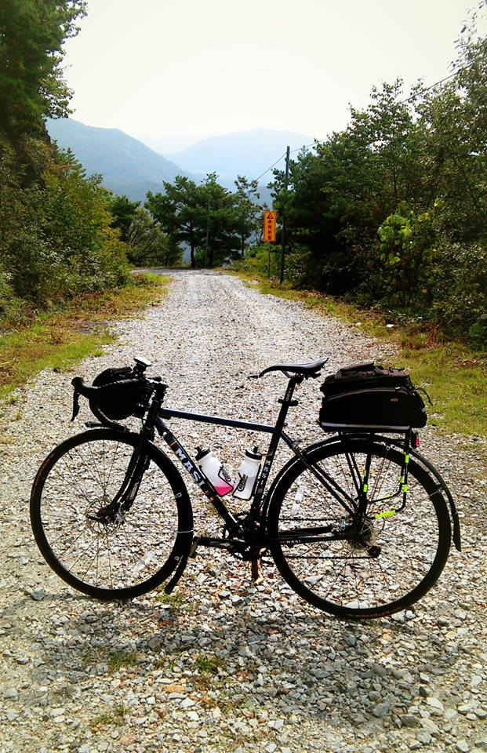
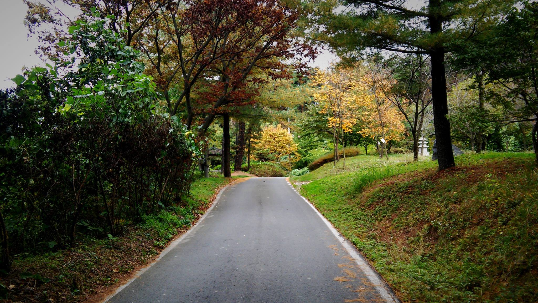

Slide 30
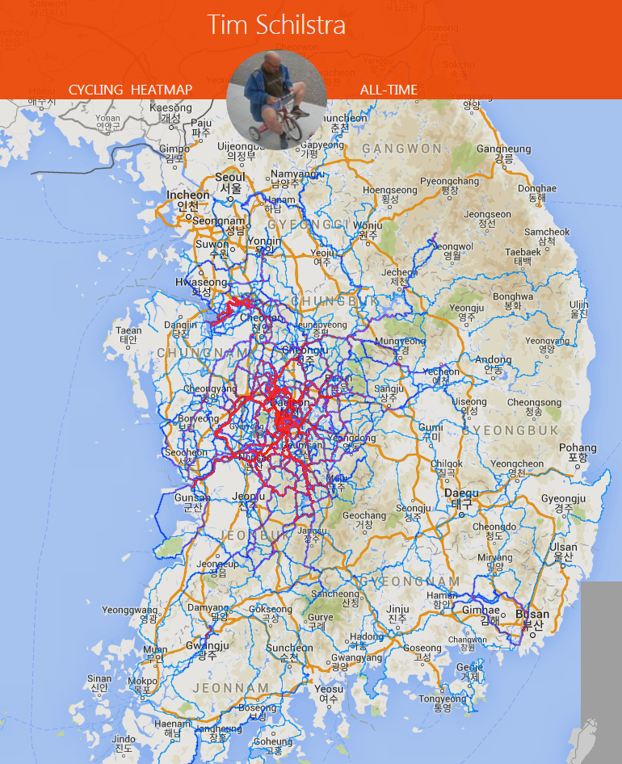

Slide 31
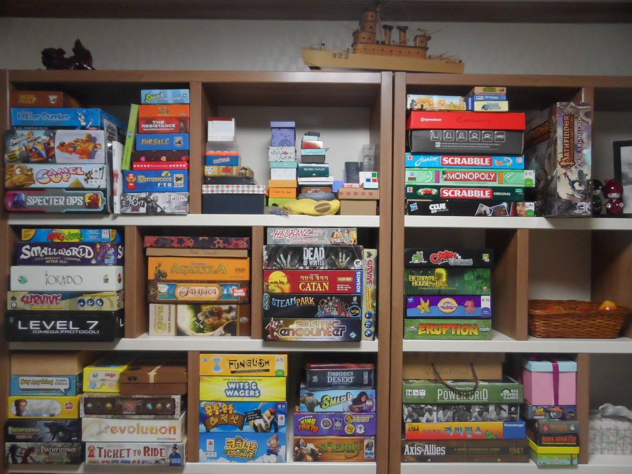
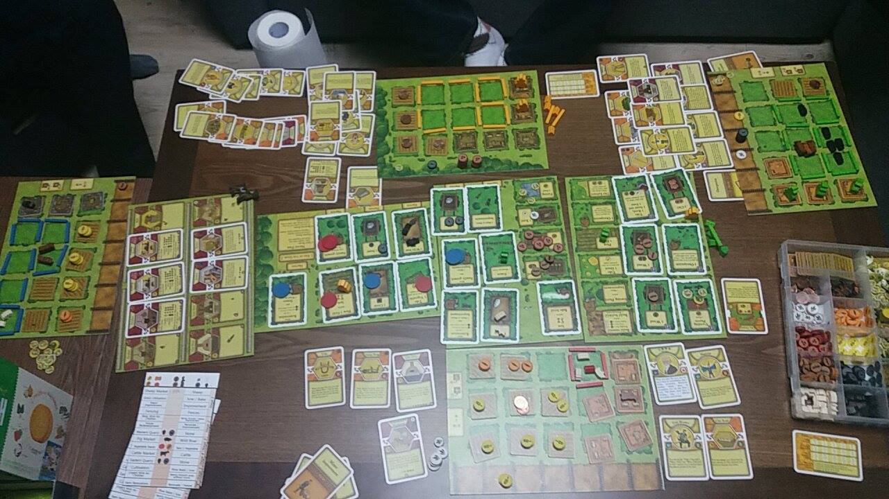
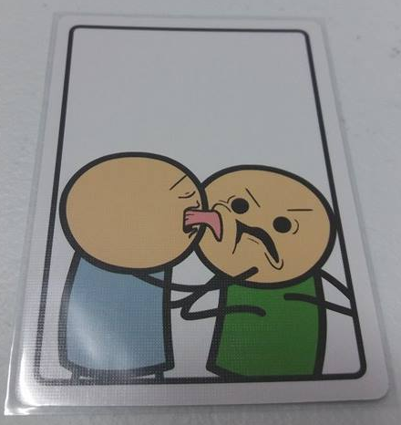

Slide 32
What is my favorite animal?

Slide 33
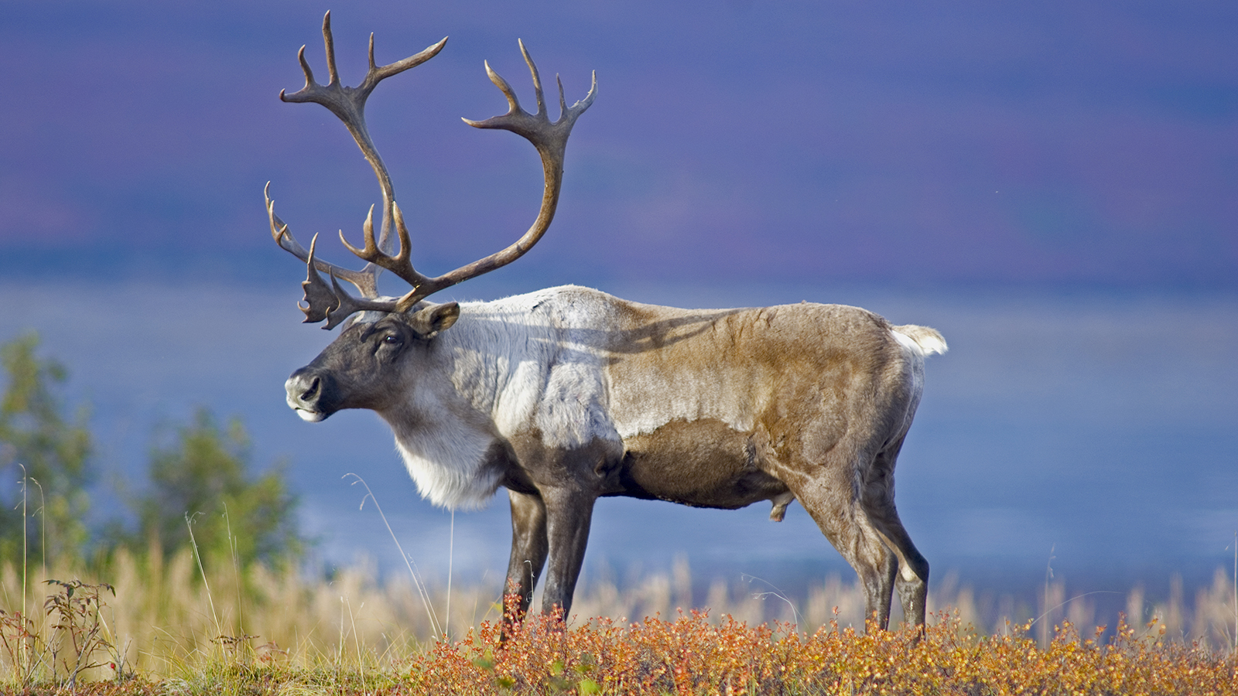
What is my favorite animal?

Slide 34
What is the strangest place I have been?

Slide 35
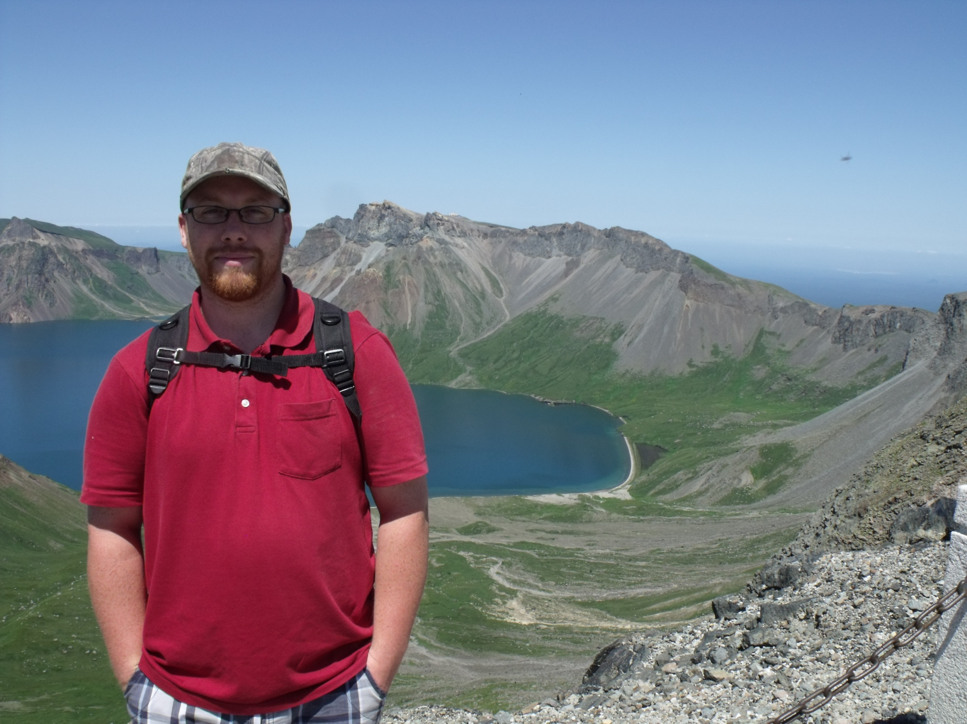

Slide 36
GOALS
WRITING III

Slide 37
HISTORY OF WRITING
…AND THE ENGLISH LANGUAGE

Slide 38
CREATIVE WRITING
CHARACTER-BASED STORY

Slide 39
FORMAL WRITING
ESSAYS

Slide 40
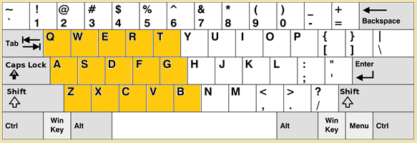
Writing Puzzles
What is the longest word you can write with just the left side of your keyboard?
Tesseradecades
Aftercataracts
Sweaterdresses

Slide 41
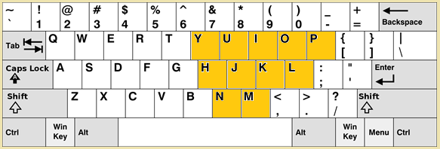
Writing Puzzles
What is the longest word you can write with just the right side of your keyboard?
Monimolimnion
Phyllophyllin

Slide 42
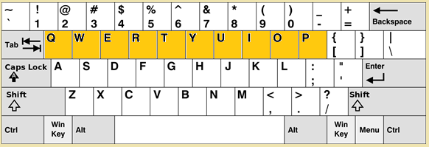
Writing Puzzles
What is the longest word you can write with just the top row of your keyboard?
Typewriter
Pepperwort
Perpetuity
Proprietor
Requietory
Repertoire
Tripertite
Pourriture

Slide 43
Find the spelling mistake

Slide 44
Writing Puzzles
What is the longest word with only 1 vowel?
Strengths

Slide 45
Writing Puzzles
What is the longest word you can write on a 7 bar display.
https://www.youtube.com/watch?v=zp4BMR88260

Slide 48
Writing Puzzles

Slide 49
Writing Puzzles
What is the longest word with no repeated letters?
Subdermatoglyphic

Slide 50
Writing Puzzles
What is special about these sentences?
“Sphinx of black quartz, judge my vow.”
“Pack my box with five dozen liquor jugs”
“The quick onyx goblin jumps over the lazy dwarf.”
All 26 letters.

Slide 51
Writing Puzzles
Why is “smiles” the longest word?
There is a mile between s and s S………….mile……………s

Slide 52
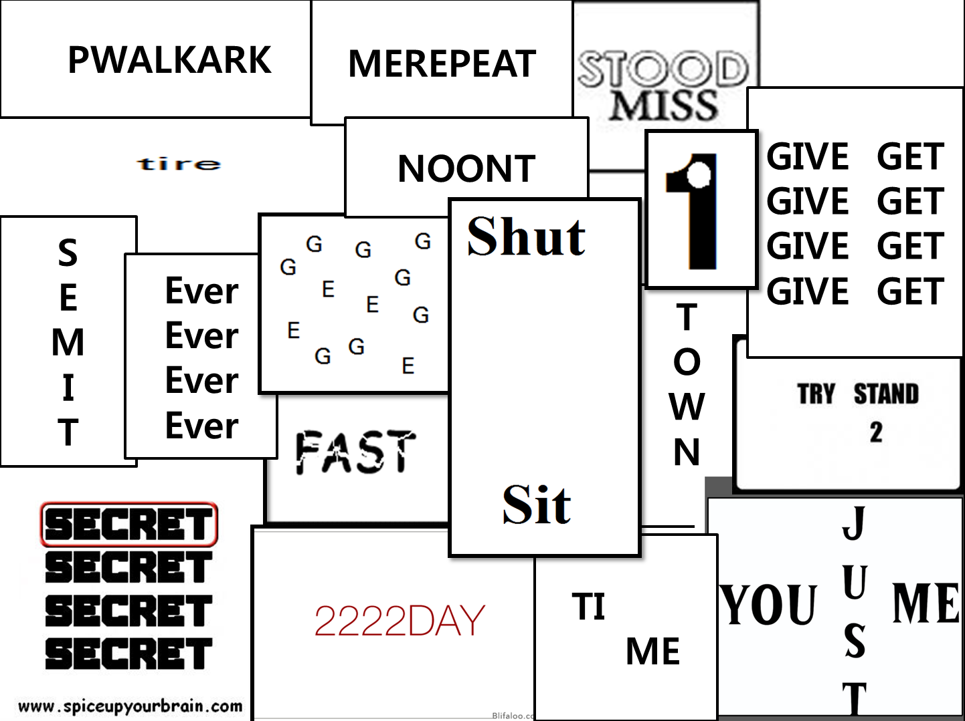
REBUS Puzzles
Repeat after me.
Walk in the park.
Forgive and forget
Try to understand.
Shut up and sit down.
Hole in one.
Downtown
Half time / Break time
Forever
Times up
Flat tire
Breakfast
Misunderstood
Scrambled eggs
Afternoon tea
Tuesday
Top secret
Just between you and me

