Slide 1
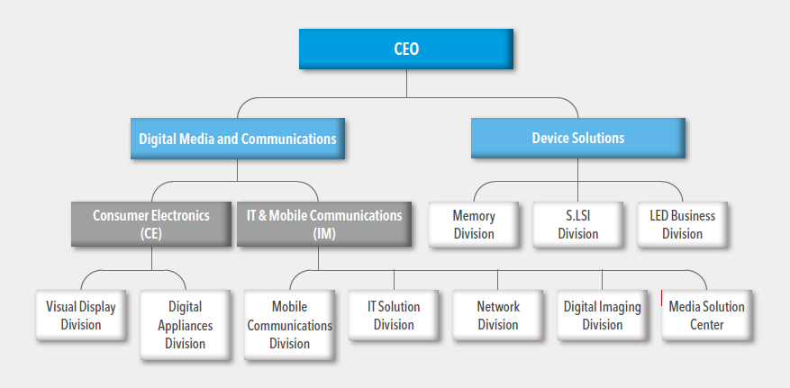
Lesson 2 – Corporate Structure

Slide 2
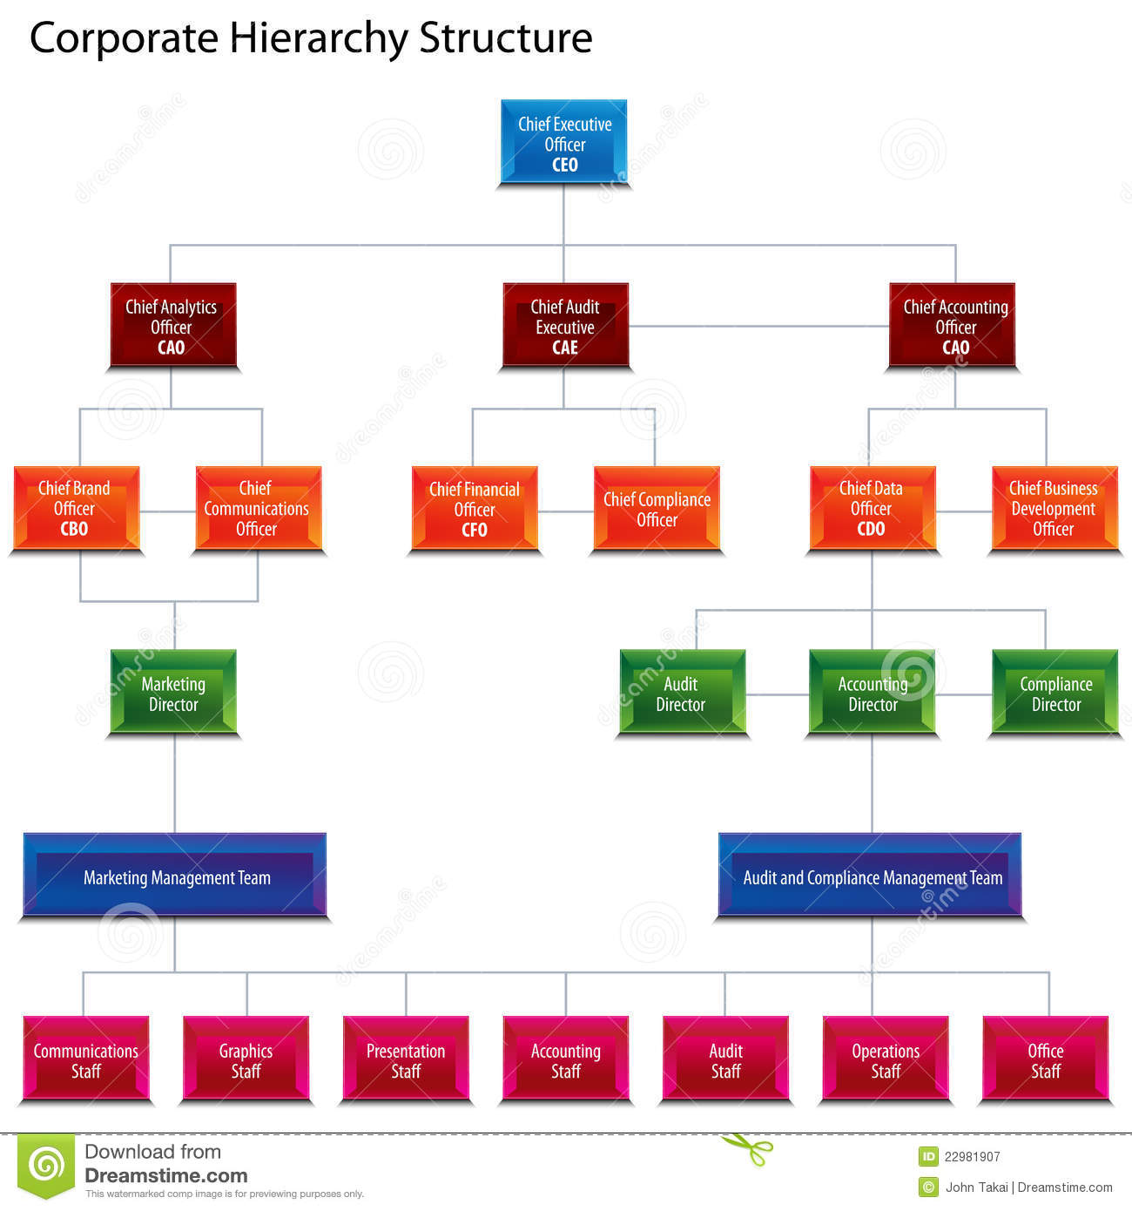

Slide 3

CEO

Slide 4
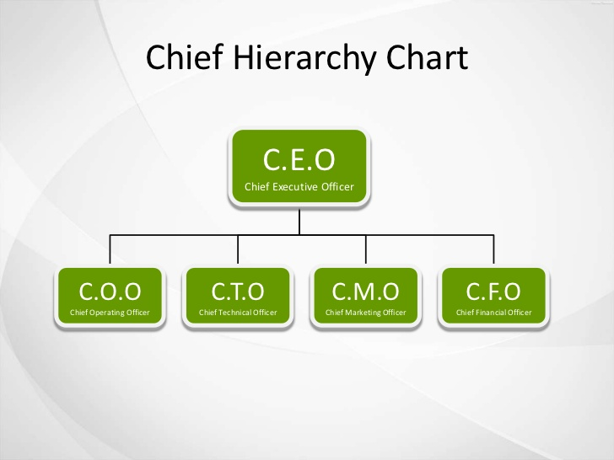


Slide 5
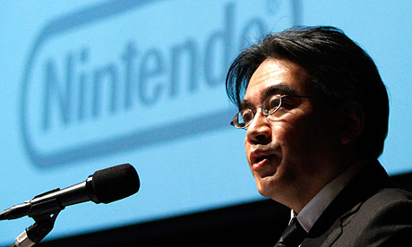
President

Slide 6

Vice - President

Slide 7
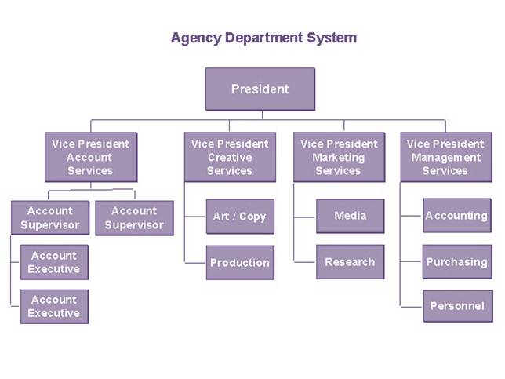

Slide 8

Manager

Slide 9
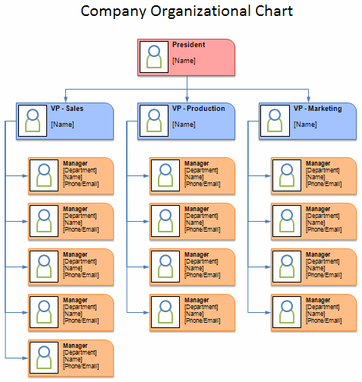

Slide 10

Staff

Slide 11
CEO
President
Vice President
Vice President
Manager
Manager
Manager
Staff
Staff
Staff
Staff
Staff
Staff
Staff
Staff

Slide 12
CEO
Departments
President
Vice President
Vice President
Manager
Manager
Manager
Staff
Staff
Staff
Staff
Staff
Staff
Staff
Staff

Slide 13

R+D
(Research and Development)

Slide 14

Sales

Slide 15

Accounting
(Finance Department)

Slide 16

HR
(Human Resources)

Slide 17

Software???

Slide 18
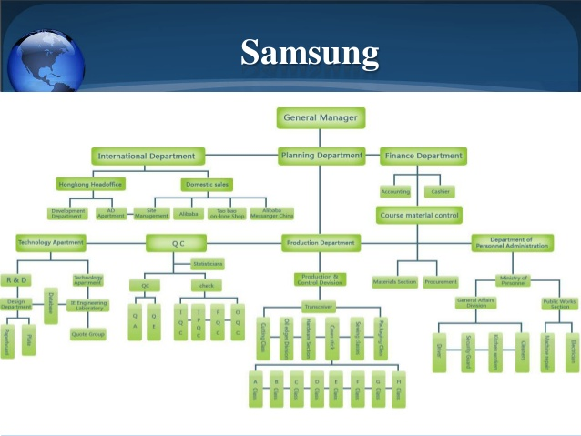

Slide 19

The CEO wants to save money by firing people…
How does this work?

Slide 20

The CEO of Apple wants to make a new ipad

