Slide 1
Self Introduction
Korean Romanization

Slide 2
Korean Romanization
How to write Korean with English letters.

Slide 3
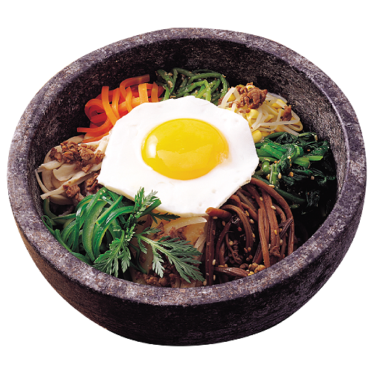
Use the chart:
비빔밥
Bibimbap

Slide 4
Use the chart:
서울
Seoul

Slide 5
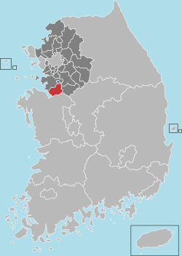
Use the chart:
평택시
Pyeongtaek City

Slide 6
Use the chart:
My Korean Name:
김가온
Ga-on Kim

Slide 7
Use the chart:
윤종신
Jong-Sin Yun

Slide 8
Use the chart:
임윤아
Yun-a Im

Slide 9
Use the chart:
유재석
Jae-seok Yu

Slide 10
Use the chart:
김소현
So-hyeon Kim

Slide 11
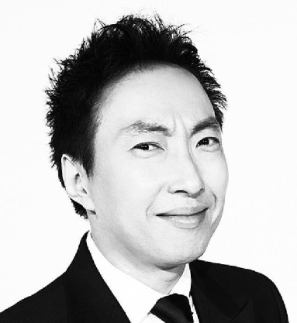
Use the chart:
박명수
Myeong-su Bak
(Bak = Park)

Slide 12
Use the chart:
Write your own name!
(Remember, family name comes after your given name.)

Slide 14
Hello, My name is _____________.
It’s nice to meet you.
It’s nice to meet you, too.

Slide 15
Hello, My name is _____________.
It’s nice to see you.
It’s nice to see you, too.

Slide 16
Now what can you say?

Slide 17
Age
34
I am __________ years old.

Slide 18
Birthday
March 12
My birthday is ____________.

Slide 19
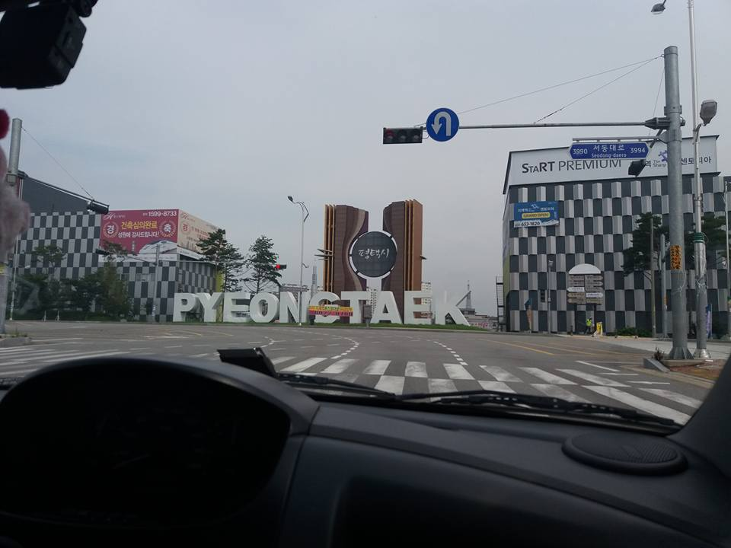
Place
Pyeongtaek, South Korea
I am from ___________________. (I live in …)

Slide 20
Job
I am __________ at ________________.
a student Shinhan High School

Slide 21
Something Interesting
cycling
I like (love / enjoy) _________.
My favorite _________ is _____________.
Korean food Hoedeopbap
회덮밥
I am good at ________.

Slide 22
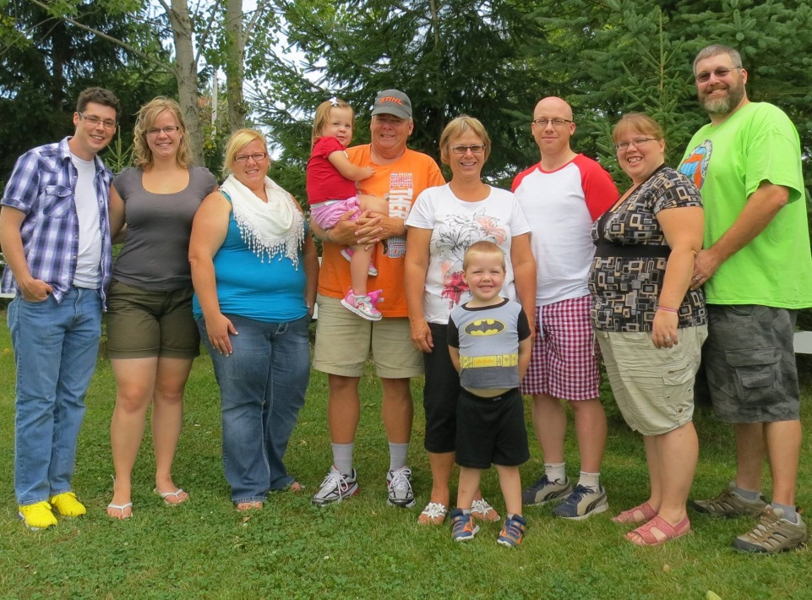
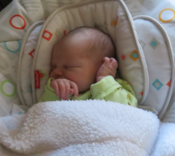
Family
10
I have ____ family members.

Slide 23
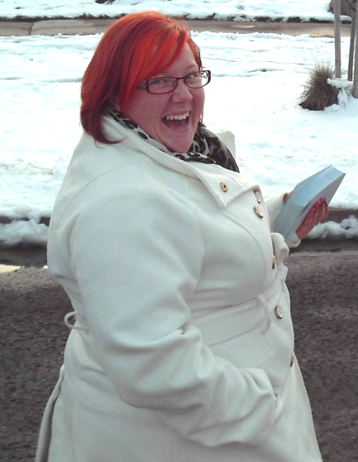
Family
sister
I have _____________.
His / Her name is ________________.
He / She is _________ at __________.
Amanda
hair stylist Inspire Hair

Slide 24
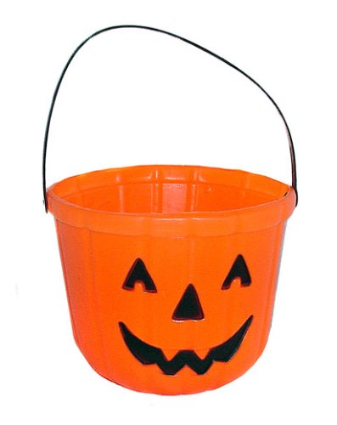
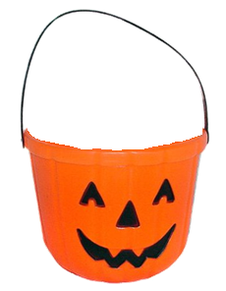
Self Introduction
On the paper, write about yourself.
When you are finished, make a paper ball and put it in the bucket.

Slide 25
Name (한글): Name (Romanized): English Name:

Slide 26
Self Introduction
Don’t read the name
Read the introduction
Other students will guess who wrote it.

