Slide 1
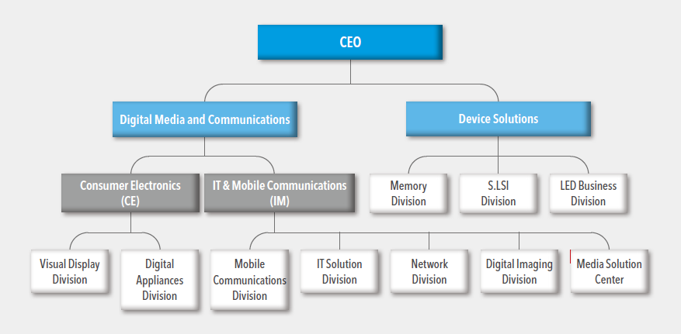
Lesson 2 – Corporate Structure

Slide 3
CEO

Slide 5
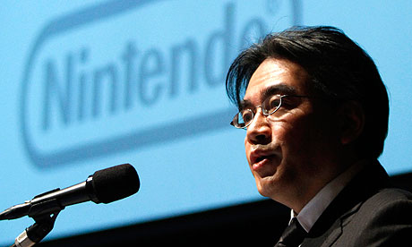
President

Slide 6
Vice - President

Slide 7
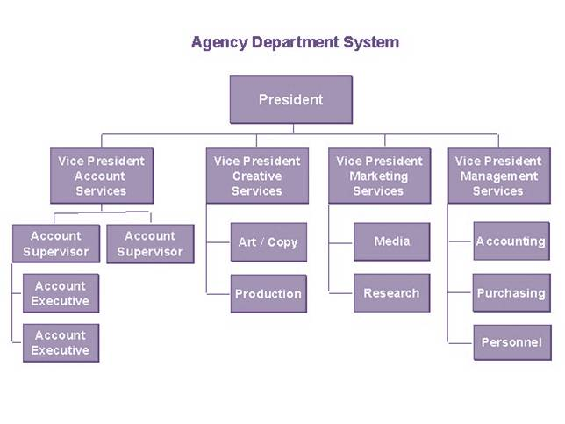

Slide 8
Manager

Slide 9
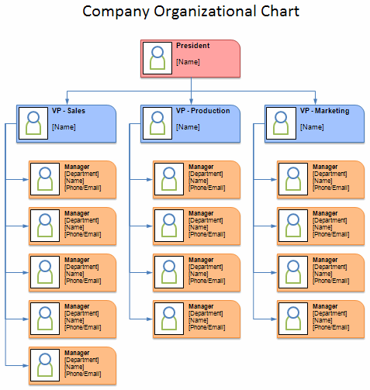

Slide 10
Staff

Slide 11
CEO
President
Vice President
Vice President
Manager
Manager
Manager
Staff
Staff
Staff
Staff
Staff
Staff
Staff
Staff

Slide 12
CEO
Departments
President
Vice President
Vice President
Manager
Manager
Manager
Staff
Staff
Staff
Staff
Staff
Staff
Staff
Staff

Slide 13
R+D (Research and Development)

Slide 14
Sales

Slide 15
Accounting (Finance Department)

Slide 16
HR (Human Resources)

Slide 17
Software???

Slide 19
The CEO wants to save money by firing people…
How does this work?

Slide 20
The CEO of Apple wants to make a new ipad

