Slide 1
Reminder
수업시간에 나눠준 수업자료를 다 한 경우, 프린트에 Mr.S의 도장을 찍어드립니다. 도장을 받은 개수는 수업 참여도와 직결되며 학기 말에 세부능력특기사항에 반영될 수 있습니다. 프린트물을 잃어버리면 다시 도장을 찍어드리지 않으니 수업 프린트물을 보관할 파일을 다음 수업시간까지 준비해주세요. ^^

Slide 2
Cat Morgan Introduces Himself
TS Elliot

Slide 3
Cat Morgan
I once was a Pirate what sailed the 'igh seas - But now I've retired as a com-mission-aire: And that's how you find me a-taking' my ease And keepin' the door in a Bloomsbury Square.

Slide 4
Cat Morgan
I'm partial to partridges, likewise to grouse, And I favour that Devonshire cream in a bowl; But I'm allus content with a drink on the 'ouse And a bit o' cold fish when I done me patrol.

Slide 5
Cat Morgan
I ain't got much polish, me manners is gruff, But I've got a good coat, and I keep meself smart; And everyone says, and I guess that's enough: `You can't but like Morgan, 'e's got a kind 'art.'

Slide 6
Cat Morgan
I got knocked about on the Barbary Coast, And me voice it ain't no sich melliferous horgan; But yet I can state, and I'm not one to boast, That some of the gals is dead keen on old Morgan.

Slide 7
Cat Morgan
So if you 'ave business with Faber - or Faber - I'll give you this tip, and it's worth a lot more: You'll save yourself itme, and you'll spare yourself labour If jist you make friends with the Cat at the door.

Slide 8
Questions

Slide 9
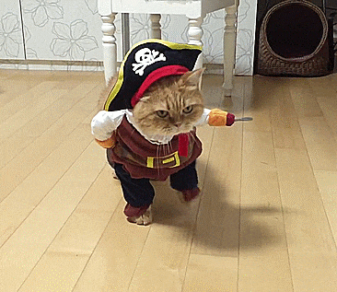
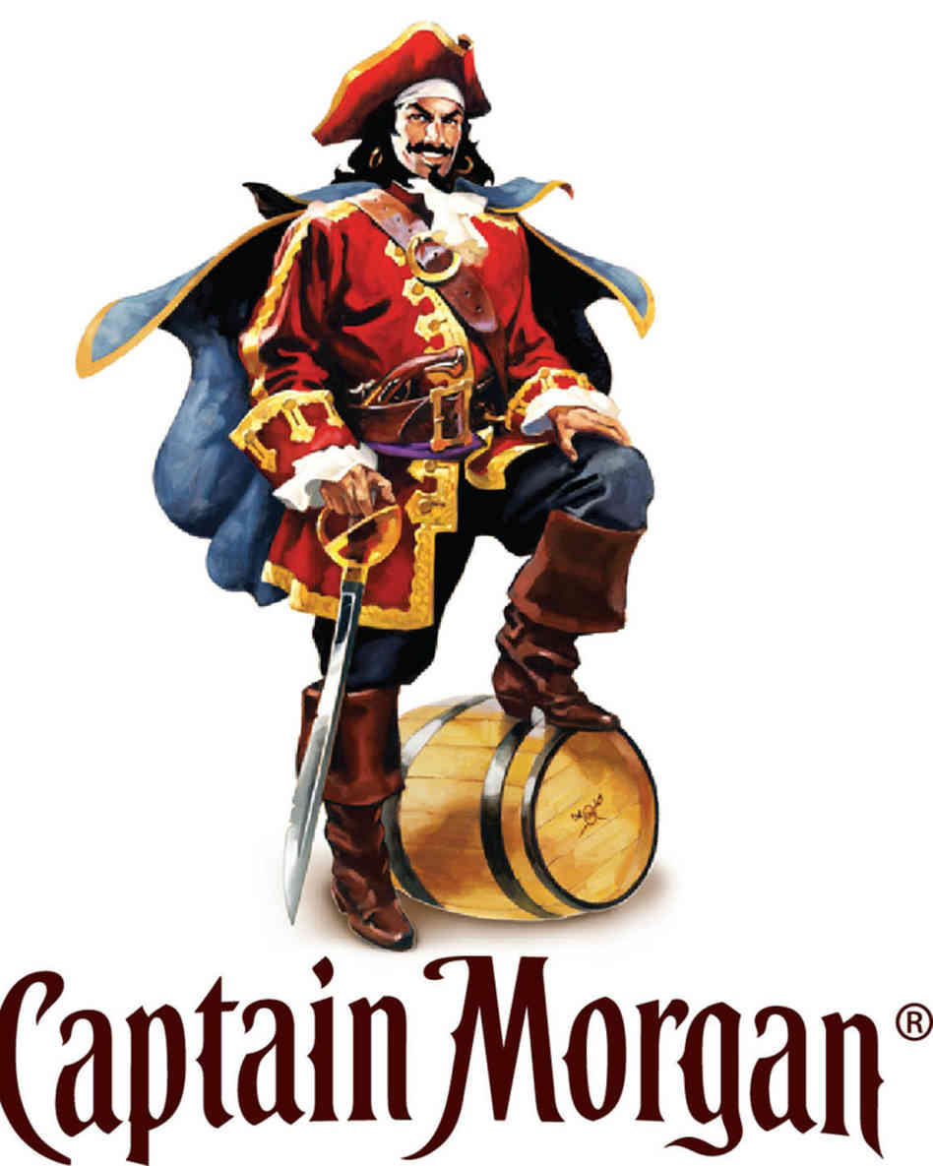
Questions
1. What was Cat Morgan’s job?

Slide 10
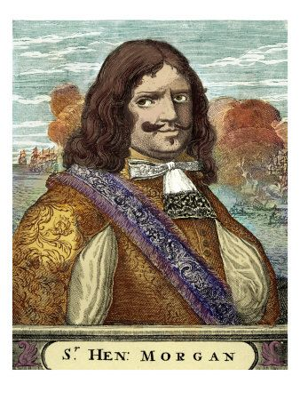
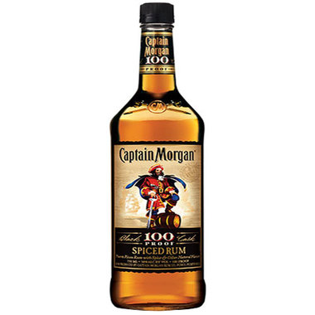
Henry morgan
Privateer
Born in Wales (1635)
Based in Jamaica
Folk Hero in England
Became famous in books, art and RUM!

Slide 11
Questions
2. Who wrote the introduction?
Cat Morgan (TS Elliot)

Slide 12
Questions
What did you think about the poem?

Slide 13
Questions
How was the writing?
Did you find many mistakes?
Why did TS Elliot write with so many mistakes?

Slide 14
Spelling Mistakes

Slide 15
Contractions
Sometime in English, we replace some letters with ‘.
Can you think of some words?
Can’t
Don’t
I’m
I’ve
You’re
We’ve
She’s
Didn’t
Let’s
He’ll
It’s

Slide 16
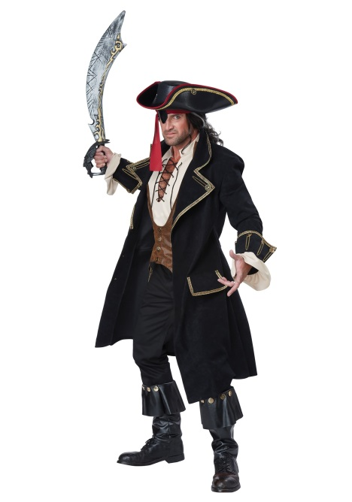
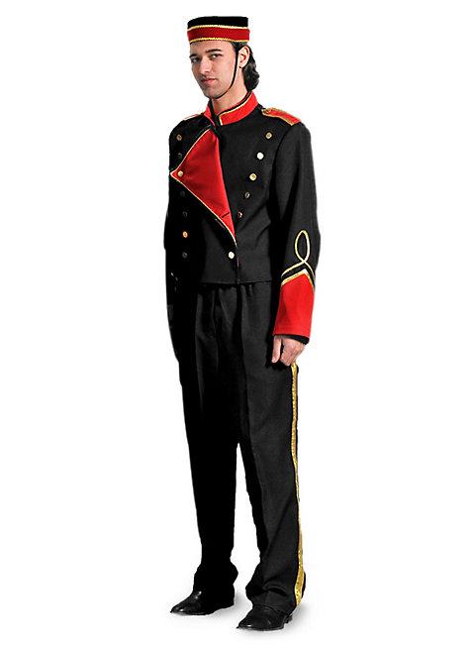
Cat Morgan
I once was a Pirate what sailed the 'igh seas - But now I've retired as a com-mission-aire: And that's how you find me a-taking' my ease And keepin' the door in a Bloomsbury Square.
that
high
Commissionaire
taking
keeping

Slide 17
Cat Morgan
I'm partial to partridges, likewise to grouse, And I favour that Devonshire cream in a bowl; But I'm allus content with a drink on the 'ouse And a bit o' cold fish when I done me patrol.
favor
, alas,
house
of cold
my

Slide 18
Cat Morgan
I ain't got much polish, me manners is gruff, But I've got a good coat, and I keep meself smart; And everyone says, and I guess that's enough: `You can't but like Morgan, 'e's got a kind 'art.'
my
are
myself
he’s
heart

Slide 19
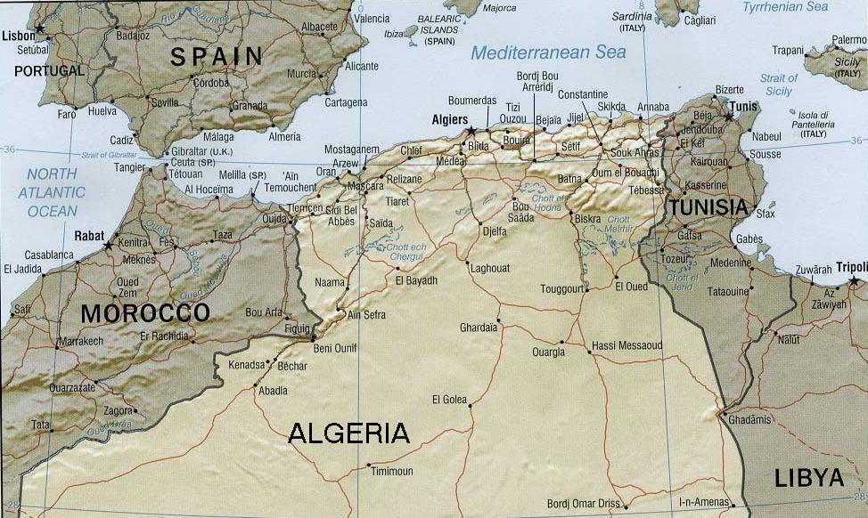
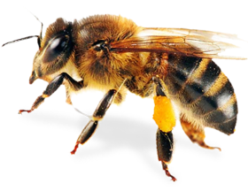
Cat Morgan
I got knocked about on the Barbary Coast, And me voice it ain't no sich melliferous horgan; But yet I can state, and I'm not one to boast, That some of the gals is dead keen on old Morgan.
such
Horgan
are

Slide 20
Cat Morgan
So if you 'ave business with Faber - or Faber - I'll give you this tip, and it's worth a lot more: You'll save yourself itme, and you'll spare yourself labour If jist you make friends with the Cat at the door.
have
time
labor
just

Slide 21
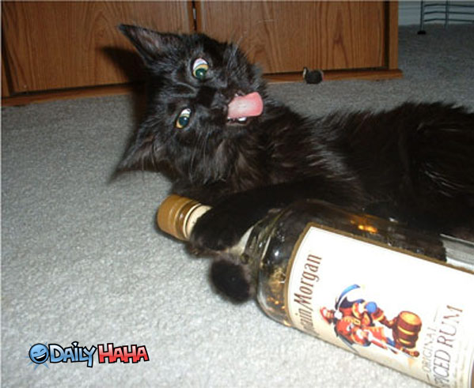
Question
3. Who is the cat at the door?
Cat Morgan

Slide 22
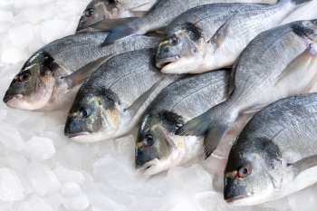
Question
4. What does Cat Morgan eat?
Cold fish

Slide 23
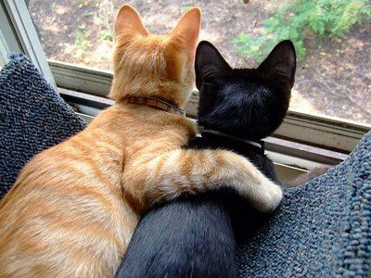
Question
5. What do people say about Cat Morgan?
He has a kind heart.

Slide 24
Analysis

Slide 25
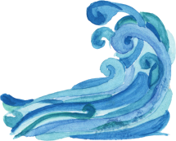
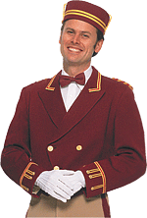
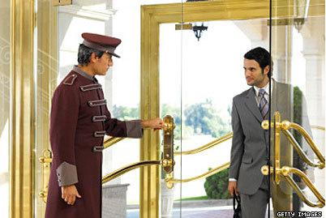
Cat Morgan
I once was a Pirate that sailed the high seas - But now I've retired as a commissionaire: And that's how you find me taking my ease And keeping the door in a Bloomsbury Square.

Slide 26
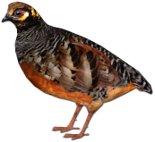
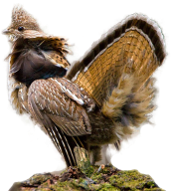
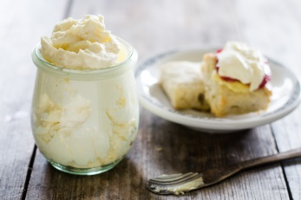
Cat Morgan
I'm partial to partridges, likewise to grouse, And I favor that Devonshire cream in a bowl; But I'm, alas, content with a drink on the house And a bit of cold fish when I done my patrol.

Slide 27
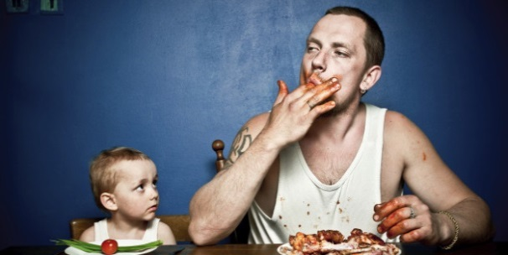
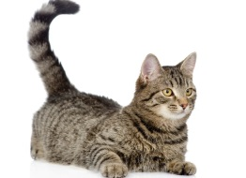
Cat Morgan
I ain't got much polish, my manners are gruff, But I've got a good coat, and I keep myself smart; And everyone says, and I guess that's enough: `You can't but like Morgan, he's got a kind heart.'

Slide 28
Cat Morgan
I got knocked about on the Barbary Coast, And me voice it ain't no such melliferous Horgan; But yet I can state, and I'm not one to boast, That some of the gals are dead keen on old Morgan.

Slide 29
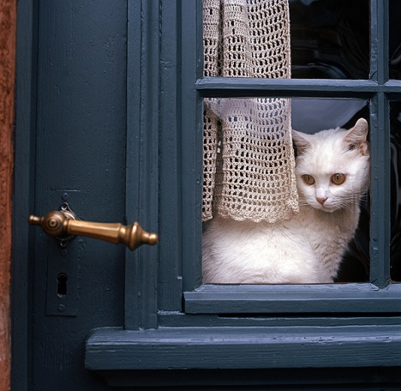
Cat Morgan
So if you have business with Faber - or Faber - I'll give you this tip, and it's worth a lot more: You'll save yourself time, and you'll spare yourself labor If just you make friends with the Cat at the door.

Slide 30
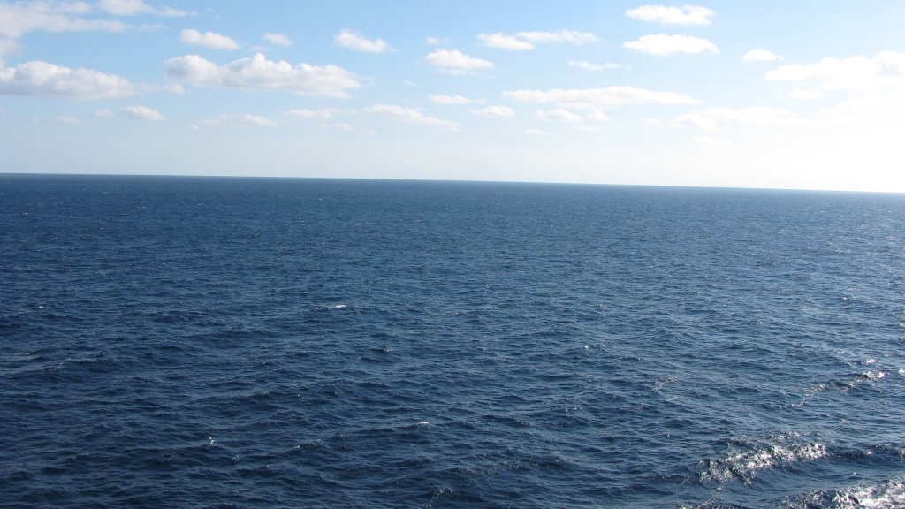
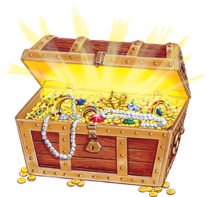
Treasure Hunt (7 Seas)
Answer the question
Guess a number.
Find the treasure to win a prize.
Sea #1
Sea #2
Sea #3
Sea #4
Sea #5
Sea #6
Sea #7

Slide 31
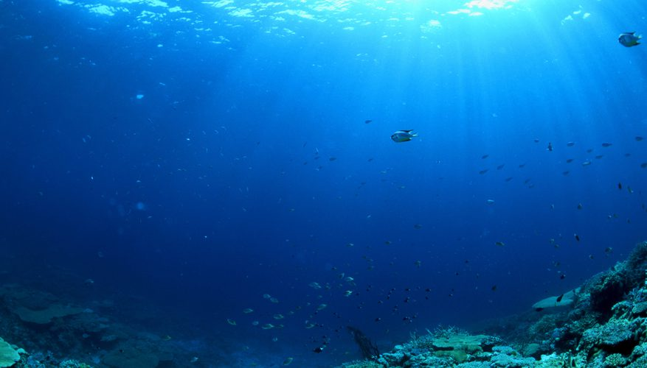
Sea #1
1
5
9
13
17
2
6
10
14
18
3
7
11
15
19
4
8
12
16
20
Return Home

Slide 32
Sea #2
1
5
9
13
17
2
6
10
14
18
3
7
11
15
19
4
8
12
16
20
Return Home

Slide 33
Sea #3
1
5
9
13
17
2
6
10
14
18
3
7
11
15
19
4
8
12
16
20
Return Home

Slide 34
Sea #4
1
5
9
13
17
2
6
10
14
18
3
7
11
15
19
4
8
12
16
20
Return Home

Slide 35
Sea #5
1
5
9
13
17
2
6
10
14
18
3
7
11
15
19
4
8
12
16
20
Return Home

Slide 36
Sea #6
1
5
9
13
17
2
6
10
14
18
3
7
11
15
19
4
8
12
16
20
Return Home

Slide 37
Sea #7
1
5
9
13
17
2
6
10
14
18
3
7
11
15
19
4
8
12
16
20
Return Home

