Slide 1
Preposition of Place
https://www.youtube.com/watch?v=XKu3NE7Omkw

Slide 2
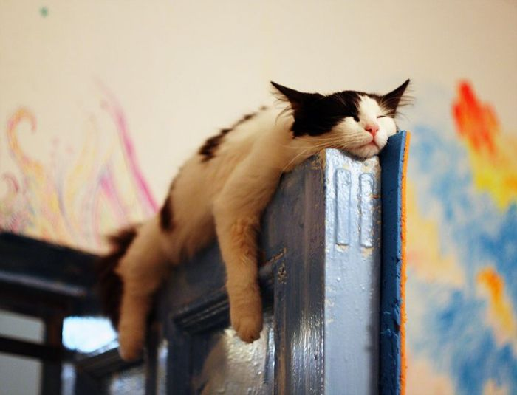
On

Slide 3
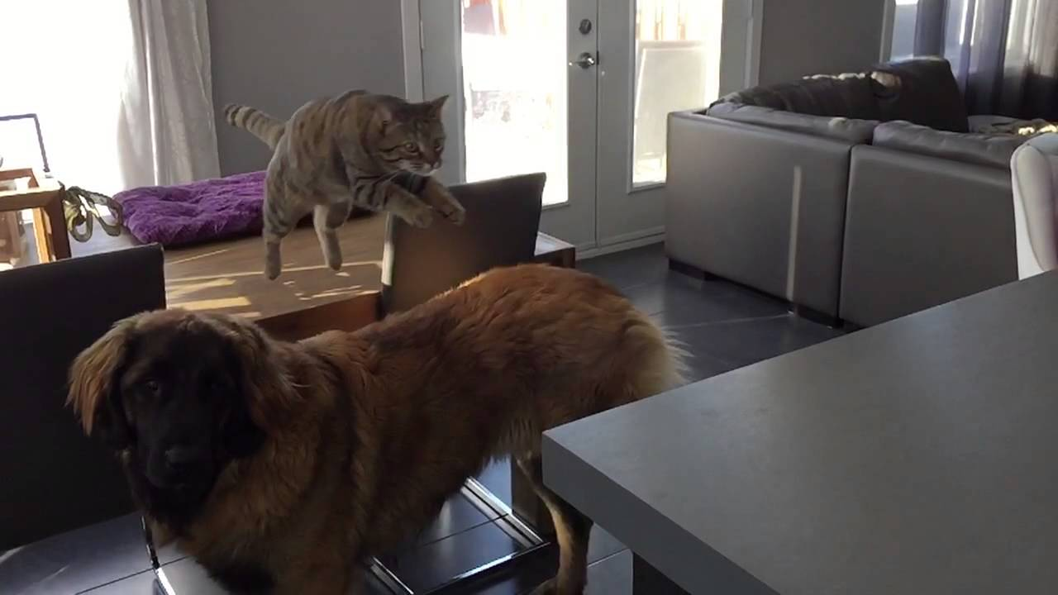
Over / Above

Slide 4
Under

Slide 5
Below

Slide 6
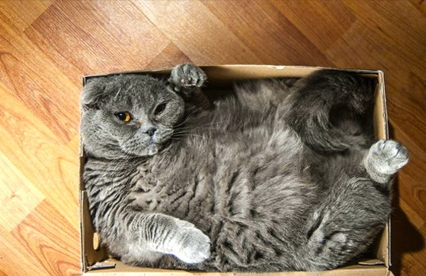
In

Slide 7
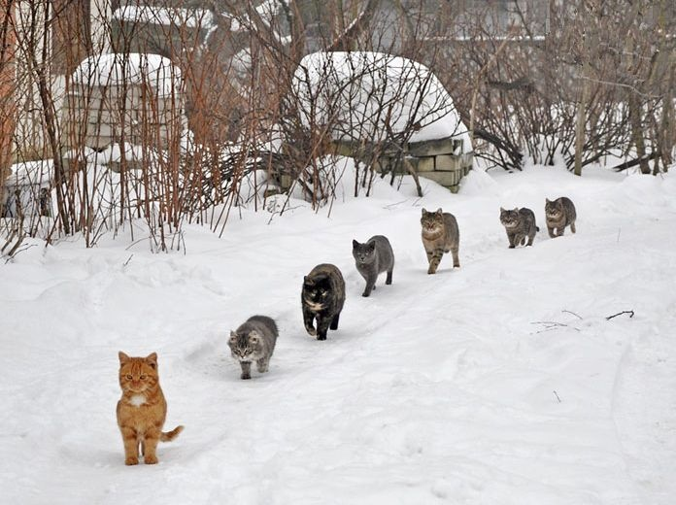
Behind / In front / between

Slide 8
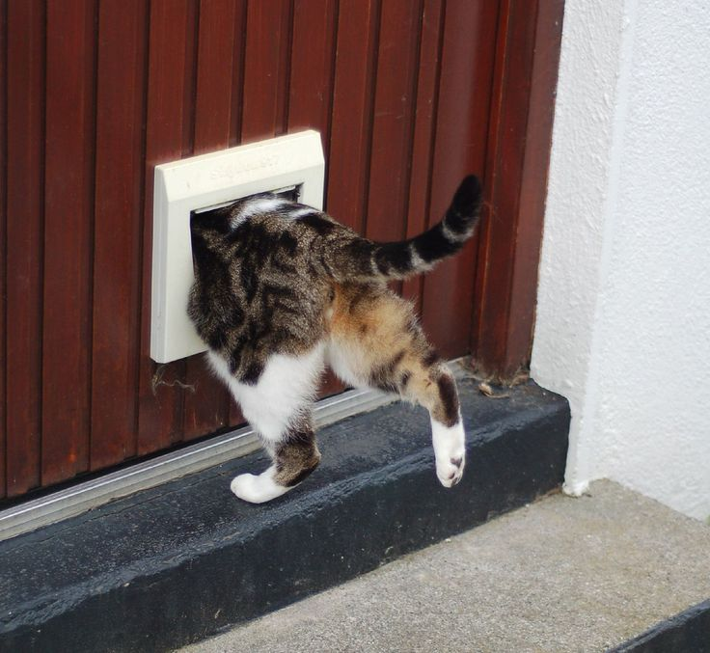
Through

Slide 9
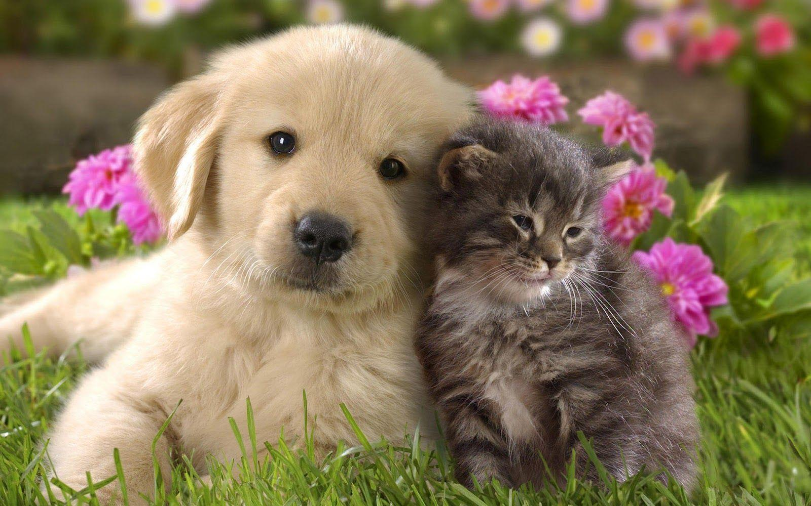
Beside

Slide 10
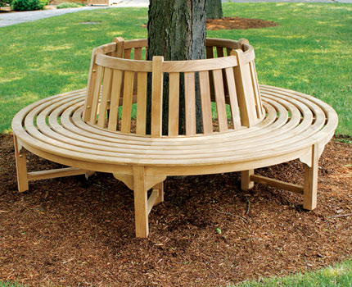
Around

Slide 11
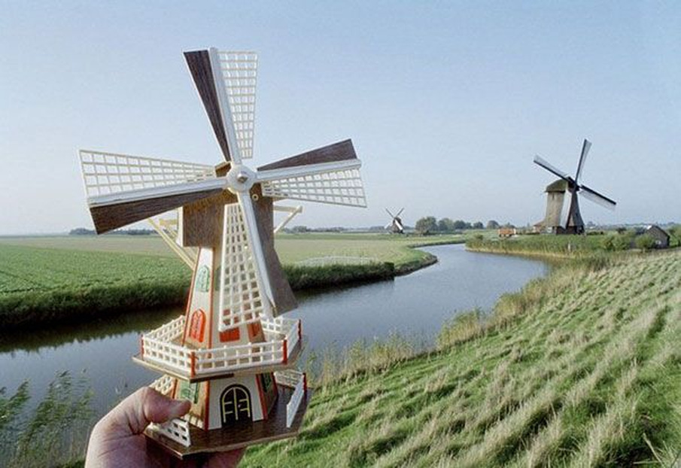
Near

Slide 12
Far

Slide 13
Among

Slide 14
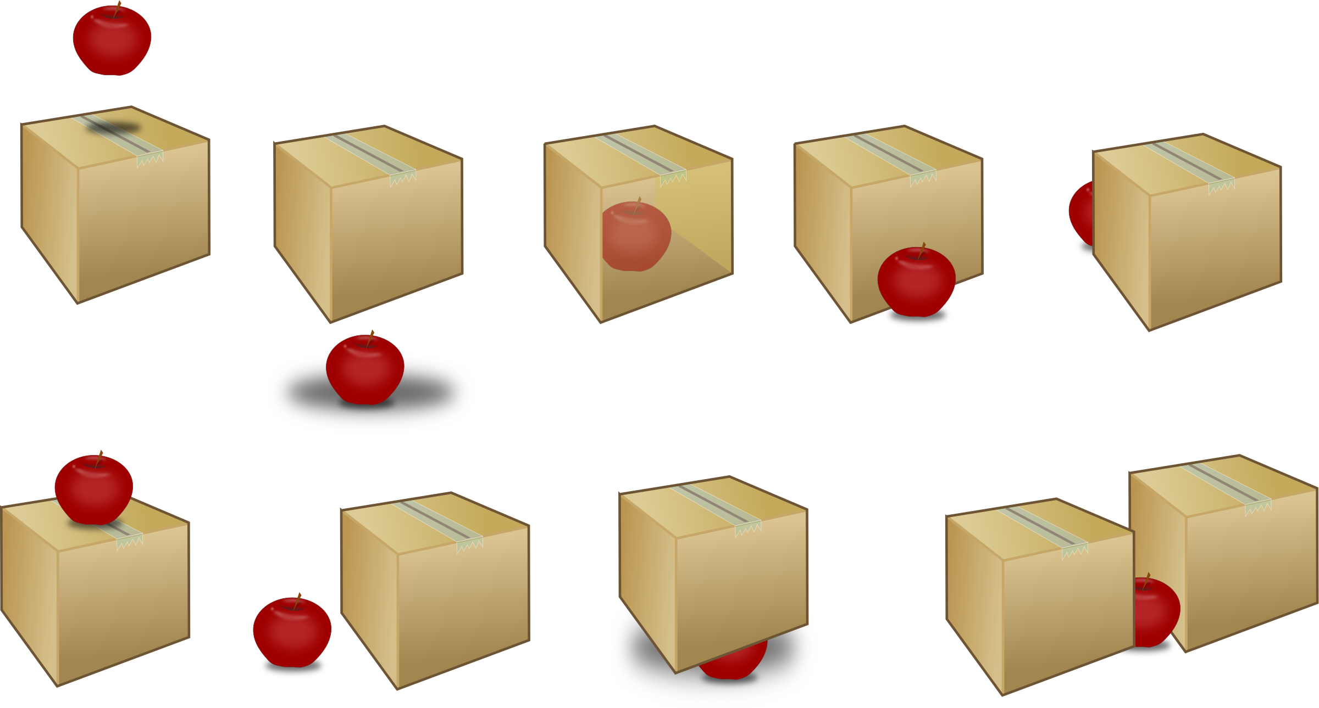
Over / above
Below
Behind
in
In front of
between
on
Beside (next to)
under

Slide 15
around
Through
Amoung
near
far

Slide 16
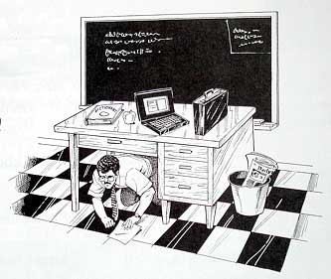

Slide 17
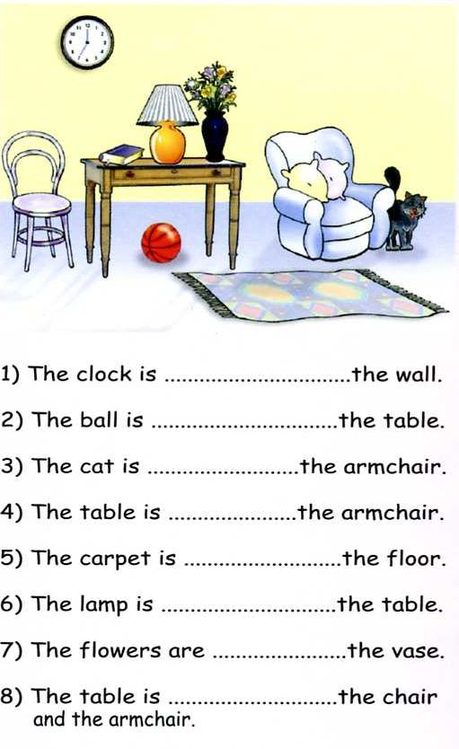
The clock is on the wall.
The ball is under the table.
The cat is beside the armchair.
The table is near the armchair.
The carpet is on the floor.
The lamp is on the table.
The flowers are in the vase.
The table is between the chair and the armchair.

Slide 18
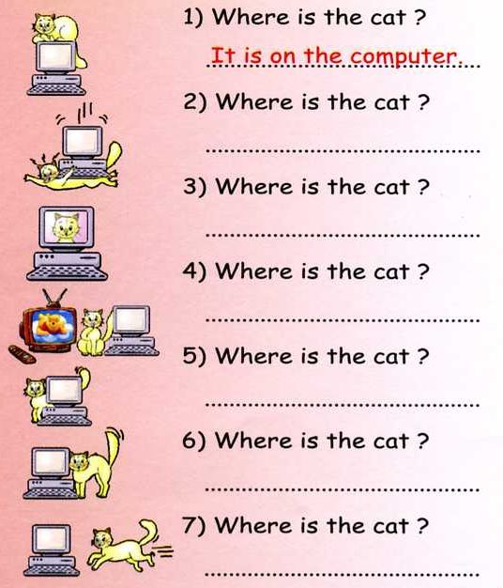
It is under the computer
It is in the computer
It is between the computer and tv.
It is behind the computer
It is beside the computer
It is going towards the computer

Slide 19
Practice
All students

Slide 20
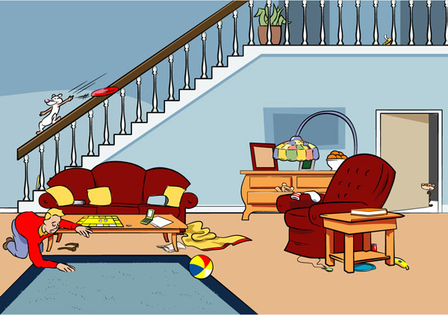

Slide 21
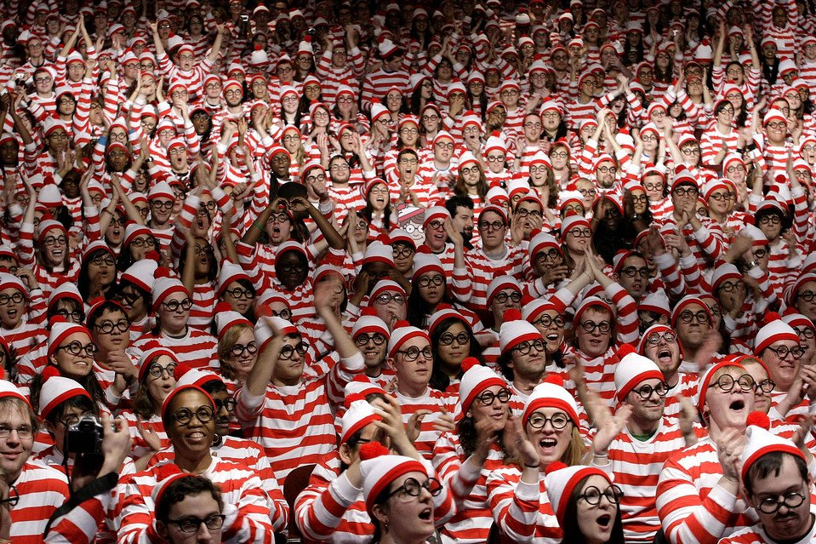
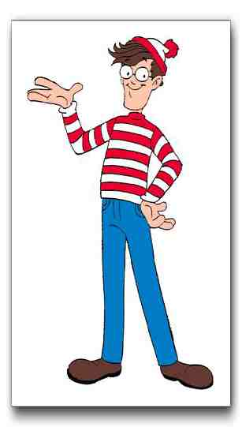
Where’s Waldo (Wally)
If you find Waldo, raise your hand.
You must describe (over, under, etc.) where he is.
No pointing.

Slide 22
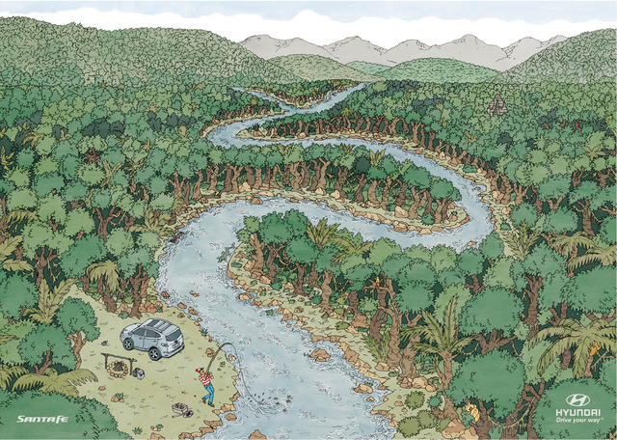

Slide 23
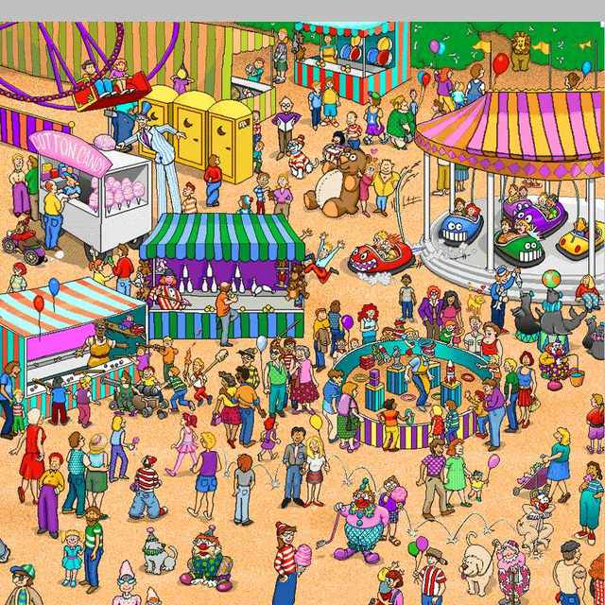

Slide 24
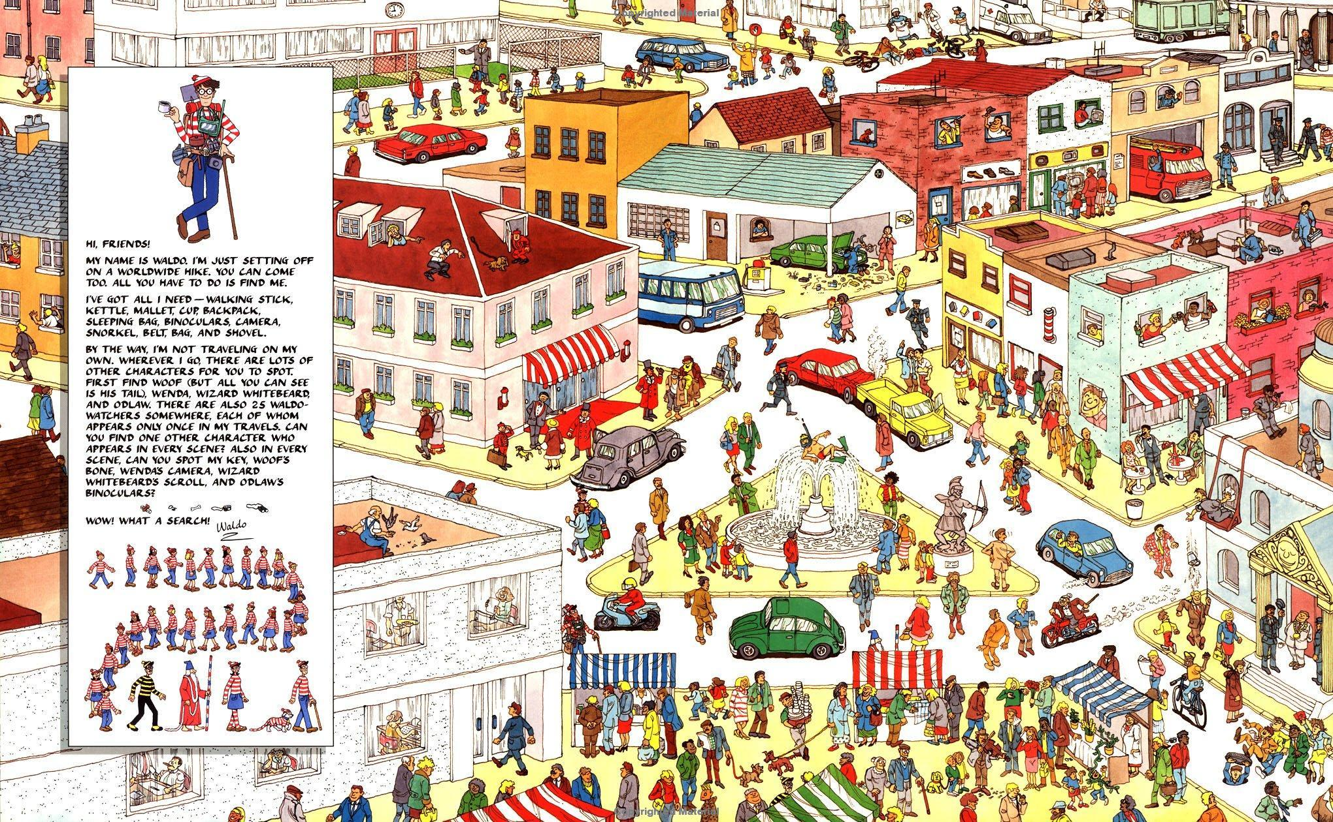

Slide 25
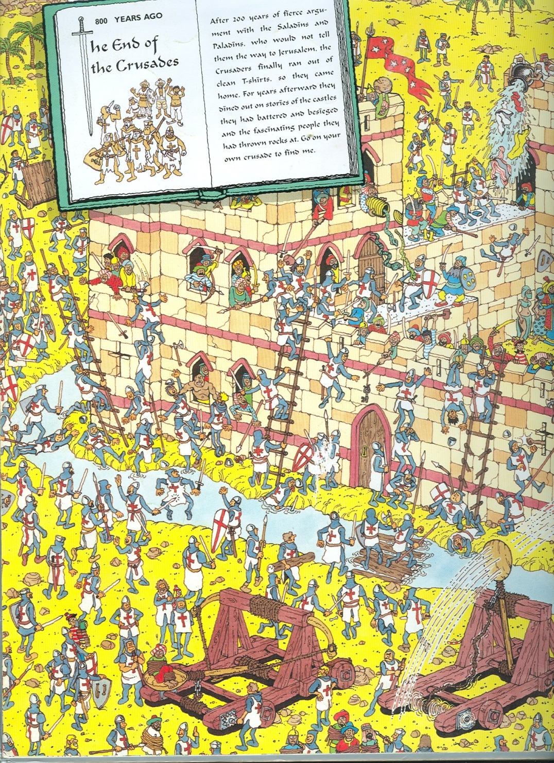

Slide 26
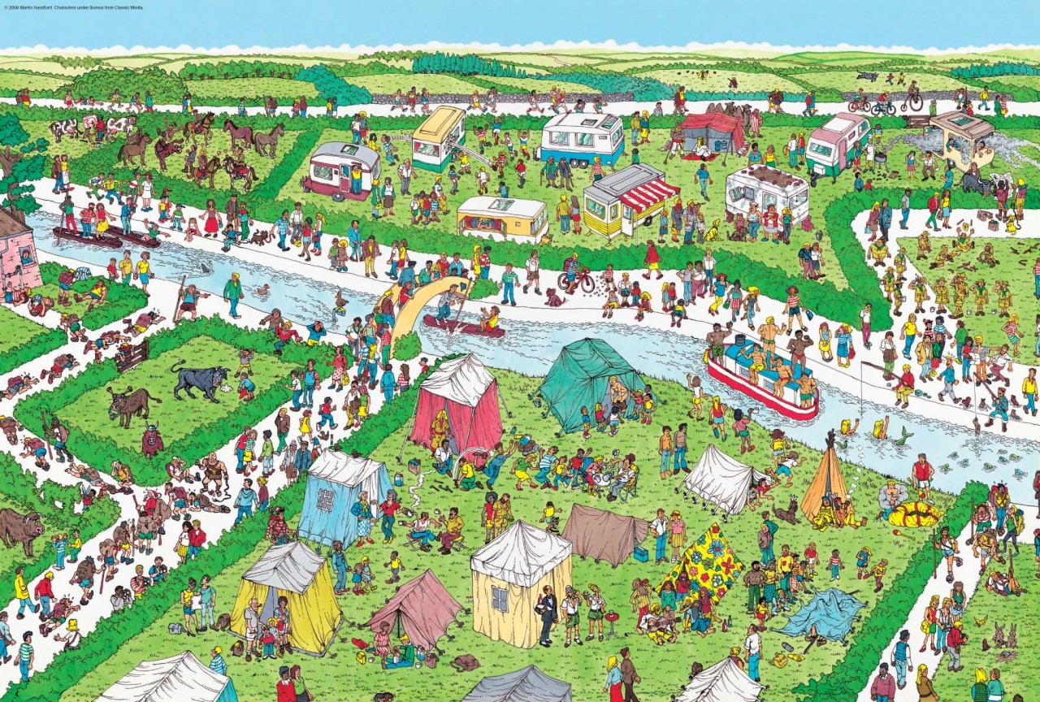

Slide 27
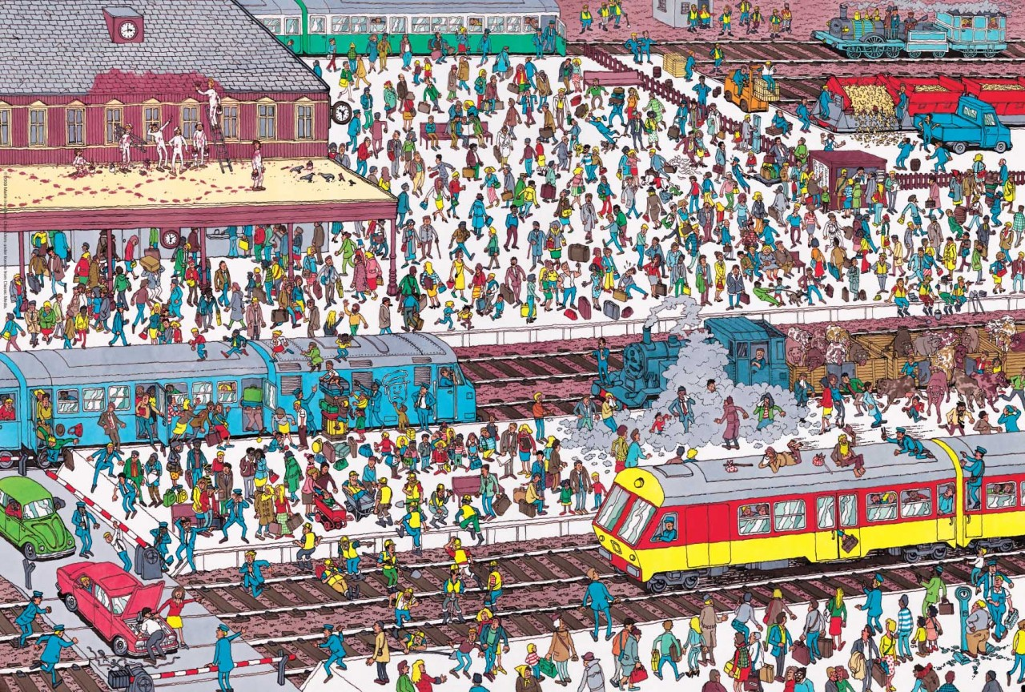

Slide 28
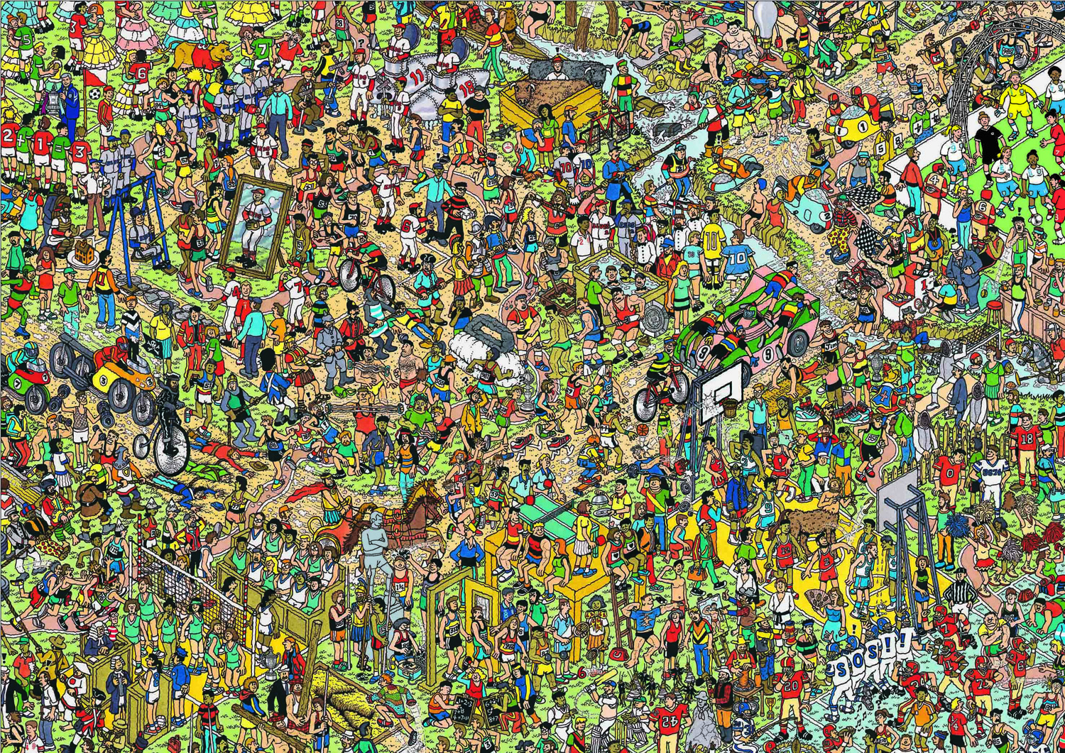

Slide 29
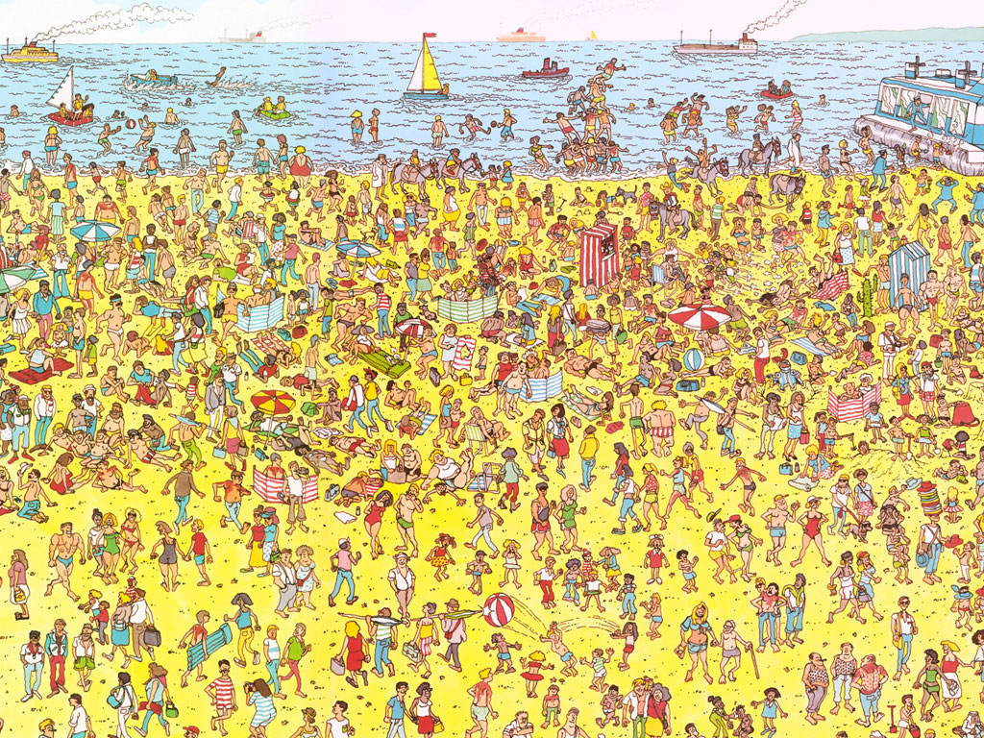

Slide 30
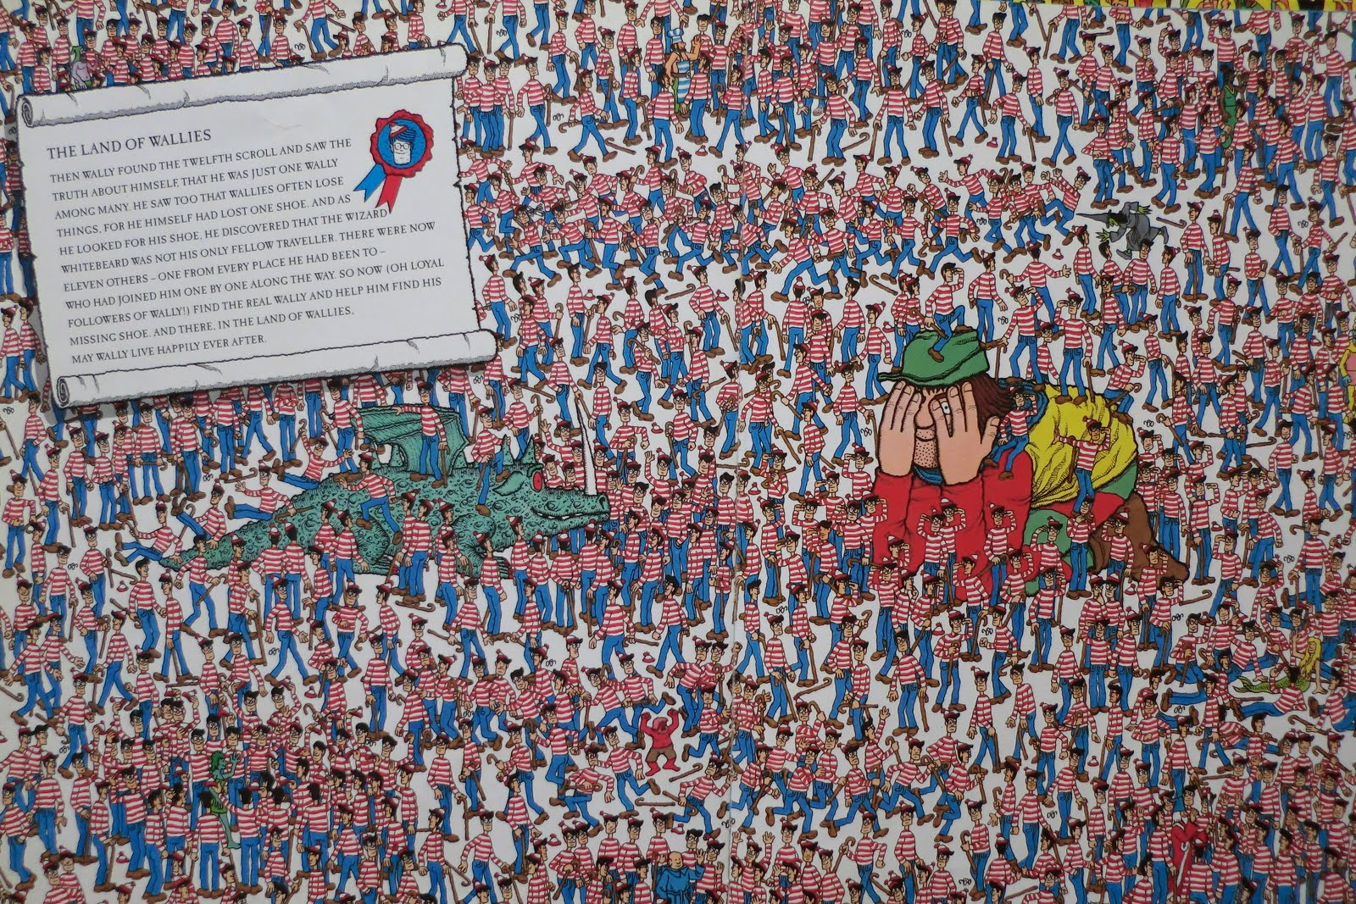

Slide 31
Let’s Play
Pass out the Game Cards

Slide 32
How to play
Play in groups of 4 – 6
One player asks where something is – “Where is the white cat?”
The other players must try to find it.
When a player finds the item, they must make a sentence – “The cat is in the drawer”
The first person to make a correct sentence gets a point.
Whoever got the point will ask the next question.

Slide 33
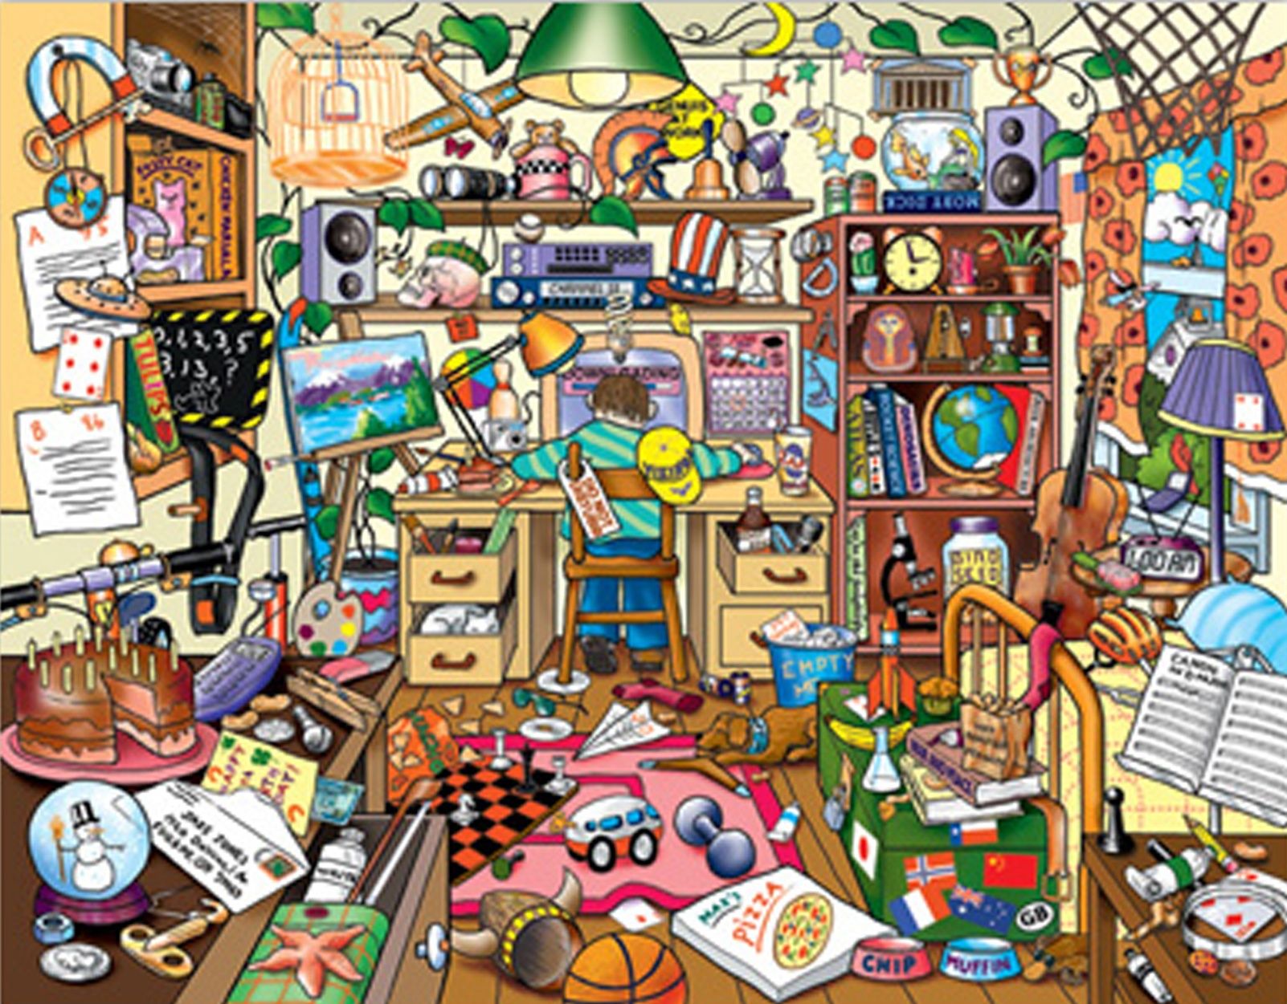

Slide 34
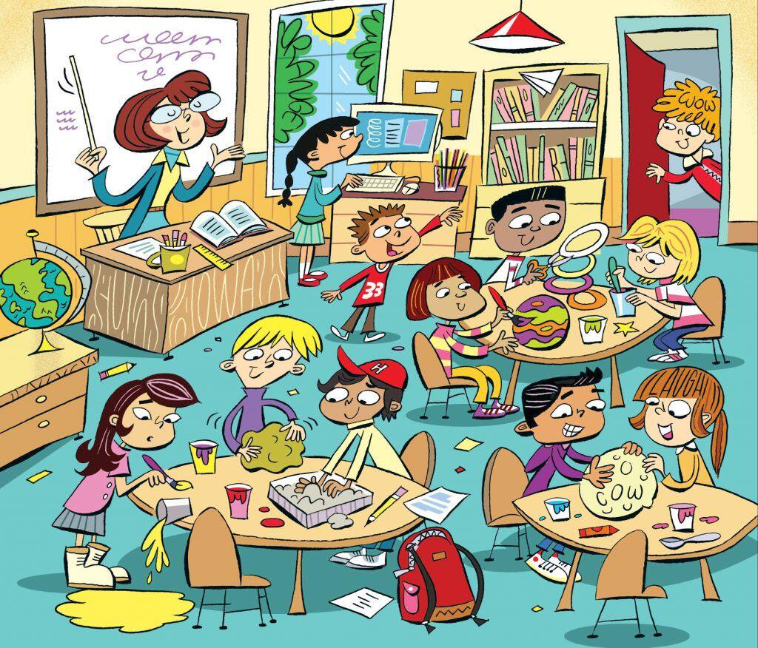

Slide 35
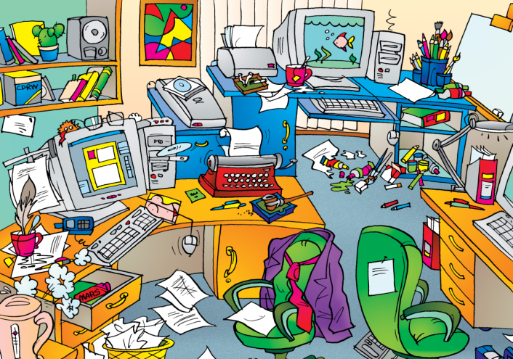

Slide 36
