Slide 1
Preposition of Place
https://www.youtube.com/watch?v=XKu3NE7Omkw

Slide 2
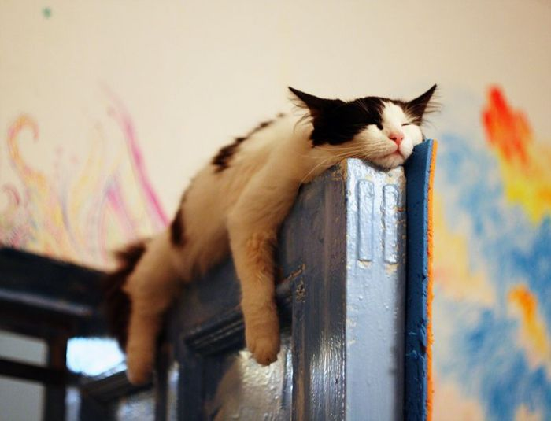
On

Slide 3
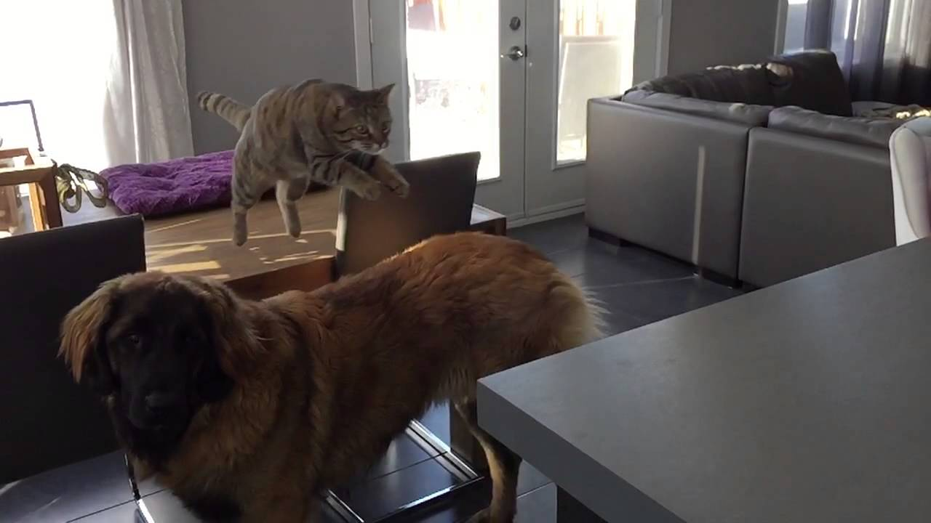
Over / Above

Slide 4
Under

Slide 5
Below

Slide 6
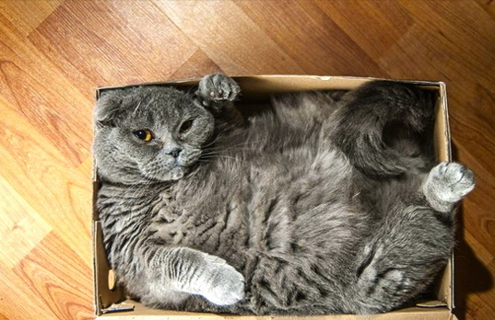
In

Slide 7
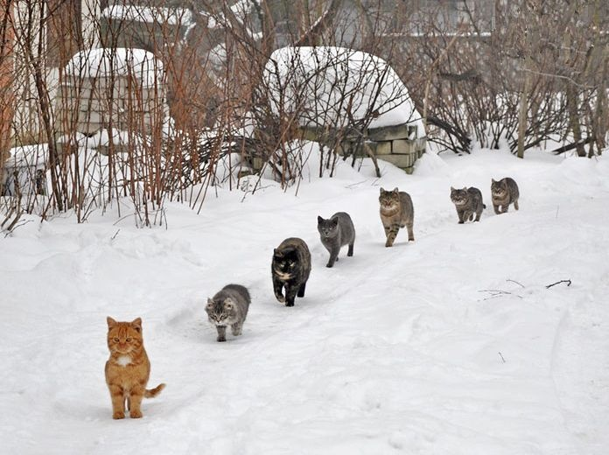
Behind / In front / between

Slide 8
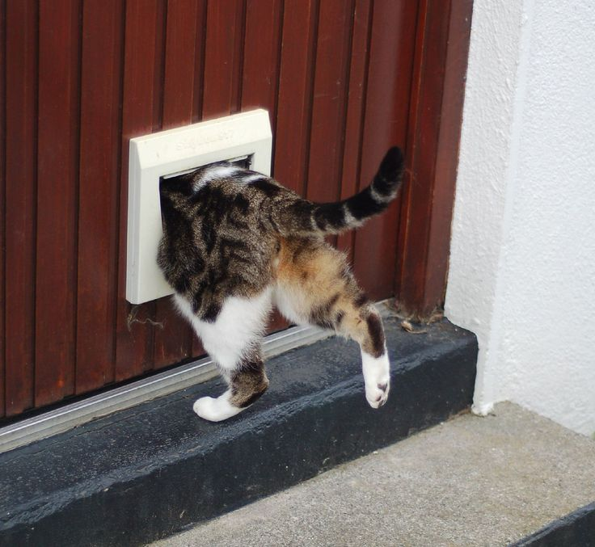
Through

Slide 9
Beside / Next to

Slide 10
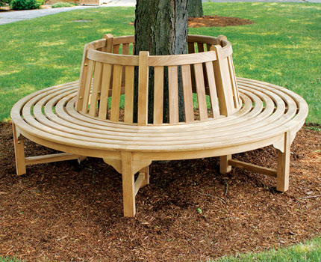
Around

Slide 11
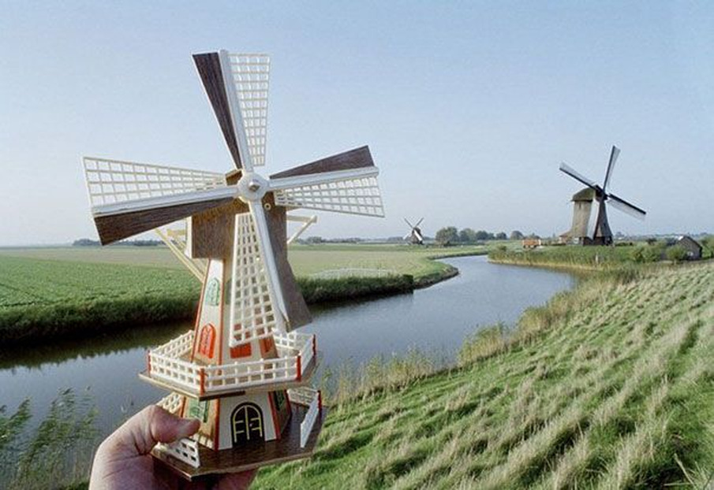
Near

Slide 12
Far

Slide 13
Among

Slide 14
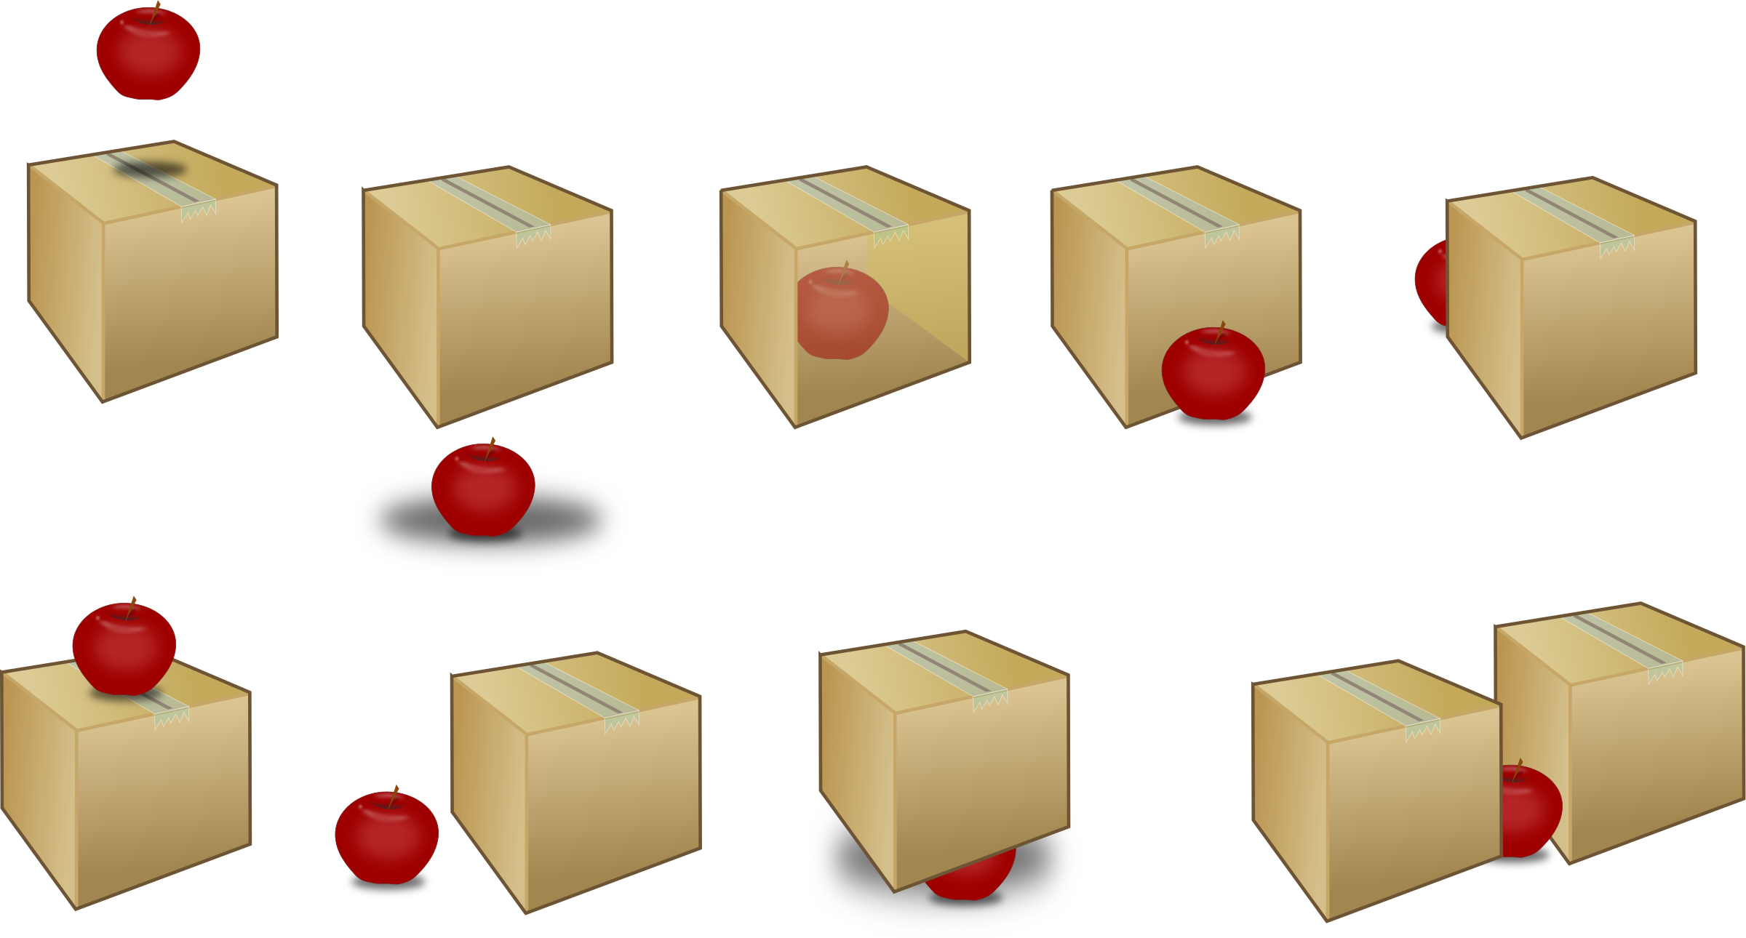
Over / above
Below
Behind
in
In front of
between
on
Beside (next to)
under

Slide 15
around
Through
Among
near
far

Slide 16
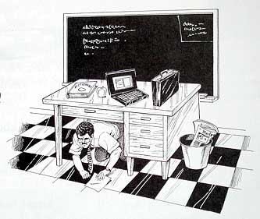

Slide 17
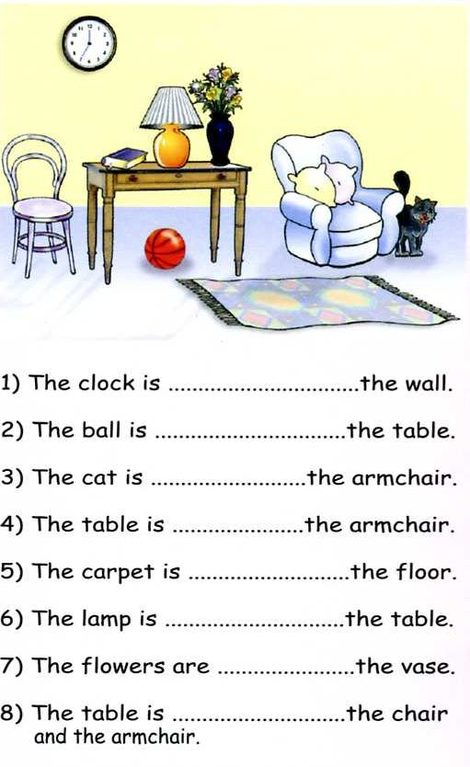
The clock is on the wall.
The ball is under the table.
The cat is beside the armchair.
The table is near the armchair.
The carpet is on the floor.
The lamp is on the table.
The flowers are in the vase.
The table is between the chair and the armchair.

Slide 18
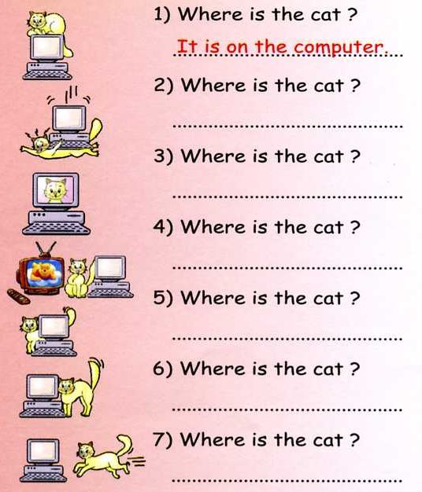
It is under the computer
It is in the computer
It is between the computer and tv.
It is behind the computer
It is beside the computer
It is going towards the computer

Slide 19
Lesson 10 – Find the Items
Game

Slide 20
How to Play
The teacher will make a sentence, “Where is the _______.”
When you find it, make a sentence, “It’s ______________”
The fastest to say the sentence is the winner (touching doesn’t count)

Slide 21
Practice
All students

Slide 22
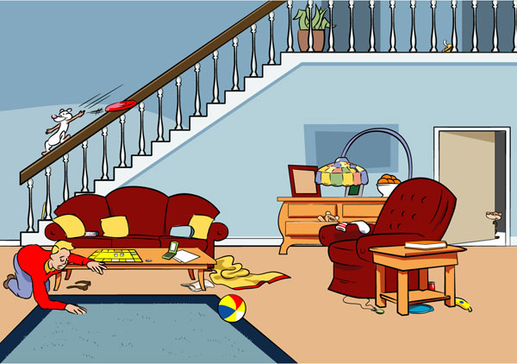

Slide 23
Let’s Play
Pass out the Sheets and a marker to keep score.

Slide 24
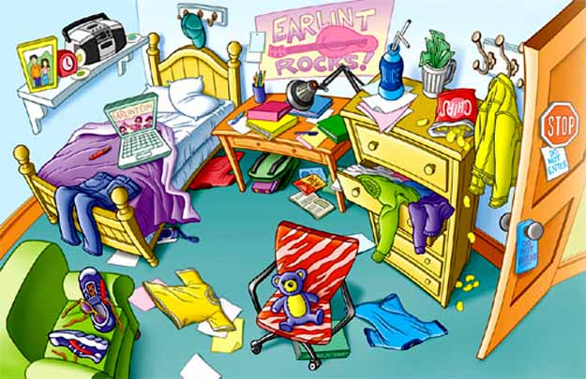
Player 1: Player 2:

Slide 25
Tournament
The winners
(two or three at a time)
Come to the front.
Race to touch the item

Slide 26
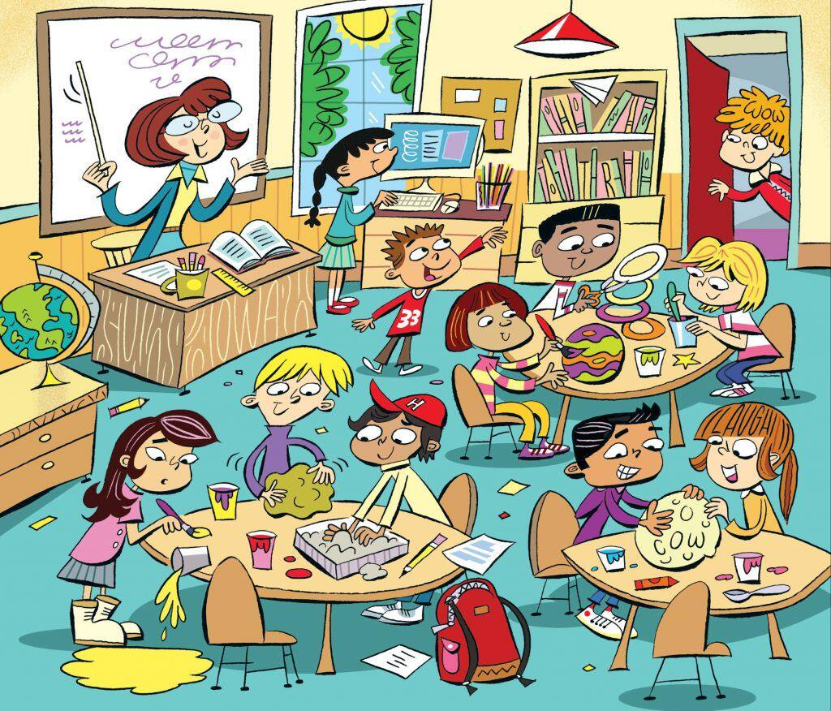

Slide 27
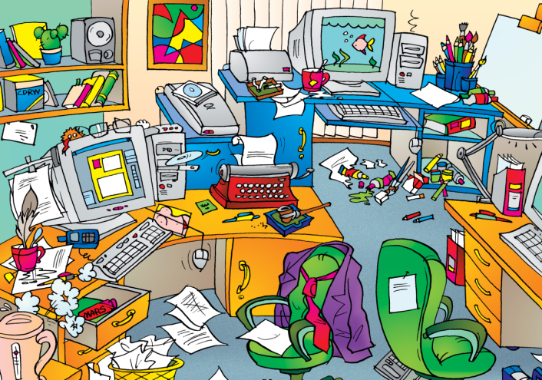

Slide 28
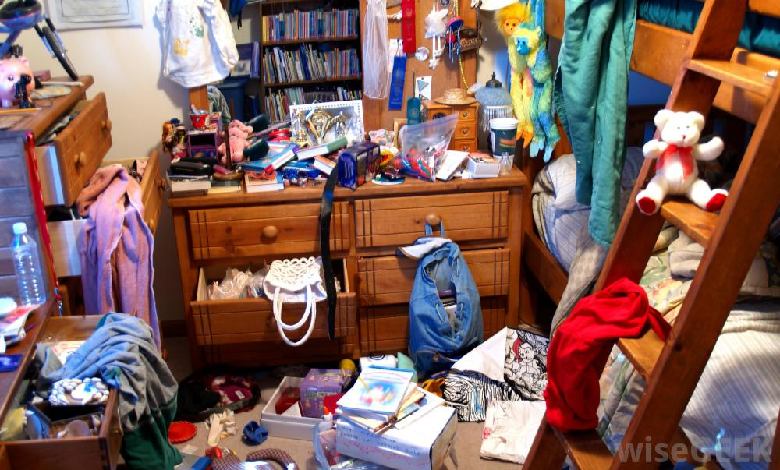

Slide 29
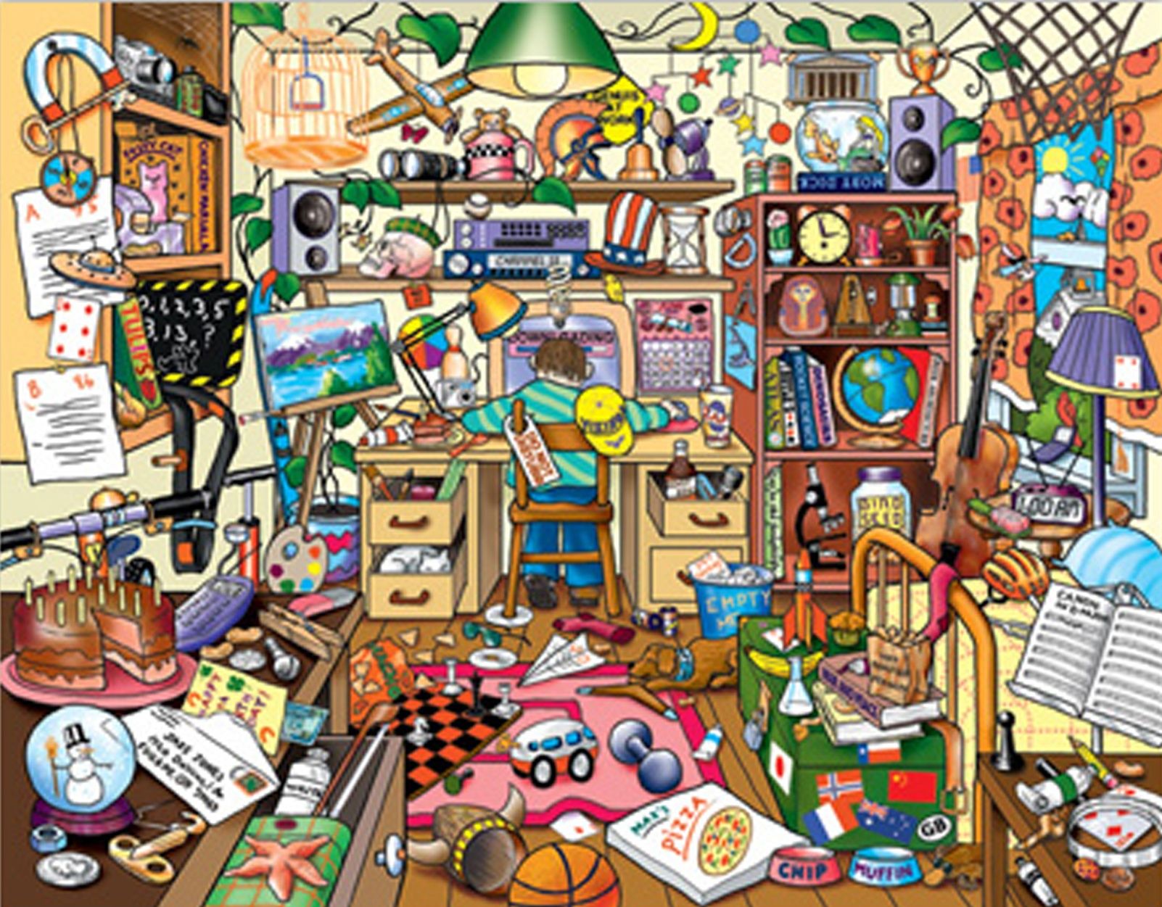

Slide 30
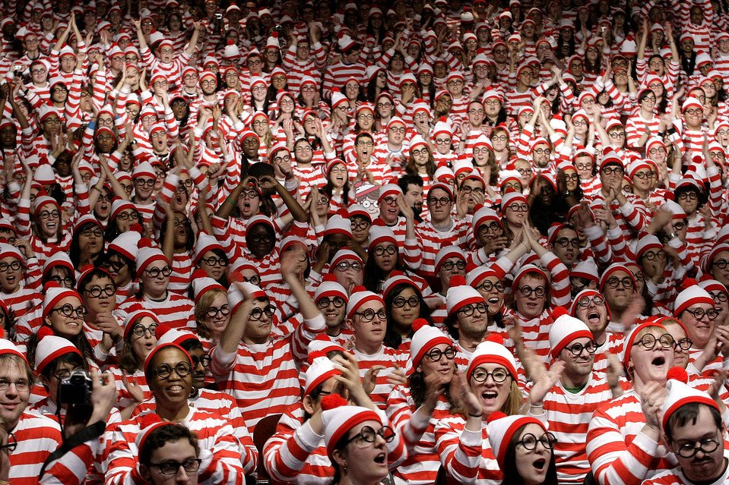
Where’s Waldo (Wally)
If you find Waldo, raise your hand.
You must describe (over, under, etc.) where he is.
No pointing.

Slide 31
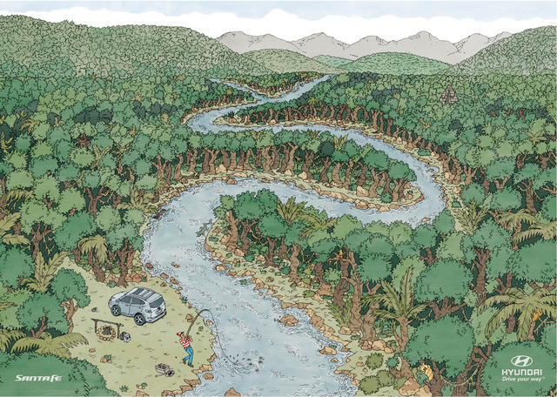

Slide 32
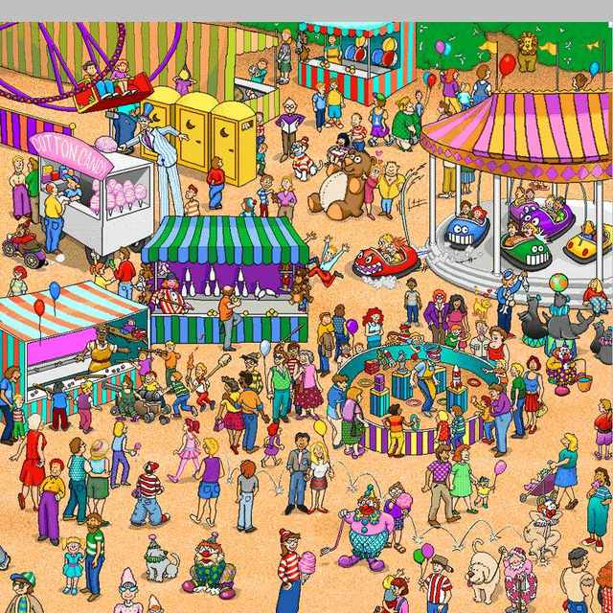

Slide 33
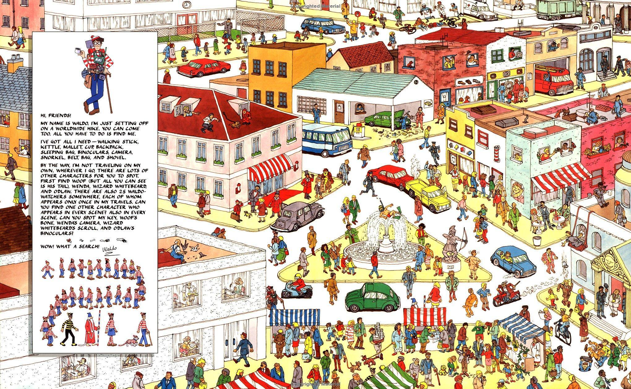

Slide 34
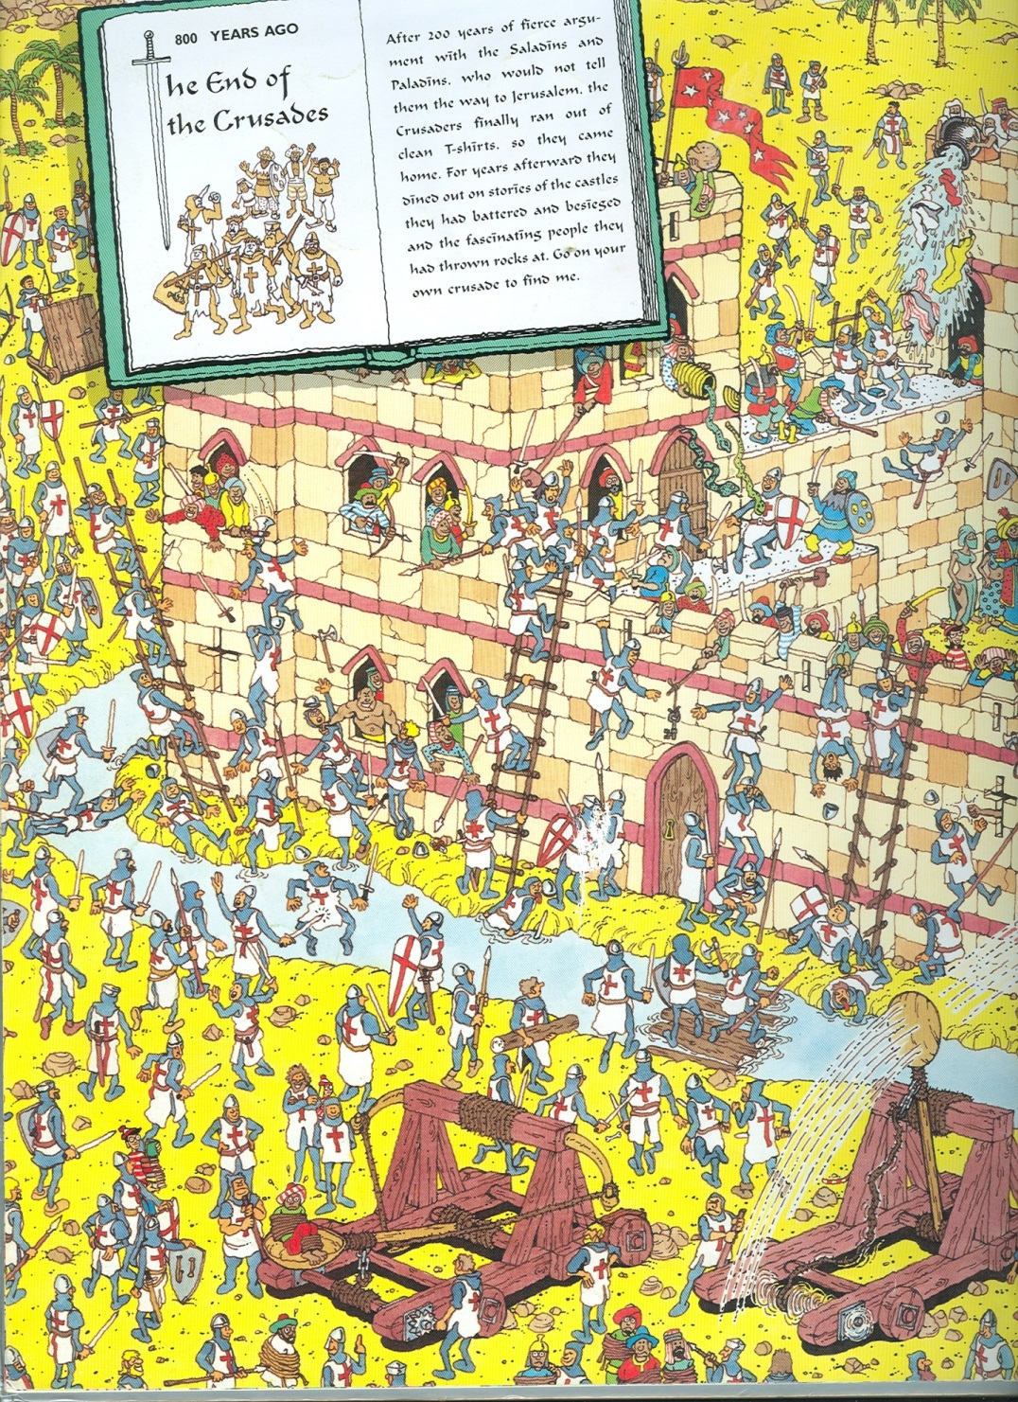

Slide 35
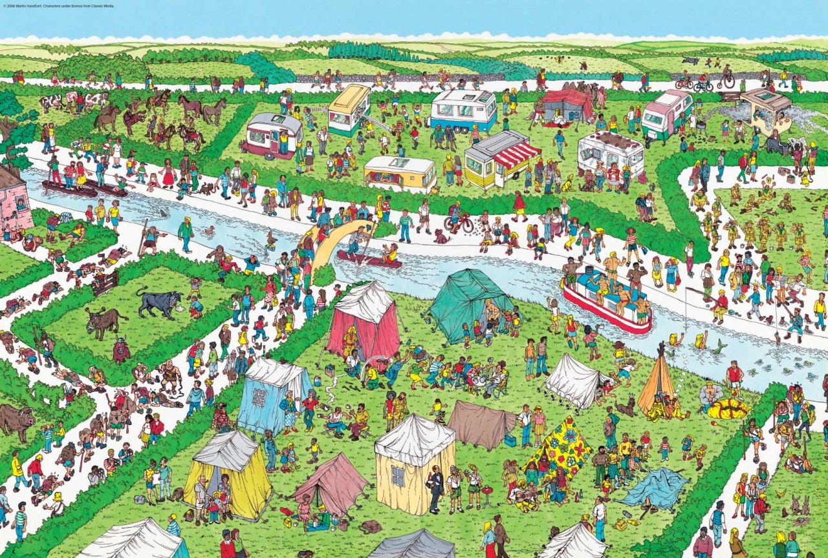

Slide 36
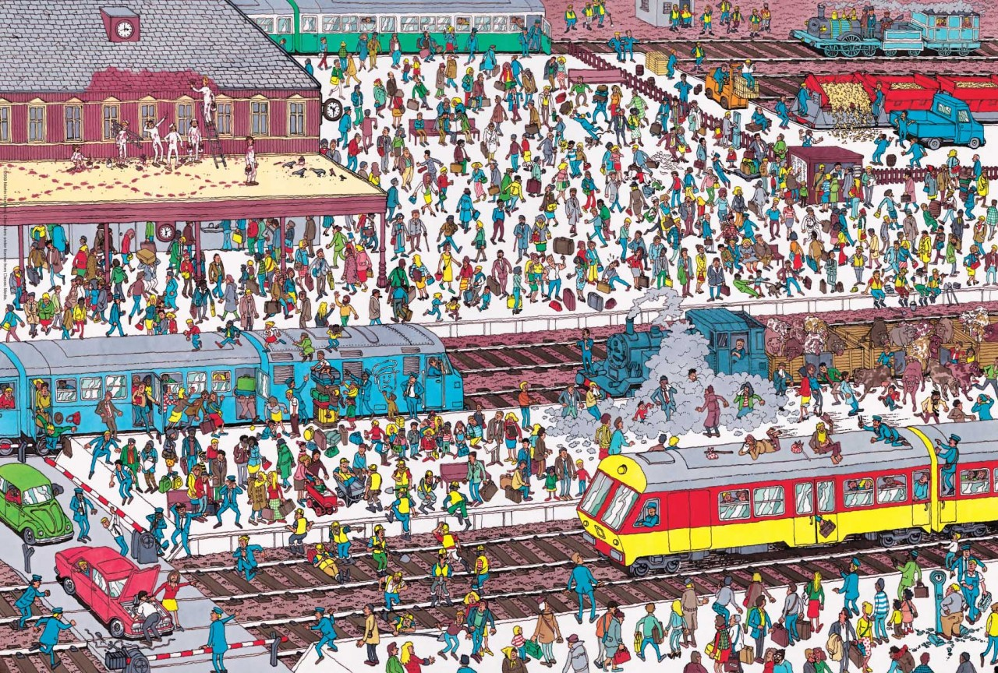

Slide 37
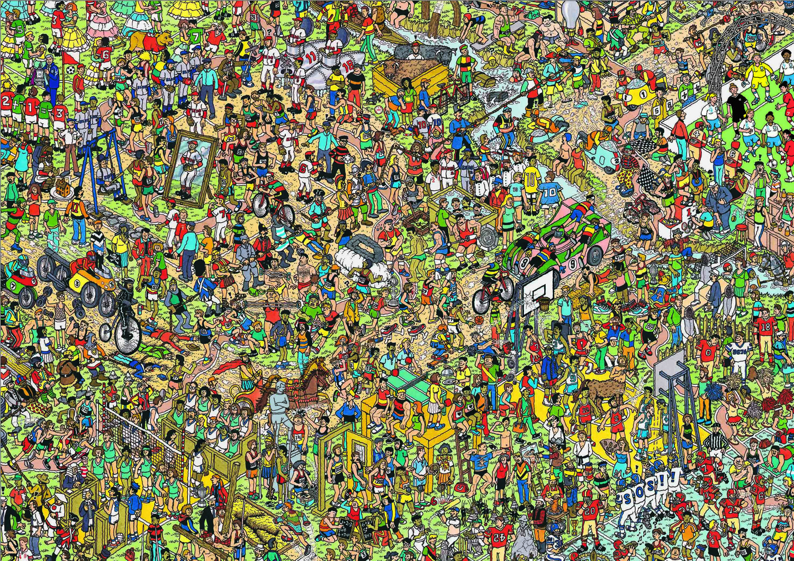

Slide 38
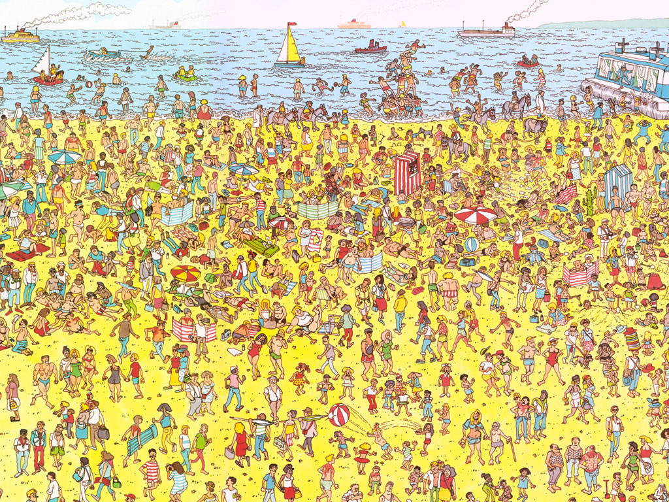

Slide 39
