Slide 1
Where is it from?

Slide 2
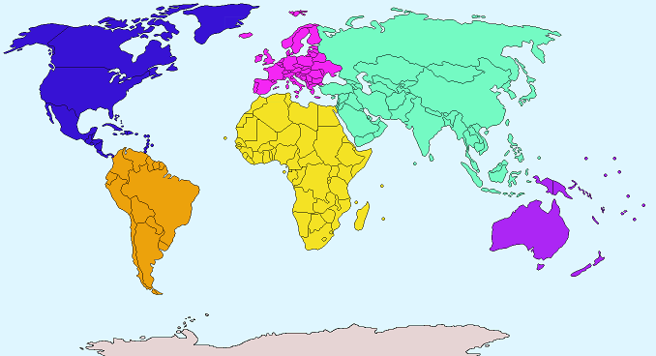
5 Continents

Slide 3
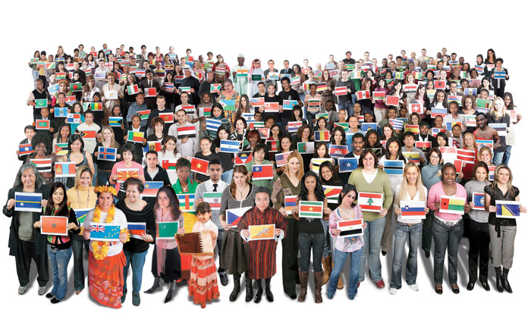
People from there?
Nationalities

Slide 4
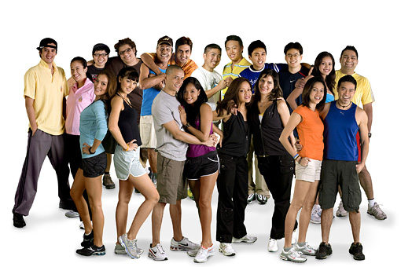
Asia
Asian

Slide 5
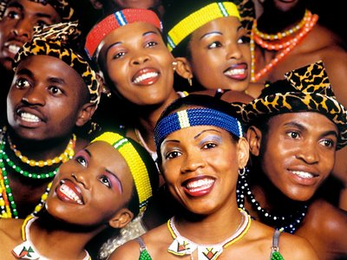
Africa
African

Slide 6
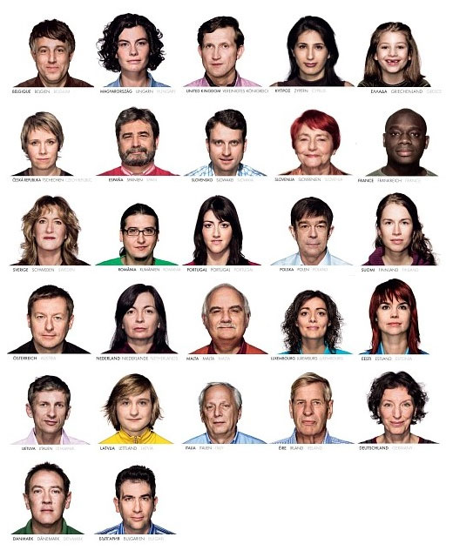
Europe
European

Slide 7
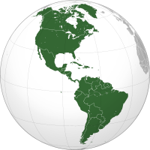
North / South America
North American
South American

Slide 8
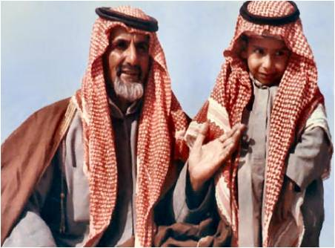
Middle East
Middle Eastern

Slide 9
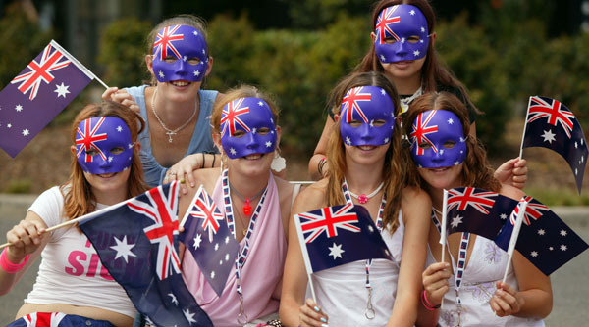
Australia
Australian

Slide 10
Countries

Slide 11
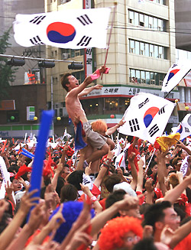
Korea
Korean

Slide 12
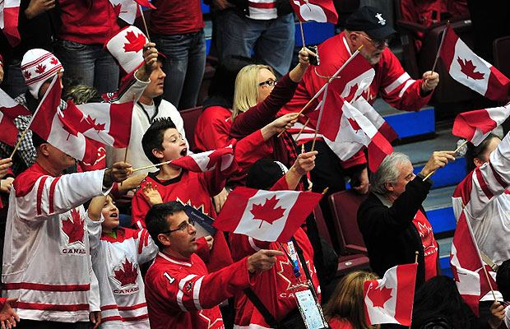
Canada
Canadian

Slide 13
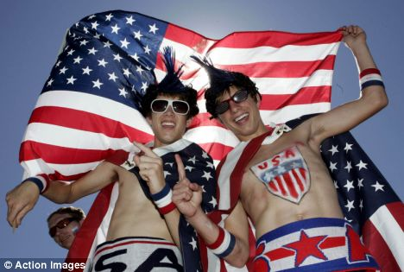
USA
American

Slide 14
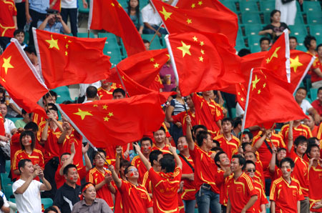
China
Chinese

Slide 15
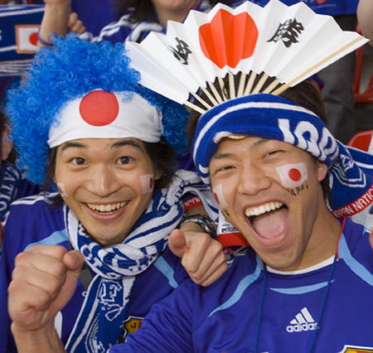
Japan
Japanese

Slide 16
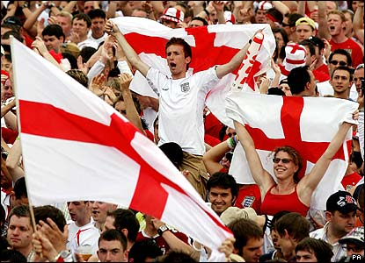
England
English

Slide 17
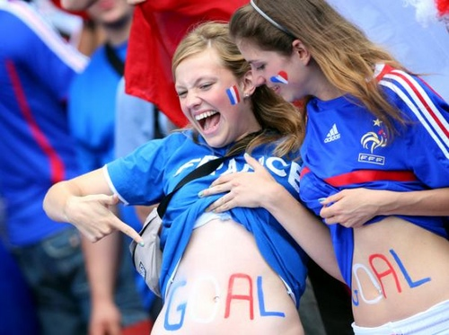
France
French

Slide 18
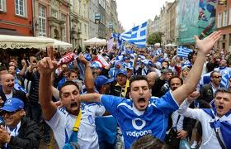
Greece
Greek

Slide 19
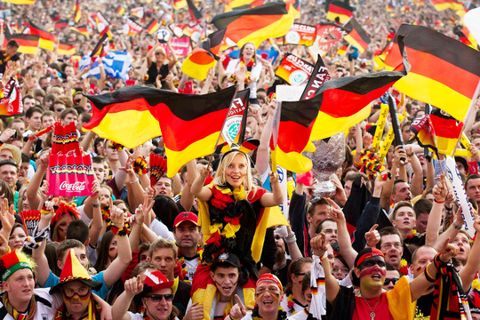
Germany
German

Slide 20
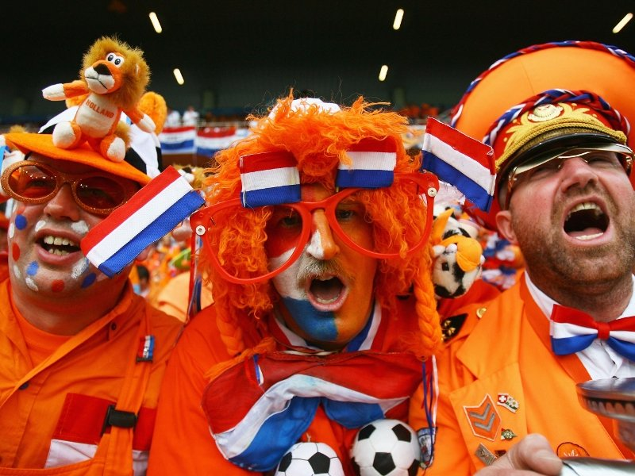
Netherlands
Dutch

Slide 21
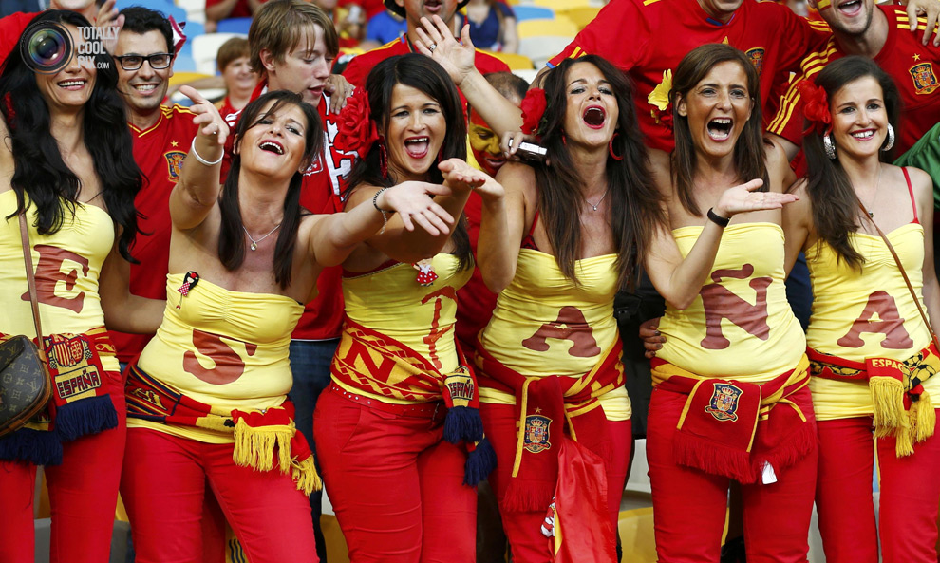
Spain
Spanish

Slide 22
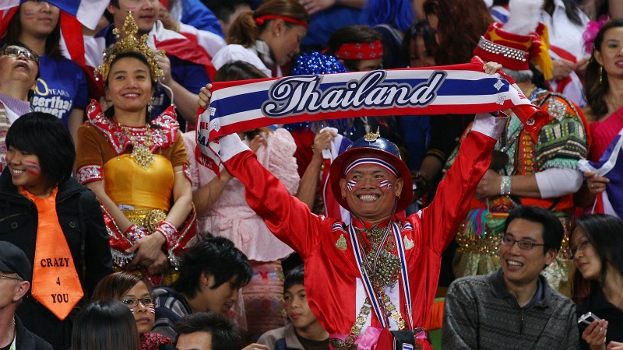
Thailand
Thai

Slide 23
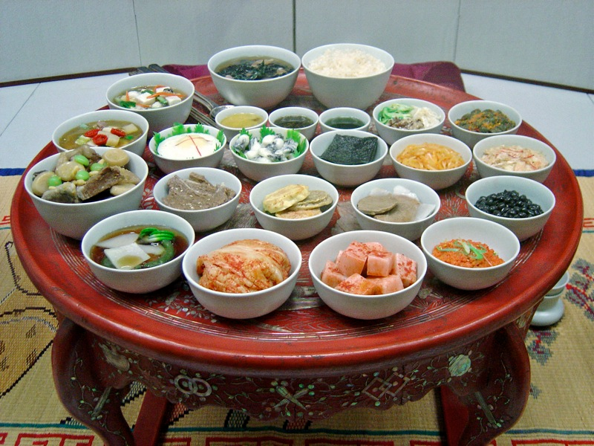
________ food

Slide 24
Chinese Food

Slide 25
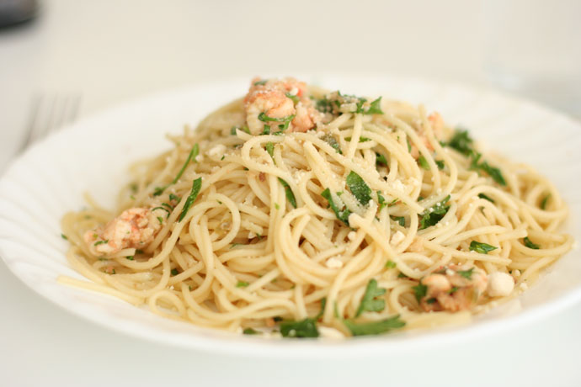
Italian Food

Slide 26
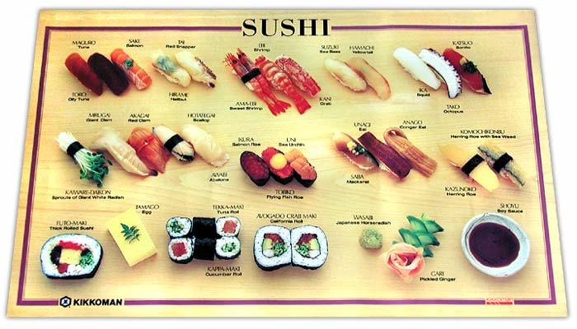
Japanese Food

Slide 27
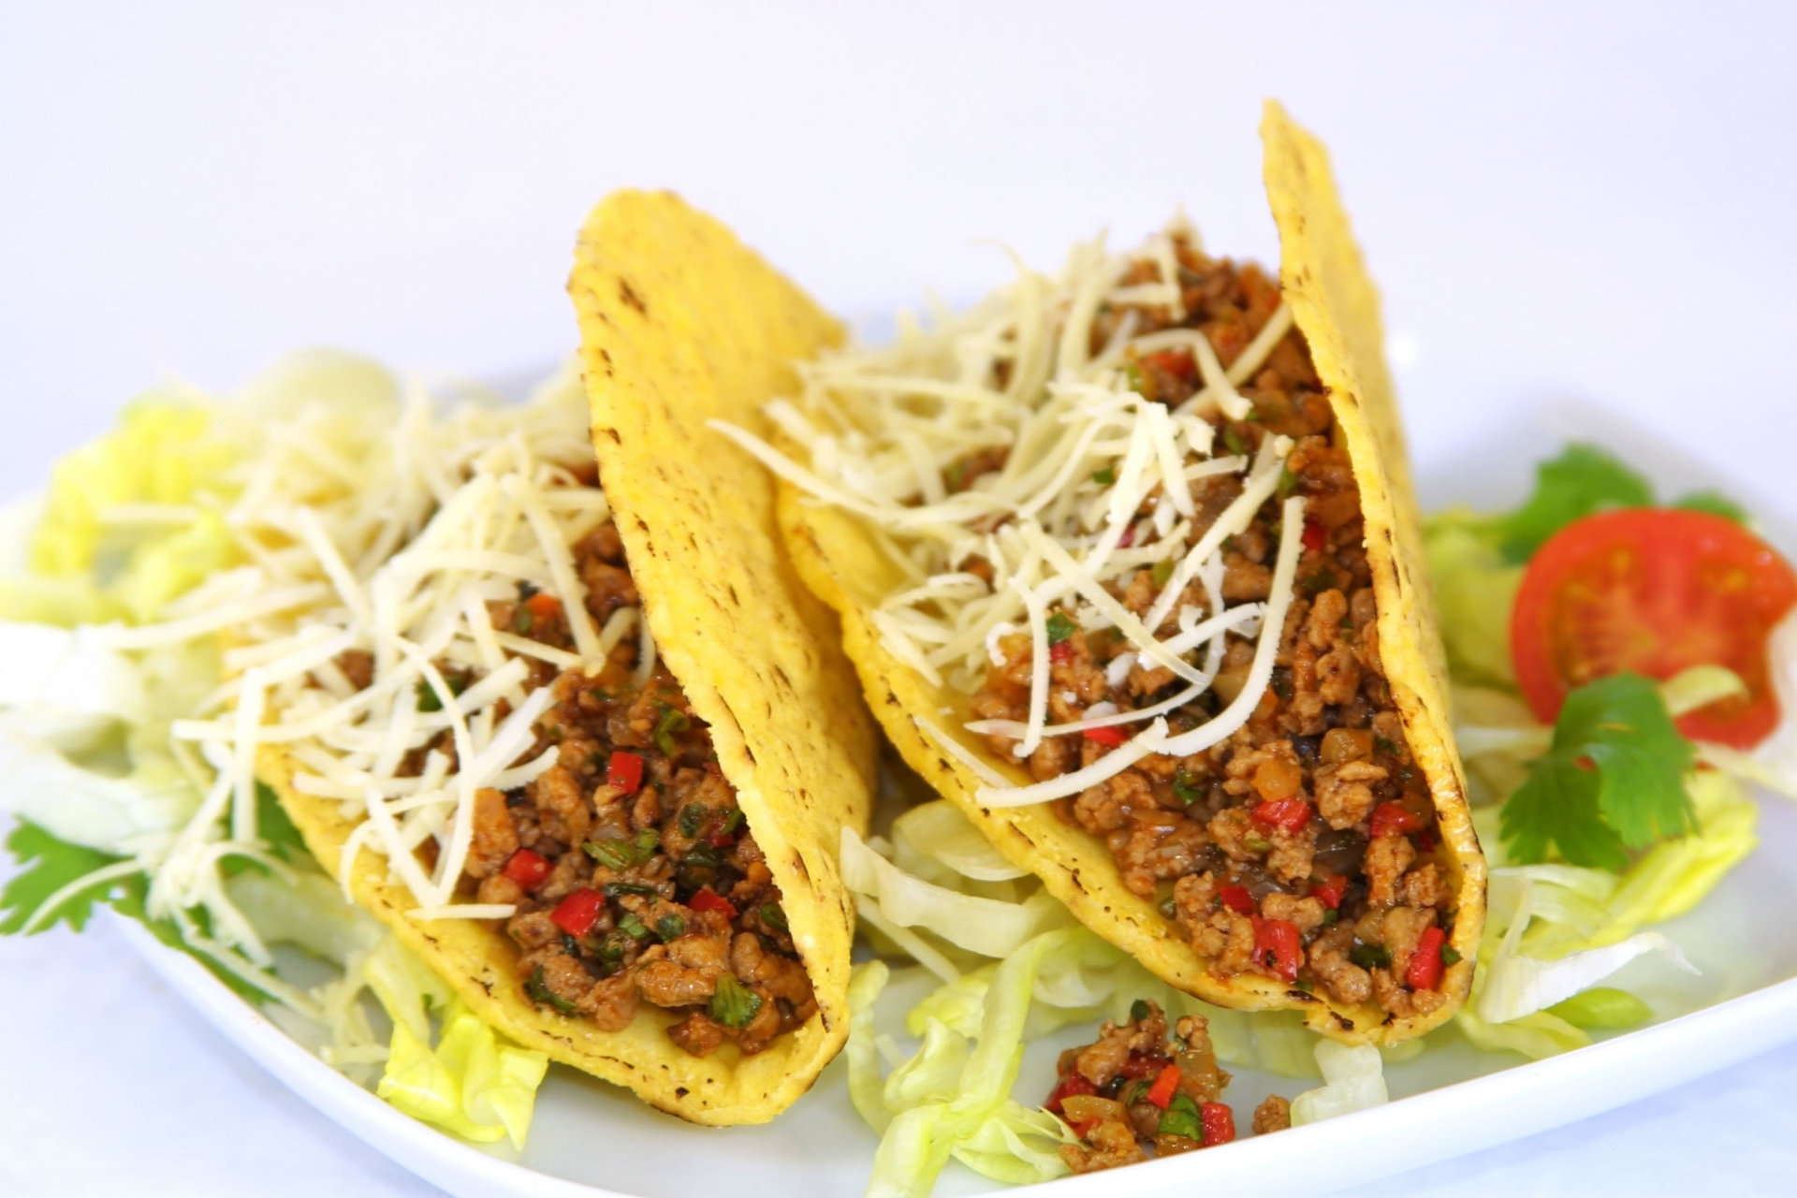
Mexican Food

Slide 28
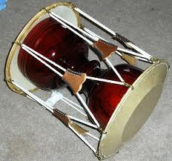
Korean drum

Slide 29
Matching Game
Match the pictures to the nationalities.
Use the pictures to unlock the question.
What is the answer to the question?

Slide 30
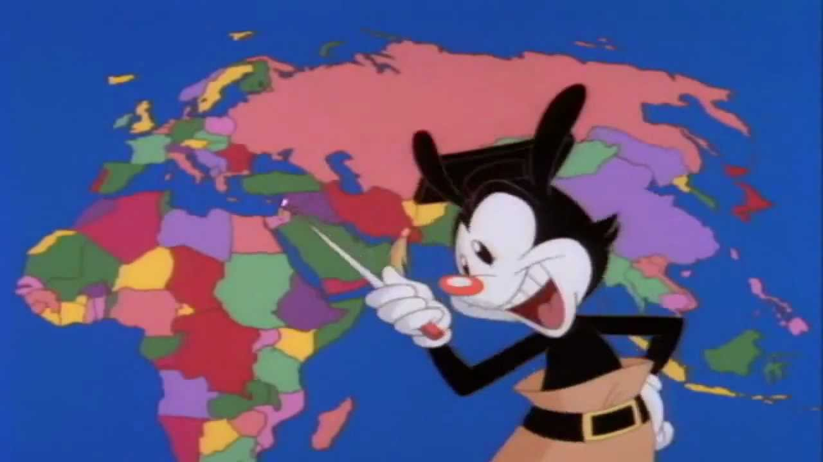
Quick Countries
https://www.youtube.com/watch?v=5pOFKmk7ytU

Slide 31
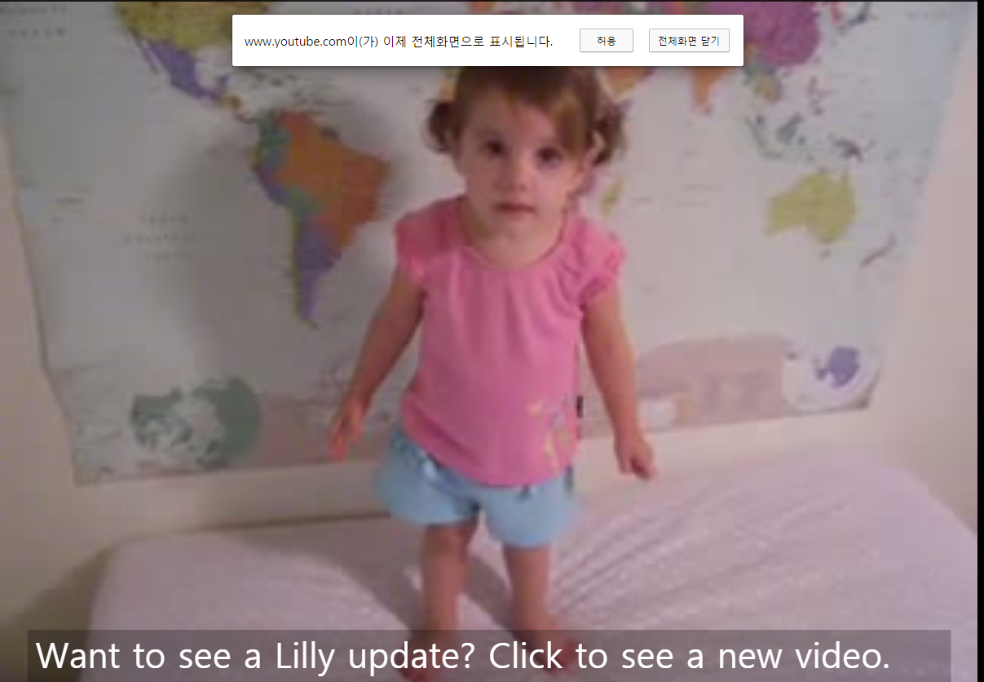
Who is faster than lily?
https://www.youtube.com/watch?v=r43yCiKlbCo

Slide 32
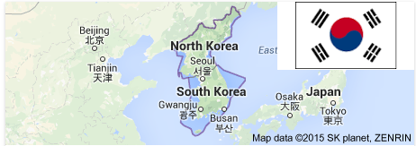
Name the continent: Korea

Slide 33
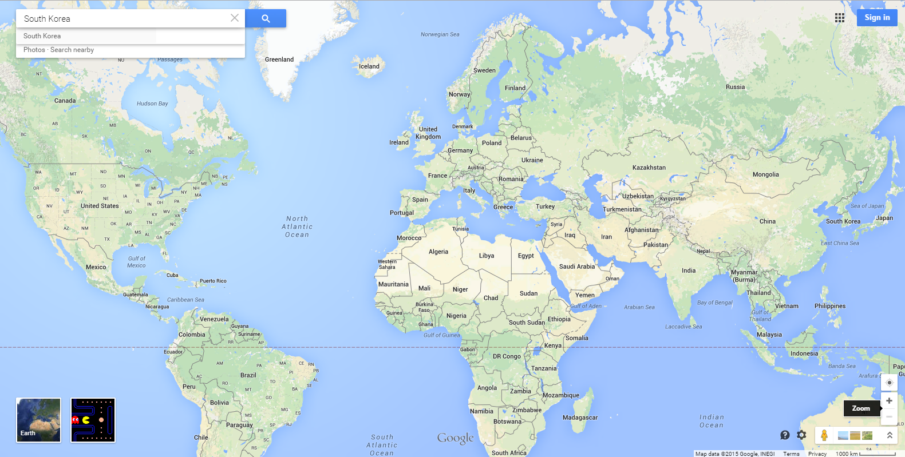
http://random.country/

Slide 34
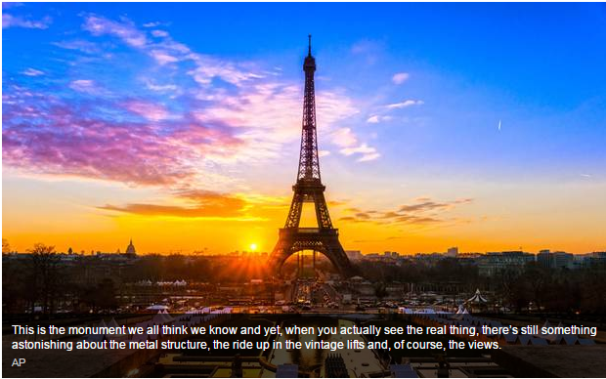
Name the country: Paris

Slide 35
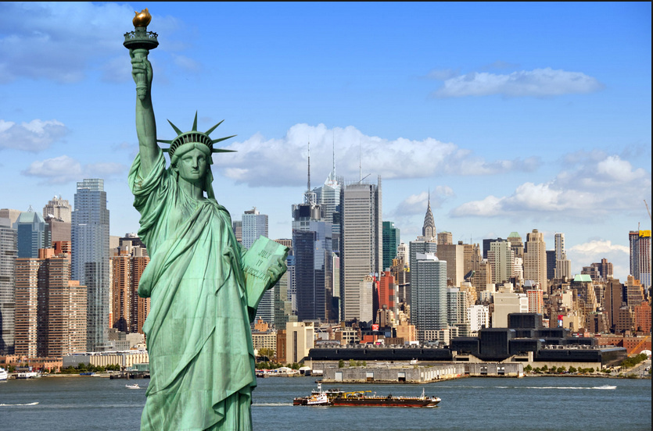
Name the country: New York

Slide 36
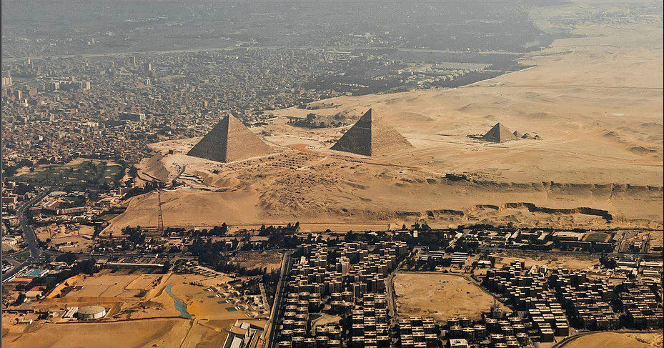
Name the country: Cairo

Slide 37
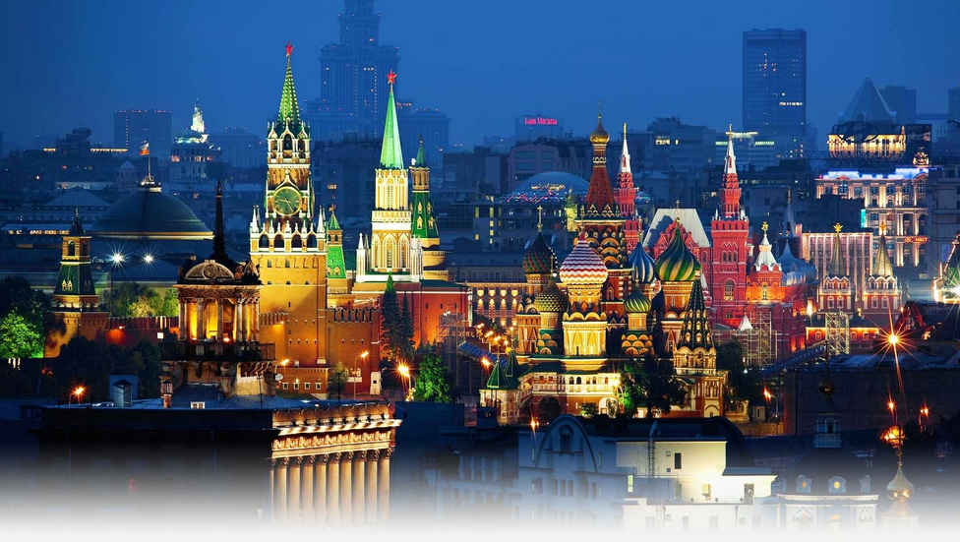
Name the country: Moscow

Slide 38
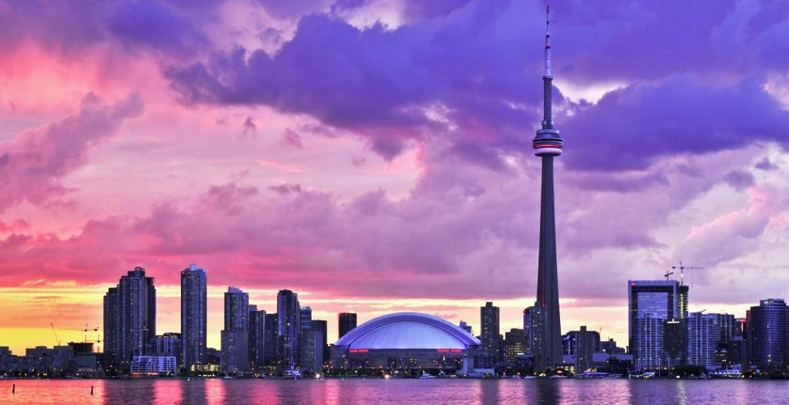
Name the country: Toronto

Slide 39
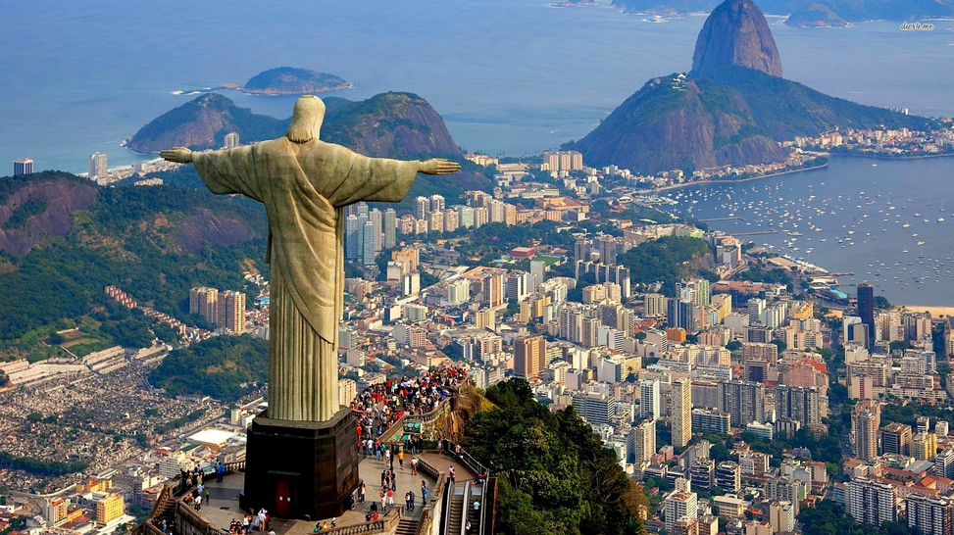
Name the country: Rio De Janiero

Slide 40
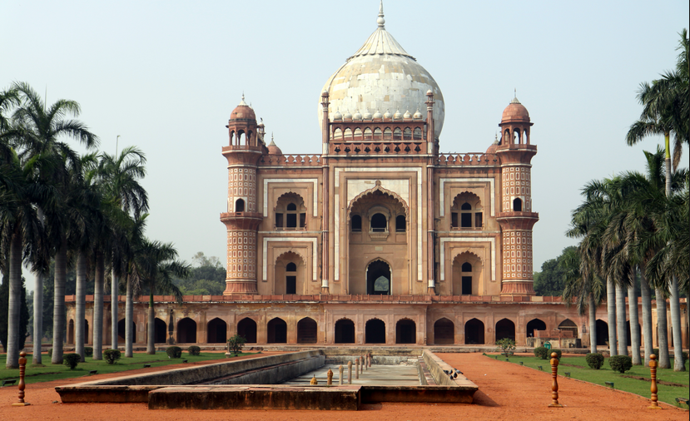
Name the country: Delhi

Slide 41
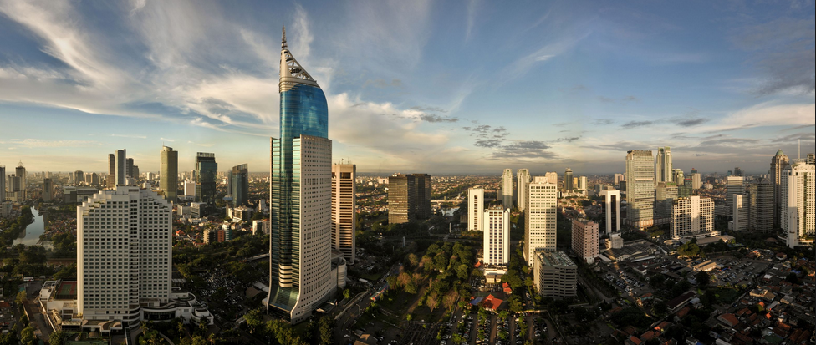
Name the country: Jakarta

Slide 42
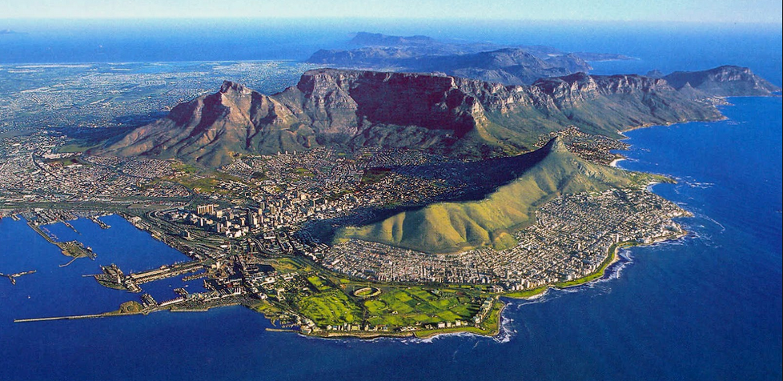
Name the country: Cape Town

Slide 43
Name the country: Canberra

Slide 44
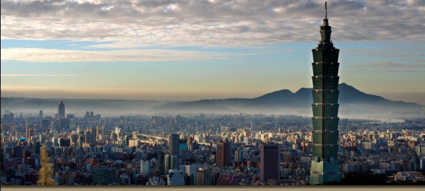
Name the country: Taipei

Slide 45
Continent, Country, City

Slide 46
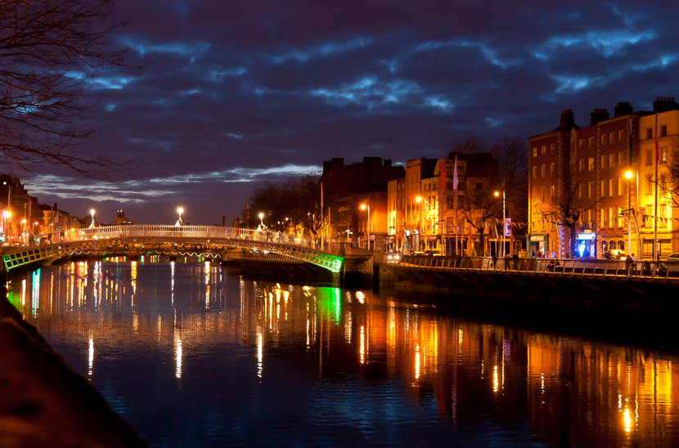
Name the country: Dublin

Slide 47
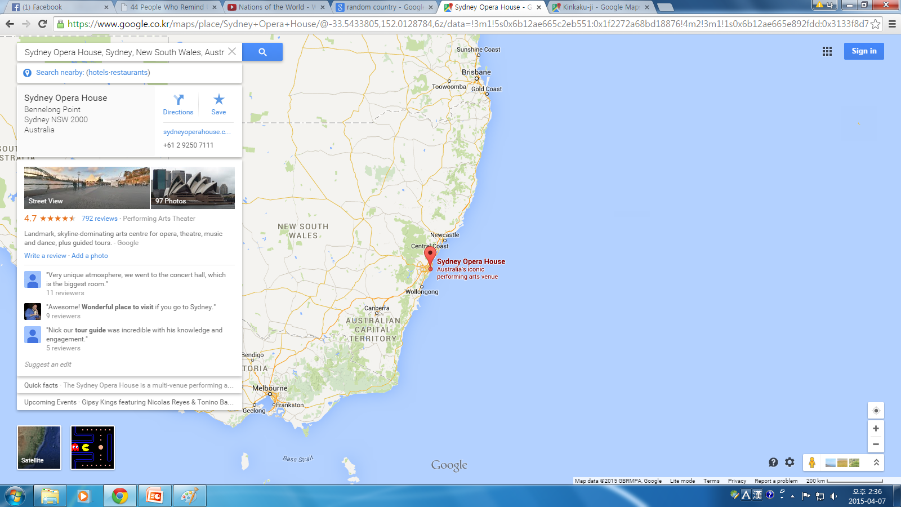
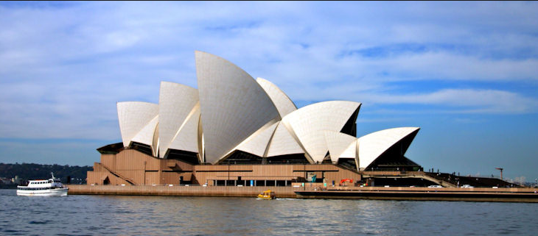
Name the Continent, Country, City

Slide 48
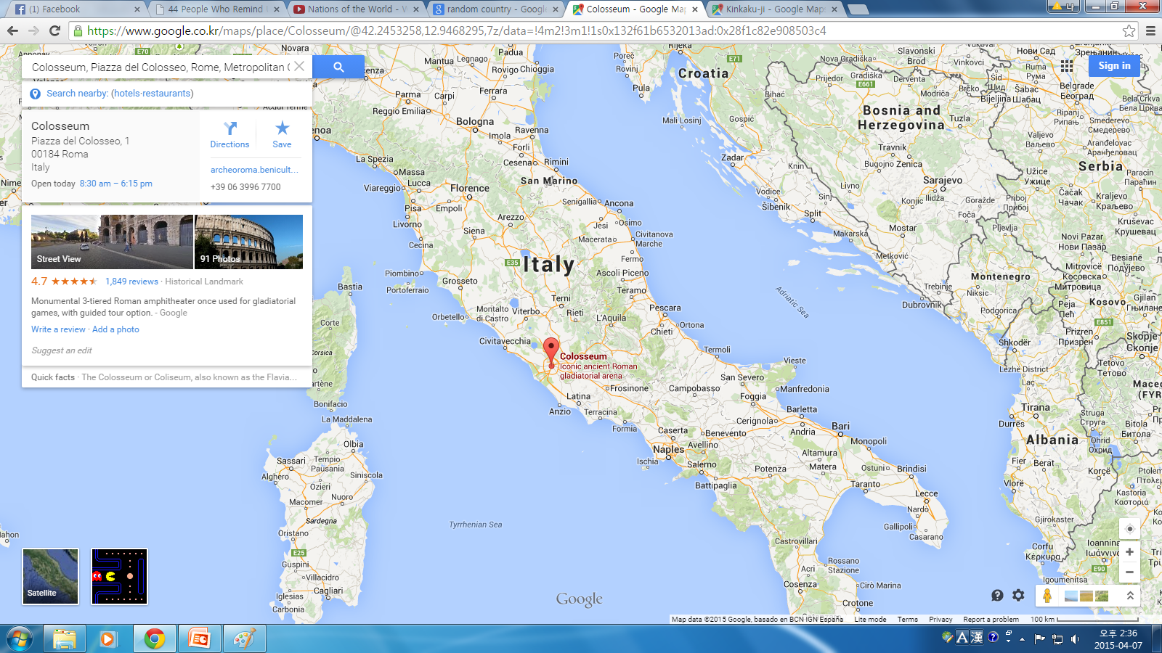
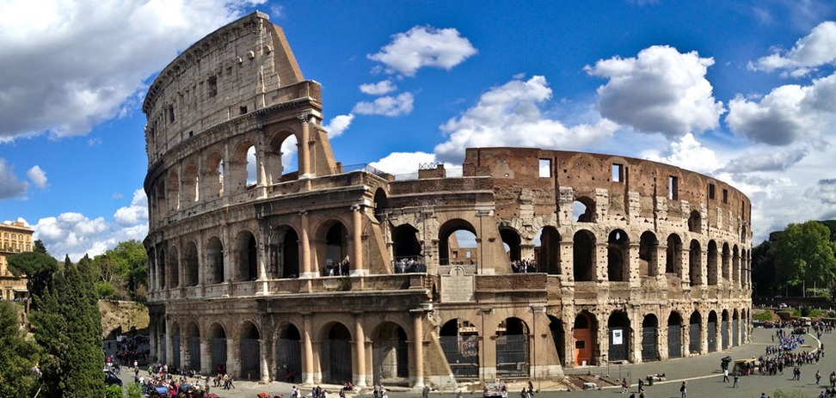
Name the Continent, Country, City

Slide 49
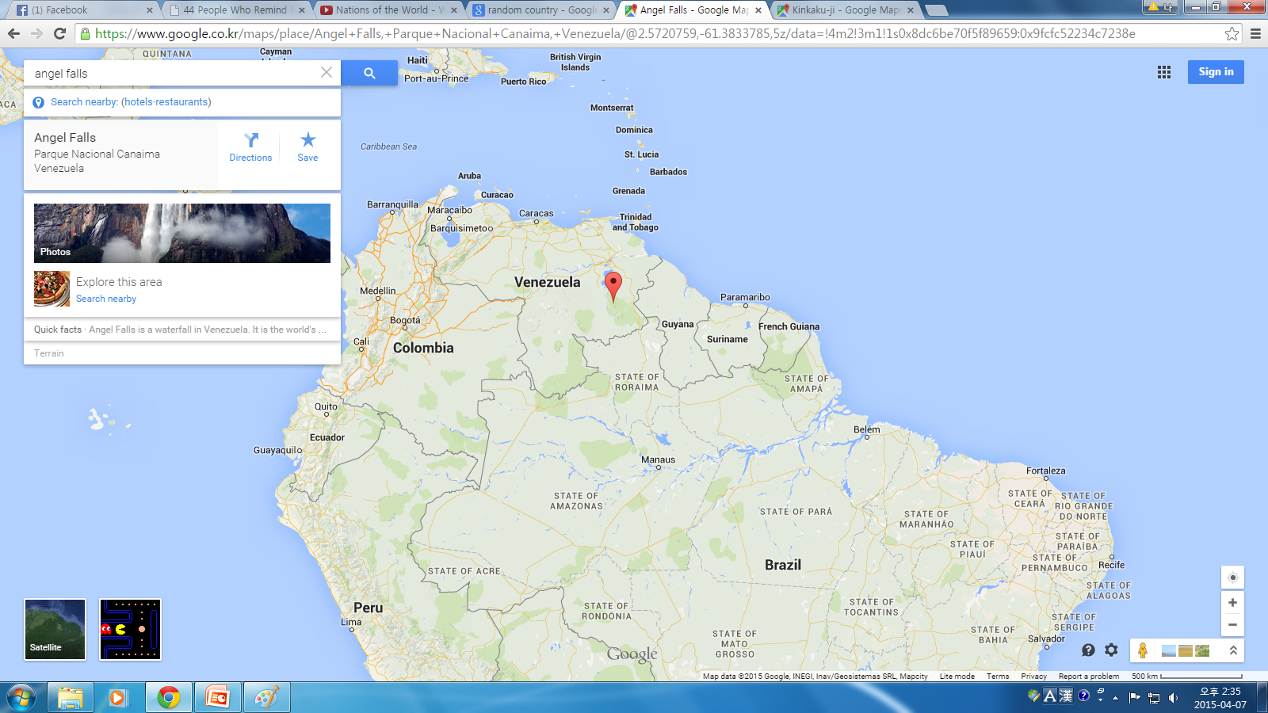
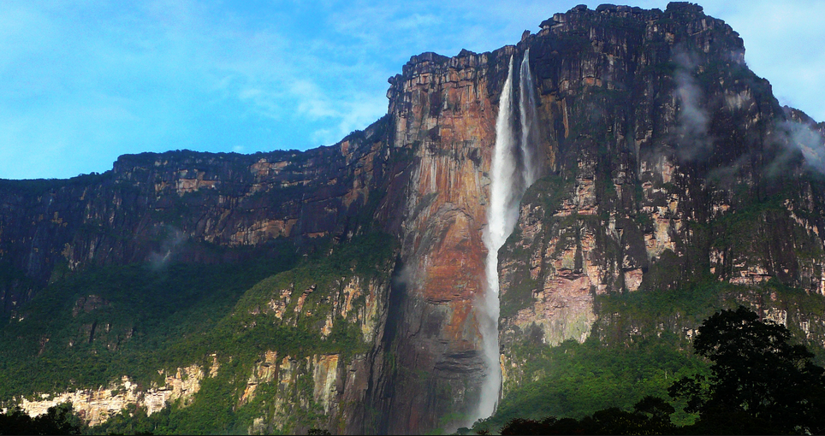
Name the Continent, Country, City

Slide 50
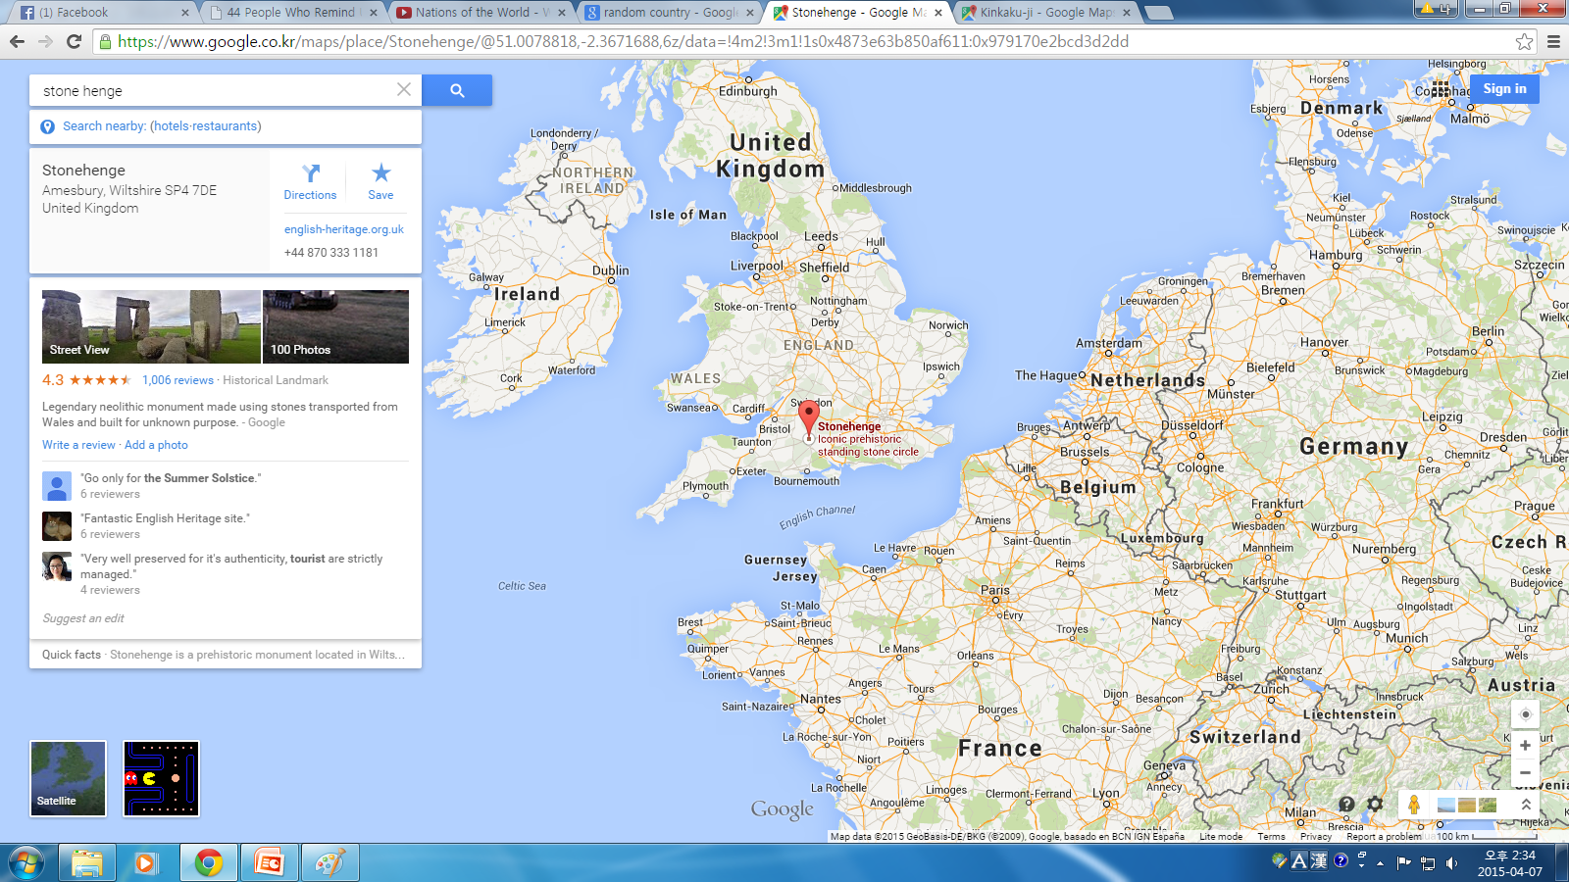
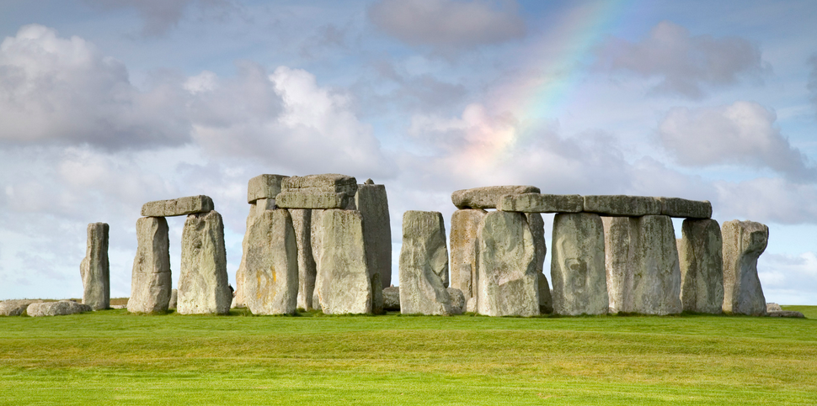
Name the Continent, Country, City

Slide 51
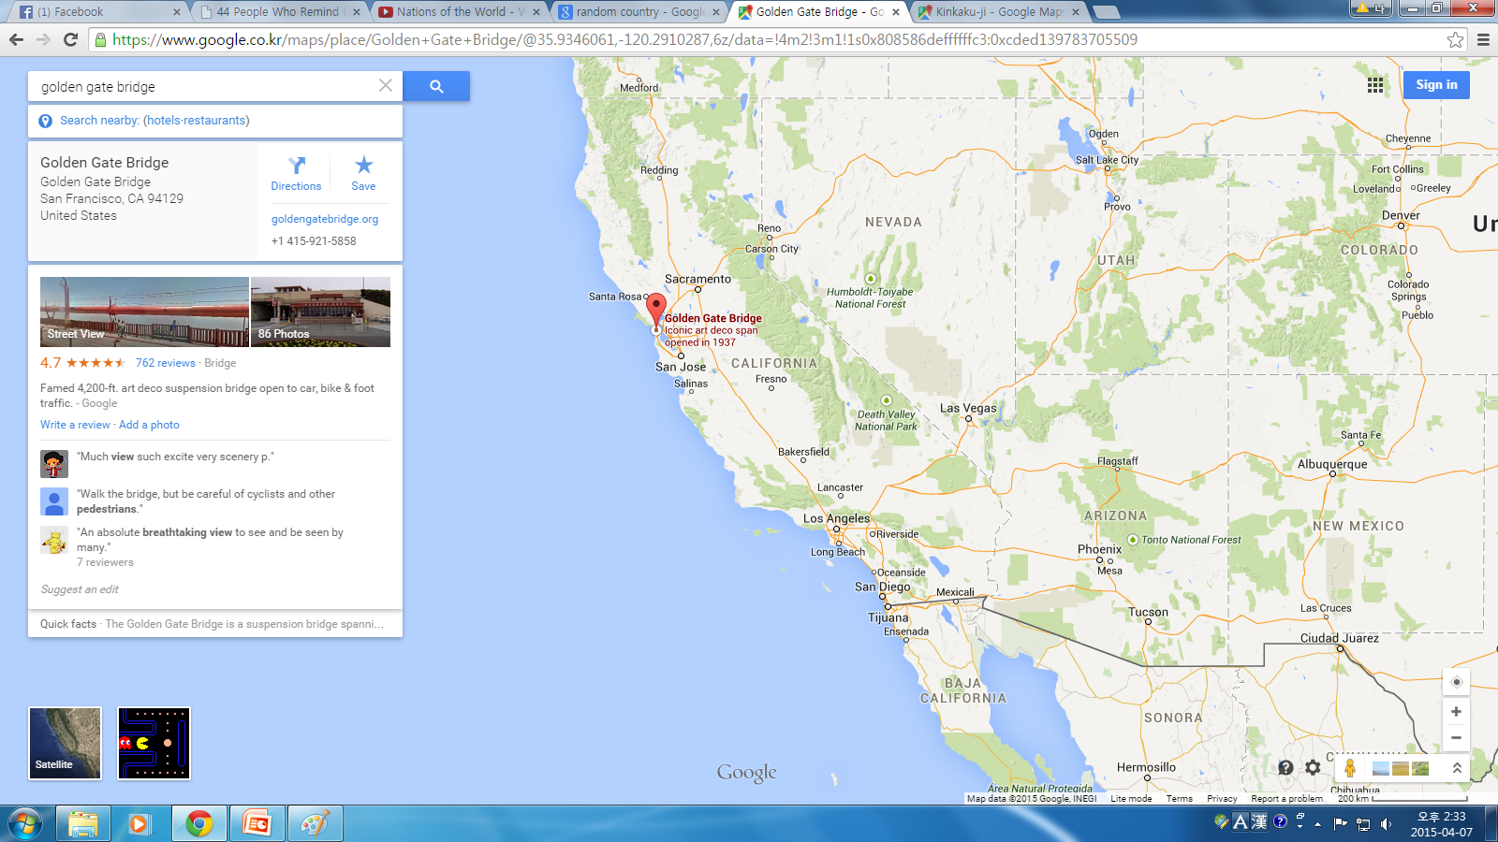
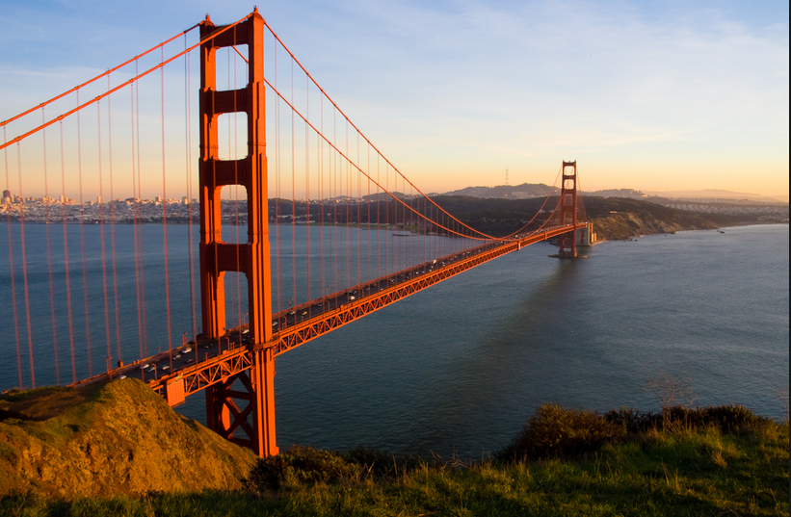
Name the Continent, Country, City

Slide 52
Name the Continent, Country, City

Slide 53
Name the Continent, Country, City

Slide 54
Name the Continent, Country, City

Slide 55
Name the Continent, Country, City

Slide 56
Name the Continent, Country, City

Slide 57
Name the Continent, Country, City

