Slide 1
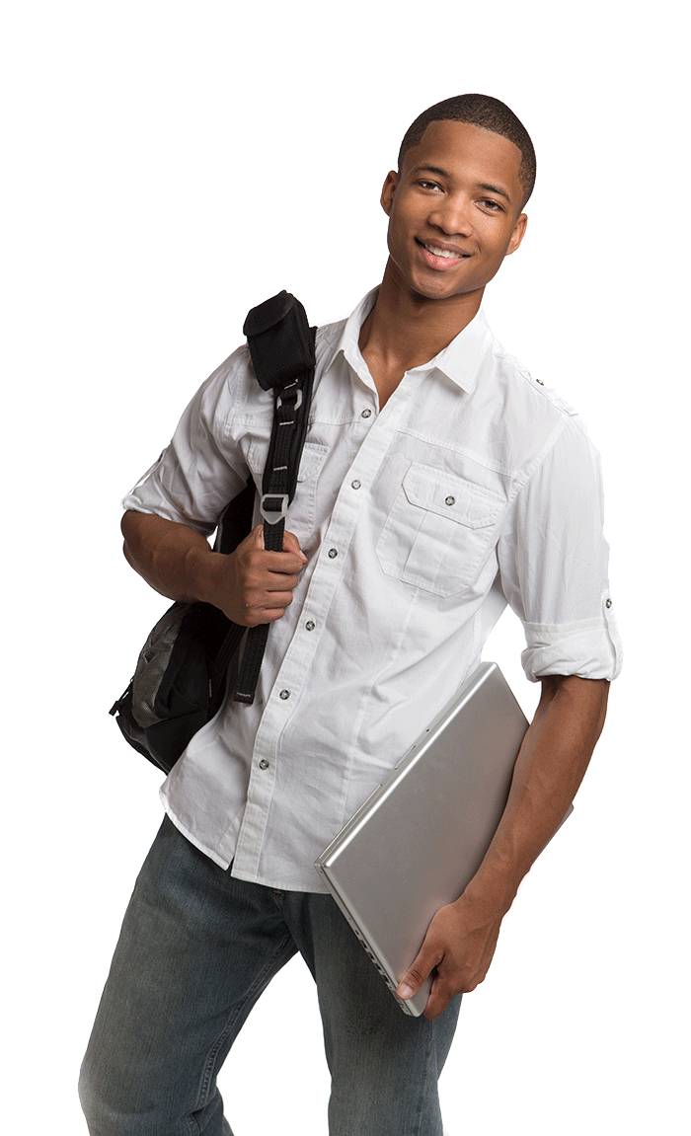
Name: Hercules
Job:
Skills:
Carrying:
Student (Athletics)
Good at sports.
Strong and Fast
Water bottle
Rope
Camera
Energy bars

Slide 2
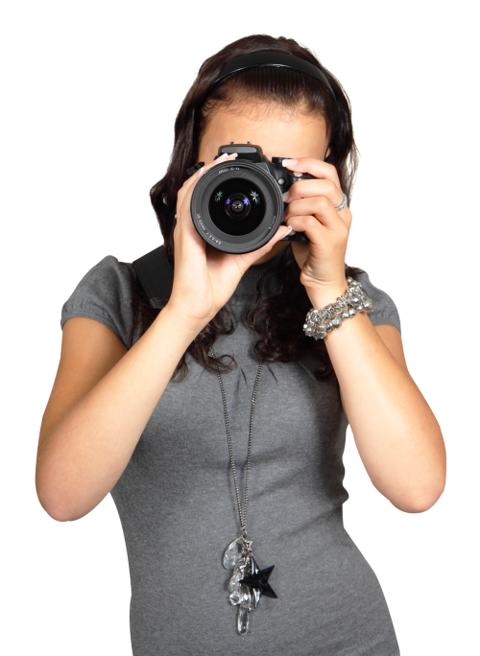
Name: Ariel
Job:
Skills:
Carrying:
Student (photography)
Some knowledge
about nature
Camera
Extra lenses

Slide 3
Name: Samantha
Job:
Skills:
Carrying:
Student (nursing)
First Aid
First Aid Kit
Tylenol
Flashlight

Slide 4
Name: Arianna
Job:
Skills:
Carrying:
Student (Art)
Can draw accurately
and quickly.
Pencil
Notebook
Candles
A novel

Slide 5
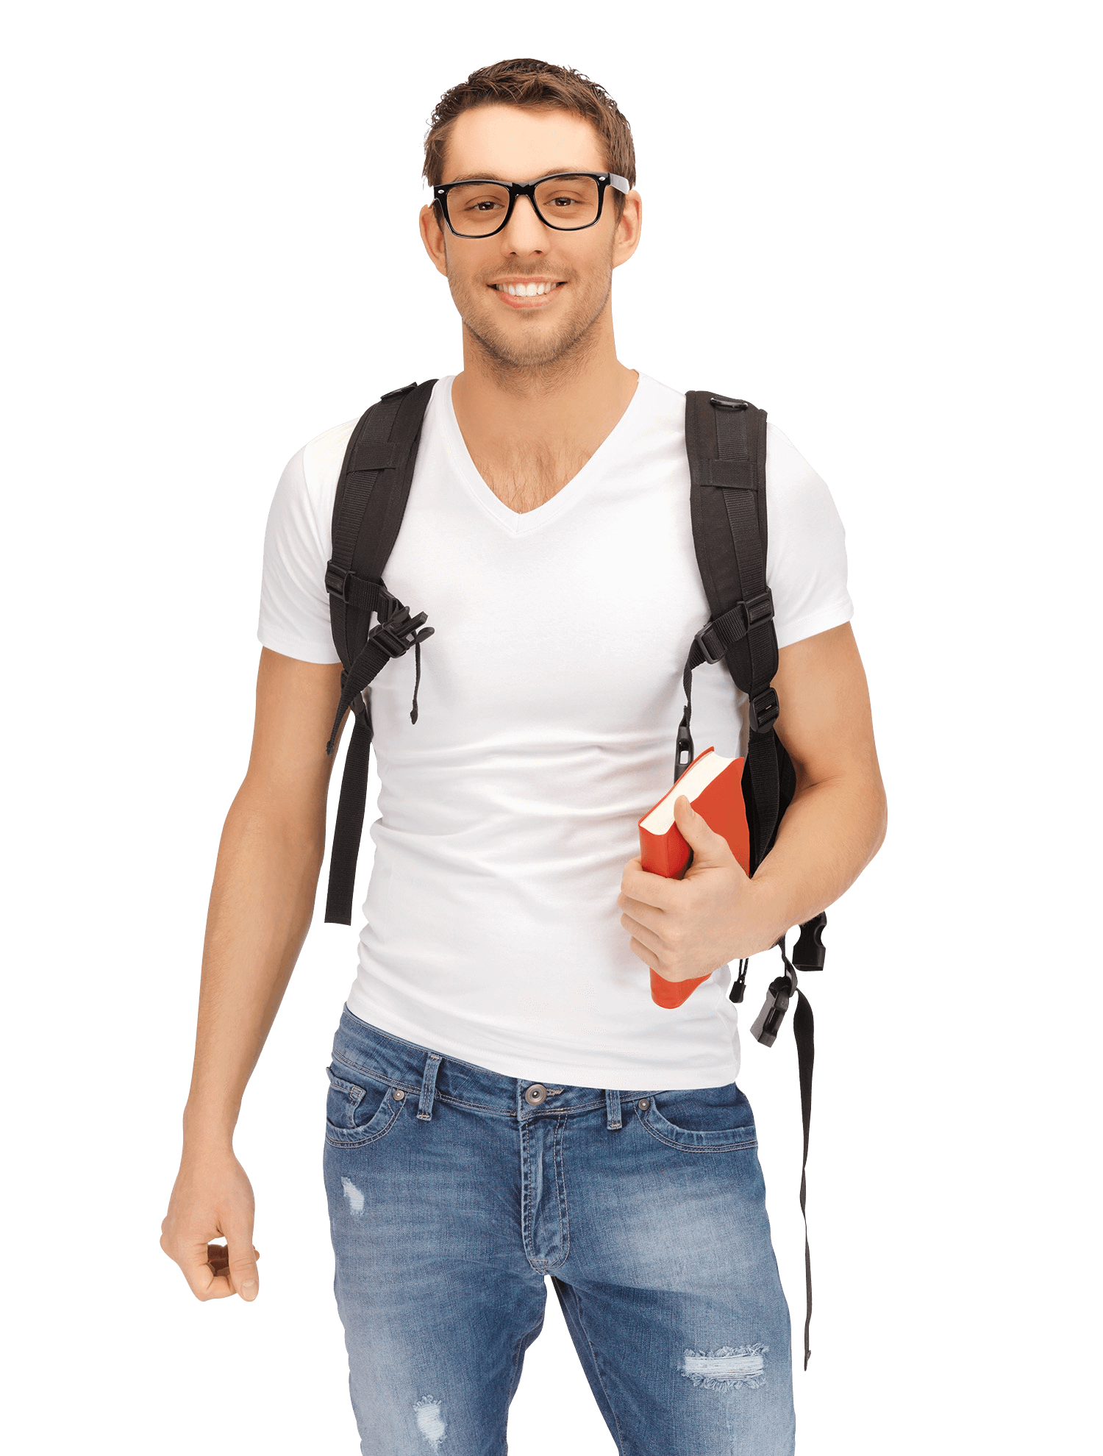
Name: Ramsy
Job:
Skills:
Carrying:
Student (Chef)
Cooking
Kettle
Cups
Noodles

