Slide 1
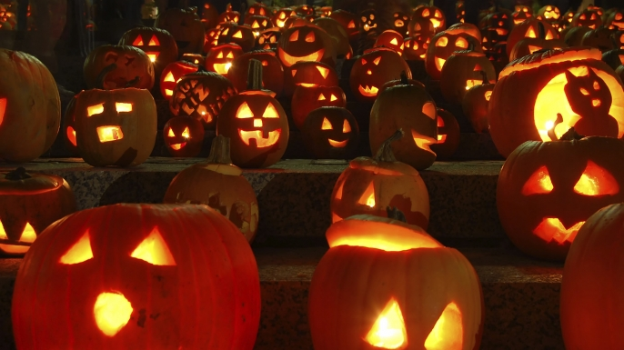
Halloween

Slide 2
What do you know about Halloween?

Slide 3
Halloween Vocabulary
to evolve (v)- to change little by little
spirit (n)- ghost, some people believe the spirit and body separate when a person dies
holy (adj)- sacred, very good, related to religion. Hallow comes from the word holy.
saint (n)- an honored, holy person
evil (adj)- very, very bad
lantern (n)- lamp or enclosed light that can be carried around
turnip (n)- a purple and white vegetable that grows in the ground

Slide 4
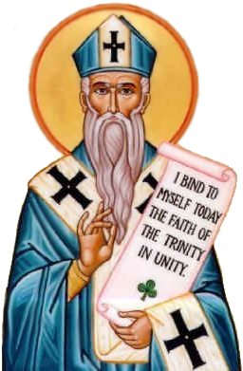
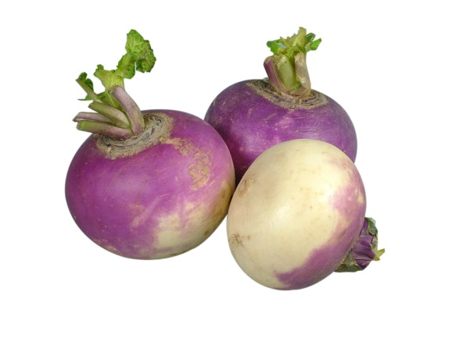
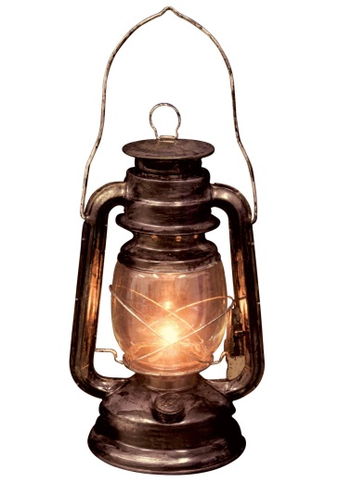
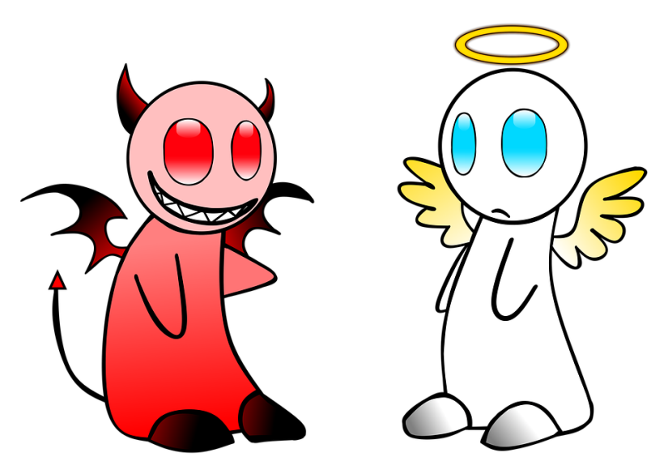
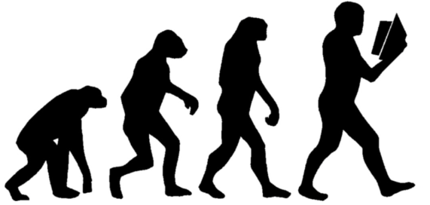
Turnip
Saint
Spirit
Evolve
Lantern
Evil Holy

Slide 5
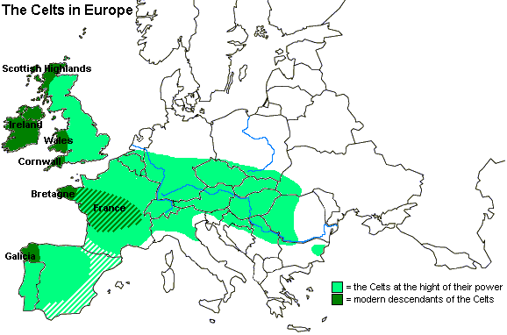
History of Halloween
Like many other holidays, Halloween has evolved and changed throughout history. Over 2,000 years ago people called the Celts lived in what is now Ireland, the UK, and parts of Northern France. November 1 was their New Year's Day. They believed that the night before the New Year (October 31) was a time when the living and the dead came together.
Celts

Slide 6
History of Halloween
What day was New Year’s Day for the Celts?
Like many other holidays, Halloween has evolved and changed throughout history. Over 2,000 years ago people called the Celts lived in what is now Ireland, the UK, and parts of Northern France. November 1 was their New Year's Day. They believed that the night before the New Year (October 31) was a time when the living and the dead came together.

Slide 7
History of Halloween
What happened the night before New Year’s Day?
(New Year’s Eve)
Like many other holidays, Halloween has evolved and changed throughout history. Over 2,000 years ago people called the Celts lived in what is now Ireland, the UK, and parts of Northern France. November 1 was their New Year's Day. They believed that the night before the New Year (October 31) was a time when the living and the dead came together.

Slide 8
History of Halloween
What did the Christians call Nov.1?
More than a thousand years ago the Christian church named November 1 All Saints Day (also called All Hallows.) This was a special holy day to honor the saints and other people who died for their religion. The night before All Hallows was called Hallows Eve. Later the name was changed to Halloween.

Slide 9
History of Halloween
What is the day before All Hallows?
More than a thousand years ago the Christian church named November 1 All Saints Day (also called All Hallows.) This was a special holy day to honor the saints and other people who died for their religion. The night before All Hallows was called Hallows Eve. Later the name was changed to Halloween.

Slide 10
History of Halloween
“The night before”
More than a thousand years ago the Christian church named November 1 All Saints Day (also called All Hallows.) This was a special holy day to honor the saints and other people who died for their religion. The night before All Hallows was called Hallows Eve. Later the name was changed to Halloween.

Slide 11
History of Halloween
Who visited earth on All Hallows Eve?
Like the Celts, the Europeans of that time also believed that the spirits of the dead would visit the earth on Halloween. They worried that evil spirits would cause problems or hurt them. So on that night people wore costumes that looked like ghosts or other evil creatures. They thought if they dressed like that, the spirits would think they were also dead and not harm them.

Slide 12
History of Halloween
Why did they wear costumes?
Like the Celts, the Europeans of that time also believed that the spirits of the dead would visit the earth on Halloween. They worried that evil spirits would cause problems or hurt them. So on that night people wore costumes that looked like ghosts or other evil creatures. They thought if they dressed like that, the spirits would think they were also dead and not harm them.

Slide 13
History of Halloween
How did Halloween get to America?
The tradition of Halloween was carried to America by the immigrating Europeans. Some of the traditions changed a little, though. For example, on Halloween in Europe some people would carry lanterns made from turnips. In America, pumpkins were more common. So people began putting candles inside them and using them as lanterns. That is why you see Jack 'o lanterns today.

Slide 14
History of Halloween
What did Europeans use for lanterns?
The tradition of Halloween was carried to America by the immigrating Europeans. Some of the traditions changed a little, though. For example, on Halloween in Europe some people would carry lanterns made from turnips. In America, pumpkins were more common. So people began putting candles inside them and using them as lanterns. That is why you see Jack 'o lanterns today.

Slide 15
History of Halloween
What did the Americans use for lanterns?
The tradition of Halloween was carried to America by the immigrating Europeans. Some of the traditions changed a little, though. For example, on Halloween in Europe some people would carry lanterns made from turnips. In America, pumpkins were more common. So people began putting candles inside them and using them as lanterns. That is why you see Jack 'o lanterns today.

Slide 16
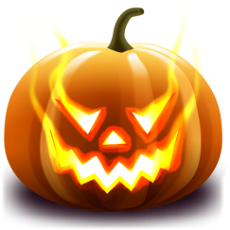
History of Halloween
What are pumpkin lanterns called?
The tradition of Halloween was carried to America by the immigrating Europeans. Some of the traditions changed a little, though. For example, on Halloween in Europe some people would carry lanterns made from turnips. In America, pumpkins were more common. So people began putting candles inside them and using them as lanterns. That is why you see Jack 'o lanterns today.

Slide 17
History of Halloween
What do children say to get candies?
These days Halloween is not usually considered a holy holiday. It is a fun day for children. Children dress up in costumes like people did a thousand years ago. But instead of worrying about evil spirits, they go from house to house. They knock on doors and say "trick or treat." The owner of each house gives candy or something special to each trick or treater.

Slide 18
What is a costume?
Clothes that make you look like something else.

Slide 19
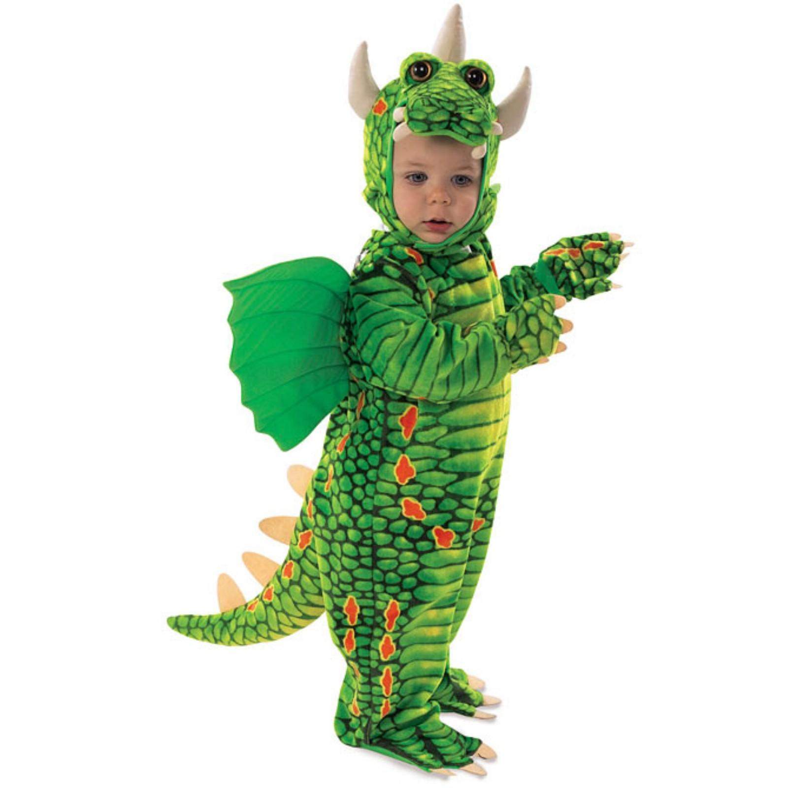
Some Costume Ideas:
Dragon

Slide 20
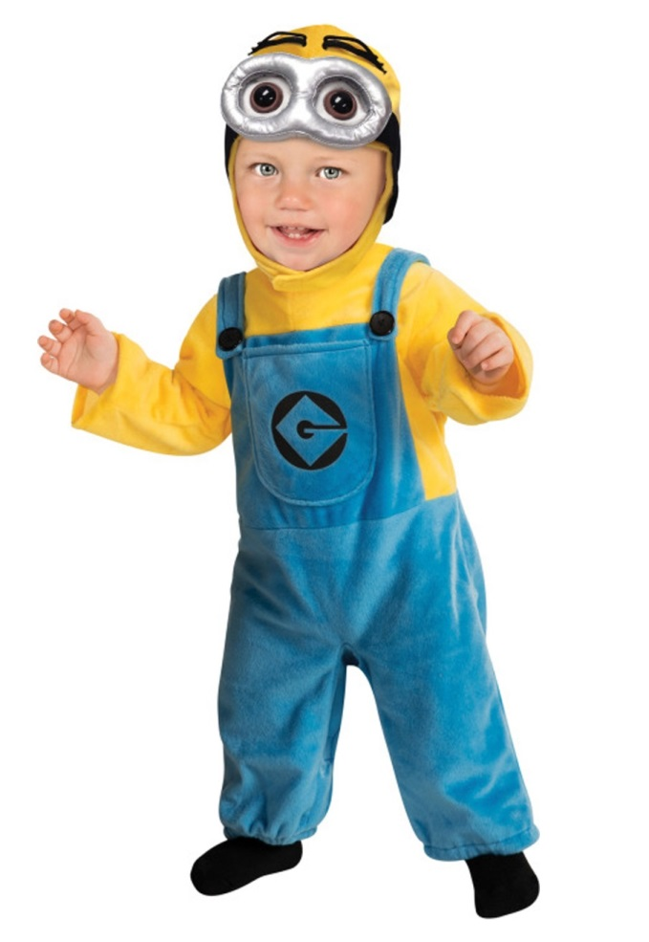
Some Costume Ideas:
Minion

Slide 21
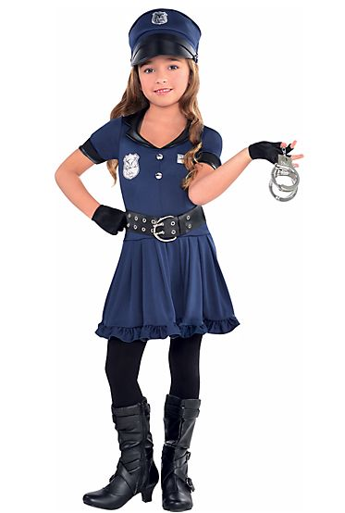
Some Costume Ideas:
Police Officer

Slide 22
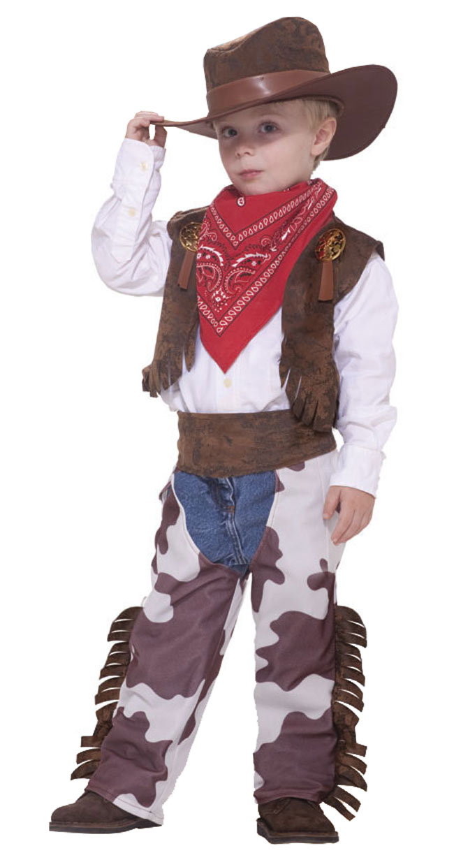
Some Costume Ideas:
Cowboy

Slide 23
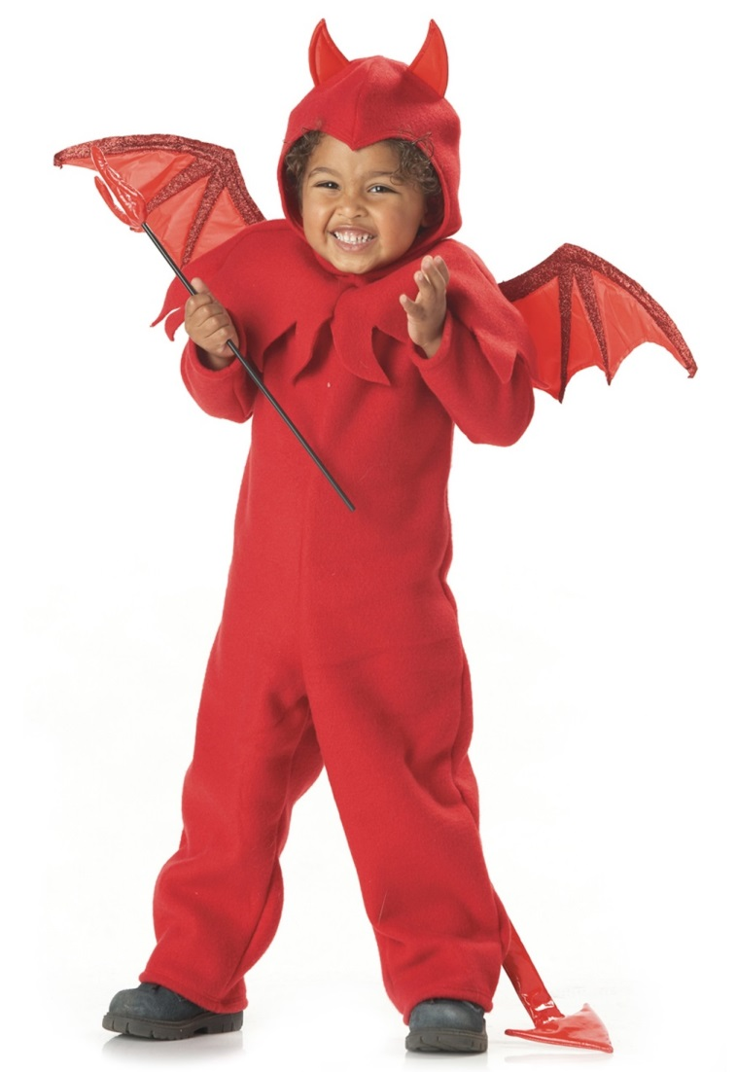
Some Costume Ideas:
Devil

Slide 24
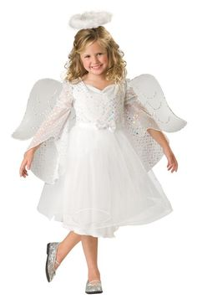
Some Costume Ideas:
Angel

Slide 25
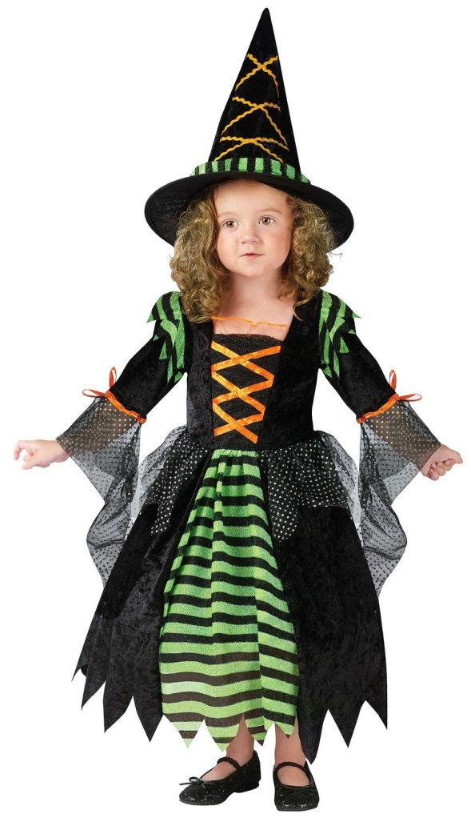
Some Costume Ideas:
Witch

Slide 26
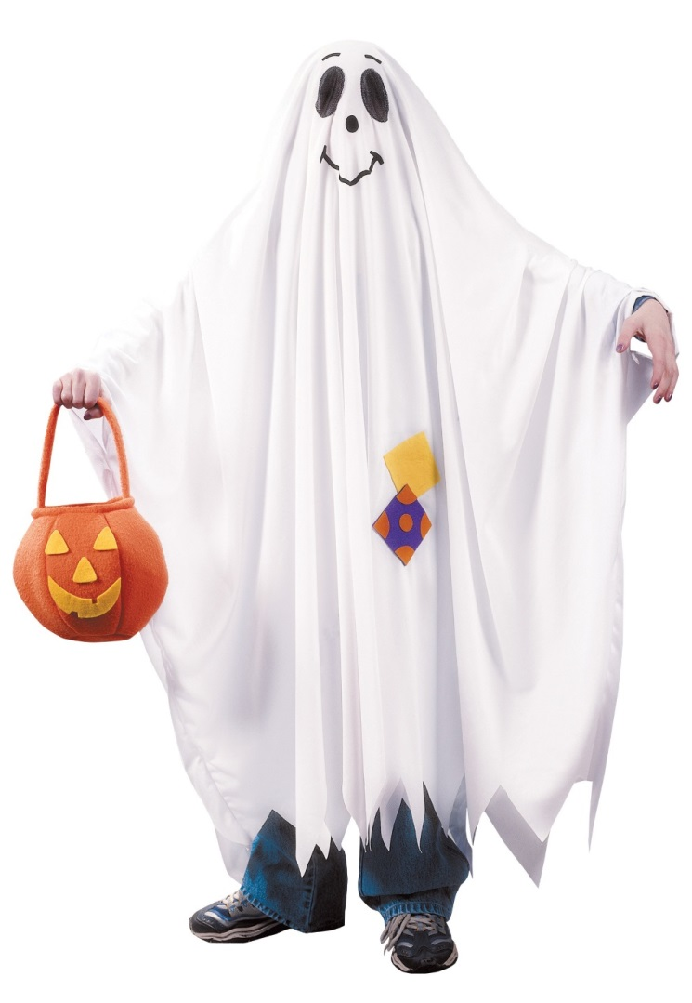
Some Costume Ideas:
Ghost

Slide 27
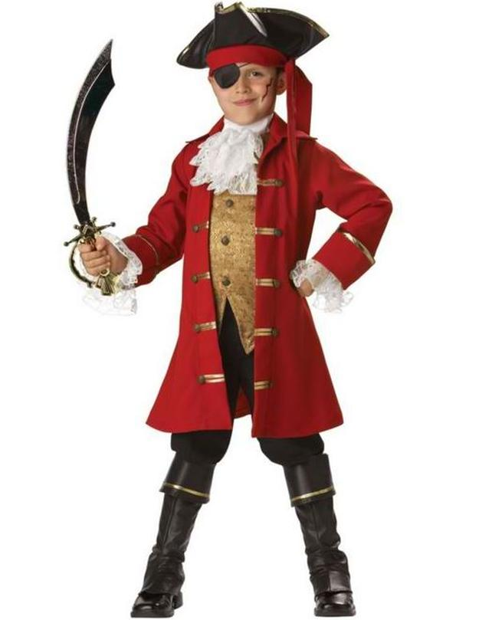
Some Costume Ideas:
Pirate

Slide 28
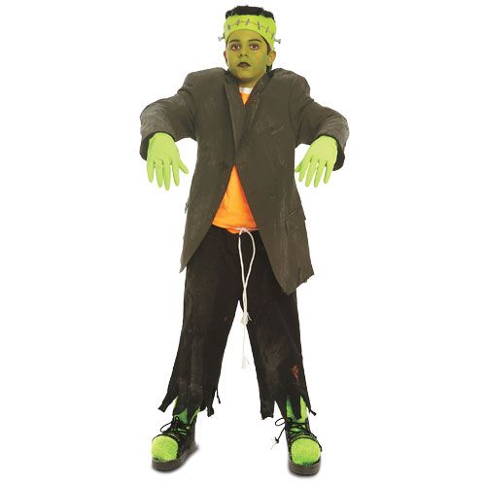
Some Costume Ideas:
Frankenstein

Slide 29
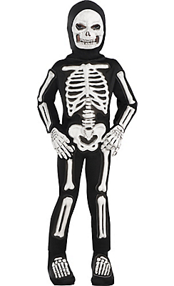
Some Costume Ideas:
Skeleton

Slide 30
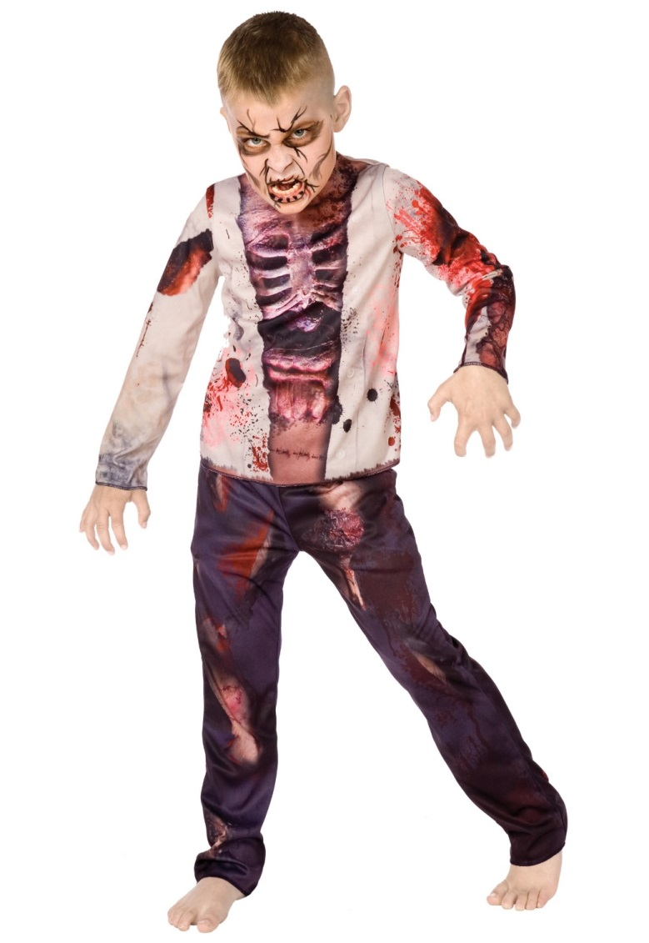
Some Costume Ideas:
Zombie

Slide 31
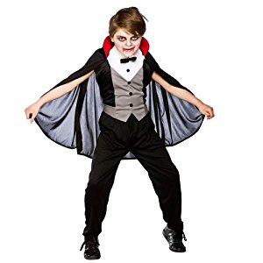
Some Costume Ideas:
Vampire

Slide 32
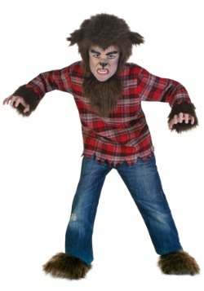
Some Costume Ideas:
Werewolf

Slide 33
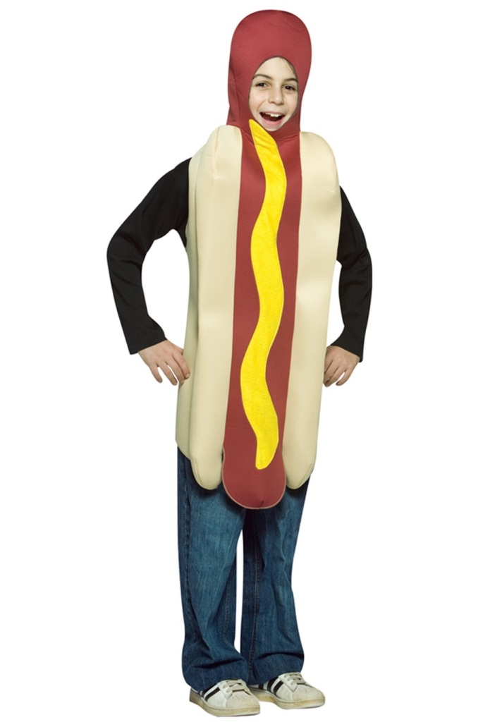
Some Costume Ideas:
Hotdog

Slide 34
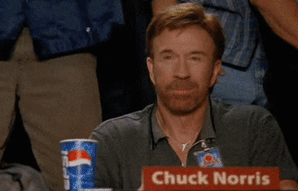
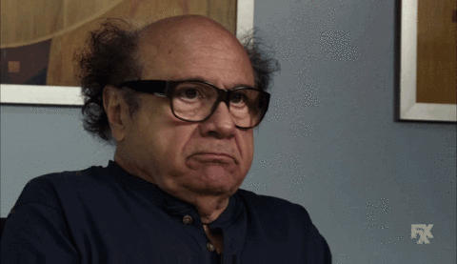
The Celts thought the spirits of dead people returned to the earth on October 31st.
True
False

Slide 35
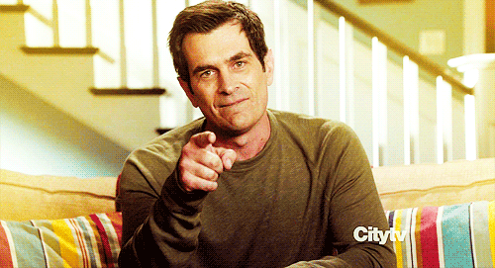
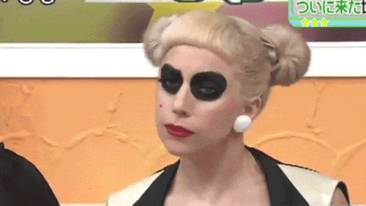
The Celts created All Hallows.
True
False

Slide 36
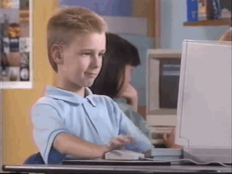
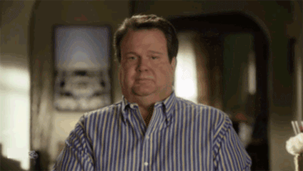
All Hallows is on October 31st.
True
False

Slide 37
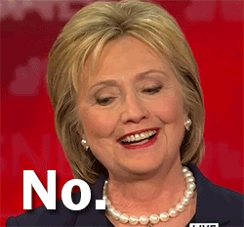
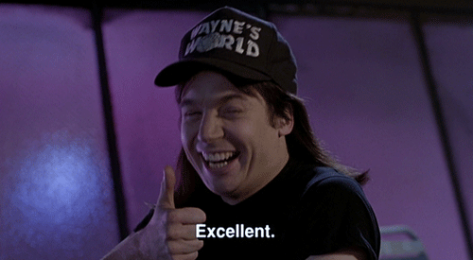
The word Halloween comes from the word Hallows eve.
True
False

Slide 38
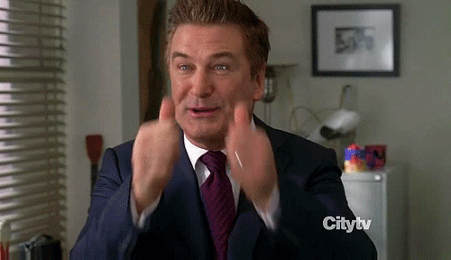
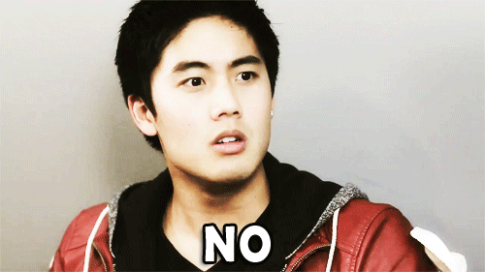
A thousand years ago Europeans wore costumes to get candy.
True
False

Slide 39
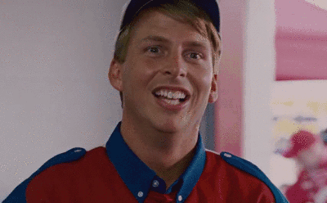
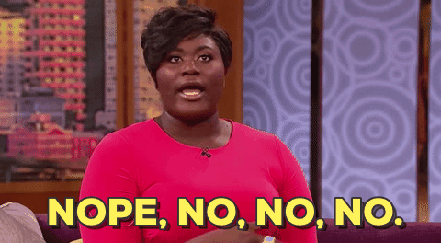
Americans still carve turnips to use as lanterns.
True
False

Slide 40
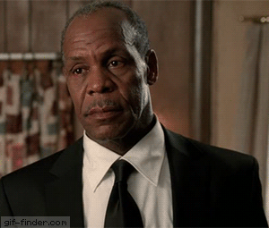
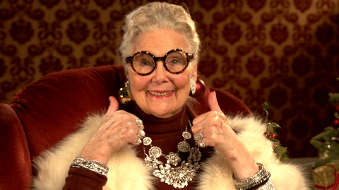
Today Halloween is for children.
True
False

Slide 41
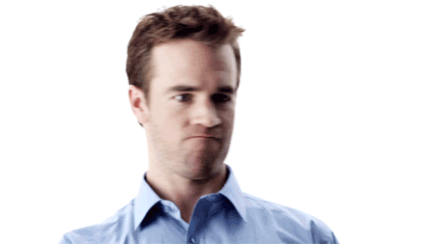
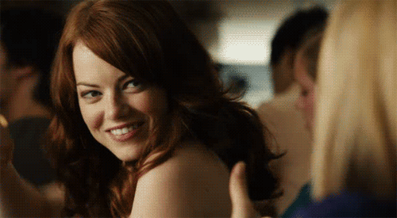
Children get candy by saying "trick or treat."
True
False

Slide 42
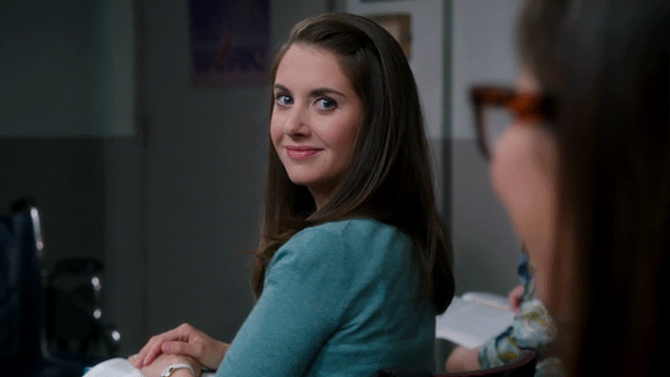
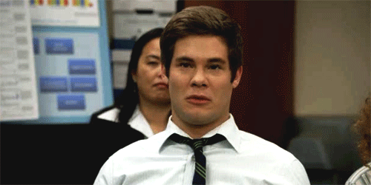
Originally, Europeans wore costumes so the evil spirits would think they were also dead.
True
False

Slide 43
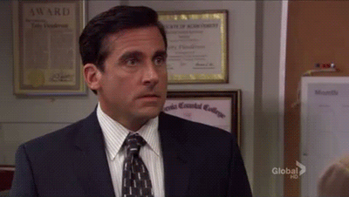
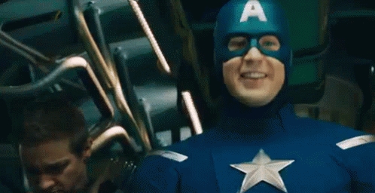
Jack-o-lanterns are made from turnips.
True
False

Slide 44
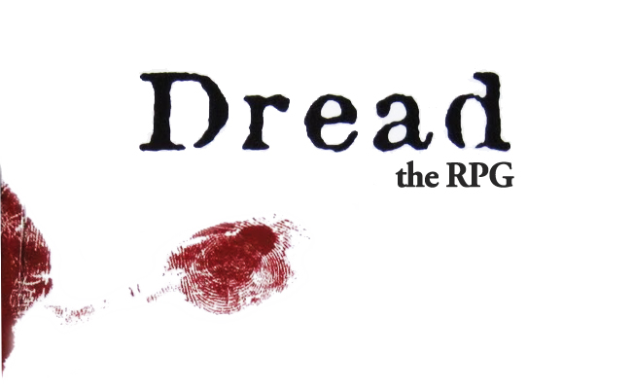

Slide 45
Dread
Can you get out before the end of class?

Slide 46
Dread
Each group will play as a character.
Make suggestions on what your character will do.
Take a block (Jenga)
If it falls, something bad will happen to you.

Slide 47
Maze
http://www.allproudamericans.com/maze-game.html

Slide 48
Extra Video
https://www.youtube.com/watch?v=N1pTZTHZF4E
(We ate all of your candy)

