Slide 1
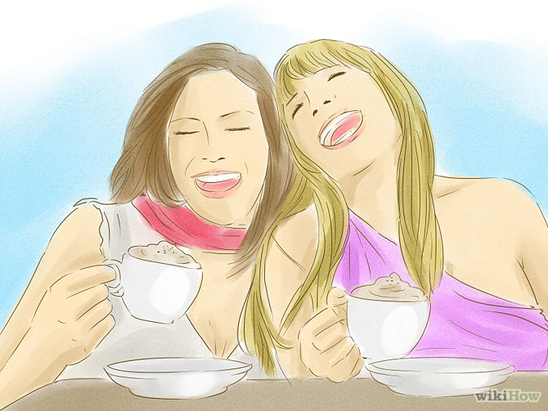
Hanging Out with Friends
Meeting friends for fun.

Slide 2
What are some things to do while hanging out?

Slide 3
006 – At the Restaurant

Slide 4
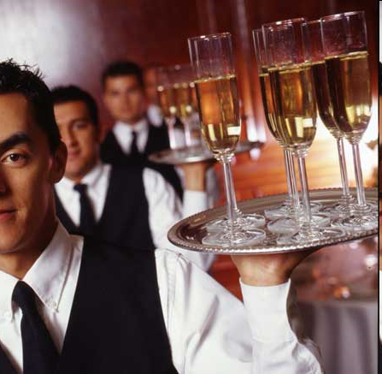
Who is this person?
= Waiter
= Waitress
Server

Slide 5
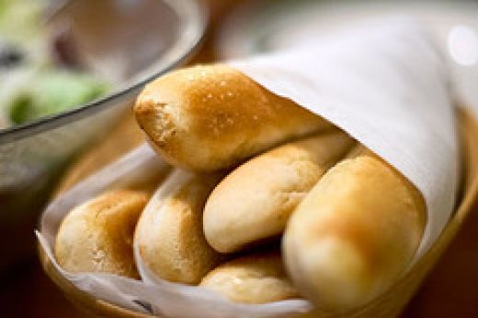
Starter / Appetizer

Slide 6
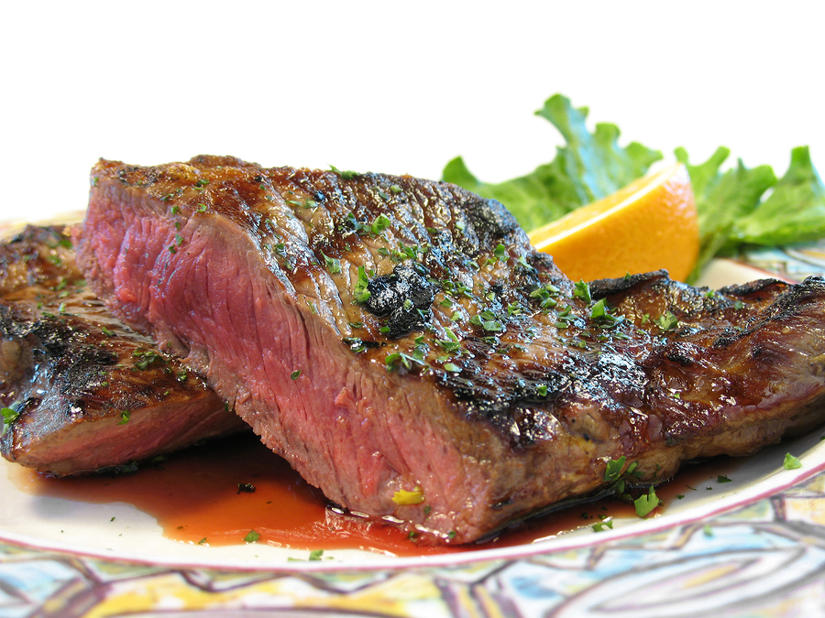
Main Dish

Slide 7
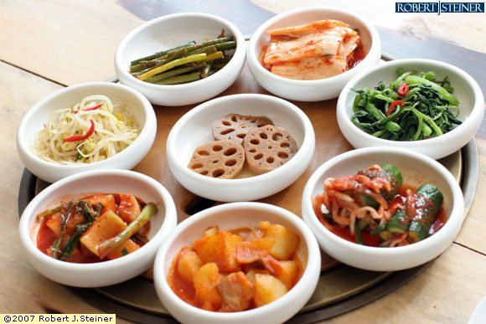
Side Dish

Slide 8
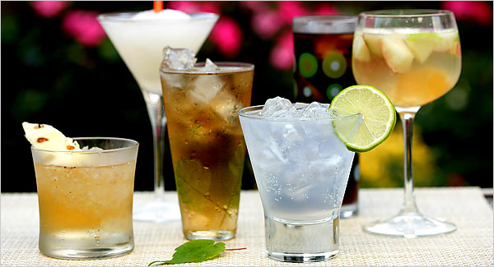
Drink / Beverage

Slide 9
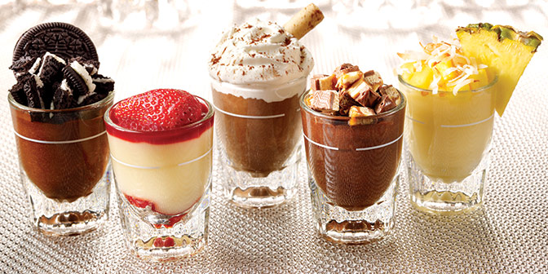
Dessert

Slide 10
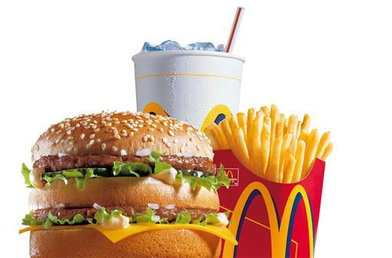
Main dish
Drink / Beverage
Side dish

Slide 11
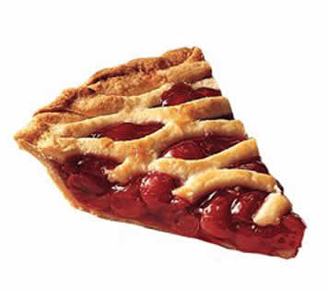
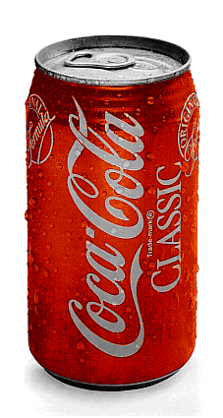
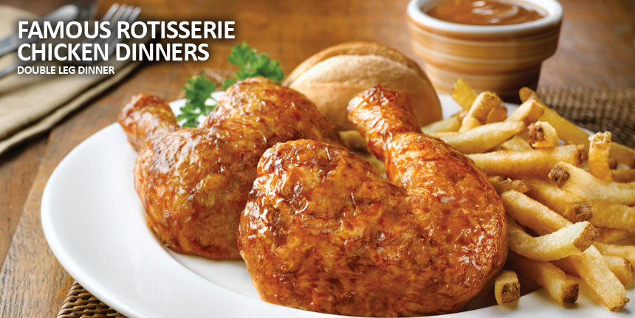

Slide 12
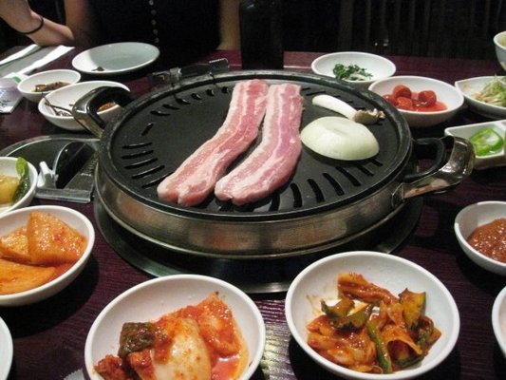

Slide 13
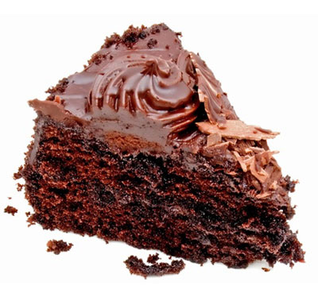
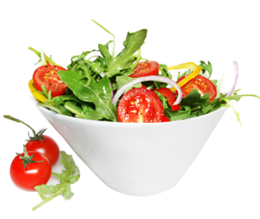
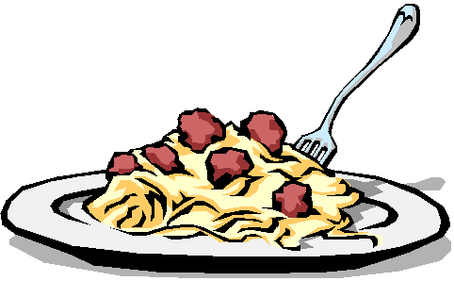

Slide 14
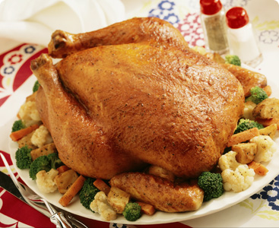
Hello, may I take your order?
Yes, __________________ the chicken dinner.
I’ll have
I’ll take
I’d like (I would like...)

Slide 15
OR

Slide 16
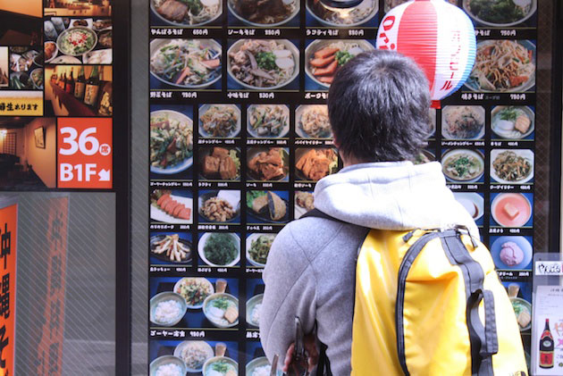
Hello, may I take your order?
I haven’t decided yet.
Please give me a few minutes.
What dish do you recommend?

Slide 17
Recommend =
추천하다

Slide 18
How about =
어때요?

Slide 19
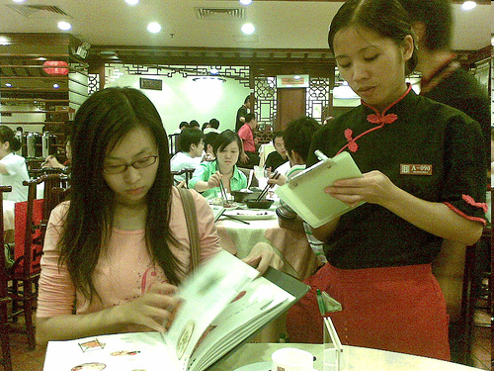
What dish do you recommend?
How about the Steak dinner? It is very delicious.

Slide 20
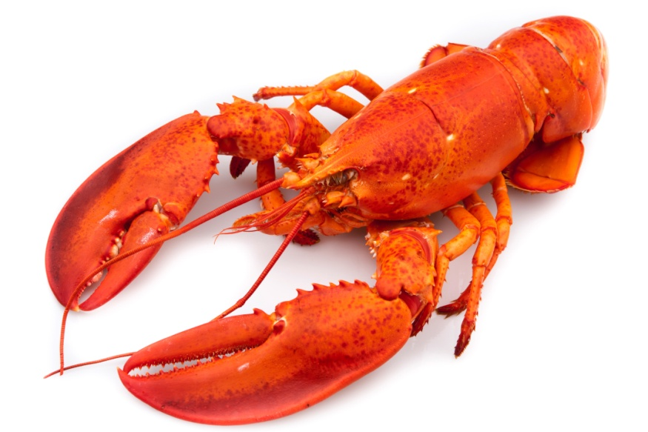
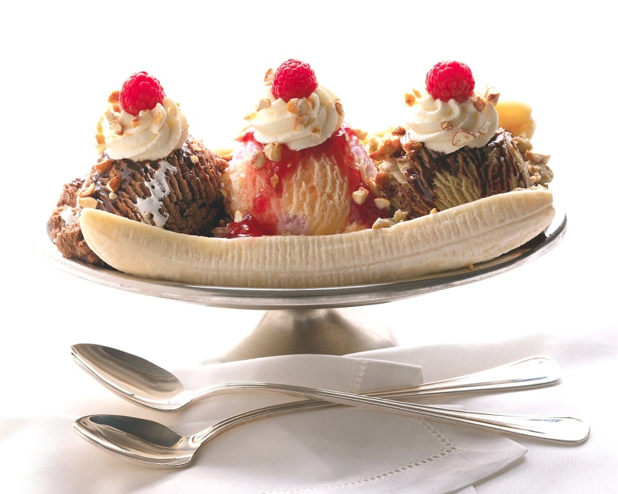
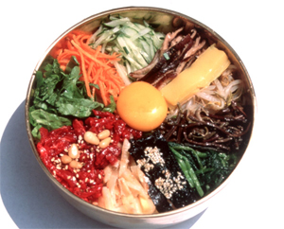
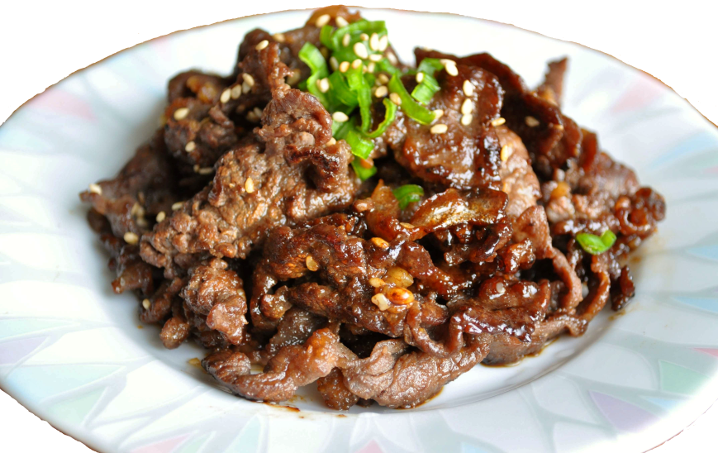
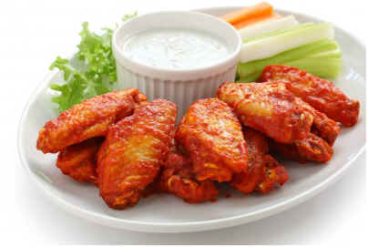
How about...
Bibimbap
How about _______________.
That sounds delicious, I love rice.

Slide 21
How about...
Bulgogi
How about _______________.
Ok, we can share the beef.

Slide 22
How about...
Hot wings
How about _______________.
No, it’s too spicy.

Slide 23
How about...
Lobster
How about _______________.
No thank you, I am allergic to seafood.

Slide 24
How about...
Ice cream
How about _______________.
Yes, it’s great on a hot day like today.

Slide 25
Hello, may I take your order?
I’ll take
I’ll have
I would like
Would you like a side dish?
I’ll take
I’ll have
I would like

Slide 26
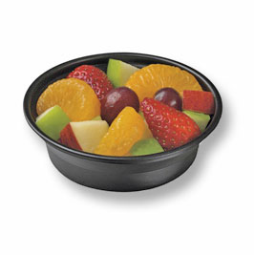
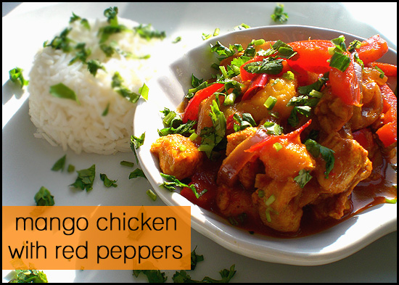
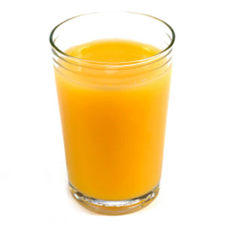
Practice

Slide 27
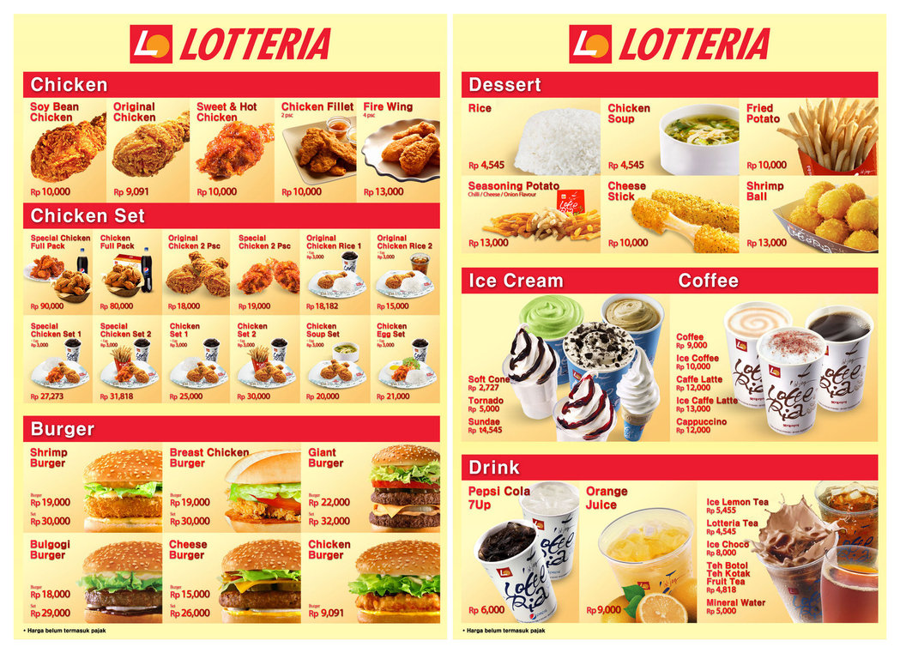

Slide 28
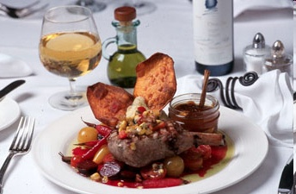
Have a good lunch!
맛있게 드세요
Bon Appetite

Slide 29
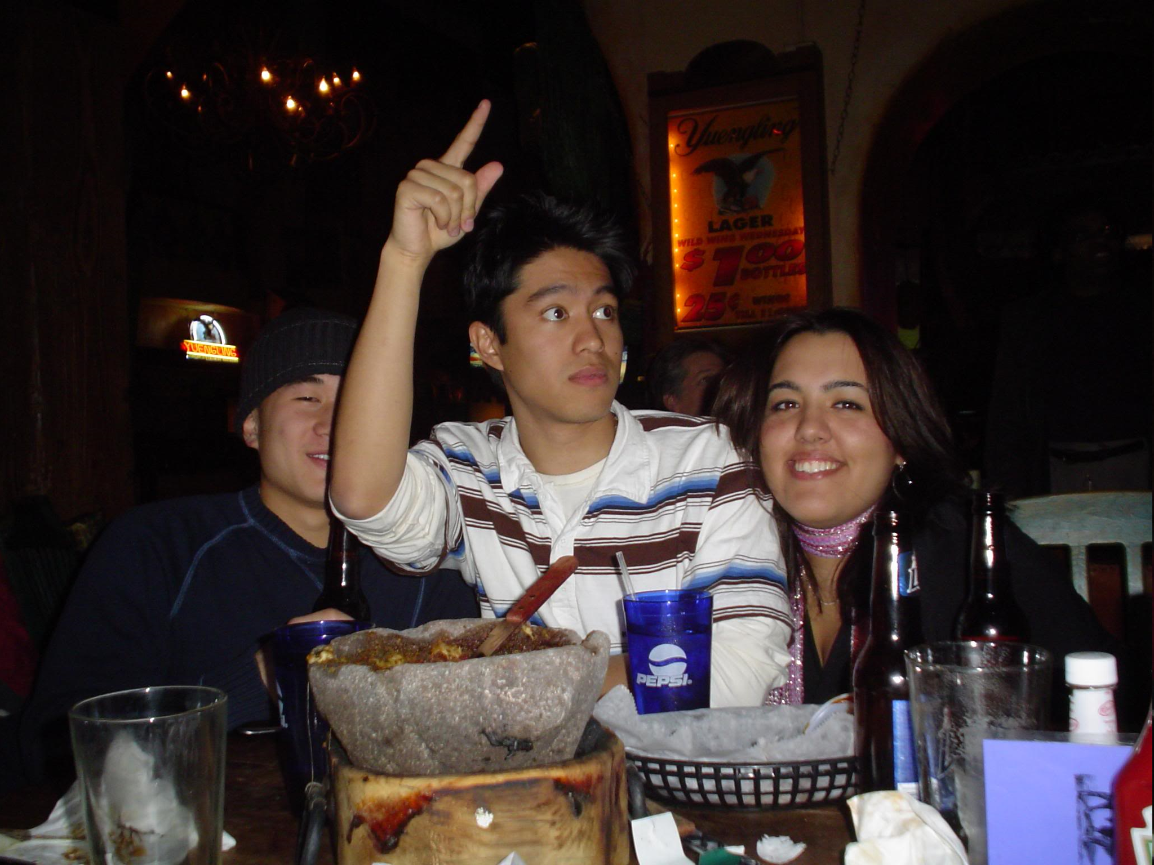
When you finish:
Check, please!

