Slide 1
Statements
Declarative sentences

Slide 2
Statement
Subject + Predicate
(Pronoun) + (to be + ________)

Slide 3
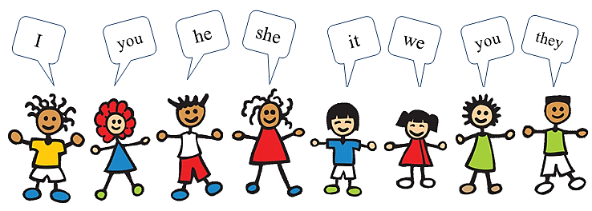
Pronouns

Slide 4
To Be…
Past
Present
Future
I
You
He / She
It
They
We
was
were
was
was
were
were
am
are
is
is
are
are
will
will
will
will
will
will

Slide 5
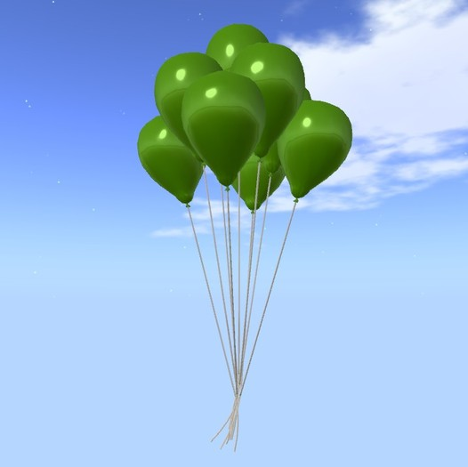
Examples:
I am Mr. S.
You are students.
It is green.
The sky is blue.

Slide 6
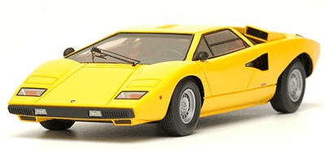
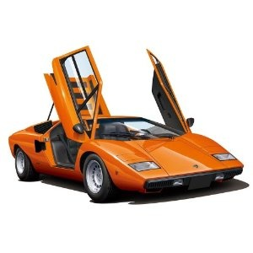
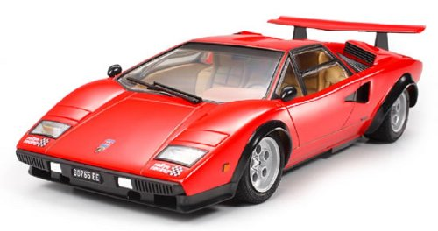
Examples:
It was yellow.
It is orange.
It will be red.

Slide 7
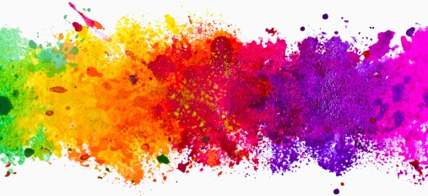
Adjectives: Color

Slide 8
Black, white, grey

Slide 9
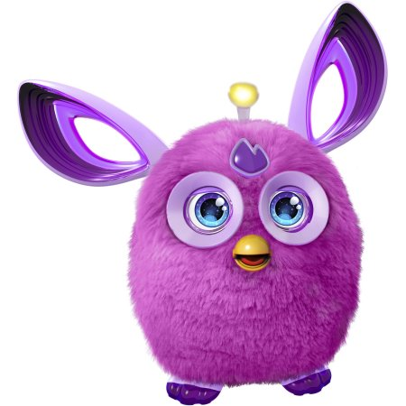
Purple

Slide 10
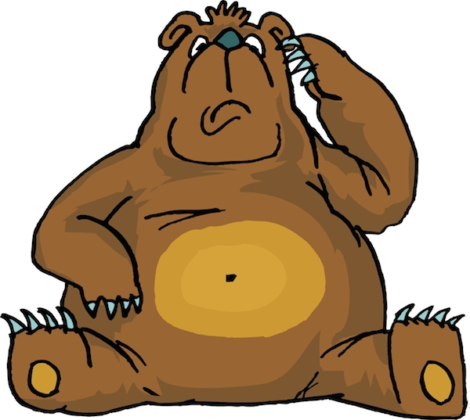
Brown

Slide 11
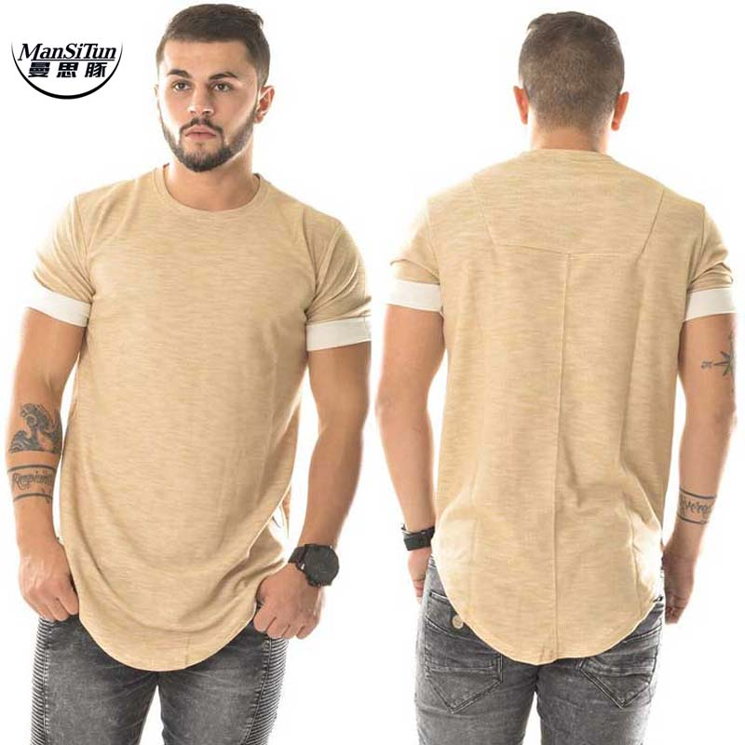
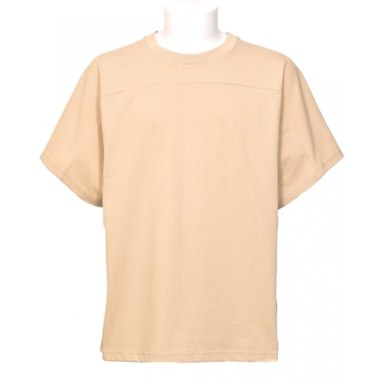
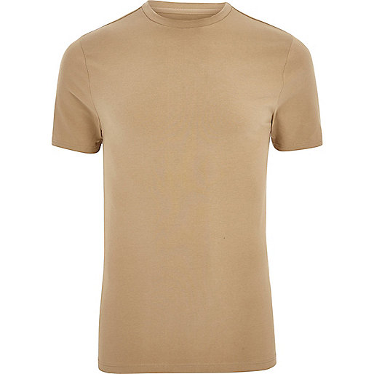
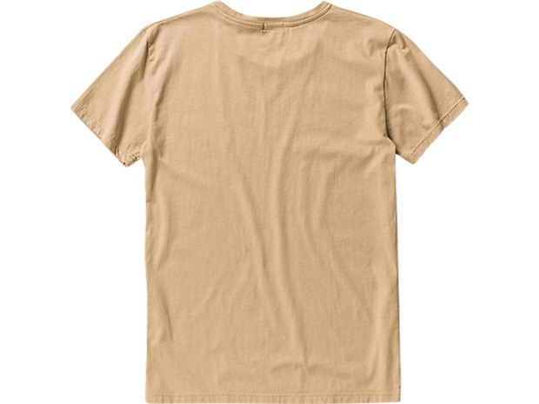
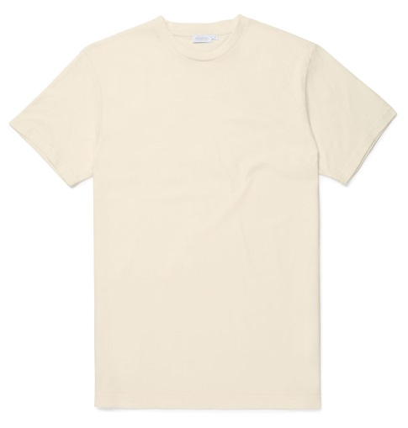
Beige

Slide 12
Gold, Silver, Bronze

Slide 13
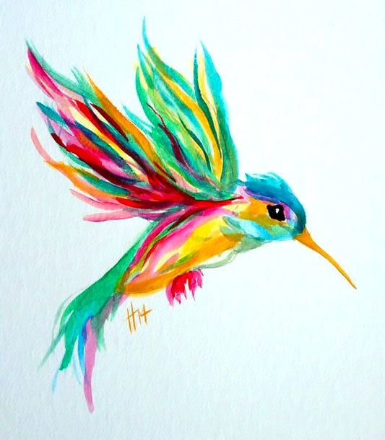
Colorful

Slide 14
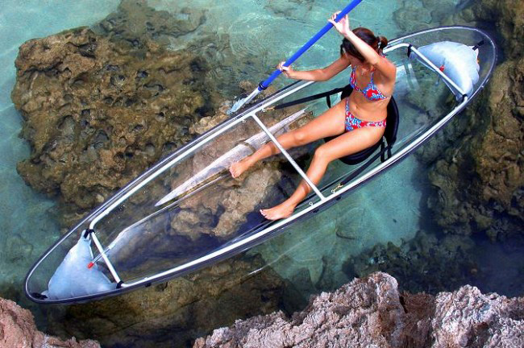
clear

Slide 15
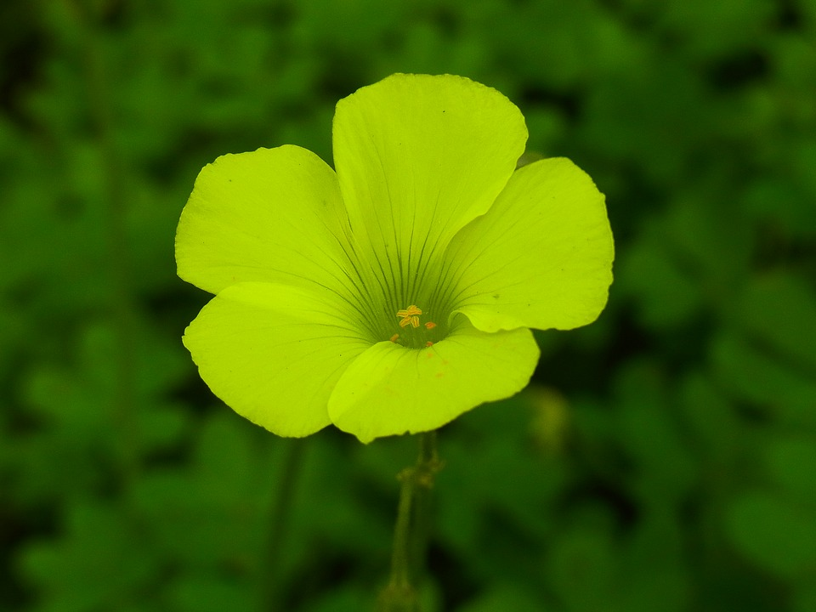
Dark green, Light green

Slide 16
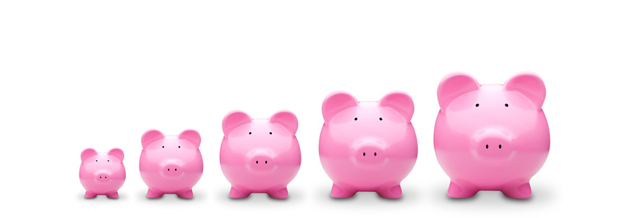
Adjectives: size

Slide 17
Small

Slide 18
Medium

Slide 19
Large, Big

Slide 20
Tiny

Slide 21
Average sized

Slide 22
Giant

Slide 23
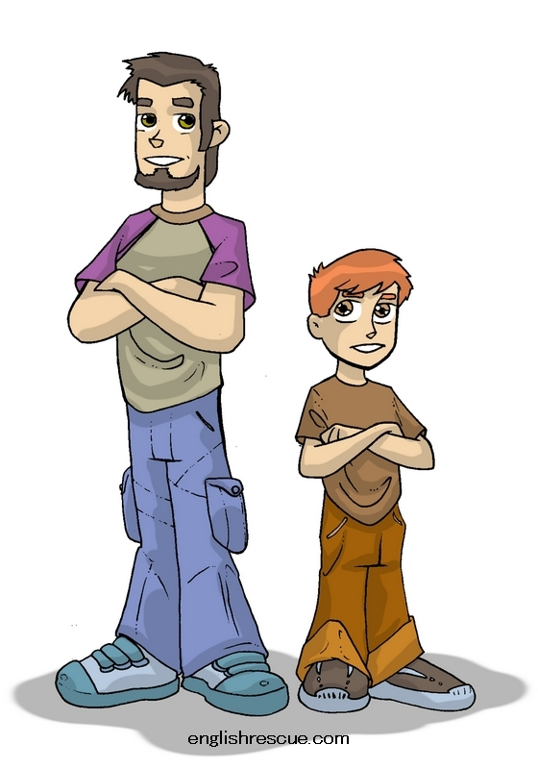
Tall, short

Slide 24
Long, short

Slide 25
Adjectives: age

Slide 26
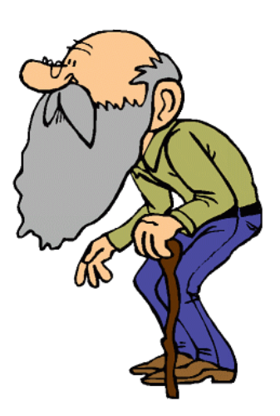
Old

Slide 27
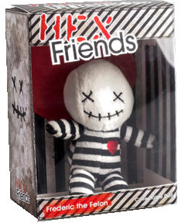
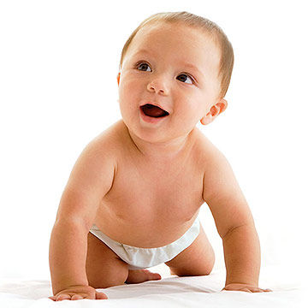
Young vs New

Slide 28
What is it?
Can you guess what I am describing?

Slide 29
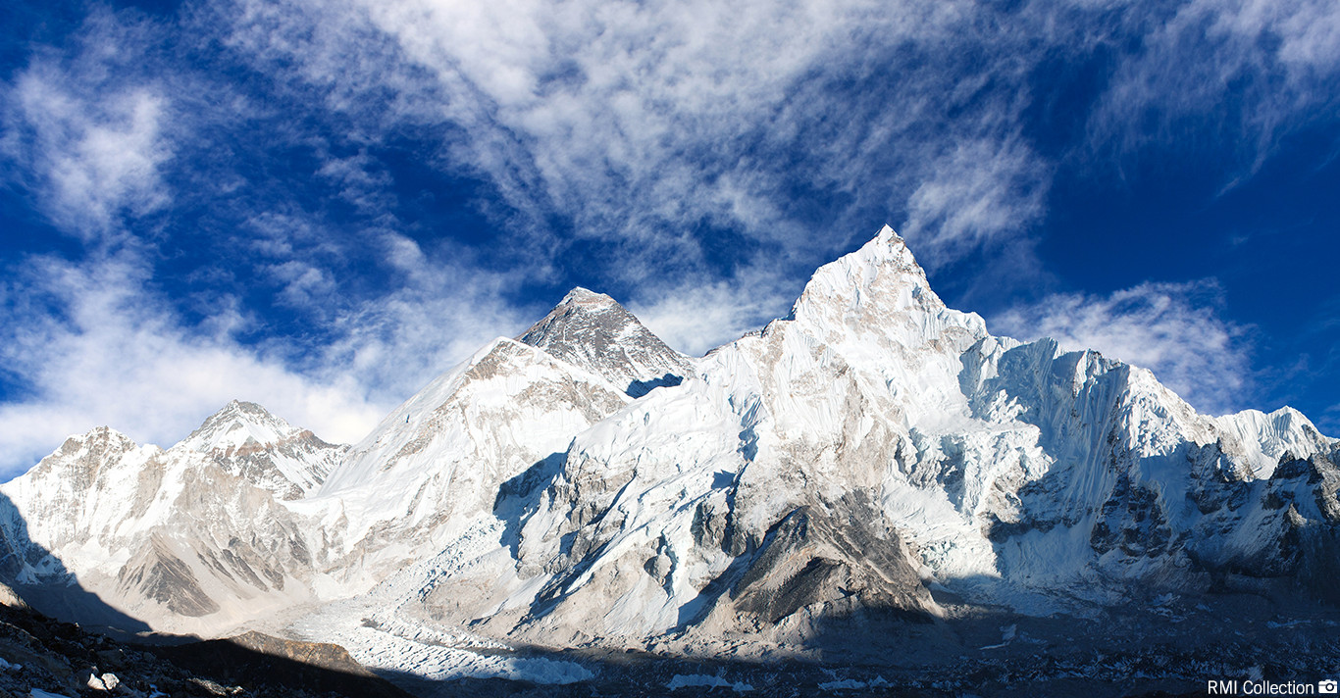
It’s a tall mountain

Slide 30
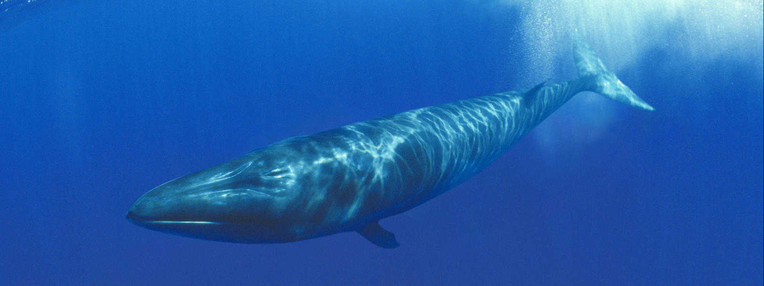
It’s a giant animal.

Slide 31
It is brown and hot.

Slide 32
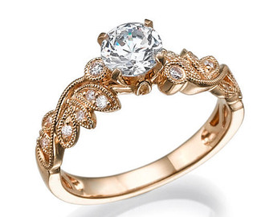
It’s a gold accessory.

Slide 33
It is clear.

Slide 34
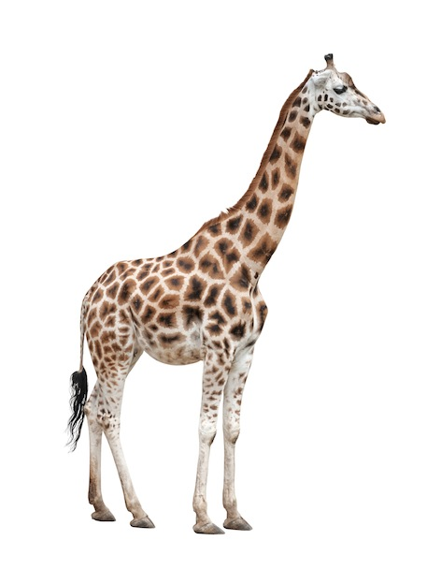
It Is a tall animal.

Slide 35
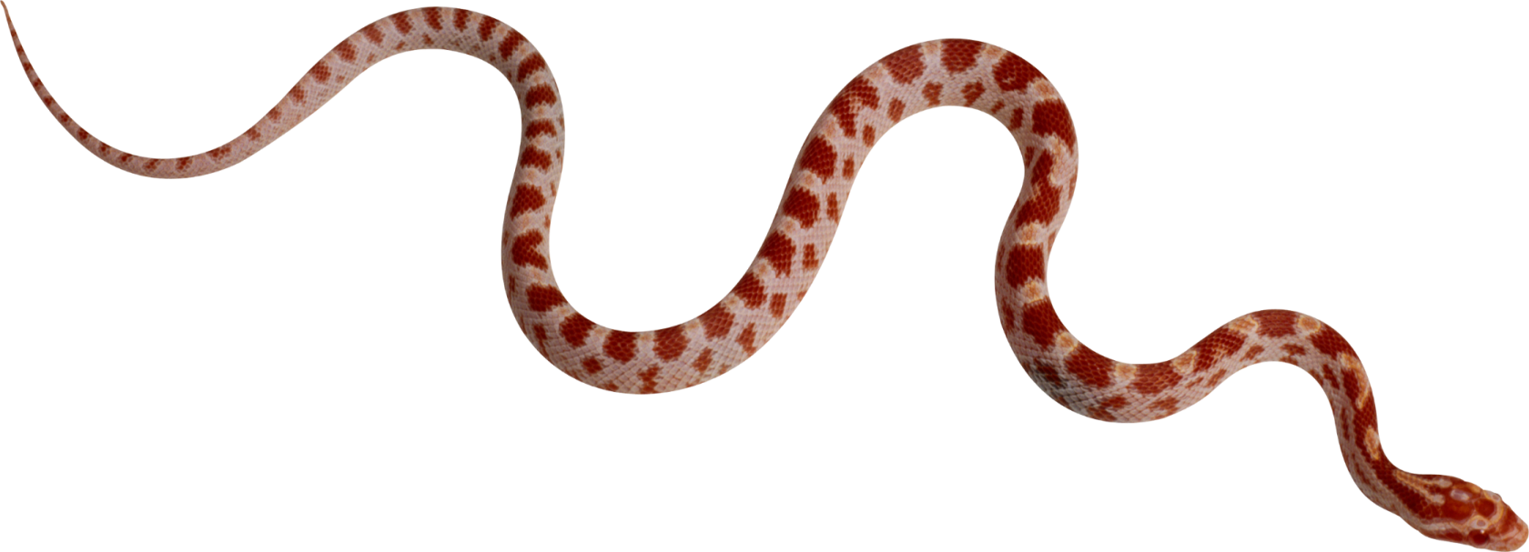
It’s a long animal.

Slide 36
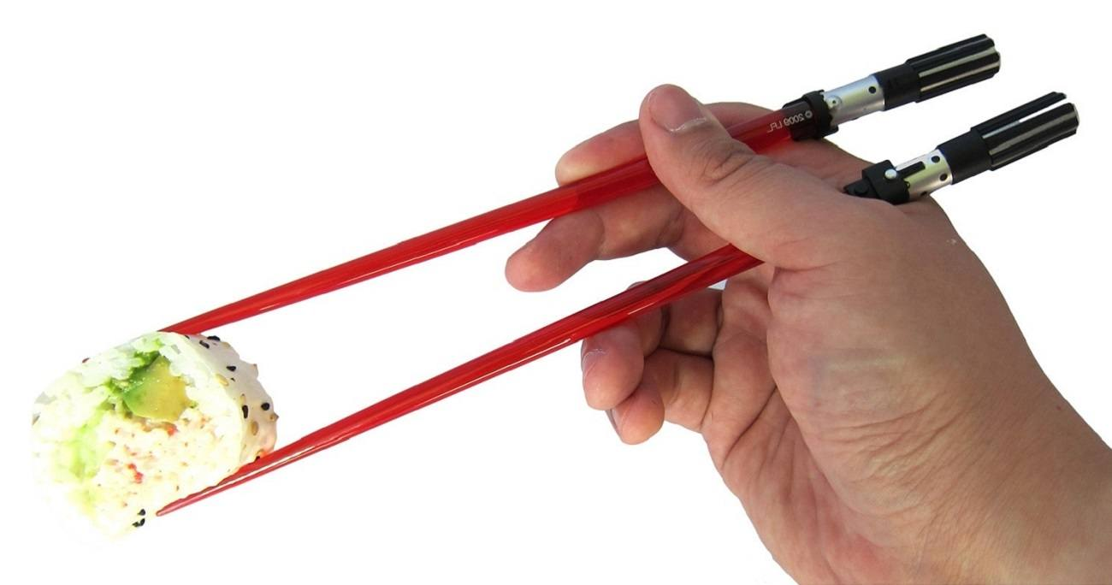
They are small and long. They are used for eating.

Slide 37
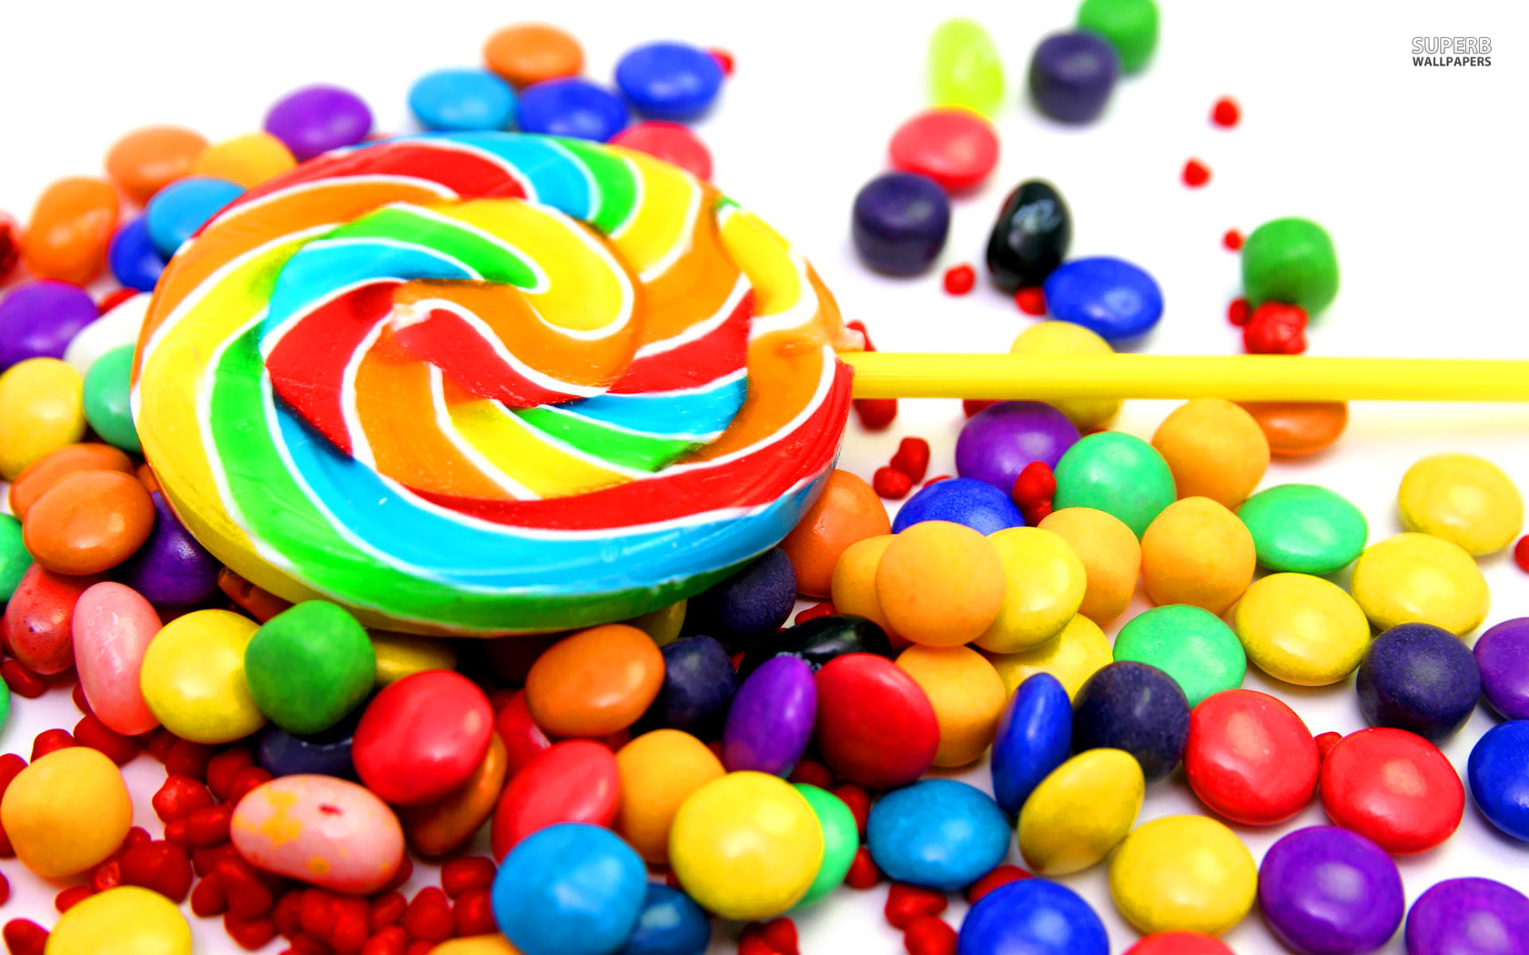
They are colorful and sweet.

Slide 38
It is large and beige or green. It is in this room.

Slide 39
It is black and white. It is round.

Slide 40
He is an old president.

Slide 41
It is a long and thin part of your body.

Slide 42
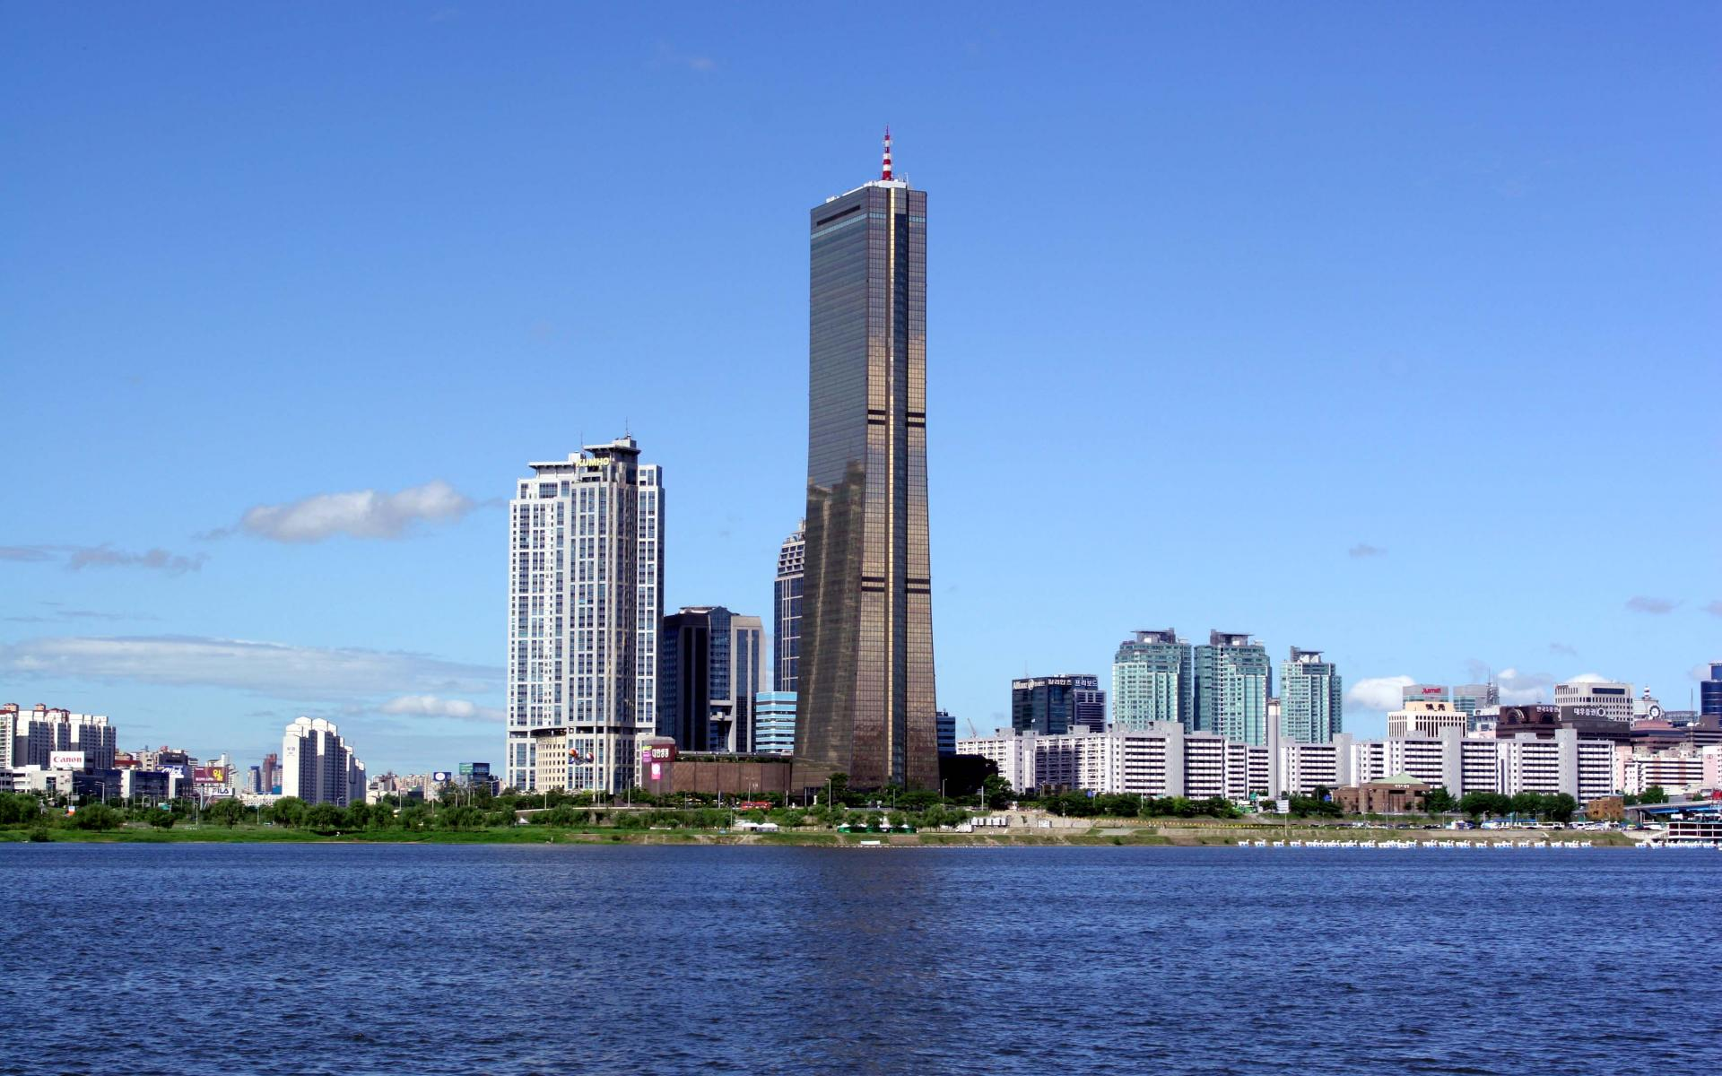
It’s a tall building in Korea.

Slide 43
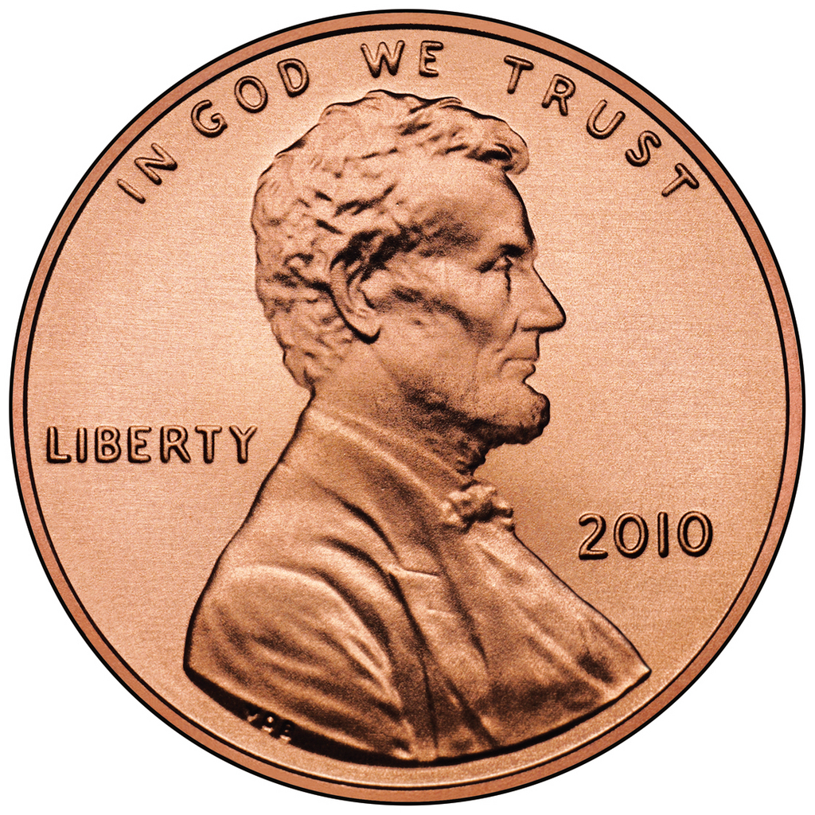
It is small and circular. It is silver or bronze.

Slide 44
It is long and black (or grey).

Slide 45
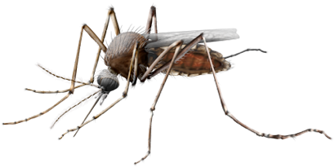
It is a tiny and dangerous animal.

Slide 46
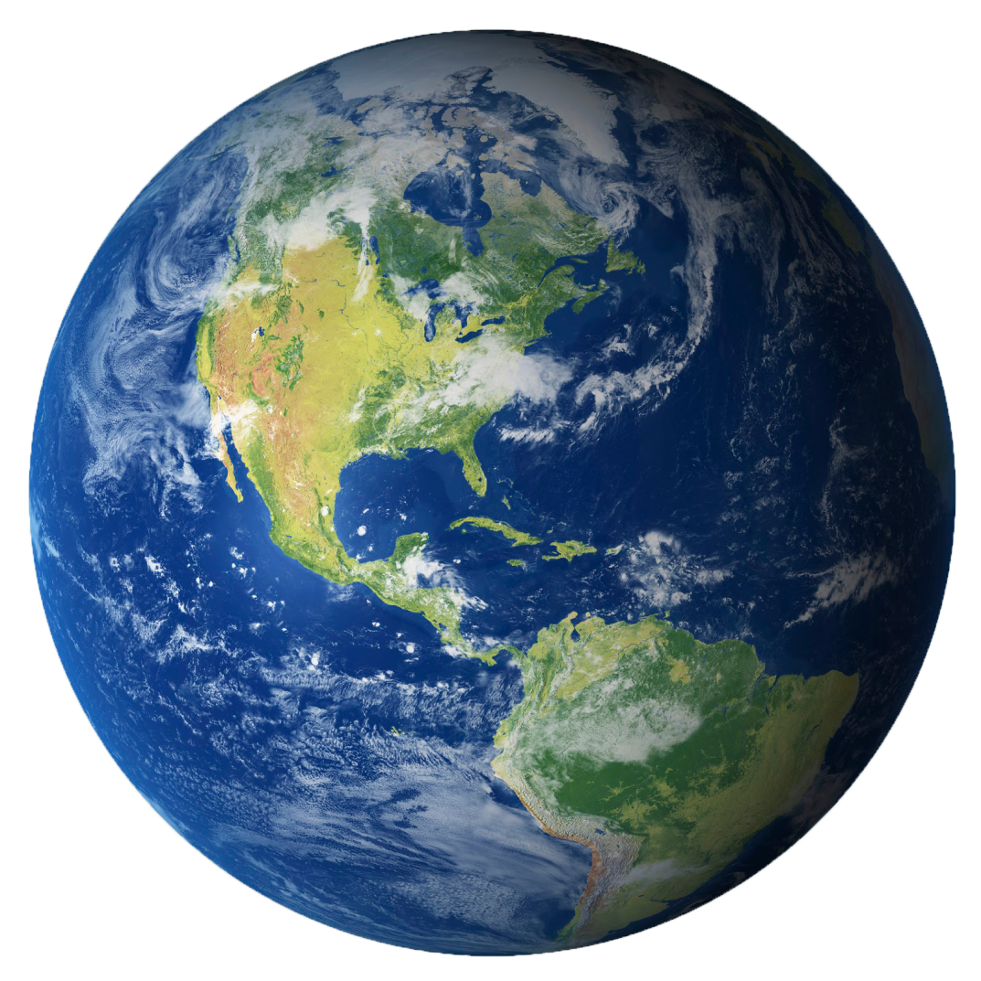
It’s (mostly) blue and green. It’s giant.

Slide 47
It’s green and tall.

Slide 48
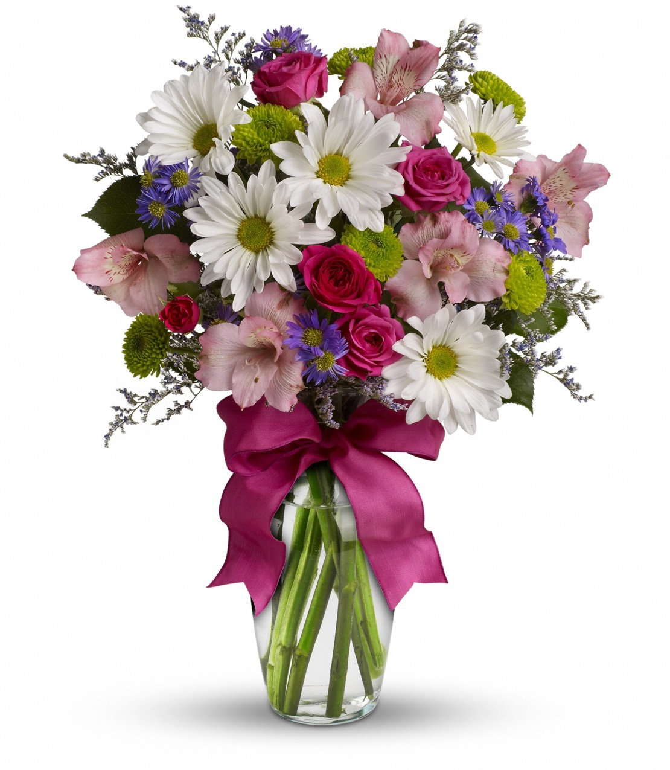
It’s a colorful gift.

Slide 49
It’s beige. It can be small, medium, or large.

Slide 50
Thumbs Up Game
Do you think it’s the “truth” or a “lie”
Truth =
Lie =

Slide 51
Thumbs Up Game
Everyone stands up
Listen to the statement.
Is it the truth or a lie
If you guessed correctly, keep standing.
If you guessed wrong, sit down.
Last person standing is the winner.

Slide 52
Elephants are large.

Slide 53
Oranges are colorful.

Slide 54
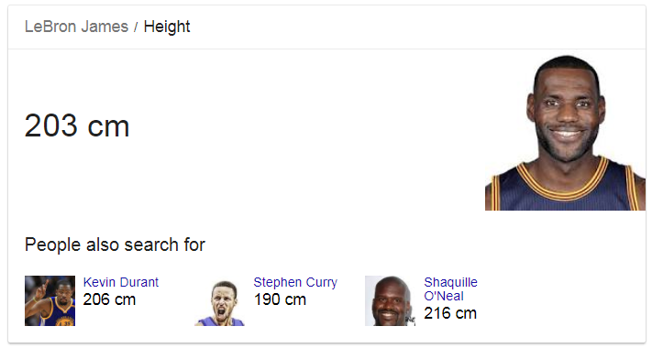
Lebron James is a tall man.

Slide 55
The word Halloween comes from the words “Hallows Eve”

Slide 56
Kim Tae-Yeon is average height.

Slide 57
Chess is an old game.

Slide 58
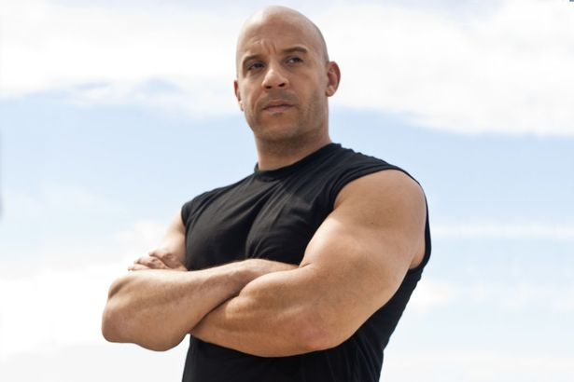
Vin Diesel has long hair.

Slide 59
Christmas Eve is the night before Christmas.

Slide 60
There are more people in North Korea than in South Korea.

Slide 61
I am from America

Slide 62
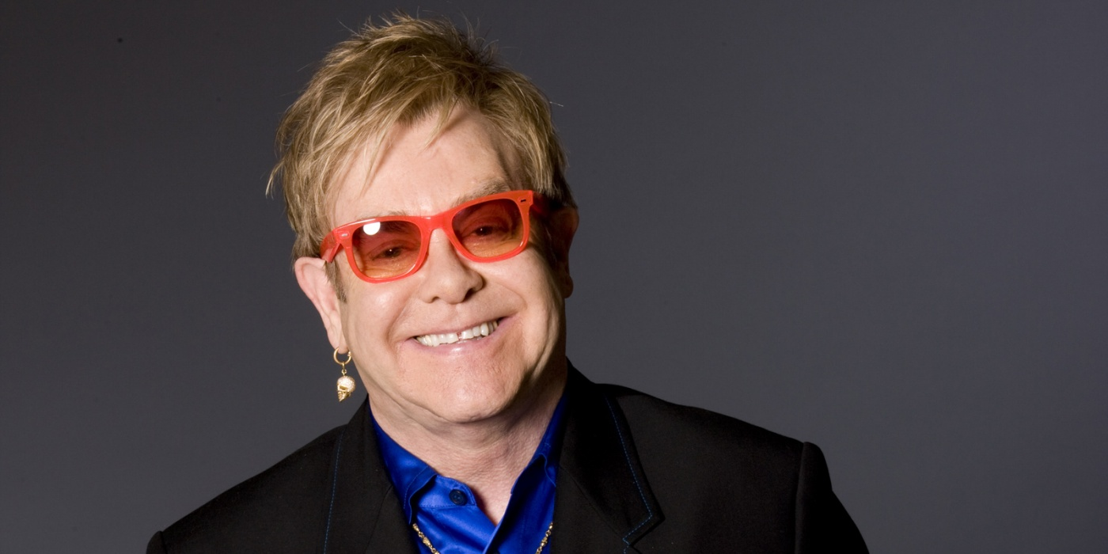
Elton John is an old singer.

Slide 63
The cat at the door is Captain Henry Morgan.

Slide 64
September 19th is National Talk like a Pirate Day

Slide 65
Jack-o-Lanterns are made from turnips.

Slide 66
A baby octopus is very tiny when it is born.

Slide 67
Coffee is the most popular drink in the world.

Slide 68
A saint is a holy person.

Slide 69
At night, fans are dangerous.

Slide 70
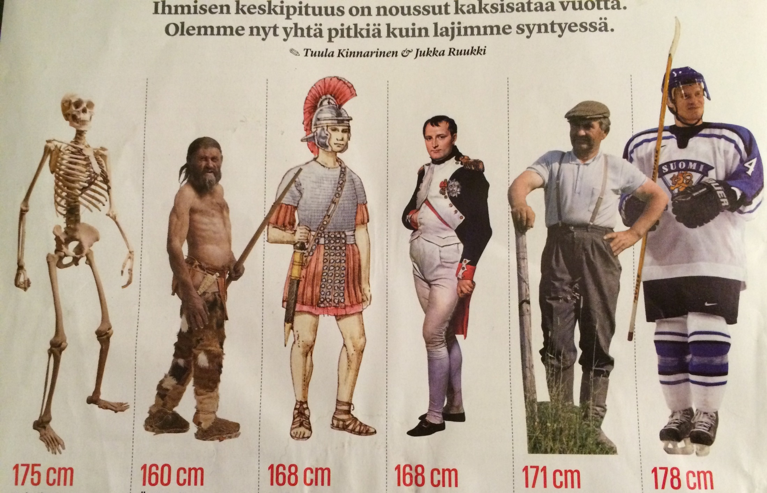
Napoleon was short.

Slide 71
2 truths, 1 lie
Write two things that are true and one that is a lie on the paper.
Take turns reading the statements.
The other students must guess which is the lie.

