Slide 1
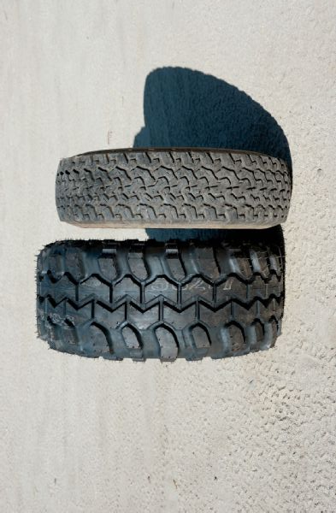
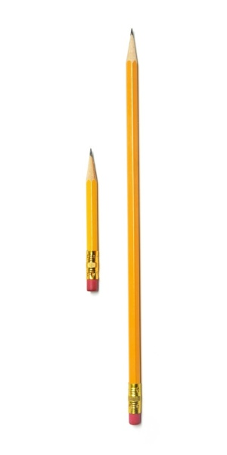
Molecular,
Microscopic,
Itty-Bitty,
Minuscule,
Subatomic
Tiny
Shrunken
Small
Medium
Good-Sized
Large
Great
Huge
Mega
Colossal
Ginormous

Slide 2
