Slide 1
Questions
Interrogative Sentences

Slide 2
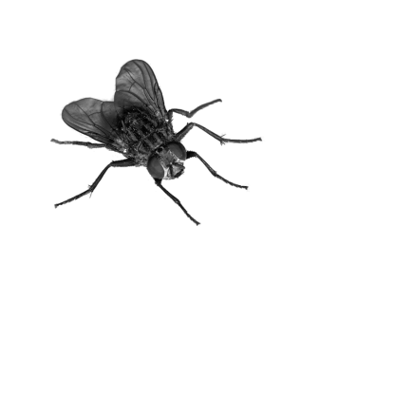
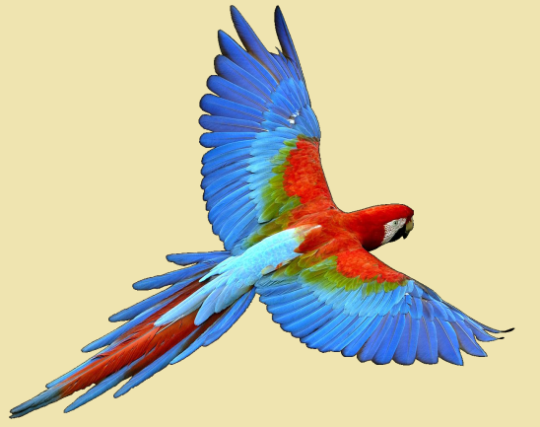
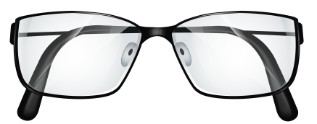
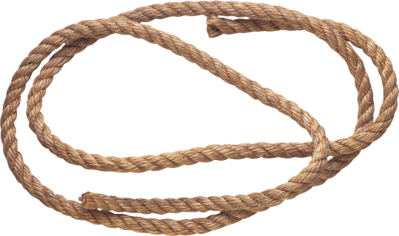
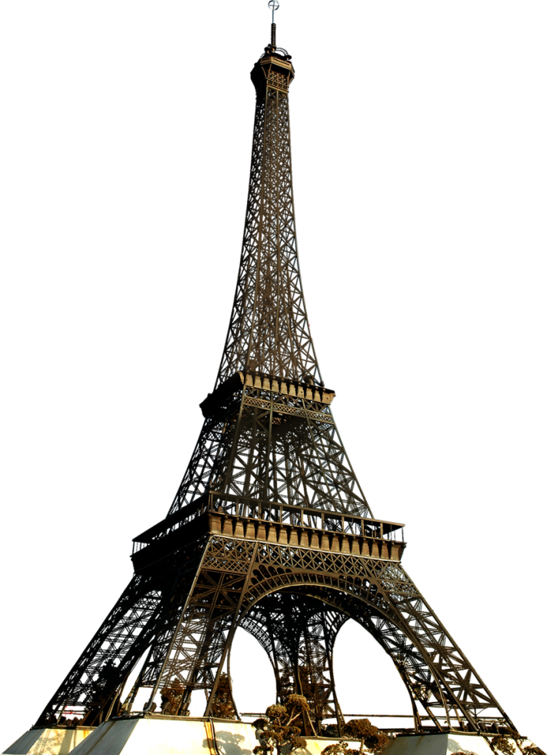
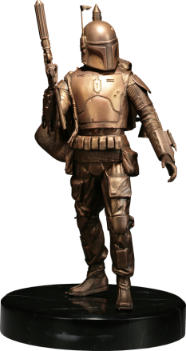
Review:
Tiny
Colorful
Bronze
Tall
Long
Giant
Clear

Slide 3
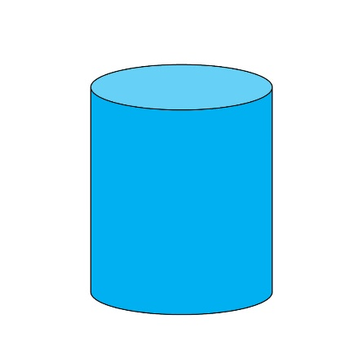
Today’s Adjectives: Shape
Round
Spherical
Cube
Cubic
Cone
Conical
Pyramid
Pyramidal
Flat
Cylinder
Cylindrical

Slide 4
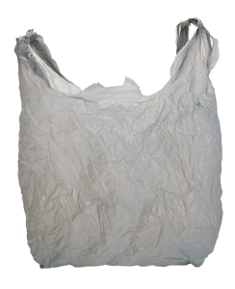
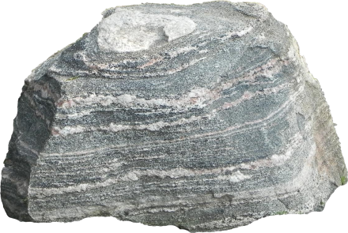
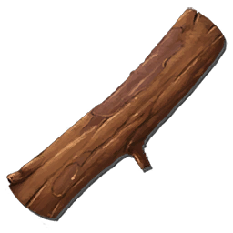
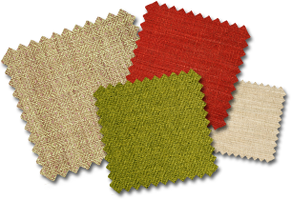
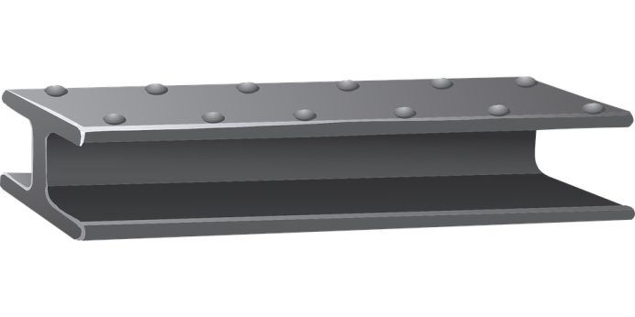
Today’s Adjectives: Material
Stone
Cloth
Fabric
Plastic
Wooden
Metallic
Paper
Glass

Slide 5
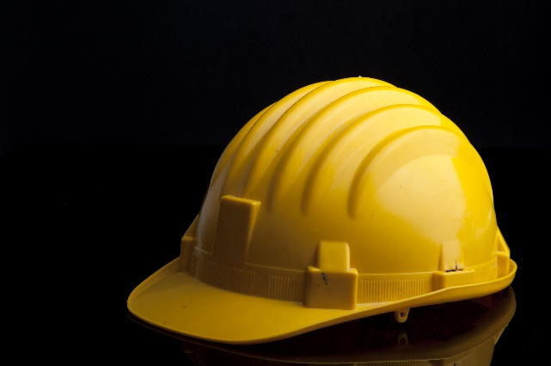
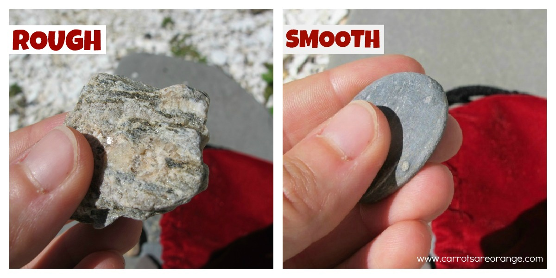
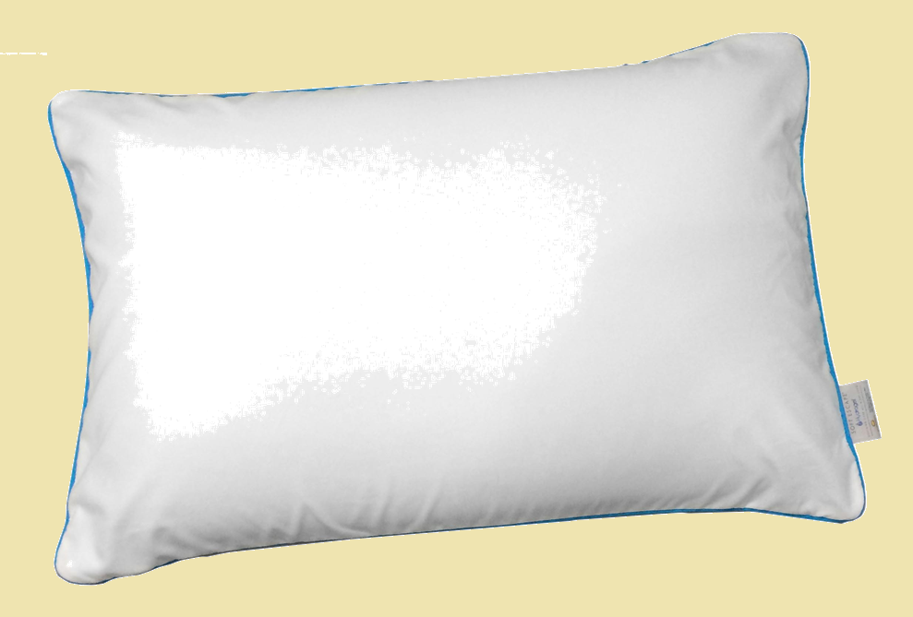
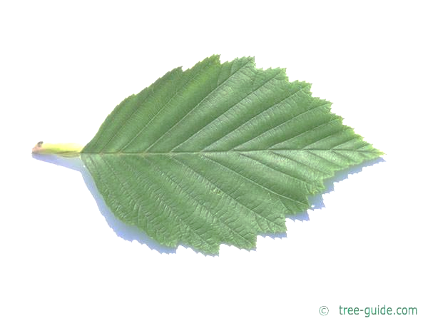
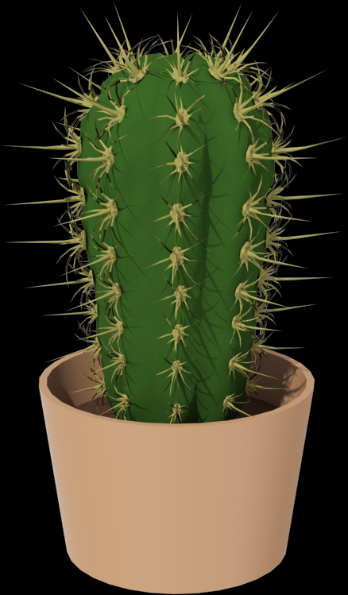
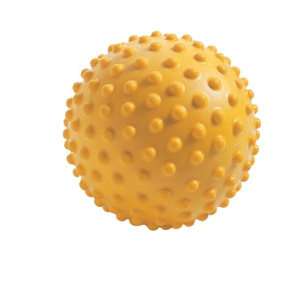
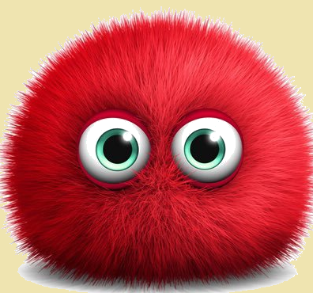
Today’s Adjectives: Texture
Hard
Soft
Fuzzy
Furry
Hairy
Bumpy
Lumpy
Jagged
Prickly
Notes:
https://www.pinterest.com/pin/385480049326602415/?autologin=true

Slide 6
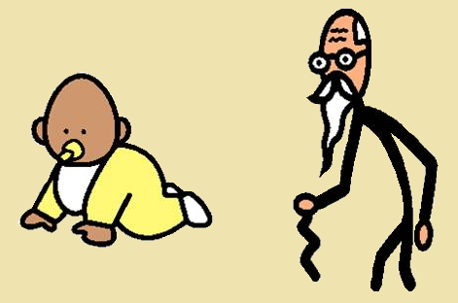
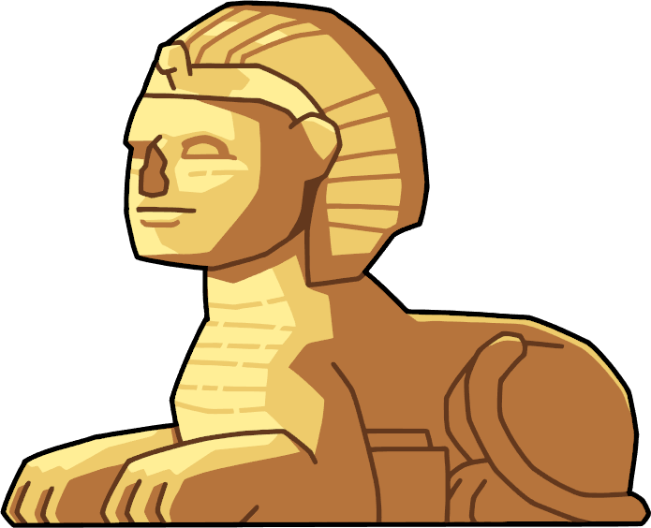
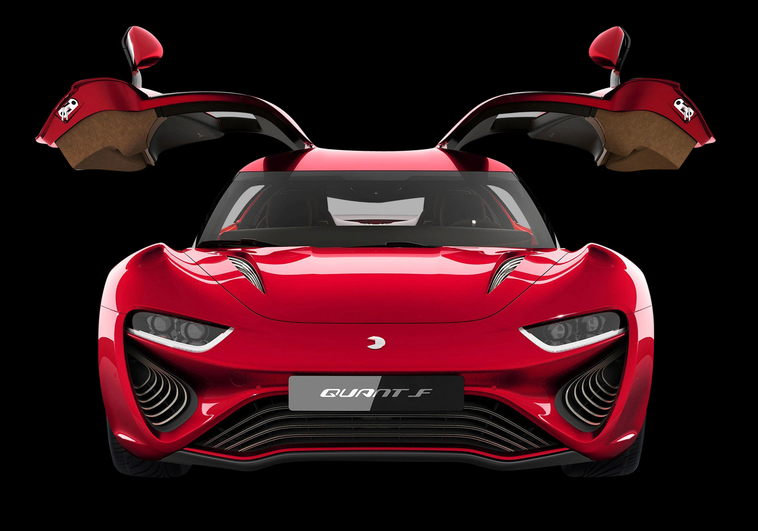
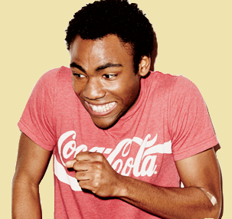
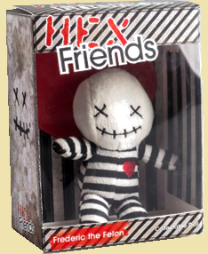
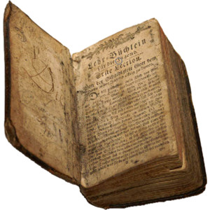
Today’s Adjectives: Age
Ancient
Young
Elderly
Old
Mature
Childish
New
Modern
Notes:
https://www.pinterest.com/pin/385480049326602415/?autologin=true

Slide 7
What is a statement?
Subject + Predicate
(Pronoun) + (to be + adjective)

Slide 8
Change a statement to a question:
(Pronoun) + (to be + adjective)

Slide 9
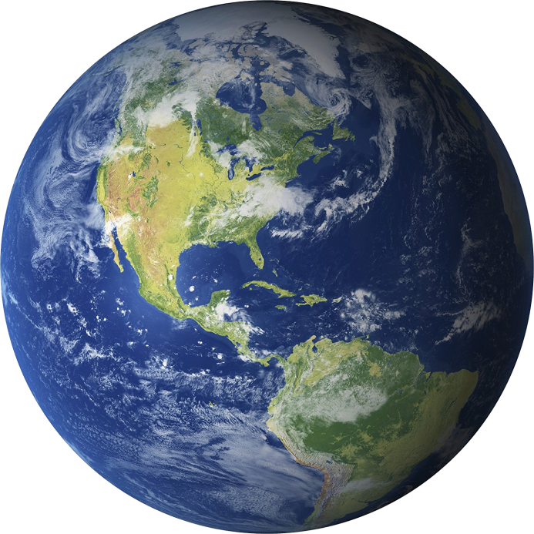
Make a question:
It is round.
Is it round?

Slide 10
Make a question:
We are living in Korea.
Are we living in Korea?

Slide 11
Make a question:
I am correct.
Am I correct?

Slide 12
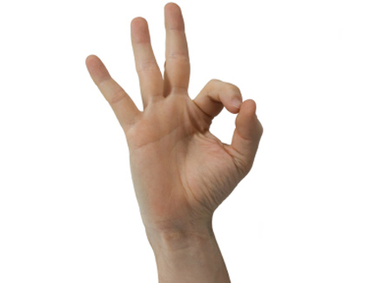
Make a question:
You’re ok.
Are you ok?

Slide 13
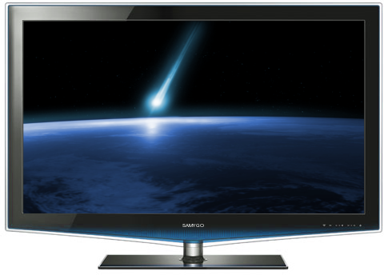
Make a question:
The TV is flat.
Is the TV flat?

Slide 14
Make a question:
English is a difficult class.
Is English a difficult class?

Slide 15
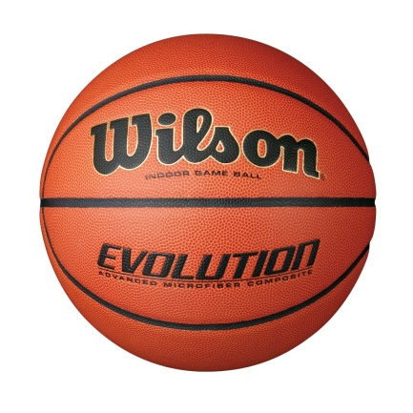
Make a question:
They were playing basketball.
Were they playing basketball?

Slide 16
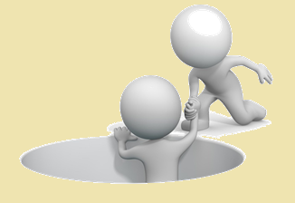
Helping Verbs
What is a verb?
What is a helping verb?
Action word
A verb that changes another verb

Slide 17
Helping Verb Examples
Find the helping verb:
He was eating pizza.
We can go home now.
They have watched a lot of movies.
The teachers have treated us kindly.
I would like a hamburger, please.

Slide 18
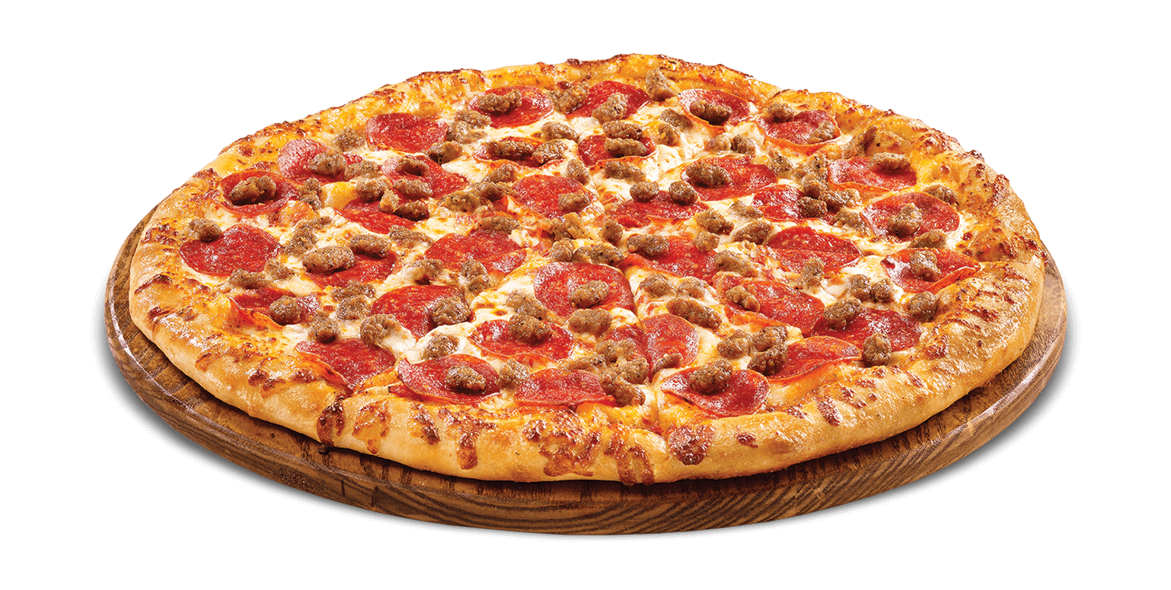
Make a question:
He was eating pizza.
Was he eating pizza?

Slide 19
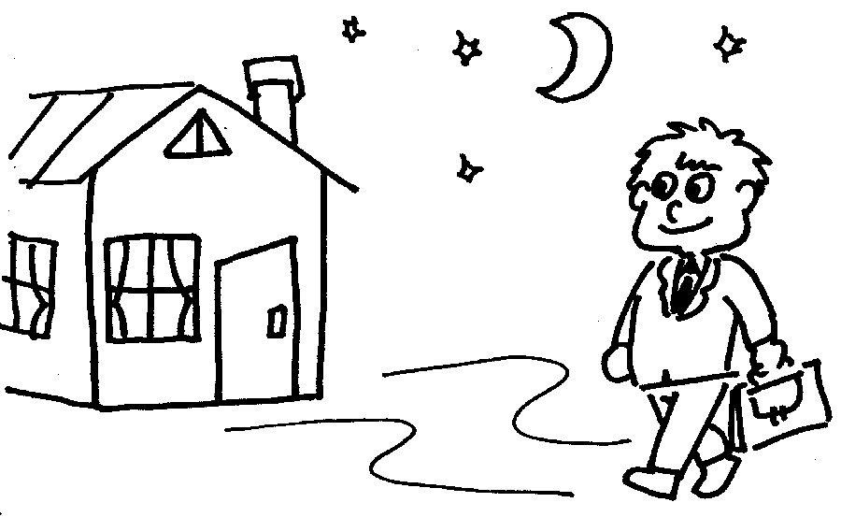
Make a question:
We can go home now.
Can we go home now?

Slide 20
Make a question:
They have watched a lot of movies.
Have they watched a lot of movies?

Slide 21
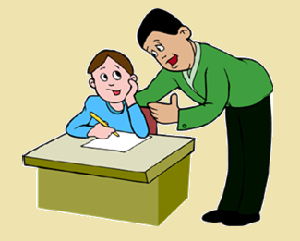
Make a question:
The teachers have treated us kindly.
Have the teachers treated us kindly?

Slide 22
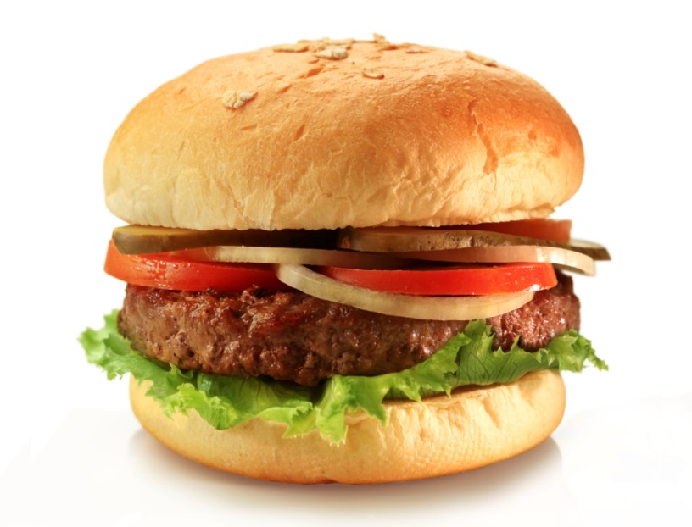
Make a question:
She would like a hamburger.
Would she like a hamburger?

Slide 23
Other Statements:
Add Does / Do
Simple present sentence.
(likes, love, want, “have”)

Slide 24
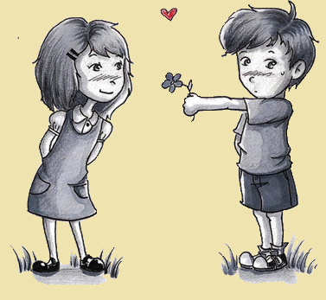
Make a question:
He likes her.
Does he like her?

Slide 25
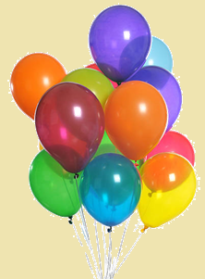
Make a question:
They want the balloons.
Do they say want the balloons?

Slide 26
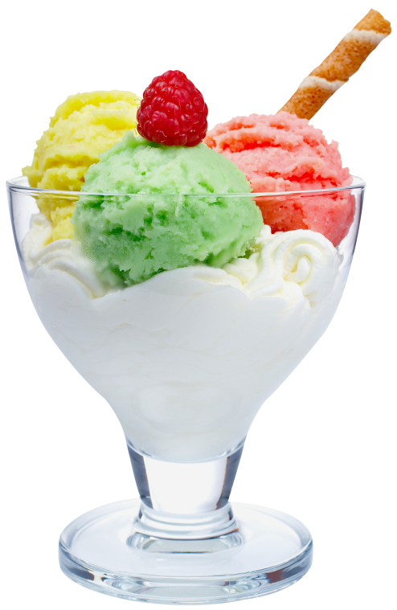
Make a question:
We love ice cream.
Do we love ice cream?

Slide 27
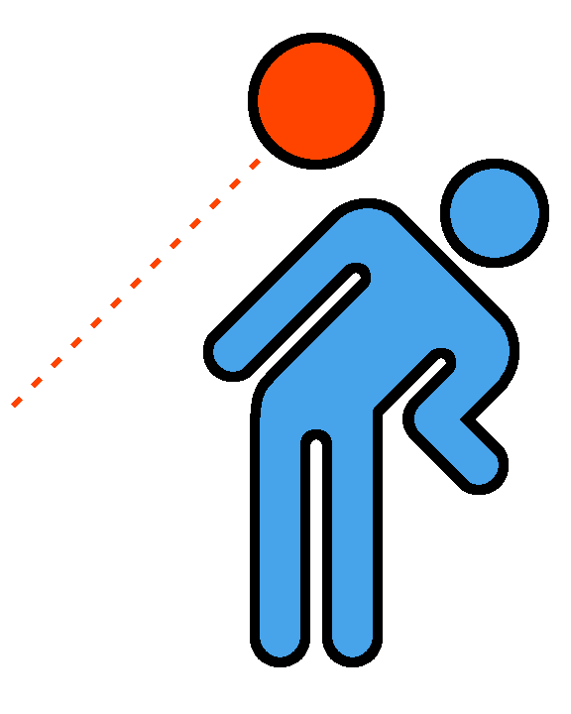
Make a question:
She likes to play dodge ball.
Does she like to play dodge ball?

Slide 28
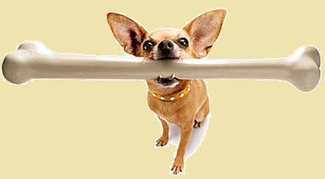
Make a question:
The dog has a bone.
Does it have a bone?

Slide 29
Review
Make a sentence

Slide 30
The Eiffel Tower is tall.
Is the Eiffel Tower tall?

Slide 31
She can play the piano.
Can she play the piano?

Slide 32
The pizza is circular and flat.
Is the pizza circular and flat?

Slide 33
They love candy.
Do they love candy?

Slide 34
You have a metallic ruler.
Do you have a metallic ruler?

Slide 35
How to Answer:
Is it green?
Has she read the book?
Yes, it is green.
No, it is not green.
Yes, she has read the book.
No, she has not read the book.

Slide 36
How to Answer:
Do you like cafeteria food?
Are you tired?
Yes, I like cafeteria food.
No, I don’t like cafeteria food.
Yes, I am tired.
No, I am not tired.

Slide 37
What is it?

Slide 38
What is it? Game
One student comes to the front
Look at the picture on the computer.
The other students must ask questions
Answer must be “Yes” or “No”
Try using the questions from today.

Slide 40
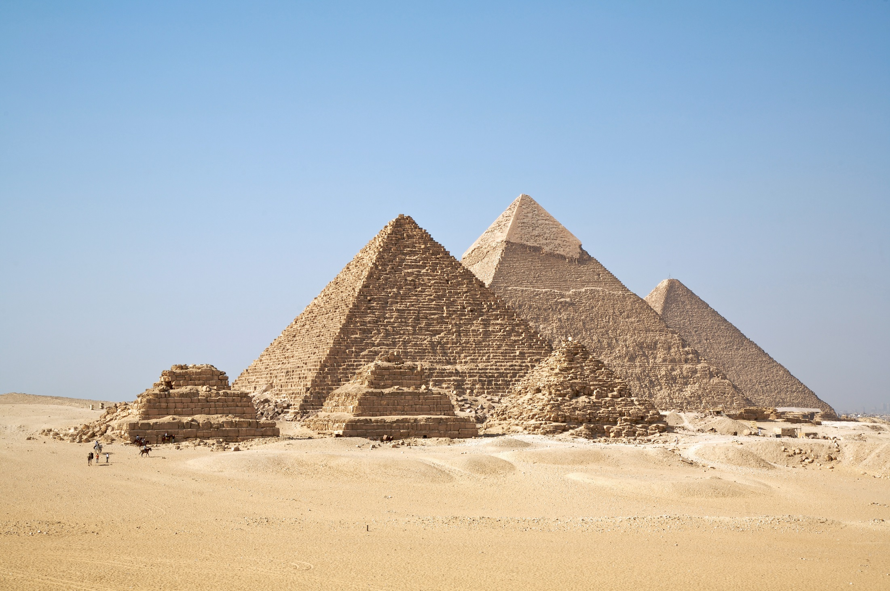

Slide 41
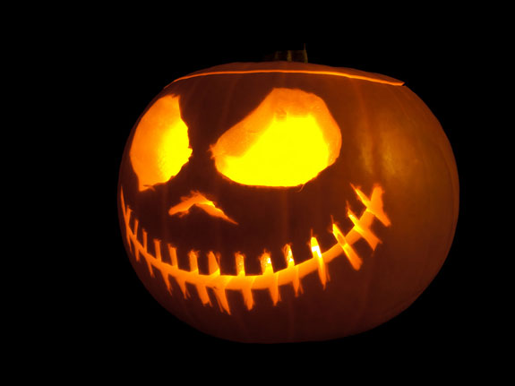

Slide 42
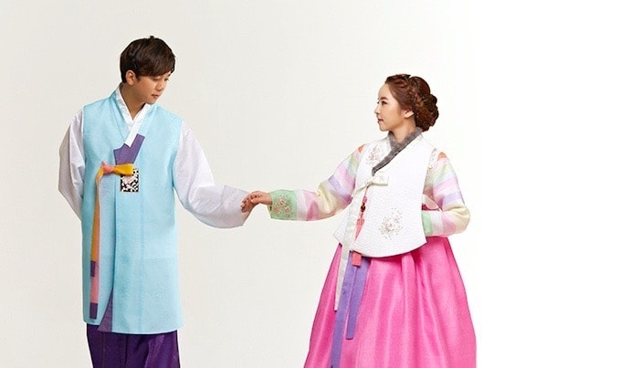

Slide 43
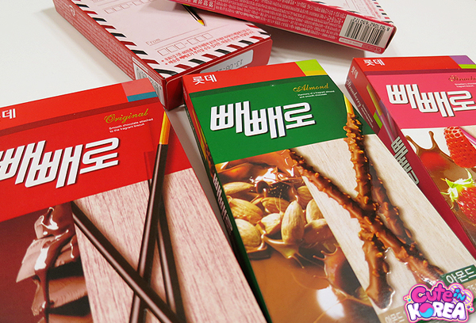

Slide 44
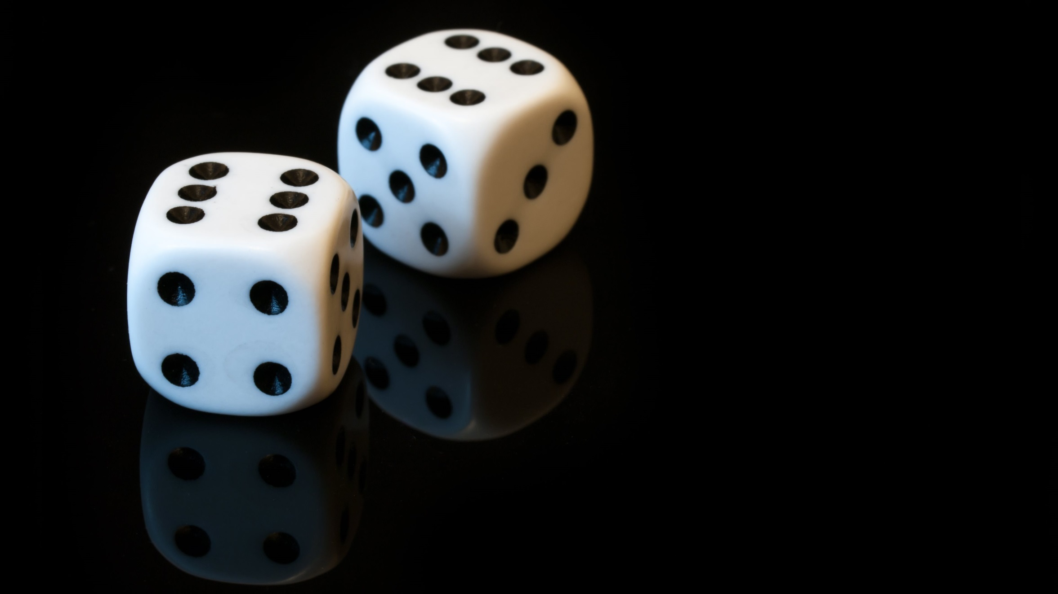

Slide 45
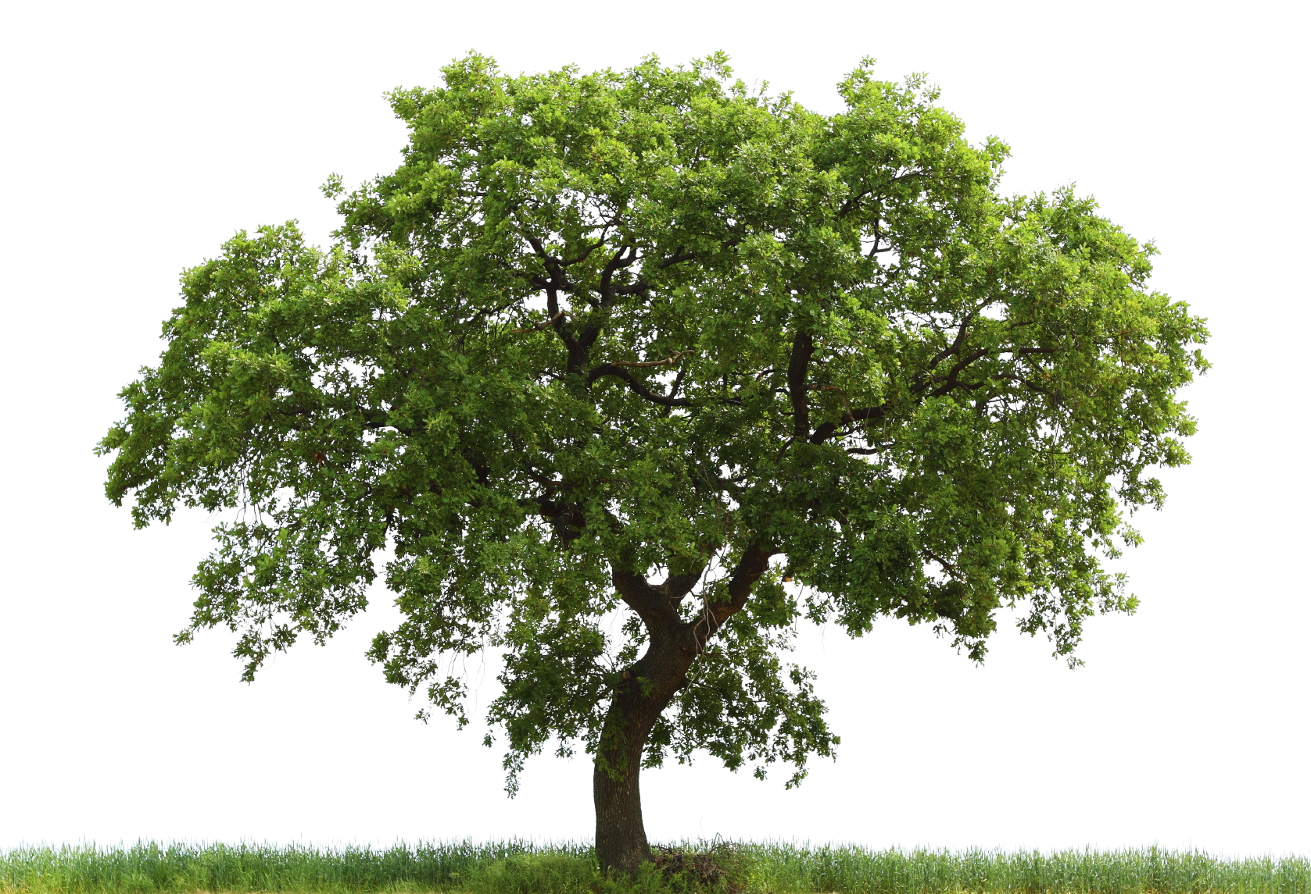

Slide 46
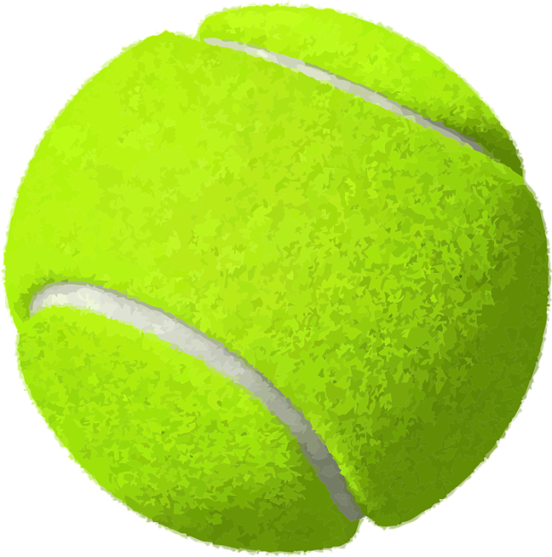

Slide 47
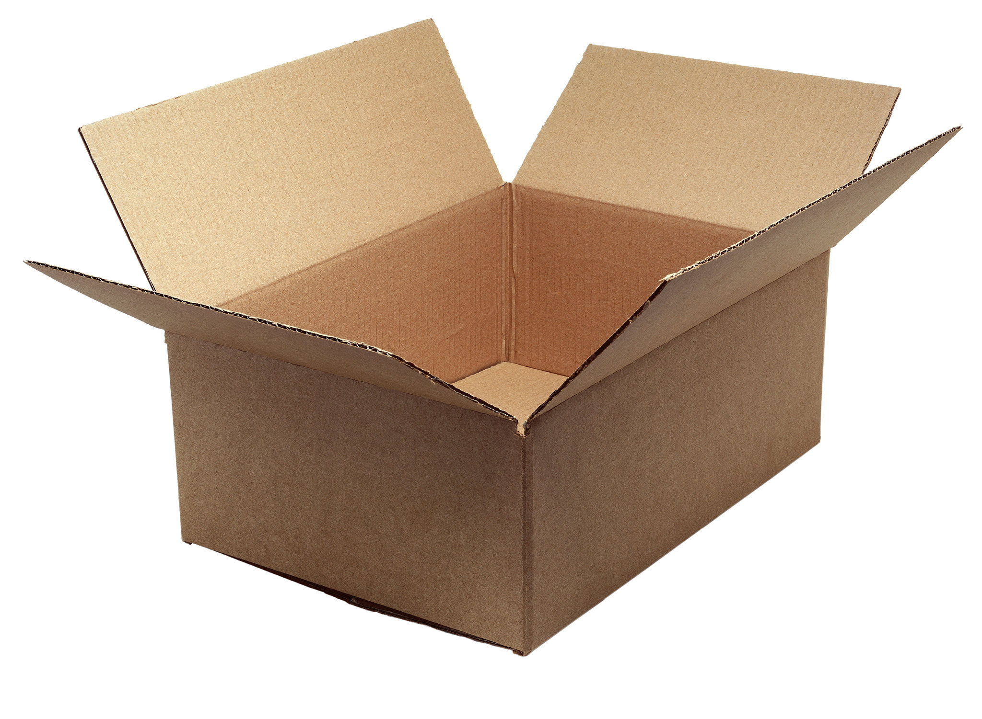

Slide 48
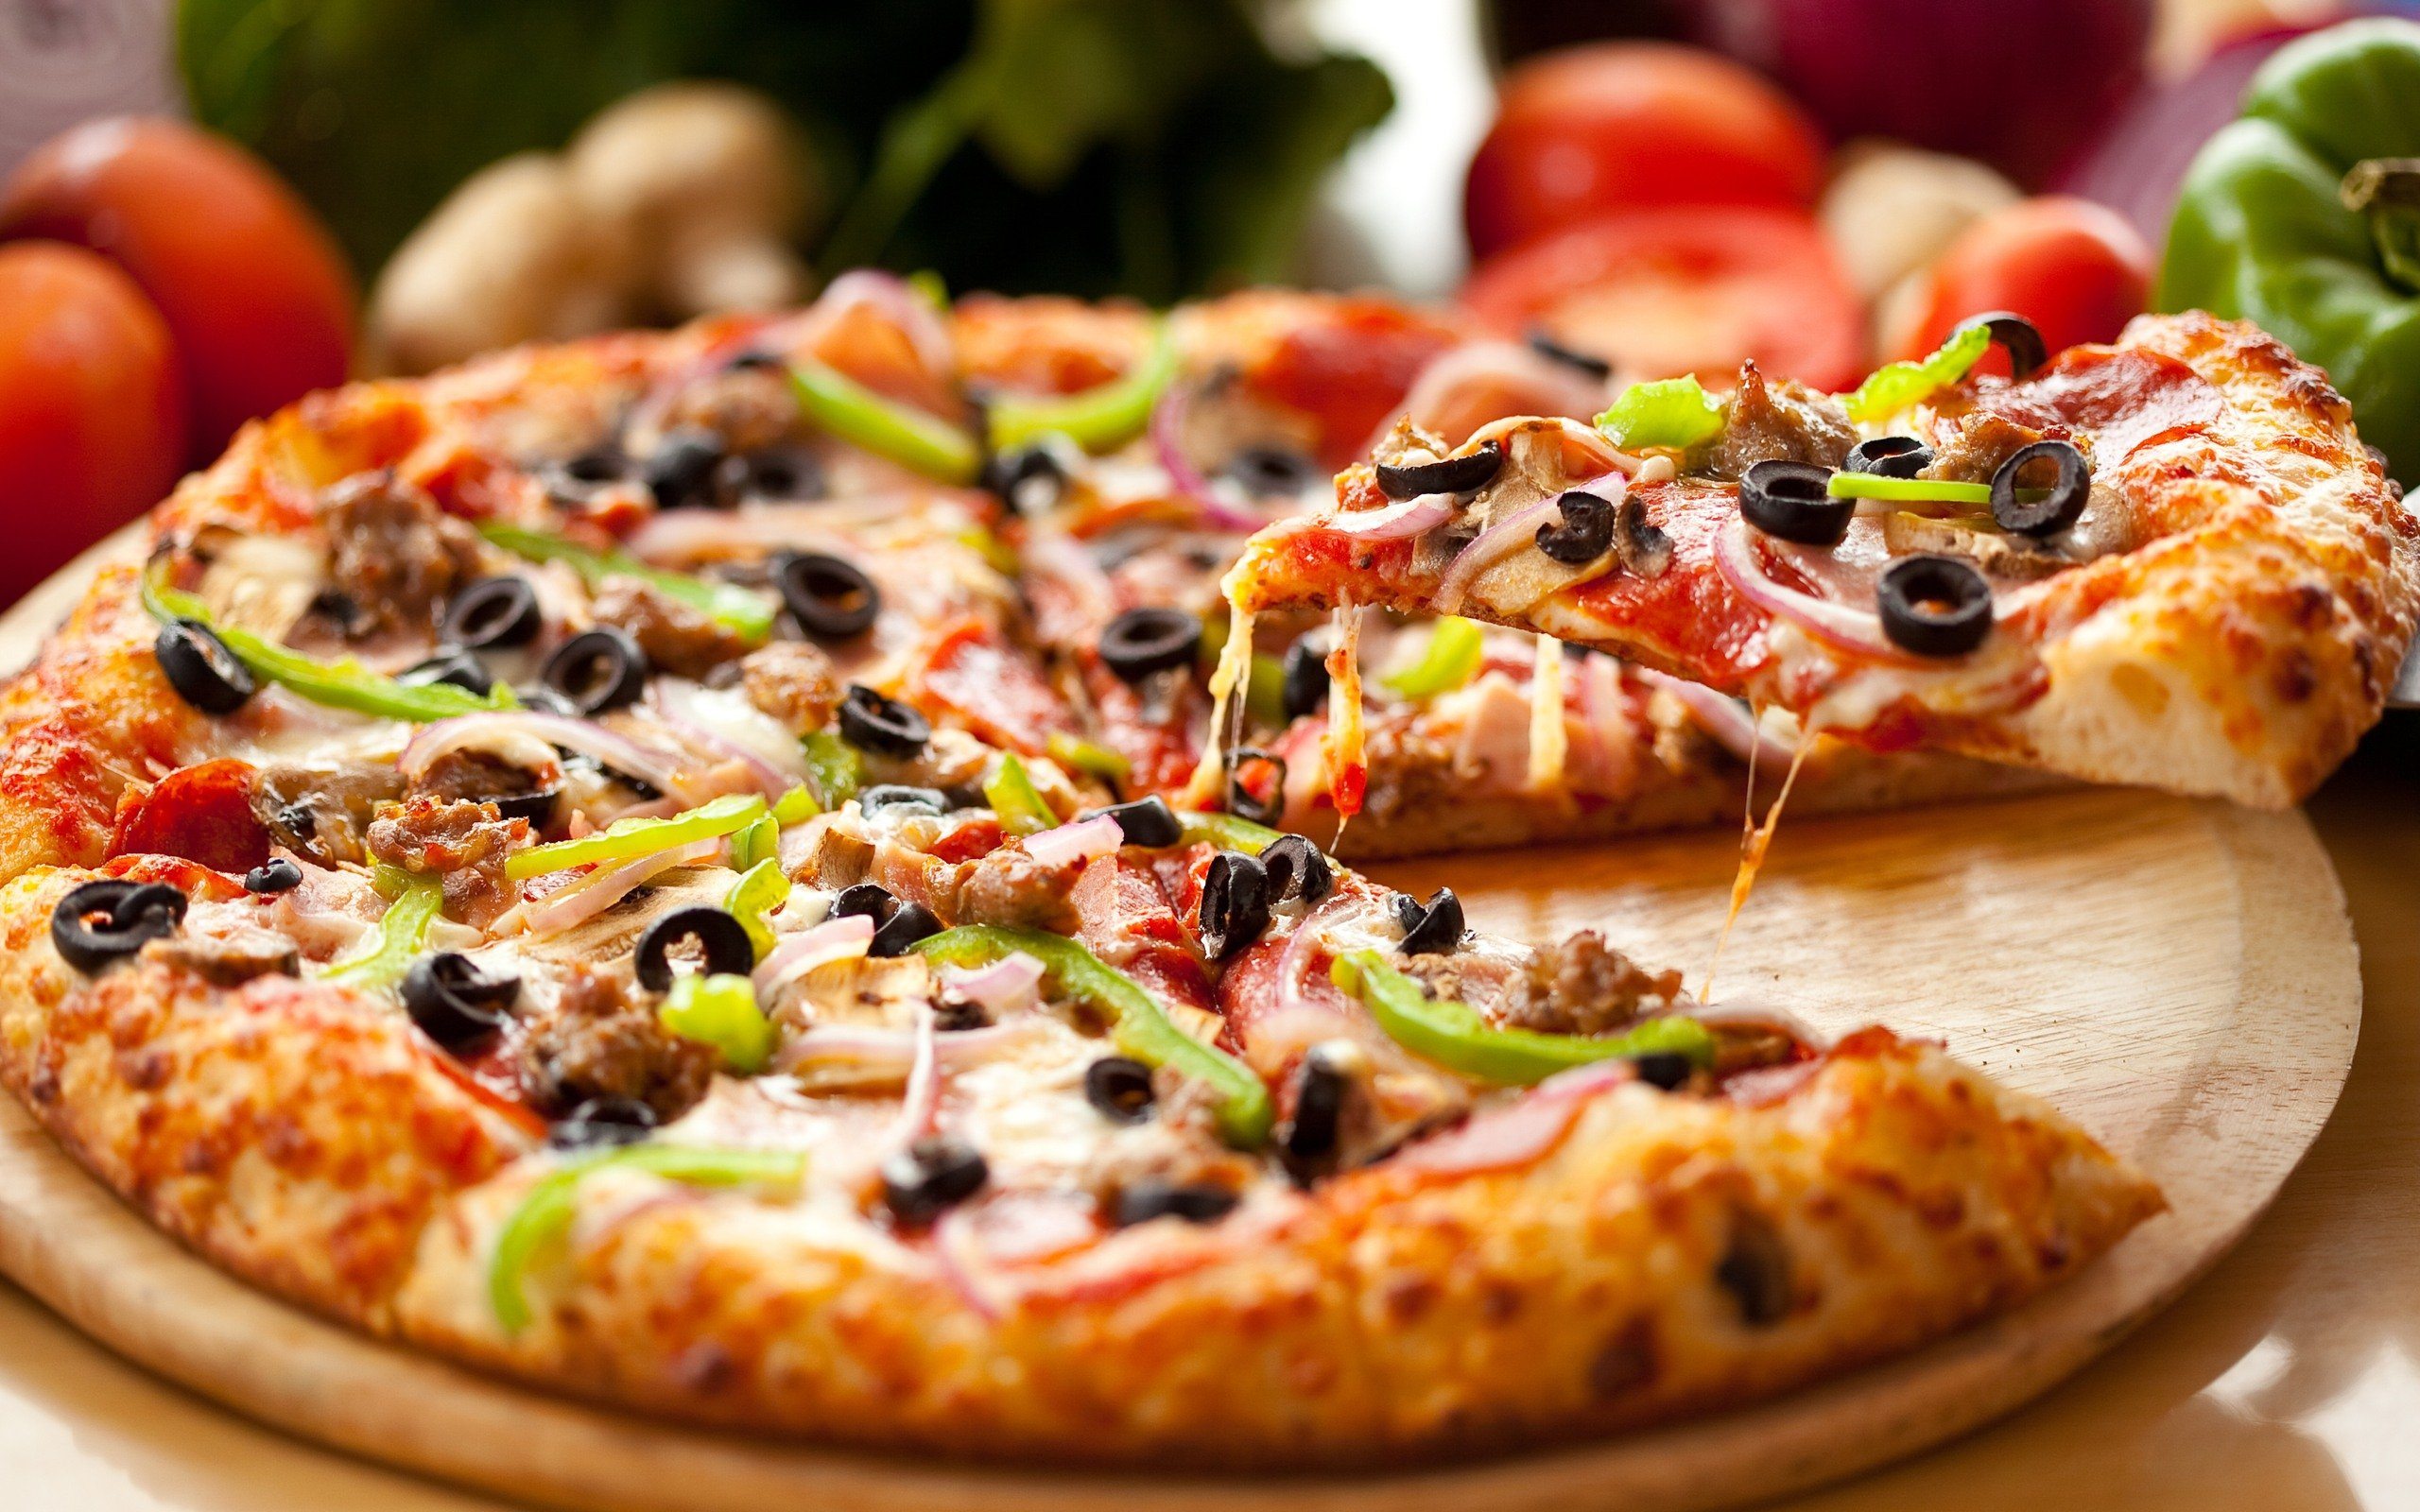

Slide 49
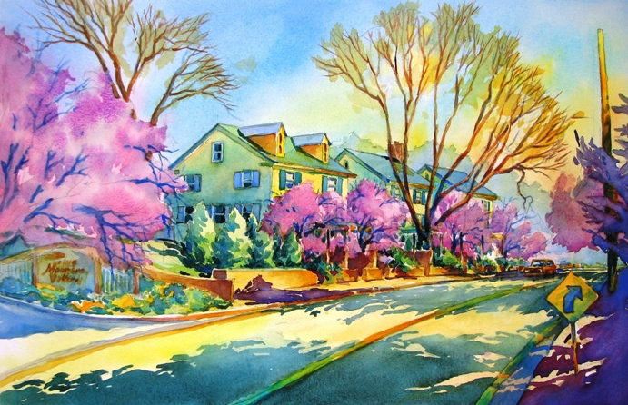

Slide 50
