Slide 1
Questions
Interrogative Sentences

Slide 2
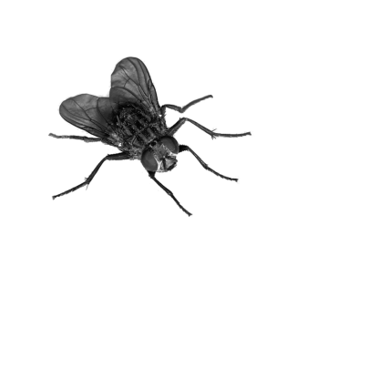
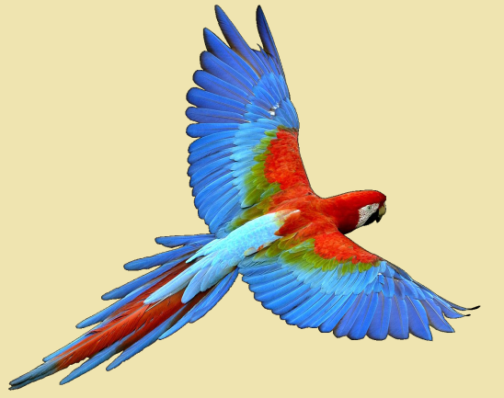
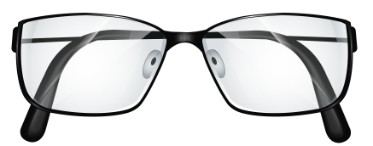
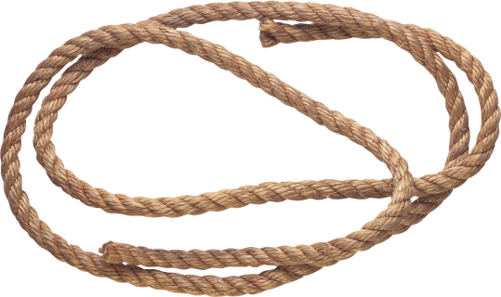
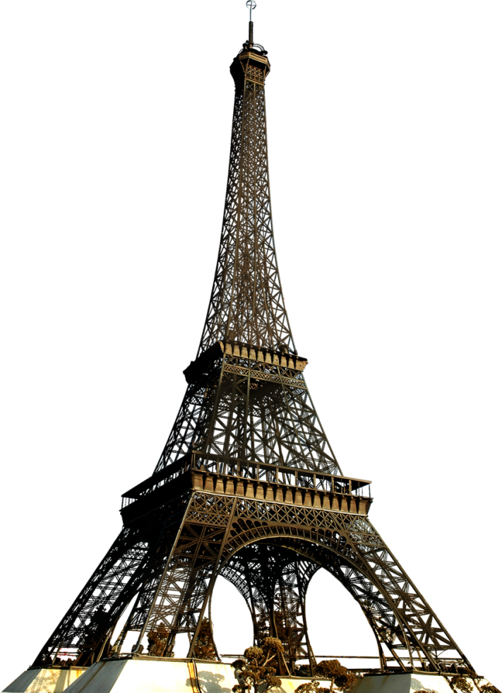
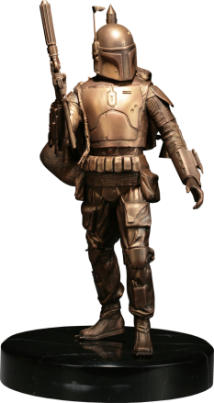
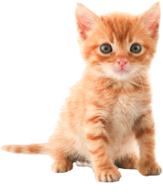
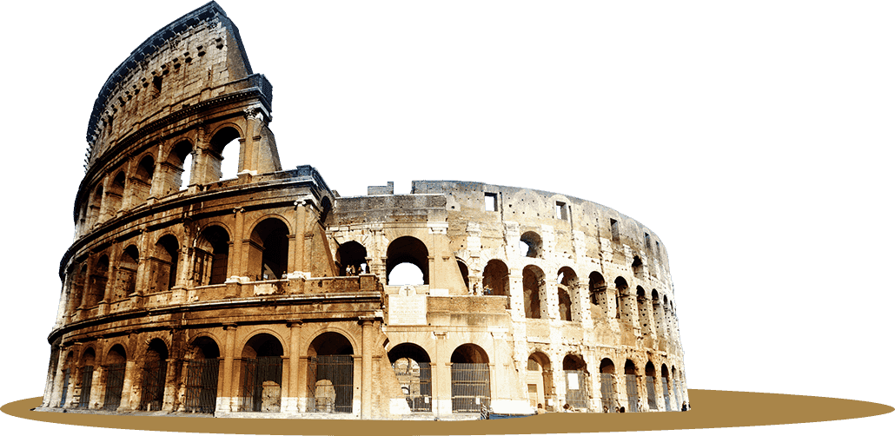
Review:
Tiny
Young
Colorful
Bronze
Old
Tall
Long
Giant
Clear

Slide 3
Today’s Adjectives: Shape
Circular
Square
Rectangular
Straight
Triangular
Curved (bent)

Slide 4
Today’s Adjectives: Shape
Round
Spherical
Cubic
Conical
Pyramidal
Flat

Slide 5
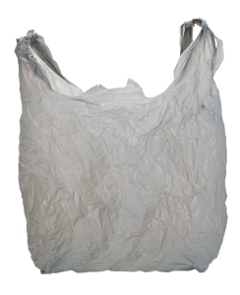
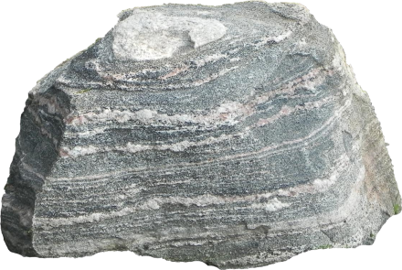
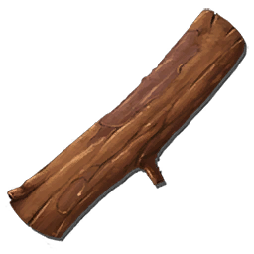
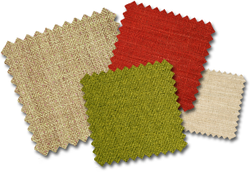
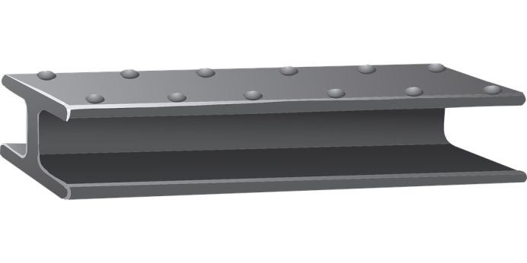
Today’s Adjectives: Material
Stone
Cloth
Fabric
Plastic
Wooden
Metallic
Paper
Glass

Slide 6
What is a statement?
Subject + Predicate
(Pronoun) + (to be + adjective)

Slide 7
Change a statement to a question:
(Pronoun) + (to be + adjective)

Slide 8
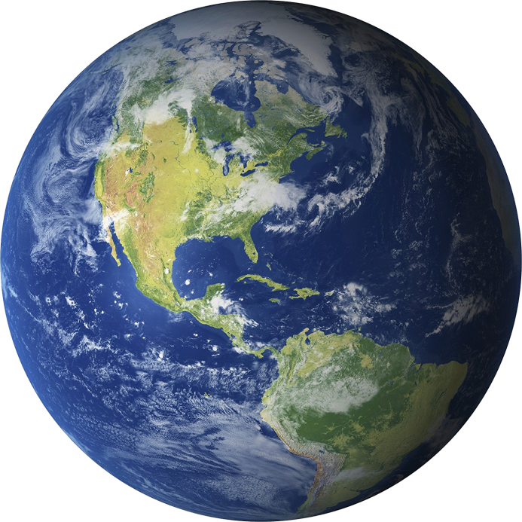
Make a question:
It is round.
Is it round?

Slide 9
Make a question:
We are living in Korea.
Are we living in Korea?

Slide 10
Make a question:
I am correct.
Am I correct?

Slide 11
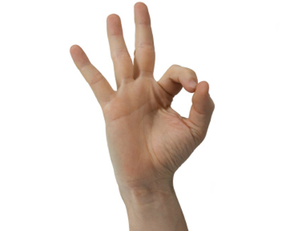
Make a question:
You’re ok.
Are you ok?

Slide 12
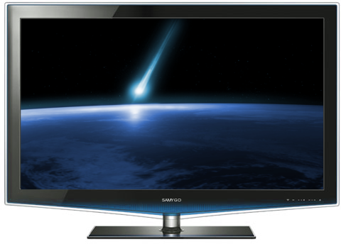
Make a question:
The TV is flat.
Is the TV flat?

Slide 13
Make a question:
English is a difficult class.
Is English a difficult class?

Slide 14
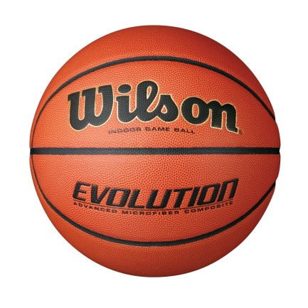
Make a question:
They were playing basketball.
Were they playing basketball?

Slide 15
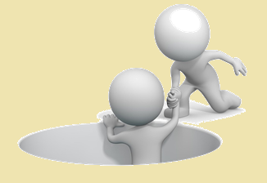
Helping Verbs
What is a verb?
What is a helping verb?
Action word
A verb that changes another verb

Slide 16
Helping Verb Examples
Find the helping verb:
He was eating pizza.
We can go home now.
They have watched a lot of movies.
The teachers have treated us kindly.
I would like a hamburger, please.

Slide 17
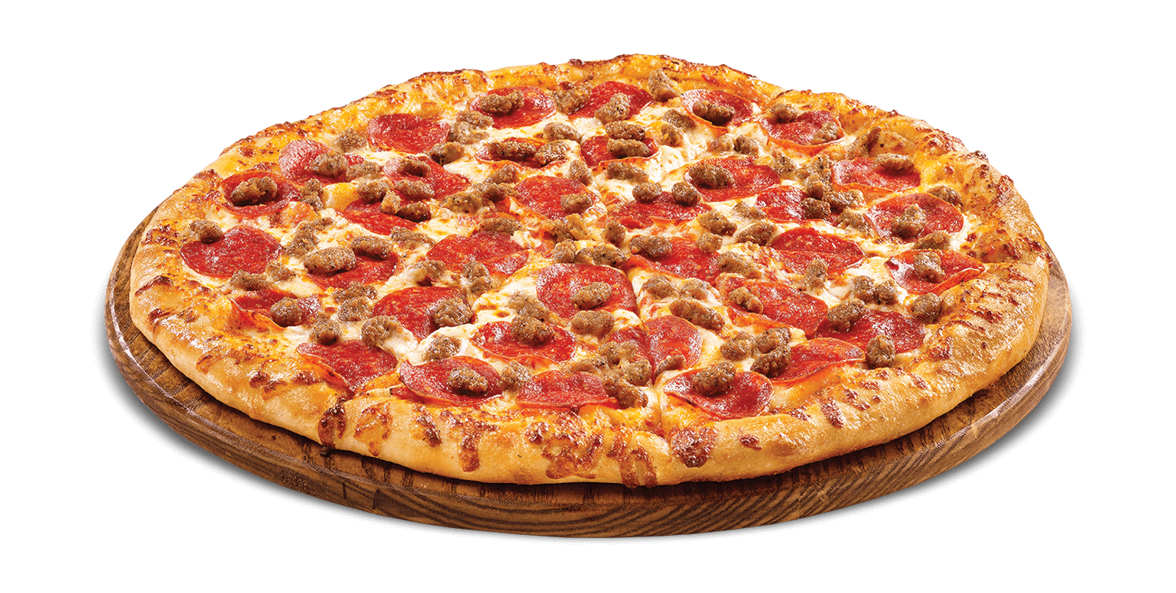
Make a question:
He was eating pizza.
Was he eating pizza?

Slide 18
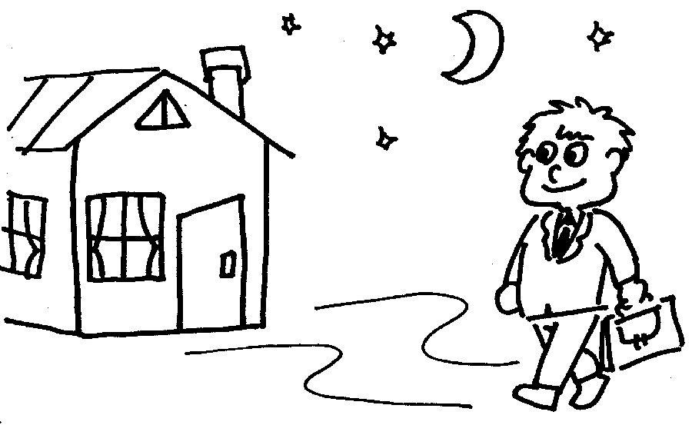
Make a question:
We can go home now.
Can we go home now?

Slide 19
Make a question:
They have watched a lot of movies.
Have they watched a lot of movies?

Slide 20
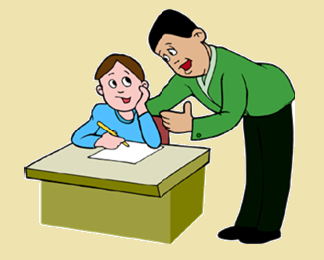
Make a question:
The teachers have treated us kindly.
Have the teachers treated us kindly?

Slide 21
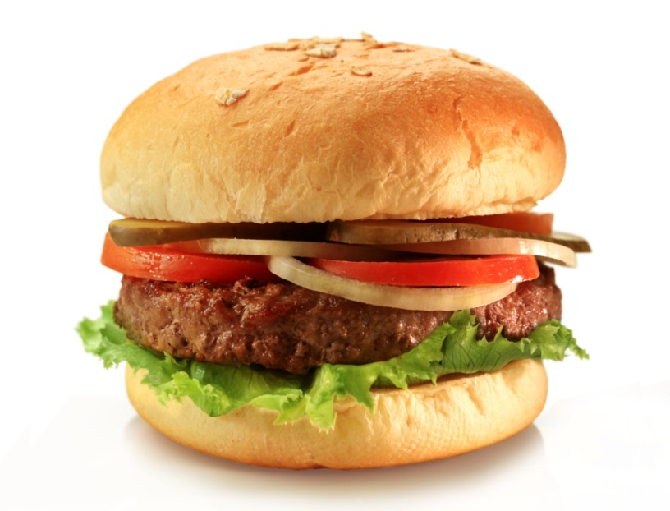
Make a question:
She would like a hamburger.
Would she like a hamburger?

Slide 22
Other Statements:
Add Does / Do
Simple present sentence.
(likes, love, want, “have”)

Slide 23
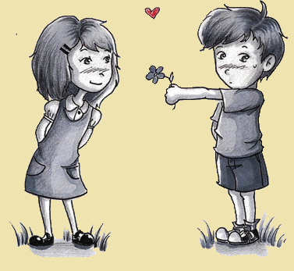
Make a question:
He likes her.
Does he like her?

Slide 24
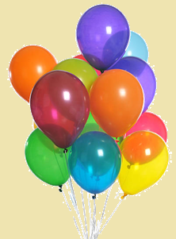
Make a question:
They want the balloons.
Do they want the balloons?

Slide 25
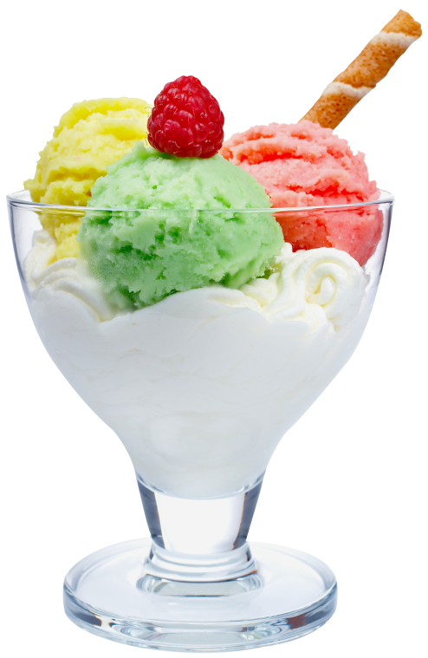
Make a question:
We love ice cream.
Do we love ice cream?

Slide 26
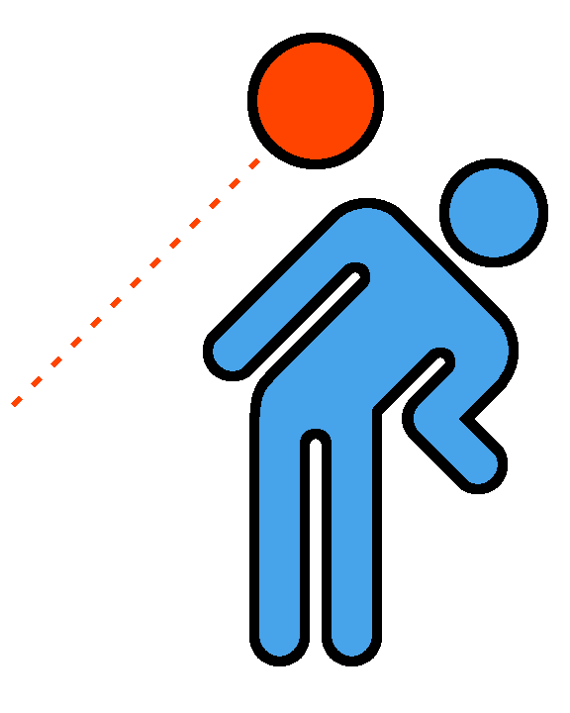
Make a question:
She likes to play dodge ball.
Does she like to play dodge ball?

Slide 27
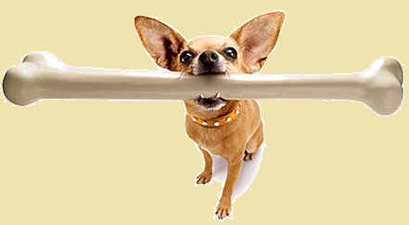
Make a question:
The dog has a bone.
Does it have a bone?

Slide 28
Review
Make a sentence

Slide 29
The Eiffel Tower is tall.
Is the Eiffel Tower tall?

Slide 30
She can play the piano.
Can she play the piano?

Slide 31
The pizza is circular and flat.
Is the pizza circular and flat?

Slide 32
They love candy.
Do they love candy?

Slide 33
You have a metallic ruler.
Do you have a metallic ruler?

Slide 34
How to Answer:
Is it green?
Has she read the book?
Yes, it is green.
No, it is not green.
Yes, she has read the book.
No, she has not read the book.

Slide 35
How to Answer:
Do you like cafeteria food?
Are you tired?
Yes, I like cafeteria food.
No, I don’t like cafeteria food.
Yes, I am tired.
No, I am not tired.

Slide 36
What is it?

Slide 37
What is it? Game
One student comes to the front
Look at the picture on the computer.
The other students must ask questions
Answer must be “Yes” or “No”
Try using the questions from today.

Slide 39
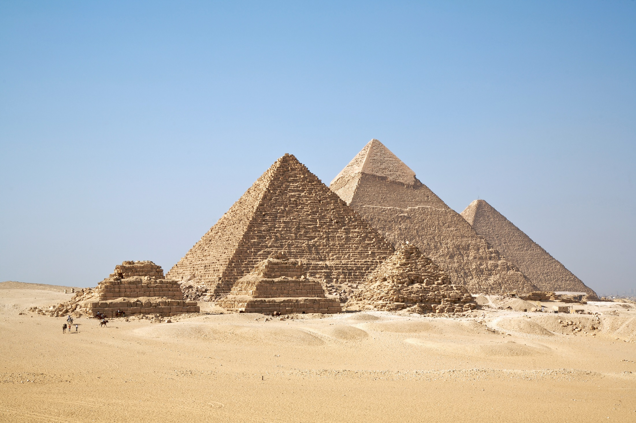

Slide 40
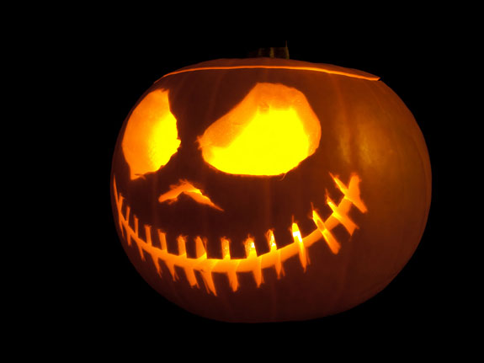

Slide 41
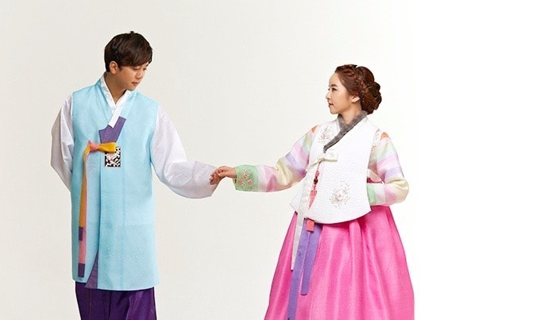

Slide 42
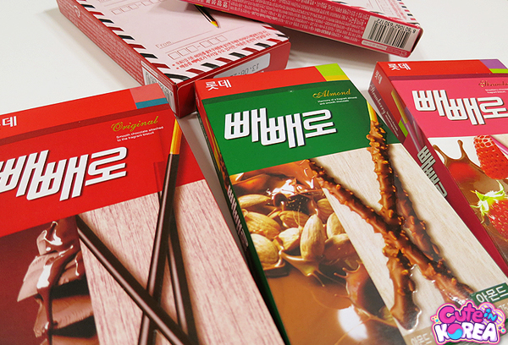

Slide 43
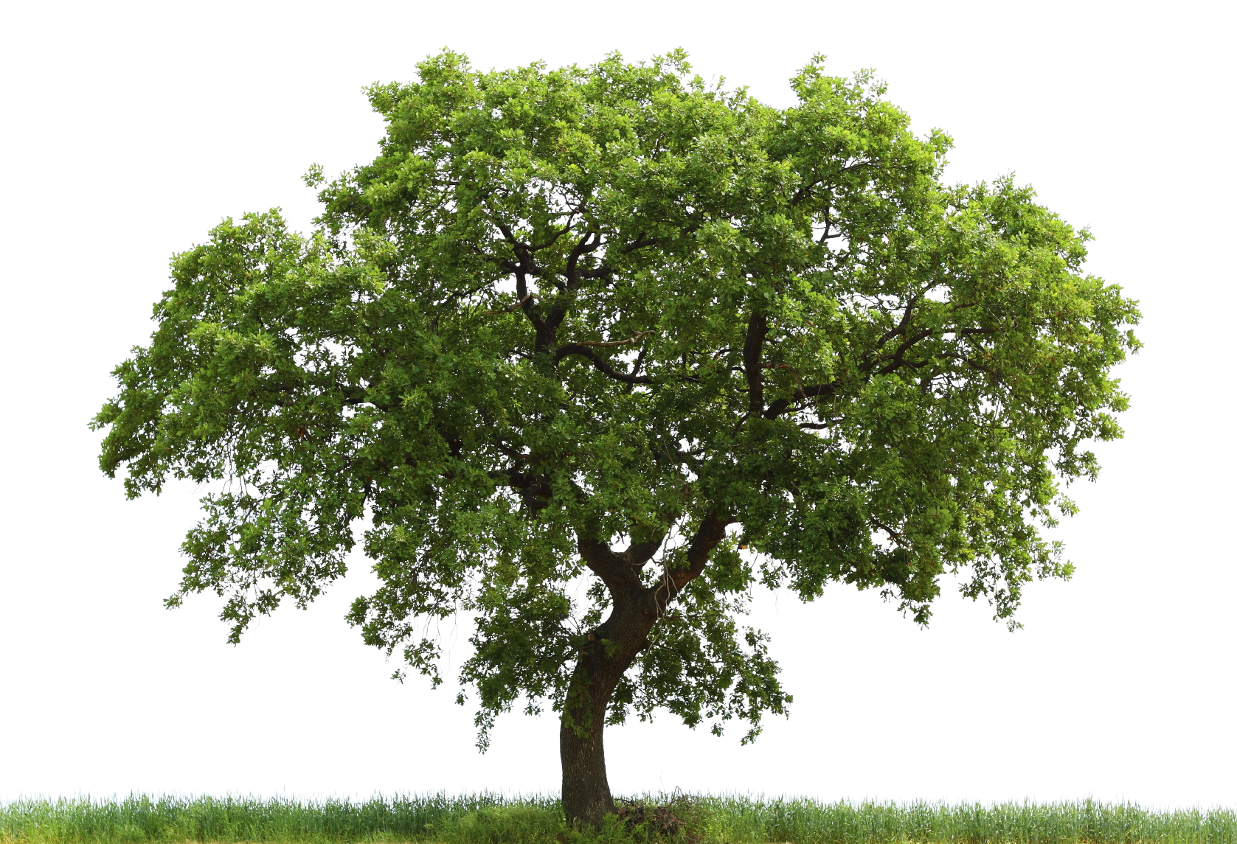

Slide 44
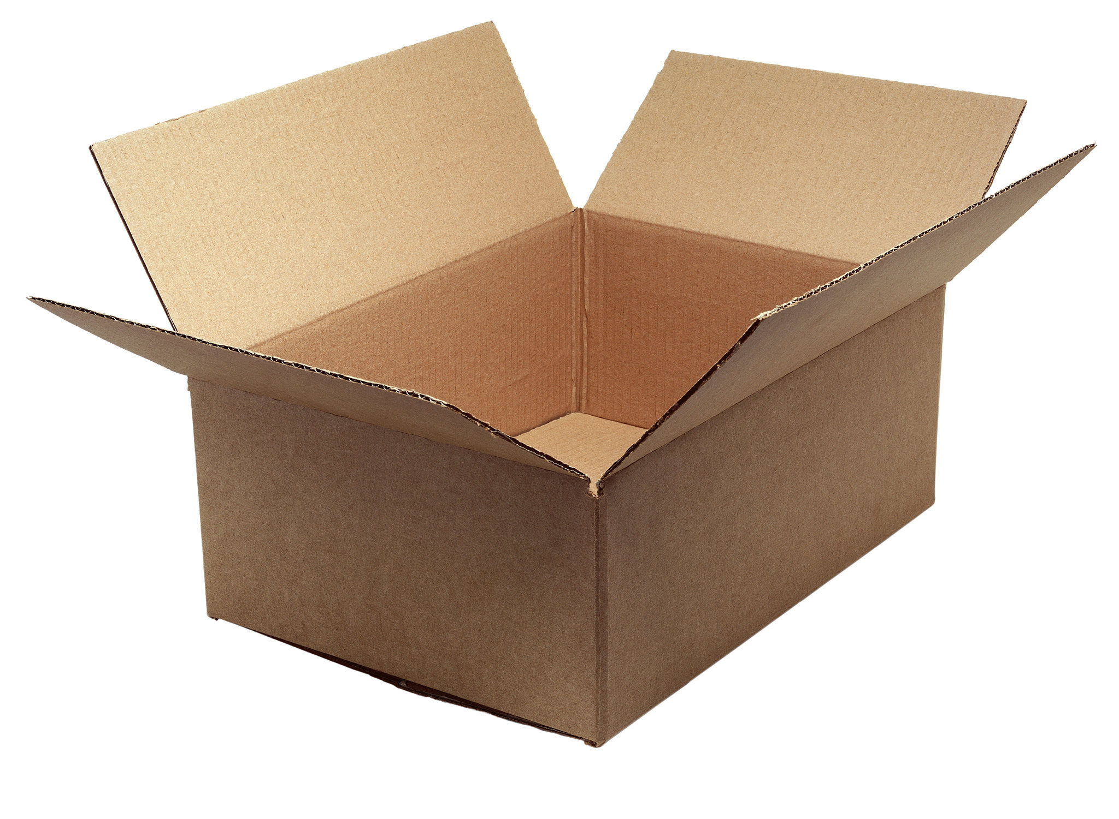

Slide 45
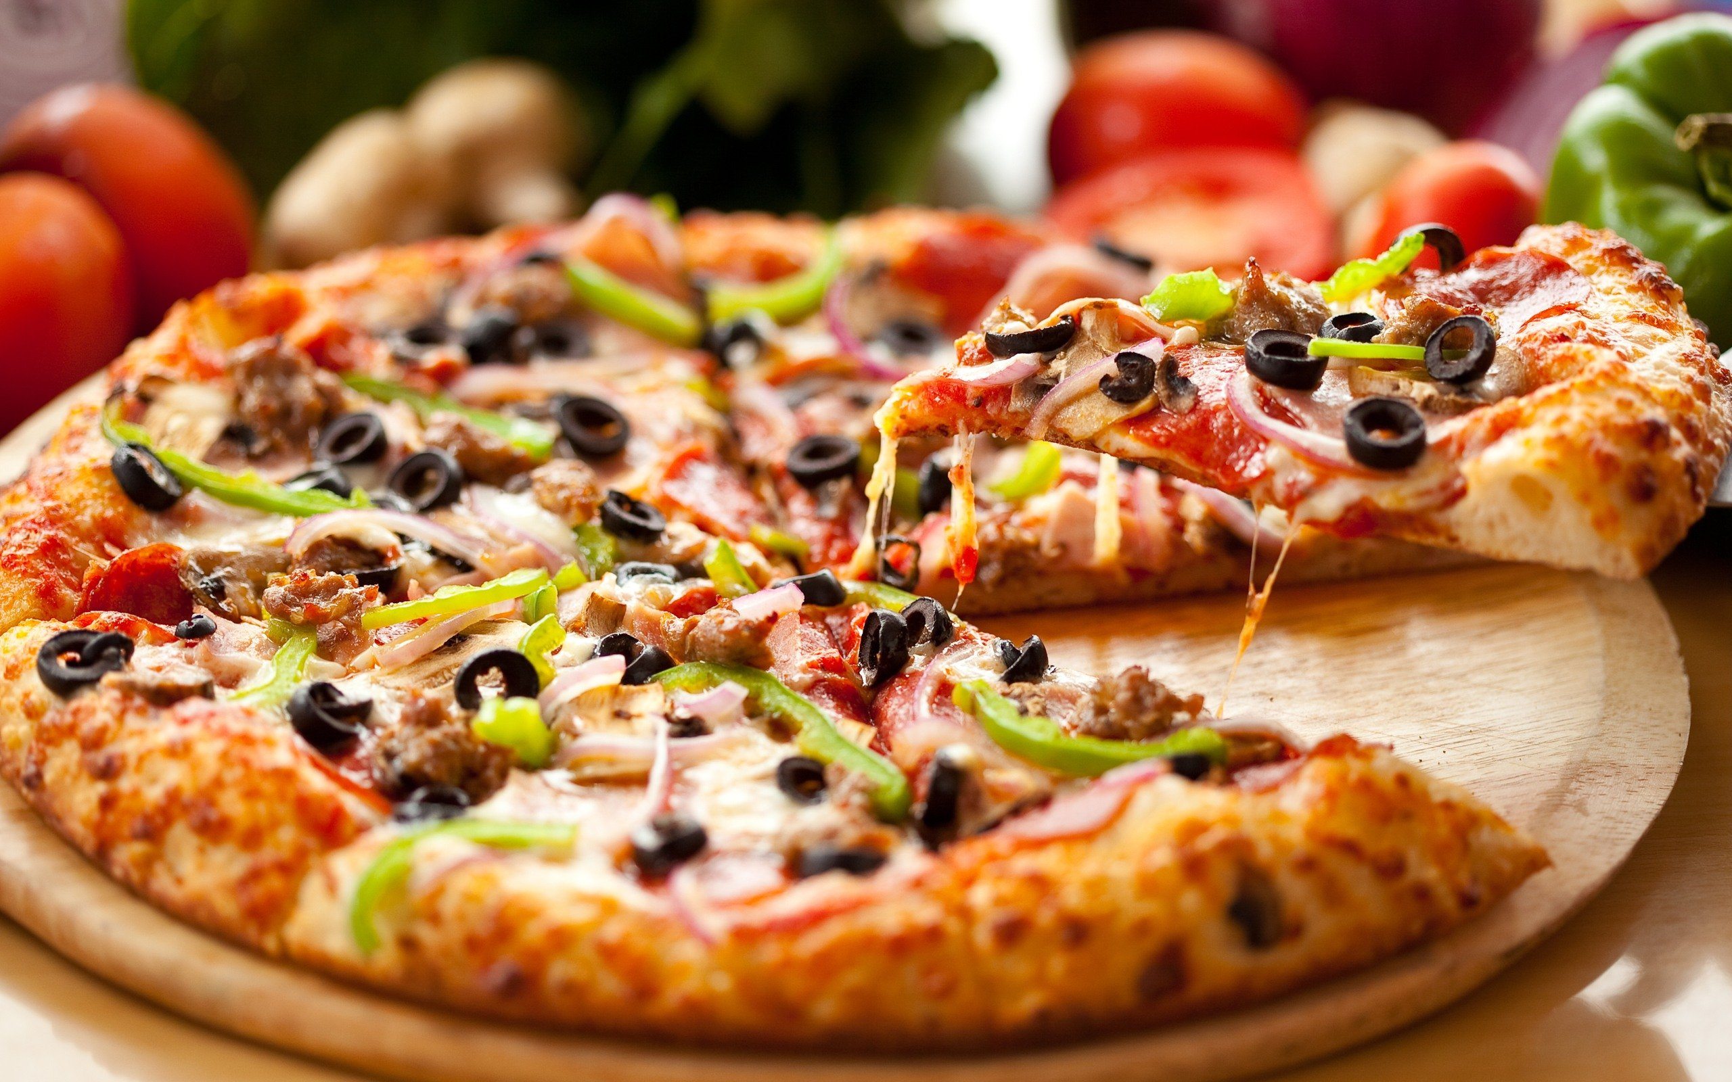

Slide 46
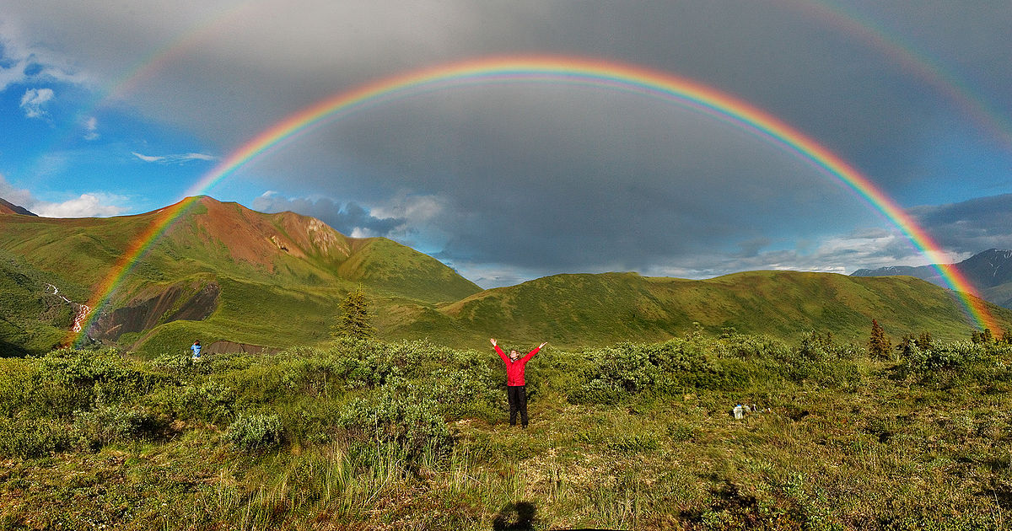

Slide 47
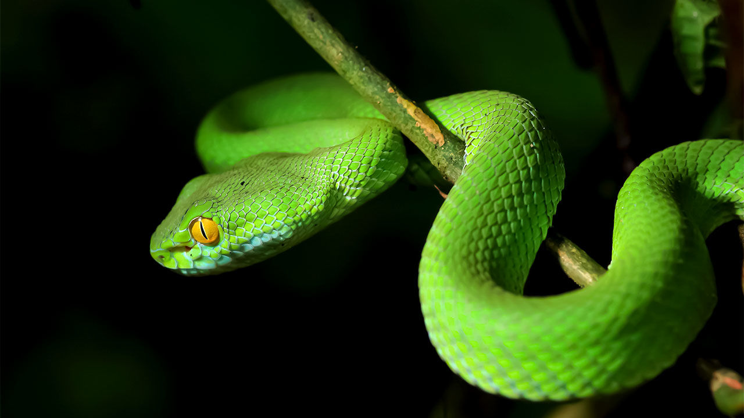

Slide 48
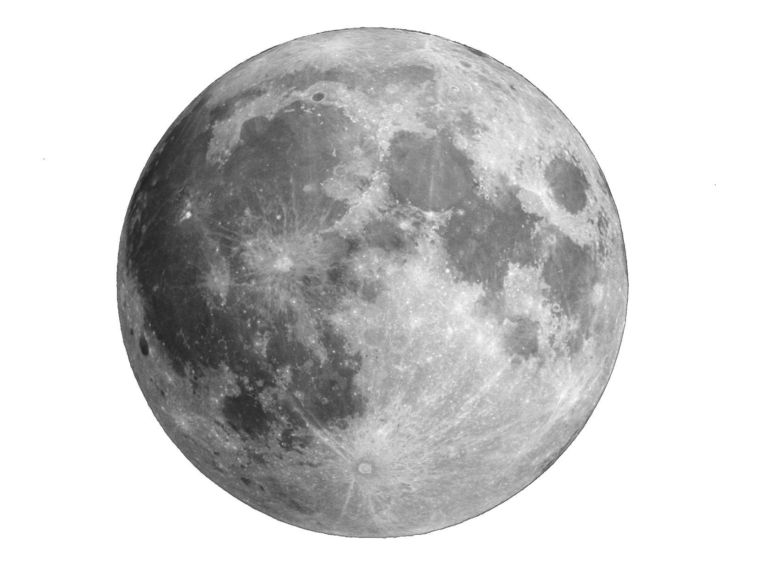

Slide 49
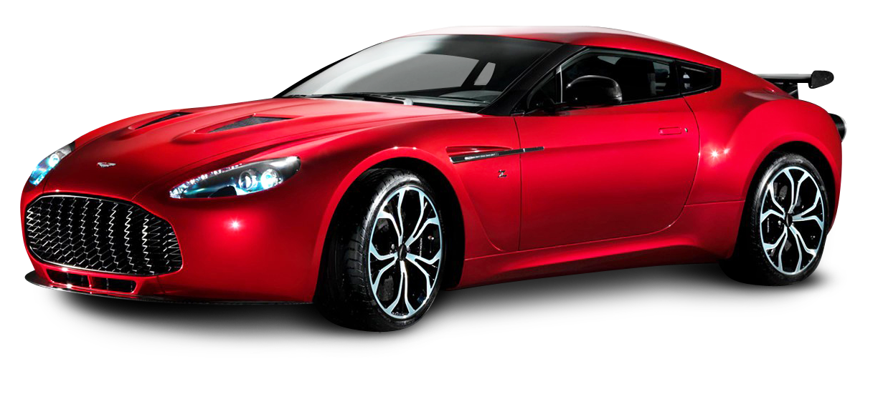

Slide 50
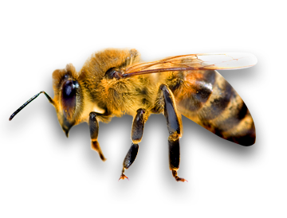

Slide 51
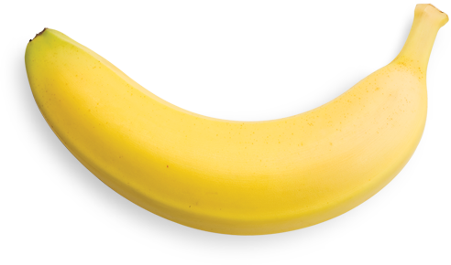

Slide 52
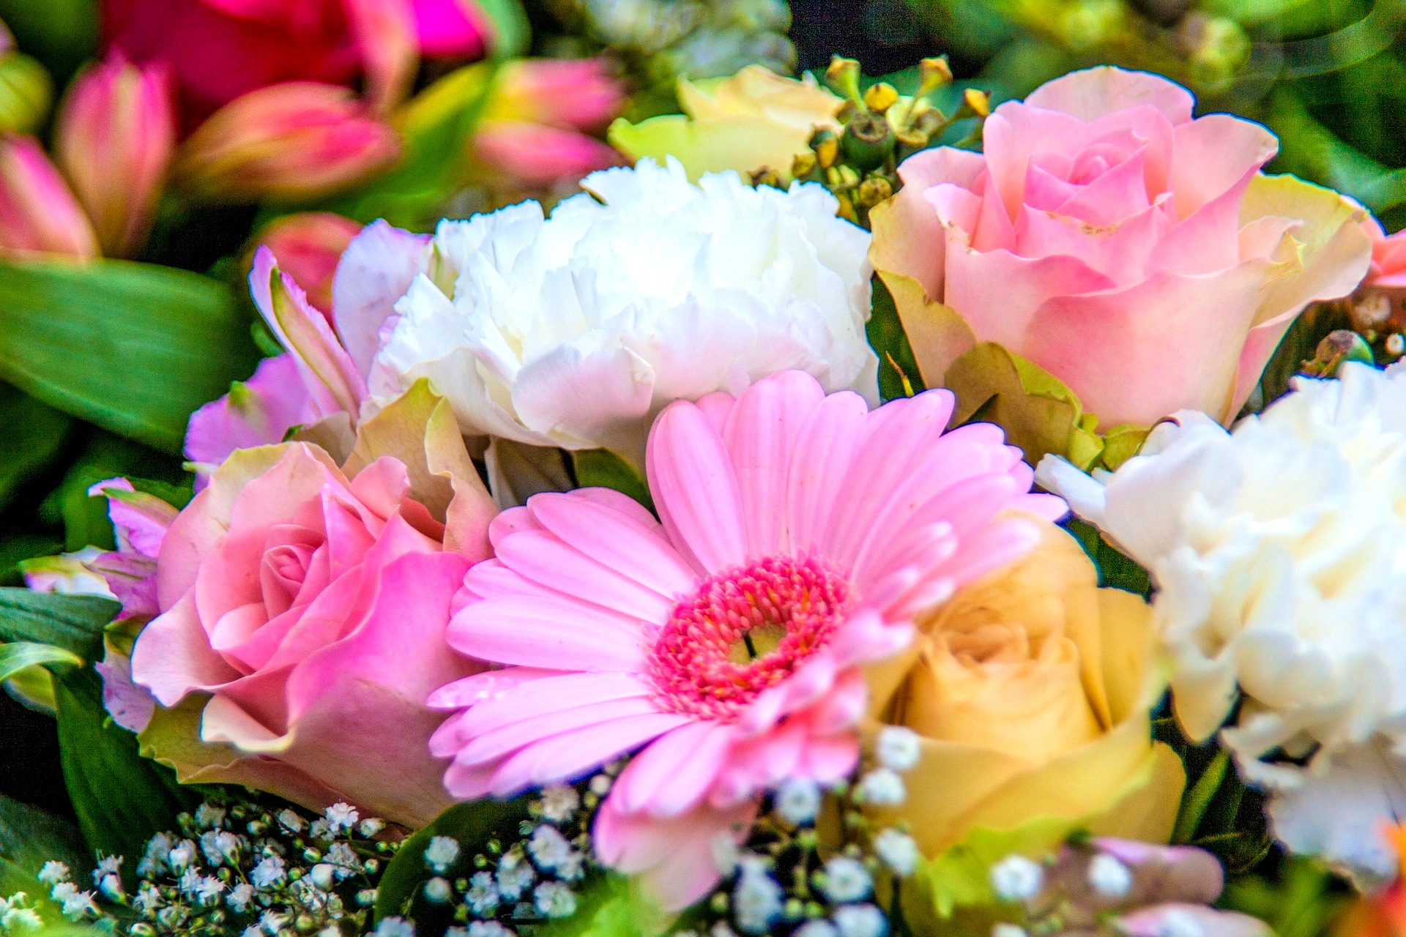

Slide 53
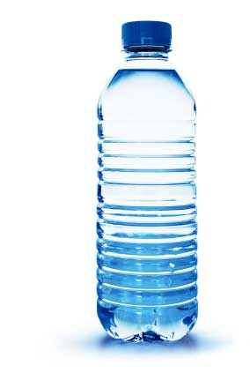

Slide 54
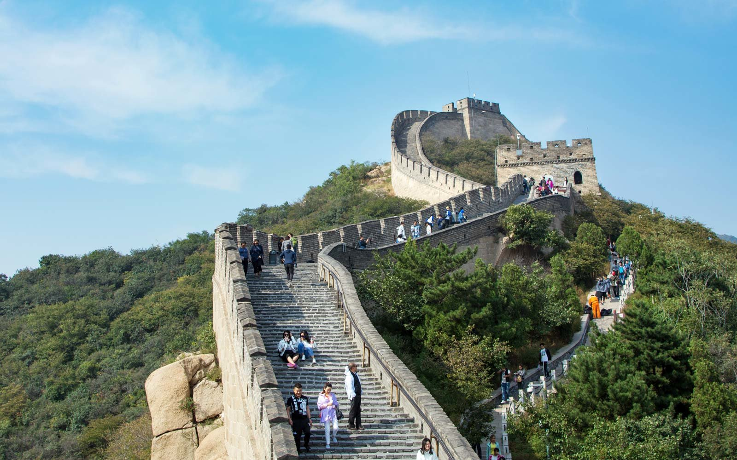

Slide 55
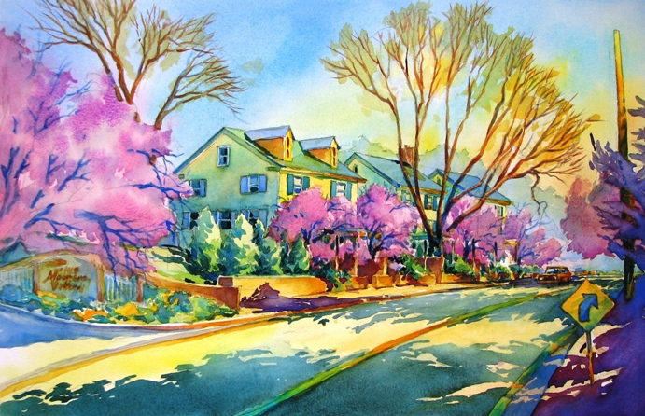

Slide 56
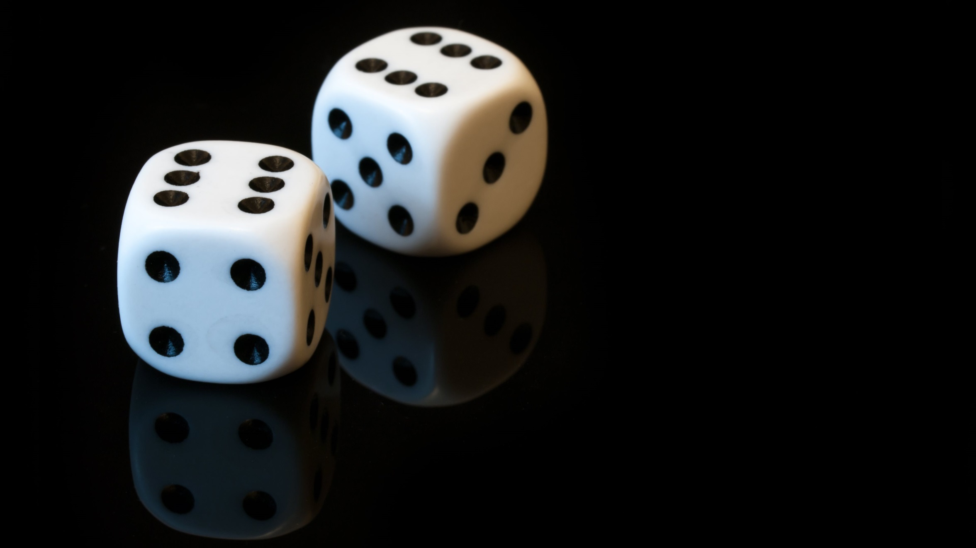

Slide 57
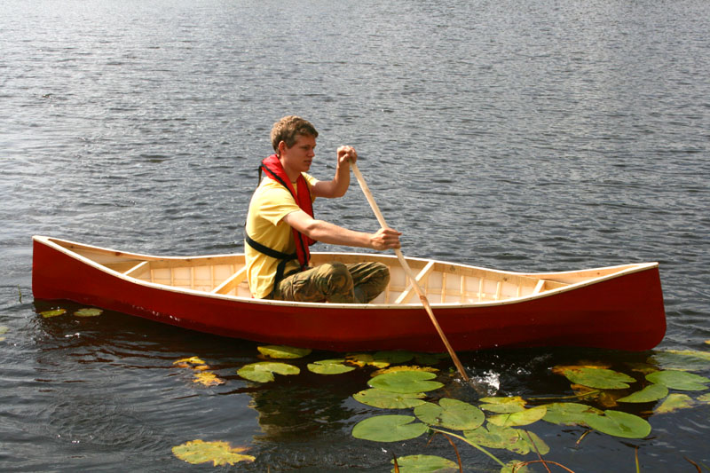

Slide 60
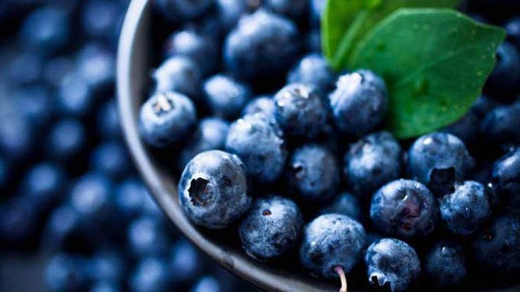

Slide 61
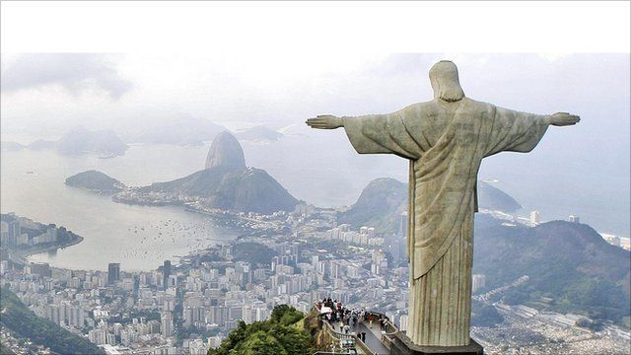

Slide 62
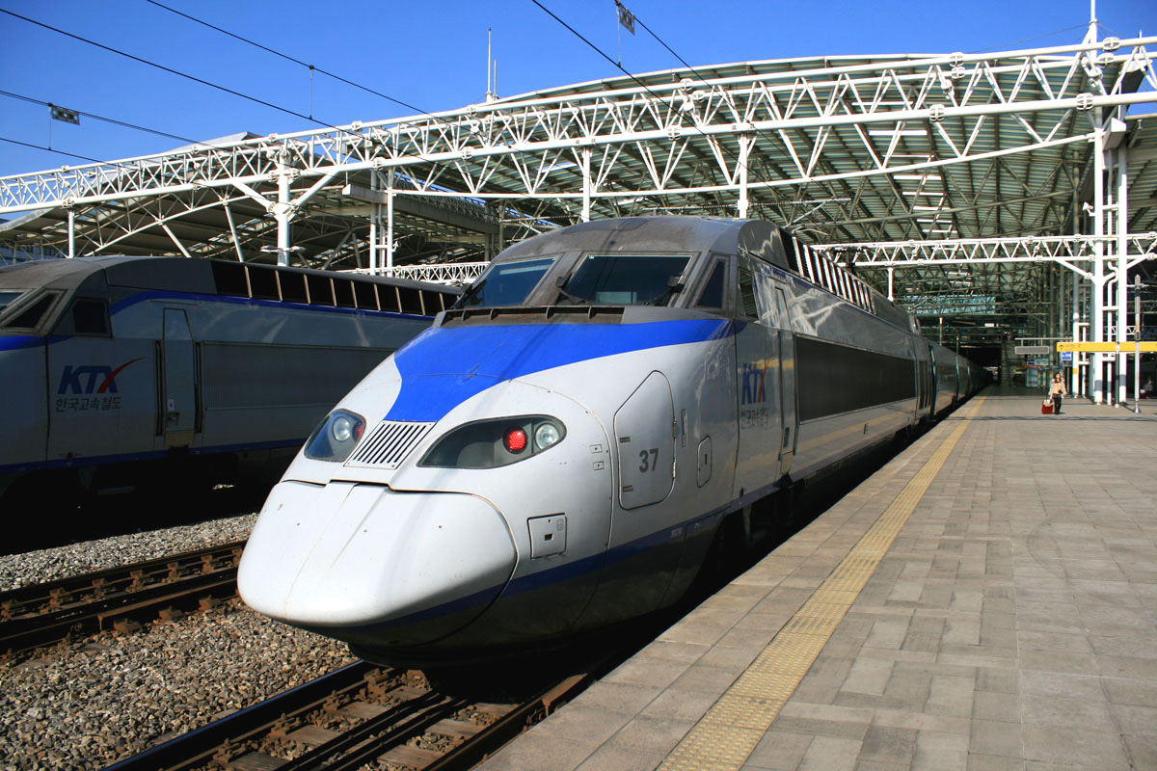

Slide 63
