Slide 1
Adjectives

Slide 2
Describe These Pictures:

Slide 3
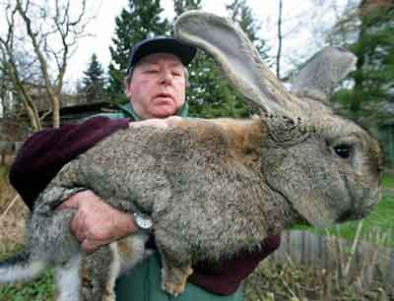

Slide 4
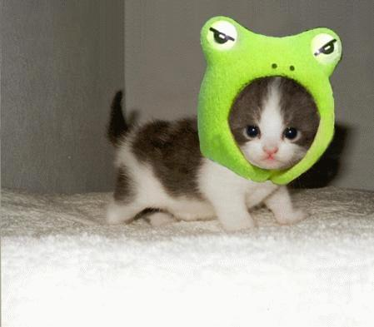

Slide 5
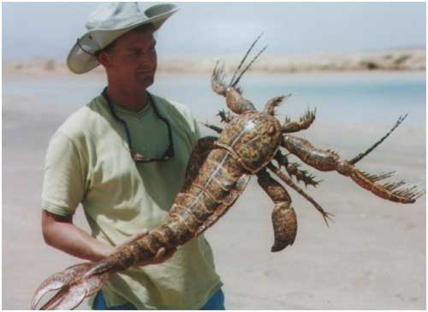

Slide 6
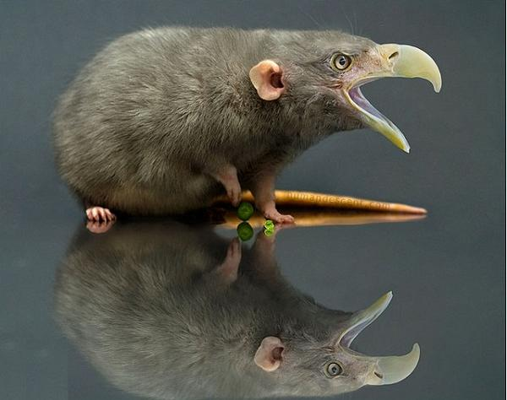

Slide 7
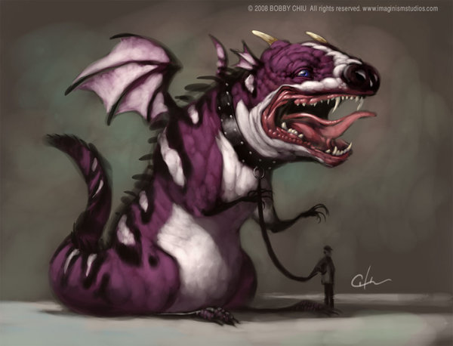

Slide 8
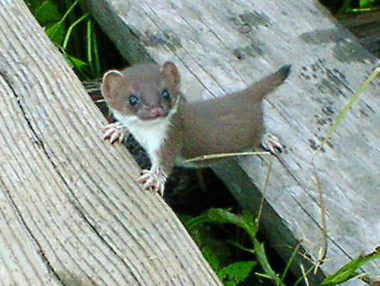

Slide 9
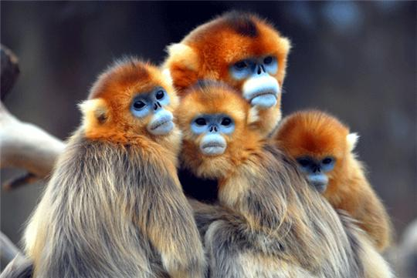

Slide 10
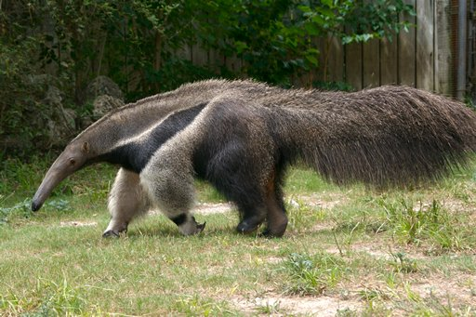
Ant eater

Slide 11
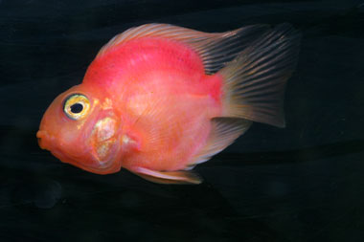
Parrot fish

Slide 12
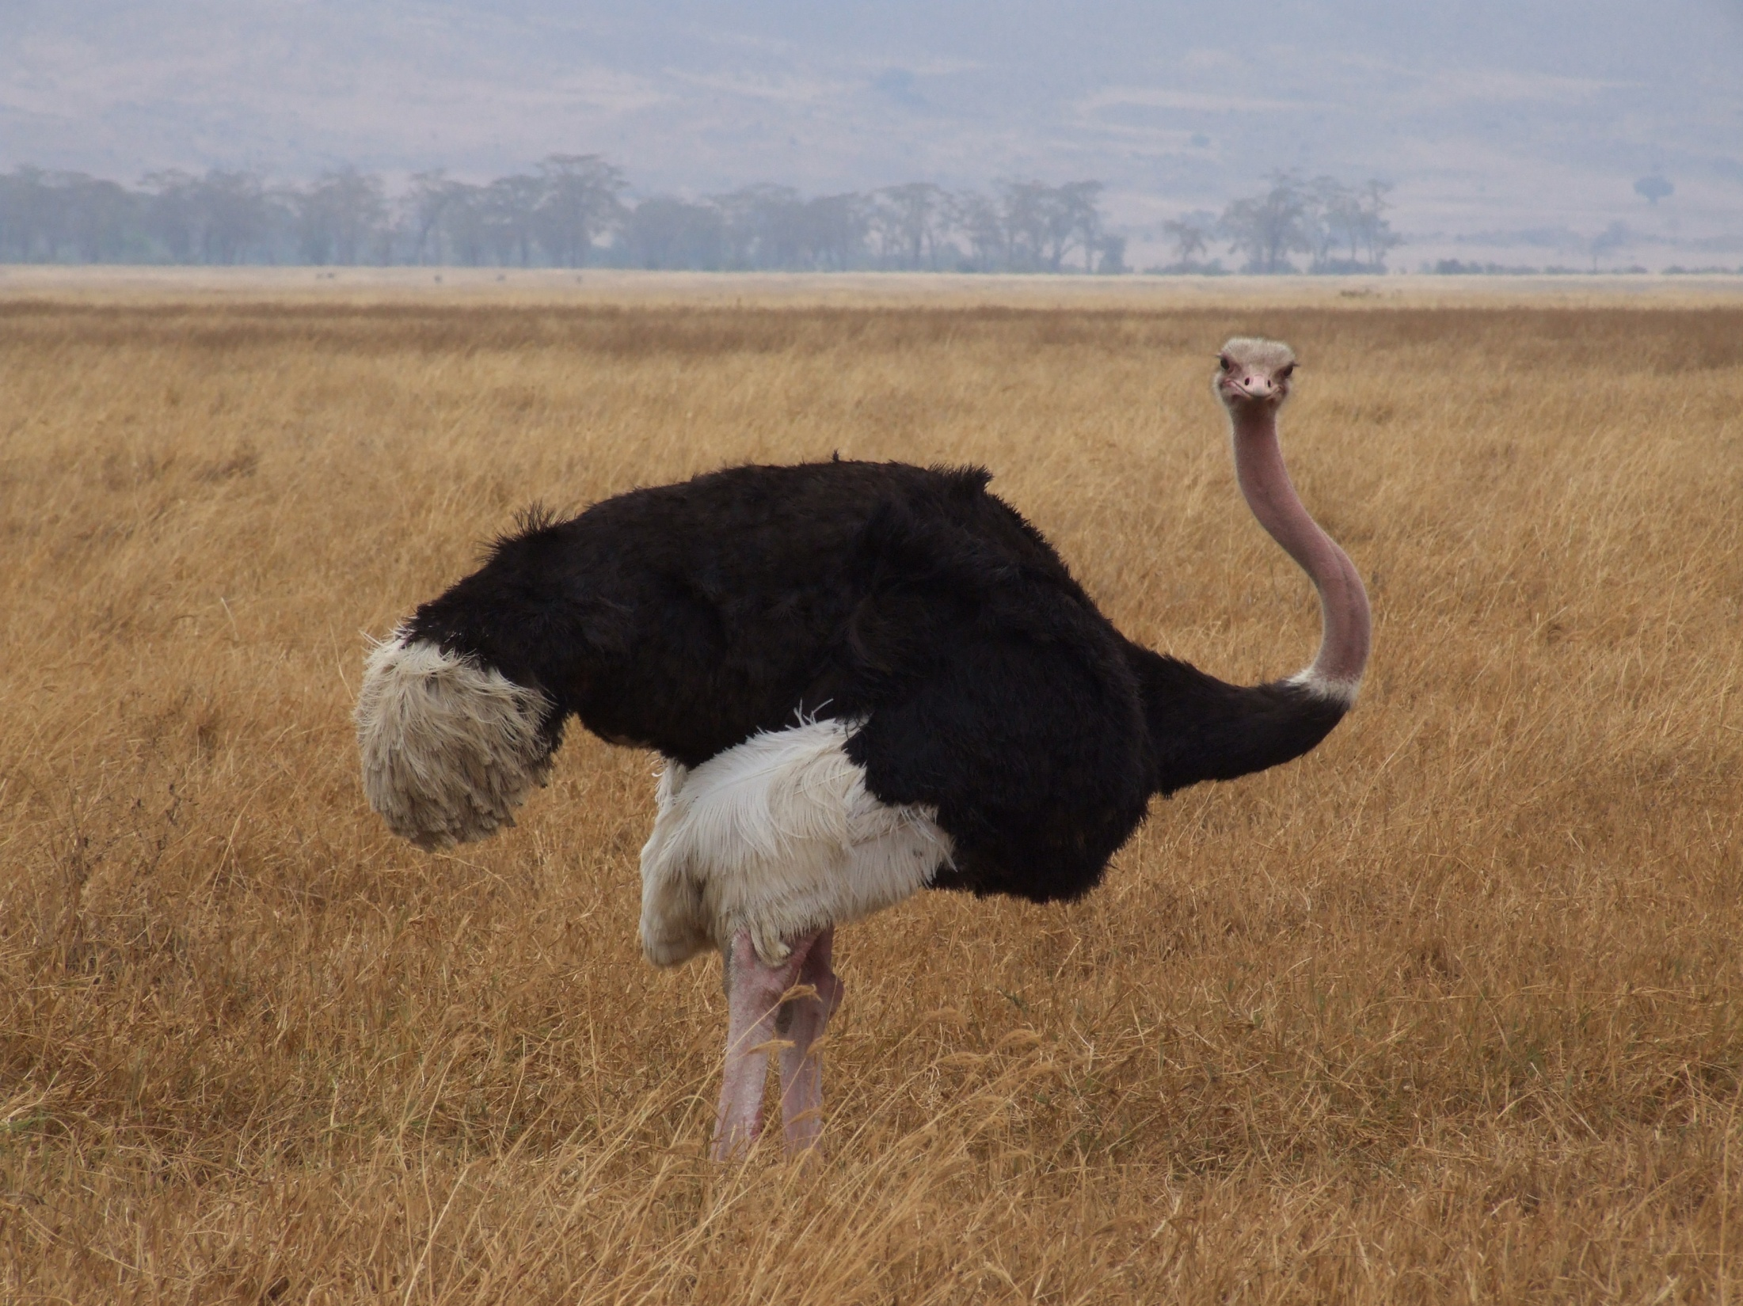
Ostrich

Slide 13
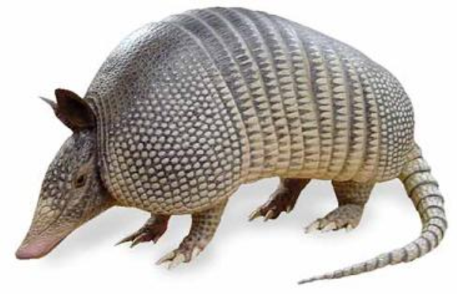
Armadillo

Slide 14
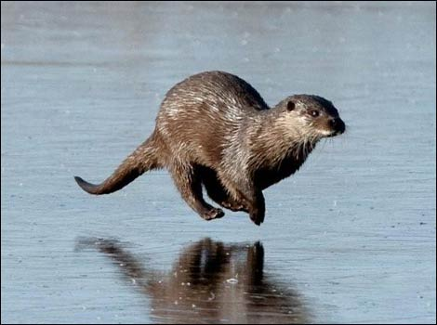
Otter

Slide 15
What is an adjective?
Describes a noun.
Noun = person, place, or thing.

Slide 16
The big, red dog.

Slide 17
Find the adjective:

Slide 18
1. The man is an old, ugly, and grey man.
2. Be careful by the scary, and large house.
3. Where are the delicious candies that I ordered?

Slide 19
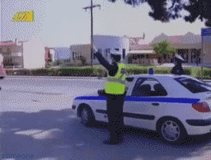
Good Job

Slide 20
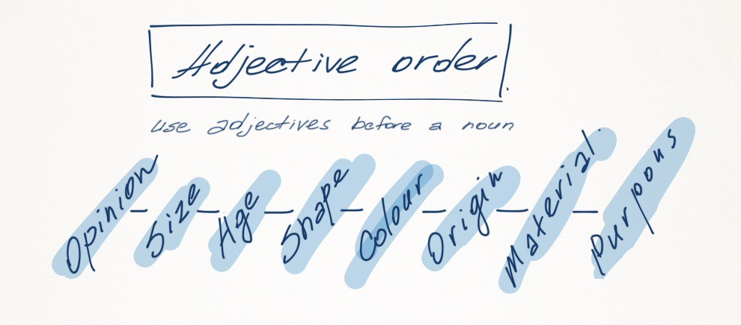

Slide 22
Opinion

Slide 23
Opinion
Best, Worst, Delicious, Beautiful, Horrible

Slide 24
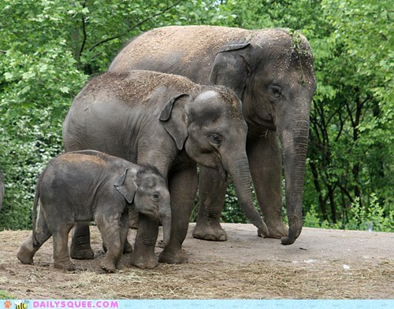
Size

Slide 25
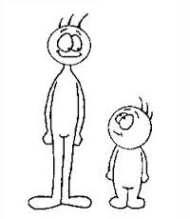

Slide 26
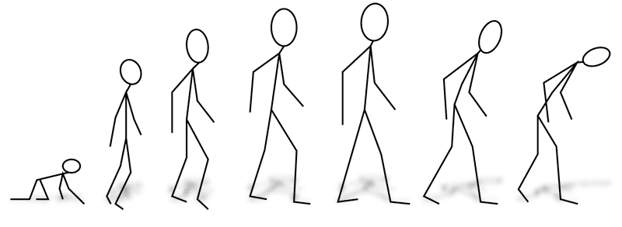
Age

Slide 27
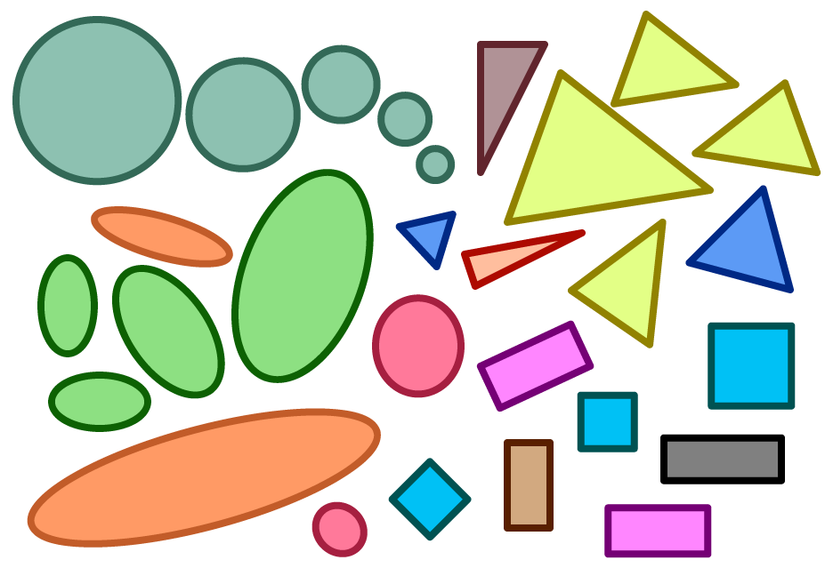
Shape

Slide 28
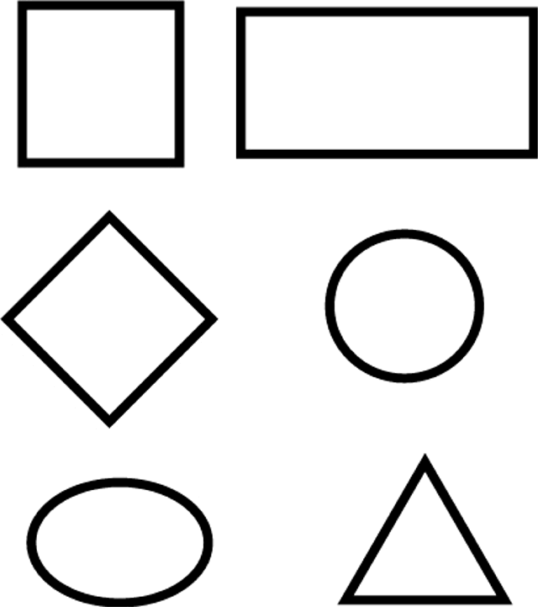
Shapes

Slide 29
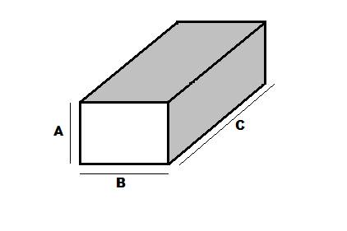
Rectangle = Rectangular

Slide 30
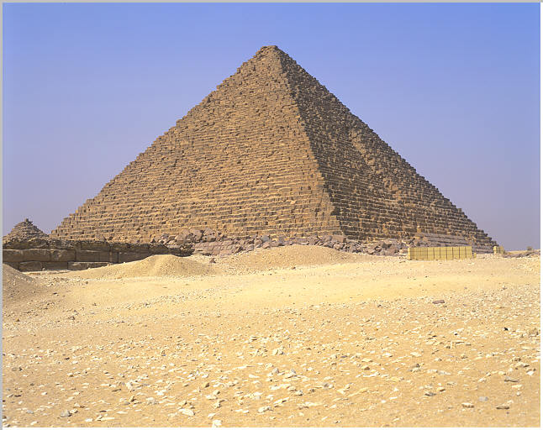
Triangle = Triangular

Slide 31
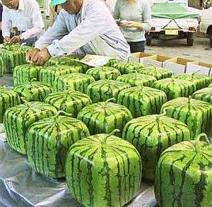
Square = Square

Slide 32
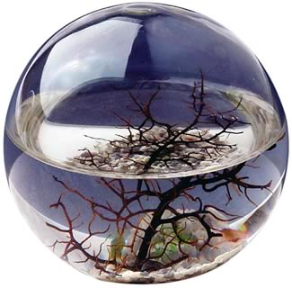
Circle = Round

Slide 33
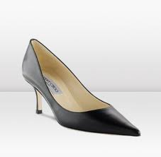
Pointy

Slide 34
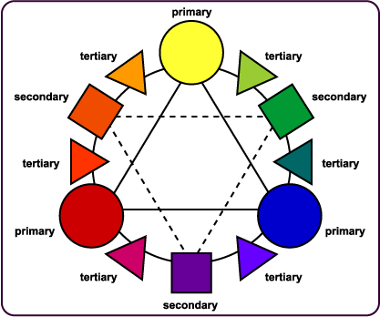

Slide 35
Color

Slide 36
Pink

Slide 37
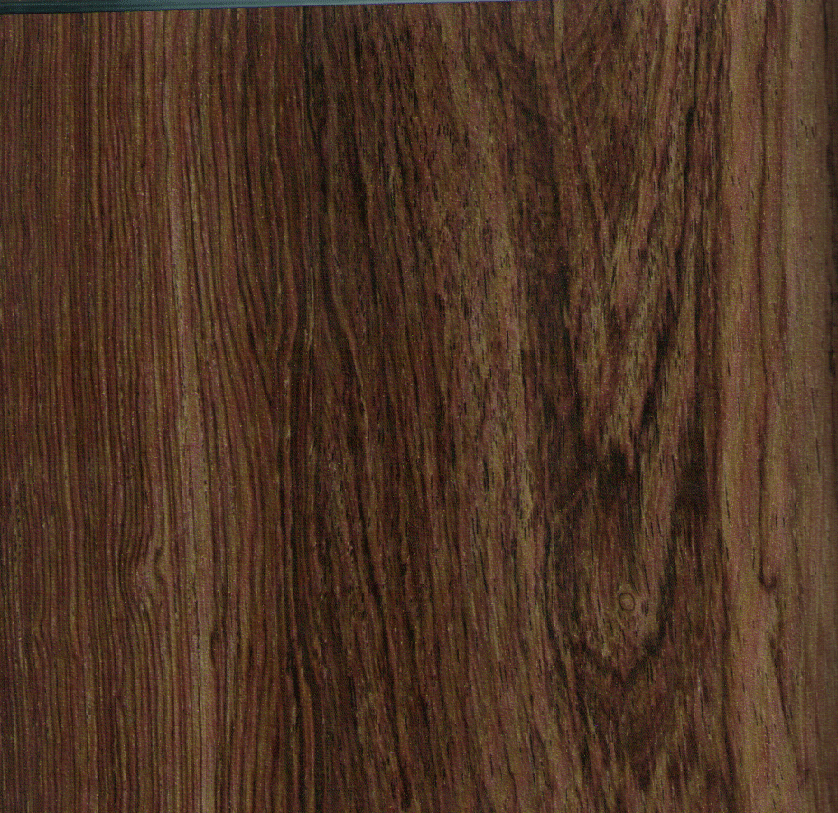
Brown

Slide 38
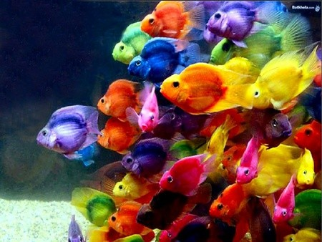
Colorful

Slide 39
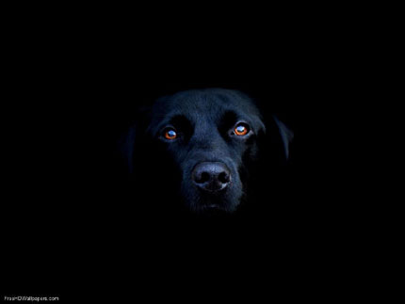
Black

Slide 40
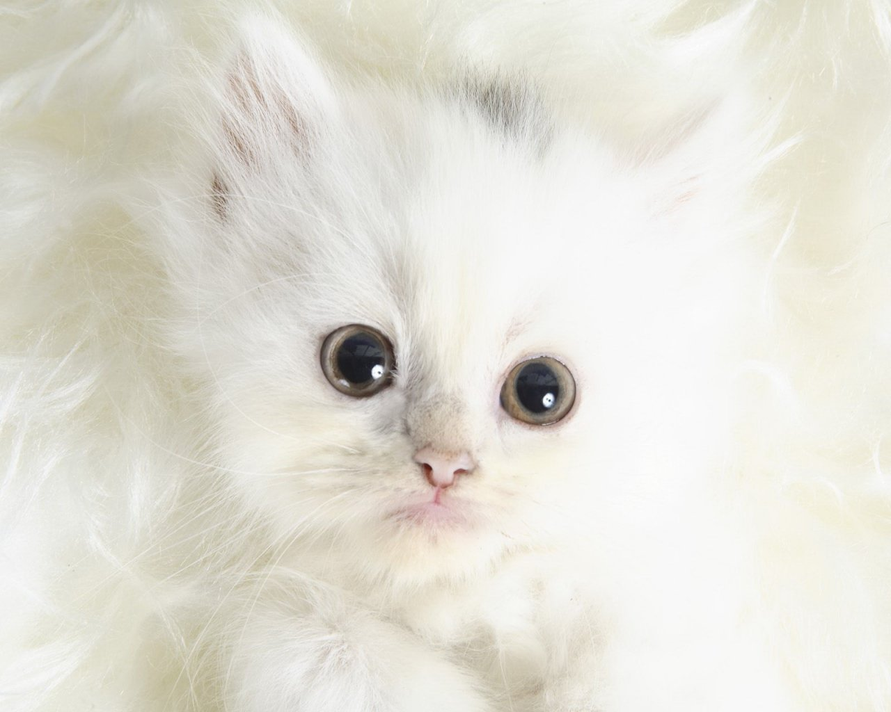
White

Slide 41
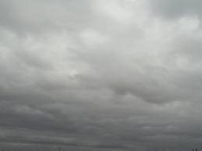
Grey

Slide 42
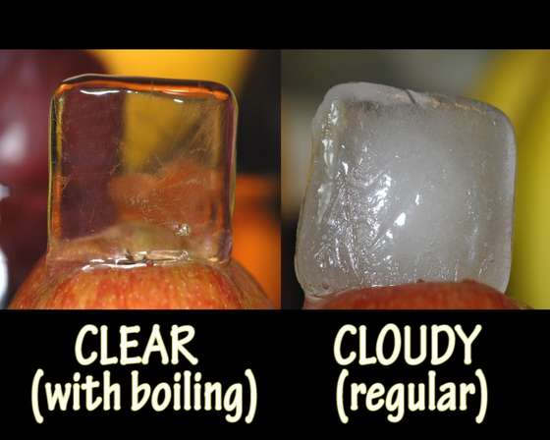

Slide 43
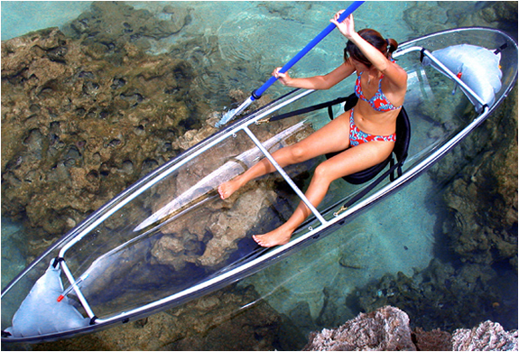
Clear

Slide 44
Origin

Slide 45
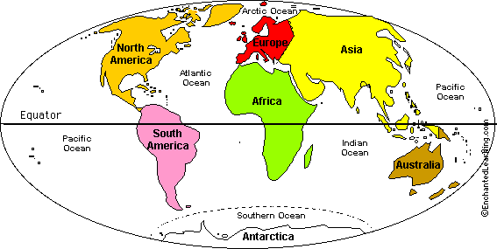

Slide 46
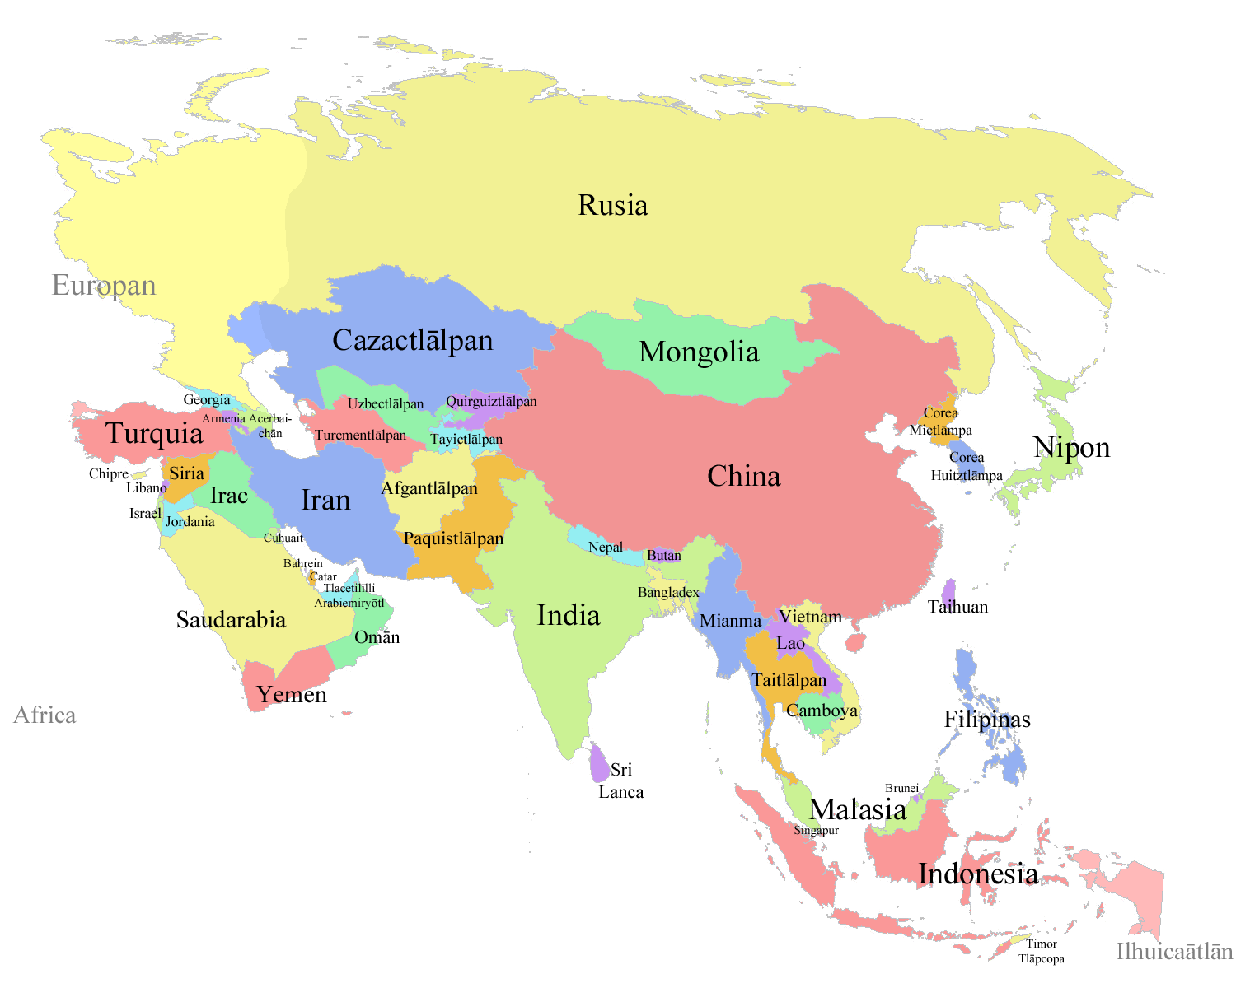
Asian

Slide 47
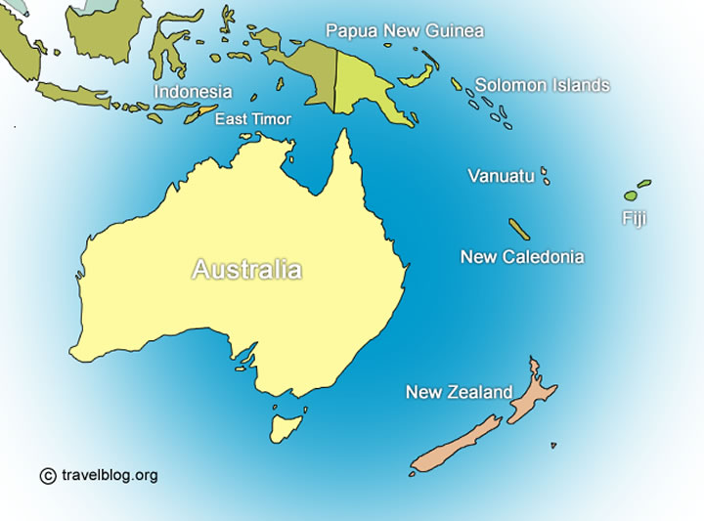
Australian

Slide 48
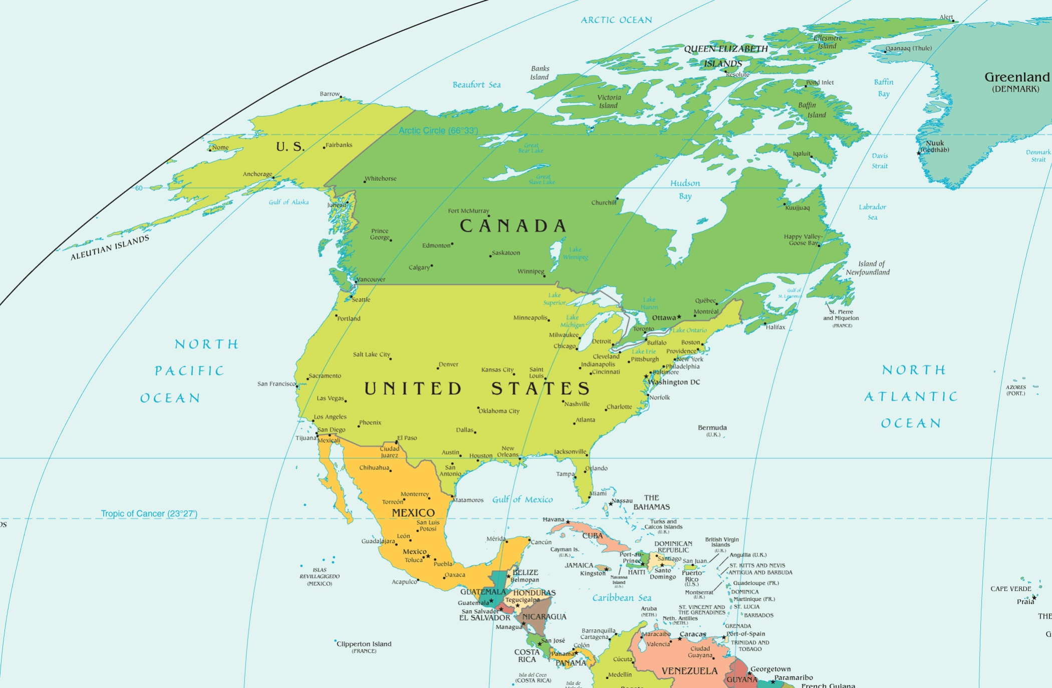
North American

Slide 49
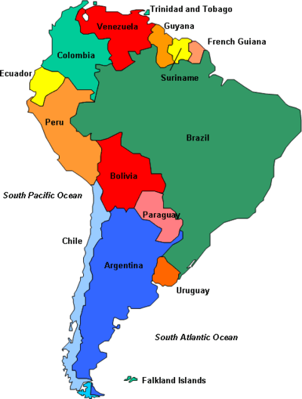
South American

Slide 50
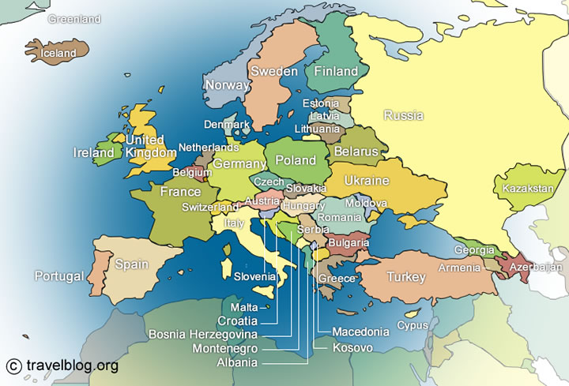
European

Slide 51
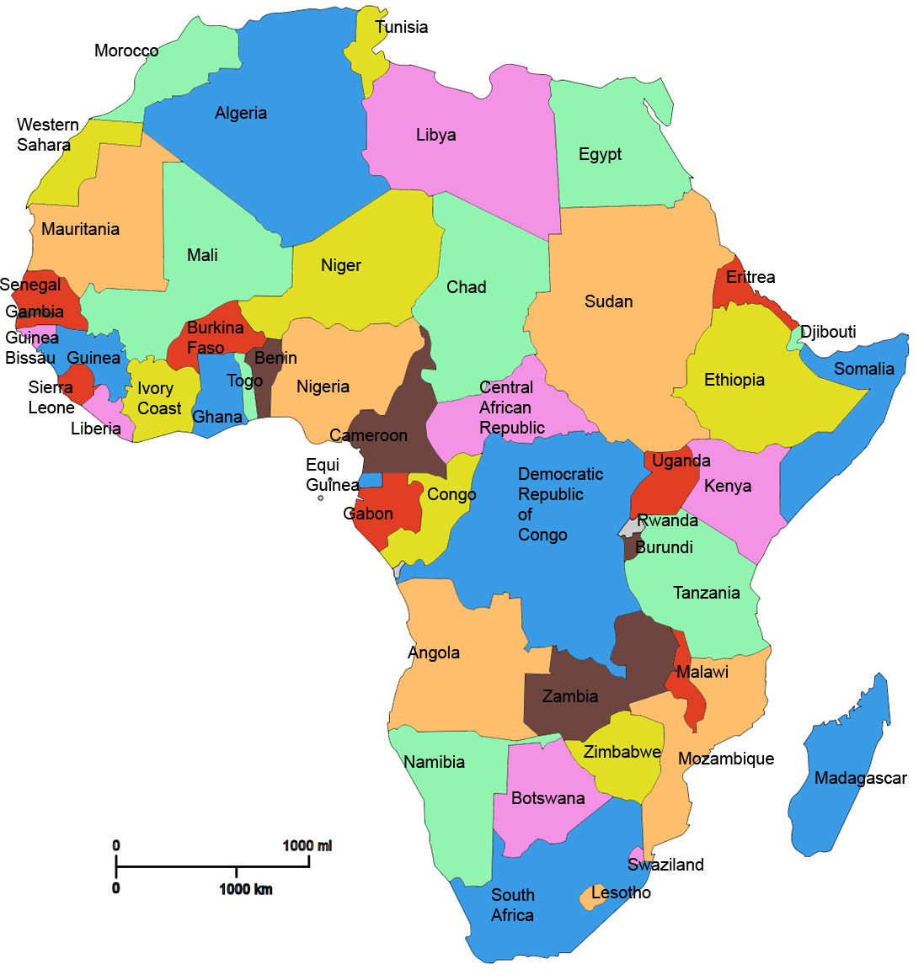
African

Slide 52
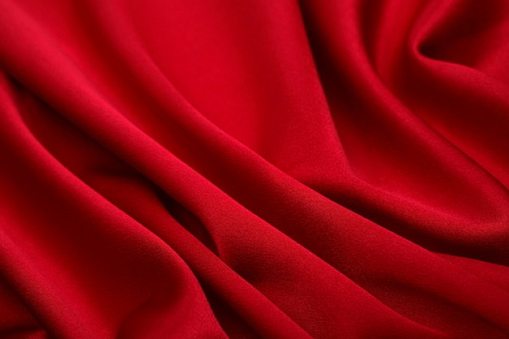
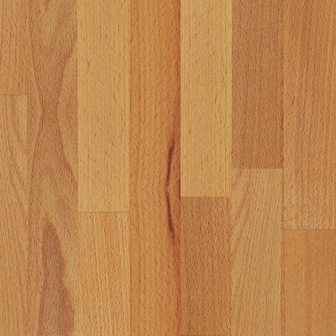
Material

Slide 53
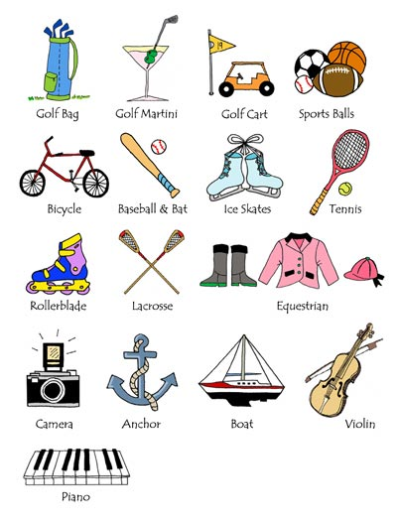
Purpose

Slide 54
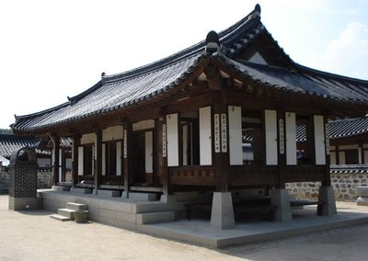
A hanok is an old, wooden, Korean house.
A hanok is a wooden, Korean, old house.

Slide 55
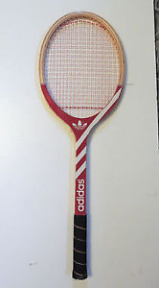
She uses a round, red wooden tennis racket.
She uses a tennis, round, red, wooden racket.

Slide 56
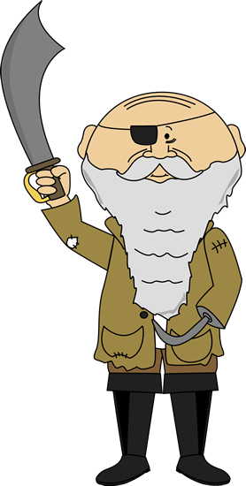
He was an ugly, tall, old, European Pirate
He was a tall, ugly, European, old pirate

Slide 57
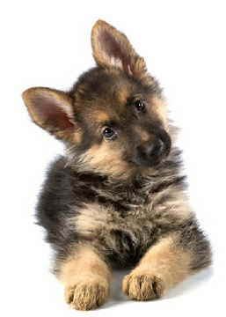
Look at that cute, tiny, young German Shepherd.
Look at that young, German, tiny, cute Shepherd

Slide 58
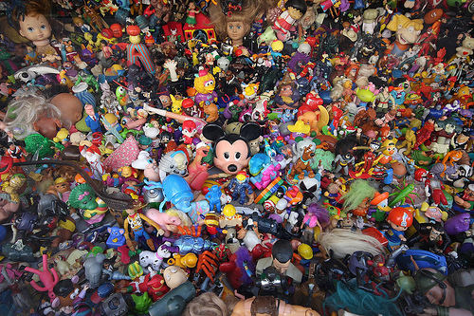
Eye Spy
Eye spy with my little eye, something that is...

Slide 59
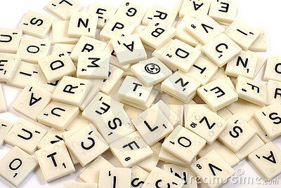
Letter and Adjective

Slide 60
Letters and Adjectives
One letter and a number of adjectives will be selected.
You must find the noun that makes sense.
First one gets the points.

Slide 61
Questions:

Slide 62
Opinion
Do you think it is ugly?
Is it beautiful?

Slide 63
Size
How big is it?
Is it small?

Slide 64
Age
How old is it?
Is it new?

Slide 65
Shape
What shape is it?
Is it pointy?
How many sides does it have?

Slide 66
Color
What color is it?
Is it blue?
Is it light / dark blue?

Slide 67
Origin
Where is it from?
Is it Korean?

Slide 68
Material
What is it made from?
Is it plastic?
Is it hard / soft?

Slide 69
Purpose
What is it used for?

Slide 70
Guessing Game
Ask questions to learn about the “noun”
Guess what it is.
Whoever guesses correctly gets to choose the next player.

Slide 71
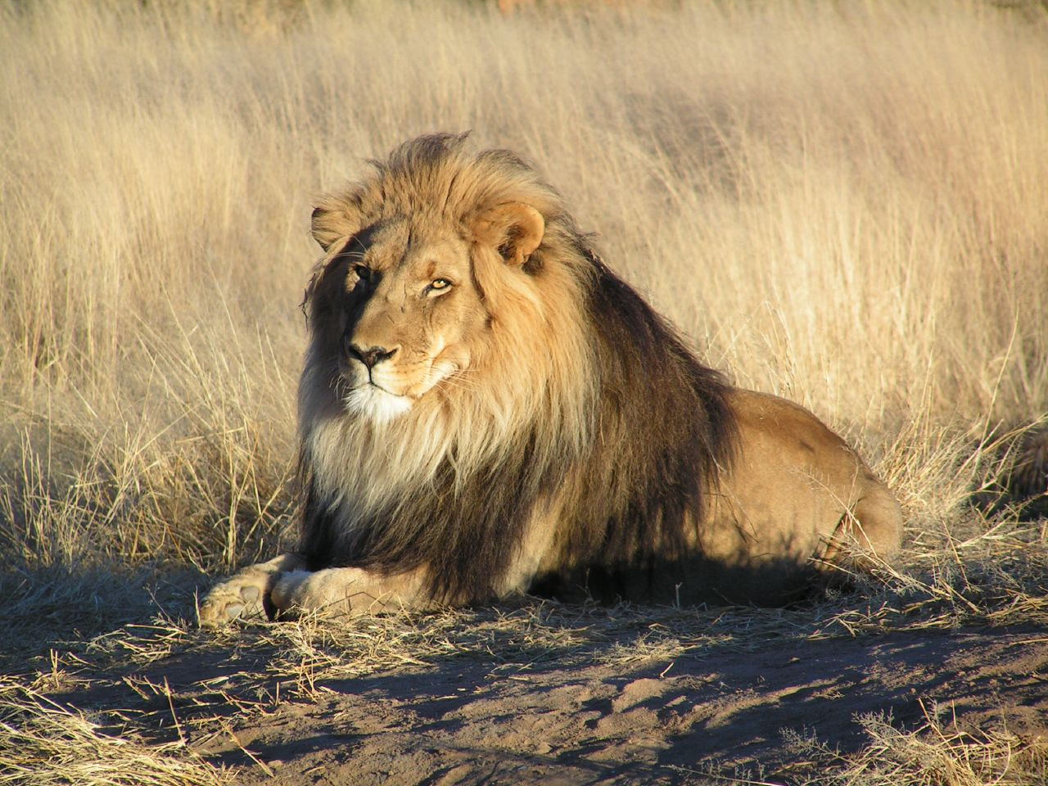

Slide 73
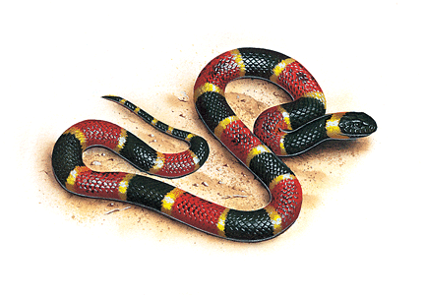

Slide 85
Scattegories
Partner game. (2 people)
Find an answer to the clues.
Answers used by other teams do not
count.

