Slide 1
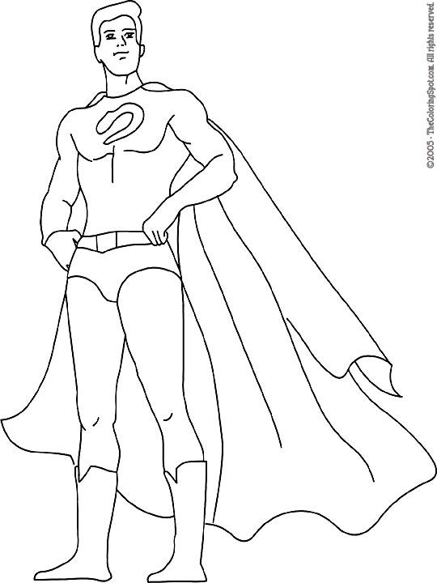
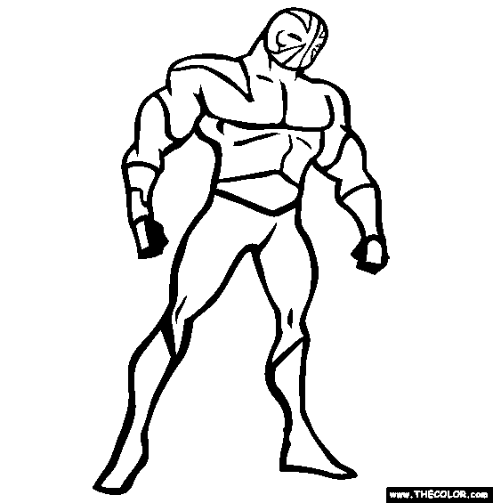
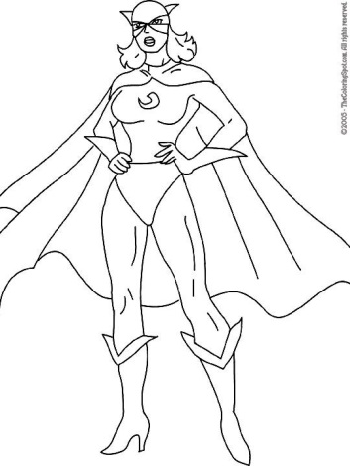
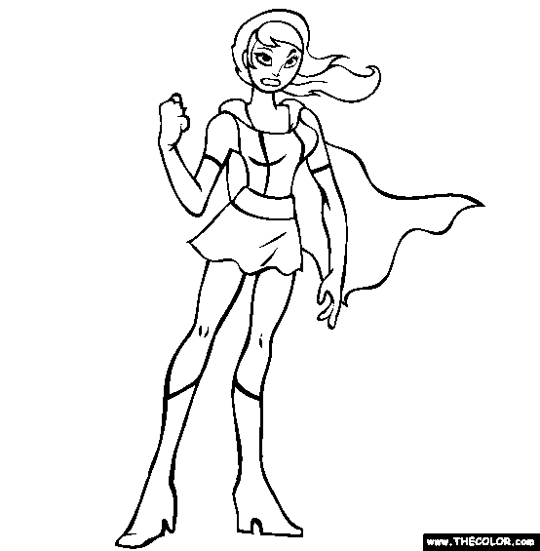
Hero name:
Hero name:
Hero name:
Hero name:
___ Size
___ Power
___ Speed
___ Intelligence
___ Magic
___ Charisma
___ Agility
___ Luck
___ Size
___ Power
___ Speed
___ Intelligence
___ Magic
___ Charisma
___ Agility
___ Luck
___ Size
___ Power
___ Speed
___ Intelligence
___ Magic
___ Charisma
___ Agility
___ Luck
___ Size
___ Power
___ Speed
___ Intelligence
___ Magic
___ Charisma
___ Agility
___ Luck
Hero name:
Hero name:
Hero name:
Hero name:
___ Size
___ Power
___ Speed
___ Intelligence
___ Magic
___ Charisma
___ Agility
___ Luck
___ Size
___ Power
___ Speed
___ Intelligence
___ Magic
___ Charisma
___ Agility
___ Luck
___ Size
___ Power
___ Speed
___ Intelligence
___ Magic
___ Charisma
___ Agility
___ Luck
___ Size
___ Power
___ Speed
___ Intelligence
___ Magic
___ Charisma
___ Agility
___ Luck

Slide 2
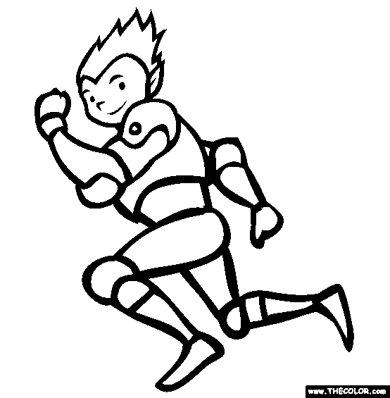
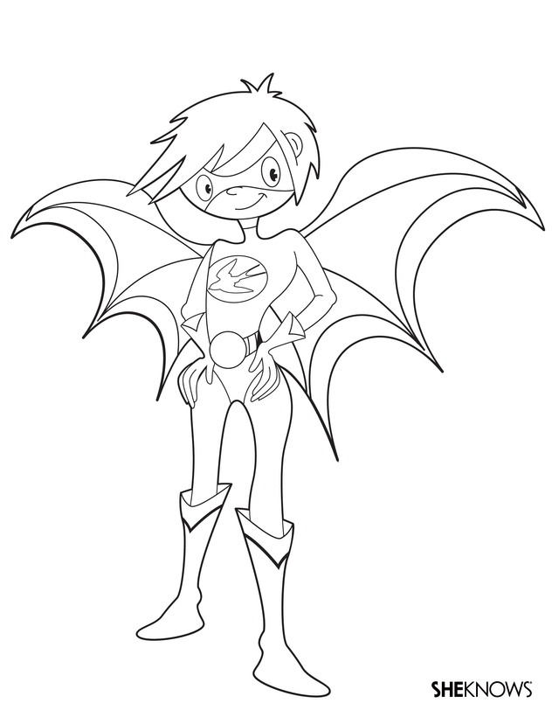
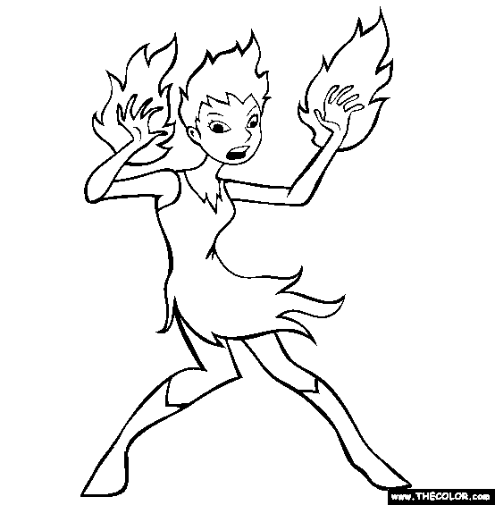
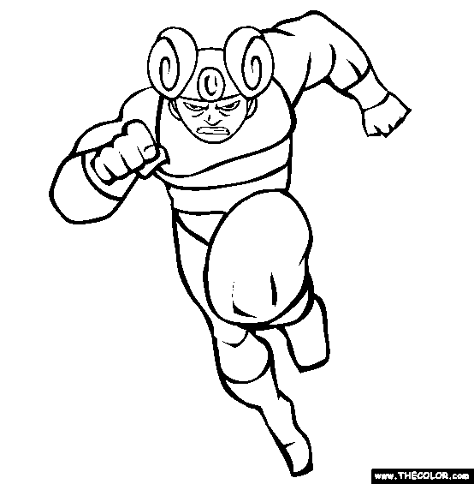
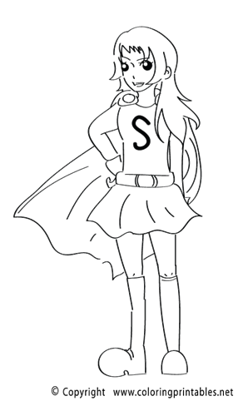
Hero name:
Hero name:
Hero name:
Hero name:
___ Size
___ Power
___ Speed
___ Intelligence
___ Magic
___ Charisma
___ Agility
___ Luck
___ Size
___ Power
___ Speed
___ Intelligence
___ Magic
___ Charisma
___ Agility
___ Luck
___ Size
___ Power
___ Speed
___ Intelligence
___ Magic
___ Charisma
___ Agility
___ Luck
___ Size
___ Power
___ Speed
___ Intelligence
___ Magic
___ Charisma
___ Agility
___ Luck
Hero name:
Hero name:
Hero name:
Hero name:
___ Size
___ Power
___ Speed
___ Intelligence
___ Magic
___ Charisma
___ Agility
___ Luck
___ Size
___ Power
___ Speed
___ Intelligence
___ Magic
___ Charisma
___ Agility
___ Luck
___ Size
___ Power
___ Speed
___ Intelligence
___ Magic
___ Charisma
___ Agility
___ Luck
___ Size
___ Power
___ Speed
___ Intelligence
___ Magic
___ Charisma
___ Agility
___ Luck

Slide 3
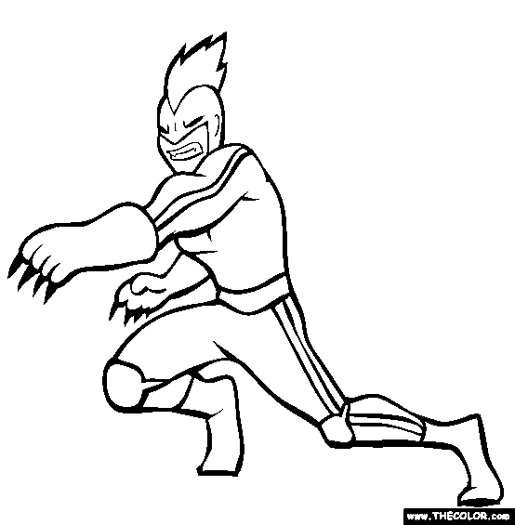
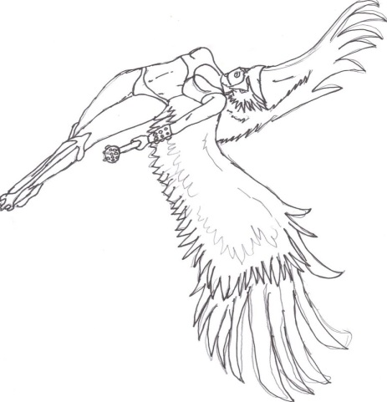
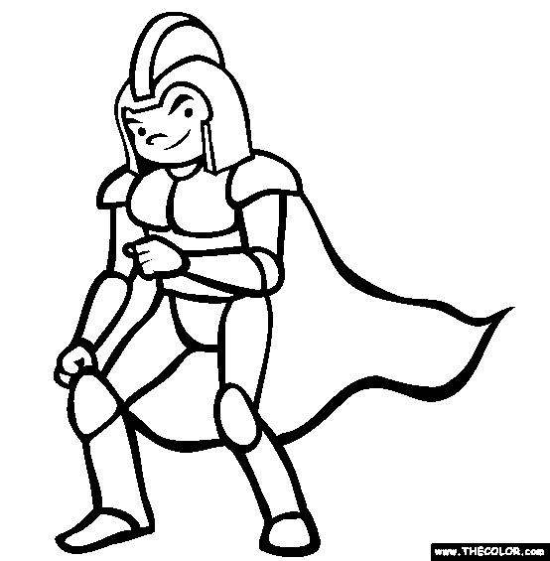
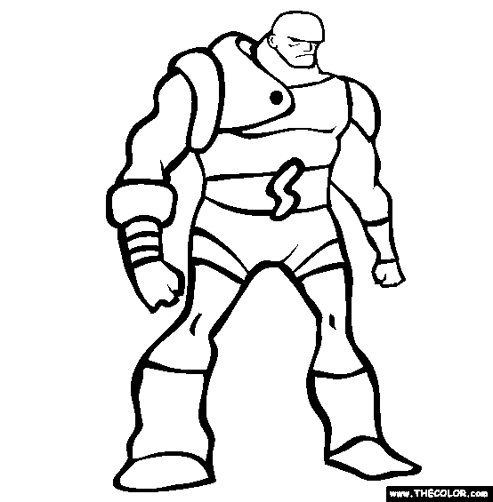
Hero name:
Hero name:
Hero name:
Hero name:
___ Size
___ Power
___ Speed
___ Intelligence
___ Magic
___ Charisma
___ Agility
___ Luck
___ Size
___ Power
___ Speed
___ Intelligence
___ Magic
___ Charisma
___ Agility
___ Luck
___ Size
___ Power
___ Speed
___ Intelligence
___ Magic
___ Charisma
___ Agility
___ Luck
___ Size
___ Power
___ Speed
___ Intelligence
___ Magic
___ Charisma
___ Agility
___ Luck
Hero name:
Hero name:
Hero name:
Hero name:
___ Size
___ Power
___ Speed
___ Intelligence
___ Magic
___ Charisma
___ Agility
___ Luck
___ Size
___ Power
___ Speed
___ Intelligence
___ Magic
___ Charisma
___ Agility
___ Luck
___ Size
___ Power
___ Speed
___ Intelligence
___ Magic
___ Charisma
___ Agility
___ Luck
___ Size
___ Power
___ Speed
___ Intelligence
___ Magic
___ Charisma
___ Agility
___ Luck

Slide 4
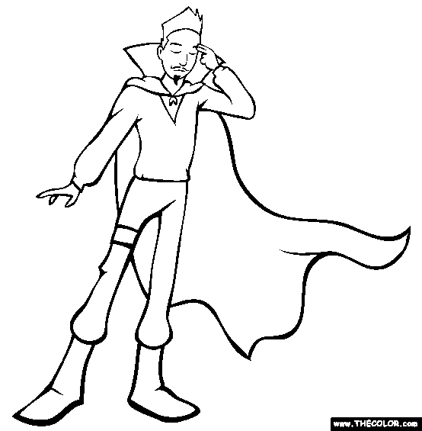
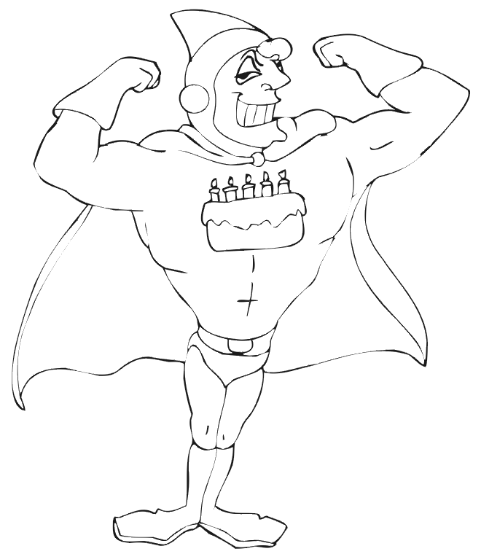
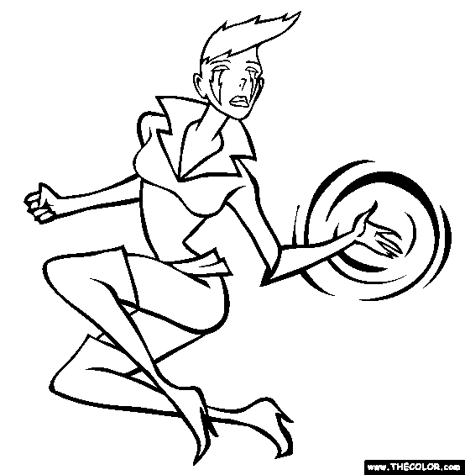
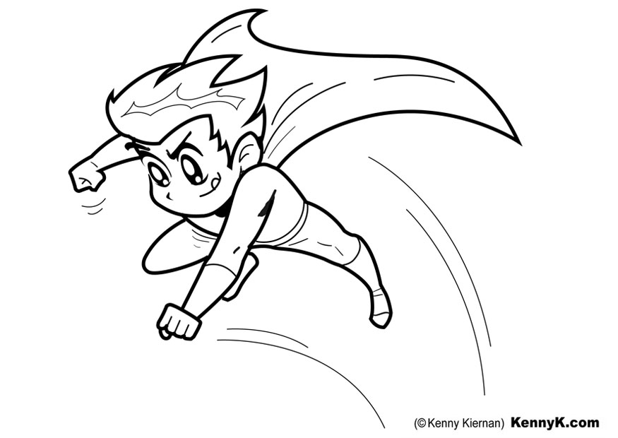
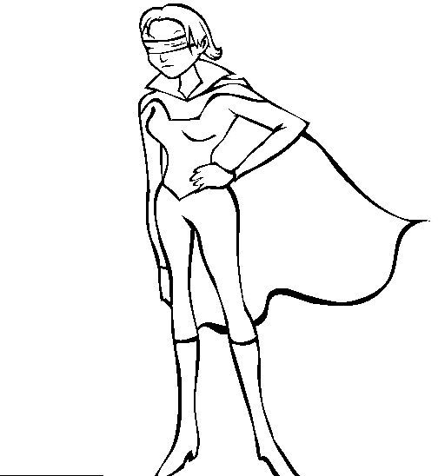
Hero name:
Hero name:
Hero name:
Hero name:
___ Size
___ Power
___ Speed
___ Intelligence
___ Magic
___ Charisma
___ Agility
___ Luck
___ Size
___ Power
___ Speed
___ Intelligence
___ Magic
___ Charisma
___ Agility
___ Luck
___ Size
___ Power
___ Speed
___ Intelligence
___ Magic
___ Charisma
___ Agility
___ Luck
___ Size
___ Power
___ Speed
___ Intelligence
___ Magic
___ Charisma
___ Agility
___ Luck
Hero name:
Hero name:
Hero name:
Hero name:
___ Size
___ Power
___ Speed
___ Intelligence
___ Magic
___ Charisma
___ Agility
___ Luck
___ Size
___ Power
___ Speed
___ Intelligence
___ Magic
___ Charisma
___ Agility
___ Luck
___ Size
___ Power
___ Speed
___ Intelligence
___ Magic
___ Charisma
___ Agility
___ Luck
___ Size
___ Power
___ Speed
___ Intelligence
___ Magic
___ Charisma
___ Agility
___ Luck

