Slide 1
Comparatives
… and superlatives

Slide 2
Consonant vs Vowel

Slide 3
Vowels

Slide 4
The Shortest Poem
Notes:
https://www.youtube.com/watch?v=6F7quI-MbzY

Slide 5
Consonants

Slide 6
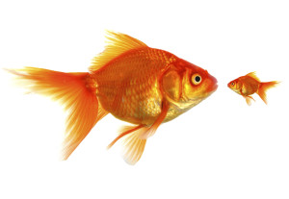
Comparatives

Slide 7
Comparatives
Adjective + “er”

Slide 8
Comparative Rules
Ends with consonant
Ends with vowel
Ends in “y”
Consonant + vowel + consonant
- er
- r
- ier
- 1 more consonant + er

Slide 9
Comparative Rules
Longer words (3* + syllables)
Irregular Comparatives
-more + adjective
- Various

Slide 10
Adjectives -> Comparatives
Tall
Hard
Wide
Blue
Taller
Harder
Wider
Bluer

Slide 11
Adjectives -> Comparatives
Skinny
Fuzzy
Big
Fat
Skinnier
Fuzzier
Bigger
Fatter

Slide 12
Adjectives -> Comparatives
Colorful
Dangerous
Good
Bad
Many
Far
More colorful
More dangerous
Better
Worse
More
Farther / further

Slide 13
______ is (comparative) than ______.

Slide 14
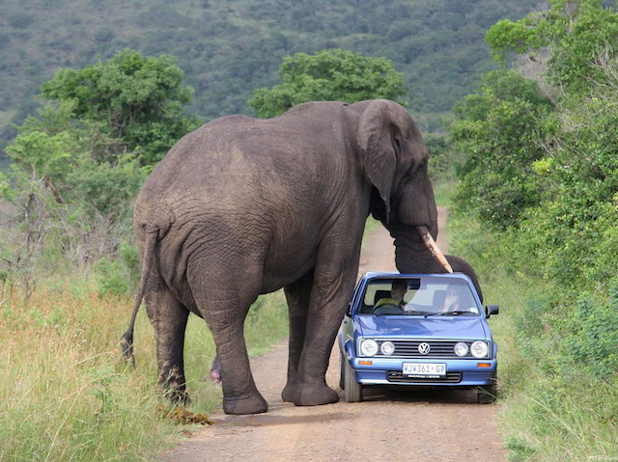

Slide 15
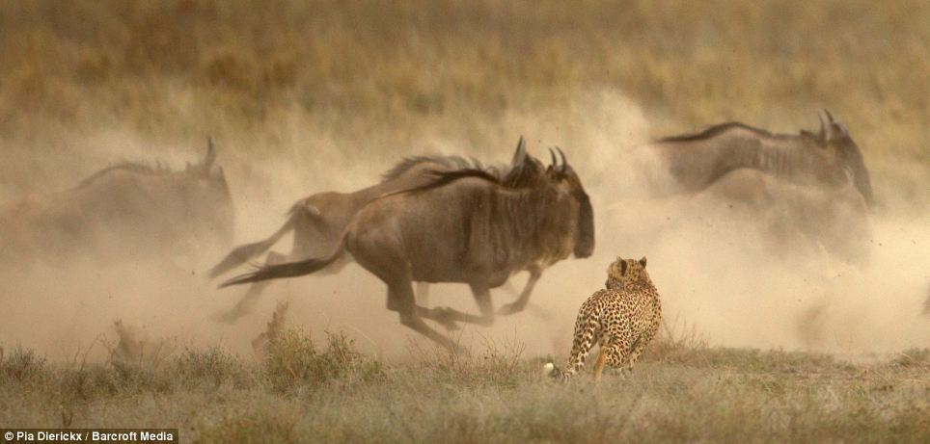

Slide 16
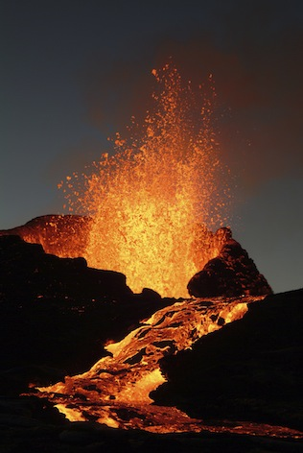
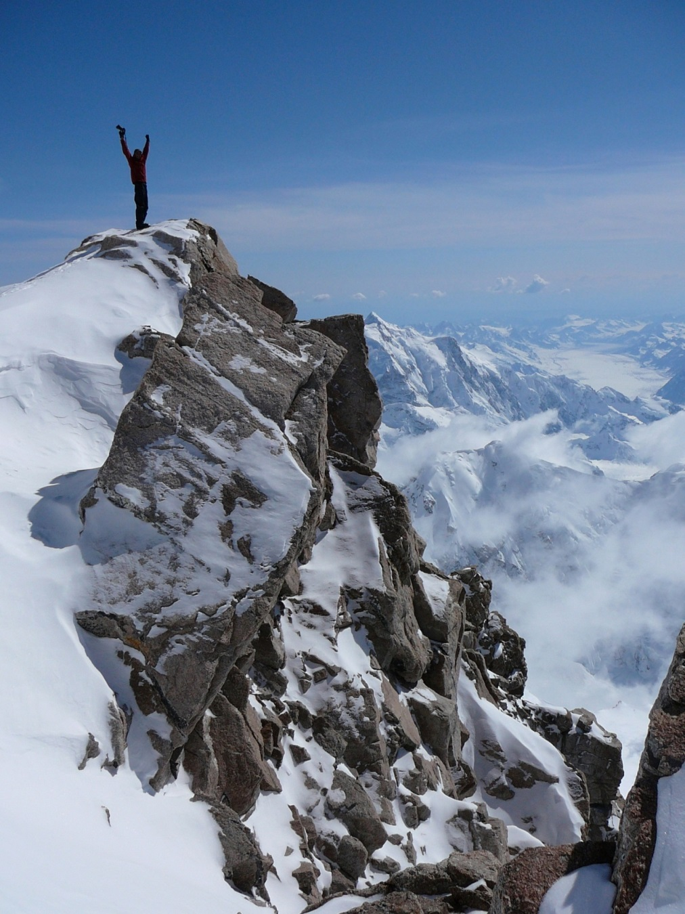

Slide 17
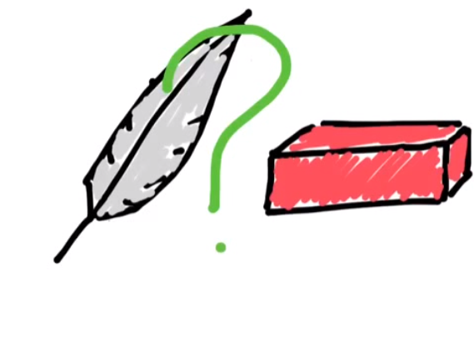

Slide 18
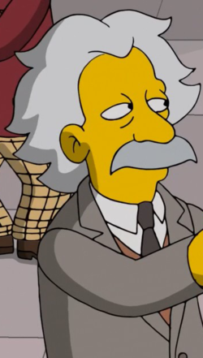

Slide 20
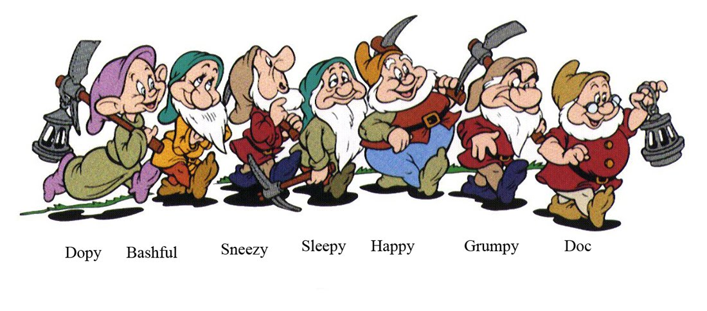
Feeling Adjectives:
Happy
Sad
Angry
Hot
Cold

Slide 21
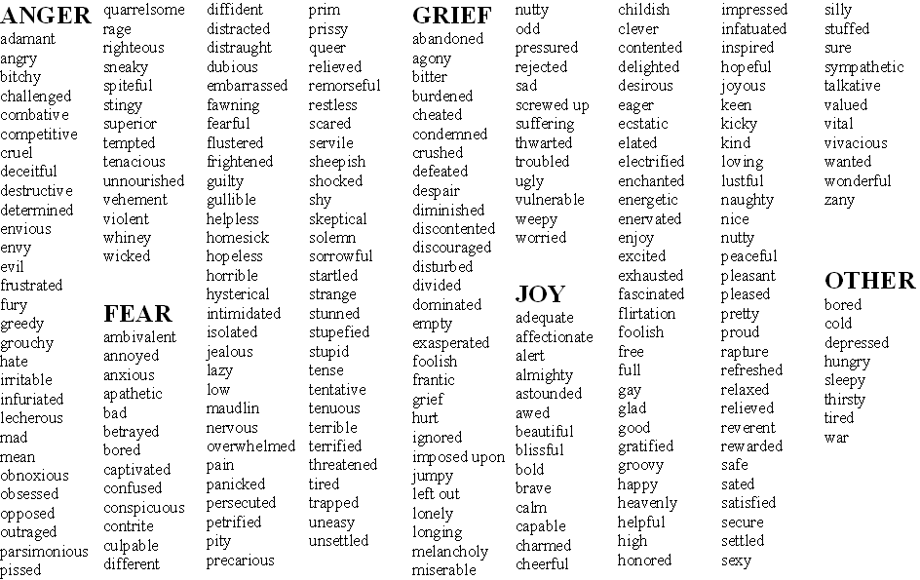

Slide 23
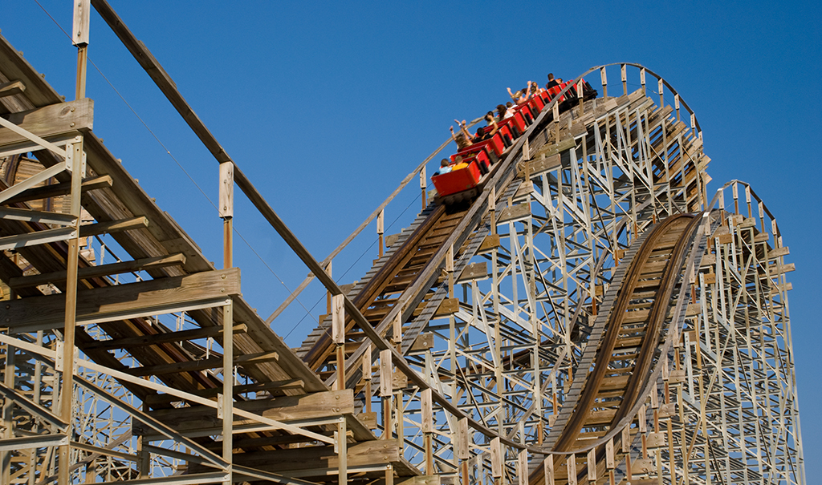
Funny vs Fun

Slide 24
Superlatives

Slide 25
Superlatives
Adjective + “est”

Slide 26
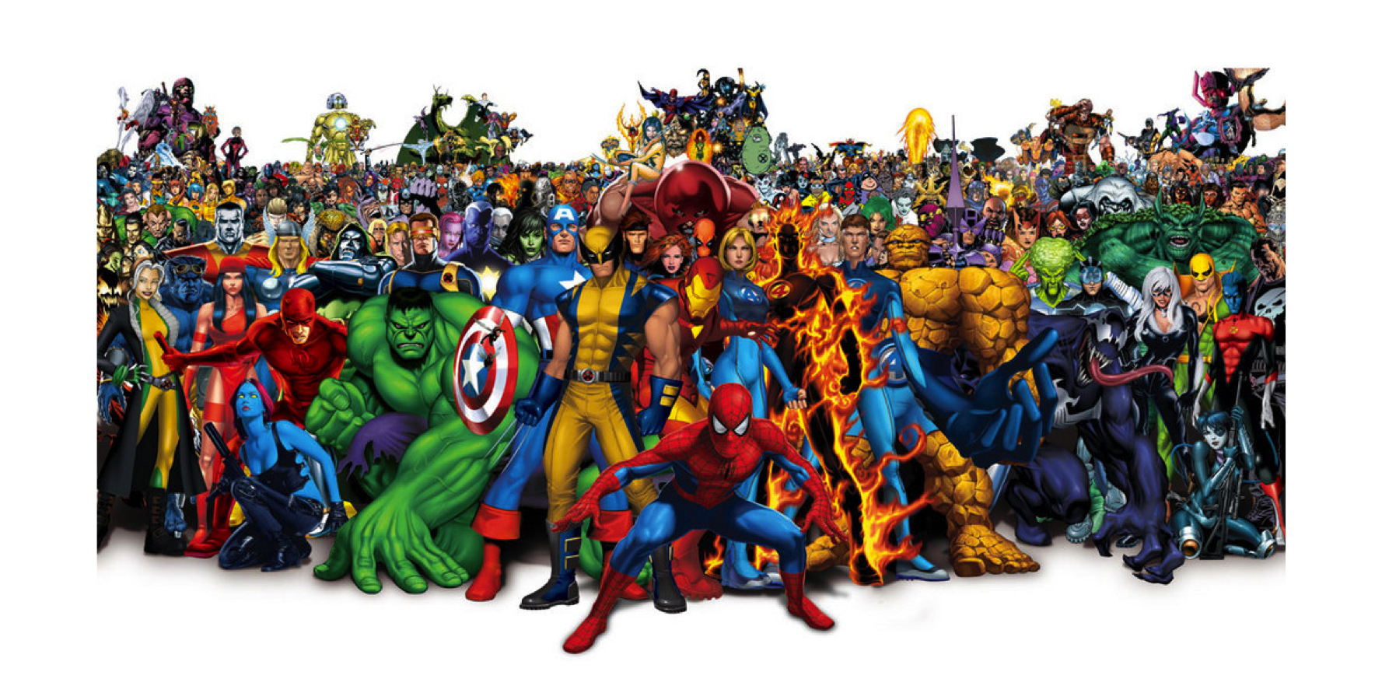
Comparative vs Superlative

Slide 27
Comparative vs Superlative
Use a comparative
Use a superlative
- Comparing two things
- Comparing more than two things.

Slide 28
Superlative Rules
Ends with consonant
Ends with vowel
Ends in “y”
Consonant + vowel + consonant
- est
- st
- iest
- 1 more consonant + est

Slide 29
Superlative Rules
Longer words (3* + syllables)
Irregular Superlatives
- most + adjective
- Various

Slide 30
Adjectives -> Superlative
Tall
Hard
Wide
Blue
Taller
Harder
Wider
Bluer
Tallest
Hardest
Widest
Bluest

Slide 31
Adjectives -> Superlative
Skinny
Fuzzy
Big
Fat
Skinnier
Fuzzier
Bigger
Fatter
Skinniest
Fuzziest
Biggest
Fattest

Slide 32
Adjectives -> Superlative
Colorful
Dangerous
Good
Bad
Many
Far
More colorful
More dangerous
Better
Worse
More
Farther / further
Most colorful
Most dangerous
Best
Worst
Most
Farthest / furthest

Slide 33
______ is the (superlative).

Slide 34
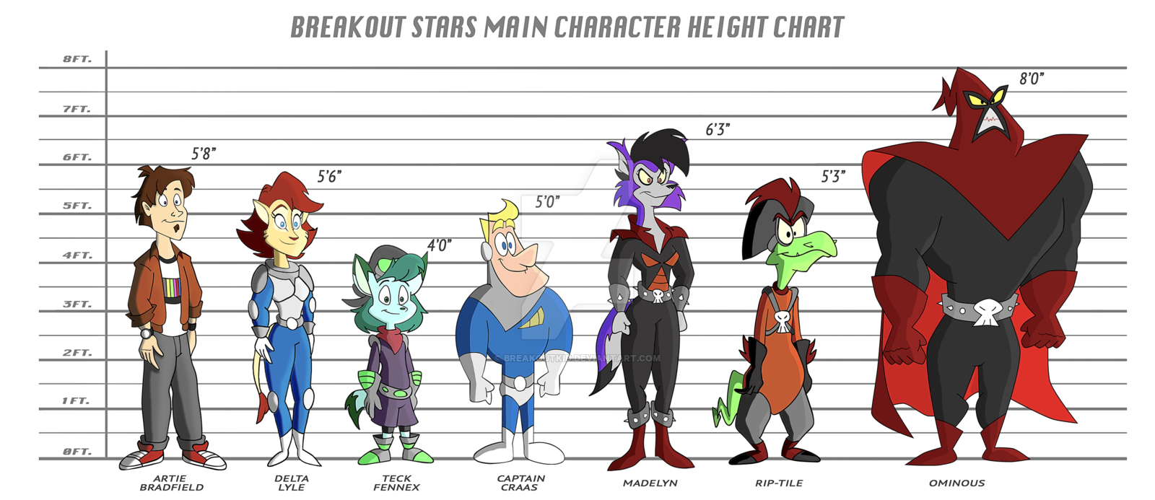
Artie
Delta
Teck
Captain
Crass
Madelyn
Rip-tile
Ominous

Slide 35
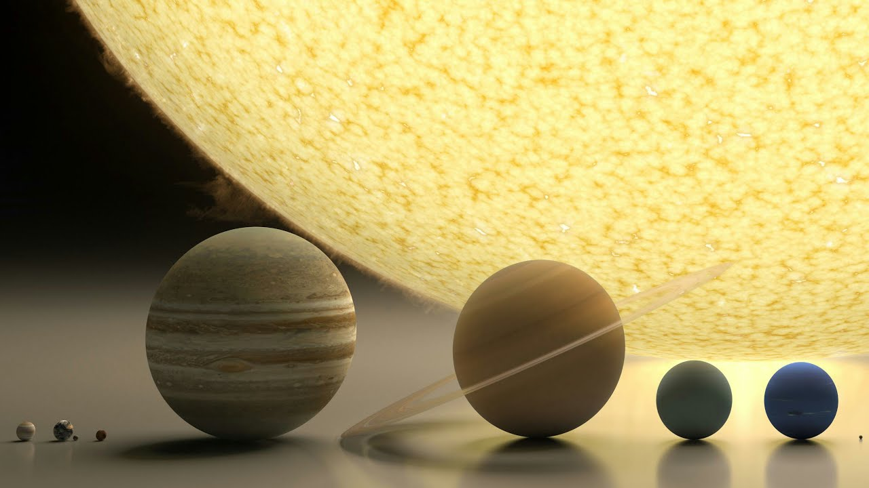

Slide 36
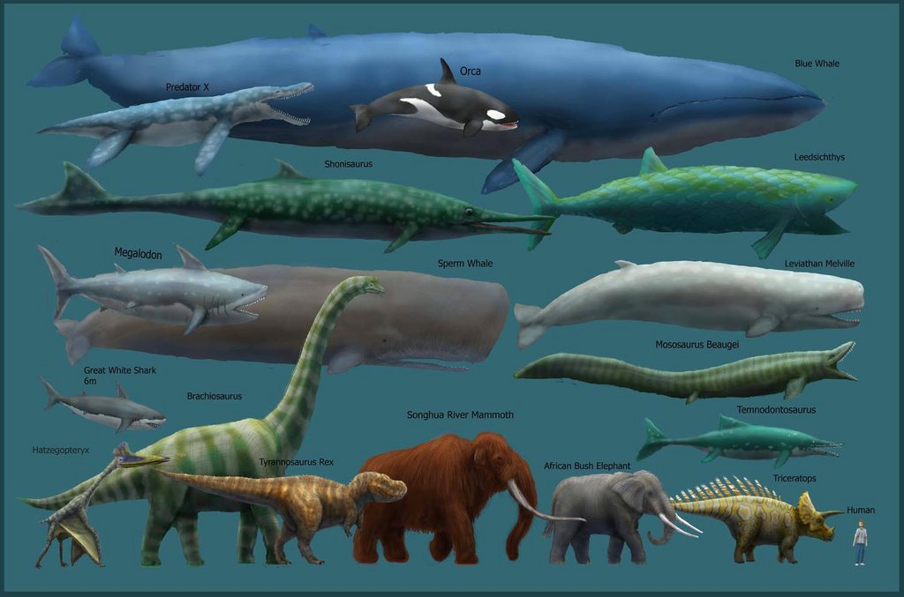

Slide 37
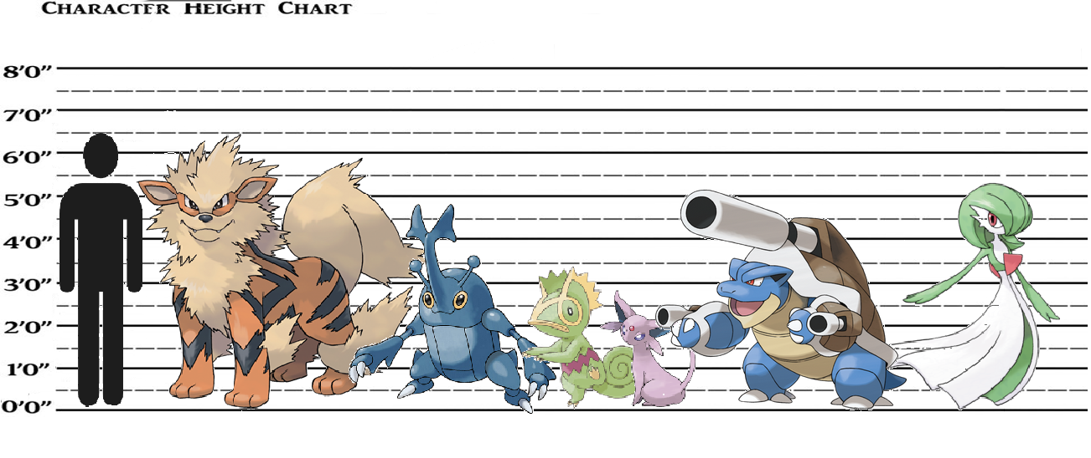
Arcanine
Heracross
Espeon
Gardevoir
Kecleon
Blastoise

Slide 38
Comparatives Game

Slide 39
Game
Speed
Power
Size
Intelligence
Fast, Faster, Fastest
Strong, Stronger, Strongest
Big, Bigger, Biggest
Smart, Smarter, Smartest

Slide 40
Game
Magic
Charisma
Agility
Luck
Magical, More magical, Most magical
Charismatic, More charismatic, Most charismatic
Agile, more agile, most agile
Lucky, luckier, luckiest

Slide 41
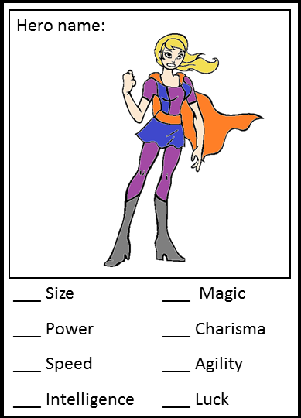
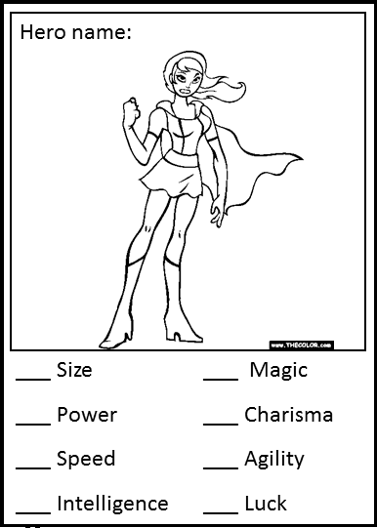
Prepare
Take 4 cards
3 pictures, one blank.
Give your character traits:
100 total points
You can divide it however, you’d like.
Cut and Color (optional)
Same time .
10
5
25
30
0
20
5
5

Slide 42
How to Play
Choose a card
Put it upside down on the table
Rock, Paper, Scissors
Choose a trait
Speed, Size, Power, Intelligence, etc.
Show your card
Same time .
Make a sentence + The winner takes the card

Slide 43
Make a Sentence
If they don’t make a sentence, you don’t have to give them your card.
I am ________er than you.
I am the _________est.

