Slide 1
Comparatives
… and superlatives

Slide 2
Consonant vs Vowel

Slide 3
Vowels

Slide 4
The Shortest Poem
Notes:
https://www.youtube.com/watch?v=6F7quI-MbzY

Slide 5
Consonants

Slide 6
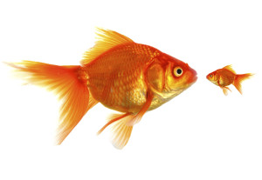
Comparatives

Slide 7
Comparatives
Adjective + “er”

Slide 8
Comparative Rules
Ends with consonant
Ends with vowel
Ends in “y”
Consonant + vowel + consonant
- er
- r
- ier
- 1 more consonant + er

Slide 9
Comparative Rules
Longer words (3* + syllables)
Irregular Comparatives
-more + adjective
- Various

Slide 10
Adjectives -> Comparatives
Tall
Straight
Blue
Nice
Taller
Straighter
Bluer
Nicer

Slide 11
Adjectives -> Comparatives
Happy
Tiny
Big
Fat
Happier
Tinier
Bigger
Fatter

Slide 12
Adjectives -> Comparatives
Colorful
Spherical
Good
Bad
Many
More colorful
More spherical
Better
Worse
More

Slide 13
______ is (comparative) than ______.

Slide 14
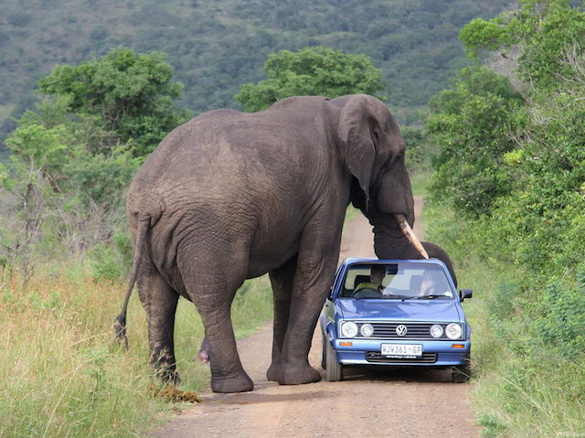

Slide 15
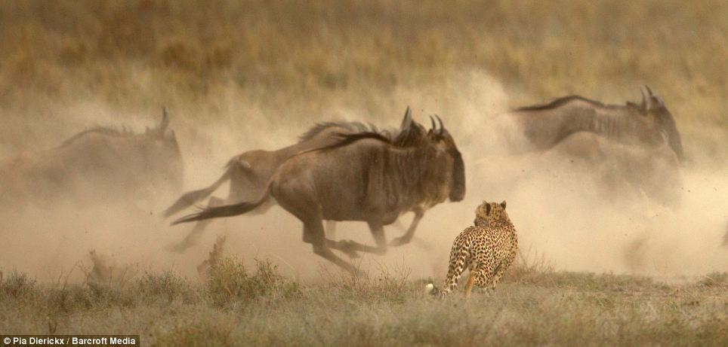

Slide 16
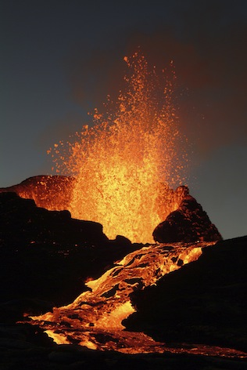
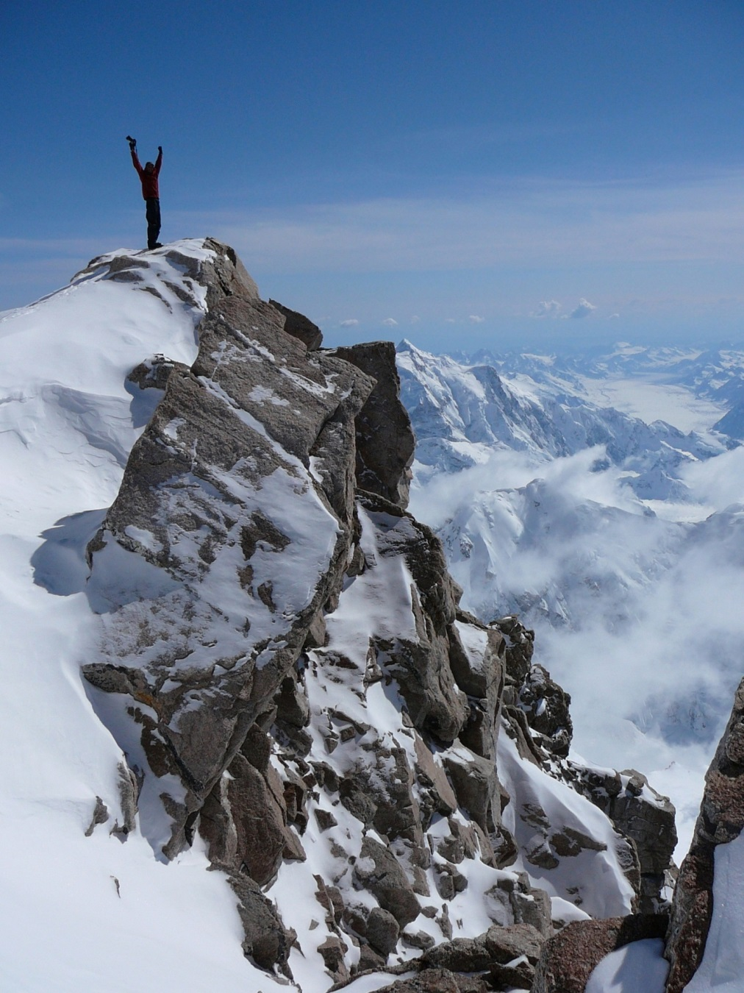

Slide 17
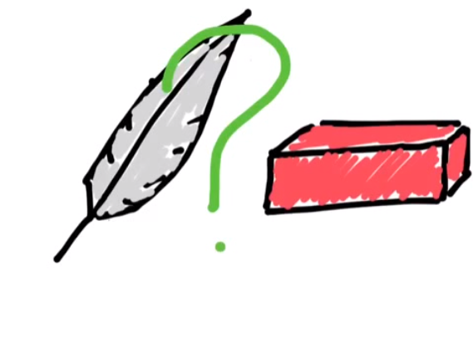

Slide 18
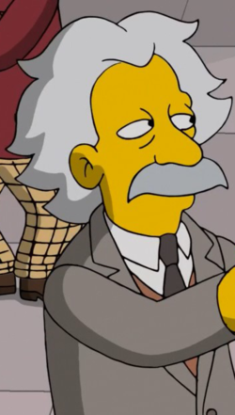
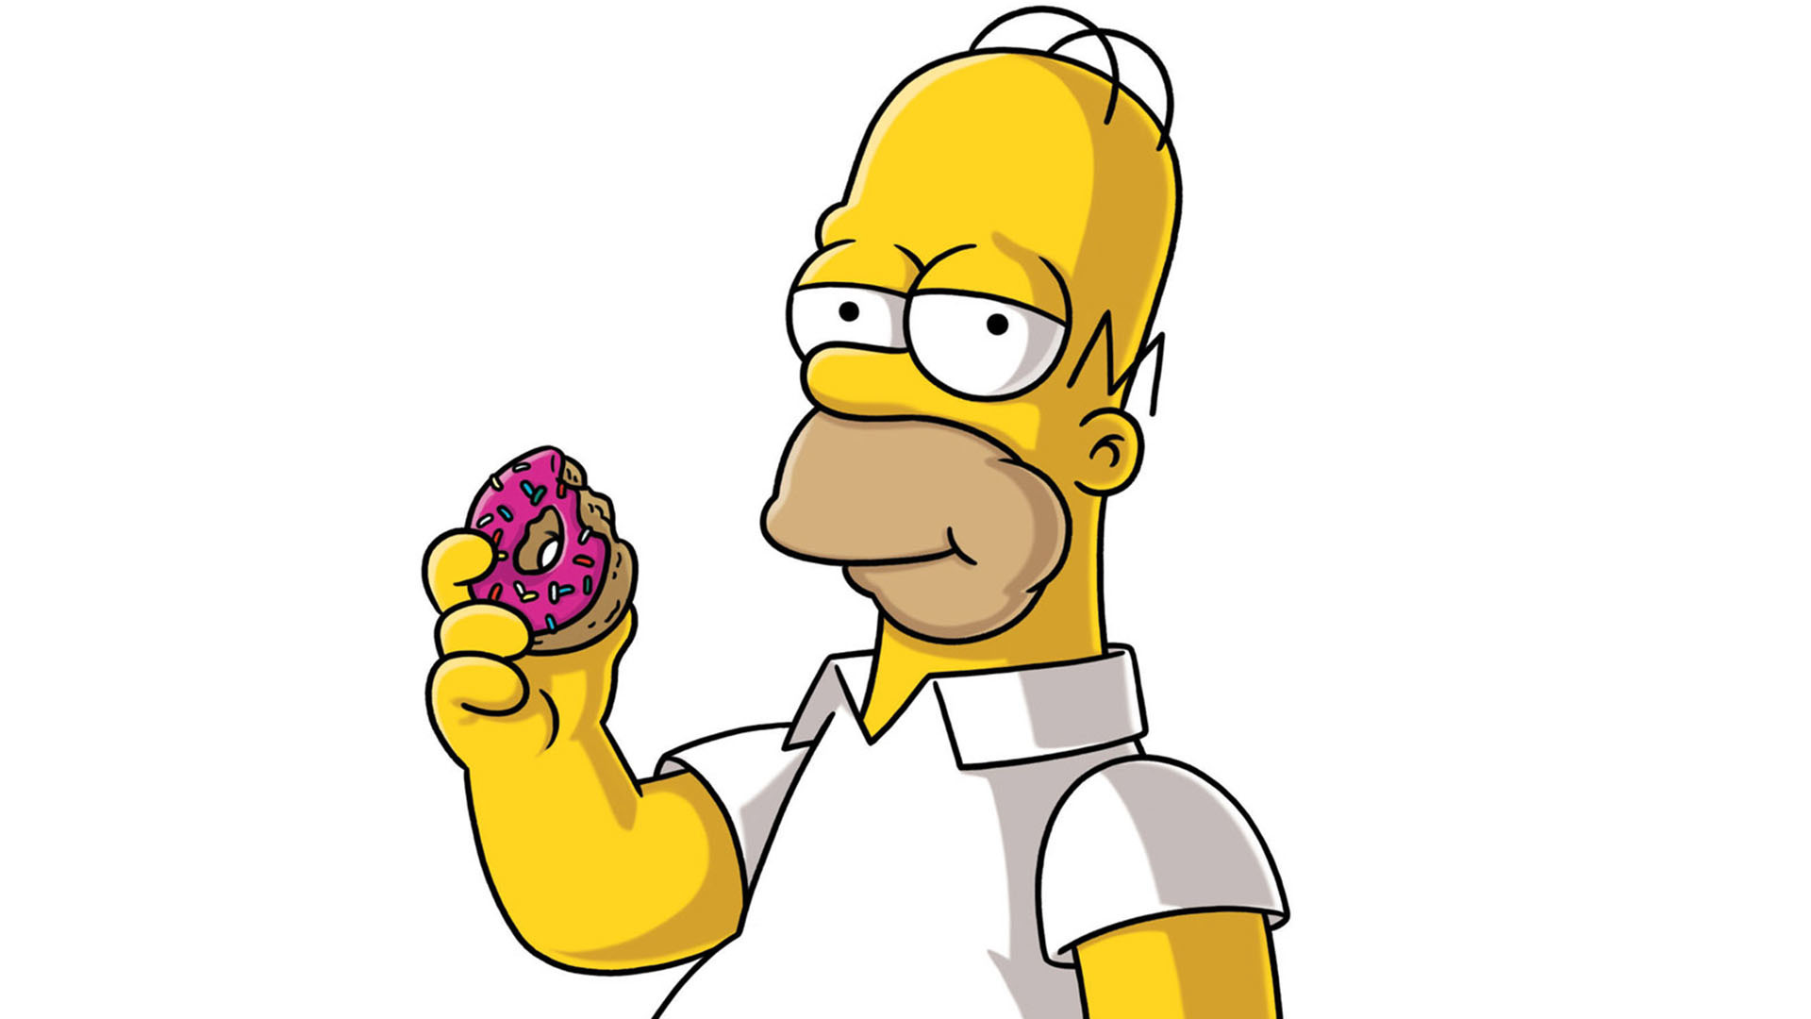

Slide 19
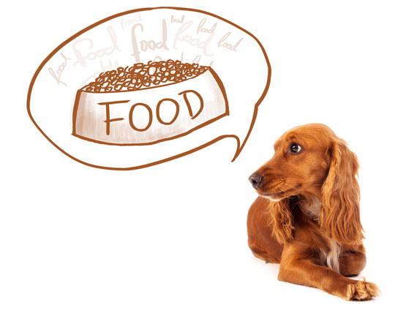

Slide 20
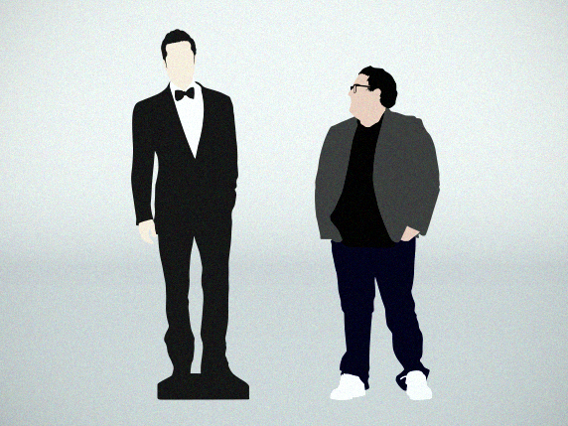

Slide 21
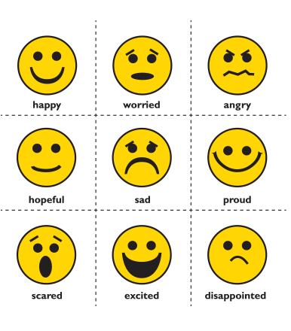
Feeling Adjectives:
Happy
Sad
Angry
Hot
Cold

Slide 22
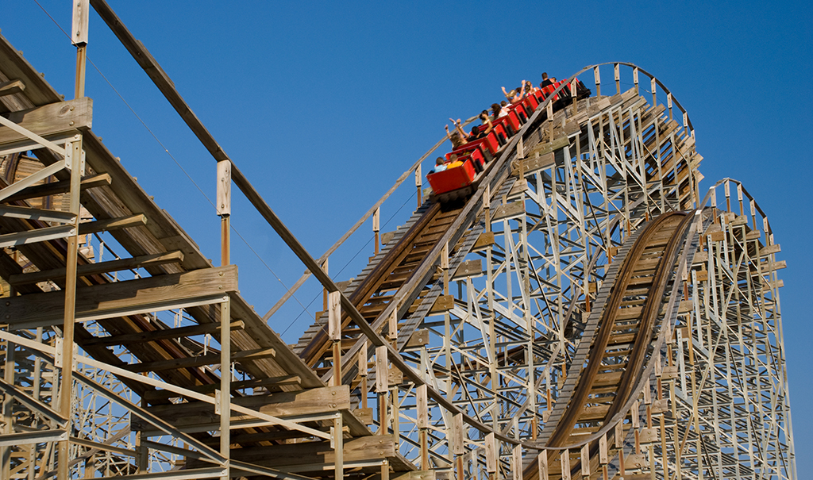
Funny vs Fun

Slide 23
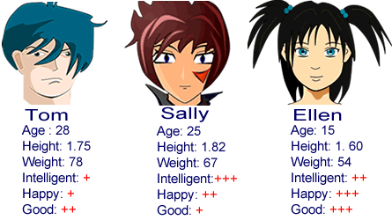
Who is taller, Sally or Ellen?
Who is heavier, Sally or Ellen?
Who is happier, Tom or Ellen?
Who is smarter, Tom or Sally?
Who is worse, Tom or Ellen?
Who is younger, Sally or Tom?

Slide 24
Superlatives

Slide 25
Superlatives
Adjective + “est”

Slide 26
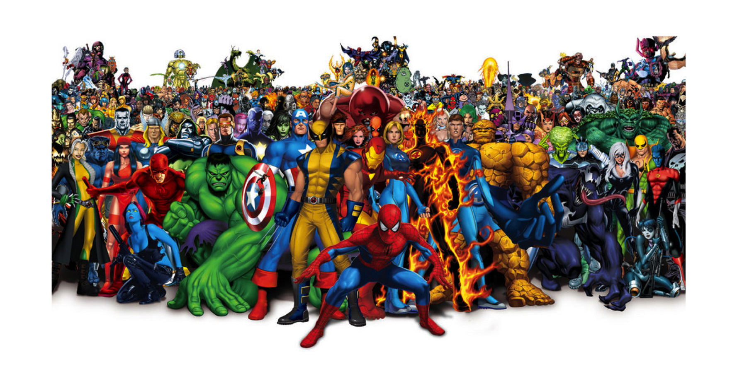
Comparative vs Superlative

Slide 27
Comparative vs Superlative
Use a comparative
Use a superlative
- Comparing two things
- Comparing more than two things.

Slide 28
Superlative Rules
Ends with consonant
Ends with vowel
Ends in “y”
Consonant + vowel + consonant
- est
- st
- iest
- 1 more consonant + est

Slide 29
Superlative Rules
Longer words (3* + syllables)
Irregular Superlatives
- most + adjective
- Various

Slide 30
Adjectives -> Superlative
Tall
Straight
Blue
Nice
Taller
Straighter
Bluer
Nicer
Tallest
Straightest
Bluest
Nicest

Slide 31
Adjectives -> Superlative
Happy
Tiny
Big
Fat
Happier
Tinier
Bigger
Fatter
Happiest
Tiniest
Biggest
Fattest

Slide 32
Adjectives -> Superlative
Colorful
Spherical
Good
Bad
Many
More colorful
More spherical
Better
Worse
More
Most colorful
Most spherical
Best
Worst
Most

Slide 33
______ is the (superlative).

Slide 34
Who is the tallest?
Who is the saddest?
Who is the youngest?
Who is the best?
Who is the oldest?
Who is the smartest?
Who is the lightest?
Who is the worst?
Who is the most stupid?

Slide 35
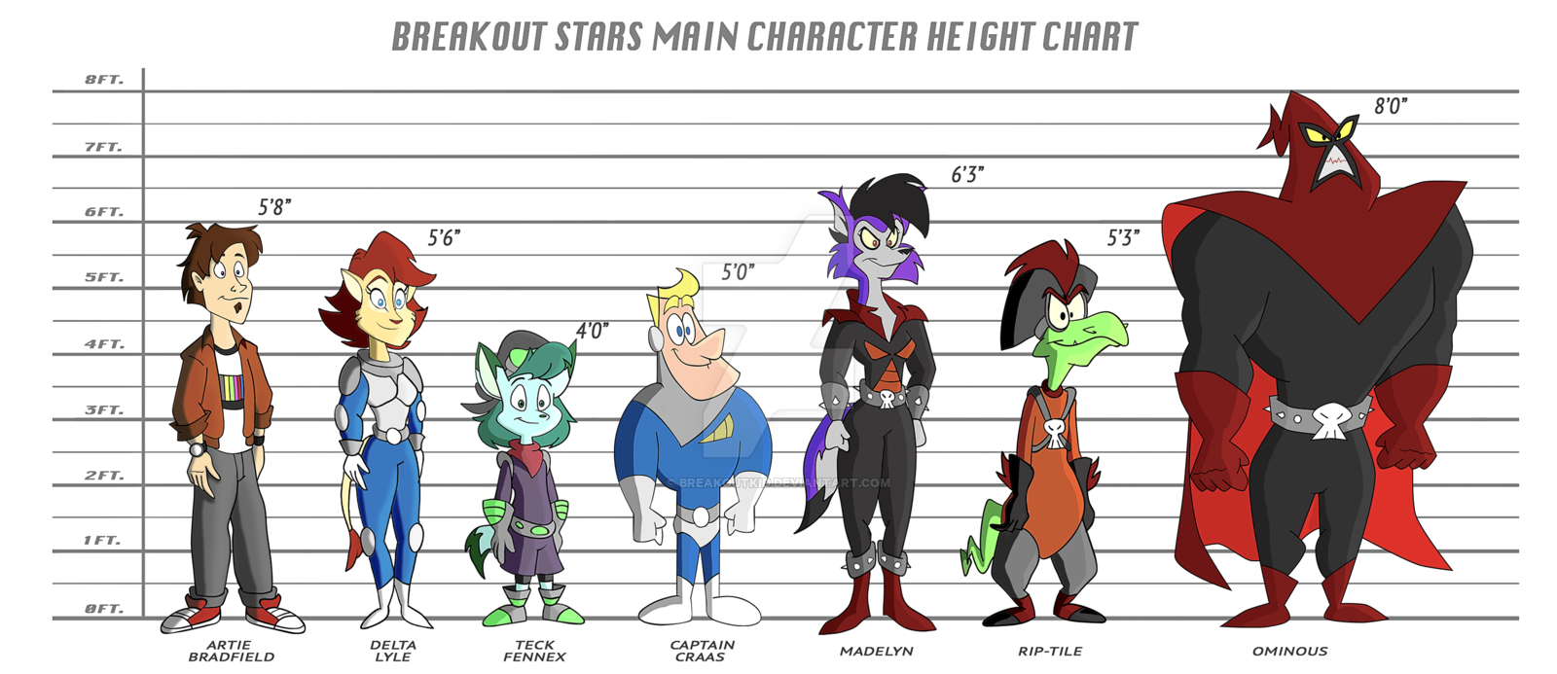
Artie
Delta
Teck
Captain
Crass
Madelyn
Rip-tile
Ominous

Slide 36
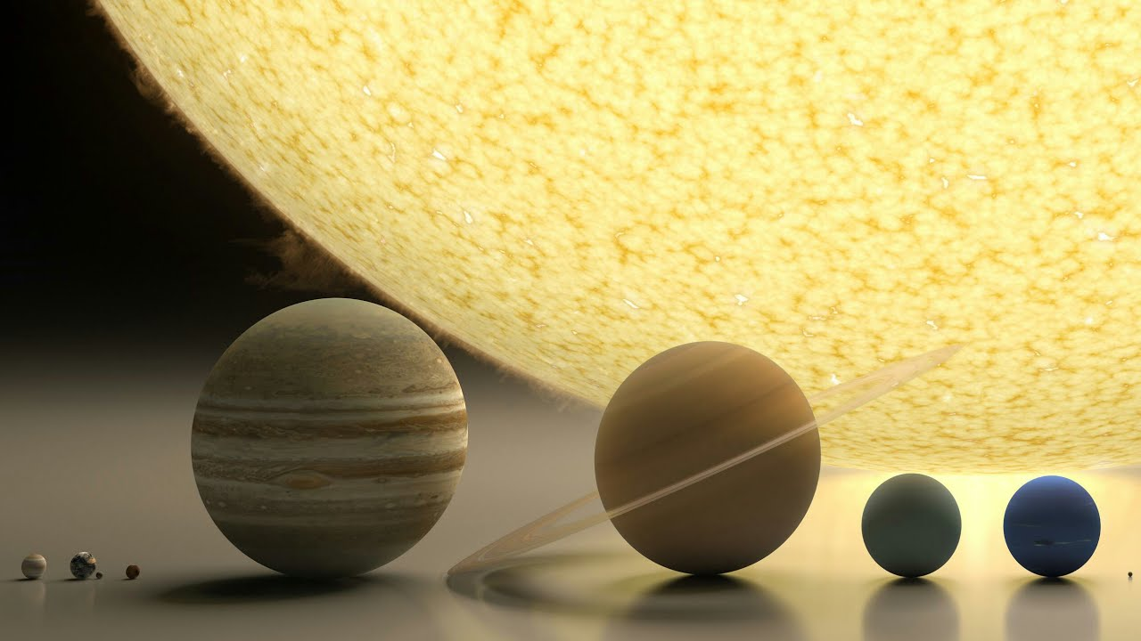

Slide 37
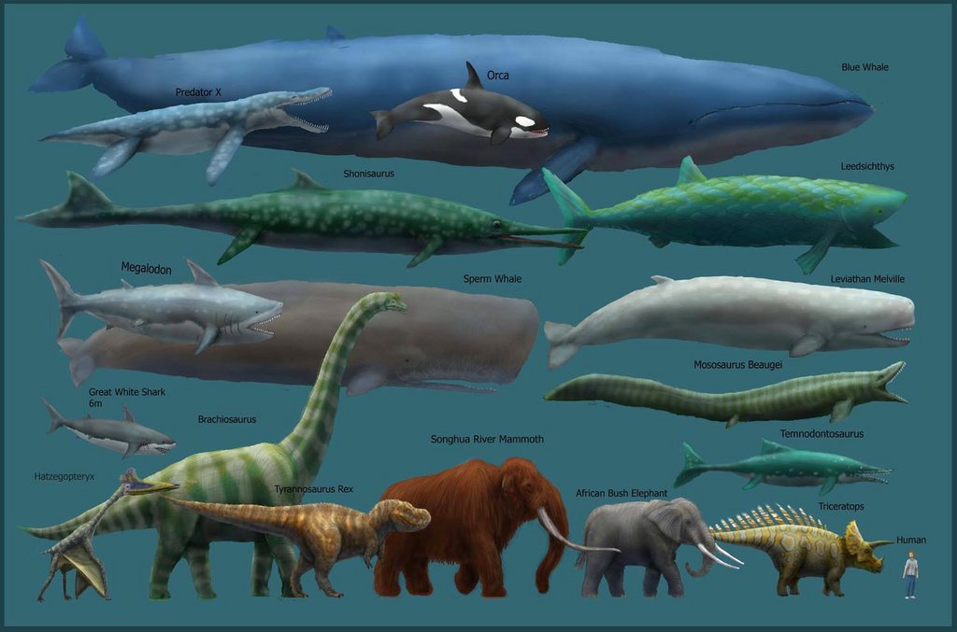

Slide 38
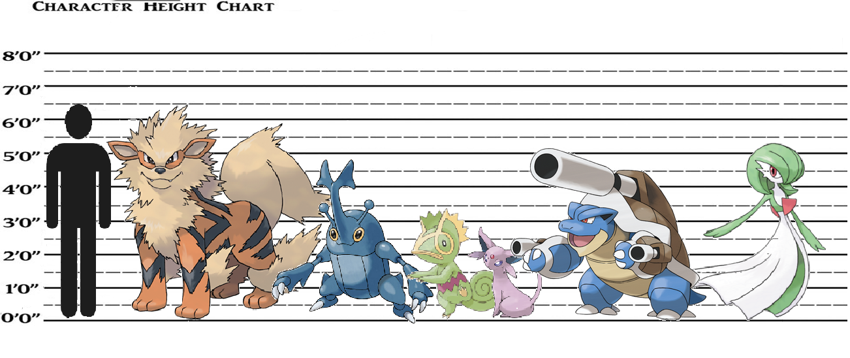
Arcanine
Heracross
Espeon
Gardevoir
Kecleon
Blastoise

Slide 39
Comparatives Game

Slide 40
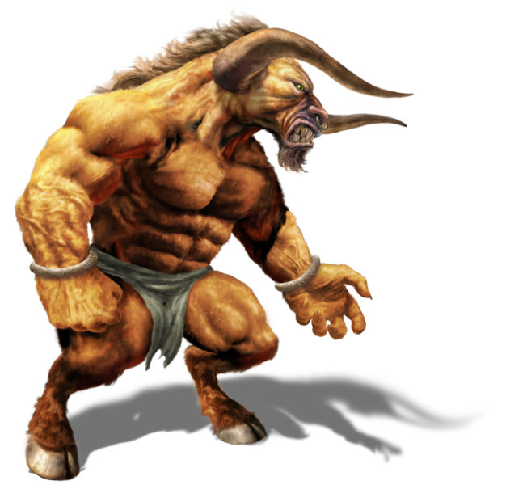
The Minotaur
55
78
99
20
Speed: Power:
Size: Intelligence:

Slide 41
Game
Speed
Power
Size
Intelligence
Fast, Faster, Fastest
Strong, Stronger, Strongest
Big, Bigger, Biggest
Smart, Smarter, Smartest

Slide 42
How to Play
Choose a card
Put it upside down on the table
Rock, Paper, Scissors
Choose a trait
Speed, Size, Power, Intelligence
Show your card
Same time .
Make a sentence + The winner takes the card

Slide 43
Make a Sentence
If they don’t make a sentence, you don’t have to give them your card.
I am ________er than you.
I am the _________est.

Slide 44
More superlatives:
Far
Popular
Common
Danger

