Slide 1
Superlatives Quiz
Inspired by:
https://www.youtube.com/watch?v=kq1SGXxyn0Y

Slide 2
Cities and Countries
The Most
Sports
Numbers
Geography
General
15
15
15
15
15
15
20
20
20
20
20
20
25
25
25
25
25
25
30
30
30
30
30
30

Slide 3
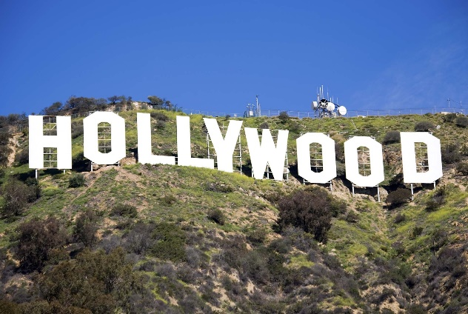
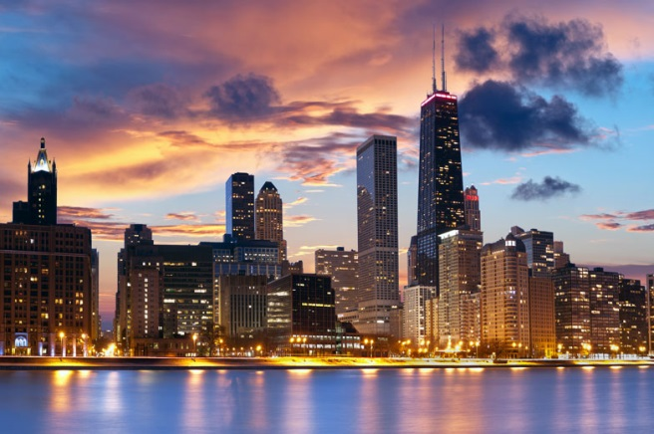
Which is the biggest city in the USA?
Los Angeles
Chicago
New York
HOME
Notes:
https://en.wikipedia.org/wiki/List_of_United_States_cities_by_population

Slide 4
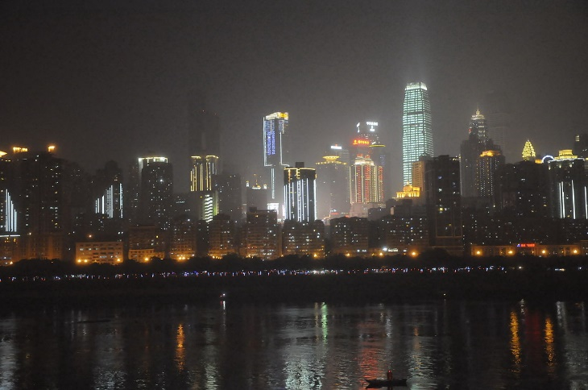
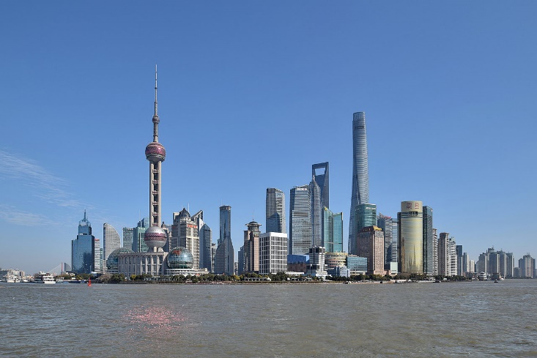
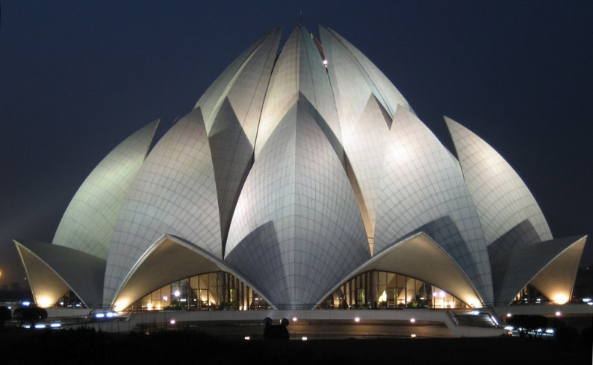
Which city has the most people (city proper)?
Chongqing
Shanghai
Delhi
HOME
Notes:
https://en.wikipedia.org/wiki/List_of_largest_cities

Slide 5
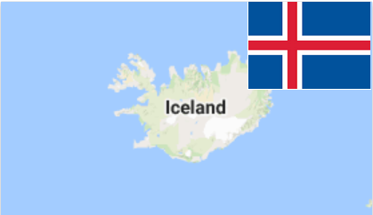
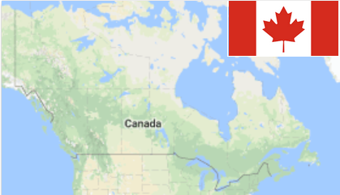
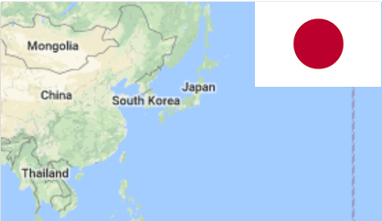
Which country is the safest?
Iceland
Canada
Japan
HOME
Notes:
http://uk.businessinsider.com/worlds-safest-countries-global-peace-index-2017-6

Slide 6
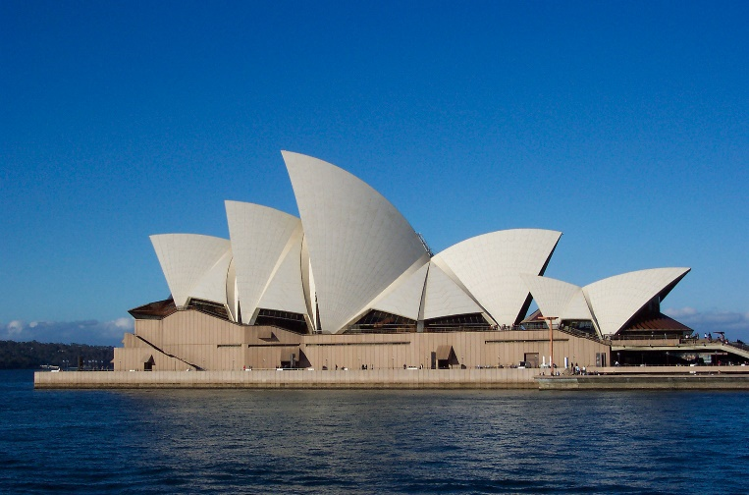
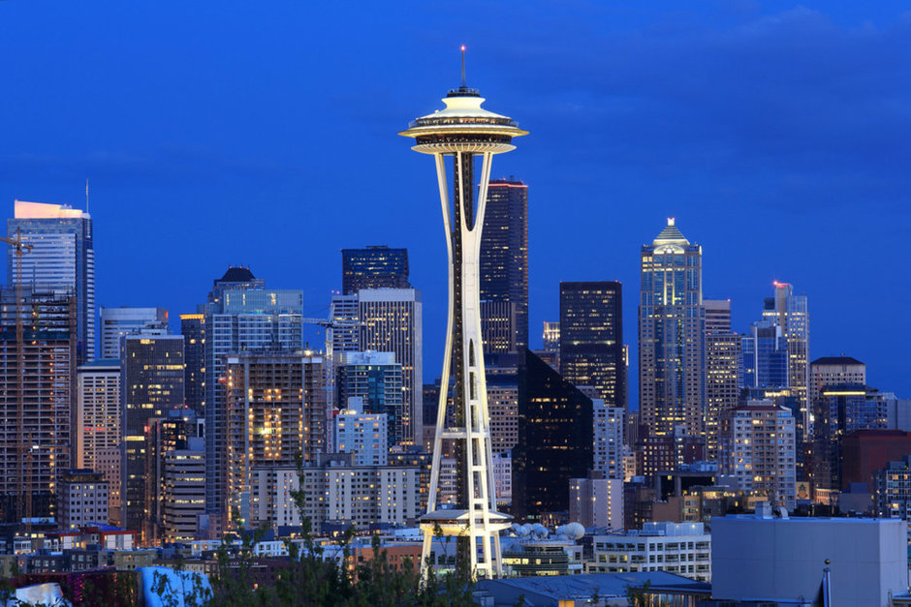
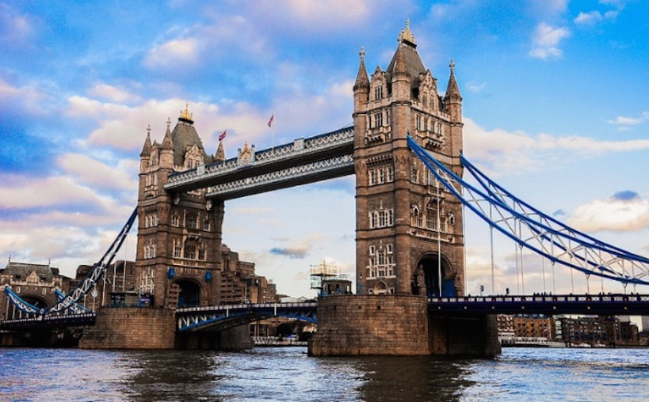
Which of these cities is the farthest from South Korea?
Sydney
Seattle
London
HOME
Notes:
https://www.timeanddate.com/worldclock/distance.html

Slide 7
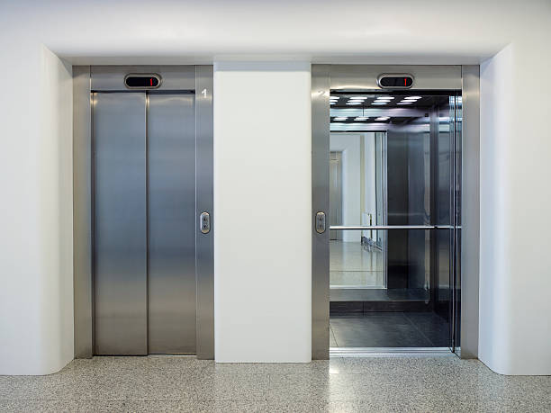
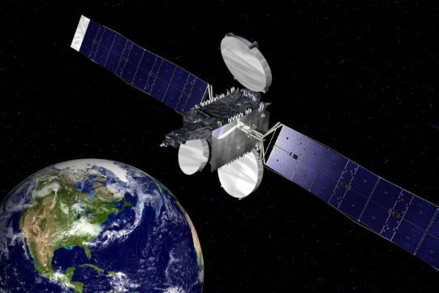
Which of these inventions is the most recent?
Internet
Elevator
Satellite
HOME
Notes:
http://www.explainthatstuff.com/timeline.html

Slide 8
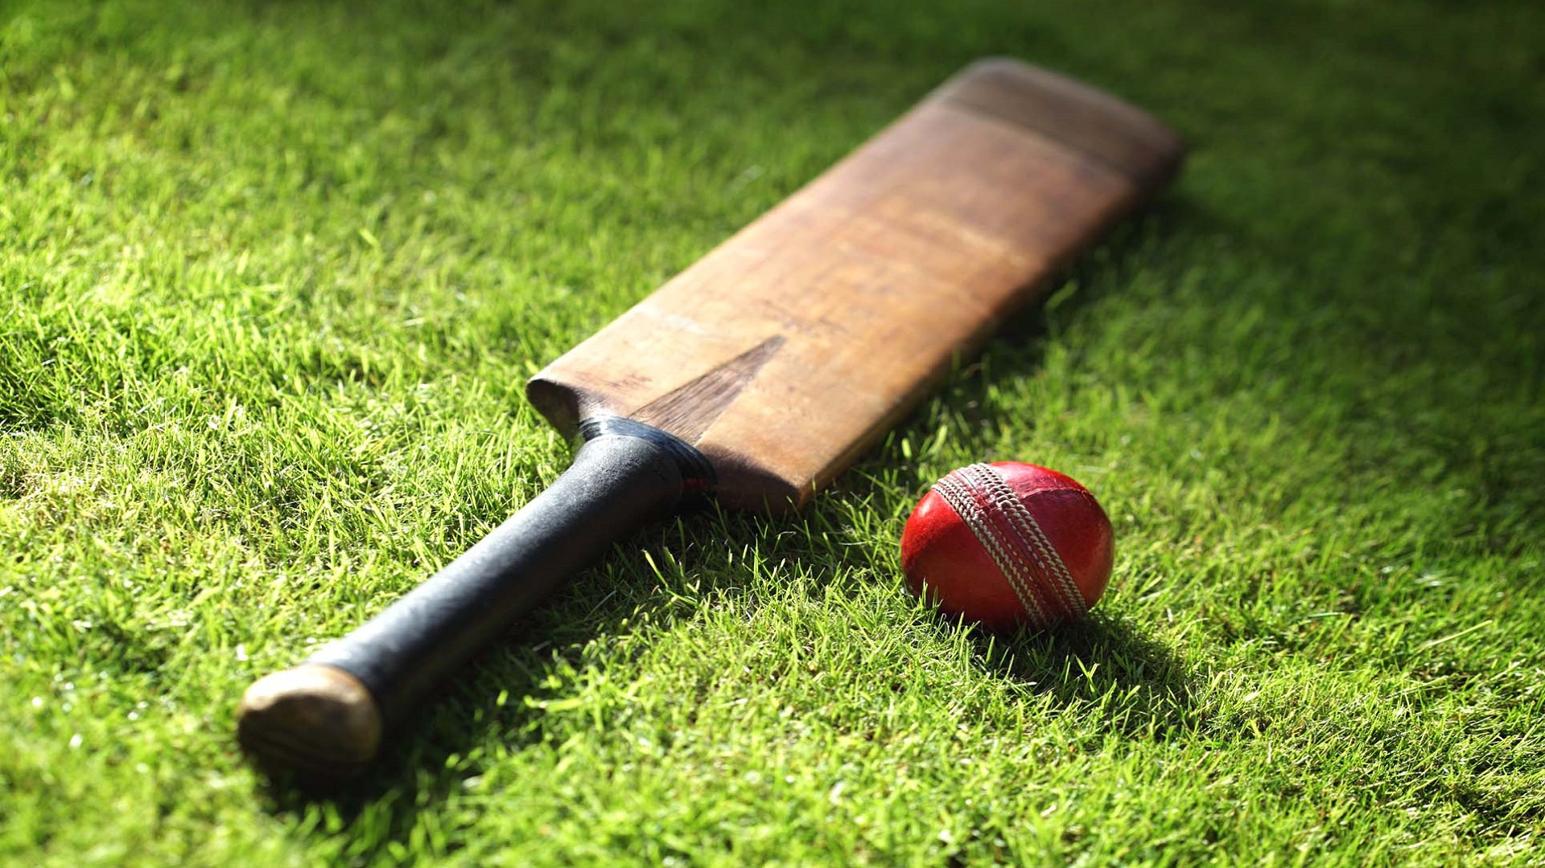
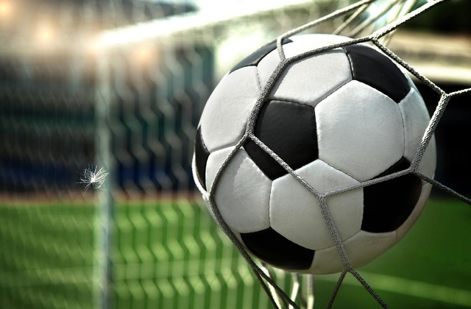
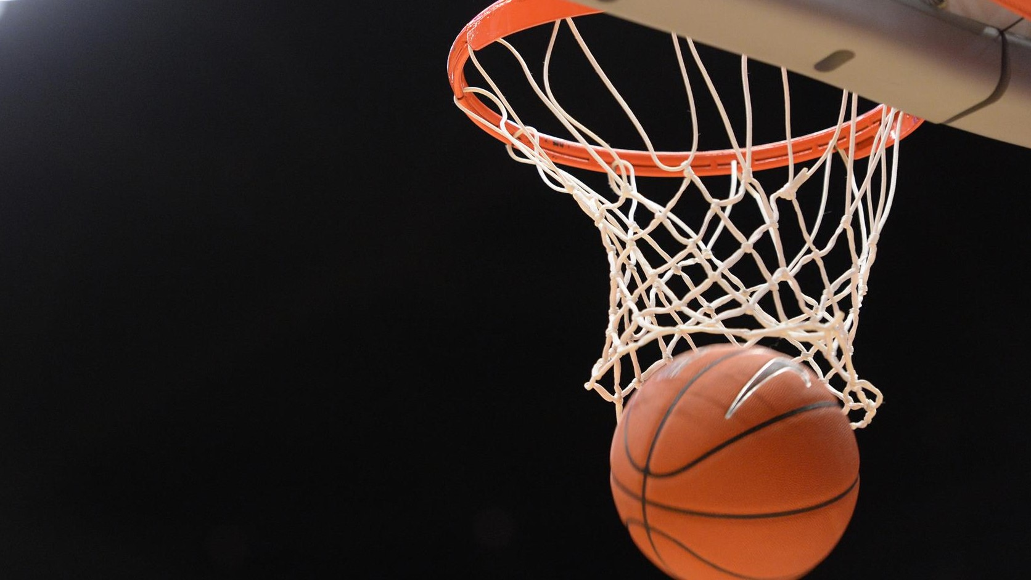
Which is the most popular sport in the world?
Soccer
Cricket
Basketball
HOME
Notes:
http://www.totalsportek.com/most-popular-sports/

Slide 9
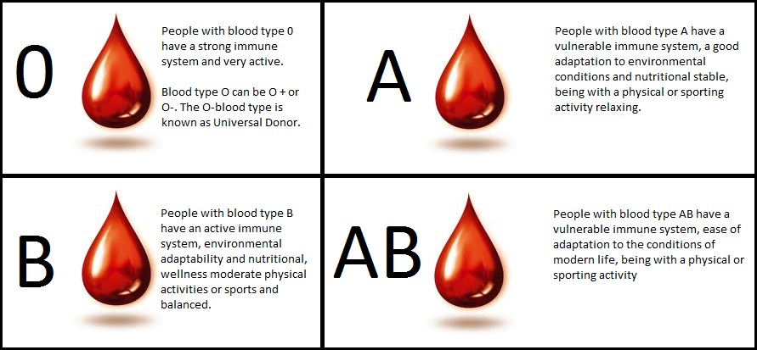
Which is the most common blood type?
O blood type
A blood type
B blood type
AB blood type
HOME
Notes:
https://www.livescience.com/36559-common-blood-type-donation.html

Slide 10
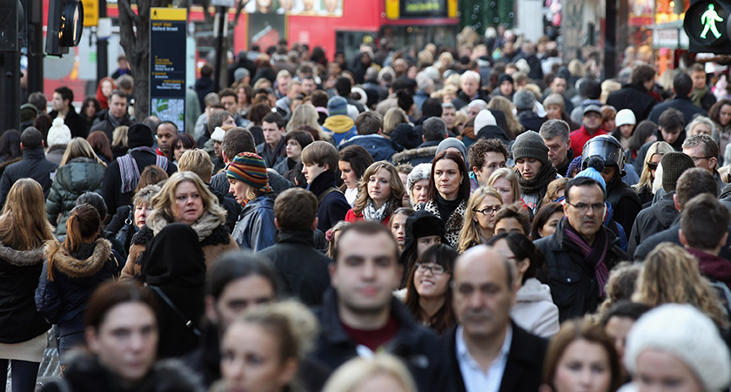
Which is the most common family name in the United Kingdom?
Smith
Johnson
Jones
HOME
Notes:
http://surname.sofeminine.co.uk/w/surnames/most-common-surnames-in-great-britain.html

Slide 11
Which of these races is the longest?
Half-Marathon
Marathon
30K
HOME

Slide 12
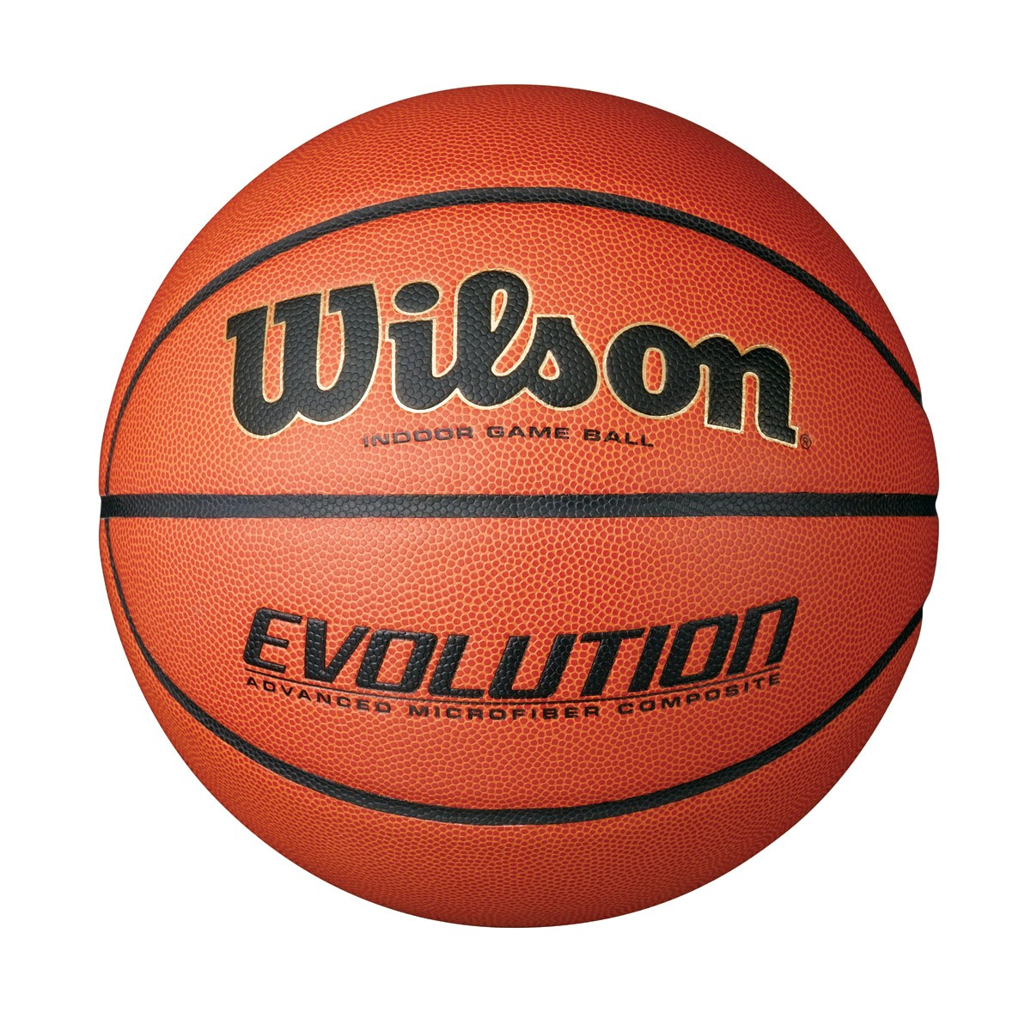
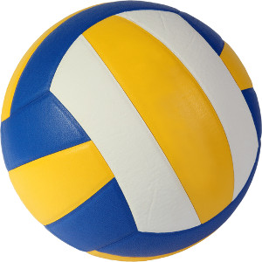
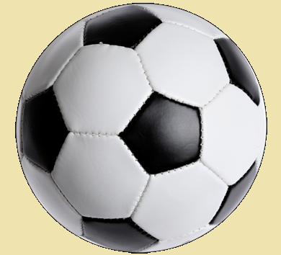
Which of these sports balls is the biggest?
Basketball
Volleyball
Soccerball
HOME
Notes:
http://www.topendsports.com/resources/equipment-ball-size.htm

Slide 13
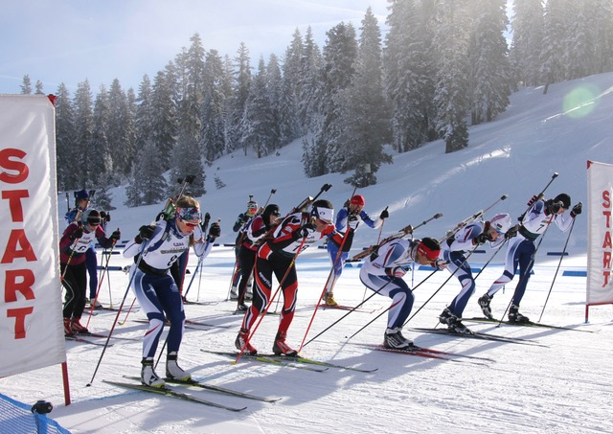
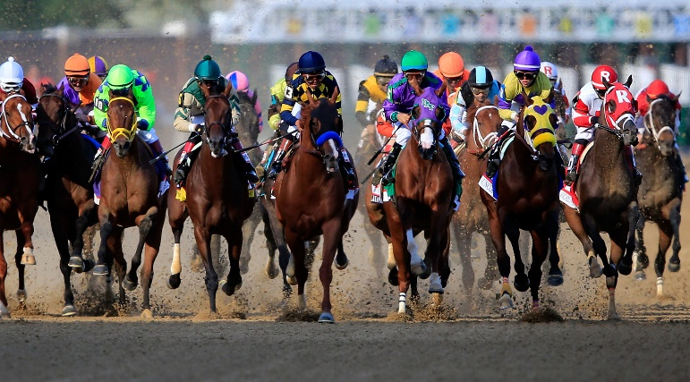
Which of these races is the longest?
Biathlon (individual)
Ironman
Kentucky Derby
HOME

Slide 14
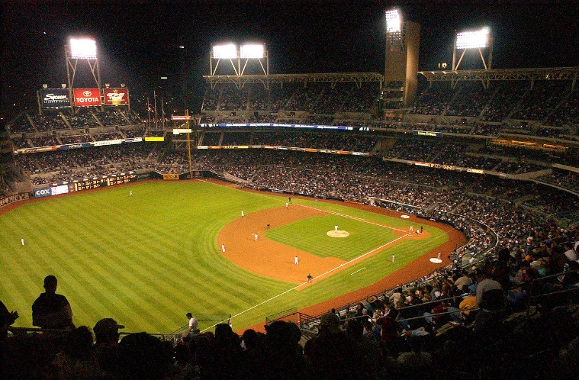
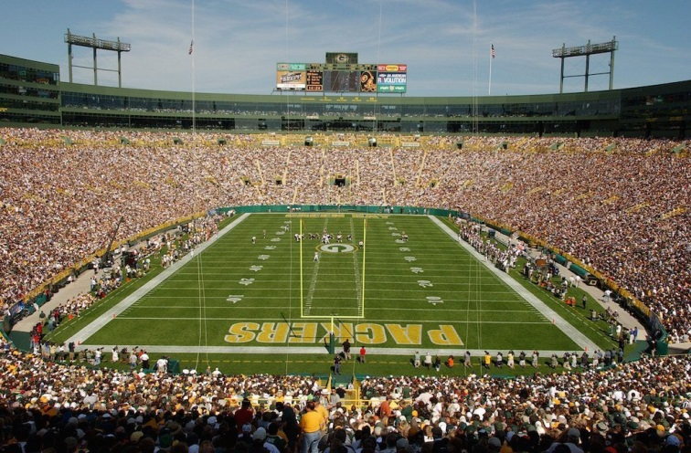
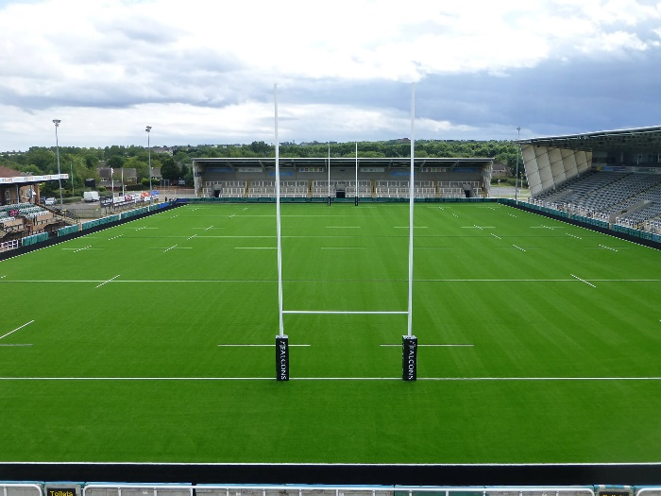
By area, which of these is the smallest?
Baseball Diamond
NFL field
Rugby League pitch
HOME
Notes:
https://en.wikipedia.org/wiki/Pitch_(sports_field)

Slide 15
Which is the shortest month of the year?
February
July
December
HOME

Slide 16
Which of these is the longest period of time?
Millennium
Decade
Century
HOME

Slide 17
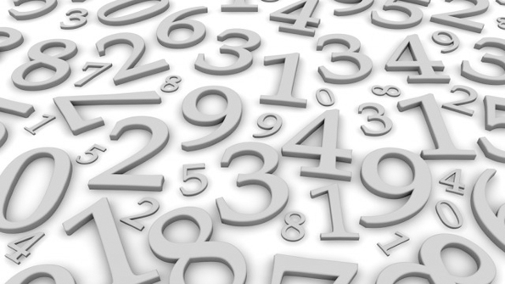
Which of these numbers is the highest?
One Trillion
One Googolplex
One Millinillion
HOME
Notes:
https://en.wikipedia.org/wiki/Names_of_large_numbers

Slide 18
Which of these temperatures is the coldest?
0 Celsius
0 Kelvin
0 Fahrenheit
HOME

Slide 19
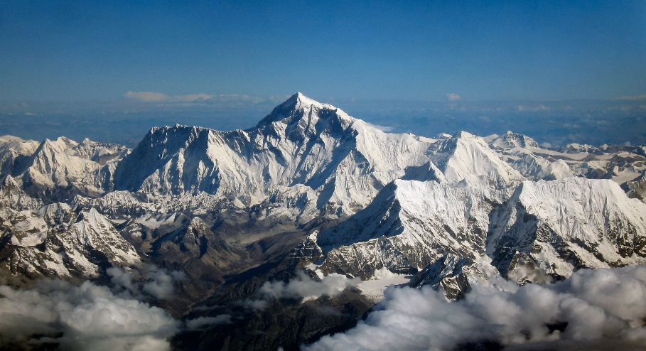
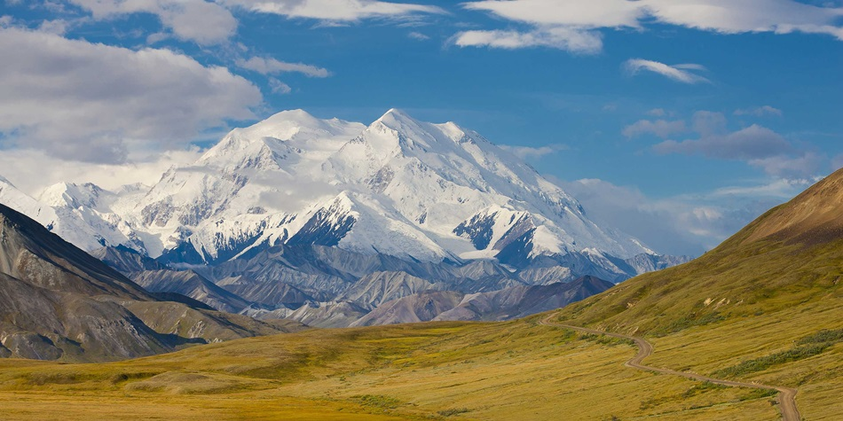
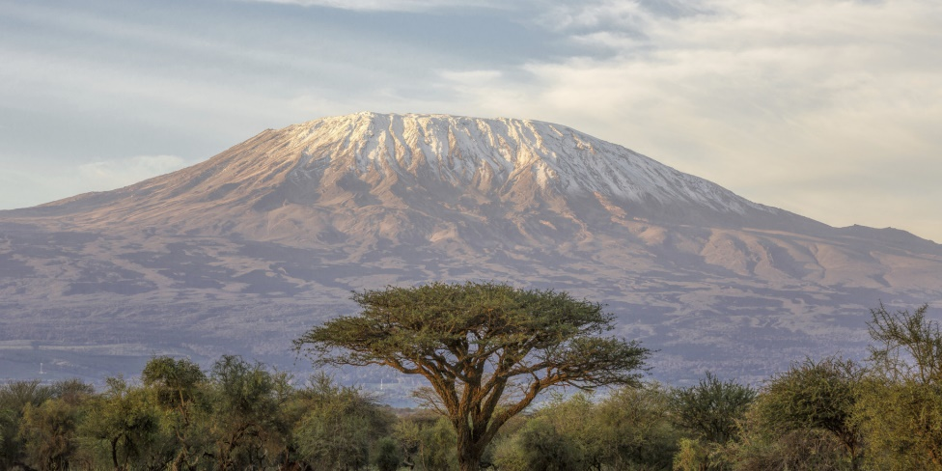
Which is the tallest mountain in the world?
Mount Everest
Denali
Mount Kilimanjaro
HOME
Notes:
https://en.wikipedia.org/wiki/List_of_highest_mountains_on_Earth

Slide 20
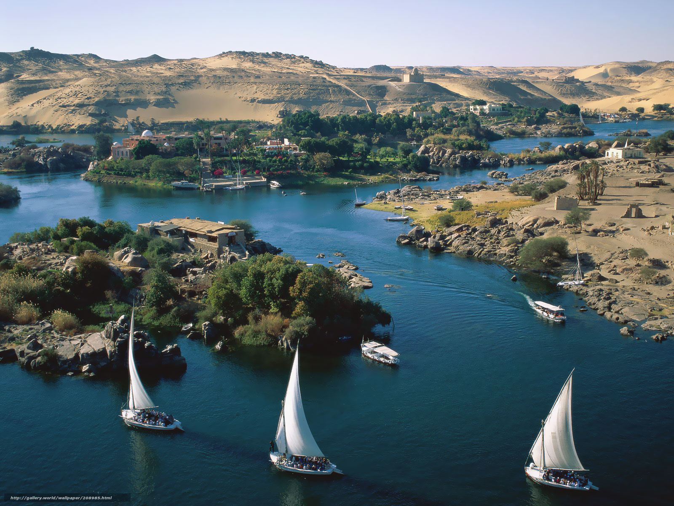
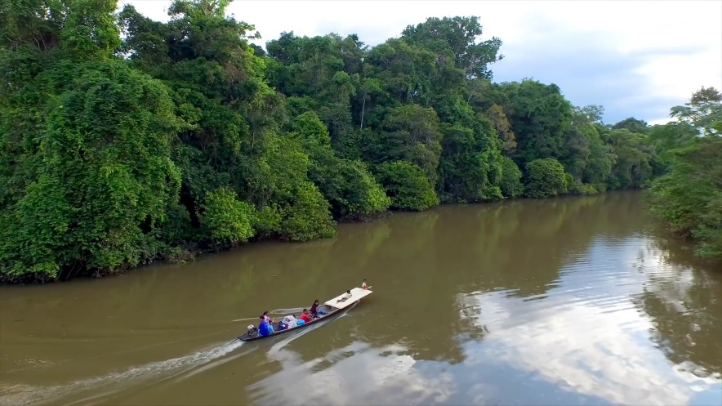
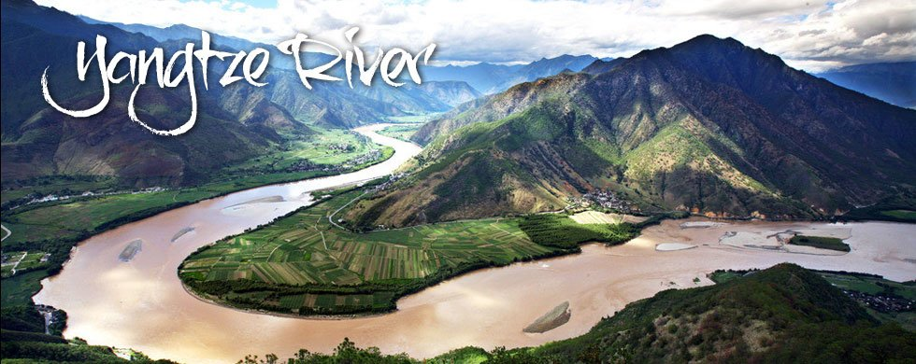
Which is the longest river in the world?
Amazon
Nile
Yangtze
HOME
Notes:
https://en.wikipedia.org/wiki/List_of_rivers_by_length

Slide 21
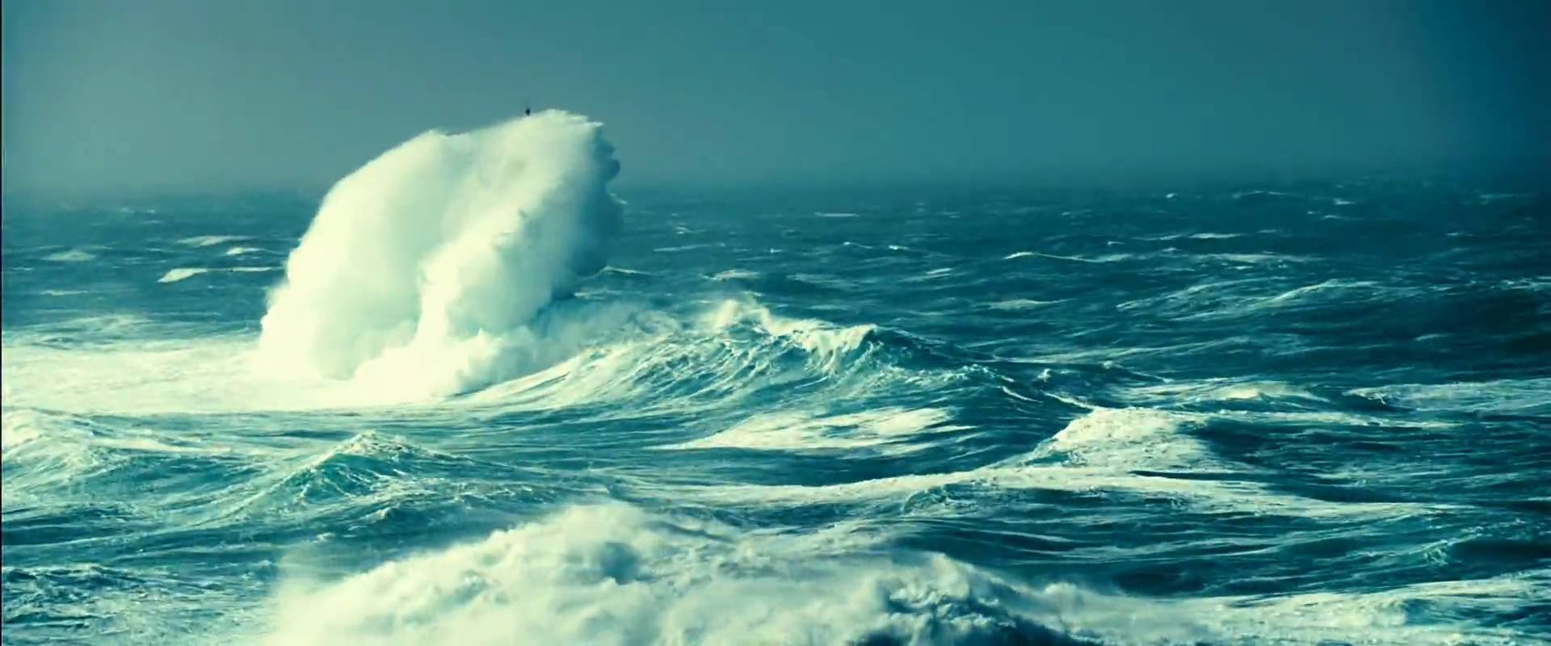
Which is the largest ocean in the world?
Atlantic Ocean
Arctic Ocean
Pacific Ocean
HOME
Notes:
https://oceanservice.noaa.gov/facts/biggestocean.html

Slide 22
Which is the smallest continent in the world?
Europe
Australia
Antarctica
HOME
Notes:
https://www.thoughtco.com/continents-by-area-and-size-ranking-1435142

Slide 23
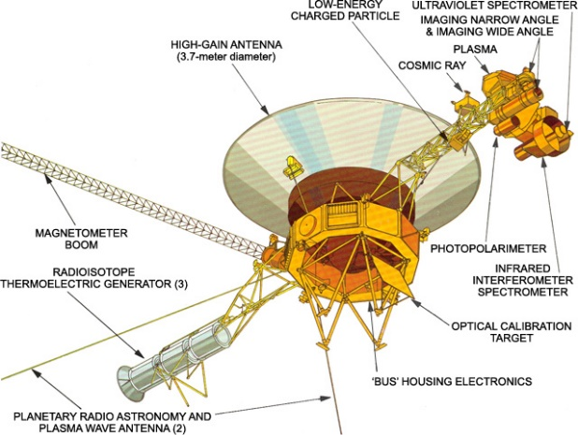
Which of these is the fastest?
Speed of sound
Speed of
light
Speed of
Voyager 1
HOME
Notes:
https://en.wikipedia.org/wiki/Speed

Slide 24
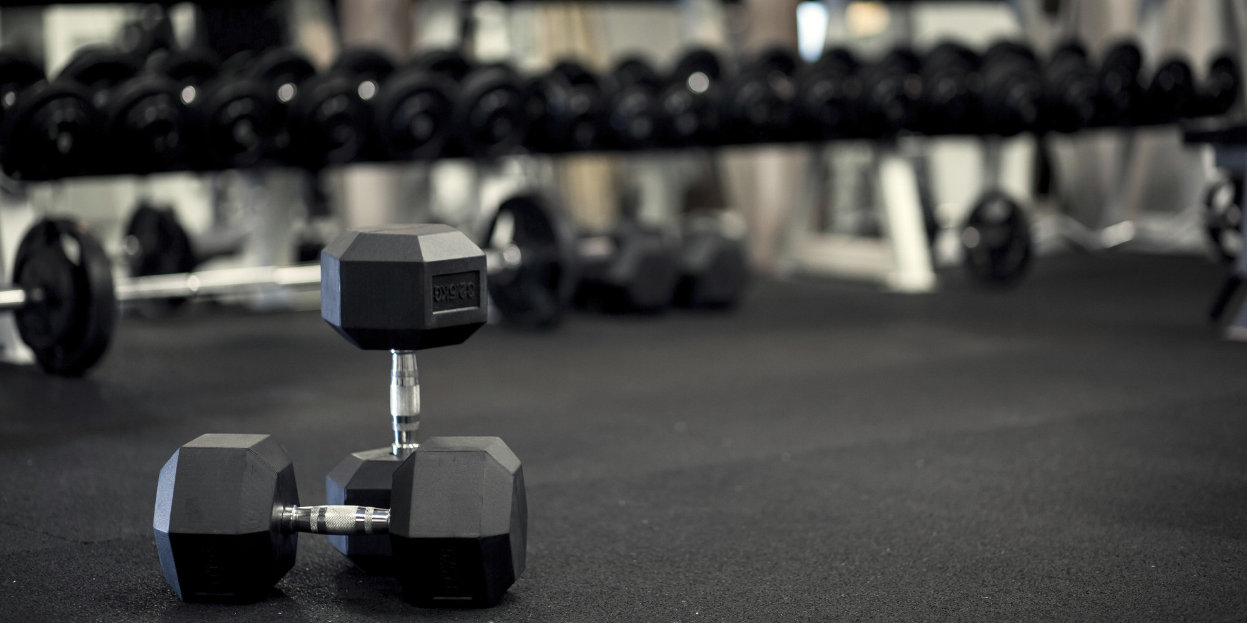
Which of these is the heaviest?
100kg
100lbs
1 tonne
HOME
Notes:
https://en.wikipedia.org/wiki/Mass

Slide 25
Which language is the most popular?
Chinese
Spanish
English
HOME
Notes:
https://www.babbel.com/en/magazine/the-10-most-spoken-languages-in-the-world

Slide 26
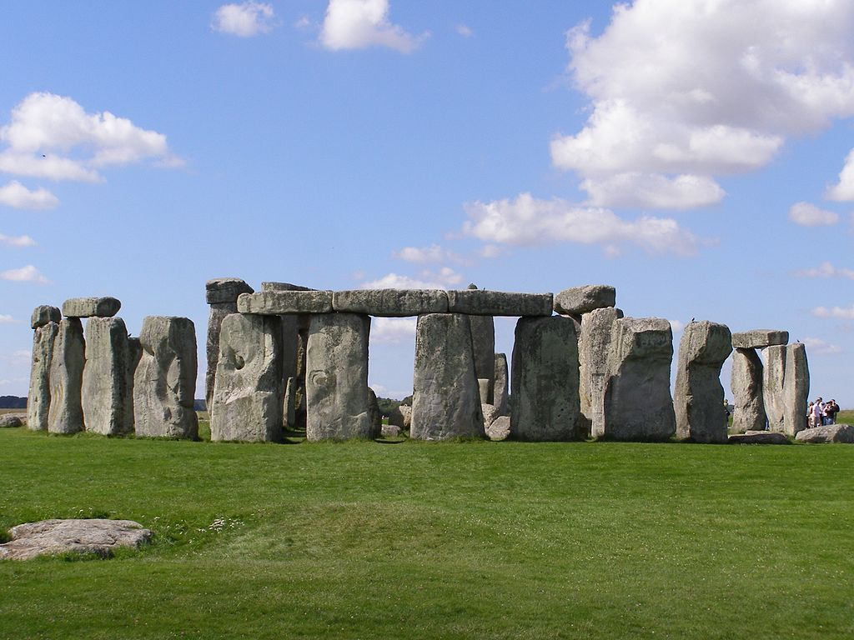
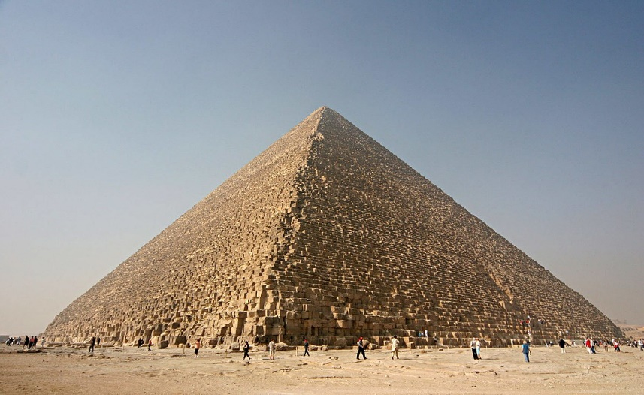
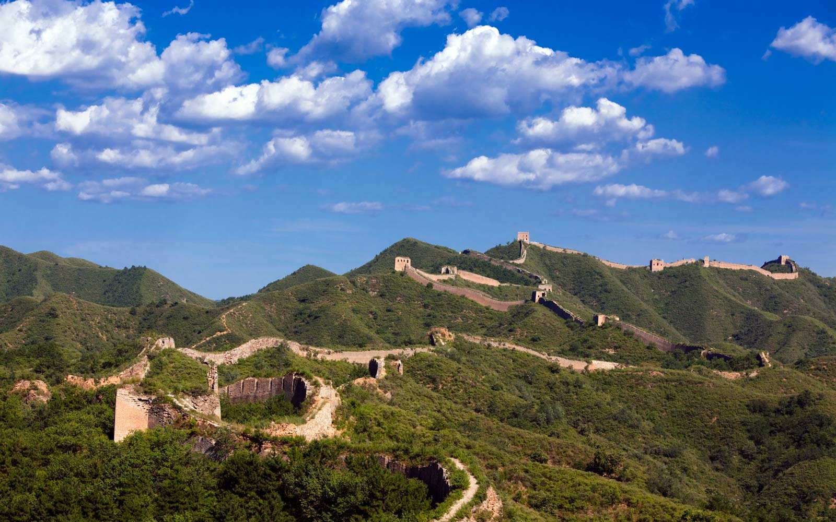
Which of these structures is the oldest?
The Great Pyramid
Stonehenge
Great Wall of China
HOME

