Slide 1
My Opinion
I think that…

Slide 2
What is opinion?
Your idea
What do you believe?
What do you think?
It’s different for everyone.
Subjective

Slide 3
Opinion vs Fact
Which is an opinion?
Which is a fact?

Slide 4
Opinions are not wrong, they’re just different from yours.

Slide 5
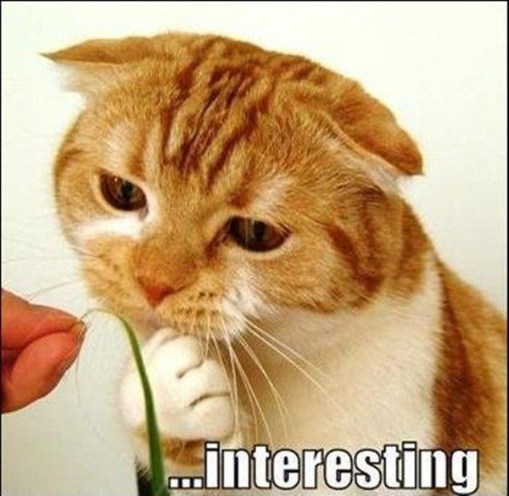
Opinion OR Fact
It’s interesting

Slide 6
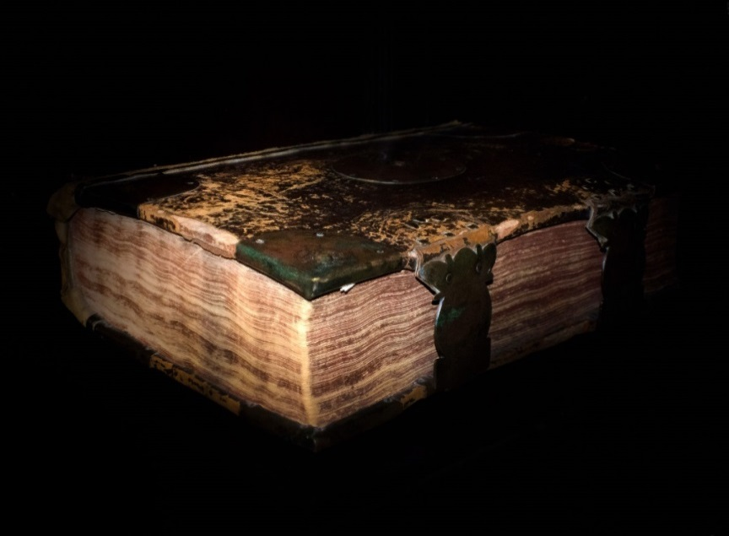
Opinion OR Fact
Interesting
It’s ancient.

Slide 7
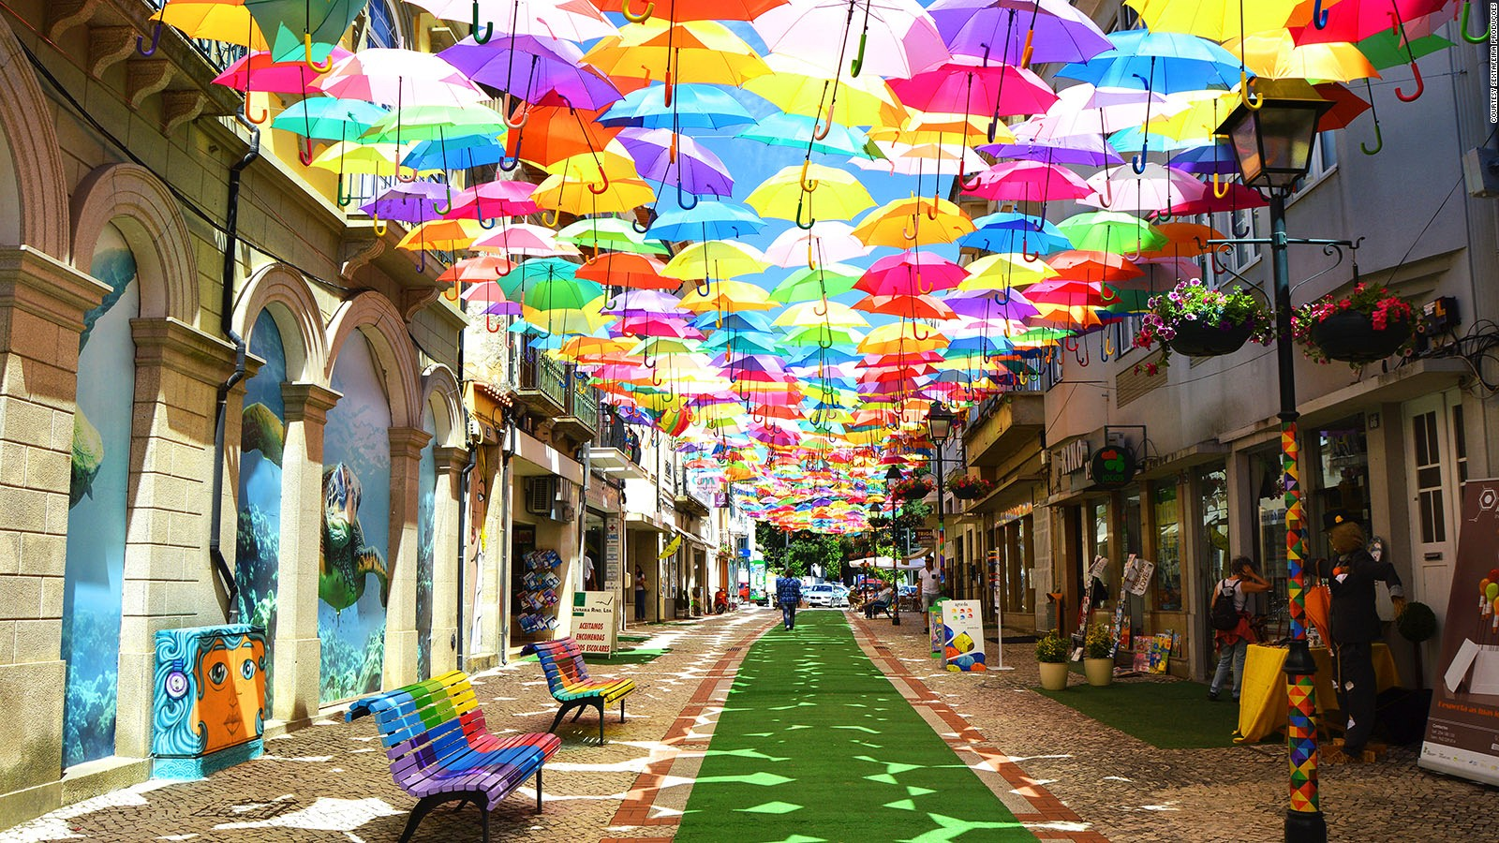
Opinion OR Fact
Interesting
Ancient
It’s colorful.

Slide 8
Opinion OR Fact
Interesting
Ancient
Colorful
It’s hot.

Slide 9
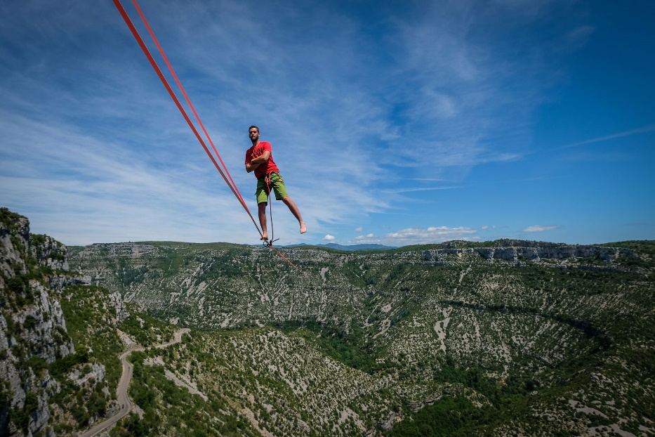
Opinion OR Fact
Interesting
Ancient
Colorful
Hot
He’s incredible.

Slide 10
Opinion OR Fact
Interesting
Ancient
Incredible
Colorful
Hot
It’s spherical.

Slide 11
Opinion OR Fact
Interesting
Ancient
Incredible
Colorful
Hot
Spherical
It’s adorable.

Slide 12
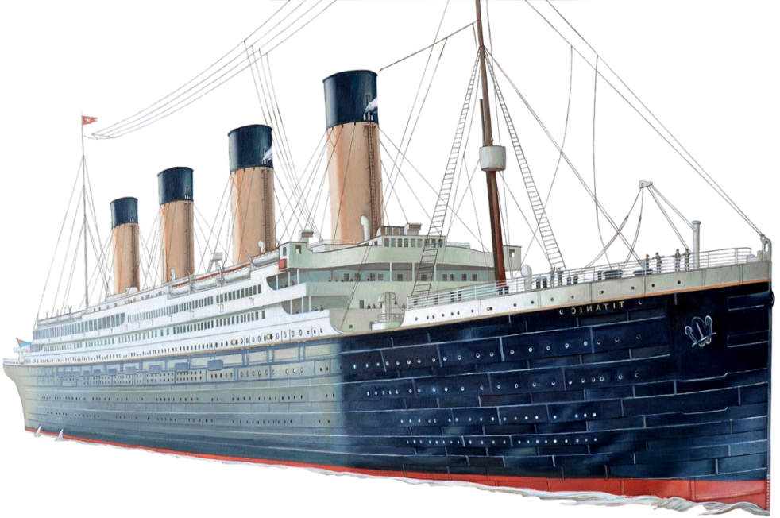
Opinion OR Fact
Interesting
Ancient
Incredible
Colorful
Adorable
Hot
Spherical
It’s enormous.

Slide 13
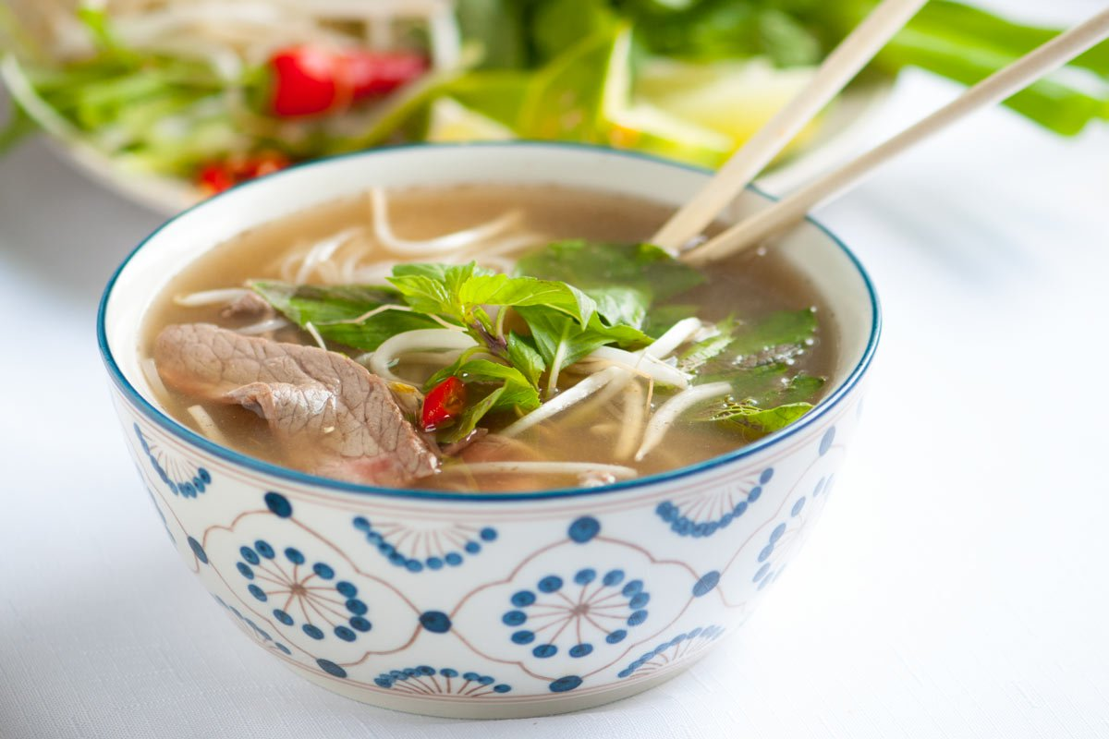
Opinion OR Fact
Interesting
Ancient
Incredible
Colorful
Adorable
Hot
Spherical
It’s Vietnamese.
Enormous

Slide 14
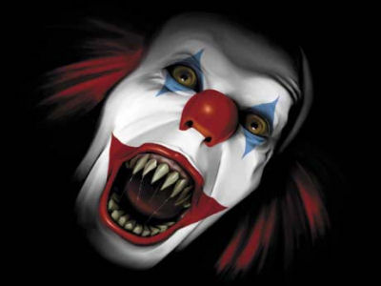
Opinion OR Fact
Interesting
Ancient
Incredible
Colorful
Adorable
Hot
Spherical
Enormous
It’s horrifying.
Vietnamese

Slide 15
How to Express Your Opinion:
I think… (statement)
I believe… (statement)
I think that… (statement)
In my opinion… (statement)

Slide 16
Can you think of something that fits the adjective?

Slide 17
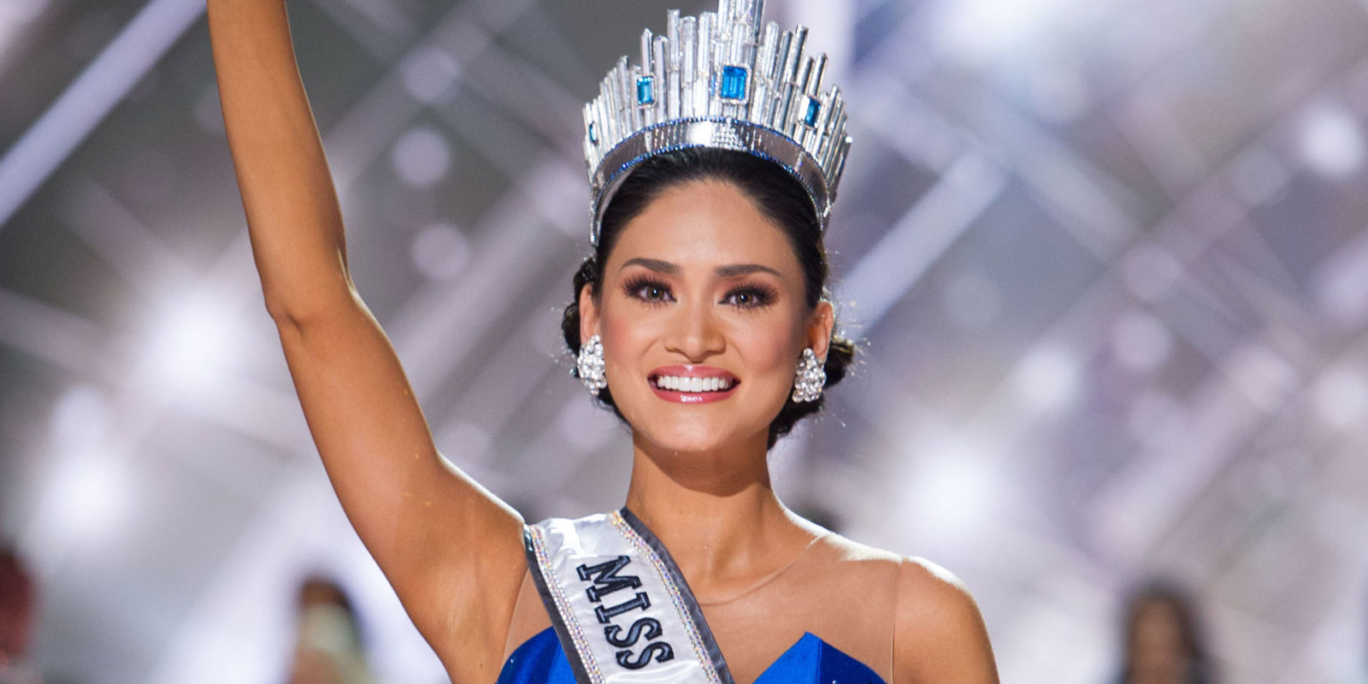
Beautiful / Pretty / Gorgeous / Good-looking

Slide 18
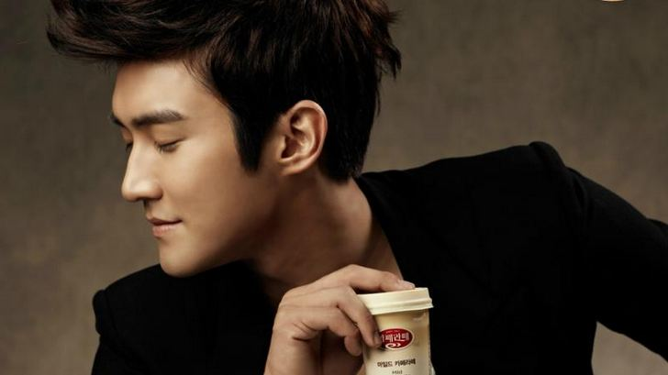
Handsome / Good-looking

Slide 19
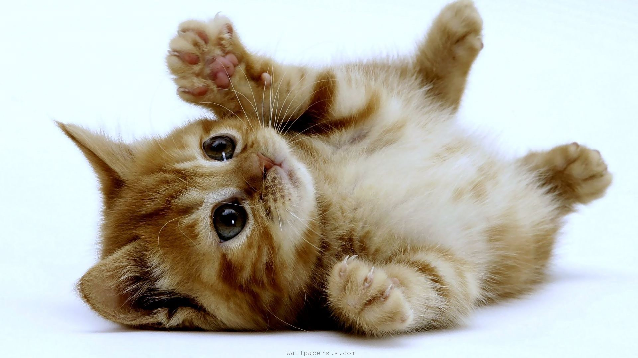
Cute / Adorable

Slide 20
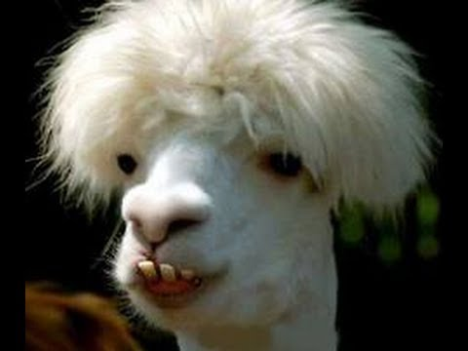
Ugly / Disgusting

Slide 21
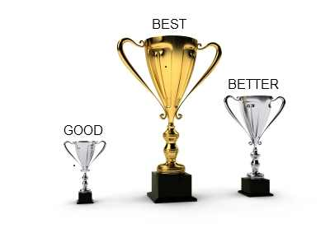
Good / Better / Best

Slide 22
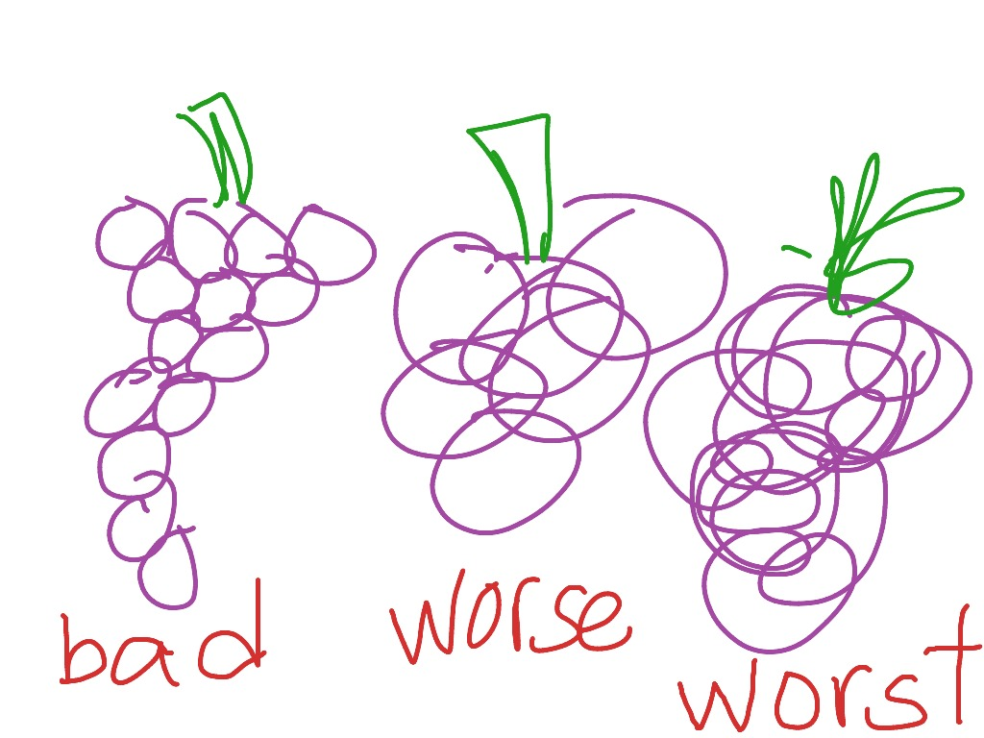
Bad / Worse / Worst

Slide 23
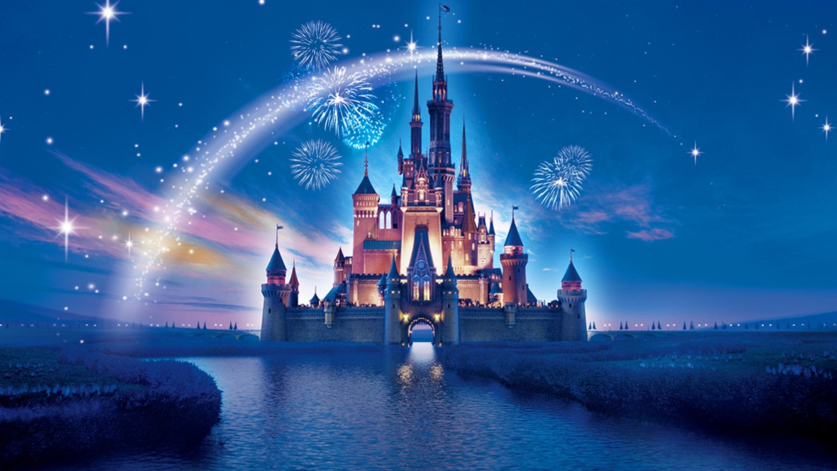
Amazing / Fantastic / Wonderful / Incredible

Slide 24
Boring

Slide 25
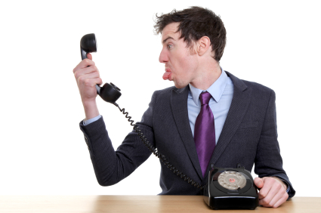
Mean / Rude

Slide 26
Smart / Clever / Intelligent

Slide 27
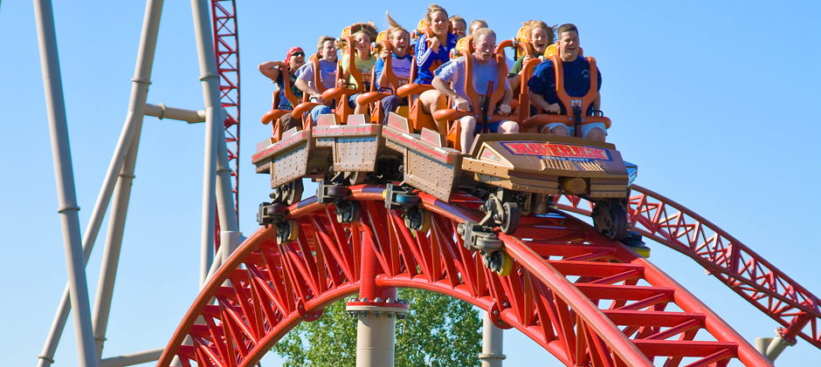
Exciting / Thrilling / Exhilarating

Slide 28
Valuable / Worthless / Priceless

Slide 29
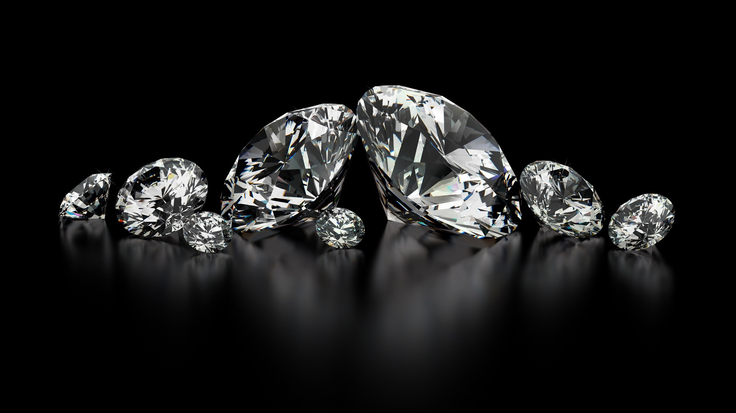

Slide 30
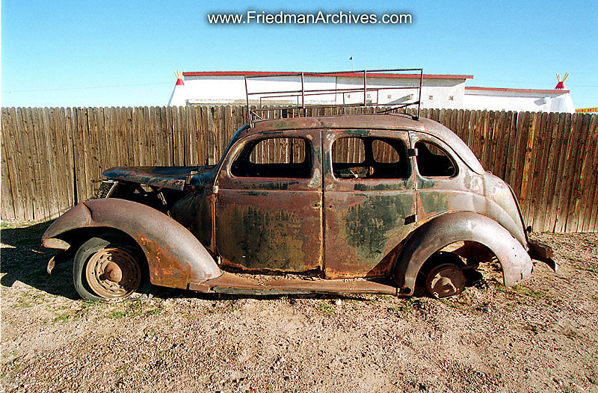

Slide 32
Useful / Useless

Slide 34
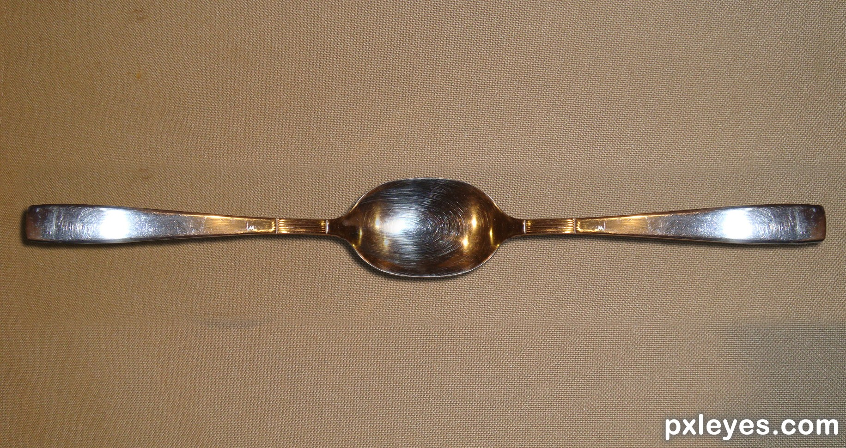

Slide 35
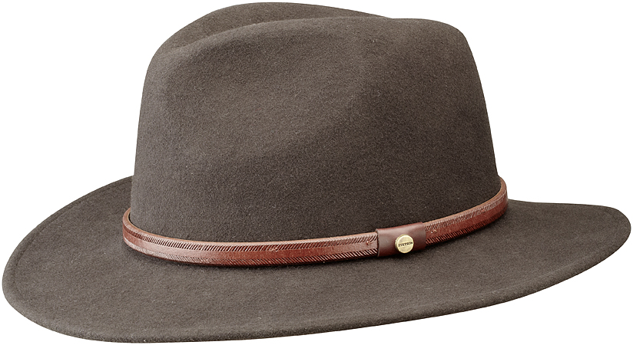

Slide 36
Difficult / Easy

Slide 37
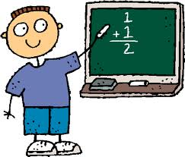

Slide 38
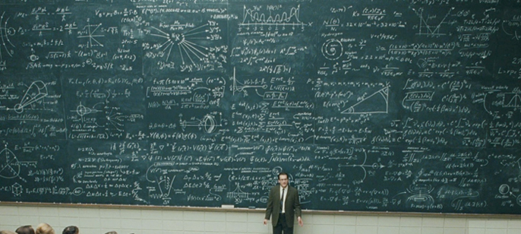

Slide 39
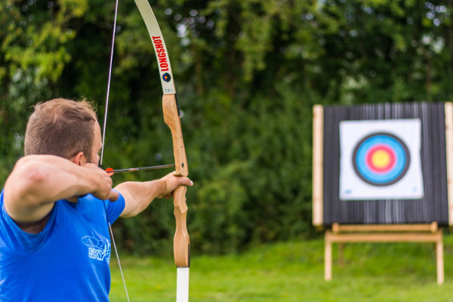

Slide 40
Clean / Dirty (messy)

Slide 41
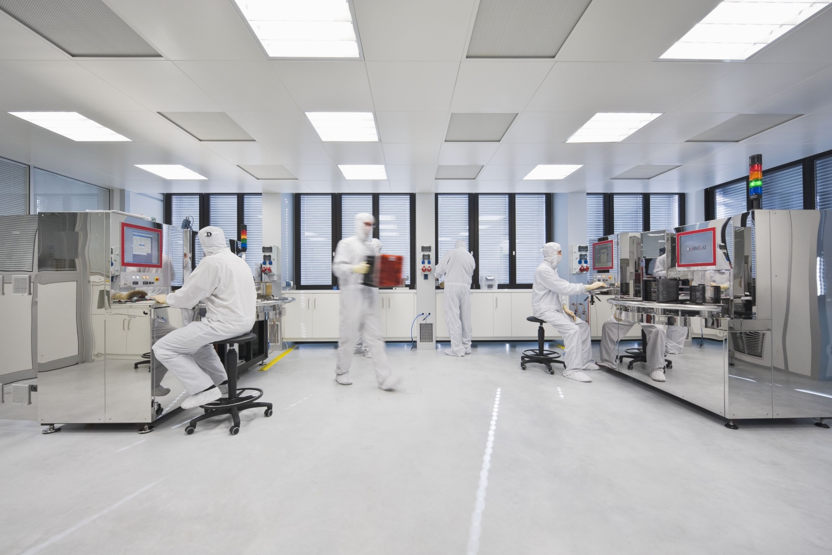

Slide 42
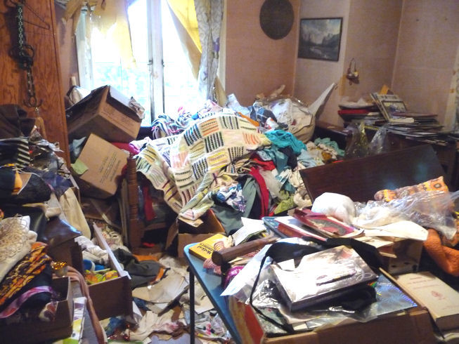

Slide 43
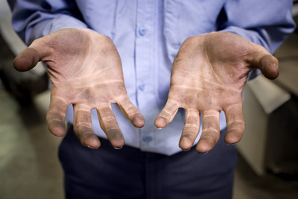

Slide 44
Smart / Stupid (dumb)

Slide 45
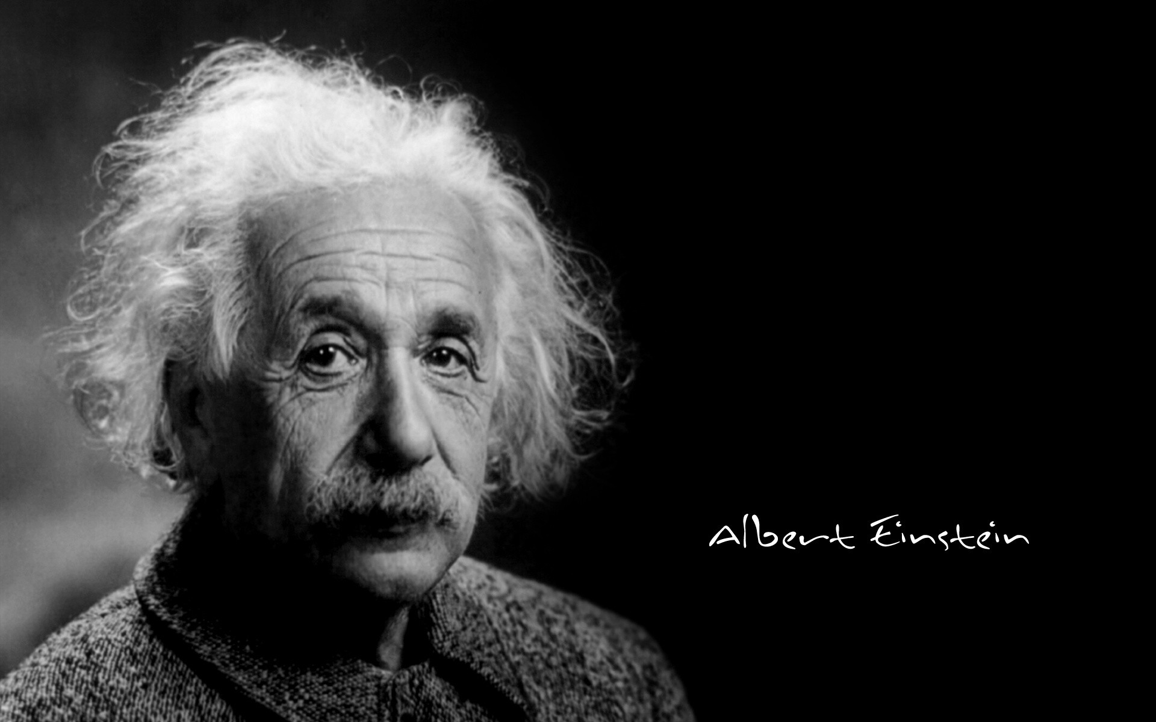

Slide 46
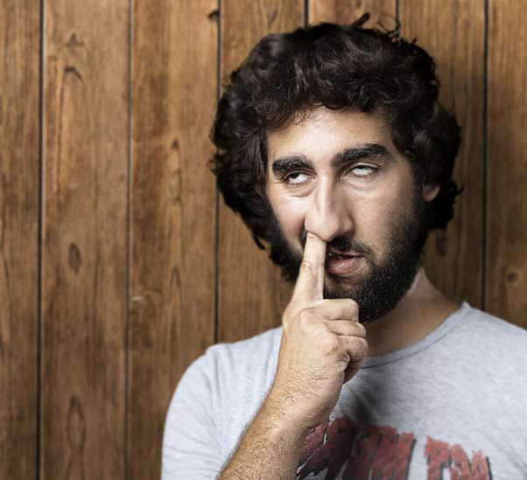

Slide 47
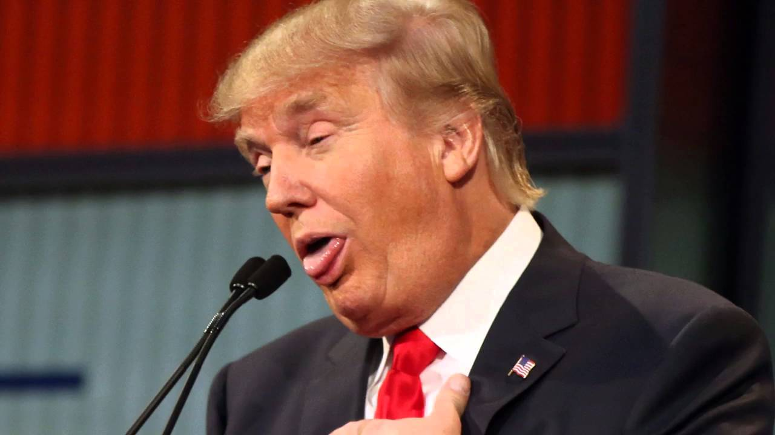

Slide 48
What do you think about… ?

Slide 49
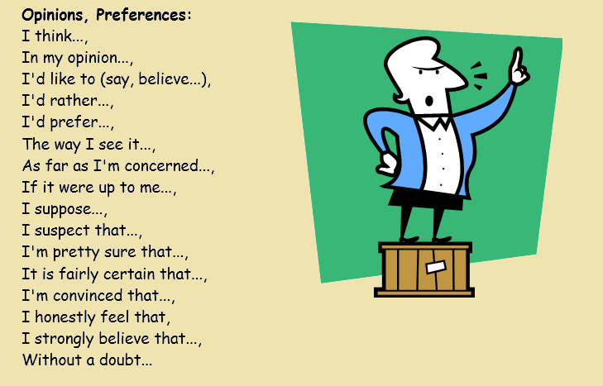
Notes:
https://en.islcollective.com/resources/printables/worksheets_doc_docx/expressing_opinions/intermediate-b1-speaking/28912

Slide 50
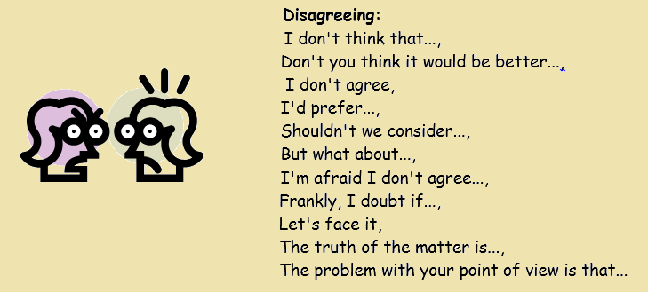
Notes:
https://en.islcollective.com/resources/printables/worksheets_doc_docx/expressing_opinions/intermediate-b1-speaking/28912

Slide 51
Notes:
https://en.islcollective.com/resources/printables/worksheets_doc_docx/expressing_opinions/intermediate-b1-speaking/28912

Slide 52
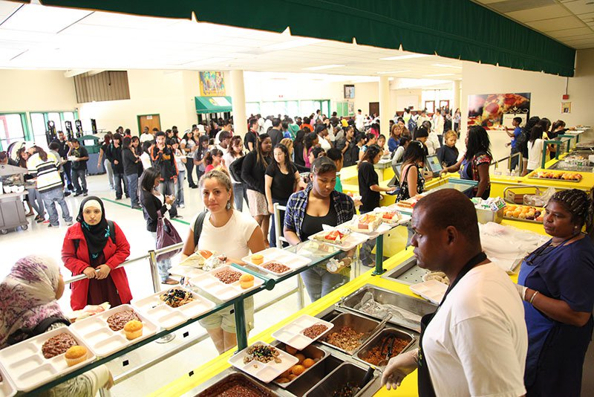
What do you think about cafeteria food?

Slide 53
“What do you think about?”
One person takes a card and reads the question.
The other students can offer their opinion.
The reader chooses the best answer.
That person keeps the card and asks the next question.
Whoever has the most cards is the winner.

Slide 54
Follow-up Questions

Slide 55
Which was the most difficult question to answer?

Slide 56
What do you want to learn more about?

Slide 57
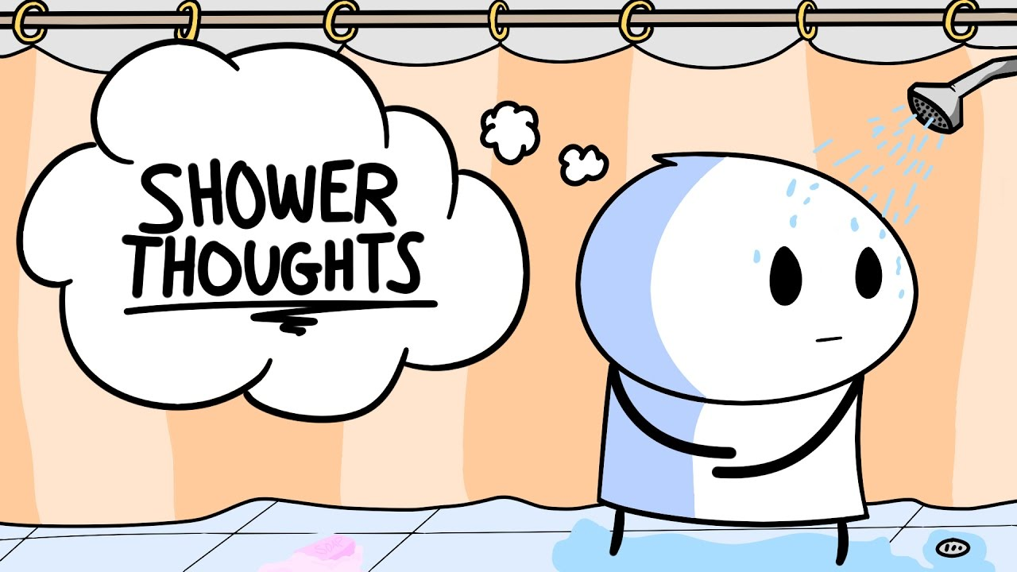
Bonus:
Shower Thoughts

Slide 63
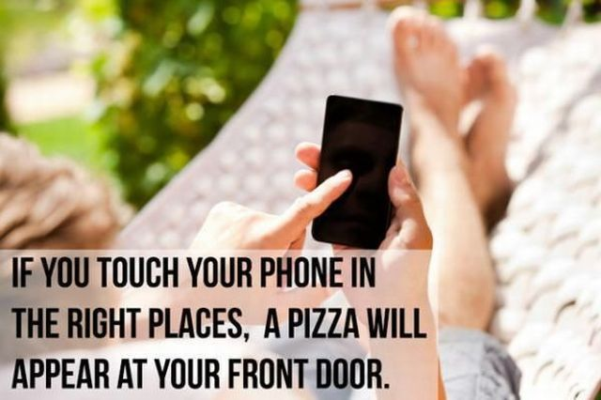

Slide 65
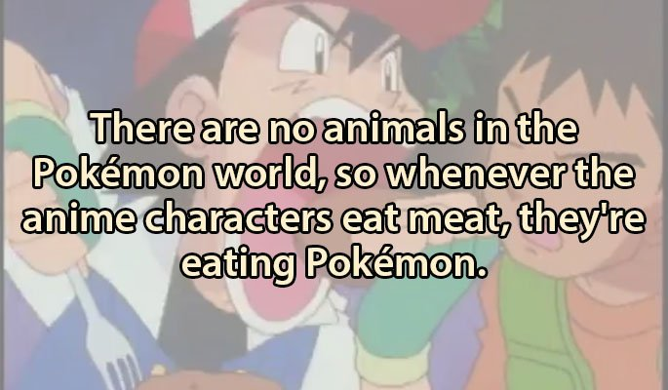

Slide 66
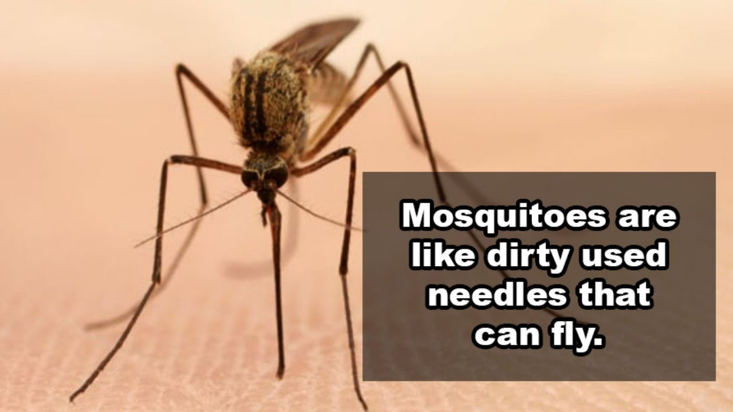

Slide 68
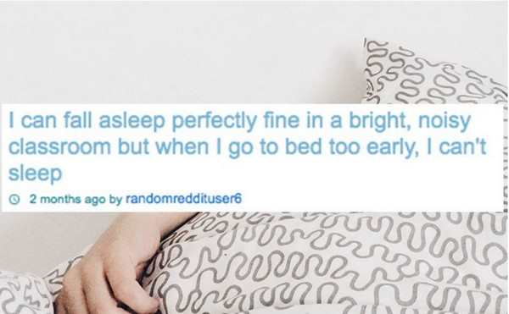

Slide 69
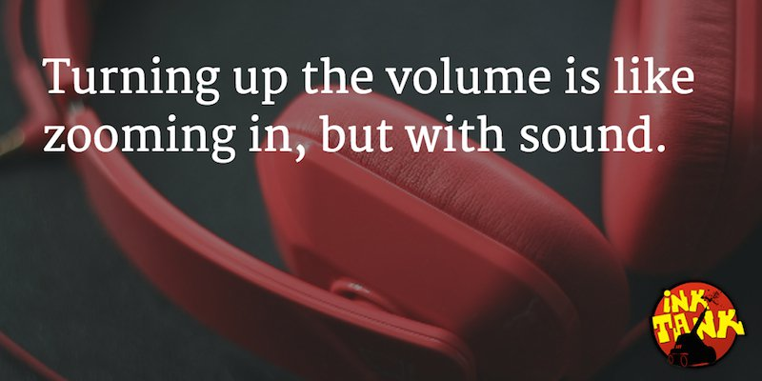

Slide 70
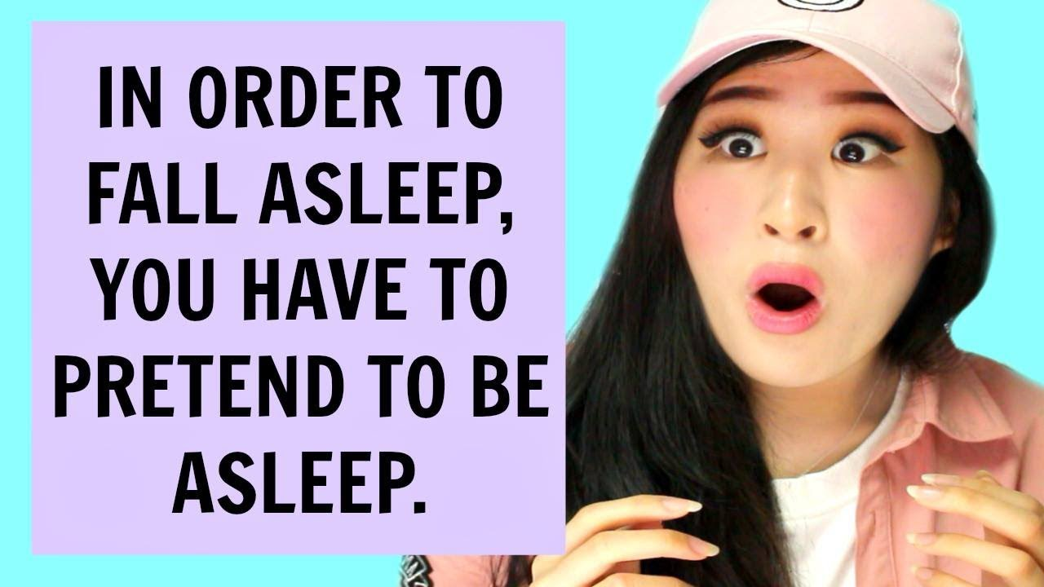

Slide 71
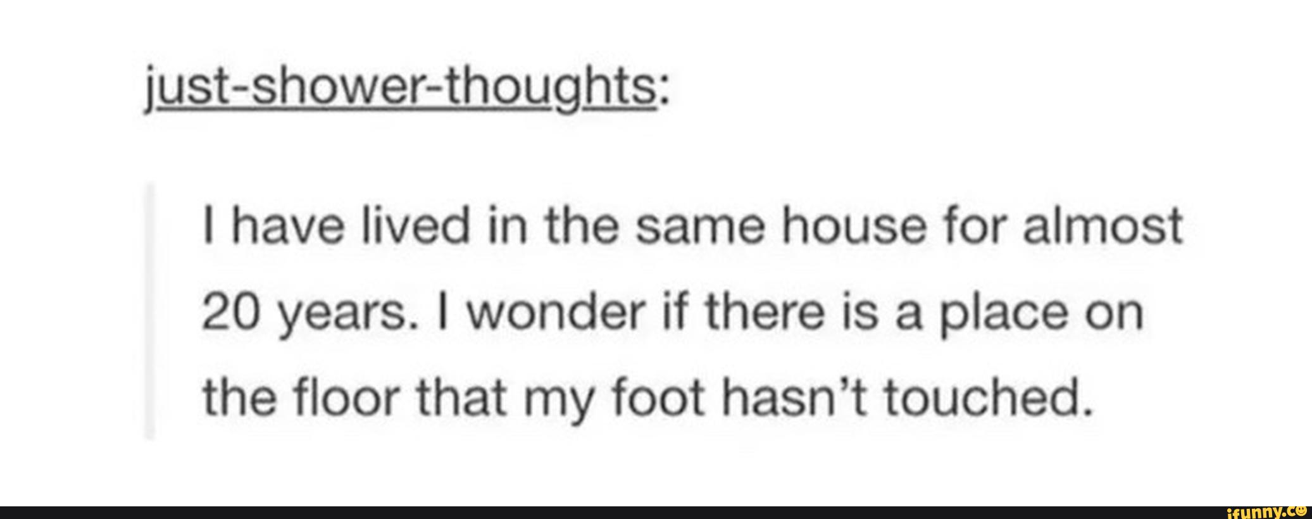

Slide 72
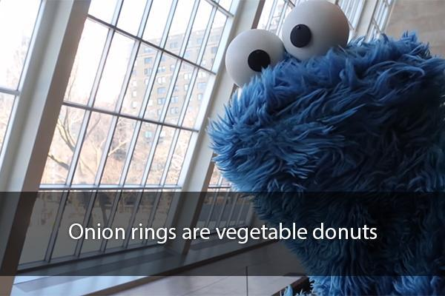

Slide 73
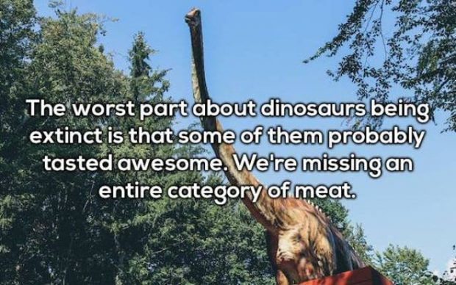

Slide 74
