Slide 1
Directions
How do I get there?

Slide 2
Left

Slide 3
Right

Slide 4
Straight

Slide 5
U-Turn

Slide 6
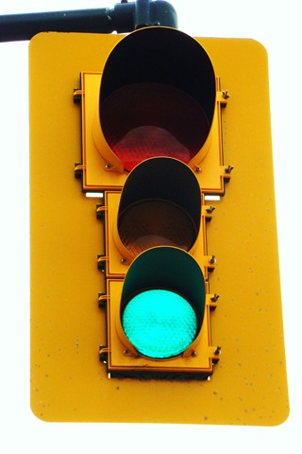
Stop Lights / Traffic Lights

Slide 7
Stop
Caution
Go

Slide 8
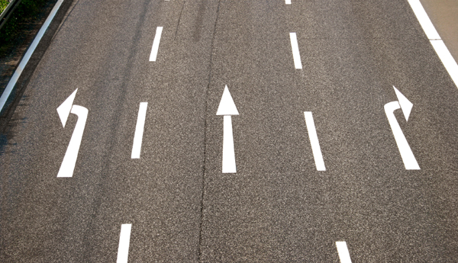
Go straight
Turn left
Turn right

Slide 9
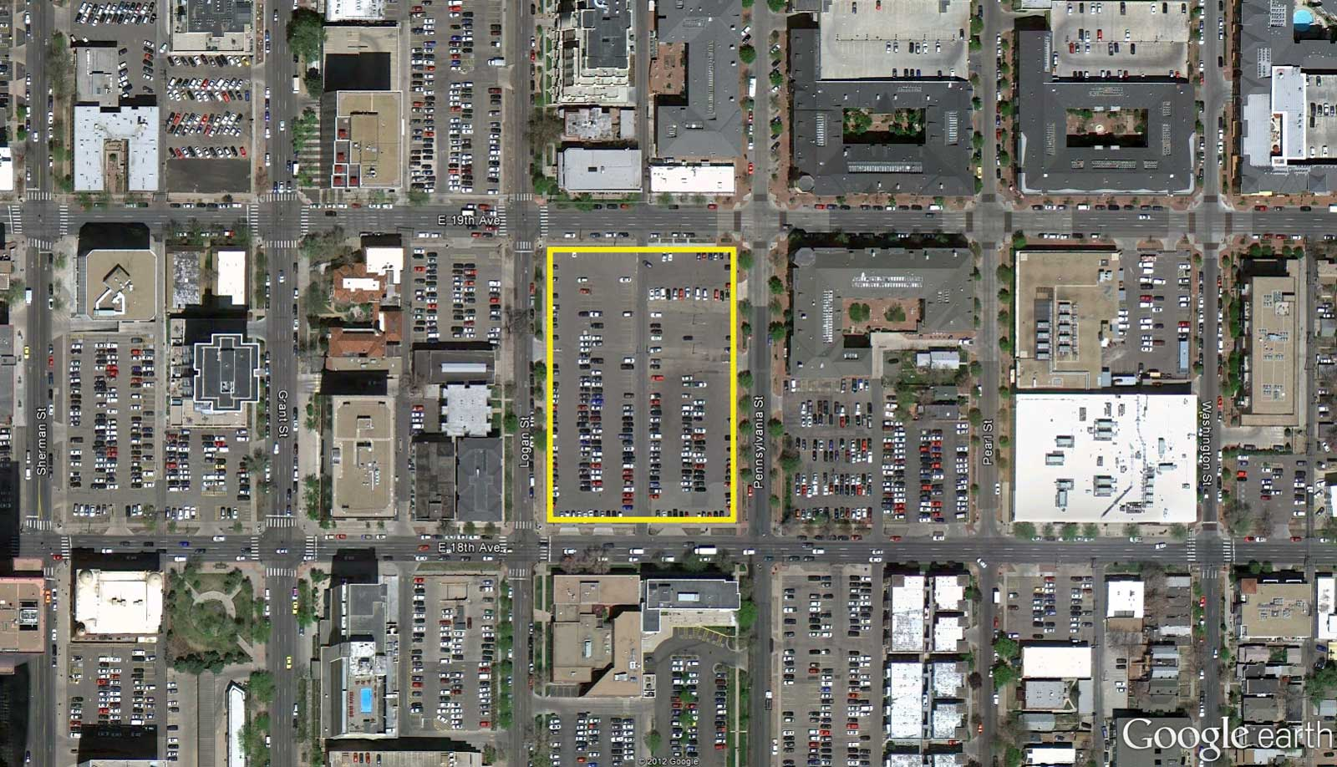
Block

Slide 10
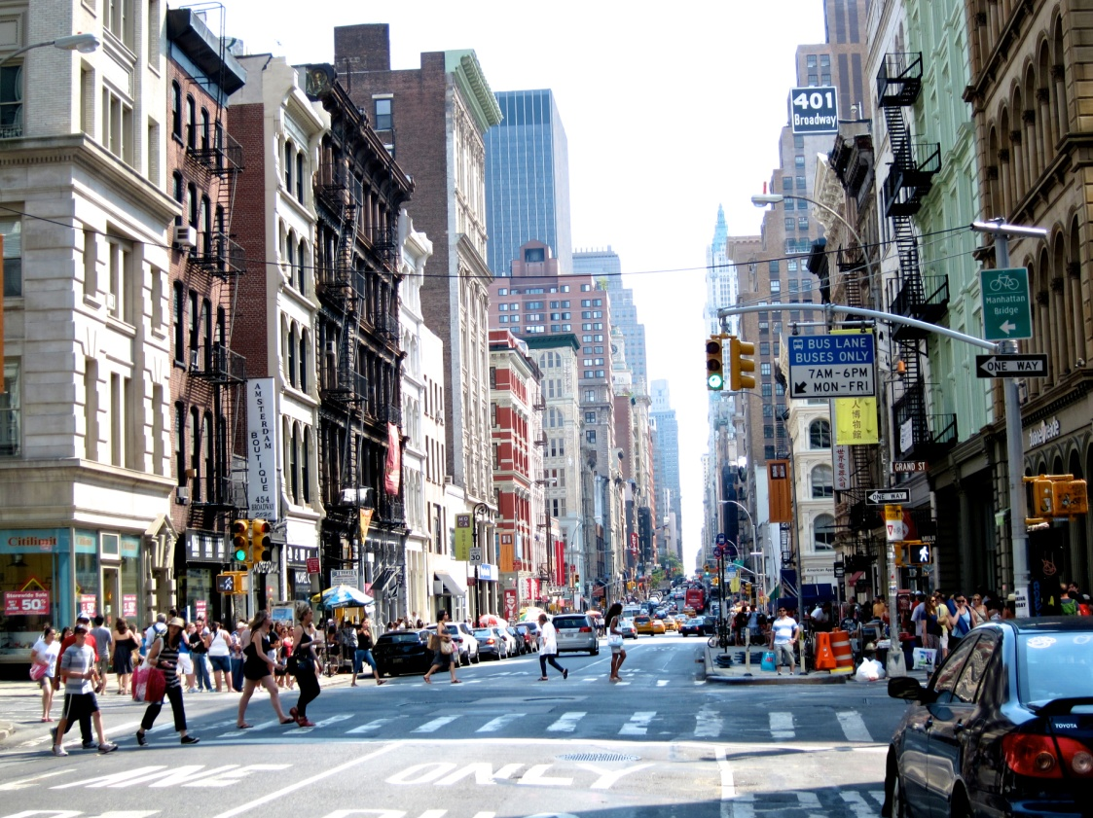
Go straight for ___ _______.
Two blocks
Ten blocks

Slide 11
Start
Finish

Slide 12
Start
Finish

Slide 13
Start
Finish

Slide 14
Start
Finish

Slide 15
Start
Finish

Slide 16
Start
Finish

Slide 17
Start
Finish

Slide 18
Start
Finish

Slide 19
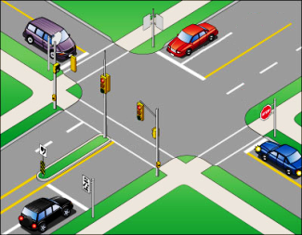
Intersection

Slide 20
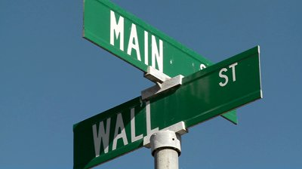
At the intersection of ________ and __________

Slide 21
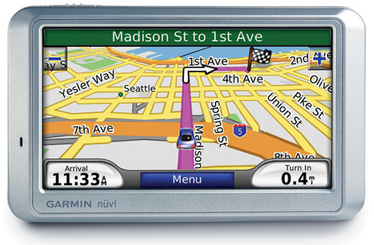
At the intersection of ________ and __________

Slide 22
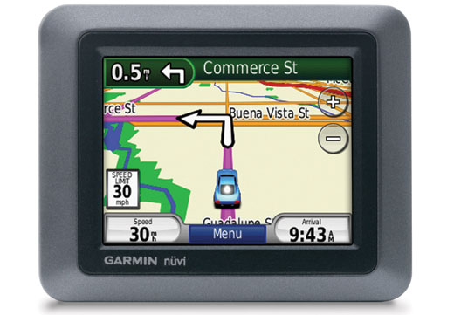
Turn ________ on _________.

Slide 23
Start
Peter St.
John St.
Annie St.
Sally St.
Mary St.
Celina St.
Finish
Alex St.

Slide 24
Start
Peter St.
John St.
Annie St.
Sally St.
Mary St.
Celina St.
Finish
Alex St.

Slide 25
Start
Peter St.
John St.
Annie St.
Sally St.
Mary St.
Celina St.
Finish
Alex St.

Slide 26
Start
Peter St.
John St.
Annie St.
Sally St.
Mary St.
Celina St.
Finish
Alex St.

Slide 27
Start
Peter St.
John St.
Annie St.
Sally St.
Mary St.
Celina St.
Finish
Alex St.

Slide 28
Start
Peter St.
John St.
Annie St.
Sally St.
Mary St.
Celina St.
Finish
Alex St.

Slide 29
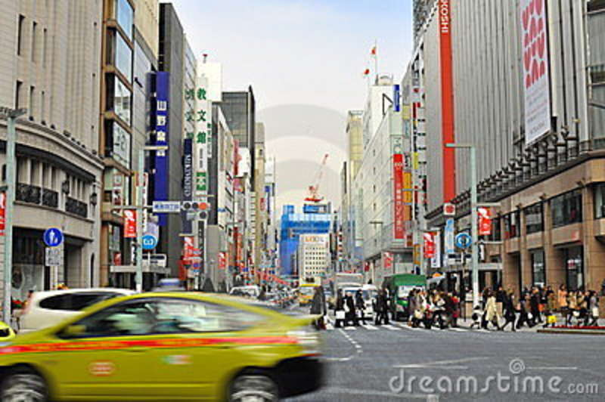
Its on the ______.
Left
Right

Slide 30
Using these directions:
How do I get to *********?
From ______________ to _____________.

Slide 31
