Slide 1
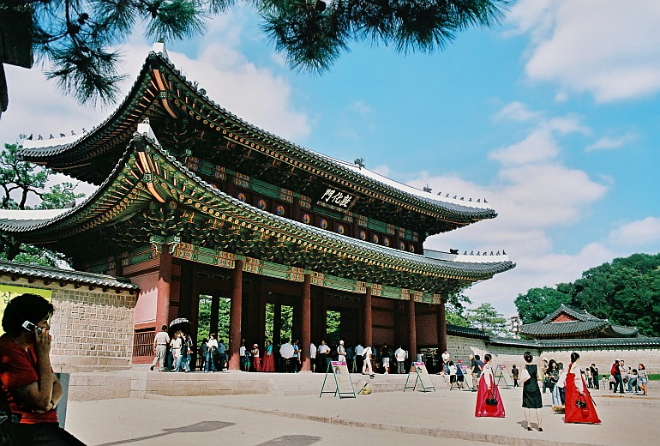
Directions #2

Slide 2
Conversation
A: Excuse me. How can I get to Changdeokgung?
B: Take the subway and get off at Anguk Station.
A: How long does it take from here?
B: It takes 15 minutes.

Slide 3
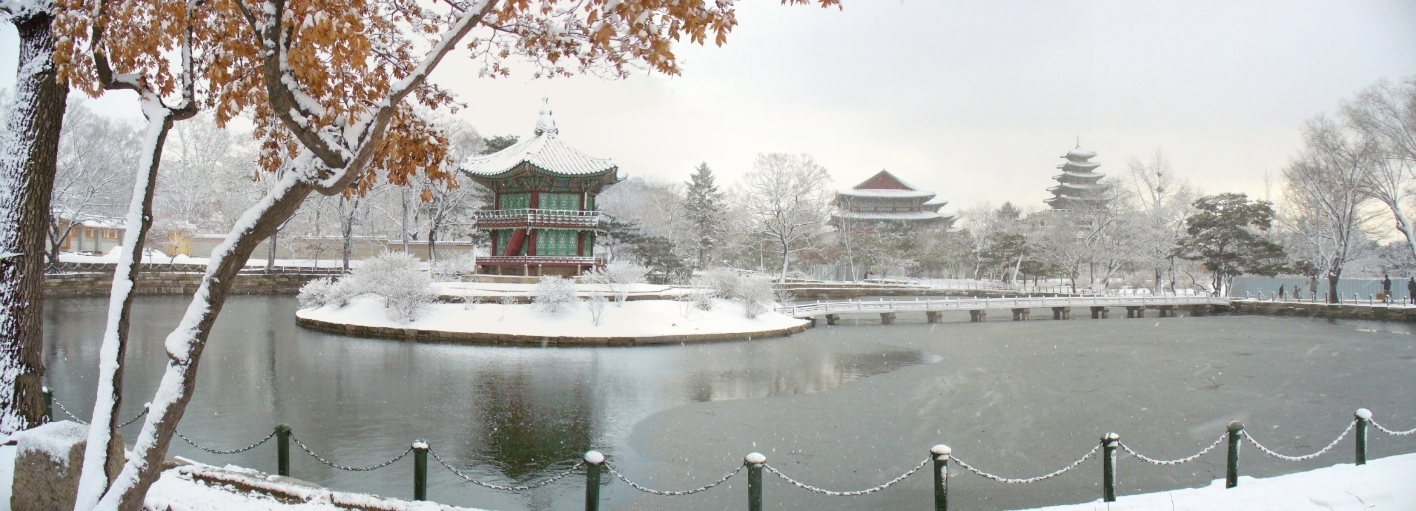
What is “gung” (-궁)
Palace

Slide 4
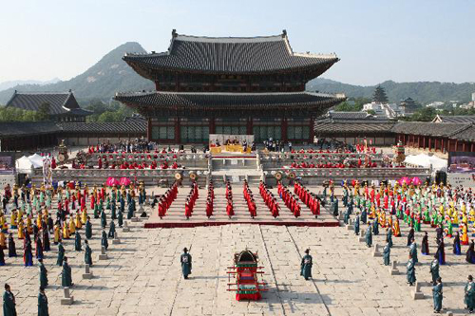
Changdeokgung =
Changdeok Palace

Slide 5
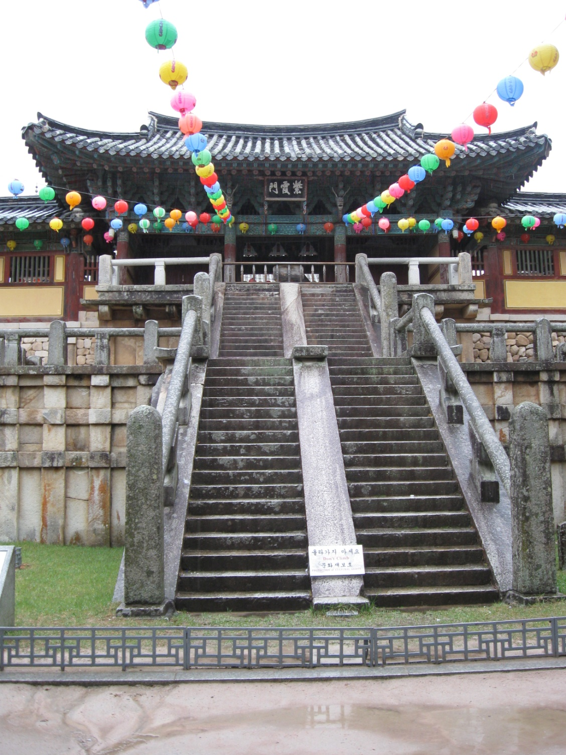
-사
Temple

Slide 6
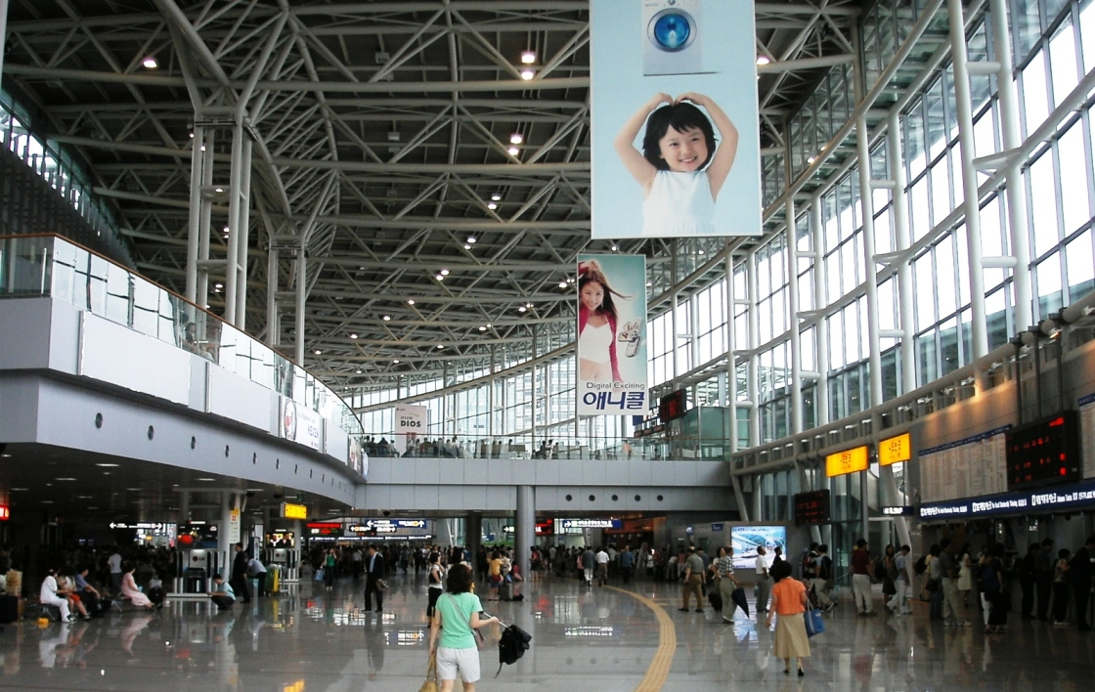
-역
Station

Slide 7
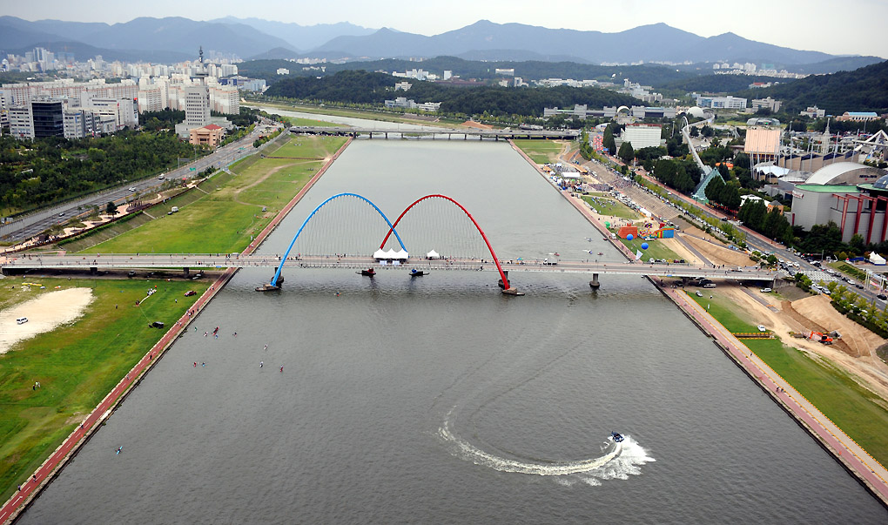
-천
River / Stream

Slide 8
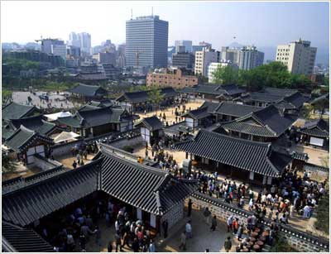
-마을
Village

Slide 9
Conversation
A: Excuse me. How can I get to Changdeokgung?
B: Take the subway and get off at Anguk Station.
A: How long does it take from here?
B: It takes 15 minutes.

Slide 10
How can I get to...
Could you tell me the way to...
Please tell me the way to...

Slide 11
Conversation
A: Excuse me. How can I get to Changdeokgung?
B: Take the subway and get off at Anguk Station.
A: How long does it take from here?
B: It takes 15 minutes.

Slide 12
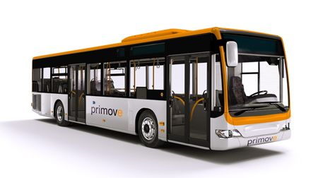
Take ____________.
the subway
a bus
the train
a taxi

Slide 13
Conversation
A: Excuse me. How can I get to Changdeokgung?
B: Take the subway and get off at Anguk Station.
A: How long does it take from here?
B: It takes 15 minutes.

Slide 14
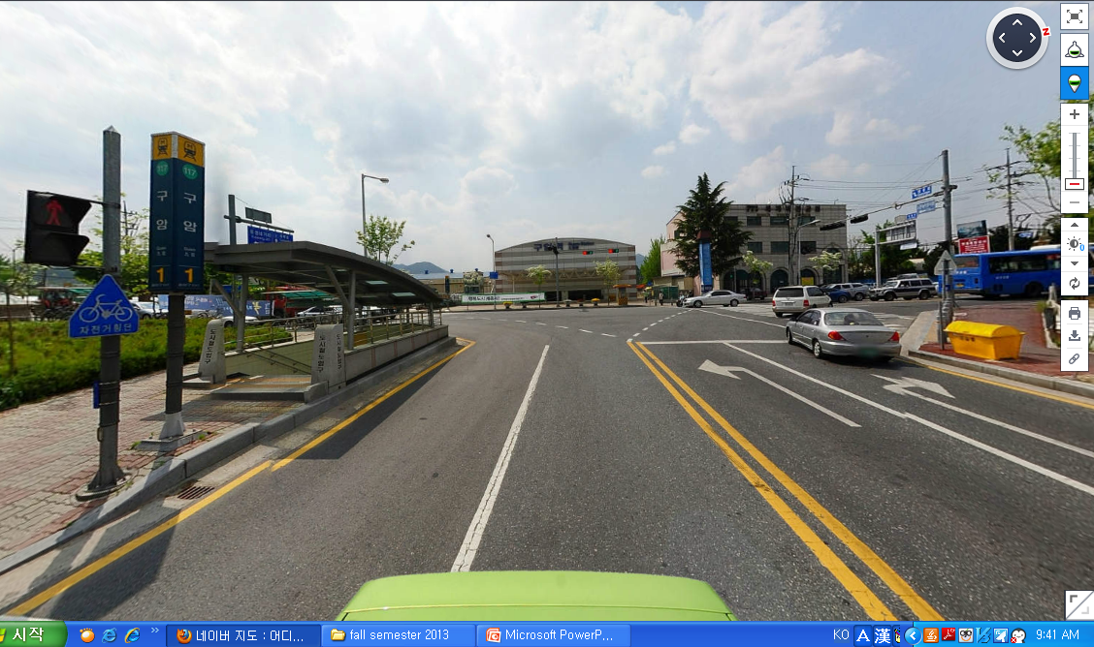
Take ______ and get off at ______.

Slide 15
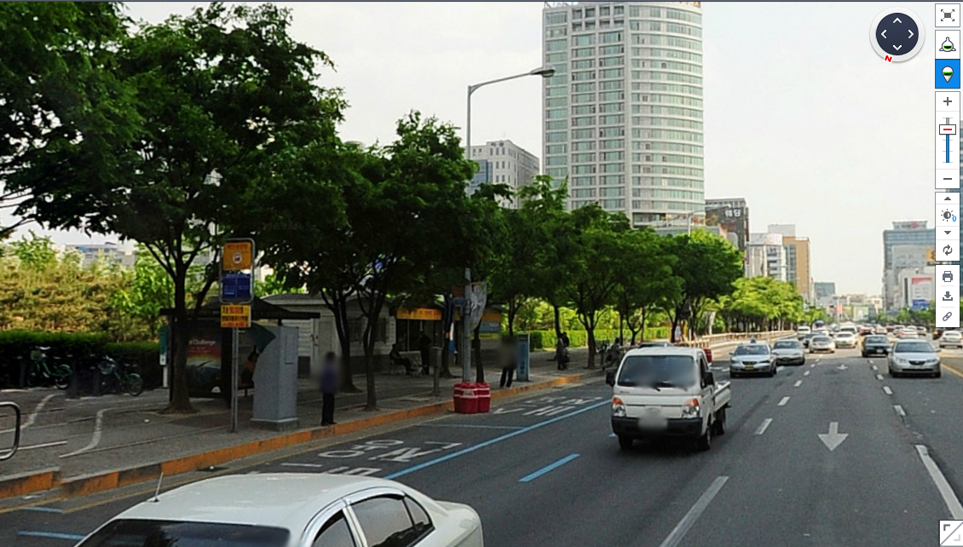
Take ______ and get off at ______.

Slide 16
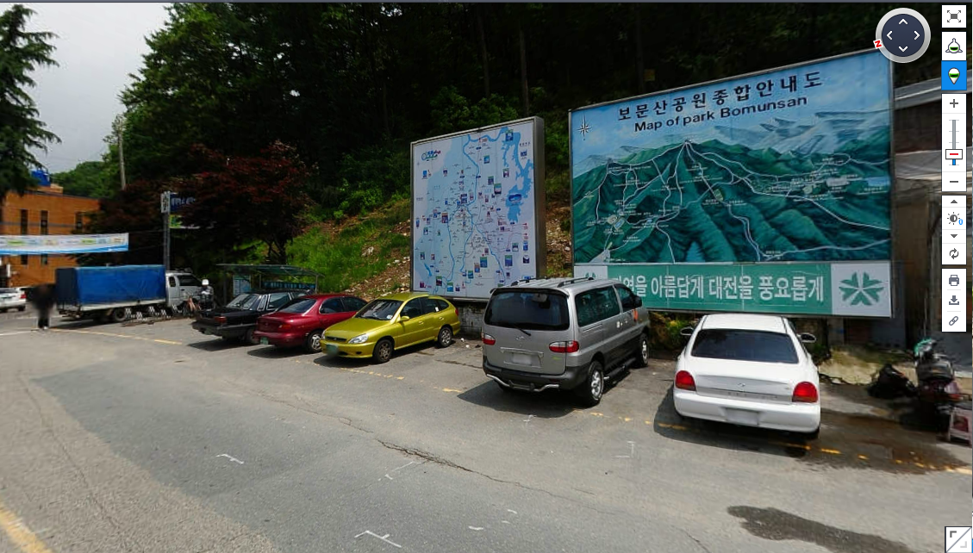
Take ______ and get off at ______.

Slide 17
Conversation
A: Excuse me. How can I get to Changdeokgung?
B: Take the subway and get off at Anguk Station.
A: How long does it take from here?
B: It takes 15 minutes.

Slide 18
How long does it take from here?
How far is it to...

Slide 19
Conversation
A: Excuse me. How can I get to Changdeokgung?
B: Take the subway and get off at Anguk Station.
A: How long does it take from here?
B: It takes about 15 minutes.

Slide 20
What places would you recommend in Daejeon?

Slide 21
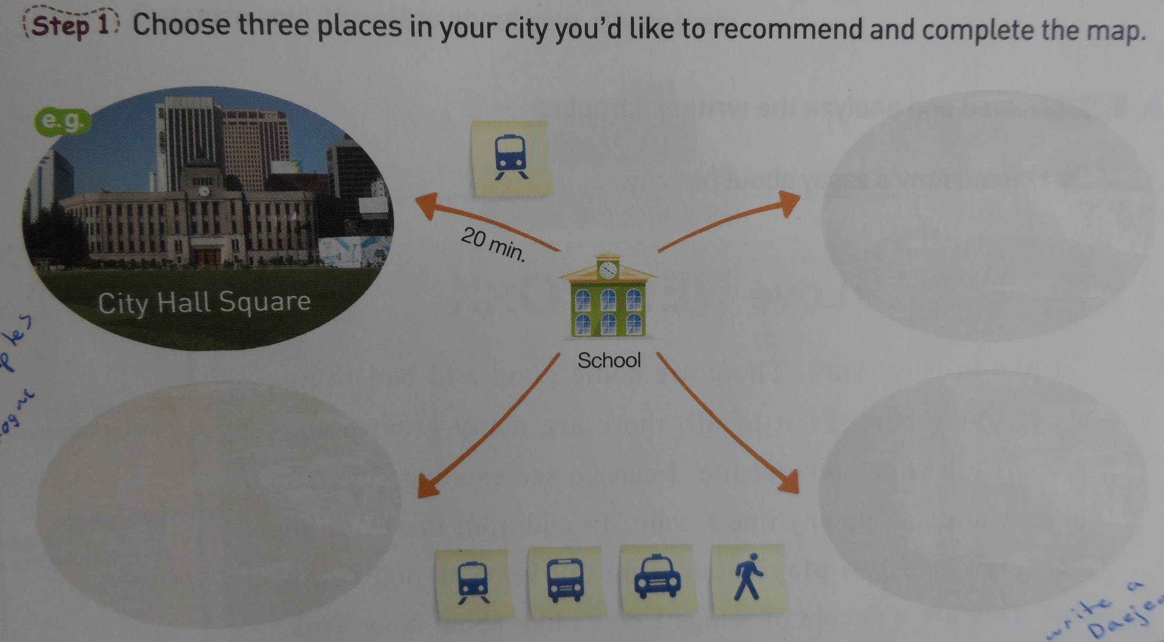
Fill in the information

Slide 22
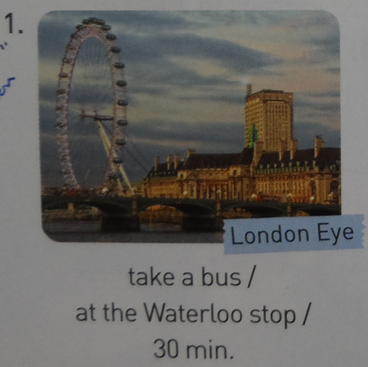
Practice using conversation A:

Slide 23
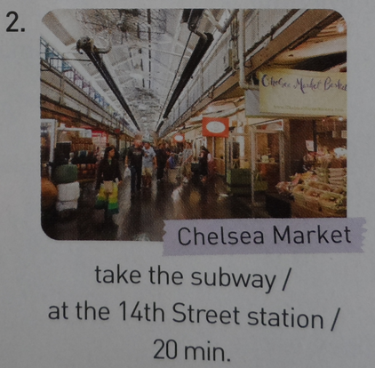
Practice using conversation A:

Slide 24
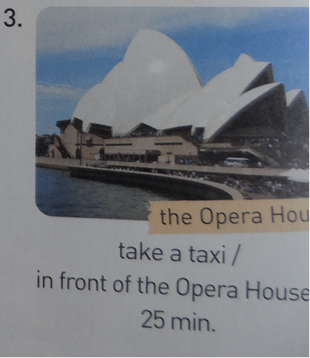
Practice using conversation A:

Slide 25
Practice with a partner using “C”
Places your partner recommends | How to get there

Slide 26
Review (p.134B)
How long does it take from here?
But it’ll take over 30 minutes.
How can I get to Changdeokgung?
A: Excuse me. __________________
B: Take the subway and get off at Anguk Station.
A: ___________________.
B: It takes only 10 minutes.
A: Can I walk there instead of taking the subway?
B: It’s possible, ____________________.
A: Oh, that’s too long. The subway would be better. Thank you.
B: You’re welcome.

