Slide 1
Write on the card:
Something you like to do.
Yellow
Something you don’t like to do?
Blue
Play basketball
Eat candy
Run a marathon
Get punched in the face.

Slide 2
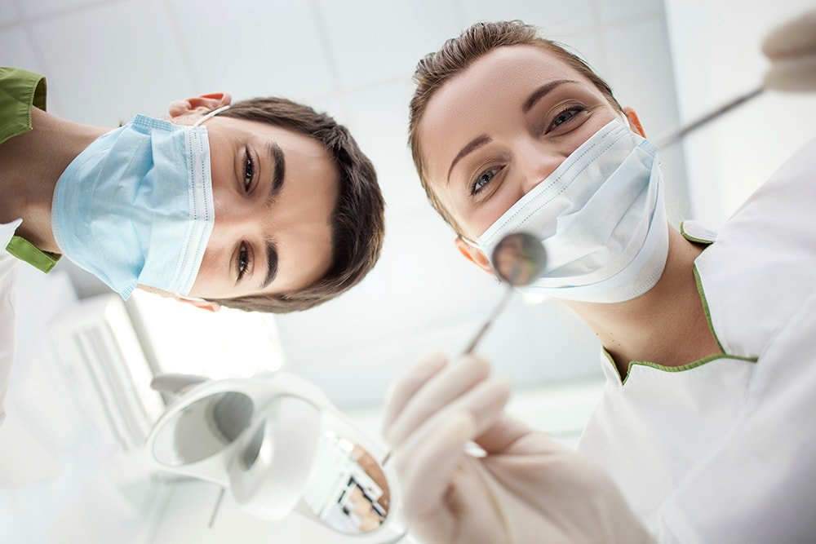
Would you rather…?

Slide 3
Would you rather … ?
Choice / Imagination
go to the dentist
have a toothache

Slide 4
Would you rather _______ or ______?
(verb) (verb)
go to the dentist
have a toothache

Slide 5
Would you rather go to the dentist or have a toothache?
I would rather _________________ than ____________________.
go to the dentist
have a toothache
*one is better option*

Slide 6
Would you rather…
examples

Slide 7
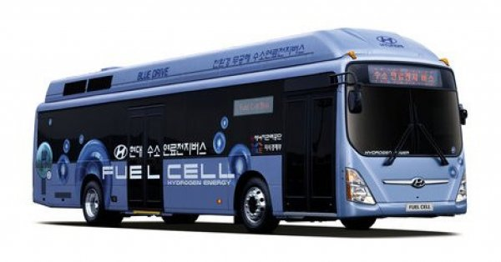
Would you rather ...
Take a bus
OR
Take a train

Slide 8
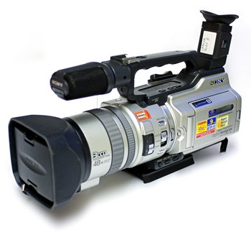
Would you rather ...
Read a book
OR
Watch a movie

Slide 9
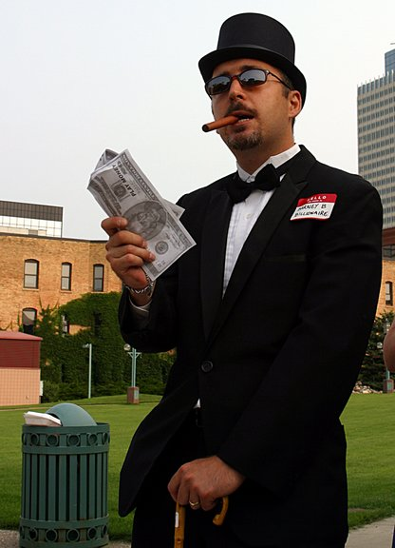
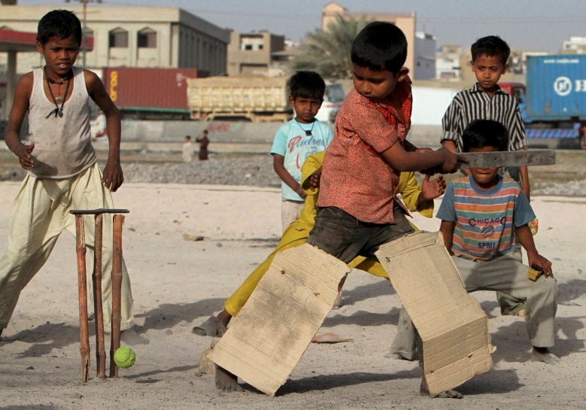
Would you rather ...
Be rich and alone
OR
Be poor but have
many friends

Slide 10
Neither / Either / Both
2 things =
0 things =
Doesn’t matter =
both
neither
either

Slide 11
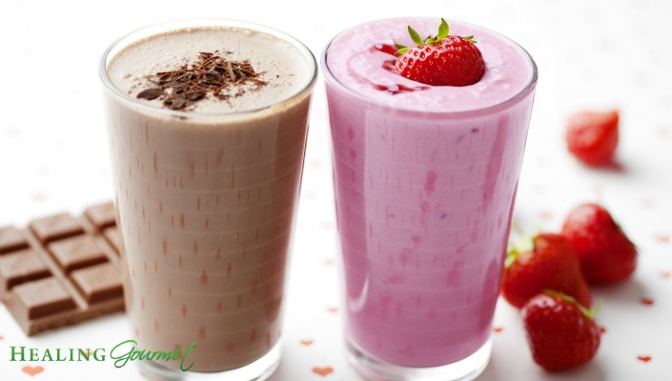
Would you prefer?

Slide 12
Would / Do you prefer… ?
Choice
chocolate
strawberry

Slide 13
Would you prefer________ or _______?
noun noun
chocolate
strawberry

Slide 14
Would you prefer chocolate or strawberry?
I prefer _________________ .
chocolate
*one is better option*

Slide 15
Would you prefer…
examples

Slide 16
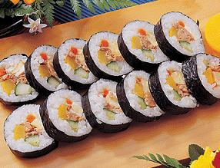
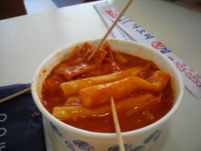
Would you prefer…
Kimbap
OR
Ddeokbokki

Slide 17
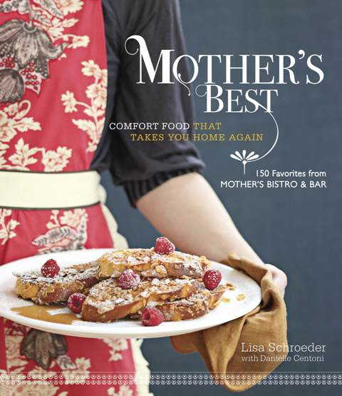
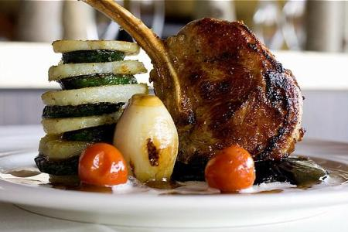
Do you prefer…
Home cooking
OR
Restaurant food

Slide 18
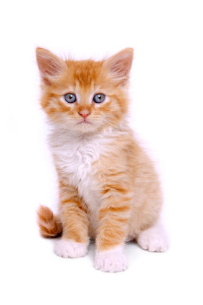
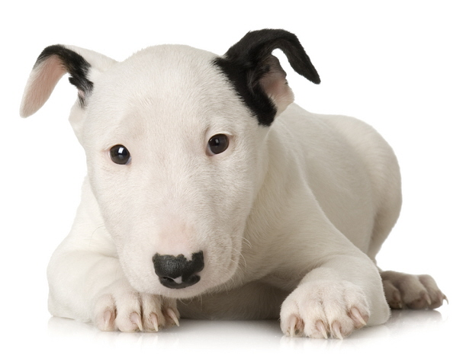
Do you prefer…
Cats
OR
Dogs

Slide 19
Make Your Own Question:
Would you rather __________ or _________?
Would you prefer __________ or _________?
Do you prefer ___________ or ____________?

Slide 20
Ask 9 students:
Name | Choice 1: | Choice 2:

Slide 21
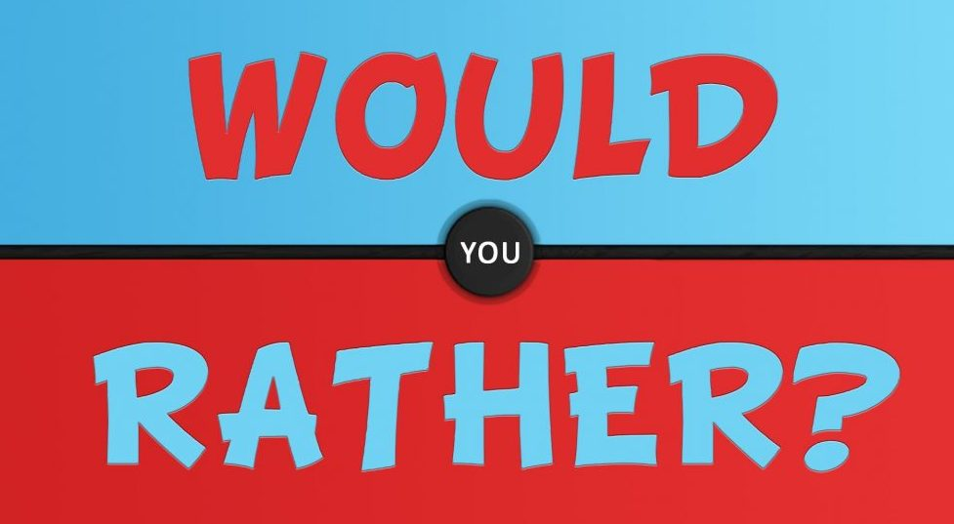

Slide 22
Would You Rather Game
One student will come to the front
Take two of the choices (same color)
Mr.S will make a question
Secretly answer the question by choosing or
Everyone votes on what the correct answer will be
If you guessed correctly, you get a point.
Be honest.
1
2

Slide 23
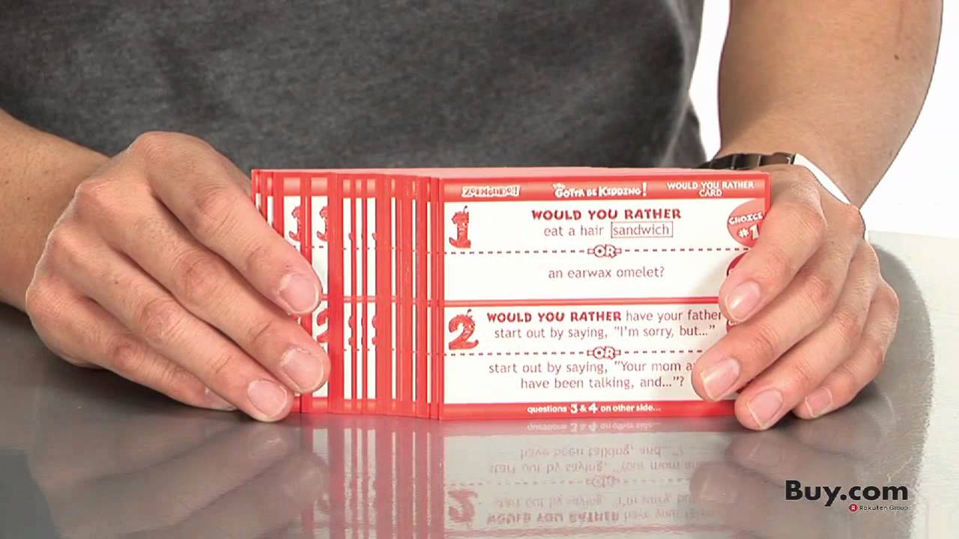
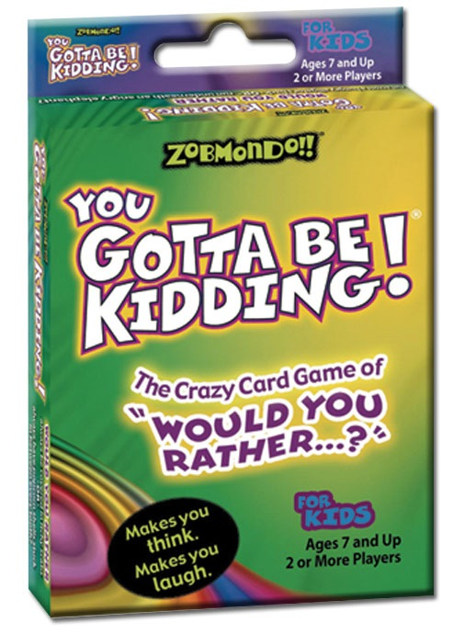
Would You Rather Game
When we run out of cards, use the cards from the game:

Slide 24
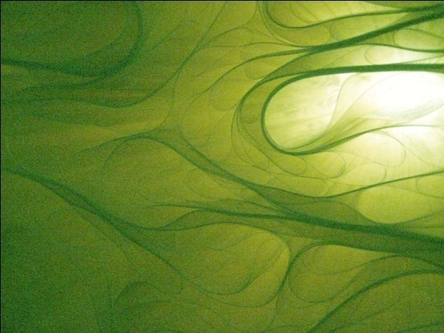
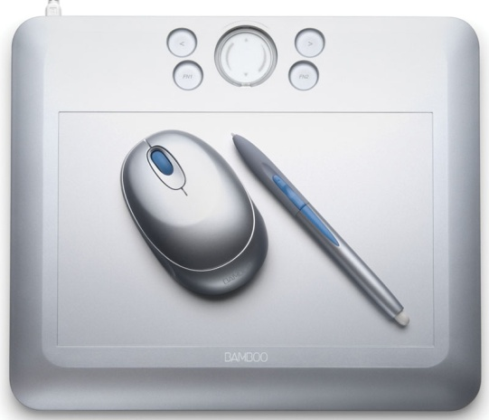
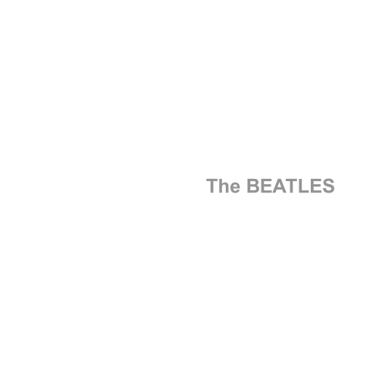
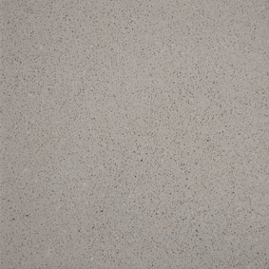
What is your favourite color?

Slide 25
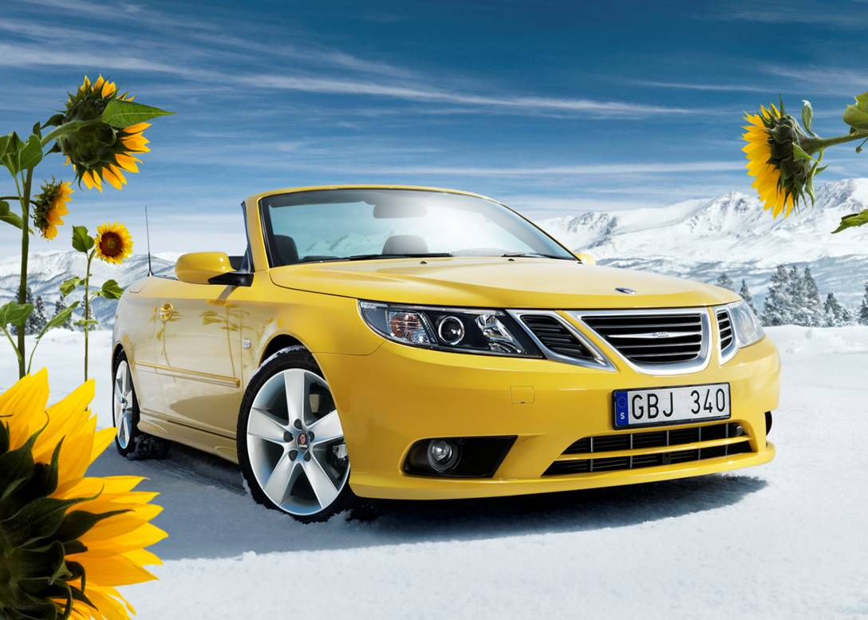
Yellow
Happiness
Wisdom
Imagination
“sunny personality”
Coward (easily scared)

Slide 26
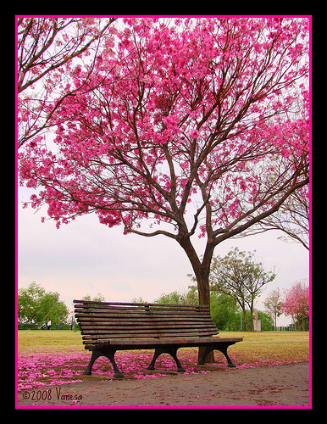
Pink
Love
Affection
Motherly
Wants protection
Sheltered life
Delicate and fragile

Slide 27
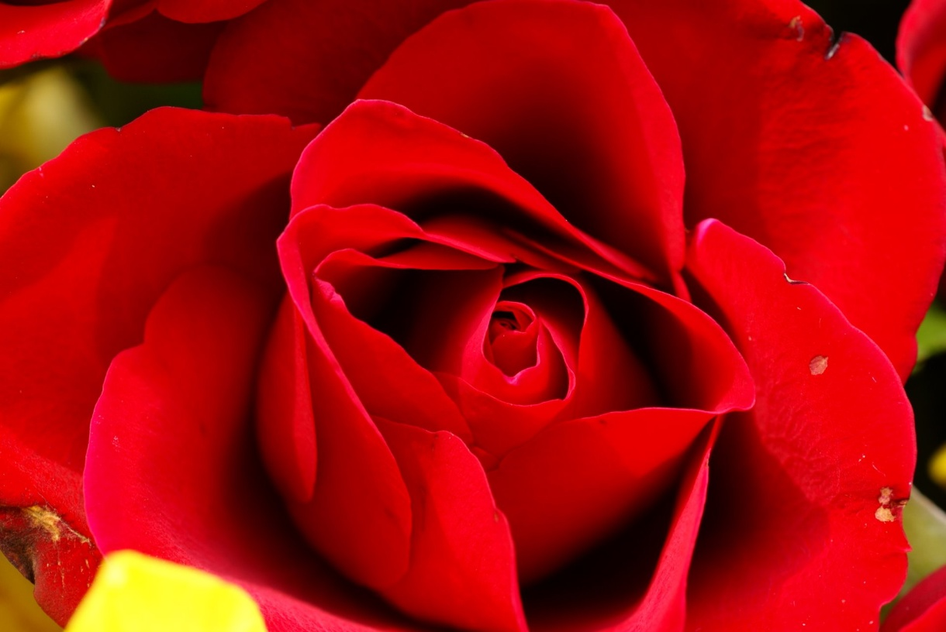
Red
Health and vitality
Passion – Love and Anger
Outgoing
Ambitious

Slide 28
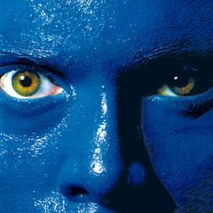
Blue
Calm
Compassionate
Sensitive
Patient
Wisdom

Slide 29
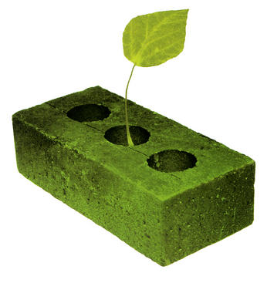
Green
Harmony
Hope
Renewal
Peaceful
Social

Slide 30
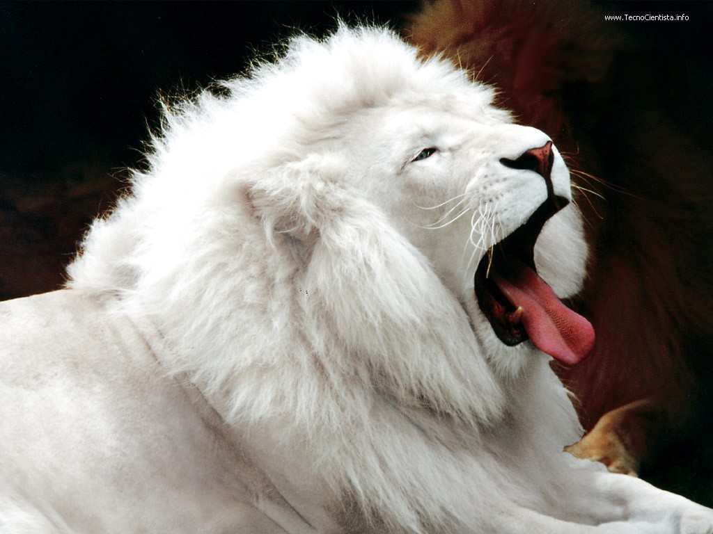
White
Pure
Clean
Innocent
Naive

Slide 31
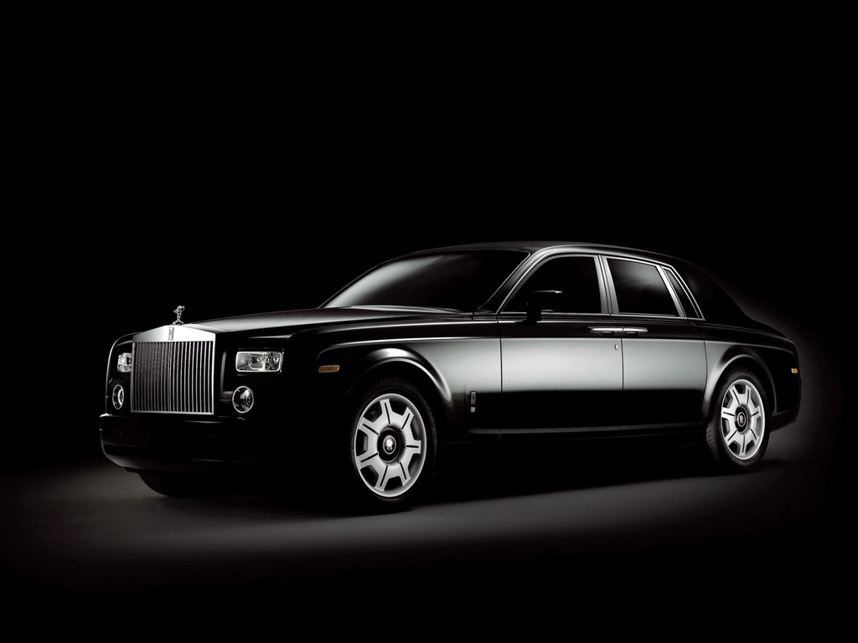
Black
Conservative
Serious
Mysterious
Evil

Slide 32
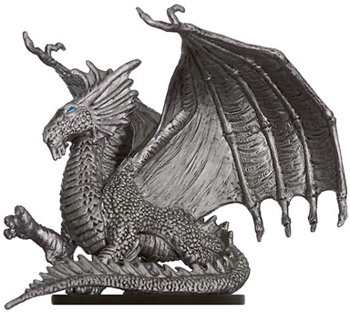
Silver
Cool
Playful
Modern
Have expensive things

Slide 33
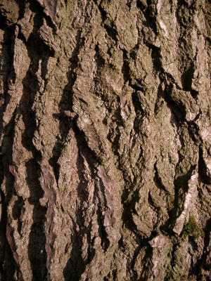
Brown
Nature
Down to earth **
Friendly
Responsible
Inflexible

Slide 34
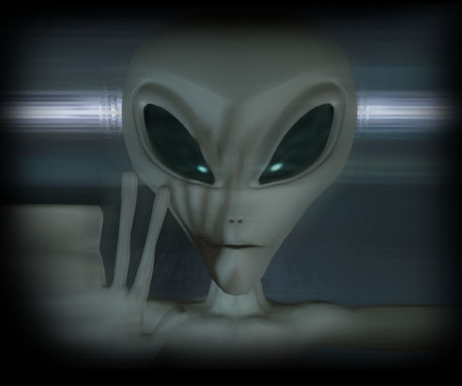
Grey
Neutral
Conservative
Cautious
Work too much

Slide 35
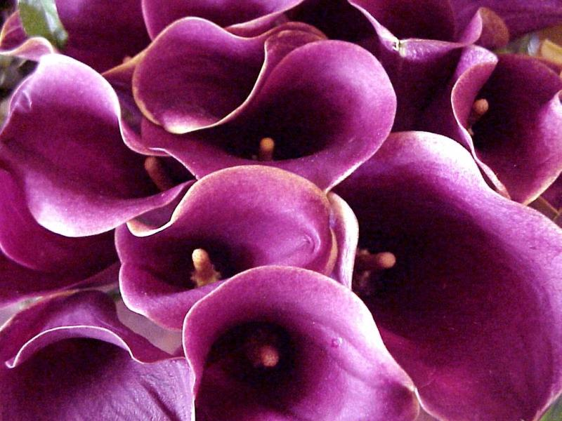
Purple
Royalty (dignified)
Artistic
Unique
Spiritual

Slide 36
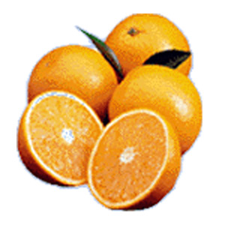
Orange
Like luxury
Energy
Popular / Social
Curiosity

