Slide 1
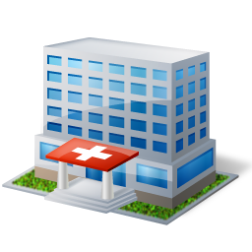
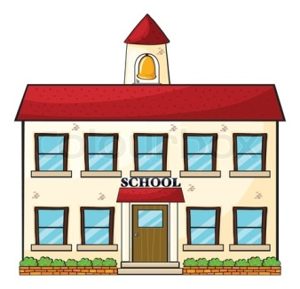
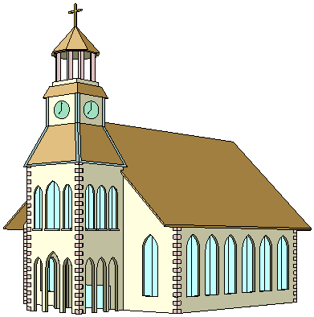
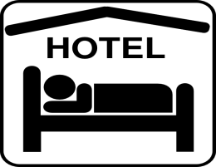
Date’s House
Victoria St.
Vuitton Rd.
Secret Ave.
Versace Blvd.
Chanel St.
Gucci Blvd.
Prada Rd.
21 St.
Tiffany St.

Slide 2
